Slide 1

Polarized positron source program at JLab
Polarized Electrons for Polarized Positrons
Physics with positrons at CEBAF
Conceptual design for CEBAF
5 year R&D plan
Joe Grames

Slide 2
Acknowledgments
I would like to thank and acknowledge those who contributed to this presentation.
  Jonathan Dumas, CEA-Paris
  Sami Habet, IJCLab-Orsay
  Carlos Hernandez-Garcia, JLab
  Sarin Philip, JLab
  Matt Poelker, JLab
  Yves Roblin, JLab
  Mark Stefani, JLab
  Riad Suleiman, JLab
  Michael Tiefenback, JLab
  Eric Voutier, IJCLab-Orsay
  Andriy Ushakov, IJCLab-Orsay

Slide 3

Jefferson Lab : CEBAF @ 12 GeV
Halls: 4 (simultaneous)
Users: 1500 (230 Institutions/30 Countries)
Energy: 11 GeV (ABC) / 12 GeV (D)
Polarization: >85% (~90%)
Intensity: 100 pA to 200 uA (~3 mA)
Structure: CW (249.5 or 499 MHz)

Slide 4
Spin polarization from GaAs/GaAsP
Represents expectation for User facilities proposed today
….…
Can make mA’s of beam with 100s of mW of “red” light

Slide 5




Exploit electron spin polarization to produce polarized positrons
Polarized Bremsstrahlung
Polarized Pair Creation
P_{circ}(γ) / P_{z} (e⁻)
P_{z} (e⁺) / P_{circ} (γ)
Longitudinal spin polarization passes from incident electrons to outgoing pair-produced positrons in the electromagnetic shower, when incident on a target, e.g. high-Z material useful.
E_{γ} / T_{e-}
T_{e+} / (E_{γ} – 2m_{e+})
E.A. Kuraev, Y.M. Bystritskiy, M. Shatnev, E.Tomasi-Gustafsson, PRC 81 (2010) 055208

Slide 6
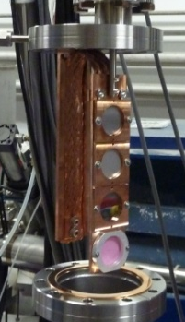

Polarized Electrons for Polarized Positrons (PEPPo) @ CEBAF
PEPPo (Polarized Electrons for Polarized Positrons) => demonstrate feasibility of using bremsstrahlung radiation of MeV energy Polarized Electrons for production of Polarized Positrons.
J. Grames, E. Voutier et al., JLab Experiment E12-11-105 (2011)
Tungsten (L=1mm)
Fixed <100 W
8 MeV, 1μA, 85% polarization
PEPPo possible due to support from SLAC E166, DESY, Princeton, Cornell, International Linear Collider Project and the Jefferson Science Associates

Slide 7
Polarized Positron Production
(PEPPo Collaboration) D. Abbott et al. , Phys. Rev. Lett. 116 (2016) 214801
PEPPo demonstrated efficient polarization transfer of 8.2 MeV/c polarized electrons to positrons, expanding polarized positron production using MeV electron beam energies.
electron beam polarization
85.2 ± 0.6 ± 0.7 %
Whenever producing e⁺ from e⁻, polarization is coming for free, if initial electrons are polarized.

Slide 8
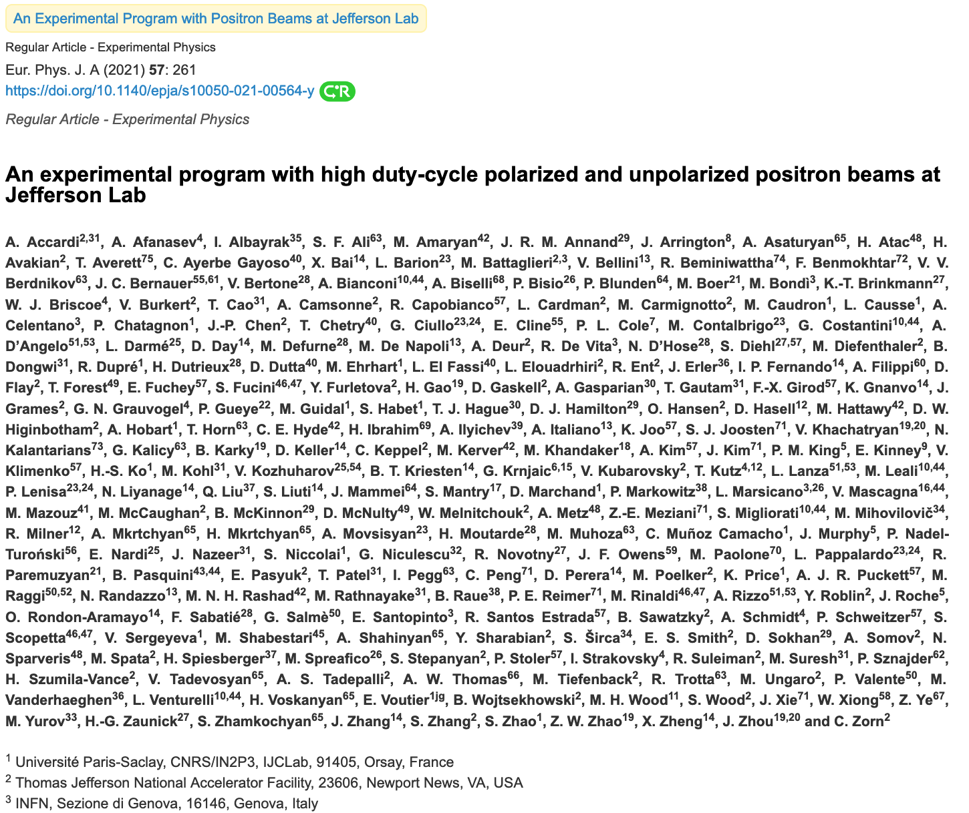
2021 – Topical Issue of the European Physics Journal A
Comprises 20 contributions from a community of 230 physicists representing 75 institutions
Physics reach of e+ beams at Jefferson Lab:
  Two-photon effects in elastic scattering
  Radiative effects in elastic scattering
  The charge radius of the proton
  The Parton Distributions
  The Generalized Parton Distributions
  Electroweak couplings
  The search for light dark matter particles
  Charged lepton-flavor violation

Slide 9
Jefferson Lab Positron Working Group
Users have made a strong case for
positron beams at CEBAF 12 GeV
Complementary charge and spin of e+ would provide a new and unique probe at Jefferson Lab
Jefferson Lab Users Positron Working Group (250 members from 75 institutions):
  2018 – 7 letters of intent to PAC
  2020 – 2 conditionally approved PAC proposals
    Hall B ~ 100 nA polarized (>60%) @ 11 GeV
    Hall C ~ 3 μA unpolarized @ 11 GeV

Slide 10
12 GeV CEBAF : Polarized Electron or Polarized Positron Beams
Capability | Electrons | Positrons
Hall Multiplicity | 4 | 4
Max Energy | 12 GeV | 12 GeV
Beam Frequencies | 249/499 MHz – cw | 249/499 Mhz – cw
Unpolarized intensity | 170 uA (limit) | >1 uA
Polarized intensity | 170 uA (limit) | >50 nA
Polarization | > 85% | > 60%
Fast/Slow Helicity Reversal | Yes | Yes
2020 JLAAC Recommendations
  “R6: Augment the scientific case with a plan to translate the R&D into a realistic facility.”
  “R7: Include radiation protection considerations into the evaluation of the electron beam energy choice.”

Slide 11

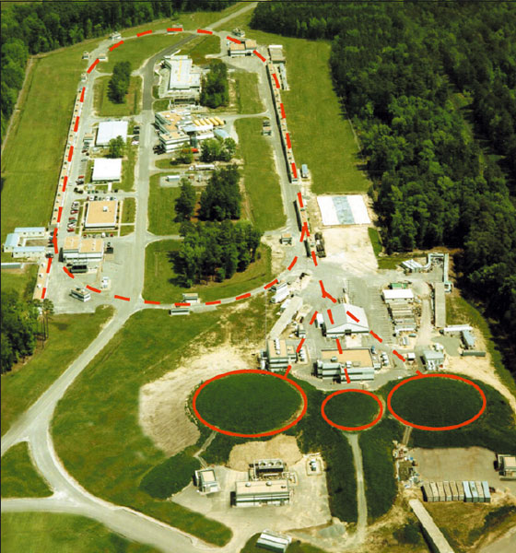

PEPPo – Polarization and Intensity Trade Off
The Yield (e+/e-) depends on the beam power Beam Energy x Beam Current
Polarization transfer is universal whether the electron beam is 10 MeV, 100 MeV, 1 GeV, etc…
D
High Pol
Low Yield
1 GeV
100 MeV
10 MeV
High Yield
Low Pol
C
B
A

Slide 12
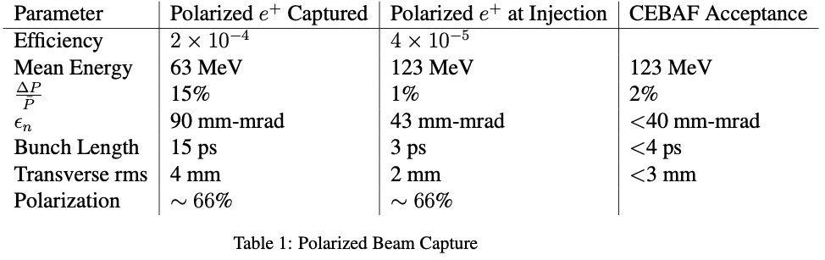
LDRD : 123 MeV polarized-e driven PEPPo Injector
Jefferson Lab the Users are asking for e+ beams with polarized (>60%) intensities >100 nA.
Collimation defines normalized emittance
Dipoles separate particle species
Dispersion selects final dp/p
Bunching achieve with R56 chirper/chicane
>5 x 10⁻⁵
>60%

Slide 13
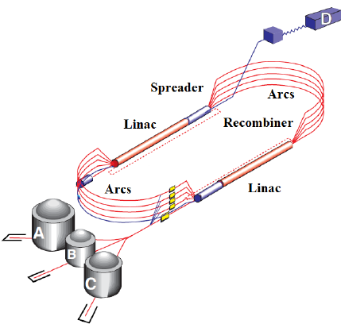
CEBAF 12 GeV : Transverse Emittance* and Energy Spread†
Large e+ initial dp/p and emittance damped adiabatically unitl SR in upper arcs
Whereas e- parameters grow, e+ parameters improve to 10-12 GeV (sim to e-)
Values are provided at the end of each segment. For positron this is up to pass 5 extraction, for electrons it goes all the way to hall D.
* Emittances are geometric
† Quantities are rms

Slide 14
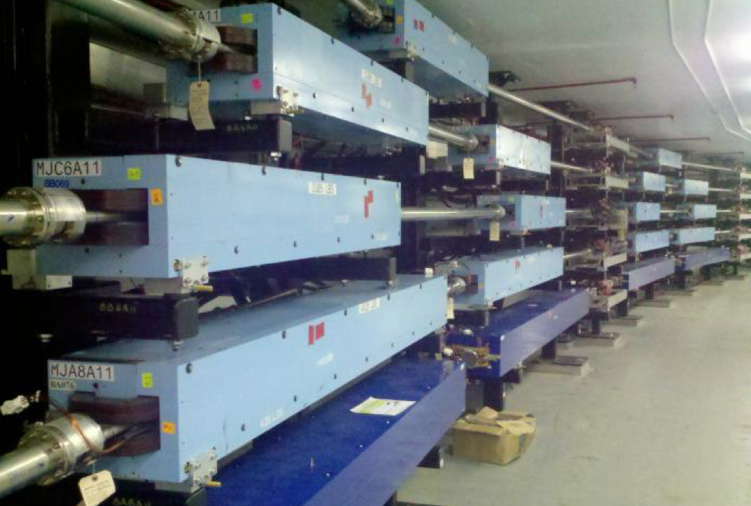
CEBAF 12 GeV : Magnetic Transport System
Reversing polarity of 2100 CEBAF magnets
>1900 (correctors & quads) already bipolar operation
39 (recirculation/transport dipoles) will require engineered solution
  21 recirculation & dog-leg
  12 extraction units
  6 end-station transport/dump
$0.5M – Remote PS switches, shunt modules, firmware, PSS integration
Hall D is only permanent magnet – would have to be rotated
Magnetic Field Integrity
Unipolar dipoles would need to be deliberately tested
  demonstrate field restores after polarity inversion
  quantify possible systematic effects
Soft iron steel are expected to perform well under polarity reversal
Two decades of operation suggest remnant fields <20 G tolerable
  Sudden power supply trips introduce uncontrolled flux
  Modifications to power supplies or field maps

Slide 15
LDRD : 123 MeV polarized-e driven PEPPo Injector
Jefferson Lab the Users are asking for e+ beams with polarized (>60%) intensities >100 nA.
Collimation defines normalized emittance
Dipoles separate particle species
Dispersion selects final dp/p
Bunching achieve with R56 chirper/chicane
>5 x 10⁻⁵
>60%
A GaAs source source providing 1 mA for a week = 600 Coulombs We would like to have a charge lifetime >1000 C

Slide 16
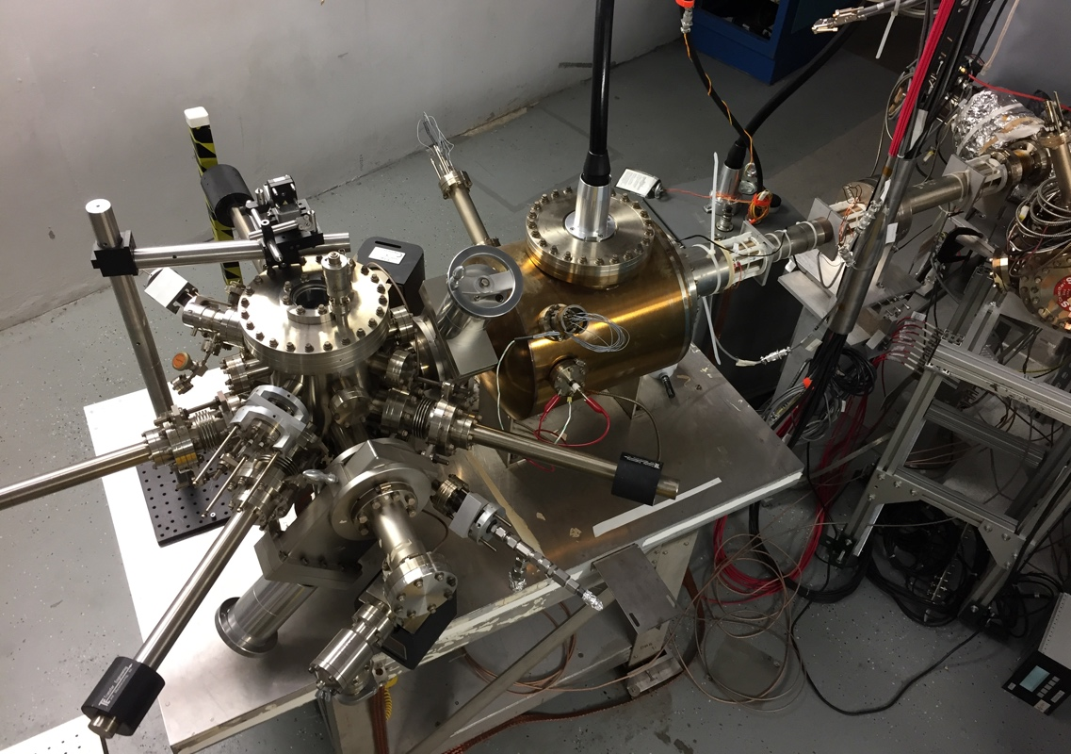
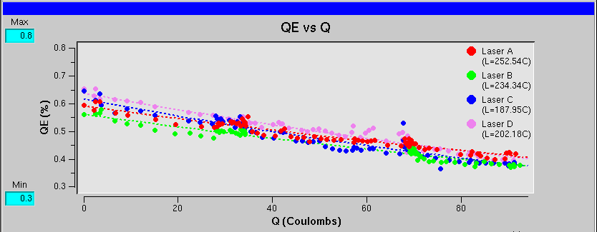
CEBAF: an example of e-driven polarized source
Gun2 Photocathode (Fall 2016 – Spring 2017)
  Lifetime ~200 C (σ_{4D} ~ 1mm) with intensity @ 200 μA
Preparation
Chamber
Activation Laser
HV Chamber
QE = QE₀ e ^{-(Q/Lifetime)}
GaAs
Storage
Loading
Chamber
P. Adderley et al., Phys. Rev. Accel. Beams 13, 010101 (2010)

Slide 17


Increasing laser size to increase charge lifetime
Charge lifetime increased by four when doubling the laser spot size from 0.5 mm to 1.0 mm (fwhm)
Ionized residual gas bombards the photocathode, lowers quantum efficiency, limits charge lifetime.

Slide 18
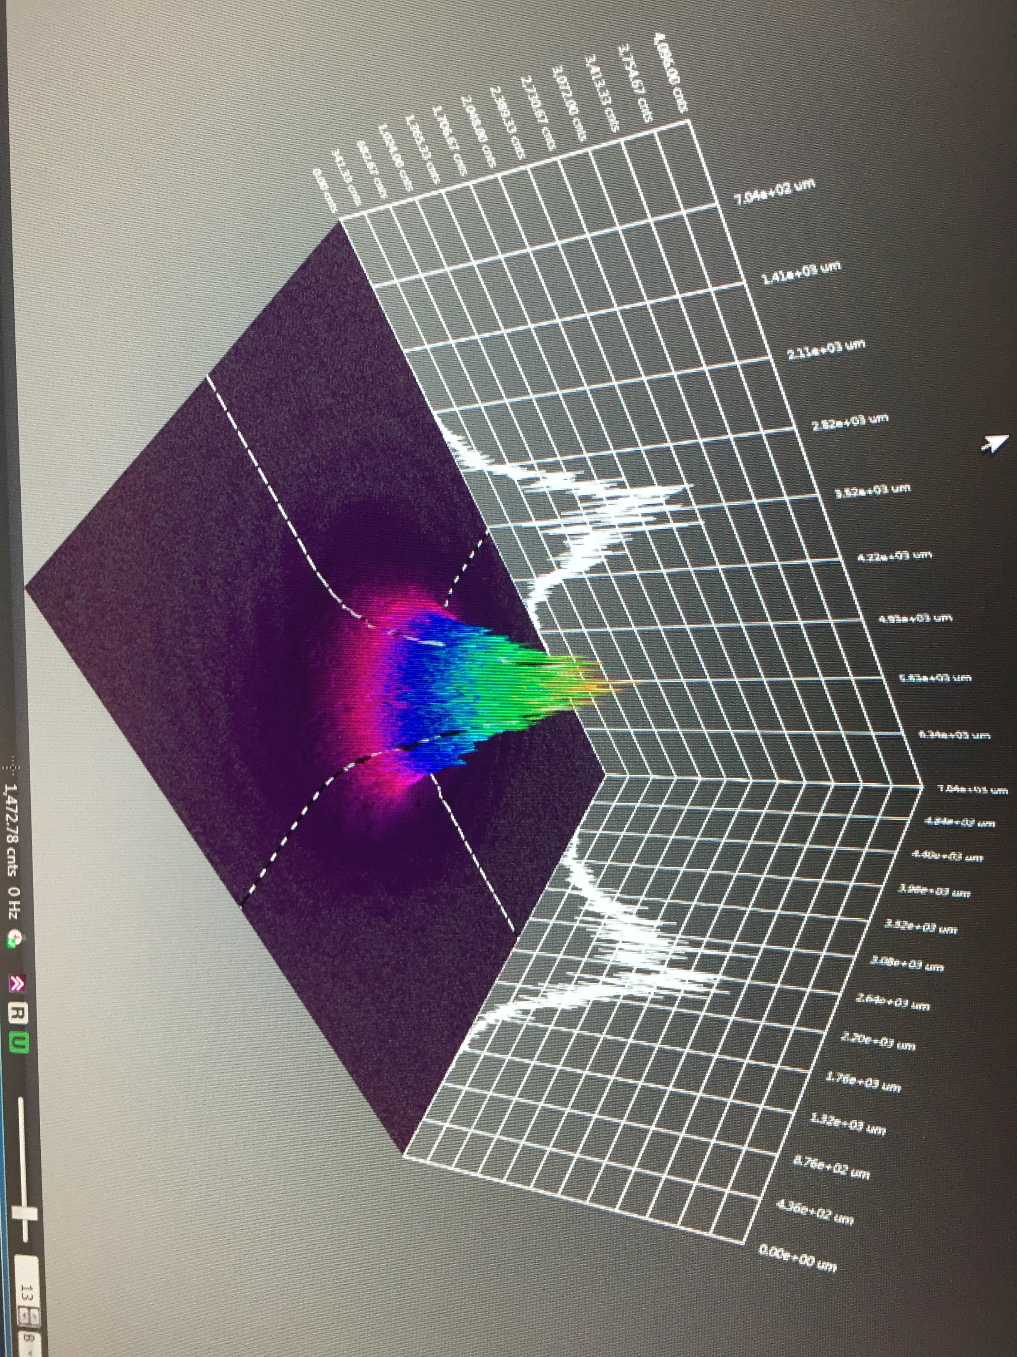

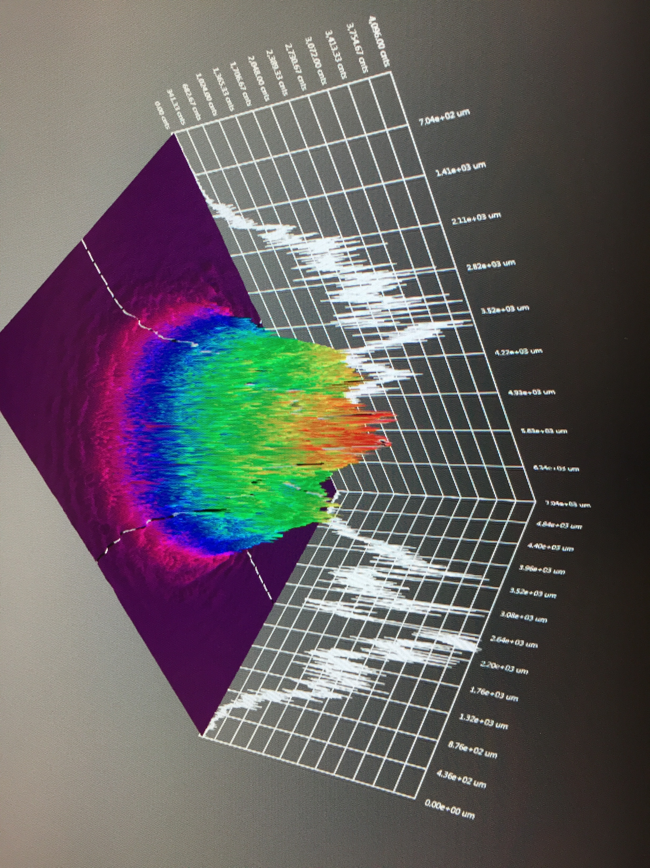
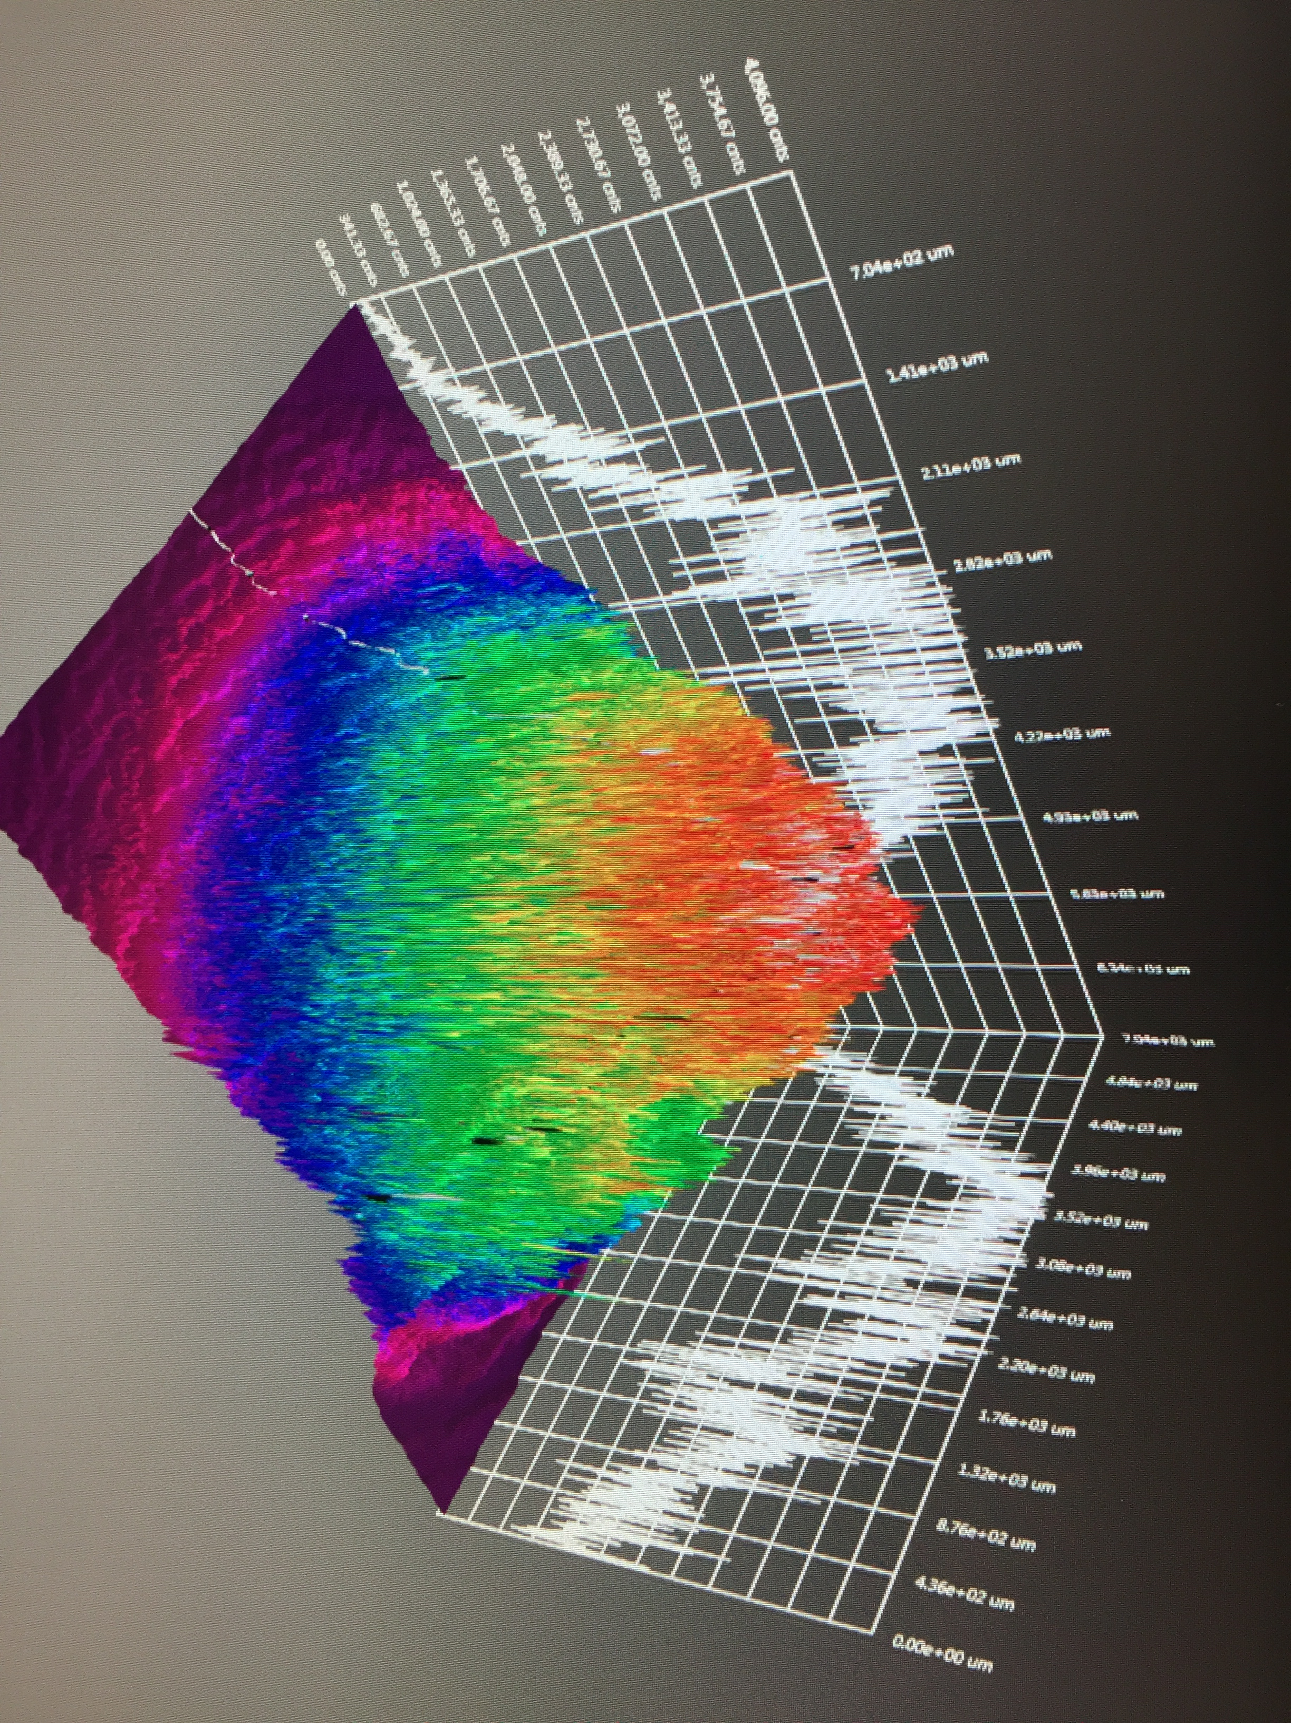
Operating >1 mA for weeks
  Initial testing shows increasing laser size extend milliamp operations into the “Week” regime
  Active R&D simulation efforts to “straighten the curve”
J. Grames, P. Adderley, J. Hansknecht, R. Kazimi, M. Poelker, D. Moser, M. Stutzman, S. Zhang, “Milliampere beam studies using high polarization photocathodes at the CEBAF Photoinjector” Polarized Sources, Targets and Polarimeters Workshop, Dajeon South Korea (2017)
Days
Trend we want to realize

Slide 19
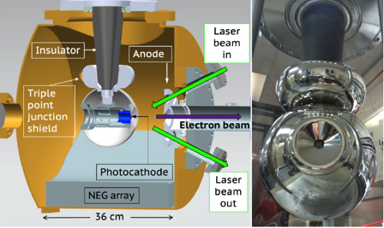
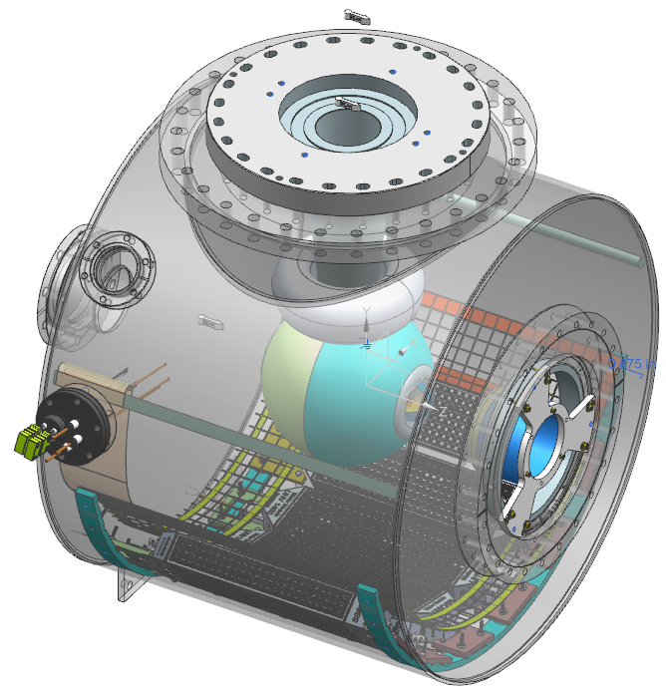
Building a higher voltage – higher current – polarized electron source
  Applying the experience and lessons learned from the 300 kV magnetized beam photogun to build a 200 kV UHV polarized electron source for SSL operation
300 kV Magnetized Beam Electron Source (CsKSb)
Model of CEBAF 200 KV Polarized Gun (GaAs/GaAsP)
C. Hernandez-Garcia et al., Phys. Rev. Accel. Beams 22, 113401 (2019)
R30 inverted geometry ceramic insulator
Conditioned to 350 kV
Demonstrated 4.5 mA CW 300 keV
Operate at >200 kV without field emission
HV conditioning >350 kV (uses R30 inverted ceramic insulator)
Dynamic pressure (during beam delivery) ~ 1x10⁻¹² Torr

Slide 20
Goals over the next 5 years
Complete a conceptual design for CEBAF
  Polarized e- injector
  100 kW e+ target / injector design
  Start to End injection/transport/magnets to CEBAF @ 12 GeV
  High Energy spin rotators
Build a scalable polarized positron injector
  350 kV gun polarized electron beam with 1000 C lifetime at 1mA
  1 mA e- beam through ¼ CM, 8 MeV electron beam
  Optics model of the positron source including especially the positron distribution downstream of target and capture and bunching
  e- and e+ beamline layout
  Positron target operates >10 kW (40-80 kW beam limited by choice of Power Supply)
  Solenoid magnet, <0.5 Tesla, positron spatial capture
  RF cavity, positron temporal capture
  e+ diagnostic beamline
  10 nA polarized positron beam

Slide 21

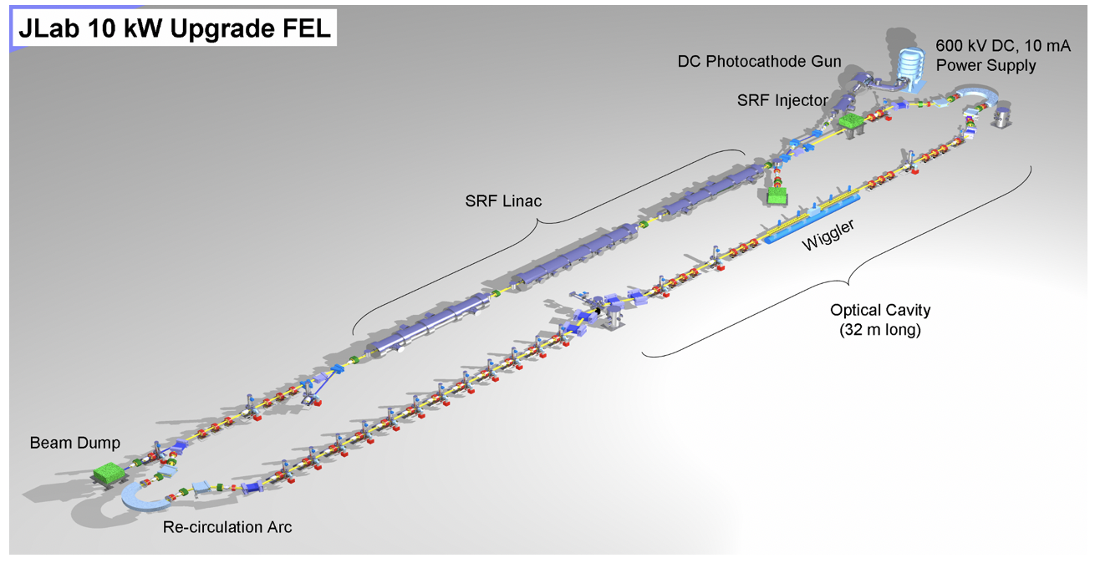
Low Energy Research Facility (LERF)

Slide 22
LERF Infrastructure is well suited
Linac Compression e+ MeV Gun
Radiation Shielding
Cryogenics
RF/Magnet controls
Safety Systems
Expandability
Experiment Hall E

Slide 23
Conclusions
Polarized positron beams of modest intensity (>100 nA) are considered as a potential upgrade path at CEBAF with GeV energy beams; and may open a door to new research opportunities in low energy (10-100 MeV) NP or materials science at Jefferson Lab.
PEPPo demonstrated GaAs DC HV photoguns can be efficiently used to generate positrons with a high degree of spin polarization – where e+ intensity scales with beam power.
Goals over the next 5 years
  Complete a conceptual start-to-end design for CEBAF, describing scope & level of effort
  Build a scalable polarized positron injector, demonstrating critical technologies
Jefferson Lab is supporting about 2 FTE toward positron R&D, and is building collaborations with partners who want to be involved in developing the concept and participating in an experimental program. We now have an opening: 2-year post-doc position

