Slide 1
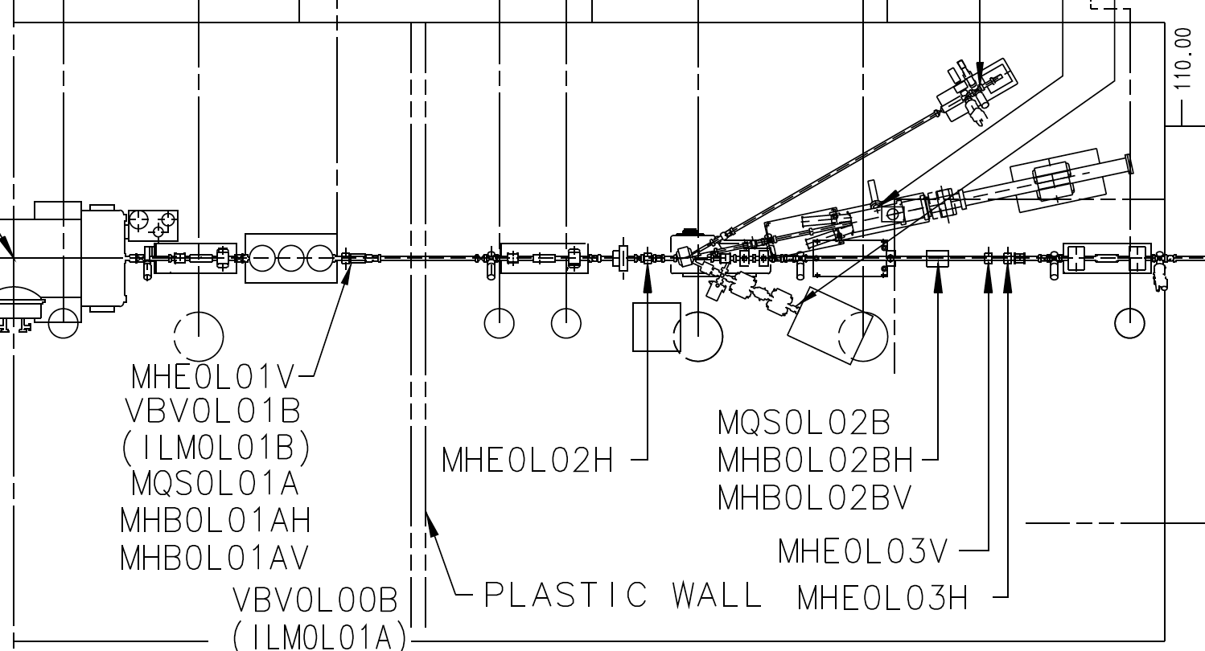
Bubble Chamber Installation Kick-Off Meeting
May 28, 2014, Grames
Let’s discuss two jobs between the cryounit and injector gate.
cryounit
New fast valve (0L)
Bubble chamber (5D)
gate

Slide 2
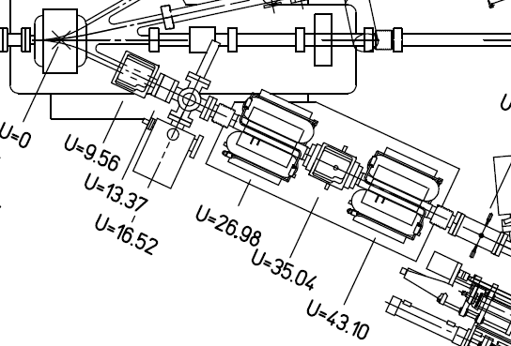
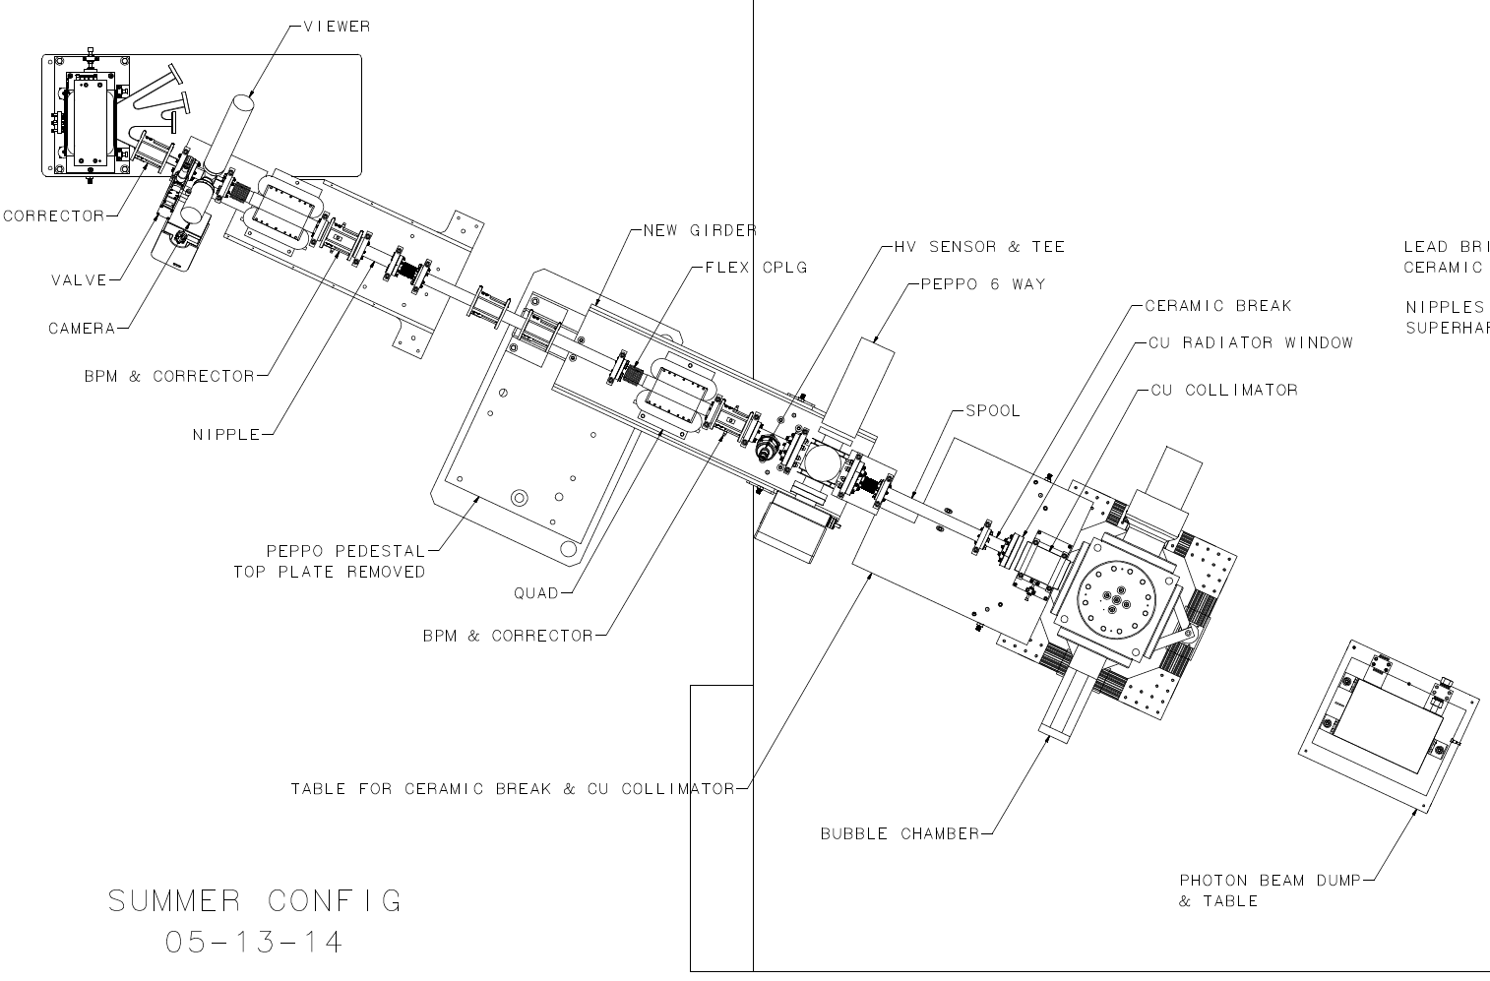
5D NOW:
5D NEW:
Upgrading “5 MeV Dipole”
Reconfiguring electron beam line
Adding photon collimator/target/dump

Slide 3
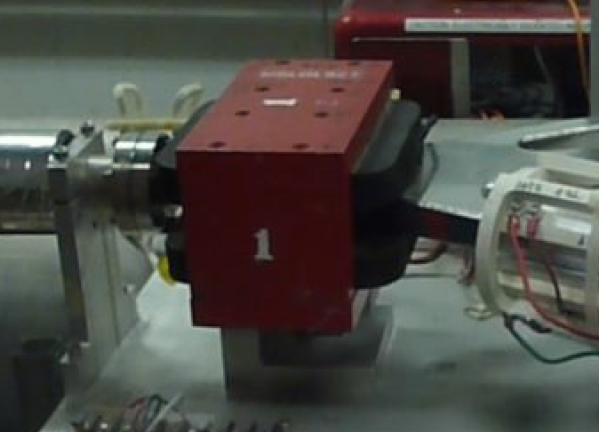
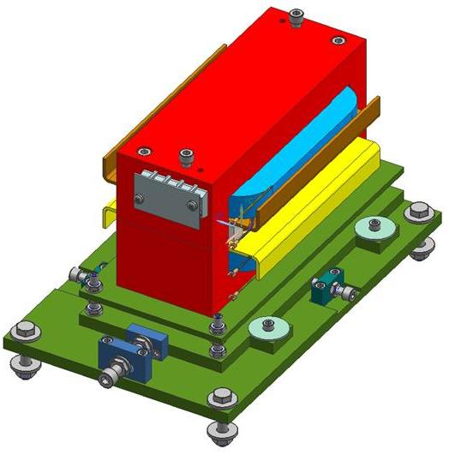
Upgrading “5 MeV Dipole”
NOW:
NEW:
Plan is to built two (magnet + spare) in-hand by August 1st
Design of magnet complete ... waiting on magnet vendor quote.
Design of fixture complete … due here this week.
Magnet measurement plan discussed last week … looks reasonable.
New insitu Hall probe + tunnel meter in-hand … software (Croke) to do controls
EGG will swap magnets when NEW is ready, latter half of August
Will use same 10A trim PS
Will need alignment support … using new fixture
Will need to update field map, CED, songsheet, name instances

Slide 4
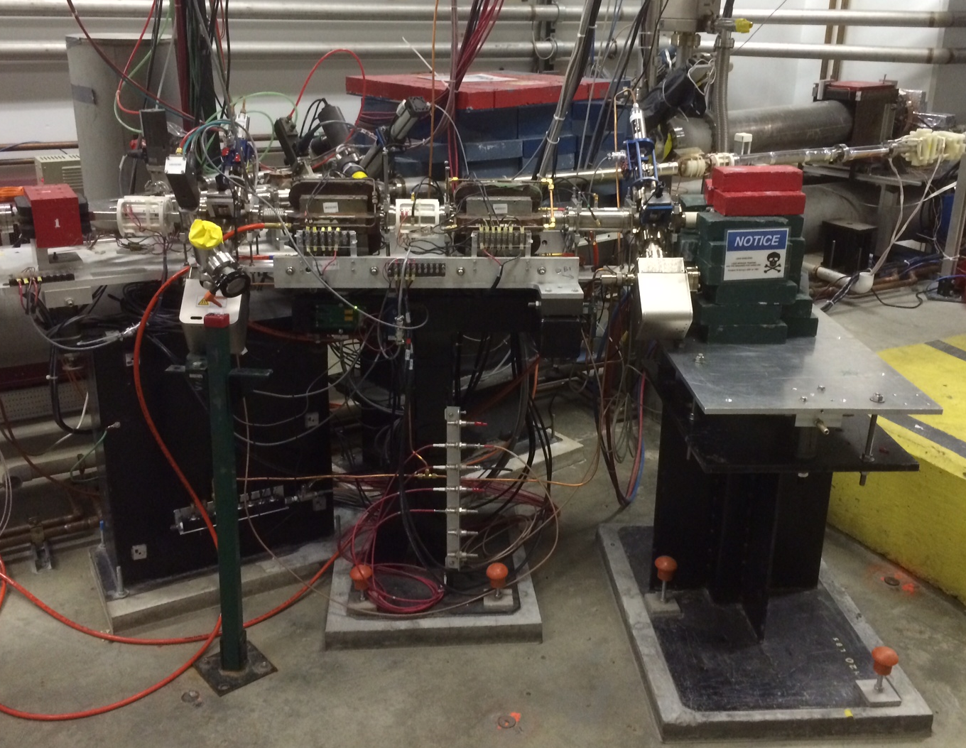
Decommission 5D beam line (prep task for Bubble installation)
http://opsweb.acc.jlab.org/CSUEApps/atlis/task/14308
De-Post dump and dismantle lead hut – done
Temporarily disconnect and safe BPM electronics - done
Temporarily dismount ITV5D01 electronics
De-energize and disconnect power to MQD5D00, MQD5D01 (others have safe connectors)
EGG will temporarily isolate quad and dump LCW + viewer air lines
EGG will temporarily vent to remove red boxed items

Slide 5
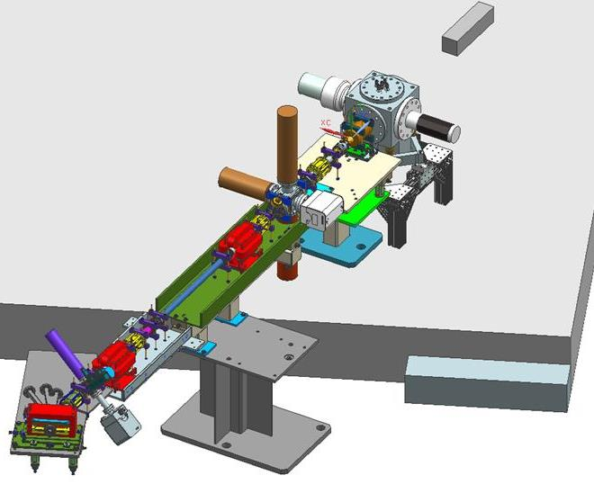
Bubble Installation : one perspective to get overall size / positioning
http://opsweb.acc.jlab.org/CSUEApps/atlis/task/14323

Slide 6
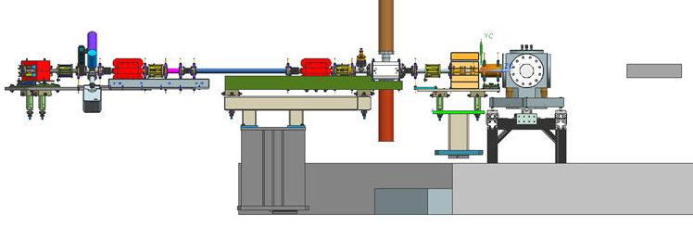
Bubble Installation (1st half of beam line, continues on next page)
Old Name | Type | Proposed | Comment
MBV0L02 | Dipole | MDL0L02 | Same 10A, but new field map, limits. New Hall probe instrument.
MBH5D00H | Corrector | same | No change
MBH5D00V | Corrector | same | No change
VBV5D00 | Valve | same | No change
VIP5D00 | Ion pump | same | No change
ITV5D00 | Viewer | same | No change
MQD5D00 | Quad | same | No change
IPM5D00 | BPM | same | No change
MBH5D00AH | Corrector | same | No change
MBH5D00AV | Corrector | same | No change

Slide 7
Bubble Installation (2nd half of beam line, continues from previous page)
Old Name | Type | Proposed | Comment
MQD5D01 | Quad | same | New position
IPM5D01 | BPM | same | New position
n/a | Corrector | MBH5D01H | New – needs 1A
n/a | Corrector | MBH5D01V | New – needs 1A
n/a | FV gauge | VCG5D01 | New – fast valve
n/a | Faraday Cup | IFY5D01 | PEPPo cross, Interlock ITV5D01, new LCW spigot, new picoammeter
ITV5D01 | Viewer | same | New position, PEPPo cross, Interlock IFY5D01
VIP5D01 | Ion pump | same | New position
n/a | Corrector | MBH5D01AH | New – needs 1A
n/a | Corrector | MBH5D01AV | New – needs 1A
IDL5D01 | Dump (1kW radiator) | same | New position, Reuse LCW spigot, reuse picoammeter channel
n/a | Photon collimator | IPC5D01 ? | New, ANL ships copper annulus, S/A support
n/a | Bubble Chamber | ITG5D01 | New, ANL ships, installation & S/A support, requires X (TBD) network/video cables to ISB
n/a | Photon dump | IDL5D01 ? | New, solid aluminum block positioned within 5mm on stand

Slide 8
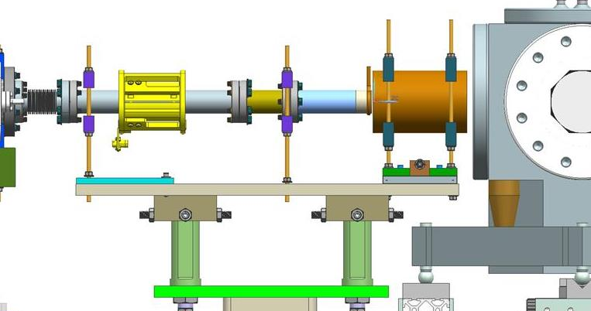
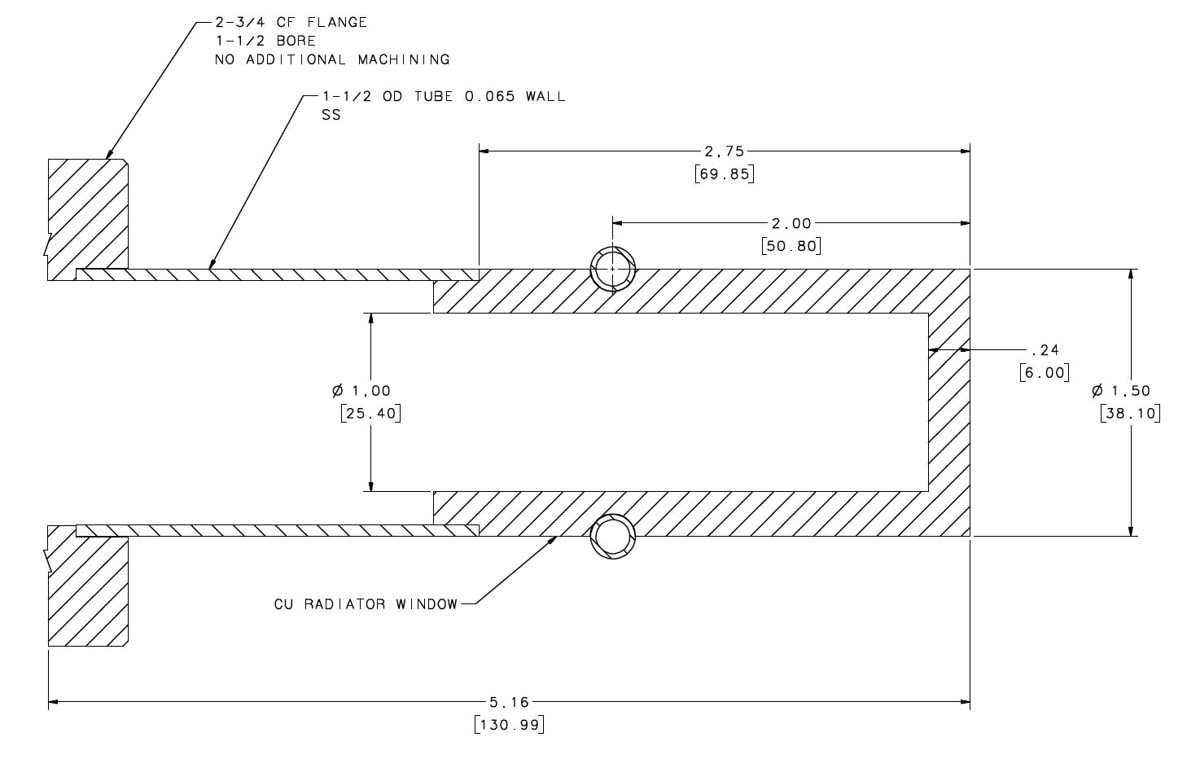
Bubble Installation – Supplemental Electron Dump/Radiator Image
Prelim
design
Final
design
Dump (radiator) similar to Faraday cup
6mm Cu wall brazed to SS nipple
LCW cooled
Ceramic joint allow current monitoring

Slide 9
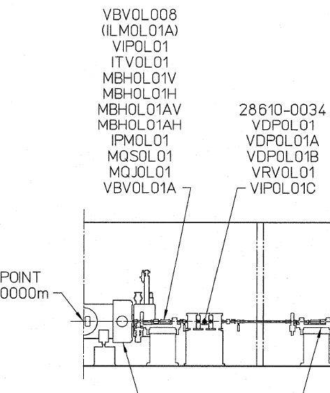
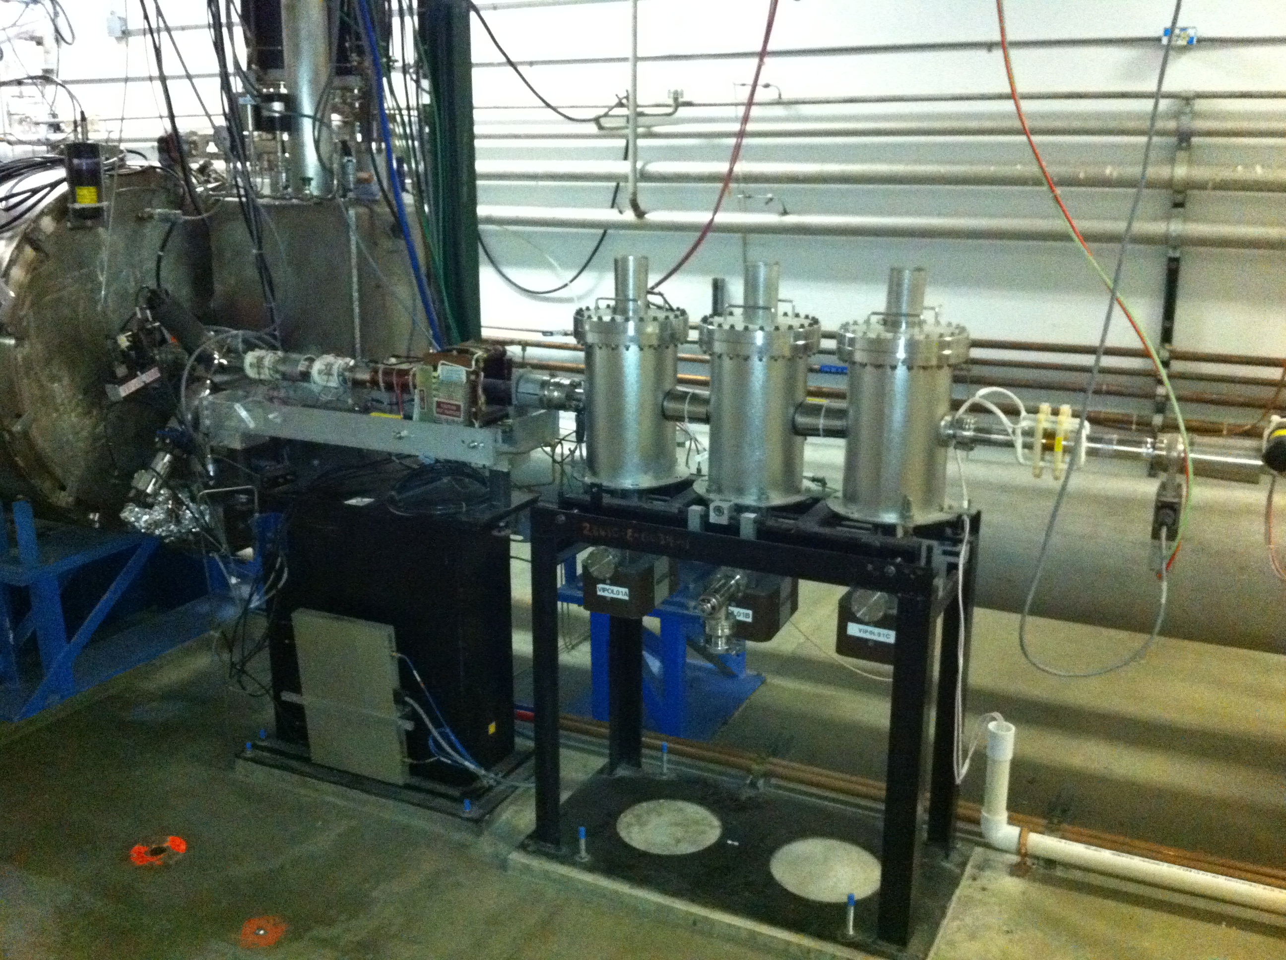
New fast valve downstream of cryounit
http://opsweb.acc.jlab.org/CSUEApps/atlis/task/14130
Vacuum (Heckman) + ICN (Kortze) + PSS

Slide 10
Timeline
June
Final drawings and nomenclature
Fabricate & purchase (pedestals, girders, vacuum components)
Decommission 5D line components (viewer, magnets)
Vacuum work to claim components for new beam line
Fast valve install ???
July
Complete fabrication
Assemble and align new girders in Test Lab
Points for new girders + Bubble Chamber
Test new Hall probe in tunnel, new picoammeter in ISB
Pull any cables
Fast valve controls ???
August
Receive + measure new dipole magnet
Move girders to tunnel, vacuum hookup + alignment
Controls hookup, testing
Receive, install, align Bubble Chamber from ANL, date TBD

Slide 11
Charge Codes
Labor on fast valve or new 5 MeV dipole = ACCCIS / RSRSRC
Labor on Bubble Chamber beam line = ACCCIS / ARDSRC
Procurements already rather well defined and largely complete, so accompany any unanticipated REQ’s w/ e-mail to poelker@jlab.org and grames@jlab.org

Slide 12
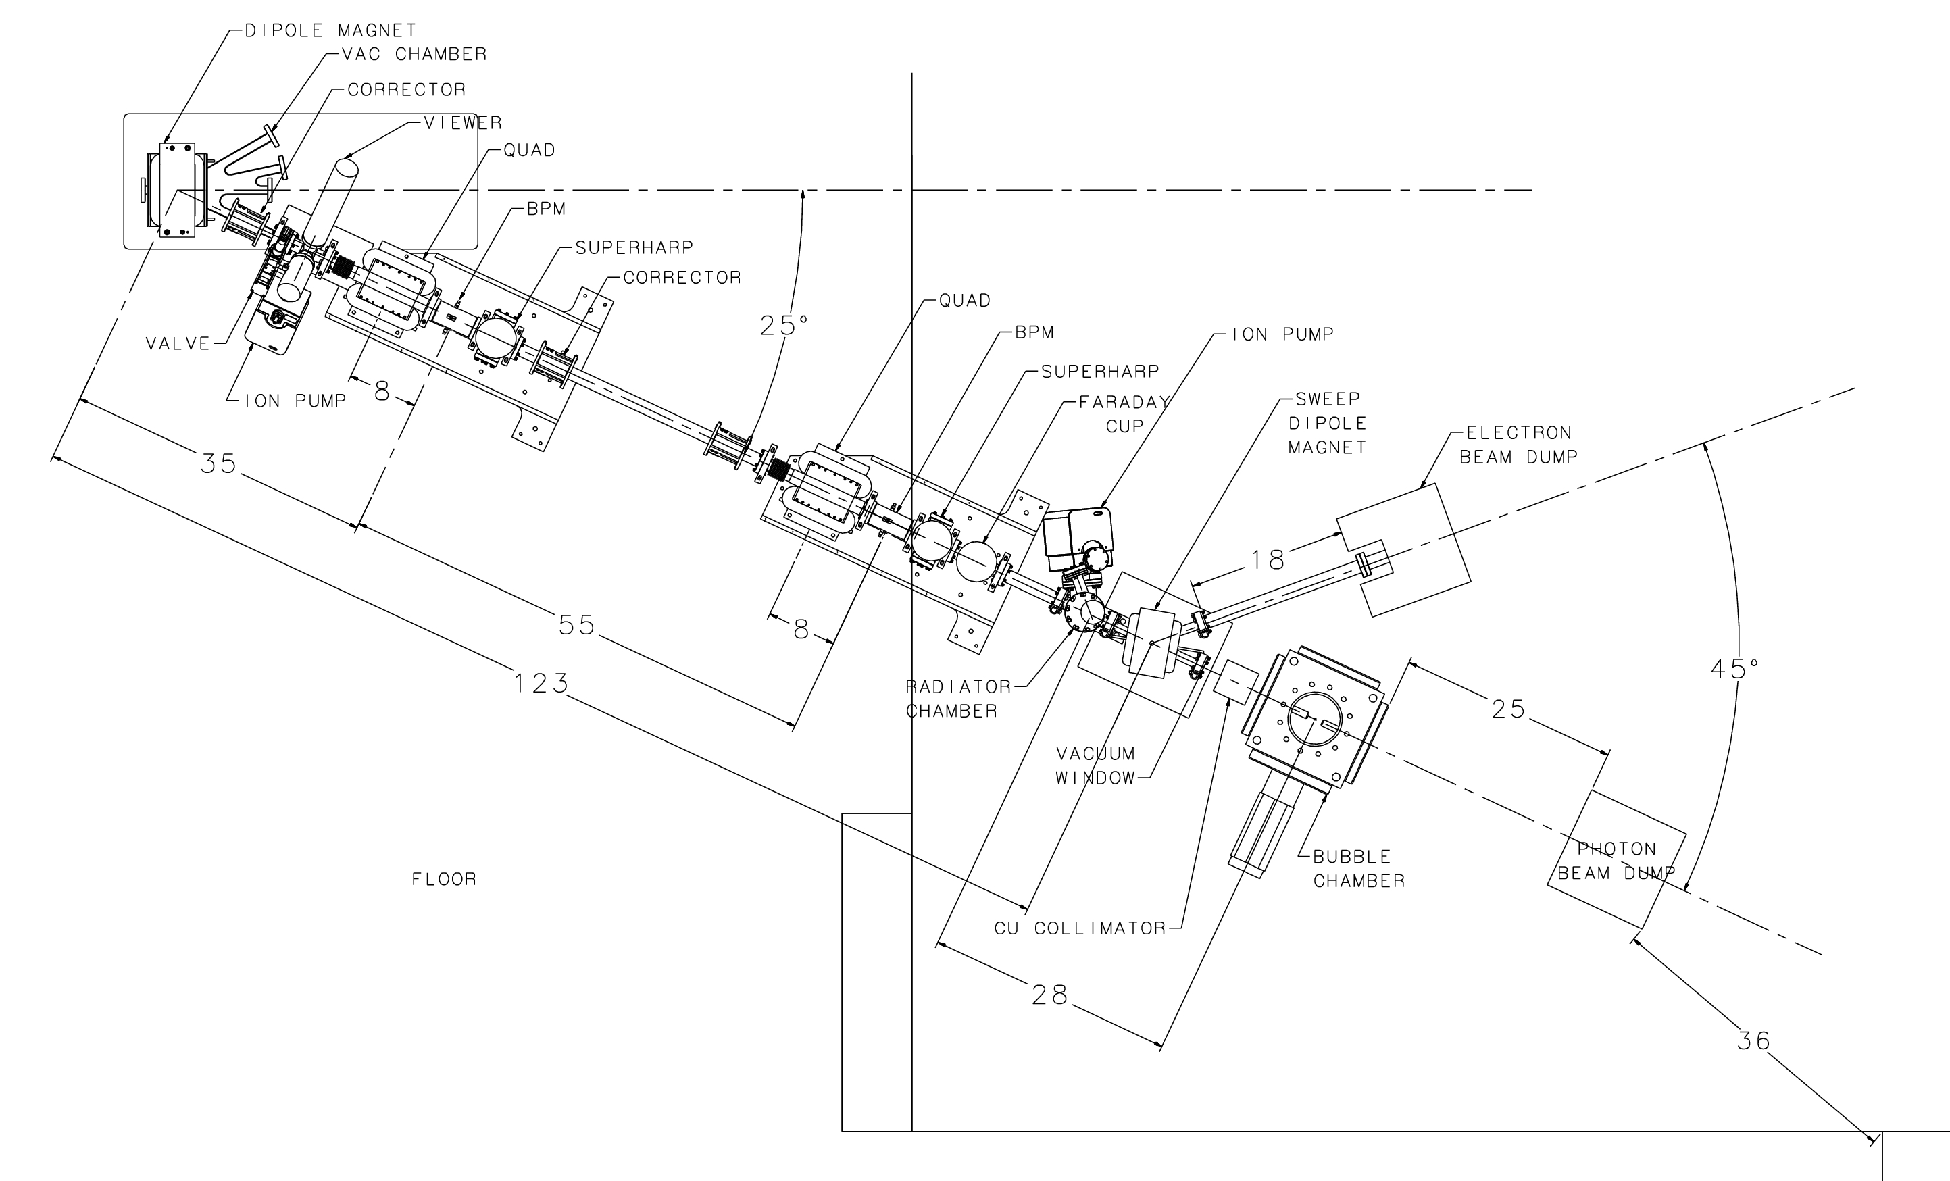
Final Experiment Configuration (TBD): Winter SAD?
One or two (super)harps
Target chamber
Dipole
Beam dump
Thin vacuum window

