Slide 1
WP4 – Polarized Electron Source
Joe Grames (Jefferson Lab)
on behalf of the ILC IDT WG2 - Sources
The baseline design of the ILC polarized electron source includes:
  200 kV DC high voltage photo-gun, free of field emission
  Drive laser providing bunch pattern, sufficient power and laser polarization
  High-P GaAs photocathodes providing P>90% and QE>1%

Slide 2
Polarized electron source parameters from the TDR
Parameter | Symbol | TDR
Number Electrons per microbunch | N_{e} | 3 x 10¹⁰
Number of microbunches | n_{b} | 1312
Width of microbunch | t_{b} | 1 ns
Time between microbunches | Δt_{b} | 556 ns
Microbunch rep rate | f_{b} | 1.8 MHz
Width of macropulse | T_{B} | 729 μs
Macropulse repetition rate | F_{B} | 5 (10) Hz
Charge per micropulse | C_{b} | 4.8 nC
Charge per macropulse | C_{B} | 6300 nC
Average current from gun (C_{B} x F_{B}) | I_{ave} | 31.5 (63) uA
Average current macropulse (C_{B} / T_{B}) | I_{B} | 19.8 mA
Duty Factor in macropulse (1 ns / 556 ns) | DF | 0.18 %
Peak current of micropulse (I_{B} / DF) | I_{peak} | 11 A
Drive Laser (repetition rate)
High-P Photocathode (quantum efficiency)
Gun Vacuum (operating lifetime)
Gun HV (peak current & surface charge limit)

Slide 3
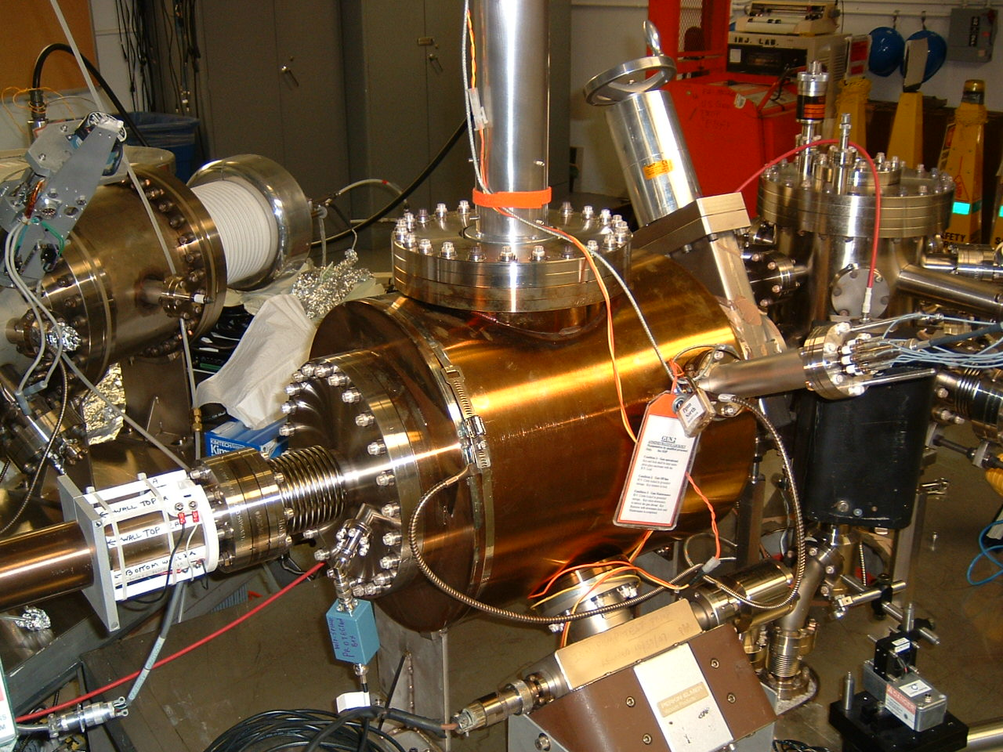
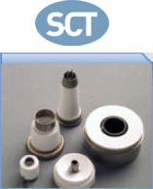
DC High Voltage Photo-Gun
Why a high gun voltage?
Reduces space-charge-induced emittance growth, maintain smaller transverse profile and short bunch length
Reduces electron impact-ionization production, prolongs operating lifetime
Addresses high current density limitation due to Child’s Law
Child’s Law:
Assume d=3 cm cathode/anode gap
V (kV) | j₀ (A/cm²)
100 | 7
140 | 14
200 | 23
350 | 53
TDR ~ 6 A/cm² (10 mm)
TDR ~ 24 A/cm² (5 mm)
Factor 2 in charge
Factor ½ in pulse
Factor 0.7 in size
Jefferson Lab has built two 200 kV DC-HV photo-guns
Large grain Nb tested 225 kV (>18 MV/m)
Stainless steel now at CEBAF 200 kV (no FE)
Both demonstrated <2e-12 Torr (N2 equivalent)

Slide 4
DC High Voltage Photo-Gun
Significant developments since the GDE period:
Reducing gradient at the ceramic-vacuum-cathode triple-point (essential to reach conditioning voltage)
Demonstrating improved photocathode lifetime with anode biasing
Building higher voltage photo-guns at JLab (350 kV), Cornell (400 kV), JAEA (450 kV), recently BNL (325 kV)
Future R&D opportunities to further improve performance and reliability:
Increase baseline design voltage to elevate Child’s law limit, for smaller laser size or shorter pulse length
Further improve the high voltage interface between the power supply and vacuum chamber
Correct for the cathode/anode optics of inverted gun asymmetric electrode geometry
Optimize the vacuum conductance in cathode-anode gap
Recommend:
Beam dynamics simulations with higher beam voltage
Electrostatic design with higher cathode voltage and biased anode
Triple point junction shield to mitigate excessive gradient
Vacuum and ion bombardment modeling and simulations
Parameters | Unit | Design
Operating voltage without measurable field emission | kV | 350
Expected conditioning voltage | kV | 450
Maximum gradient at operating voltage | MV/m | 10
Static vacuum at operating voltage | Torr | <1x10⁻¹²

Slide 5
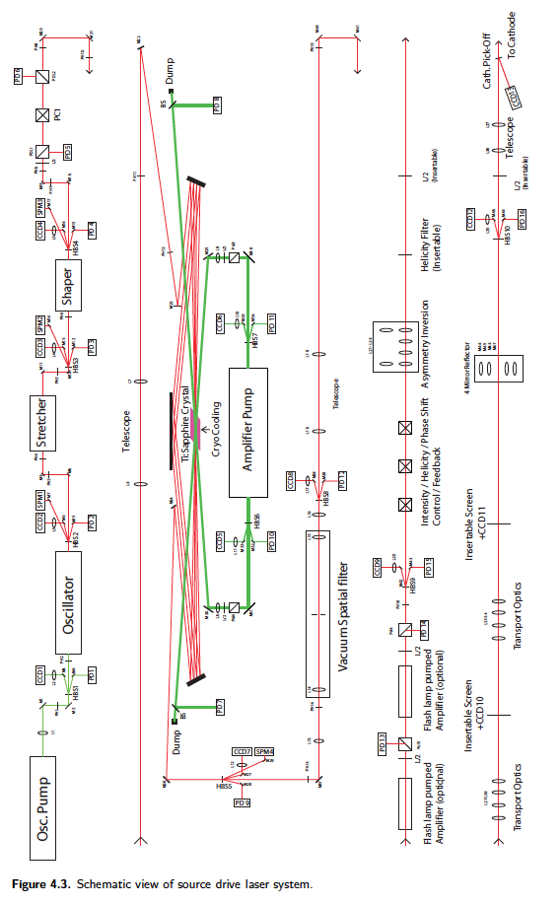
Polarized Source Drive Laser
Laser system criteria
Wavelength must match (or be tunable) to the GaAs (750-850 nm)
Fundamental frequency defined by a harmonic oscillator
Macro pulses are defined by EO cells
Peak power set by internal amplifier stages
Integrated Pockels cell for laser polarization and helicity reversal
Recent status update (interviewed Axel Brachmann)
Drive laser designed at SLAC, prototype demonstrated fundamental frequency rate and macro pulse structure
Progress made on pulse amplifiers, but not completed during the GDE
GDE period ended prior to planned JLab beam tests
Drive laser no longer exists and SLAC polarized source staff have retired or moved to other projects

Slide 6
Polarized Source Drive Laser
Future drive laser R&D:
GDE drive laser is sophisticated, and costly (>$1M)
Laser technology evolves rapidly, sensible to re-evaluate design and cost
Very reasonable to consider a narrow-band laser matched to GaAs photocathode
Gain switched fiber lasers produce ~MHz rep rates, have excellent RF-synchronization
High peak power fiber amplifiers are reliable, and have become affordable
Recommend:
Design and cost a fiber drive laser solution
Prototype the Optical Power Amplifier (OPA), and characterize performance
Economical pathway (est. 350 k$) to build drive laser, enables beam based photocathode studies

Slide 7
High Polarization GaAs Photocathodes
There is a long, rich history in the development of high polarization GaAs photocathodes:
First polarized beam from GaAs produced 45 years ago
Many important contributions, notably from SLAC, Nagoya University and St. Petersburg Technical University
The US investment over the last 30 years is likely >20 M$
Jefferson Lab experience over 25 years

Slide 8
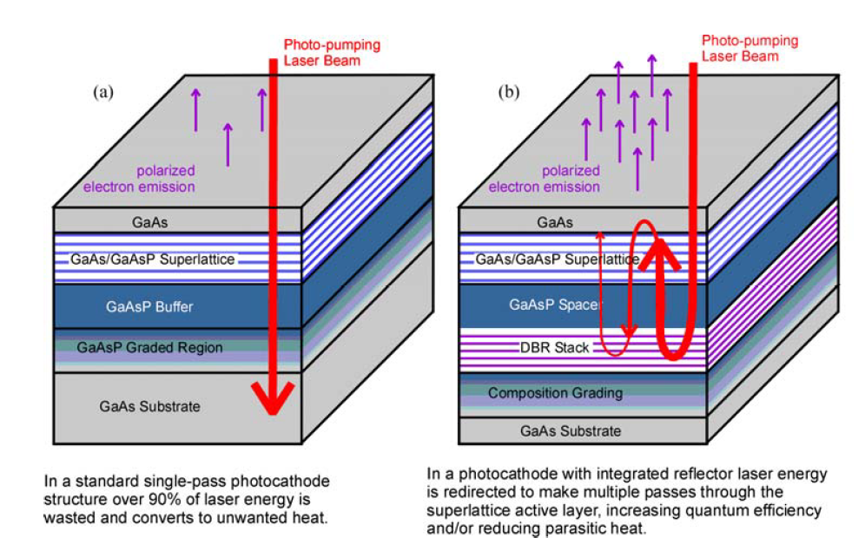
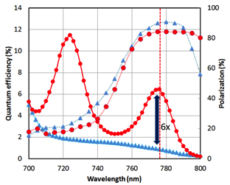
High Polarization GaAs Photocathodes
Photocathode R&D has continued since the GDE:
Diffracted Bragg Reflector (DBR) Strained Layer Superlattice Photocathode (SLSP) with QE > 6%
Strained-relieved superlattice photocathodes enhance transport and increase QE with QE > 2%
Alternative fabrication methods, e.g. MOCVD or CBE (vs. MBE, costly and hazardous)
Is there a world-wide crisis for High-P GaAs photocathodes?
Presently no commercial vendor exists
Insufficient demand for vendors to sustain cost and risk, without a long standing commitment
Jefferson Lab maintains a modest inventory.
But for ILC, EIC, MESA, others this will become a critical path
Recommend:
Develop a long term and global strategy
Anticipate 2-3 years of vendor R&D with collaborative measurements, and sustaining a decade of purchasing
Partner with other existing or planned efforts in the US (EIC – JLab/BNL) and Europe (MESA)

Slide 9
Summary & Recommendations
There are no foreseeable technological “show-stoppers” leading to the construction of the ILC polarized electron source. However, there have been meaningful improvements in lasers and high voltage guns, and a pending photocathode crisis looms. These issues ought to be considered in during PreLab for the baseline design and incorporated as makes sense, as opportunities for reliability, performance or cost improvements.
These may include:
Designing or building a prototype drive laser based on fiber technologies
Building a higher voltage inverted gun, to improve beam quality, and with greater HV reliability
Committing to a global R&D partnership to develop a commercial supplier of High-P GaAs photocathodes
Demonstrating the high peak current beam structure required for the ILC by the end of PreLab
Issue | Tasks | Cost (MILC) | Human Resources (FTEy)
Drive laser system | Design and provide a prototype drive laser with ILC bunch train | 0.35 | 2
HV Photogun | Design and build a photogun operating at 350 kV without field emission and static vacuum <2x10-12 Torr | 0.25 | 2
GaAs/GaAsP Photocathodes | Commercialize strained superlattice GaAs / GaAsP photocathodes with P>90% and QE>1% | 2.0 | 2

Slide 10
Backup

Slide 11
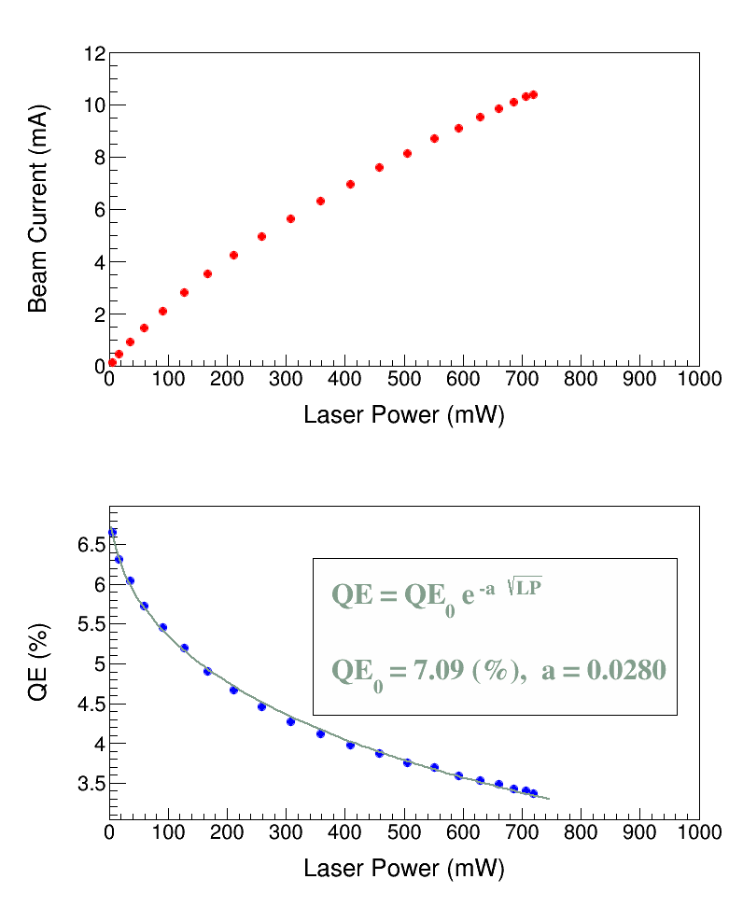
Surface Charge Limit Explained
Surface Charge Limit, also known as Surface Photovoltage Effect, reduces NEA of GaAs: Photoelectrons trapped near GaAs surface produce opposing field that reduces NEA resulting in QE reduction at high laser power (LP),
Bulk GaAs, 532 nm, 100 kV
U(LP)
χ
E_{gap}
δU(E_{s})
Where U(LP) is up-shifting of potential barrier due to photovoltage.
For heavily Zn doped GaAs surface, U(LP) → 0 (doping introduces high internal electric field to facilitate charge transport, increase diffusion length, and reduce chance of depolarization in active layer)
Higher Gun HV suppresses photovoltage

Slide 12
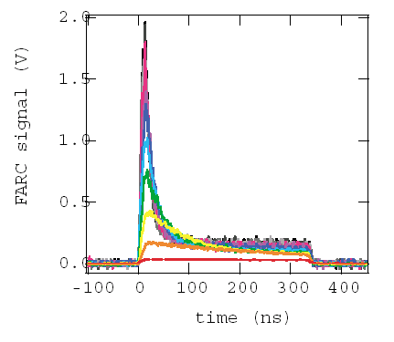
Overcoming Surface Charge Limit
Slide info courtesy Takashi Maruyama, SLAC

Slide 13
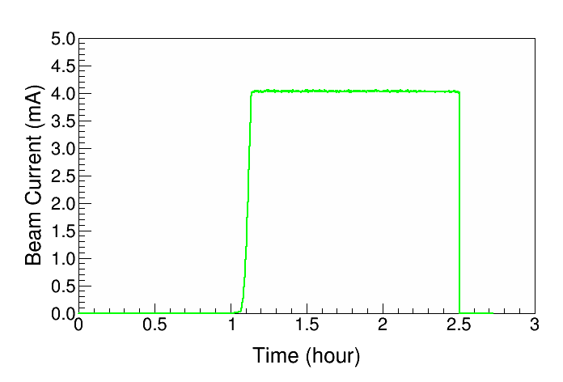
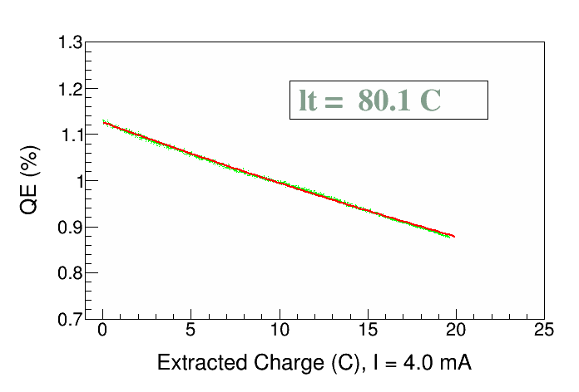
High Current Results GaAs/GaAsP
Parameter | Value | Value
Laser Rep Rate | 499 MHz | 1500 MHz
Laser Pulse Length | 30 ps | 50 ps
Laser Wavelength | 780 nm | 780 nm
Laser Spot Size | 0.45 mm | 0.35 mm
Photocathode | GaAs/GaAsP | GaAs/GaAsP
Gun Voltage | 100 kV | 200 kV
Beam Current | 1 mA | 4 mA
Run Duration | 8.25 hr | 1.4 hr
Extracted Charge | 30.3 C | 20 C
Charge Lifetime | 210 C | 80 C
Fluence Lifetime | 132 kC/cm² | 83 kC/cm²
Bunch Charge | 2.0 pC | 2.7 pC
Peak Current | 67 mA | 53 mA
Peak Current Density | 42 A/cm² | 55 A/cm²
QE(q) = QE₀ e^{–(q / 80)}
J. Grames et al., PAC07, THPMS064
R. Suleiman et al., PAC11, WEODS3

