Slide 1
Jefferson Lab – Compton Transmission Polarimeter
Summary of Progress
June 29, 2022
Riad, Joe, Eric, and Matt

Slide 2
Achievements, Milestones and Timeline
FY22 Q2 (Jan, Feb, Mar)
IJCLab is responsible for detector design w/ JLab backfilling long-lead components as necessary
Portable DAQ parts are ordered and/or onsite
One set of Radiator is ready, need to fabricate second radiator and two Collimators
FY22 Q3: (Apr, May, June)
Design of magnet with iron core is completed – (2) steel core fabricated, coil winding is underway
Mechanical design of polarimeter for UITF is nearly complete, finalize w/ BNL then fabricate both
Complete Portable DAQ
Installed Wien filter and 200 kV Mott polarimeter – Commission both in July, to calibrate Compton
FY22 Q4 (Jul, Aug, Sep):
Assemble polarimeter (4 weeks)
Install polarimeter at UITF (2 weeks)
Beam tests (2 weeks)
Commission new beam line
Calibrate Compton polarimeter against Mott
FY23 Q1 (Oct, Nov, Dec):
Aim to deliver to BNL
Budget:
Spent: $190k
Remaining: $210k
Expecting labor and M&S burn rates to remain high next 6 months

Slide 3
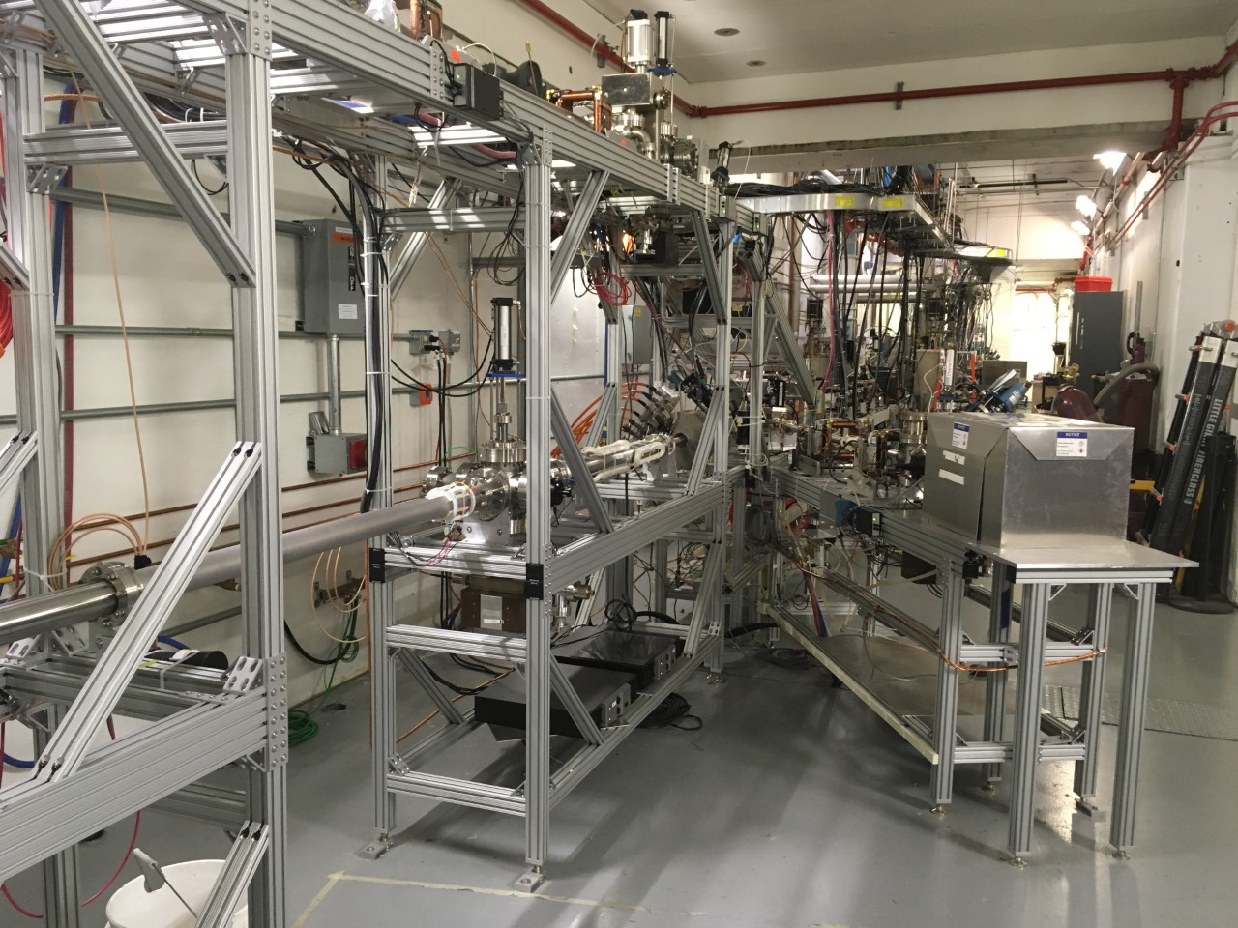
Polarimeter at IUTF
Here

Slide 4
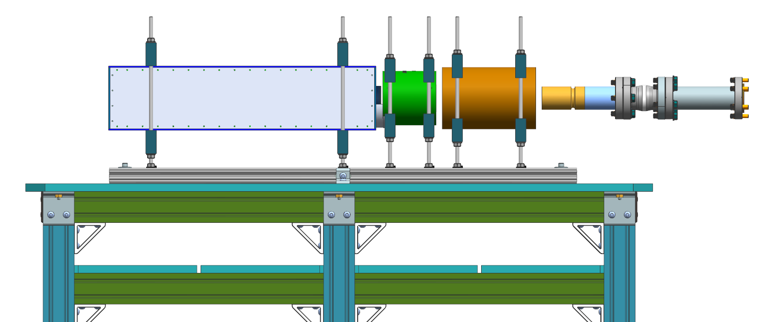
Compton Transmission Polarimeter
Detector
Magnet
Collimator
Radiator
Shaun Gregory, Gary Hays

Slide 5
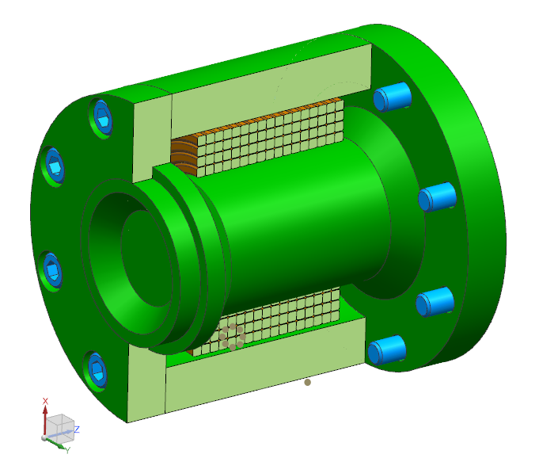
Magnet Progress
Magnet specifications defined and documented (PMAG0000-0011-S000)
Magnet coil and core geometry developed using TOSCA and MAXWELL
Peak field 2.2 Tesla
1005 Steel Core, Flange, Sleeve
Detailed coil layout and manufacturing drawings developed
Conductor (2.2 mm x 2.2 mm) and insulation dimensions defined
Coil manufacturing vendor identified and conductor purchased
Detailed core drawings being developed
1005 Steel material on-hand
Magnet power supply (MPS) requirements defined. Power supplies ordered.
MPS with 0-10Vdc, 15Adc (150W) 2 quadrant
Probir G, Sandesh G, Joe M, Mike B, Sean G
Sleeve
Coil
Flange
Core
Compton Magnet Design Overview

Slide 6
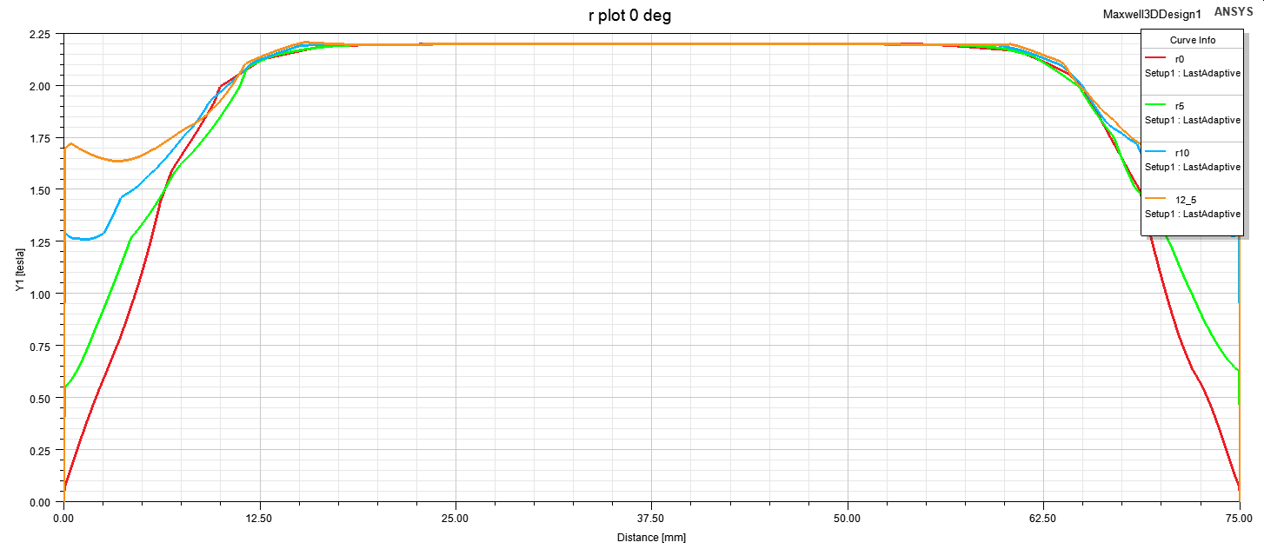
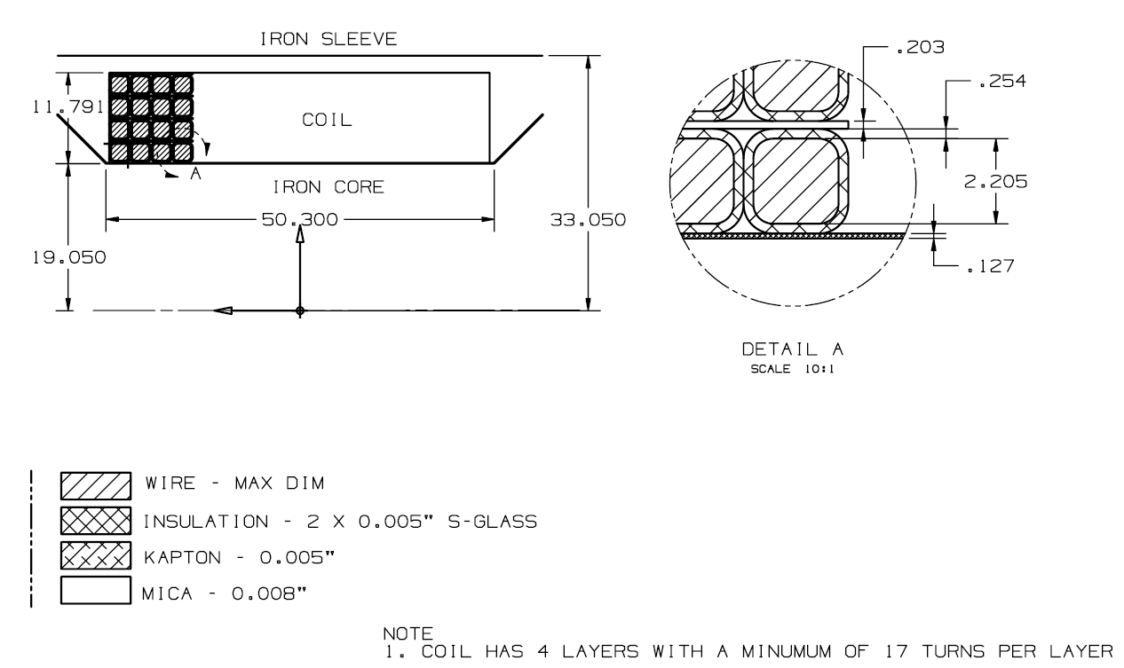
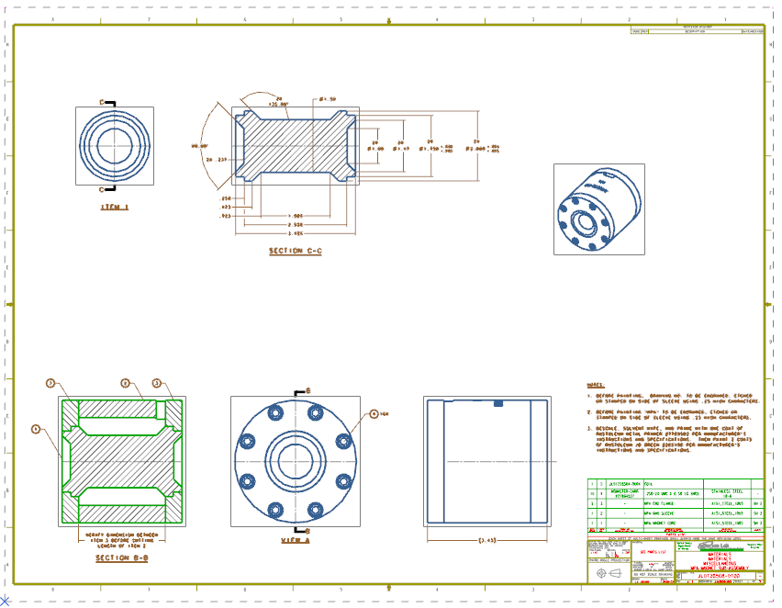
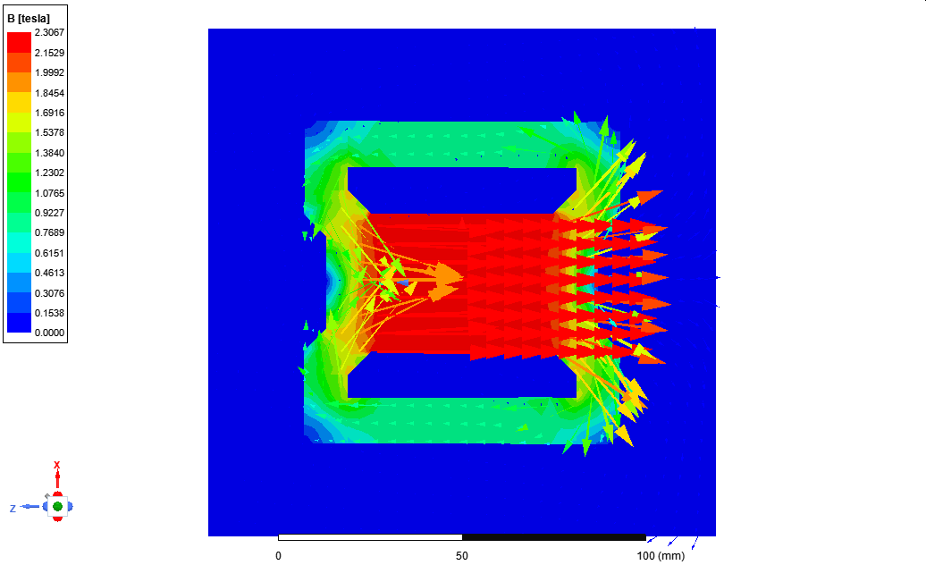
Magnet Design
Coil layout & Composition
Field variation along the core length at radius of 0, 5 mm, 10 mm, & 12.5 mm. Field on Y axis (Tesla) and core length on X axis (mm)
Magnet Manufacturing drawing
B field magnitude and vector plots in MAXWELL

Slide 7
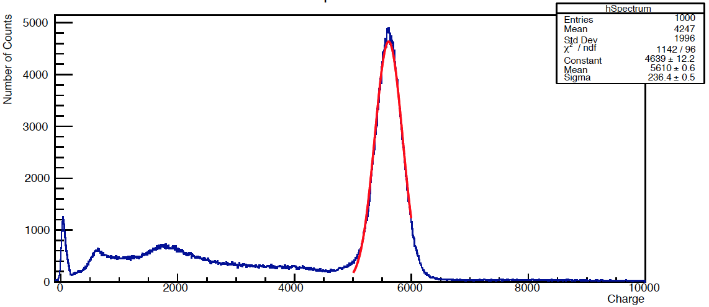
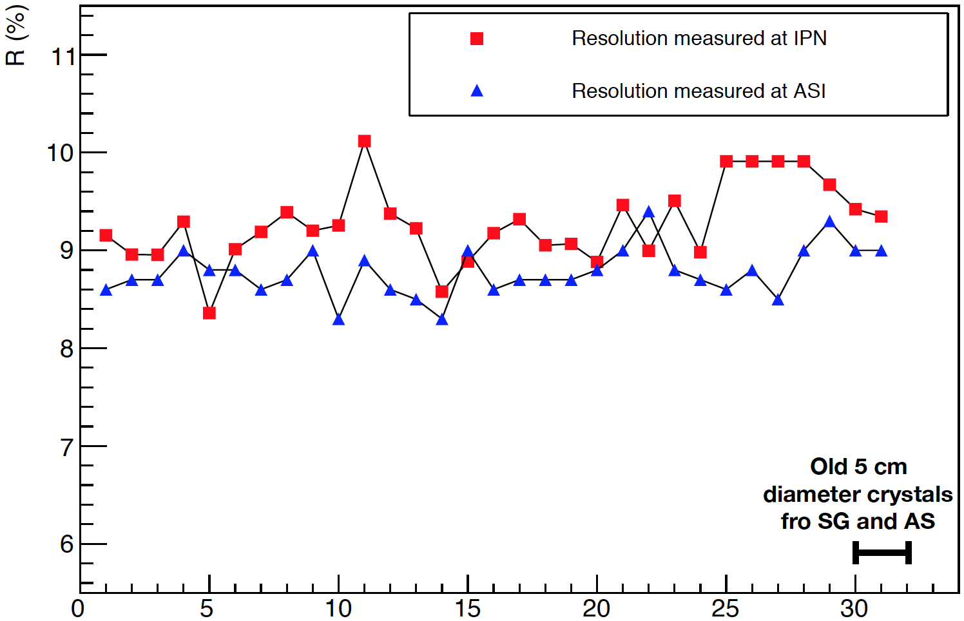
Detector
The photon detector part is a cylindrical BGO crystal 15 cm long with a 5 cm diameter previously tested at IJCLab.
The provider is Alpha Spectra Inc. (ASI) (fjwxals@alphaspectra.com).
Shipped two ready-to-install crystals to JLab.
Crystal reception @ JLab (this week)
Integration in the detector assembly
¹³⁷Cs experimental spectra
Crystals have been tested at ASI and IJCLab to have a 8.5% resolution at 662 keV.
Christine Le Galliard, Thi Nguyen Trung, Eric Voutier

Slide 8
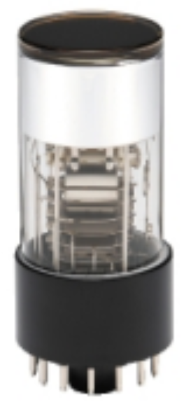
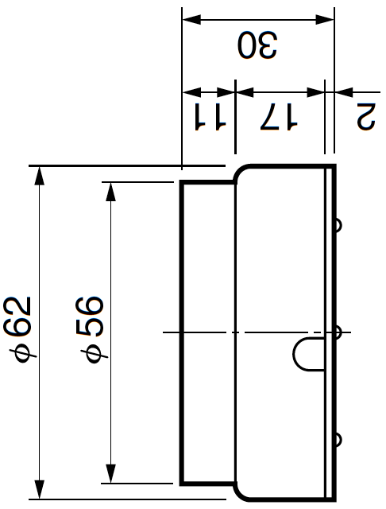
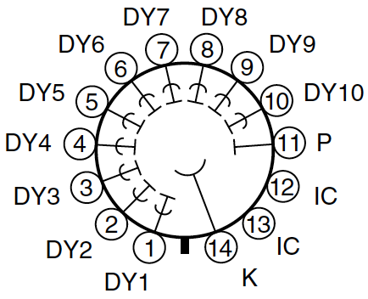
Photomultiplier
The selected photomultiplier tube is the R2154-02 from Hamamatsu. Jlab ordered four PMTs.
The PMT socket E678-14W ordering is in progress at IJCLab.
The production of silicon pads for crystal/PMT optical coupling is in progress at IJCLab.
PMT reception @ JLab (? weeks)
Test/troubleshooting (1 week)
Integration in the crystal assembly
PMT socket reception @ IJCLab (? weeks)
Integration with the PMT assembly
Integration in the crystal assembly
PMT base conception @ IJCLab (1.5 week)
Assembly (1.5 week)
Testing (1 week)
The PMT embase conception an construction process will start on June 20th.

Slide 9
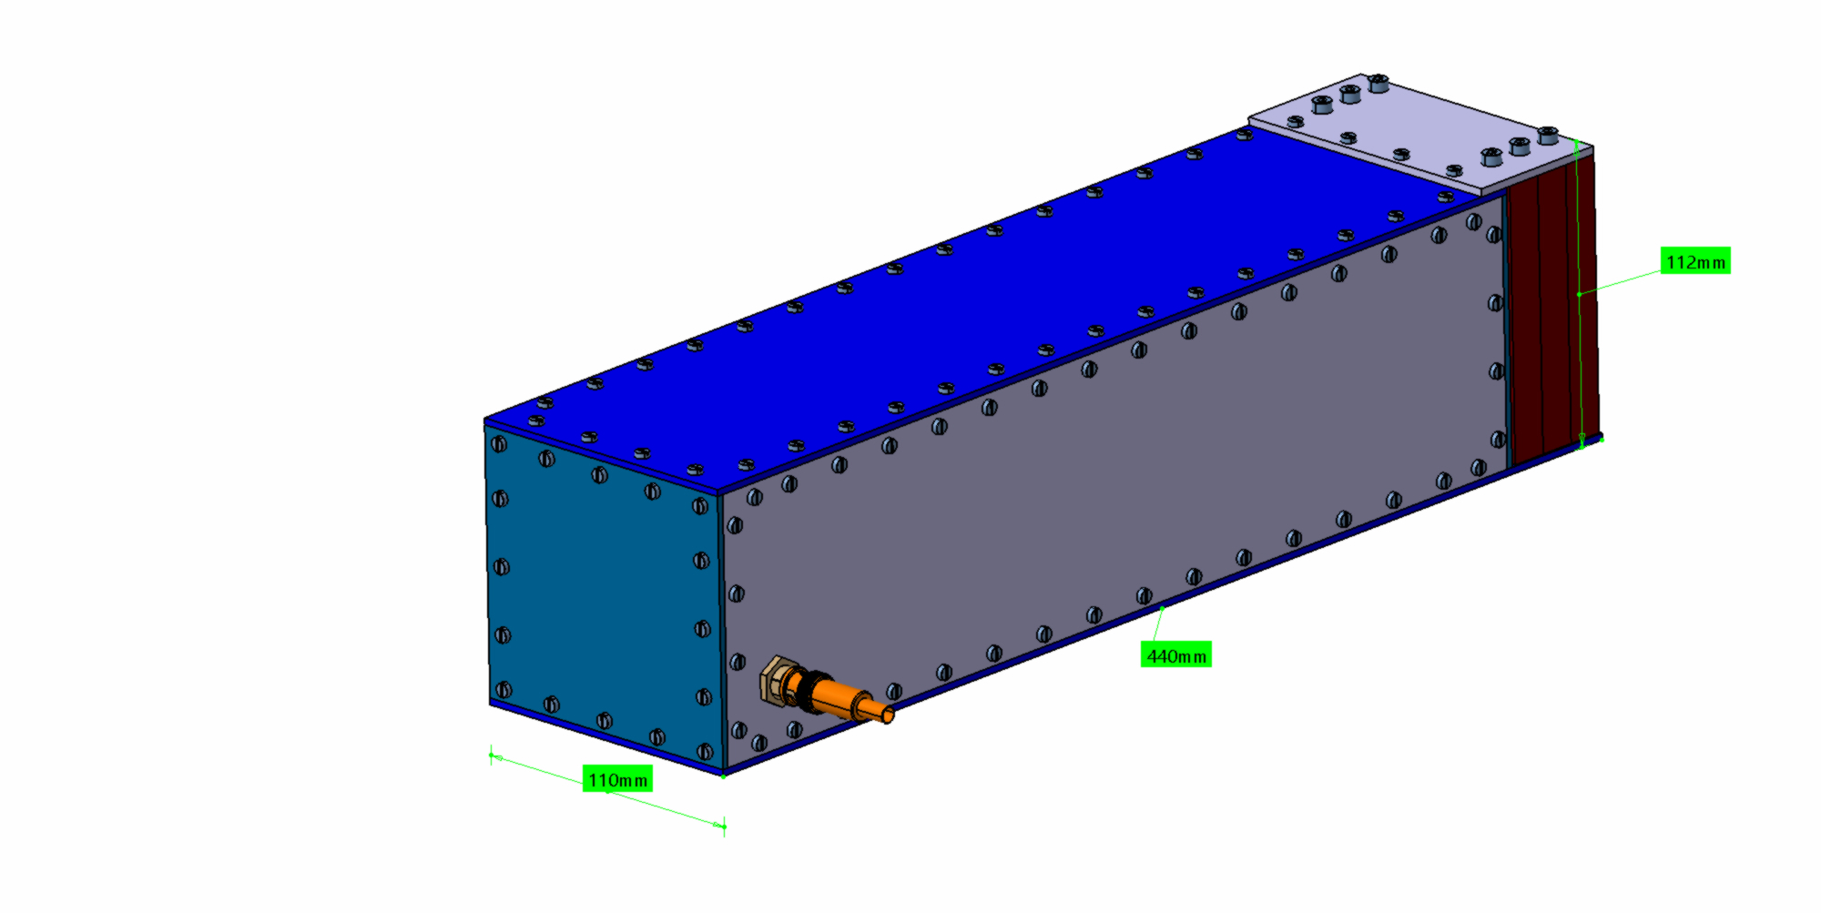
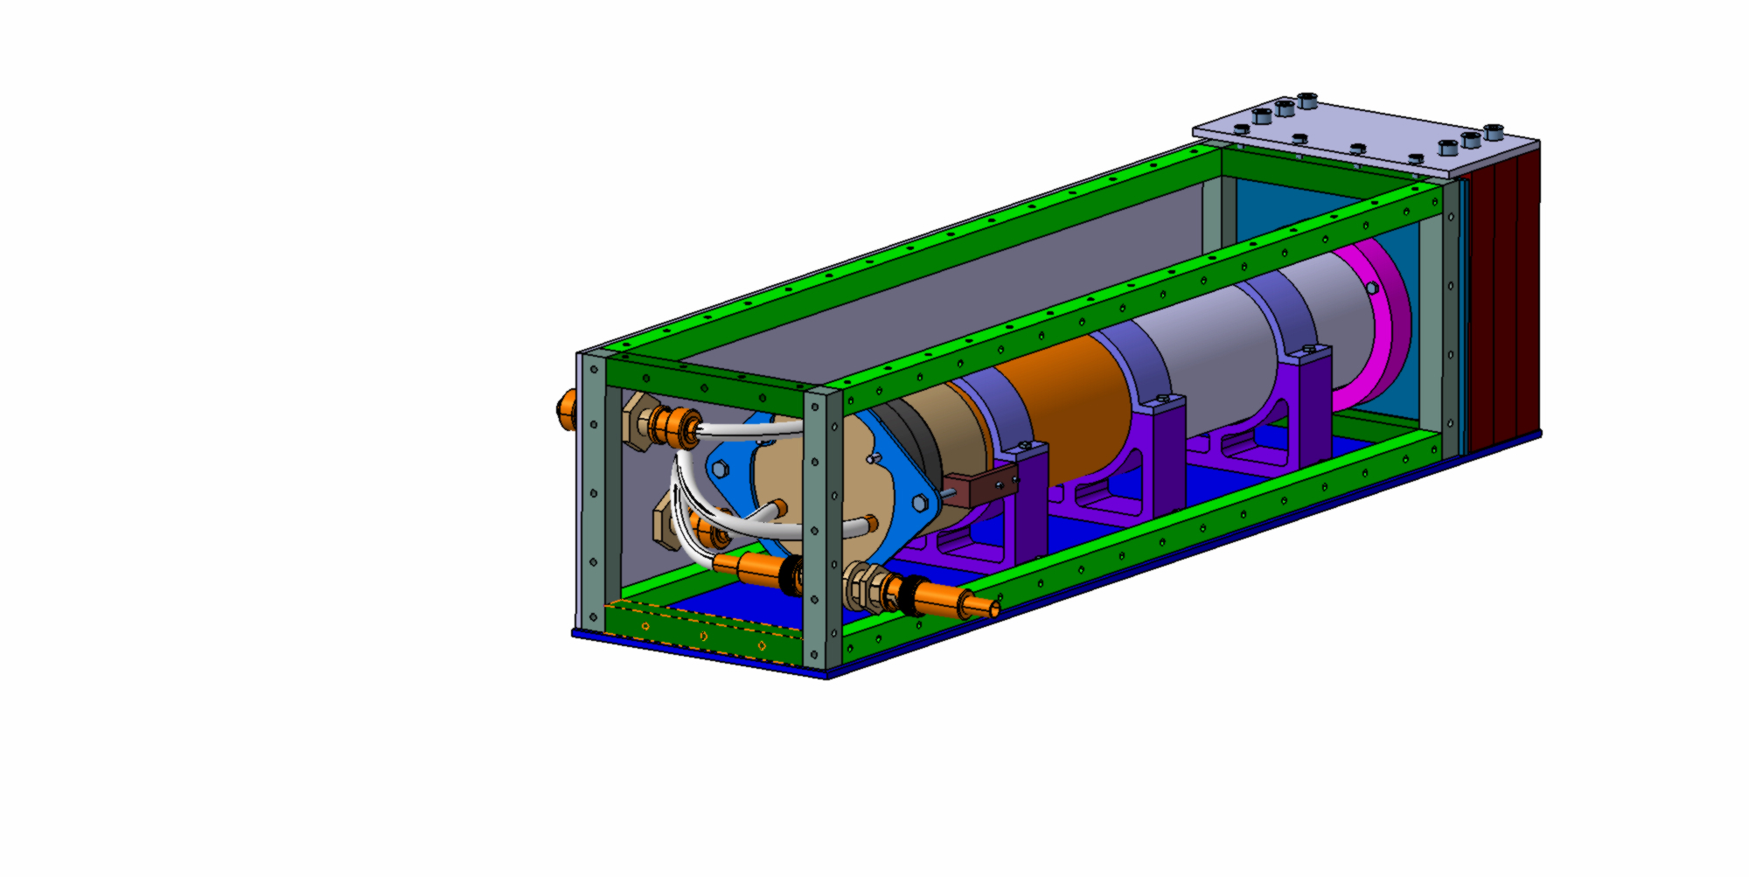
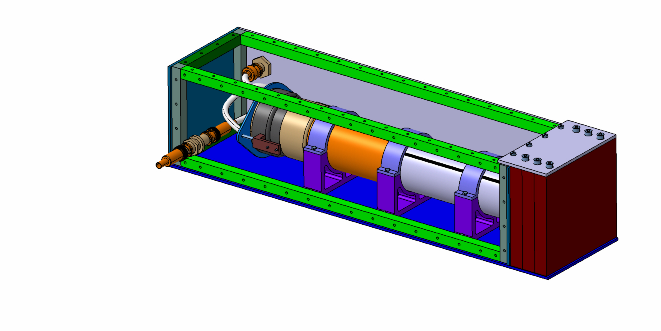
Detector Box
The design of the detector box is completed and the fabrication is underway.
The box will be brass 110x112x440 mm³ with copper absorbers
Fabrication (4 weeks)
Assembly/troubleshooting @ IJCLab (1 week)
Disassembly/packaging and shipping preparation (1 week)
Shipment to JLab (? weeks)
Assembly/testing @ JLab (1 week)

Slide 10
New Portable Data Acquisition System (DAQ)
DAQ Readout:
Delayed Helicity, T_Settle and Pattern Sync
PMT, BCM
Battery
Remote controllable IHWP
Two systems: one for BNL and one for JLab
Portable Rack
HV Power Supply, -5kV
Magnet Power Supply, ±10 Amps
PMT
Magnet
DAC
Computer
DAC
PMT Signal
Mini VME Crate
Beam Current Monitor (1 V)
Delayed
Helicity Fiber
T-Settle Fiber
Battery (1 V)
Pattern Sync
FADC
Helicity
Generator
Helicity TTL 5V Signal to
Pockels Cell

Slide 11
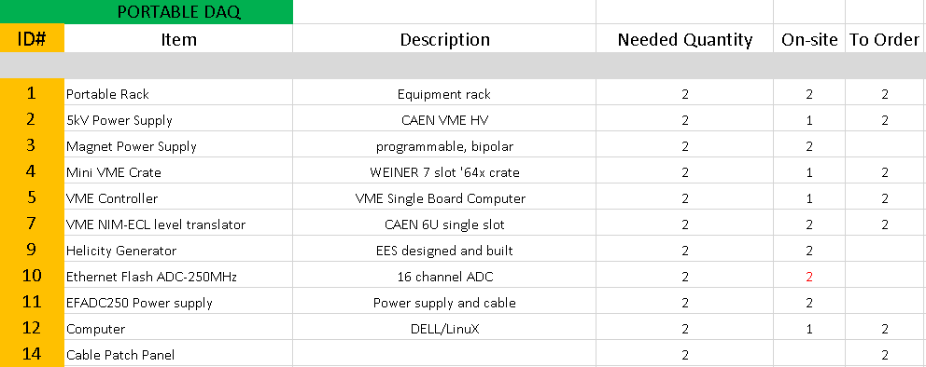
DAQ List
Chris Cuevas – Fast Electronics and DAQ

Slide 12
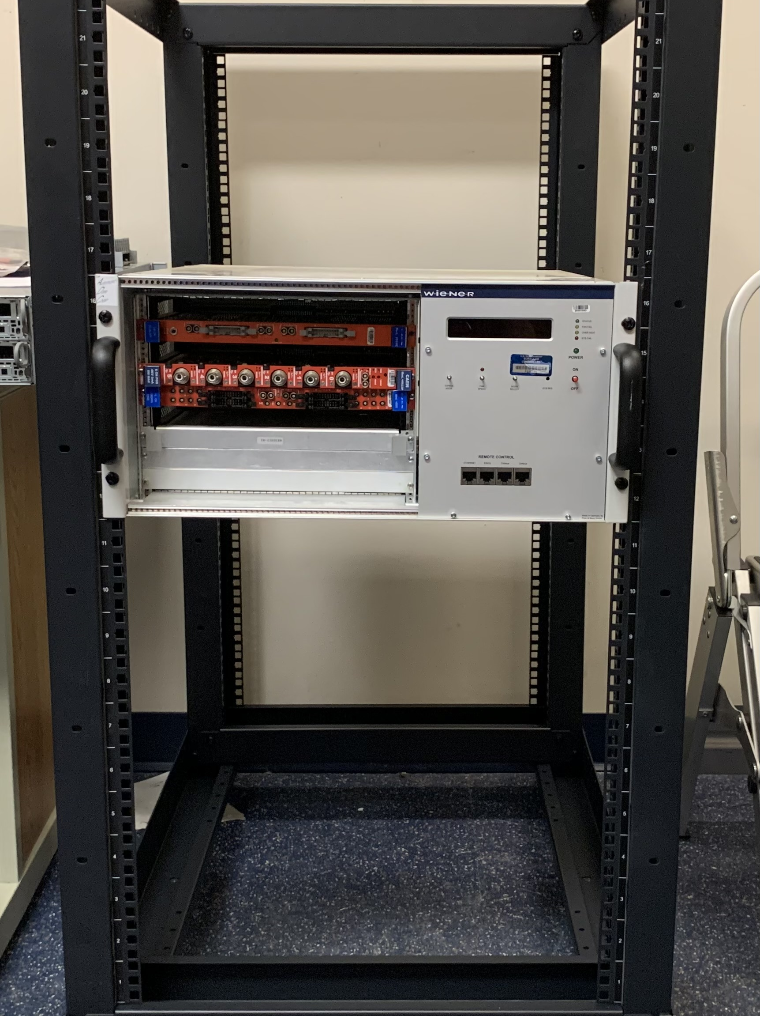
Controls and DAQ for Compton Polarimeter
Mini-rack
9 slot 6U VME-64X mini-Crate
Magnet Power Supply
DAQ/Slow Controls Server
Local network switch
EFADC250
DAQ
CODA 3 installation and setup
EFADC250 readout via ethernet
Online Monitoring
Slow Controls (local + EPICS)
VME
Controller (CT VP E24/412-12, Intel Atom + UnivII)
VME Power Supply / Fans (Weiner 395)
Detector High Voltage (CAEN v6533N)
Helicity Generator (JLAB)
Magnet Power Supply (Ordered two Kepco BOP20-10D-802E supplies )
Bryan Moffit – Fast Electronics and DAQ

