Slide 1
Status of Upgraded Injector Test Facility (UITF)
Matt Poelker
Status of UITF and dependence on CTF LHe (charge #1, 7, 9)
UITF goals: CEBAF injector, QCM tests, HDIce
Status of RadCon assessment, ARR, ASE, other approvals
Status of beam hardware & software control
Modes/Staff for providing beam
HDIce @ UITF – Experimental Readiness Review
November 19, 2019

Slide 2
Test the spin-polarized target “HDIce”

Slide 3
UITF is a 10 MeV spin-polarized electron accelerator
the UITF accelerator is built, ready to use….
(buncher not yet commissioned, we have not yet made MeV beam)

Slide 4
keV beamline commissioned, RF applied to cold “Booster”, no MeV beam yet

Slide 5
MeV beam….the accelerator
Design, construction, songsheets, software, everything is cabled up waiting for hot check out….
Run 0
Run 1

Slide 6
Past Reviews of UITF
Review #1: UITF Operations Review, aka “will it work?” March 18, 2016
https://wiki.jlab.org/ciswiki/index.php/UITF_Meeting_-_March_18,_2016
Review #2: UITF Safety Review, May 10, 2016
https://wiki.jlab.org/ciswiki/index.php/UITF_Meeting_-_May_10,_2016
Review #2.5: PSS BCM review *, October 21, 2016
https://wiki.jlab.org/ciswiki/index.php/UITF_Meeting_-_October_21,_2016
Review #3: Conduct of Operations Review, April 24, 2019
https://wiki.jlab.org/ciswiki/index.php/UITF_Meeting_-_April_24,_2019
Shielding Design Package, June 2019, JLAB-TN-18-020
Accelerator Readiness Review: June 26-28, 2019
https://www.jlab.org/indico/event/322/timetable/#20190626
* the PSS BCM, once deemed necessary now deemed optional, following detailed shielding assessment

Slide 7
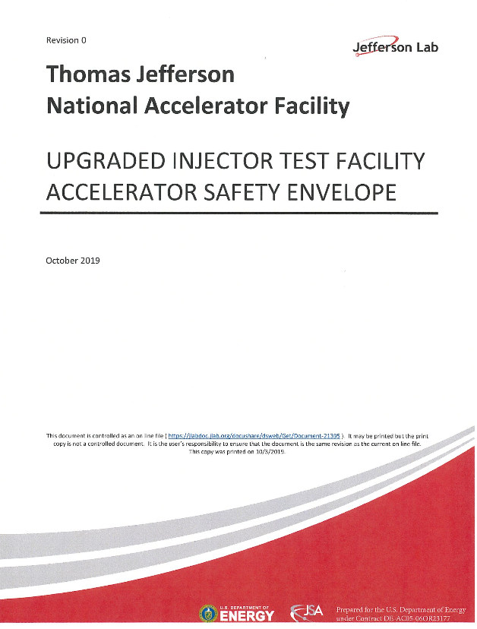
Official Documentation
These documents were approved by Lab Leadership and TJSO
https://wiki.jlab.org/ciswiki/index.php/UITF_Official_Documents
https://www.jlab.org/eshq/ProgramDocs

Slide 8
Official Documentation
https://wiki.jlab.org/ciswiki/index.php/UITF_Safety_Documents

Slide 9
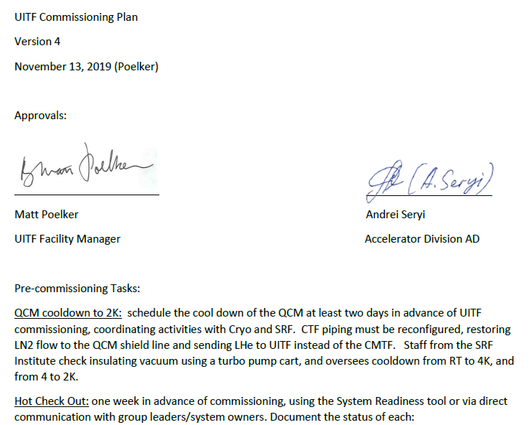
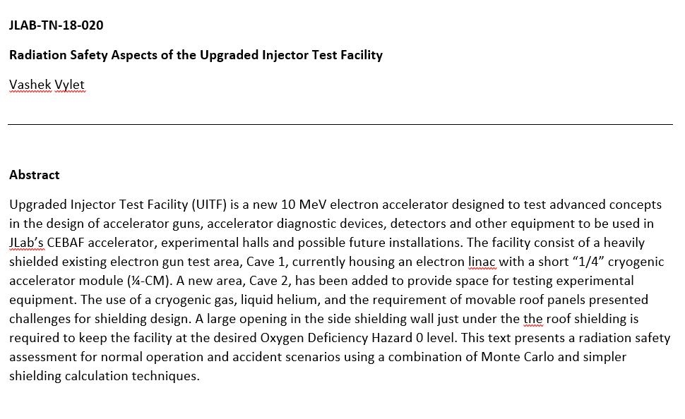
Radiation Shielding Assessment and Commissioning Plan
https://wiki.jlab.org/ciswiki/index.php/UITF_Safety_Documents
Shielding is adequate for 100 uA CW beam
https://wiki.jlab.org/ciswiki/index.php/UITF_Official_Documents

Slide 10
“Standard” tools available at UITF, just like at CEBAF
Low duty factor modes of operation: Viewer Limited and Tune Mode
Viewers, BPMs, harps, current monitoring
Spectrometers, Yao cavity, and Brock bunchlength monitor
Ditherer to center beam in solenoids and quads
Elegant to predict device settings
Archiver, save/restore, twiddle save
Frame grabber, viewer image fitting tool, StepNGraph
Machine protection (FSD), chime
…
The elevated beamline is “normal”, no anticipated problems putting beam on the viewer and Faraday Cup upstream of the IBC
(unique beam for HDIce, 1nA or less, how to “see” this beam?)

Slide 11
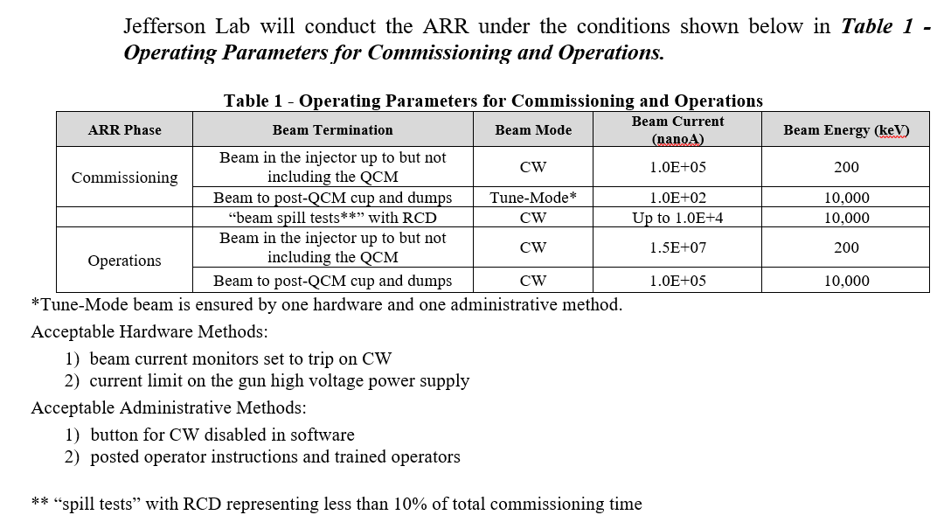
Table 1 of the UITF ARR Plan, presented to ARR Review Committee June 26-28, 2019

Slide 12
Commissioning process “break points”, verify shielding is adequate
BLM locations (ILMM401, 601 and 701)
Good locations for spill tests:
proximity to control room and labyrinth

Slide 13
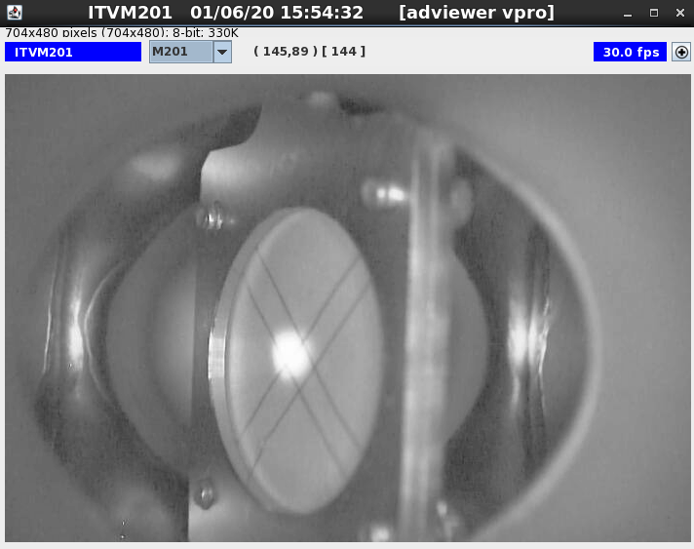
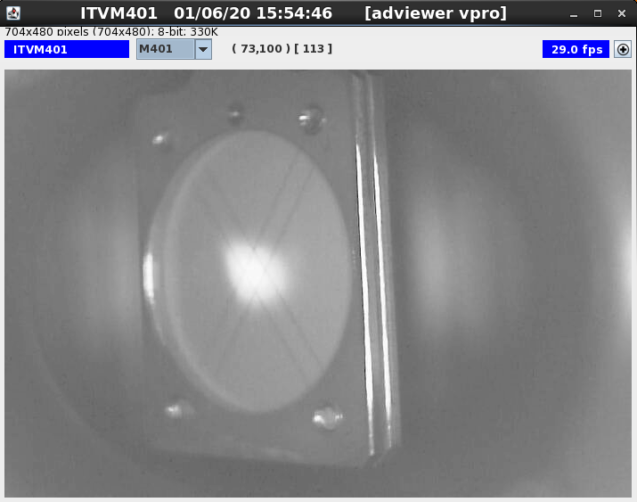
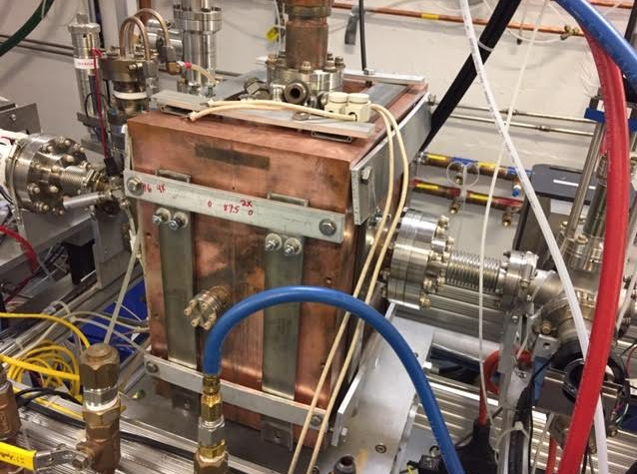
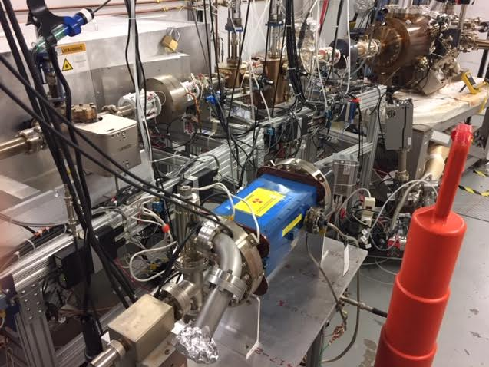
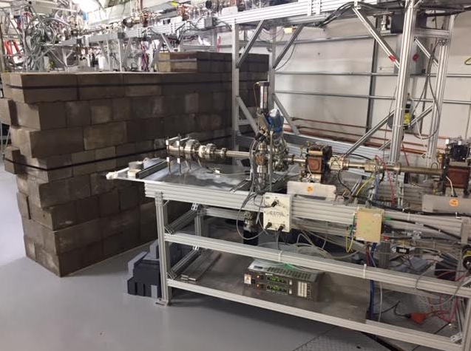
UITF status today
Floating 200 keV beam through booster
Heating the buncher to hit resonance
Testing Wien Filter for 200 keV beam
Building walls

Slide 14
UITF “schedule”
HDIce run schedule
done
After LCLS2 testing finished at CMTF, May 2020
Buncher commissioning January
Booster commissioning when opportunity presents itself

Slide 15
Back Up Slides

Slide 16
Unique aspect of HDIce testing: low current CW, ~ 1 nA
After threading normal viewer-limited and tune-mode beam (100 nA avg current) to last viewer, we will:
insert the chopper slit to obtain nA CW beam at Faraday cup in front of IBC. Chopper slit current (i.e., beam that is dumped) serves as good gun current monitor
use viewers in CW mode as current monitors, one viewer in front, two dump viewers behind IBC. Viewer image intensity cross-calibrated against Faraday cup. Downstream viewer provides real-time current and position monitoring
apertures with proper holes prevent dumping beam on cell walls
radiation monitors at apertures in front of IBC, and behind IBC. Beam trips OFF when radiation levels exceed nominal good readings
Rogowski coil (we hope) provides real-time beam position and current monitoring at nA current, it will serve as go/no go indicator, with fsd interlock to trip OFF beam
Features that protect HDIce

Slide 17
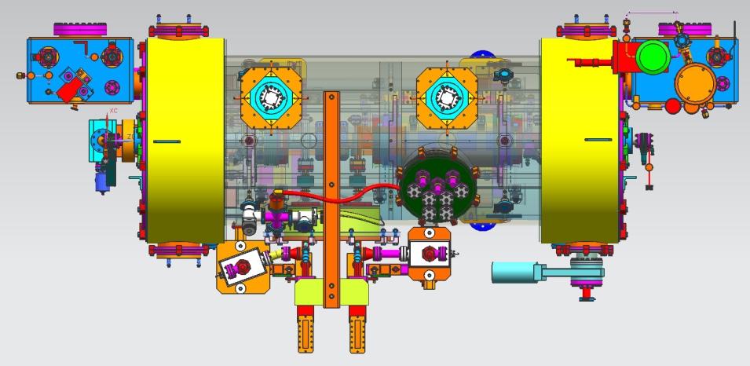
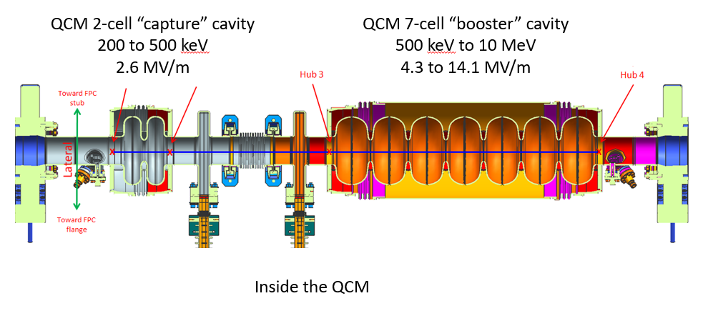
Note, we already tested Booster with RF at UITF (no beam acceleration)
QCM commissioning results at UITF
 | Cavity 7 (2-cell) | Cavity 8 (7- cell)
QextFPC | 6.2E+06 | 9.9E+06
QextFP | 2.9E+12 | 2.3E+12
Emax (MV/m) | 16.5 | 18.0
Emaxop (MV/m) (1 Hour run) | 16.0 | 18.0
Limit | Quench | Forward Pwr
FE onset (MV/m) | 11.5 | 16.0
RF heat load at typical operating gradients | 9.5E+09 (< 1W at 6 MV/m) | 1.2E+10 (~12 W at 6 MV/m)
Static heat load | 20 W
Maximum beam energy at UITF?
16 MV/m x 0.7m = 11.2 MeV
(7-cell cavity effective length 0.7 m)

Slide 18
Approved UITF Operators (underlined names)
Gun Group (Center for Injectors and Sources)
Scientists: J. Grames, C. Hernandez-Garcia, M. A. Mamun, M. Poelker, R. Suleiman, M. Stutzman and S. Zhang
Technical staff: P. Adderley, B. Bullard, (plus replacement for John Hansknecht)
Graduate Students: G. Palacios, S. Wijiethunga, J. Yoskovitz
Injector Group
Scientists: R. Kazimi, Y. Wang, A. Hofler
24/7 operations seems required - there is insufficient staffing to support 24/7 operations

Slide 19
Post Start Findings of ARR – need to be addressed before “Operations”
Post-start Findings will need to be addressed after Commissioning:

Slide 20
UITF “schedule”
Task | Comment
Restore 200 kV beam operation (photogun bakeout, HV conditioning, activate photocathode) | Gun HV conditioning now
Commission the 200 kV buncher cavity | Having trouble hitting resonance
Obtain permission from TJSO to commission the "waist-height" accelerator | EH&S approval, Andrei to ask Stuart to ask TJSO
Set a date for commissioning "waist-height" beamline (Run #0) | hard to do without having permission to commission
coordinate with Cryo and SRF, u-tube swap at CTF, booster cool down
Engineering gets two weeks notice for HCO
HDIce completes work inside enclosure: magnet, dump, halo counter installation | now through…..
administrative tasks: beam authorization, shift plans, coordinate control room staffing approved operators
Commission the Booster | estimate one week of beam, no access to the enclosure
Obtain permission to operate UITF accelerator to test HDIce, another round of signatures | Is this time consuming?
Set a date for commissioning the elevated beamline (Run #1)
installation work, HDIce specific controls and diagnostics
Engineering gets two weeks notice for HCO
accelerator checks: beam size, energy spread, stability
HDIce specific checks: ragowski coil BPM calibration, raster magnets, fsd functionality, current calibration
Remove Booster and install at CEBAF | May-20
Install CEBAF 1/4 CM

Slide 21
Test the Booster before installing at CEBAF in 2020
“Booster” - sometimes we say QCM, or ¼ CM
Increase gun voltage and Wien filters for 200 kV operation to suppress space-charge effects and improve parity quality beam
Locate Wien filters (energy filters) upstream of pre-buncher cavity and install quadrupoles to better compensate astigmatism
Increase aperture of chopper and beam line solenoids to suppress existing astigmatism and improve parity quality beam
Install new SRF booster that eliminates warm-rf capture cavity, RF deflection and x/y coupling
Our new “booster”:
2 cell capture section + 7 cell cavity,
should provide 10 MeV beam and introduce no x/y coupling, allow better matching, more adiabatic damping

Slide 22
Uses of UITF: workshop on December 12, 2018
Application | Beam Energy | Beam Current | Experiment Duration | Notes | Presenter
Commission QCM for CEBAF | 6 MeV, but prefer up to 10 MeV | up to 100 uA | three or four 1-week long tests | tests complete before long shutdown of 2020, when QCM to be installed at CEBAF | R. Kazimi
Commission HDIce for CEBAF | ~ 8 MeV | up to 100 nA for tuning, 0.25 to 5 nA for production | four or five run periods, two-weeks long each | target provides transverse polarization required for 3 A-rated Hall B experiments | A. Sandorfi
Manufacturing polarized targets for CEBAF via DNP | 10 to 18 MeV | 1 to 10 uA | hours, days | likely some R&D to determine optimum polarizing conditions | C. Keith
Bubble Chamber astrophysics | 4 - 10 MeV | 0.01 to 100 uA | 3 weeks, ~ 3 runs/year | UITF better location than CEBAF injector, when CEBAF shutdowns are short | R. Suleiman
MeV parity violation experiment | 10 MeV | milliamps preferred, will reduce experiment duration | months to years | requires polarized electron beam, transmission geometry offers advantages | R. Carlini
Testing Nb₃Sn-coated cavities | determining the beam energy of test cavity is point of test | up to 100 uA | as many tests as possible | Nb3Sn cavities require only 4K Helium | G. Eremeev
Wastewater treatment | 2- 10 MeV | 100 uA | imagine week-long test durations over three years | together with local partners | G. Ciovati
Polarized positron source | 5 - 10 MeV | up to 100 uA | staged tests, likely many required, 1-week long duration | requires polarized electron beam | J. Grames
EIC: fast kicker tests | 5 - 10 MeV | up to 100 uA | two 1-week long tests | together with sbir-partner | H. Wang
EIC: testing high bunch charge | 5 - 10 MeV | up to 100 uA | two 1-week long tests | requires polarized electron beam | J. Grames and J. Guo
https://wiki.jlab.org/ciswiki/index.php/UITF_Meeting_-_December_12,_2018

