Slide 1
Electric & Magnetic Deflectors in the EDM Prototype Ring
EDM / Storage Rings Meeting, Jefferson Lab, Dec. 29-30, 2022
Dec. 30, 2022 Dr. Helmut Soltner, Zentralinstitut für Engineering und Analytik, (ZEA-1)

Slide 2
Overview
Conceptual design of the Prototype Ring (PTR)
Specifications of electric and magnetic bending components
Description of the electrostatic deflector
Description of the nested cos(θ) magnet
Outlook

Slide 3
Prototype Ring

Slide 4
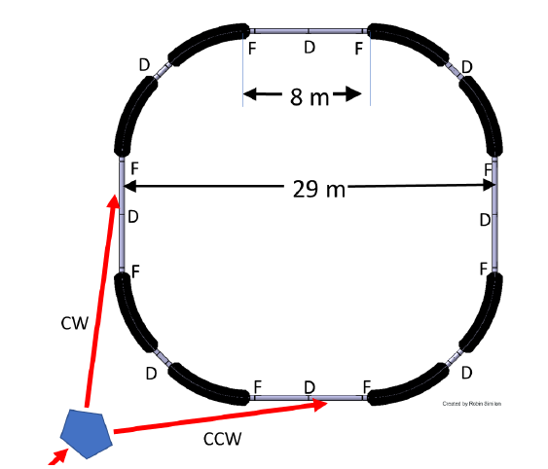
Design of the Prototype Ring (PTR)

Slide 5
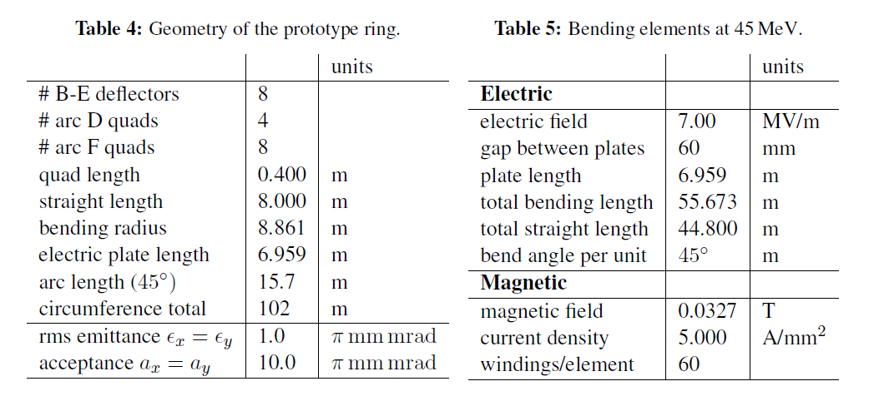
Specifications of electric
and magnetic bending components
Specifications of electric and magnetic bending components

Slide 6
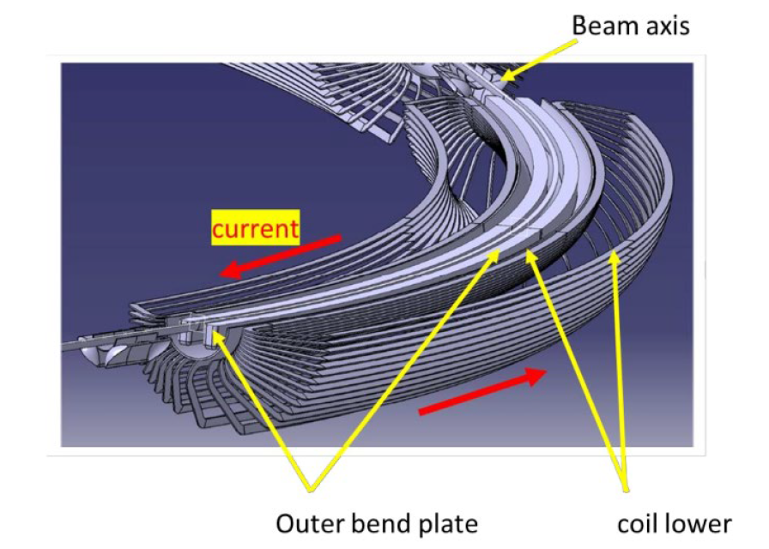
Solution: electrostatic deflector & nested cos(θ) magnet
Magnetrelevante Arbeiten in verschiedenen Jahrzehnten

Slide 7
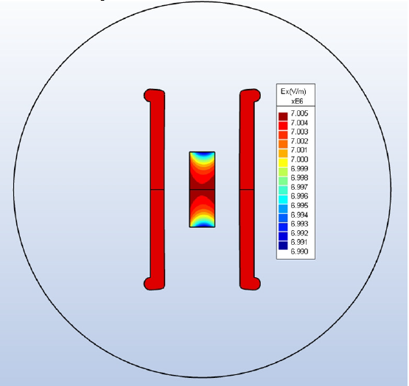
Electrostatic deflector
Estimate and BEM simulation inside field of interest (20 mm x 60 mm)

Slide 8
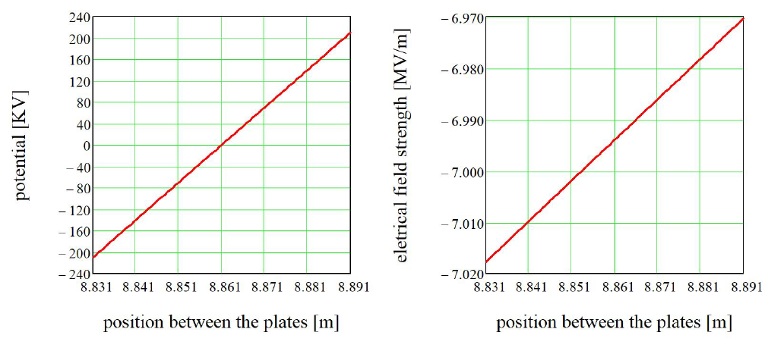
Electrostatic deflector
Electrostatic potential and electric field strength

Slide 9
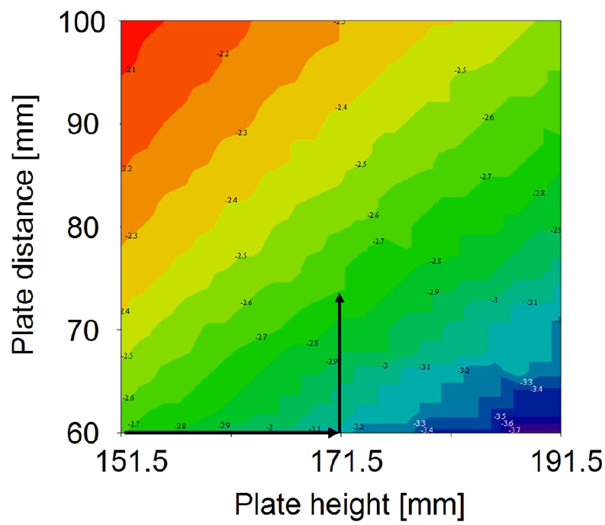
Electrostatic deflector
Homogeneity considerations

Slide 10
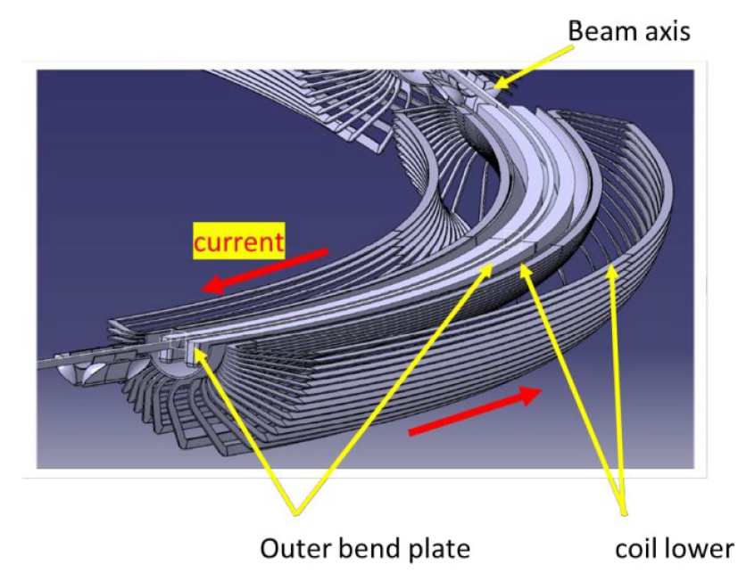
Nested cos(θ) magnet
Homogeneous magnetic fields for center coil and return path

Slide 11
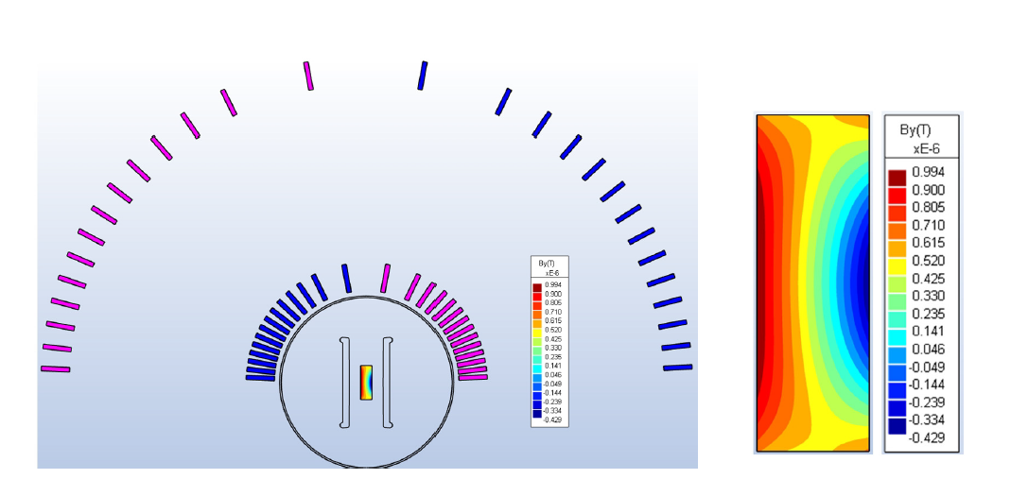
Nested cos(θ) magnet
Homogeneity on
cross section (deviaton from mean value)
cross section

Slide 12
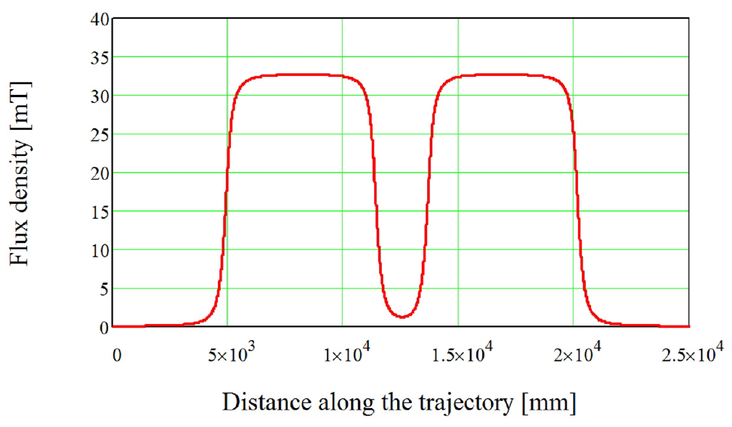
Nested cos(θ) magnet
Flux density between two magnets

Slide 13
Nested cos(θ) magnet
Diverging shape of electrostatic deflector (top view)
Five transition units

Slide 14
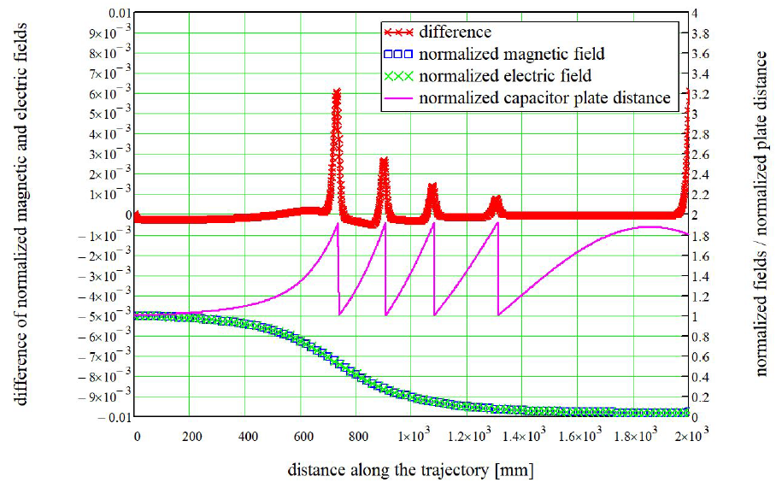
Nested cos(θ) magnet
Diverging shape of electrostatic deflector (top view),
Five transition units

Slide 15
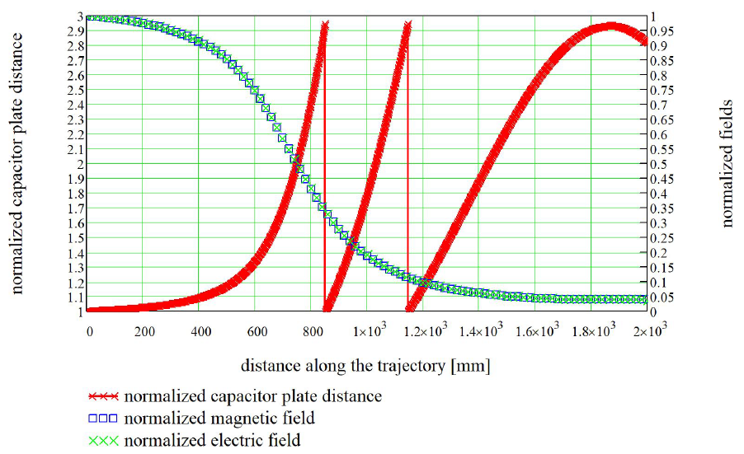
Nested cos(θ) magnet
Diverging shape of electrostatic deflector (four transition units)

Slide 16
Outlook
Integration of diverging profile with the magnetostatic unit
Comprehensive design and integration of all other devices with the PTR

Slide 17
Outlook
Further design efforts needed!

