Slide 1
Goals of this Vacuum Study
Improve our NEG coating capabilities, anticipating the creation of four new injector beamlines
Improve our understanding of NEG pump behavior, and possibly identify NEG pump limitations. Make extractor gauge read “zero”
Vacuum gauge limitations? Ion pump pros and cons – correct Ion Pump size for each system?
Demonstrate our vacuum science expertise by implementing changes to a relatively simple vacuum system, and observing the expected result. Predict cause and effect.
Make a contribution to the field, submit a poster to AVS meeting, etc.,

Slide 2
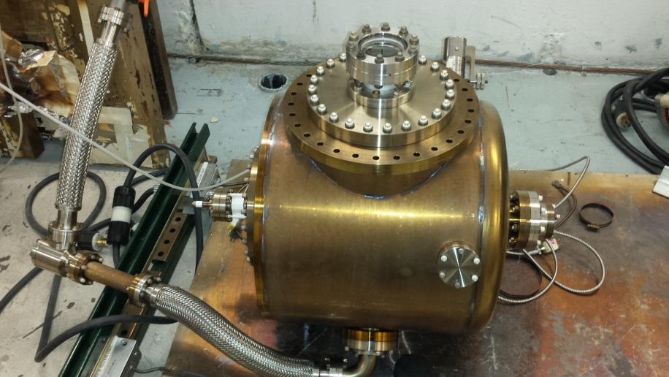
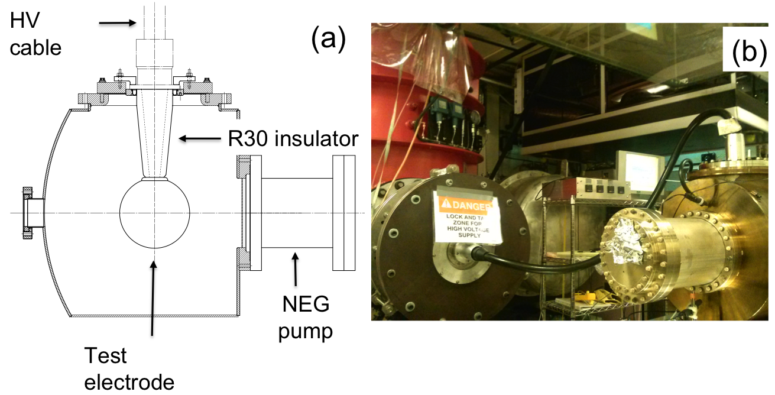
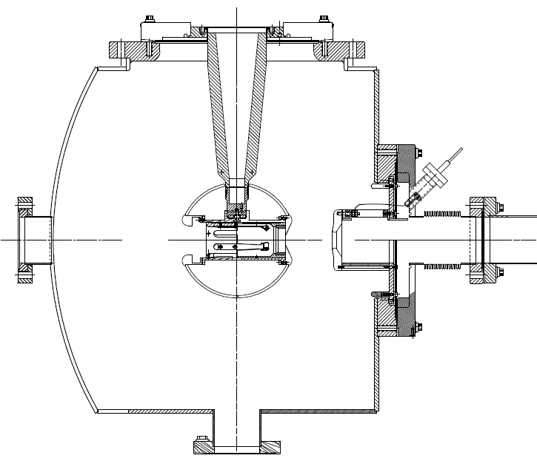
350 kV gun chamber
This page = pretty pictures that tell someone “why they should care”. We need excellent vacuum because we make polarized beam with GaAs photocathodes, and they are delicate

Slide 3
Before these tests: 400 C bakeout
The chamber is an enlarged version of our CEBAF gun: 18” diameter chamber with flat front face and dish-head back face
Empty chamber, volume = X Liters, surface areas = XX cm2
400 C bakeout for XX hours
We did not actually measure the outgassing rate, but we consistently measure 1e-13 TL/scm2

Slide 4
Configurations Tested
Homemade NEG coating + old PE ion pump behind right angle valve and some 1.5” diameter tube (not degassed)
Homemade NEG coating + new degassed TiTan pump, attached directly to chamber
Homemade NEG coating + new TiTan pump + GP500 NEG pump on 8” flange and reducer (flanges were not degassed)
Homemade NEG coating + NexTorr ion pump
For all configurations, Used a Leybold extractor gauge, with a measured x-ray limit
In future, take photo of each configuration, makes it easier to explain later

Slide 5
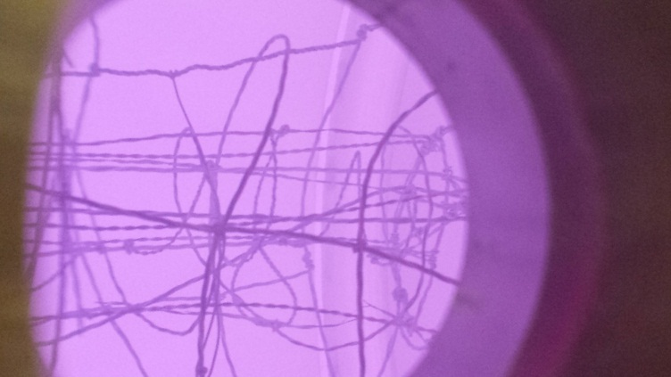
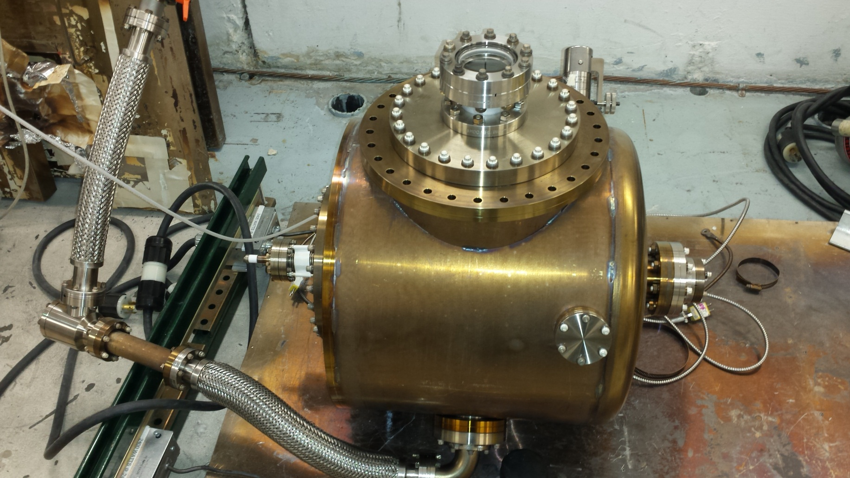
Homemade NEG coating

Slide 6
NEG coating Protocol
Used argon? What were wires made of? They were old wires, used before, right?
Scrub surface with positive bias for X hours
Reverse polarity for coating: V = - Y volts, Current = ZZ mA, no magnetic field
Throttle valve to maintain pressure XX Torr
Chamber temp maintained at XX C
How long did you coat?

Slide 7
Bake Protocol for Each Test
All bakes were performed with the same setup and bake parameters.
Initial Pump down: Overnight with heat tape @~80Cand Turbo pumping.
Ion pump on and leak check with RGA that was far away. Pressure below 30uA.
Full oven bake with oven heaters @ 250 C for 48 hrs. with Turbo and overboard Ip.
Overboard Ip valve closed after 47hrs at 250 C before bake starts down in Temp.
Inboard Ip on before closing valve, check it is well degassed and has low pressure.
Extractor Gauge on, Temp. is below 38 C.

Slide 8
Venting Protocol
When moving from one configuration to another, high purity Argon used to vent the chamber to atmosphere, to preserve NEG coating pump speed and capacity
All modifications performed in a timely manner so as to limit the chamber exposure to room air (Tidewater Air)

Slide 9
Results
Change legend to say “computer” and “manual”
Provide minor tick marks on Y axis
Looks like we still didn’t wait long enough, this is a “conclusion”
Should you fit a line to obtain predicted lowest pressure, and mention how long it would take
NEG coating + Titan pump + GP500 partial
NEG coating + NexTorr
NEG coating + overboard PE ion pump
NEG coating + Titan pump + GP500 full
NEG coating + Titan pump

Slide 10
Lowest Measured Pressure
Here, you can would point out the “good”, “puzzling” and “bad” results
Bad
Good
Puzzling
Get rid of blue bars: just say contribution from low voltage x-rays was subtracted from controller value

Slide 11
Summary of Tests
For a chamber degassed at 400C, a simple homemade NEG coating with 40L/s ion pump provided pressure in -12 Torr range! Assuming -13 TorrL/scm2 outgassing rate, NEG coating provide XX L/s pump speed (good!)
Replacing one ion pump configuration with a better one (old PE replaced with new degassed TiTan + less plumbing) , served to improve pressure as expected (good!)
Adding a flange-mounted GP500 NEG pump with advertised 500 L/s pump speed, did not result in improved pressure: points to a NEG pump limitation, or a vacuum gauge limitation. Note, the GP500 flange and 10 to 8 reducer were not degassed. (puzzling)
Replacing the good ion pump with small NextTorr served to degrade pressure, suggesting there is an optimum ion pump size, or the NextTorr has problems (NextTorr was difficult to “activate”, each activation served to degrade pressure, maybe just moved gas from one pump to another) (bad)
After XX days, the extractor gauge reading continues to decrease. Does it take that long to degass a gauge, or is pressure really improving?

Slide 12
What next?
Degas cryopump gun chamber, measure outgassing rate and repeat some of these tests: homemade NEG coating, NEG strips, NEG modules, new NEG material
Use a BBB gauge, or Axtran – you need a gauge with purported lower Pult capability
Need an RGA near chamber, behind a valve, and with independent ion pump and GP50. This will be used for leak checking and to look at accumulated gas...
Try magnetron sputtering

Slide 13
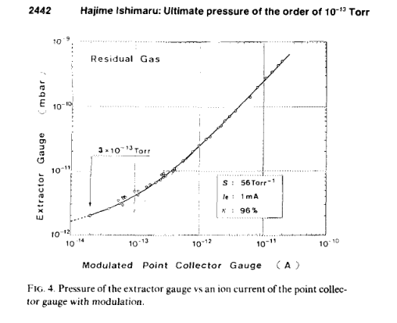
Real Pressure
So in this good paper, the author shows how extractor gauge response is not linear when pressure drops below -11 Torr. We know there are contributions to collector current not related to pressure, and so we subtract this from value. But the curve pasted here makes me think I think he also suggests that it is not sufficient to simply subtract the x-ray contribution from the reading. suggests that when extractor gauge reads

Slide 14
Marcy proved that Ishimaru plot from previous page, shows measured pressure with x-ray limit subtracted. i.e., you get a nice straight line on log plot….

Slide 15
Which configurations do these represent? The legend should reflect this

