Slide 1
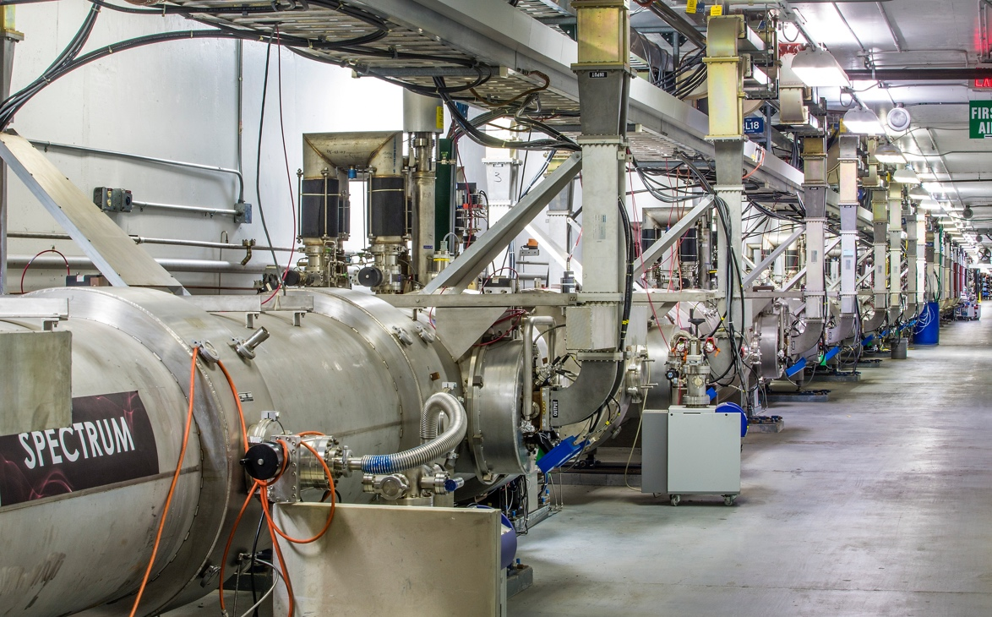
Acc Division All Hands Meeting
Accelerator Division
Safety Stand-Down
9:00 - 12:00
February 26, 2020

Slide 2
Purpose
Why we are here today
Increased number of safety issues. In the last 2 months:
Three violations of tunnel access control
Electrical shock 120V
LERF administrative controls violation
What went right
Immediate self reporting – thank you
This helps to enhance our Reporting Culture and Just Culture – the ingredients of Operational Excellence
Prompt action by Director of Accelerator Operations that prioritized understanding administrative controls violation over operations – good job
The purpose of today’s meeting – discuss the issues and their common themes, discuss how we can mitigate the trends

Slide 3
Importance
Safety is number one priority always
Previous safety incidents in the lab
Summer 2019 electrical shock, laser near miss
Office of Enforcement finishing investigation and report
A Consent Order will be signed, to follow on OoE actions
Most recent cluster of several safety issues
On top of OoE investigation, aggravate the situation
Diminish the confidence of DOE that the lab is getting safety situation under control
Similar trends in other labs in the past
Resulted in shut-down of all work for a large fraction of a year

Slide 4
Important cultural elements in a high-performing organization
Demonstrate Operational Excellence through the Elements of a Healthy Culture
Informed Culture: managers and employees communicate openly to share knowledge and experiences.
Informed Culture
Reporting Culture: employees feel free to report errors and near-misses; successes are applauded; organizational weaknesses are identified and addressed.
Learning Culture: we go beyond superficial causes to the core and are willing to make major reforms to get better.
Learning
Culture
Operational Excellence
Reporting Culture
Just Culture
Just Culture: people are not punished or penalized for omissions or decisions taken that are commensurate with their experience/training; clear distinction between acceptable and unacceptable behavior.
* Based on James Reason, Managing the Risks of Organizational Accidents, 1997
Things that went right (identified in slide 2) directly support the Just Culture aspects Learning, Reporting, and Informing
Slide from Stuart’s All-Hands Summer 2019

Slide 5
Next
Harry Fanning (DSO) – Details on recent safety issues
Steven Hoey – Perspectives from the new ES&H Director
Reiterate on common themes in the recent issues and path forward
Open Discussion

Slide 6
Overview of Recent Events
3 Accelerator Access violations – No reportable exposure
Hall A Access w/o a Radiation Survey/Escort
North LINAC Access w/o a Full Radiation Survey/Escort
South LINAC Access w/o a Full Radiation Survey/Escort
LERF Accelerator left unattended – No injury, violation, or exposure
SRF Shock event – No serious injury
SRF Knee Injury – No serious Injury

Slide 7
Accelerator Access Violation 1 – Hall A w/o a Radiation Survey/Escort
What Happened:
Personnel accessed Hall A labyrinth several times to repair a software crate after beam delivery to Hall
No survey was performed prior to nor RCT/ARM escort used
10 CFR 835 protocols require a full or an escorted survey of any enclosure which received beam, regardless of location
What Went Right
Quick investigation into issue
New access protocols put in place to prevent recurrence
What Went Wrong
Judgement made thinking no exposure danger to access personnel due to location, but…
This judgement was in conflict with program requirements

Slide 8
Accelerator Access Violation 2 – NL w/o a Full Radiation Survey/Escort
What Happened:
Personnel accessed North LINAC to assist with SRF tasks
Full survey was not performed prior to, nor RCT/ARM escort used
10 CFR 835 protocols require a full or an escorted survey of any enclosure which received beam, regardless of location
What Went Right
Entrant immediately contact MCC upon realizing something wasn’t right (expected personnel not present)
What Went Wrong
Error made – Entrant had wrong location due to distraction
Error made – Entrant given access during multiple access entries
Error made – Procedure was not followed

Slide 9
Accelerator Access Violation 3 – SL w/o a Full Radiation Survey/Escort
What Happened:
Personnel accessed South LINAC to fix access camera
Escorted survey underway
10 CFR 835 protocols require a full or an escorted survey of any enclosure which received beam, regardless of location
What Went Right
RCT personnel immediately contacted MCC
SSO used questioning attitude
What Went Wrong
Entrant given access during multiple entries
Escort was not contacted to request permission to allow access
New access protocols were not followed
Judgement made thinking no exposure danger to access personnel due to location and history, but…
This judgement was in conflict with program requirements

Slide 10
LERF Accelerator left Unattended
What Happened:
Issue with a magnet trim card during beam operations
No trim cards located within LERF to replace faulty card
Personnel secured beam by closing a laser shutter
Current Operations Directives require dropping the PSS State before last beam operator leaves the LERF Accelerator building
What Went Right
Once error was realized, beam operation was ceased
Chain of Command immediately contacted
Beam authorization rescinded and LERF brought to safe condition
What Went Wrong
Judgement made based on incorrect rule applied to LERF (loss of situational awareness)

Slide 11
Staff Shocked by Hidden Power Source
What Happened:
Worker was performing property validation
Worker inadvertently disconnected power to low voltage equipment during inspection of property
Worker came in contact with adjacent and hidden power source
What Went Right
Worker immediately contacted local Safety Warden
Worker contacted Supervisor shortly afterwards
Coworker escorted worker to OccMed for medical evaluation
What Went Wrong
Power source replaced with different source containing high voltage without communicating change to all stakeholders
Workmanship of power connections – Less Than Adequate
Judgement made by worker to place hand into hidden area based on incorrect assumption that no hazard could be present

Slide 12
Staff Injured during Non-routine Task
What Happened:
Worker contacted by coworker to assist with PPE replenishment in specialized area, and injured knee doing this
Worker interrupted what they were doing to assist coworker
What Went Right
Worker helped coworker (worker was one of few trained individuals available to assist)
Worker immediately contacted supervisor
Coworker escorted worker to OccMed for medical evaluation
What Went Wrong
Judgement made based on shortcutting area requirements
Worker was distracted and had loss of situational awareness

Slide 13
Commonalities
During the investigation process for each event, several common factors became apparent
Loss of Focus by a worker (directly involved or indirectly involved)
Loss of situational awareness
Perceived time pressure related to task at hand
Not questioning: ”What’s the worst that could happen and how can it happen here?”
Loss of professionalism* (directly involved or indirectly involved)
*See next slide for definition

Slide 14
Worker Professionalism
What does this mean?
Doing the job right the first time
Planning enough time to complete the job completely
Define the scope of the work
Understand the hazards involved
Place barriers between workers and the hazards
Work the plan
Reassess everything when the plan changes
Clean up after the job is over
Feedback what went right and what needs improvement before next task
Letting supervisor know when there is not enough time to do the job professionally
What’s the last job you rushed or didn’t complete completely?
What prevented you from completing it?
What could we, as an organization, do differently?
How could we, as an organization, set you up for success?

Slide 15
Steven A. Hoey
Director ESH
JLab

Slide 16
Background
Experience:
29 Years National Laboratory in ESH (INEL and BNL)
Aerospace (Space Shuttle and B1B bomber)
Chemical processing (highly toxic materials HCN)

Slide 17
Observations
What have I learned the past few weeks?
Dedicated staff
Strong culture of mission success
Robust controls/processes in place
What have I seen the past few weeks?
Three incidents (electrical shock, access control, LERF control) Incidents are repetitive
Overall sense of ”too much” to do (everyone is very busy)
JSA Review – track plans of action on most recent events, assessment of lab management actions to ensure corrective actions are impactful and aligned insuring safe and effective operations across the laboratory
Office of Enforcement Conference – uncertain outcome

Slide 18
Events have Consequences
NREL – January 2020
Two Shock incidents, (lab built and commercial) influenced OE look at broader programmatic deficiencies
Sandia – August 2019
Electrical arc, no injuries, started fire
ANL – 2017
Two Electrical shock incidents
Lab shutdown for 7 days
BNL – 2012
Linac Beam mis steering event
NSLS-II commissioning delayed 3-4 months
SLAC – 2004
Arc flash incident
Accelerator shut down for over 6+ months

Slide 19
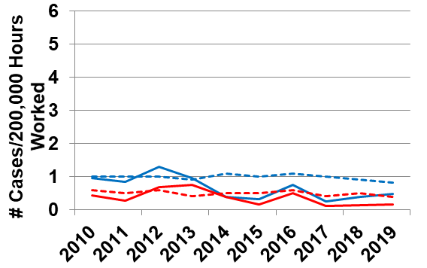
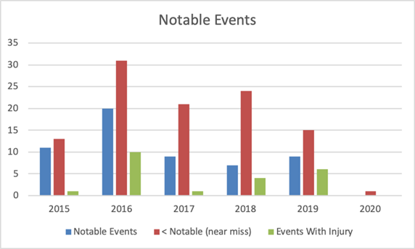
World Class Science Requires World Class Safety
Current State
TJNAF safety performance is statistically similar to SC Labs, but too many close calls
Recurring problems highlight past failures to isolate and treat root cause
Human Performance Improvement practices taking hold too slowly
Restoring a Robust Safety Culture
Major FY20 investments in:
Expanding event investigation process, stood up a separate Performance Assurance Office
Reengineered task hazard analysis process oriented to explicitly help workers do their jobs
Expanding safety training to include skills demonstration
Increasing our commitment to engineered controls to reduce reliance on administrative controls
Expanding supervisor responsibilities for worker engagement and oversight
Integrating Lab Agenda Initiatives into a comprehensive, multi-year Operational Excellence Plan
Explicit subcontractor safety requirements and selection process
TJNAF SC Labs
TRC
DART

Slide 20
Observations – Path Forward
Restore DOE’s confidence that we can operate this lab safely and meet our mission goals
Learn from incidents to make sure we understand root causes and develop meaningful and effective corrective actions – prevent repetition
Develop a “Culture of Prevention” get away from “Culture of Reaction”
Stop and think before we do work – what are the hazards and consequences
Everyone needs to participate in this stand down and ongoing corrective action plans initiatives to prevent incidents
Need to stop hurting people – engage and use HPI concepts

Slide 21
Reiterate on Common themes & path forward
What was the common theme in recent safety issues?
Loss of focus, loss of situational awareness
Scope of work changed, but work was not adjusted
E.g. we now have 3 accelerators, operation procedures differ
Perceived time pressure
Path forward
Situational awareness. Stay focused
Never give in to perceived schedule pressure. Safety is #1
If the work needs to slow down to do it safely, slow down, inform your supervisor
The path forward relies on all of us – professionals who can keep delivering on our science mission, doing it safely

Slide 22
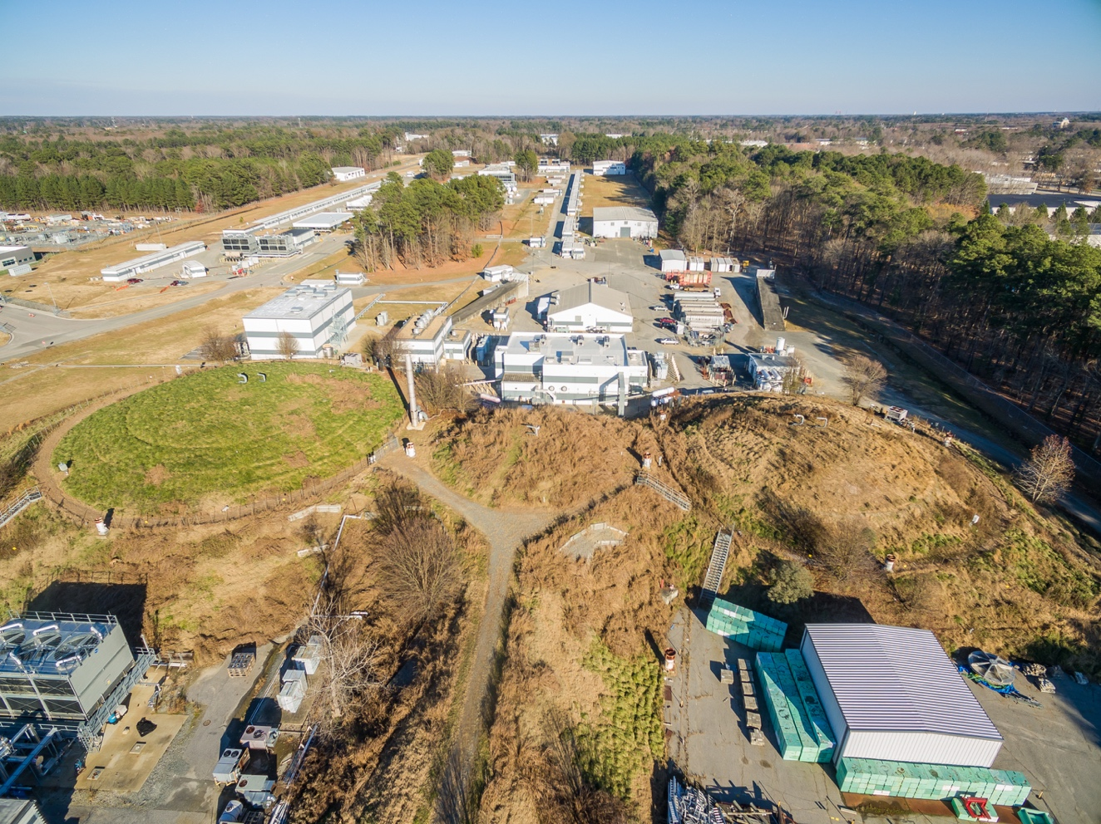
Discussion and Stand-Down plans
After this All Hands and for remaining time of Stand-Down:
Safety related activities coordinated by Division’s Departments
Now open for discussion

