Slide 1
HDIce Leak scenarios
Jan 17, 2020

Slide 2
Assumption: leak at the HDIce Target
Concern: pressure increase at the SRF booster
Simulation of beamline as cylinder, all pumping surfaces simple 20 L/s facets in approximate pump locations
For steady state, all ion pumps “on”
For leak state, downstream ion pumps turned off to simulate supply trips

Slide 3
Steady state simulation
Ion pumps at nominally correct locations, approximated as pumping surface in beamline
Could simulate pump drops, but pumps will trip off in vent event so not critical
Outgassing simulated at 5e-12 mbarL/scm²
Approximately what we measured for stainless steel with no heat treatment
No dynamic effects from beam scraping or heating
Highest pressure in waist high quad section ~3e-9 mbar
Best pressure in DP can region ~1e-11 Torr

Slide 4
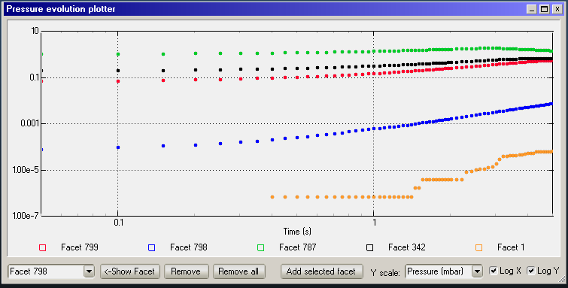
Simulate leak 100 mbarL/s at end of pipe
Burst to 100 for 0.3 seconds at 0.1 seconds
No orifice
Pumps downstream of DP can all off for leak event
No simulated valve closing yet
DP can pressure reduction: factor of 10-100
Line of sight lets some gas through

Slide 5
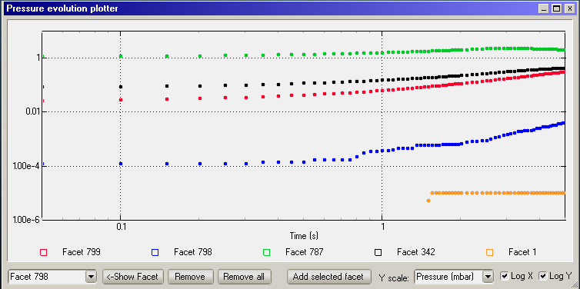
Simulate leak 100 mbarL/s at end of pipe, 5 mm orifice
Burst to 100 for 0.3 seconds at 0.1 seconds
5 mm orifice immediately upstream of raster
Pumps downstream of DP can all off for leak event
No simulated valve closing yet
DP can pressure reduction: factor of 10-100
Line of sight lets some gas through

Slide 6
100 mbarL/s burst for 0.3 seconds with and without 5 mm orifice upstream of raster

Slide 7
Other simulations
Lower “leak” rates for scaling, all no orifice

Slide 8
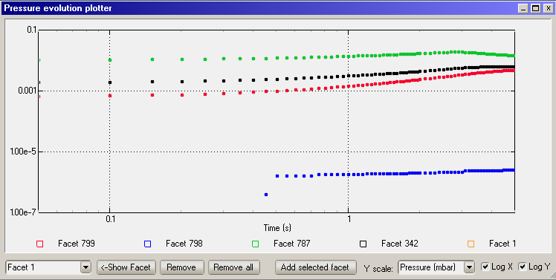
Simulation 1: Starting at 0.1 seconds, burst to 1 mbar, duration 0.3 seconds
Pressure vs. time with burst at t=0

Slide 9
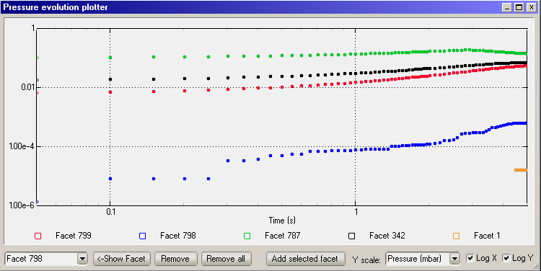
Simulation 2: Starting at 0.1 seconds, burst to 10 mbar, duration 0.3 seconds
Pressure vs. time with burst at t=0

