Slide 1
Impact of Electron Bunch Length on Positron Bunch Length
Andriy Ushakov
Febuary 8, 2023

Slide 2
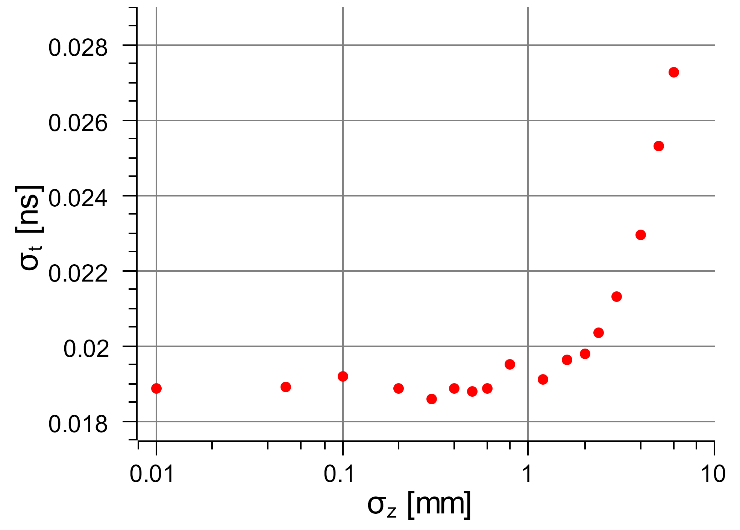
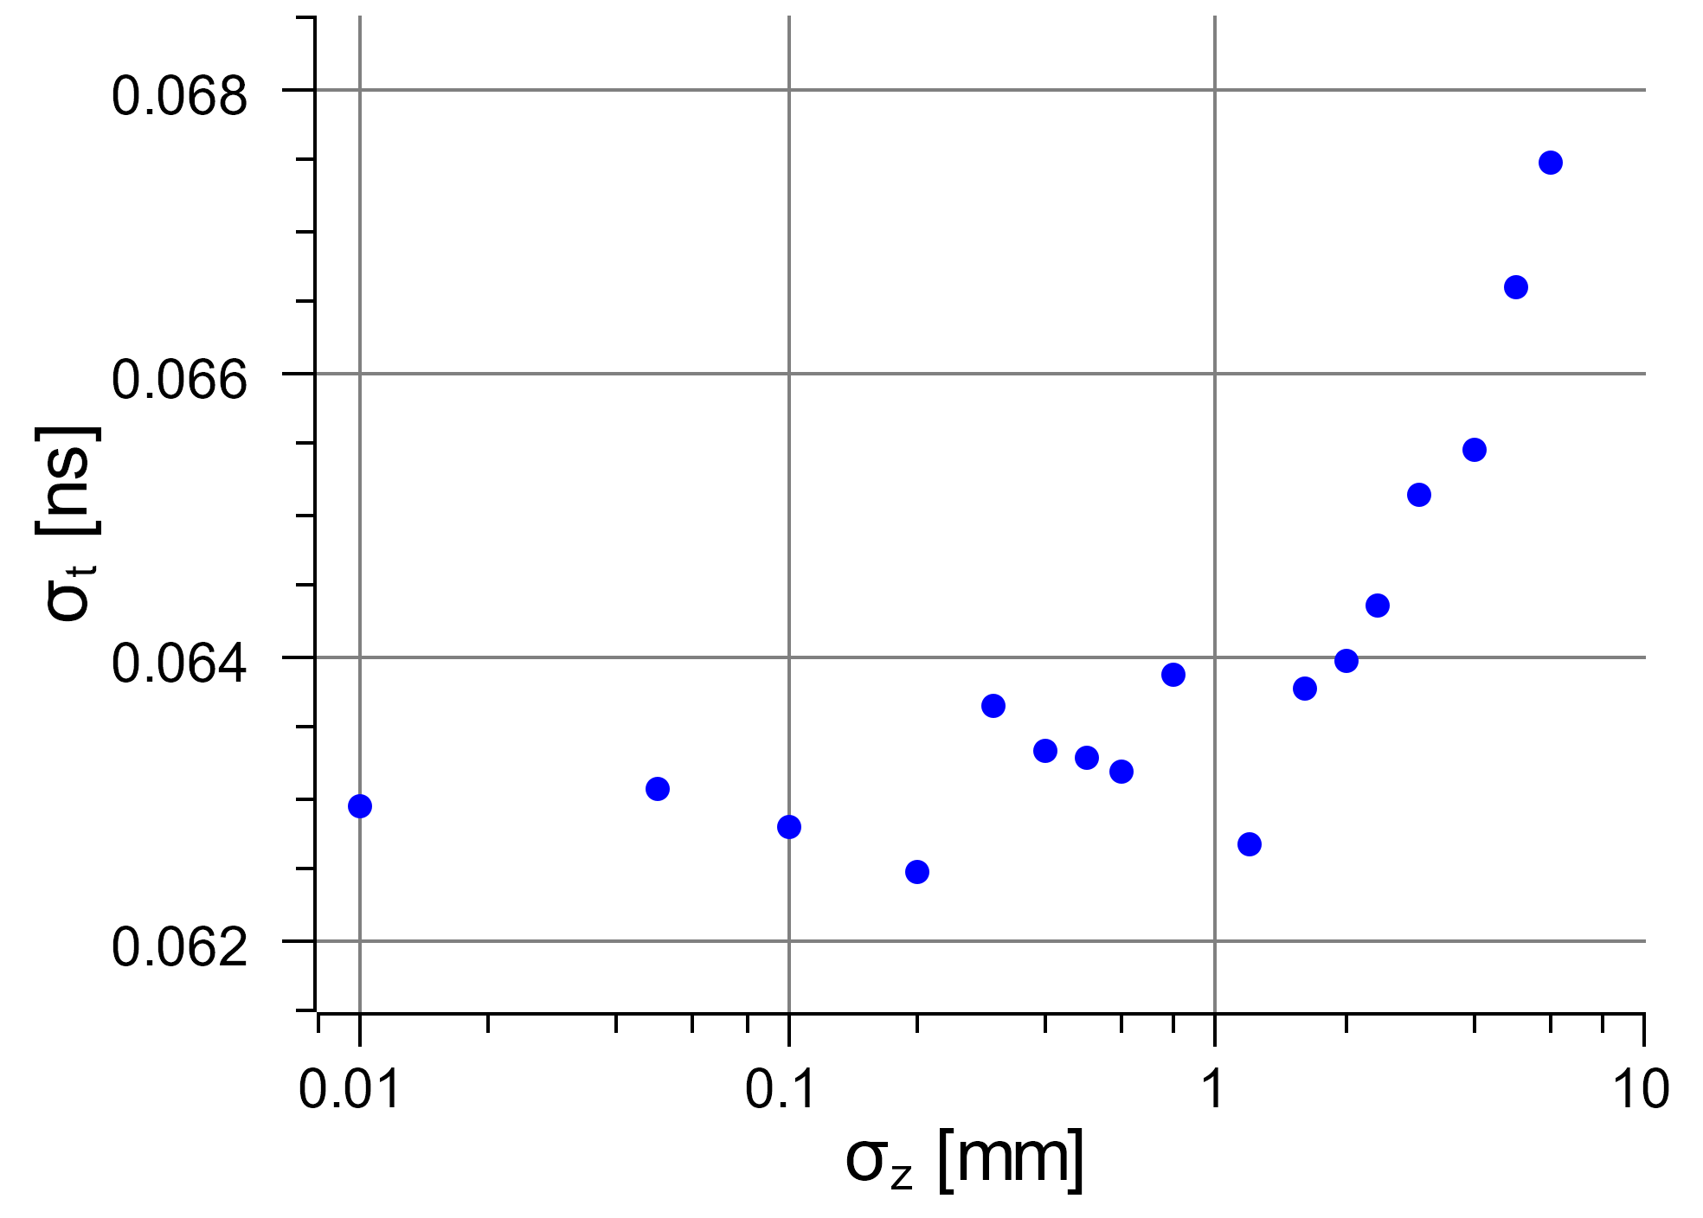
e⁺ Bunch Length σ_{time} after Target (left) and after 1st Solenoid (right) vs e‒ Bunch Length σ_{z}
e‒ beam: 120 MeV, σ_{x,y} = 1 mm, no angular divergence, z₀ = 50 cm upstream target
W target with 4 mm thickness
1st solenoid: 2 T field, 12 cm length, 5 mm to target, 40 mm to 2nd solenoid
No cuts were applied for positrons except a large longitudinal bunch length cut of ¼ RF field period at 1497 MHz
At Exit Side of Target
After 1st Solenoid

Slide 3
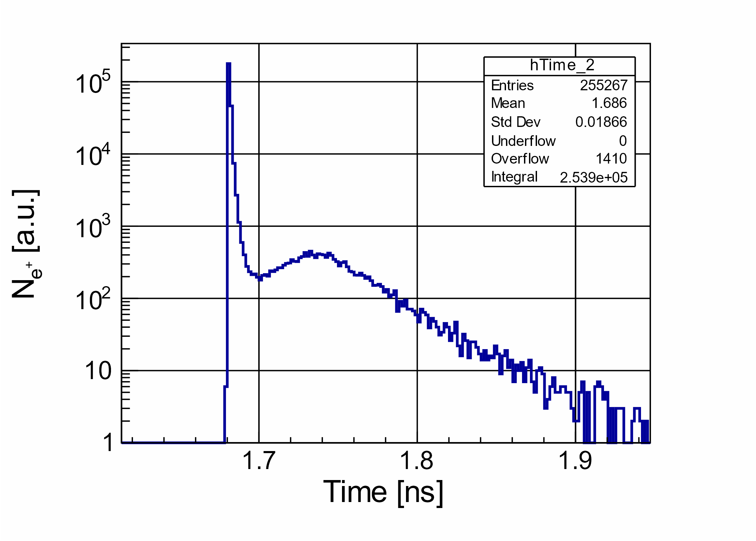
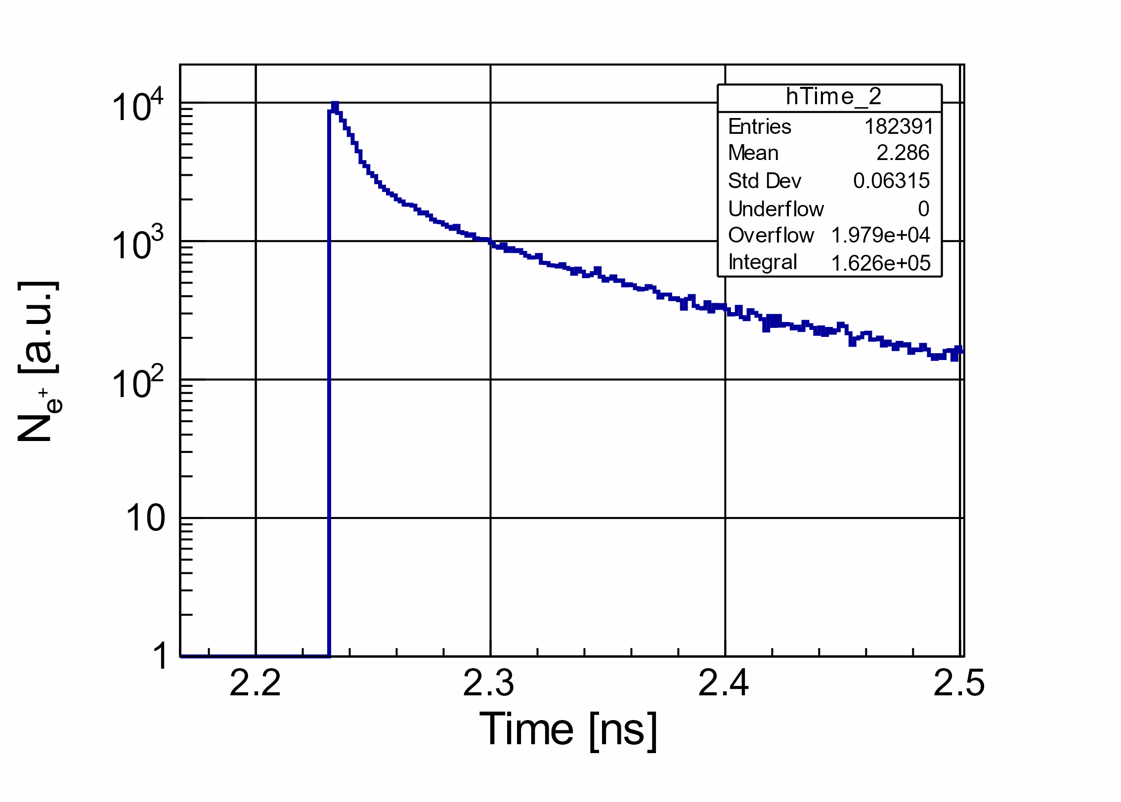
Bunch Time Profiles for Electron Beam with σ_{z} = 0
At Exit Side of Target
After 1st Solenoid
σ_{t} = 18.7 ps
σ_{t} = 63.1 ps

Slide 4
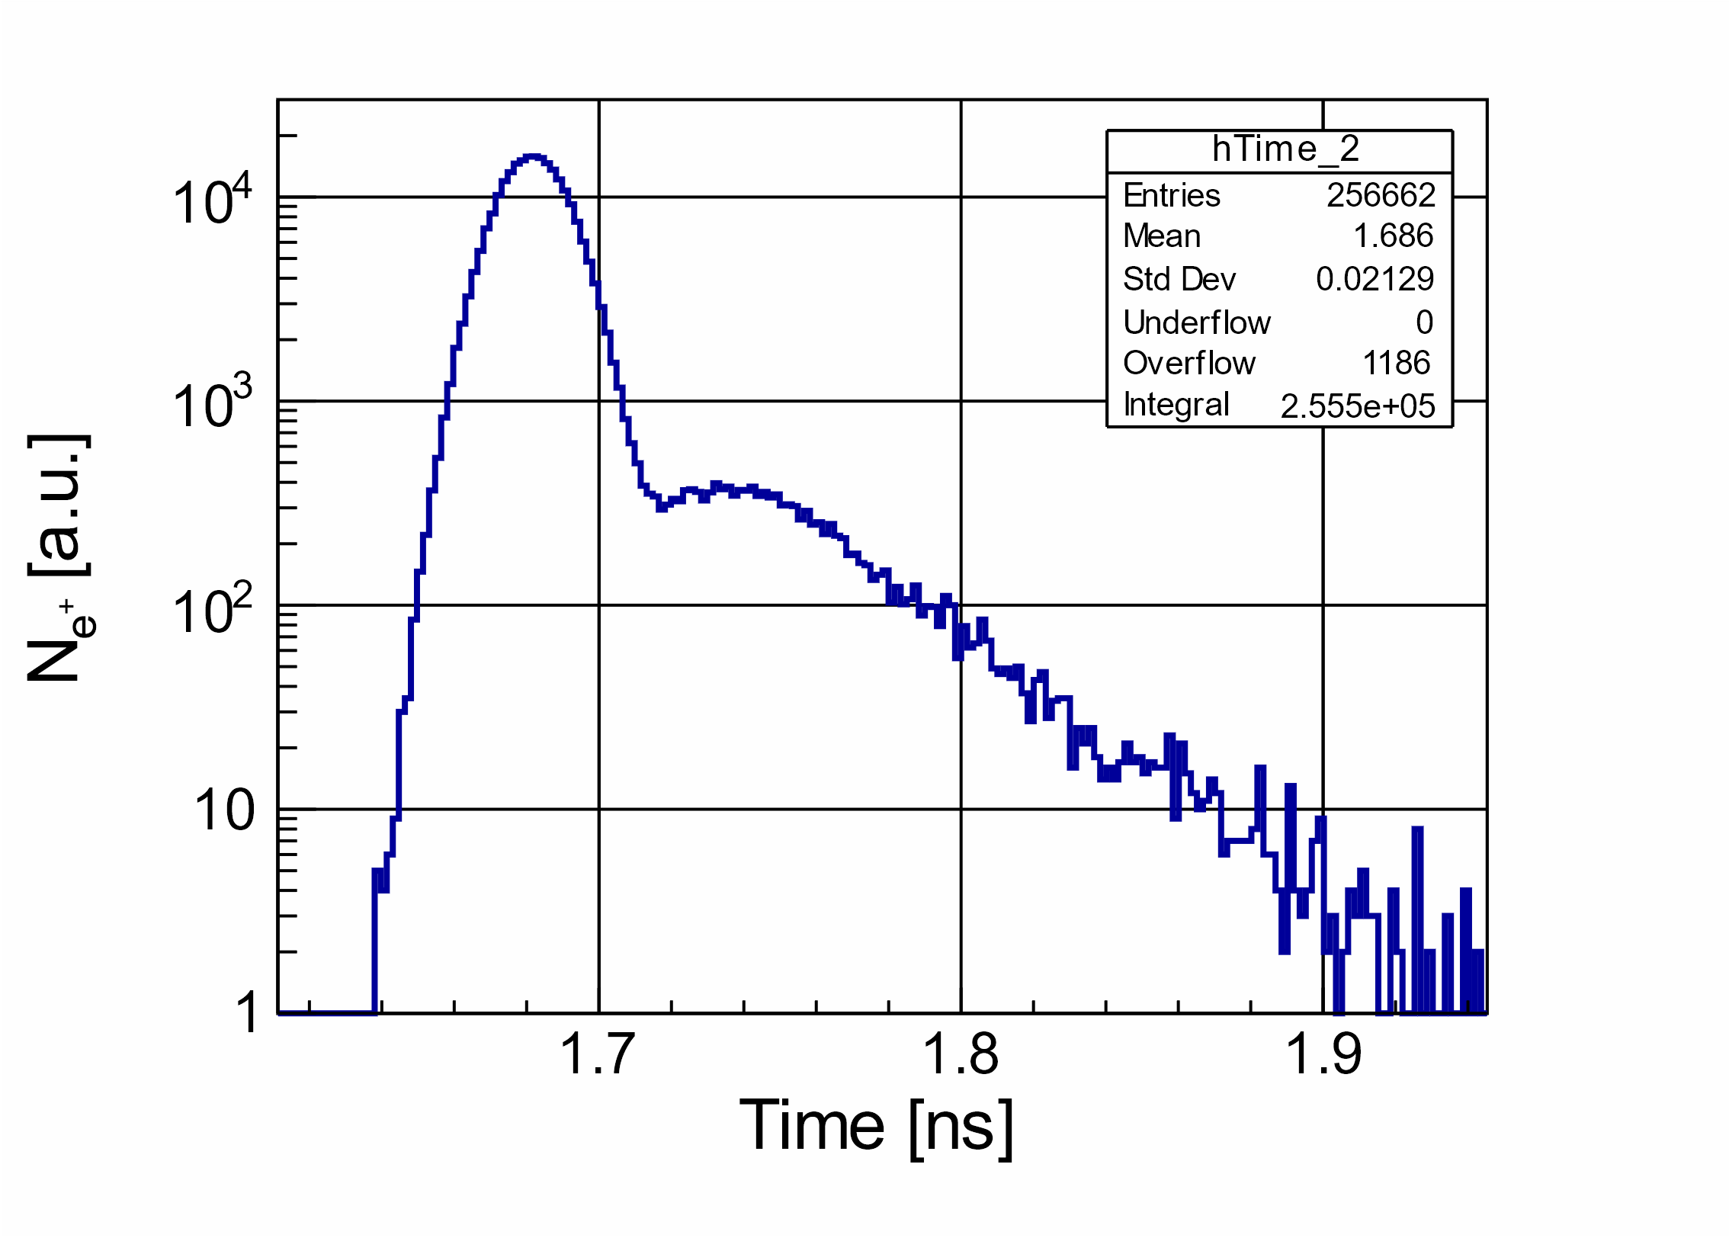
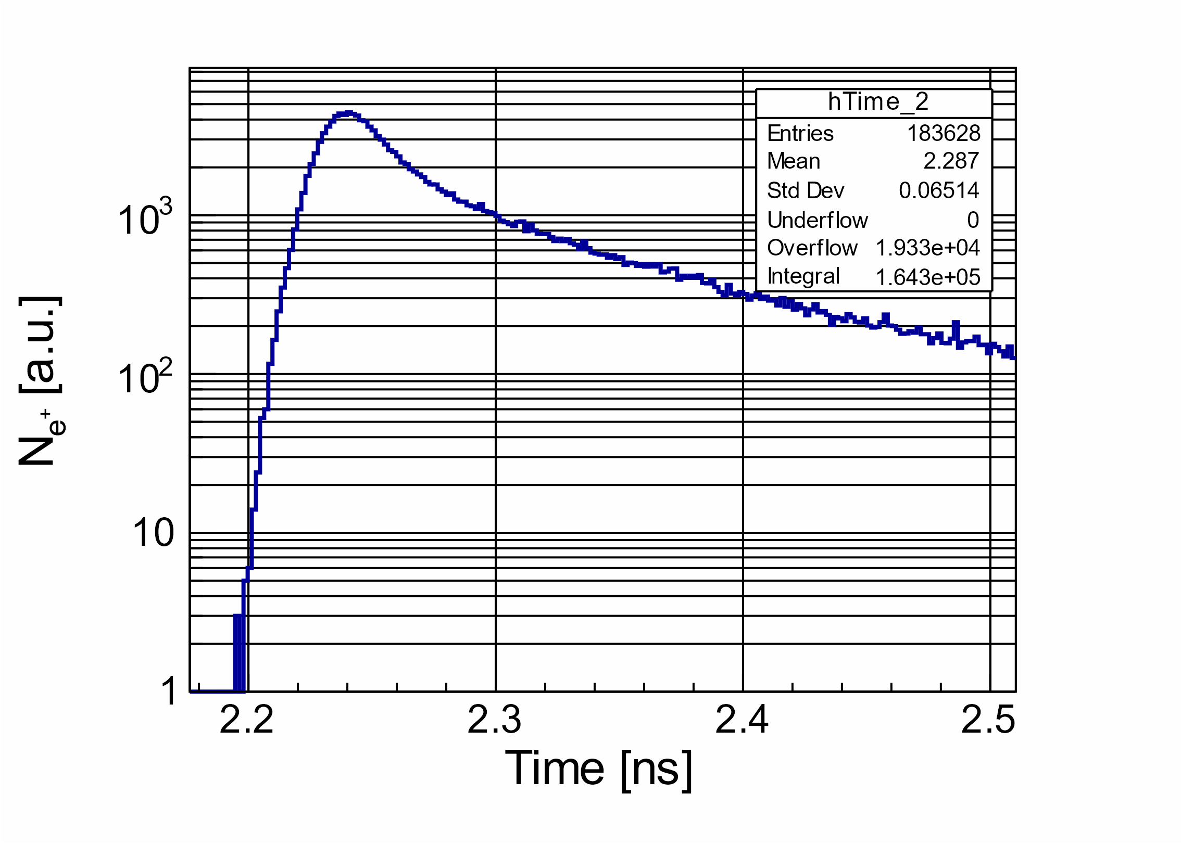
Bunch Time Profiles for Electron Beam with σ_{z} = 3 mm
At Exit Side of Target
After 1st Solenoid
σ_{t} = 21.3 ps
σ_{t} = 65.1 ps

Slide 5
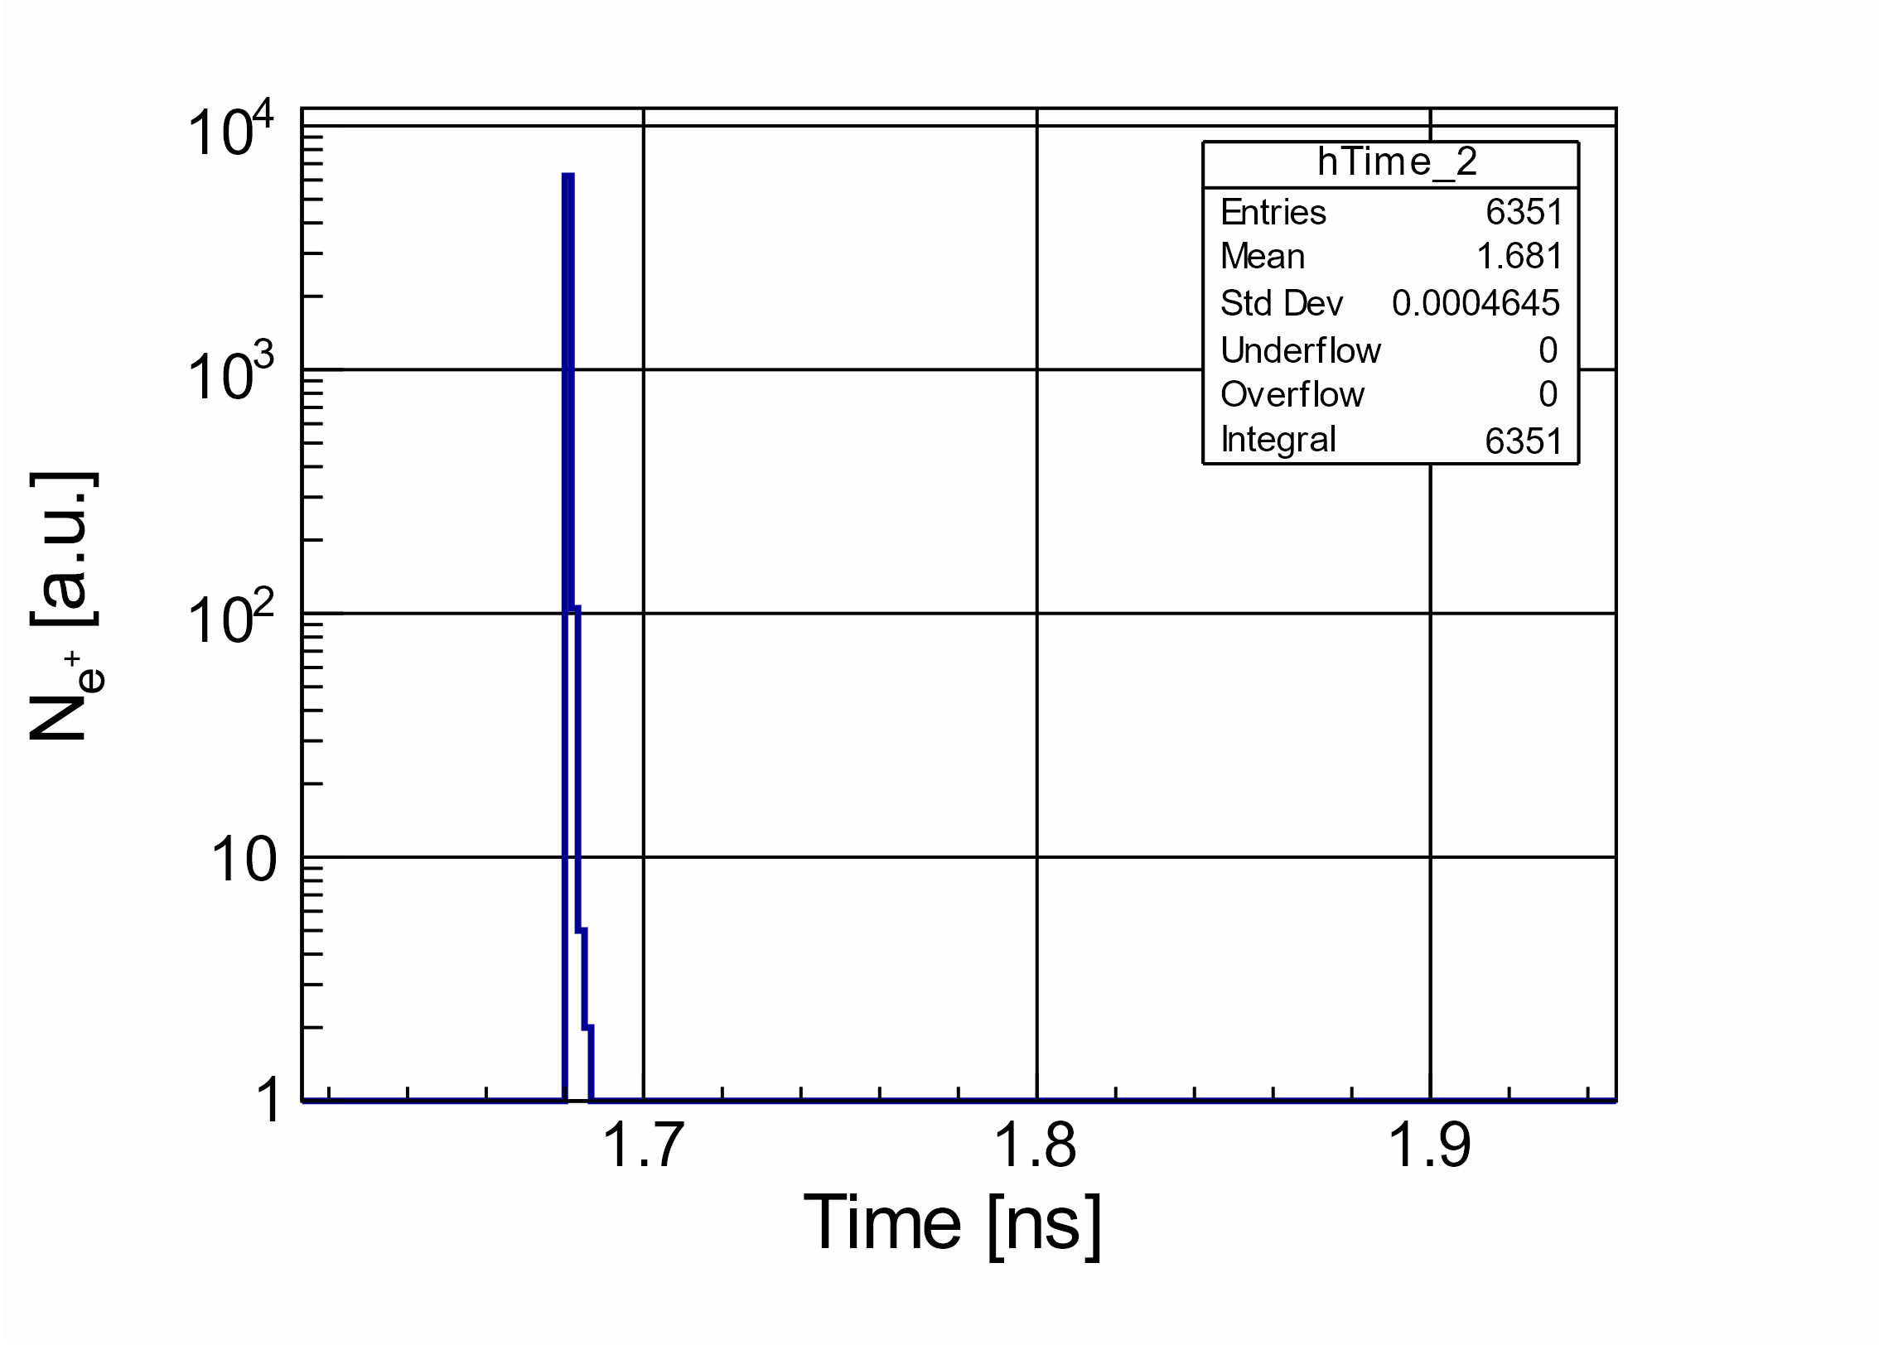
Bunch Time Profiles for Electron Beam with σ_{z} = 0 without Energy Cut (left) and E_{e+} > 60 MeV (right)
At Exit Side of Target
At Exit Side of Target
σ_{t} = 18.7 ps
σ_{t} = 0.5 ps

Slide 6
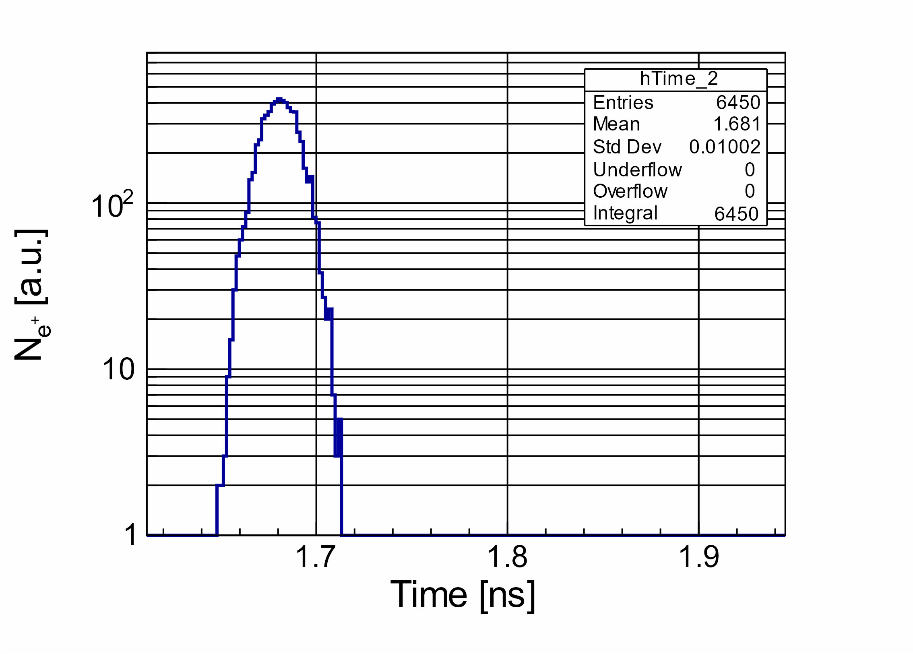
Bunch Time Profiles for Electron Beam with σ_{z} = 3 mm without Energy Cut (left) and E_{e+} > 60 MeV (right)
At Exit Side of Target
At Exit Side of Target
σ_{t} = 21.3 ps
σ_{t} = 10.0 ps

