Slide 1
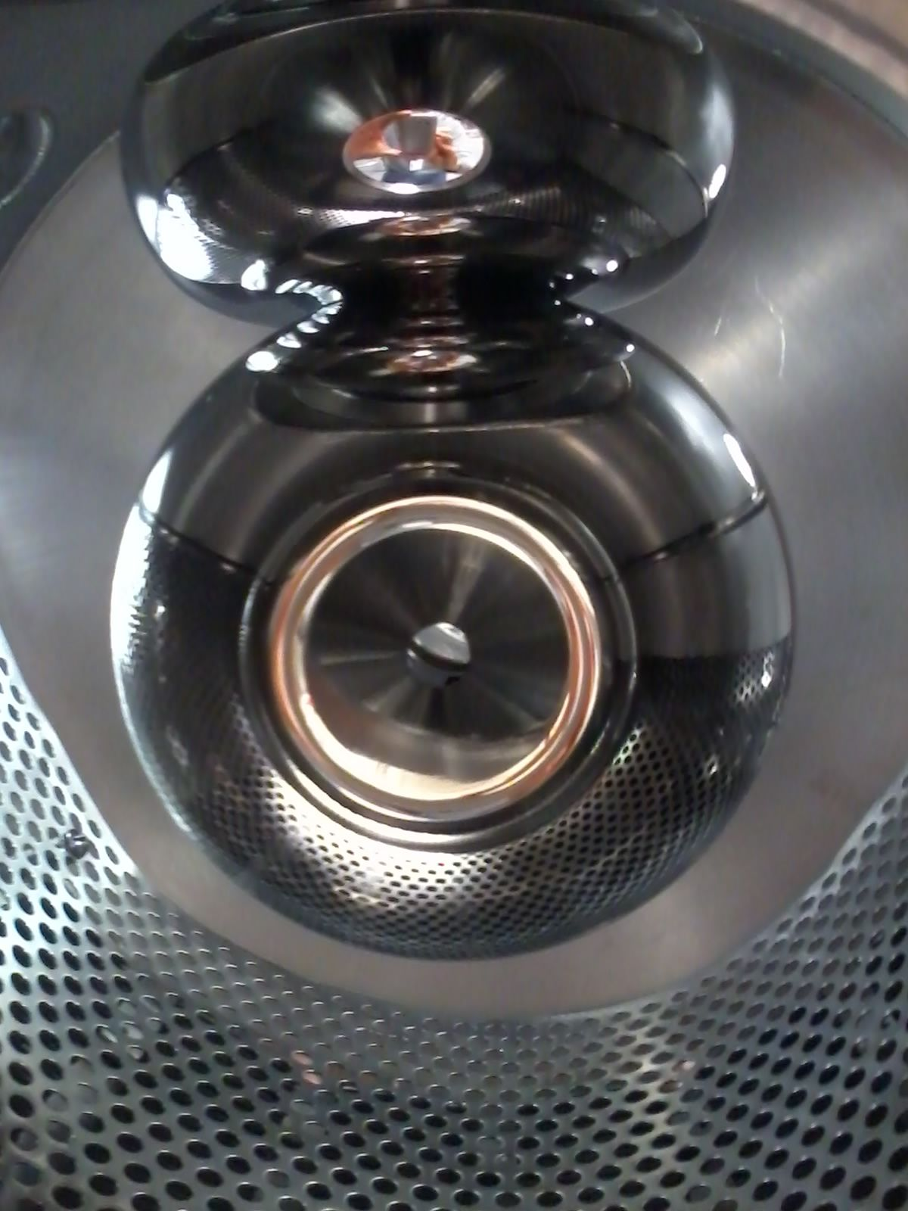
High voltage dc photo-electron guns with inverted geometry insulators: the quest for higher operating voltage
Outline:
Overview of DC photogun designs in operational accelerators at Jefferson Lab
Practical considerations to reliably apply high voltage
Successes and lessons learned over the two past decades
Latest developments on 500 kV feedthrough
Carlos Hernandez-Garcia
for the Center for Injectors and Sources team

Slide 2
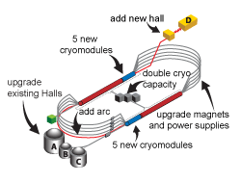
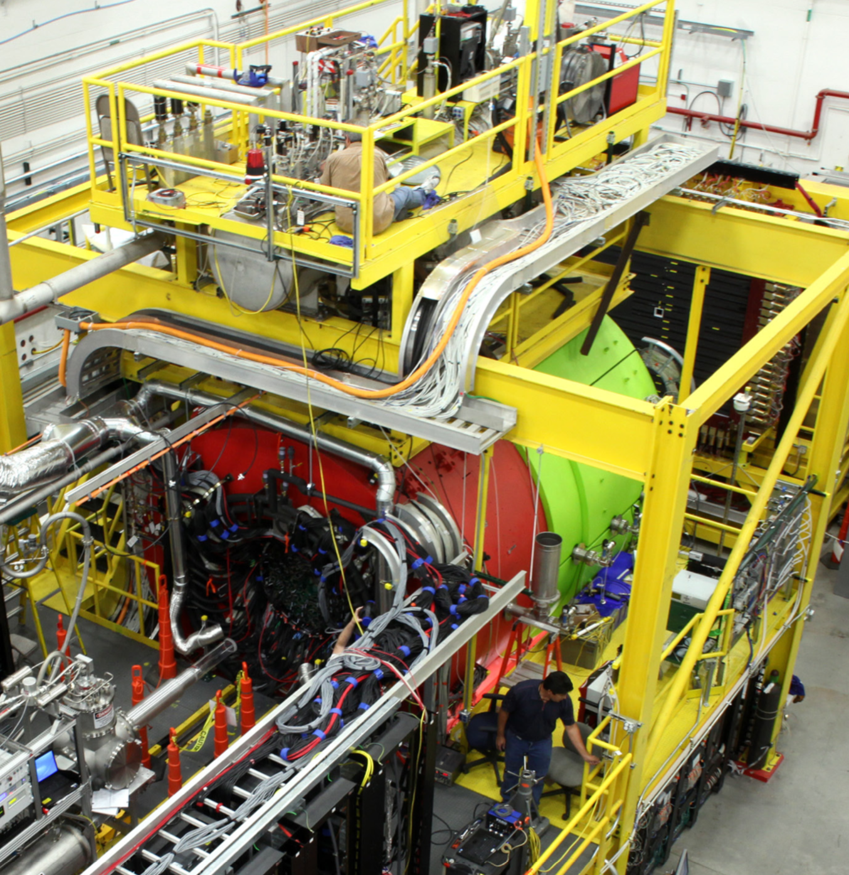
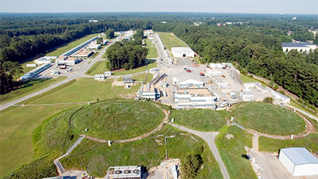
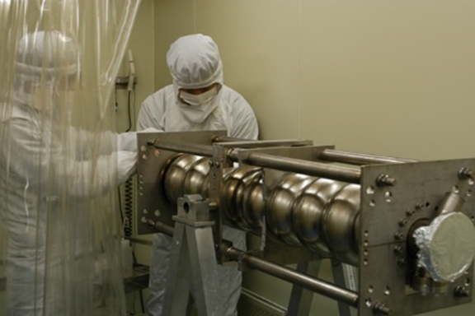
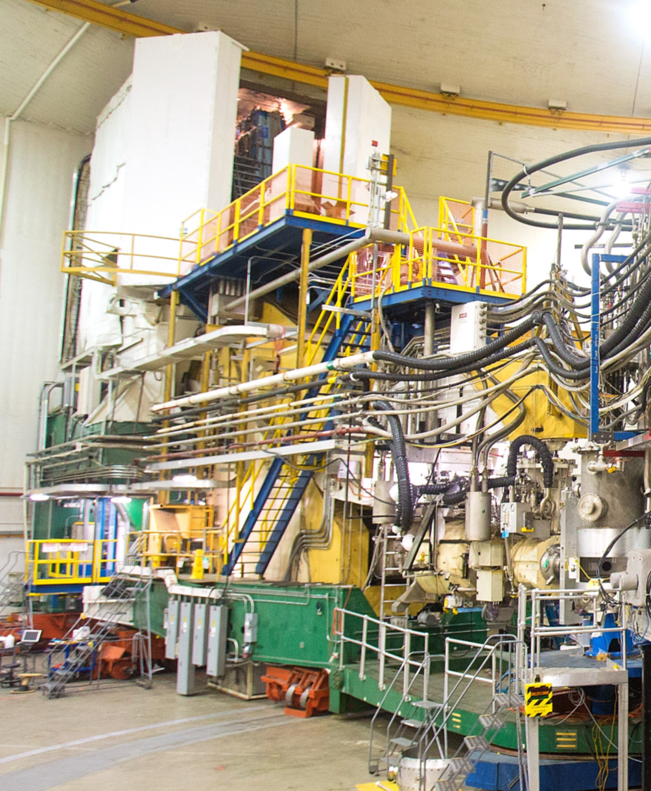
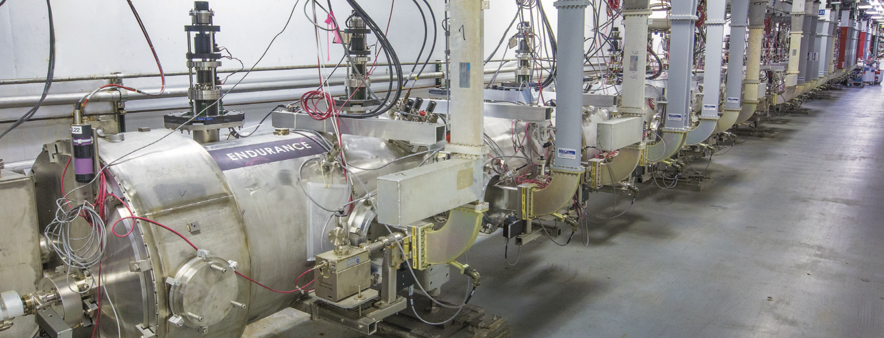
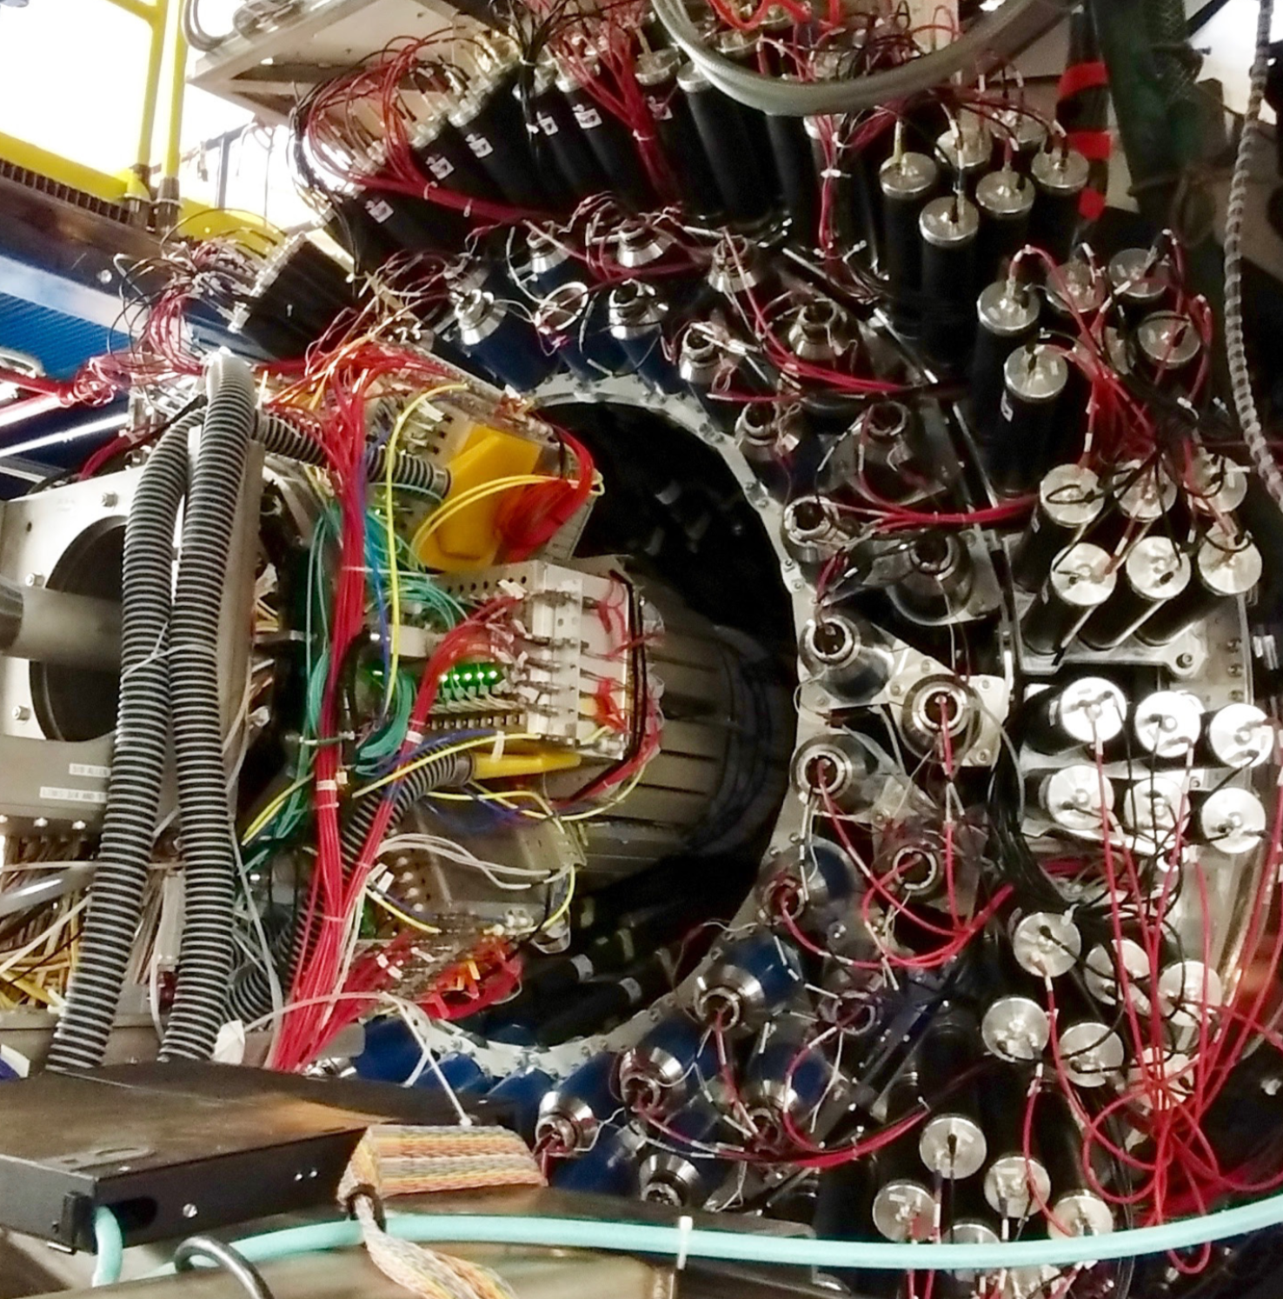
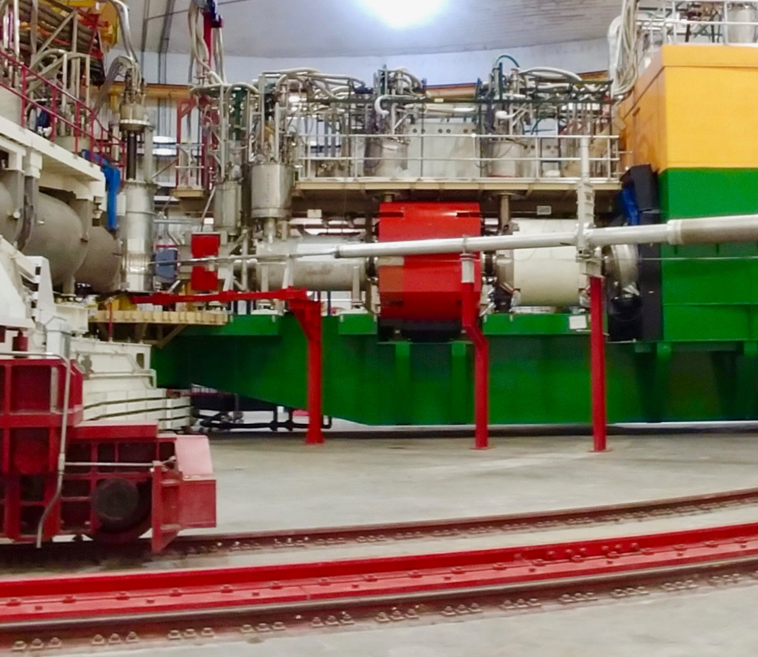
The Jefferson Lab Continuous Electron Beam Accelerator Facility (CEBAF) provides high polarization CW beam to four nuclear physics experimental halls
The electron source is based on a 180 kV DC photogun with strained super lattice GaAs photocathode
The accelerator is based on SRF linacs providing ~ 2 GeV / pass
North LINAC
1 GeV
South LINAC
1 GeV
Injector 120 MeV
Electron source 180 keV
C. Hernandez-Garcia IVESC 2023. Tsukuba, 25-29 September

Slide 3
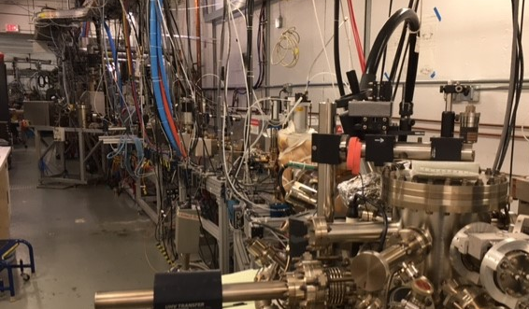
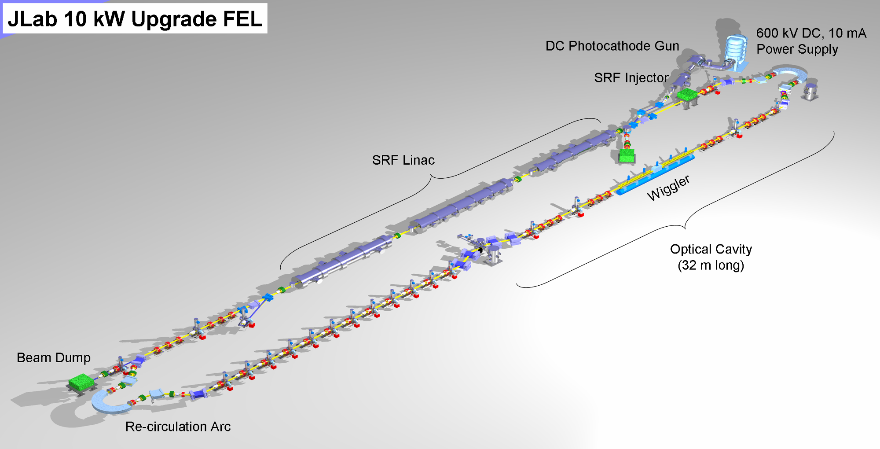
The Jefferson Lab complex hosts two additional accelerators
The Upgrade Injector Test Facility UITF is a testbed accelerator with capability for 10 MeV SRF booster and 200 kV DC photogun based on inverted insulator design
The Low Energy Recirculation Facility has a 10 MeV SRF booster and 30 MeV SRF linac. The 350 kV DC photogun is based on large-bore cylindrical insulators
Evaluation of polarized hydrogen targets (HDIce)
Irradiation of wastewater with electron beam
Demonstrated > 1 MW of recirculated beam power
Holds the world record at 14 kW CW in the IR as an FEL
C. Hernandez-Garcia IVESC 2023. Tsukuba, 25-29 September

Slide 4
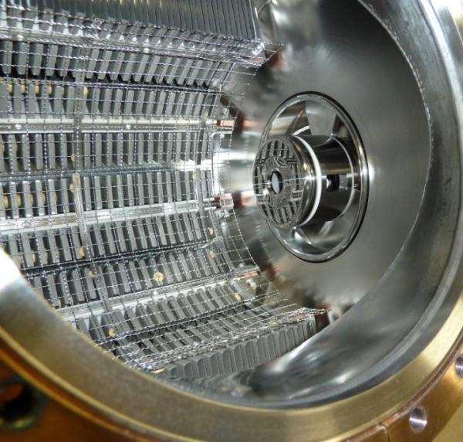
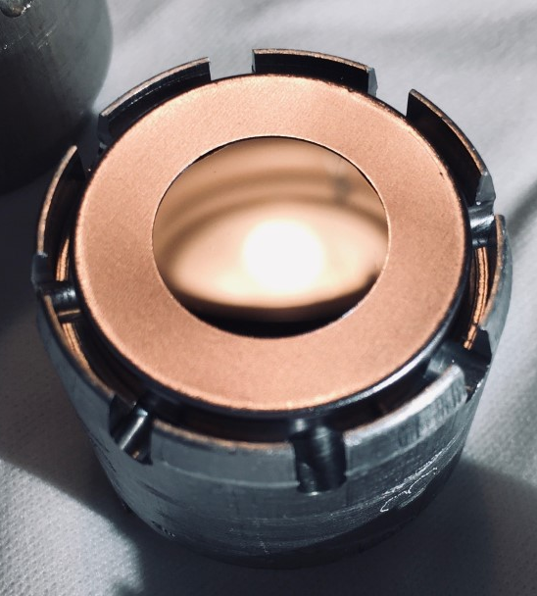
High Voltage DC photoemission gun characteristics makes them an ideal electron beam source in a variety of accelerator applications, but must meet stringent criteria
Extreme-high vacuum conditions provide long-photocathode lifetime from high polarization GaAs photocathodes for nuclear physics experiments
High CW beam current capability provide:
  Hundreds of micro-Amperes > 80% spin-polarized electron beams for nuclear physics experiments
  Tens of milli-Amperes un-polarized beams for electron coolers, energy recovery linacs and free electron lasers
High photocathode gradient contributes to managing space charge forces in high intensity bright electron beams for accelerator applications
Non evaporable getter pump array
GaAs photocathode mounted to a molybdenum puck holder
1.5 cm
C. Hernandez-Garcia IVESC 2023. Tsukuba, 25-29 September

Slide 5
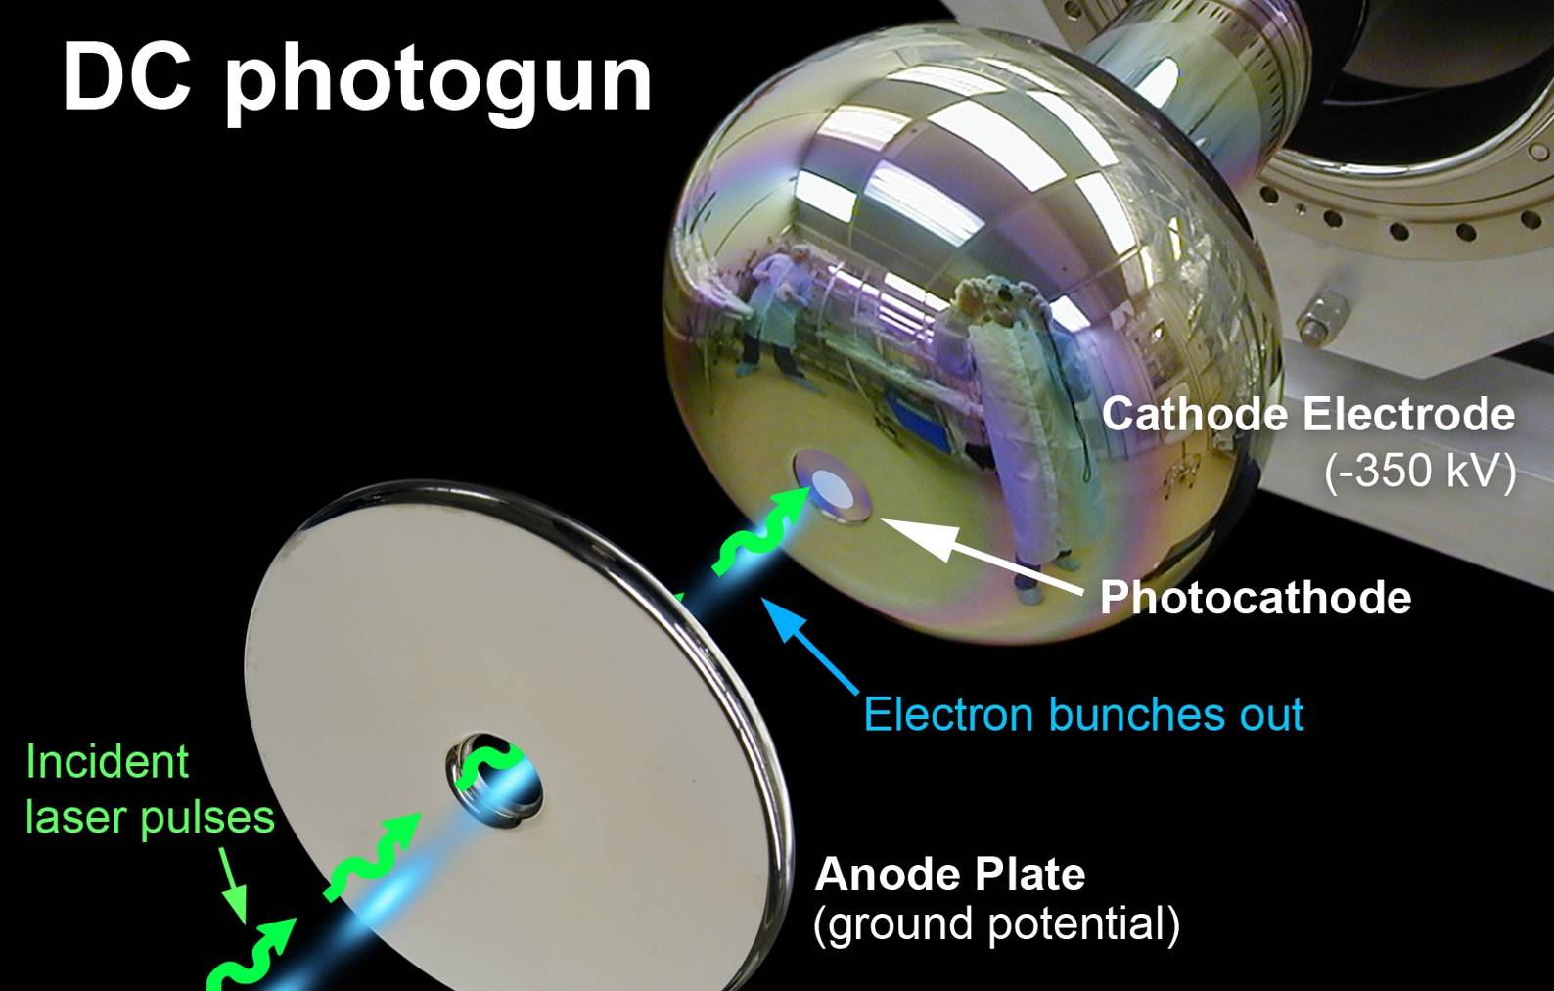
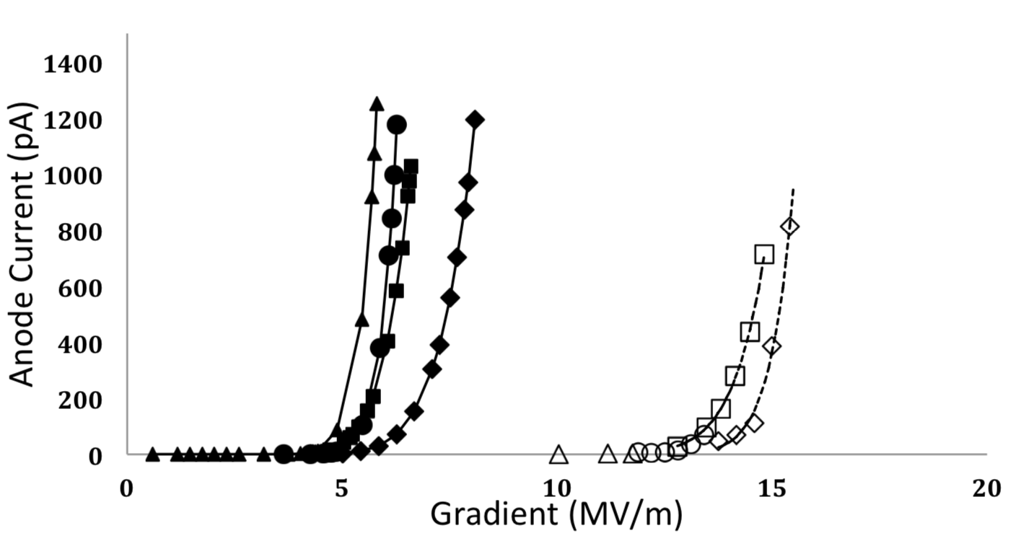
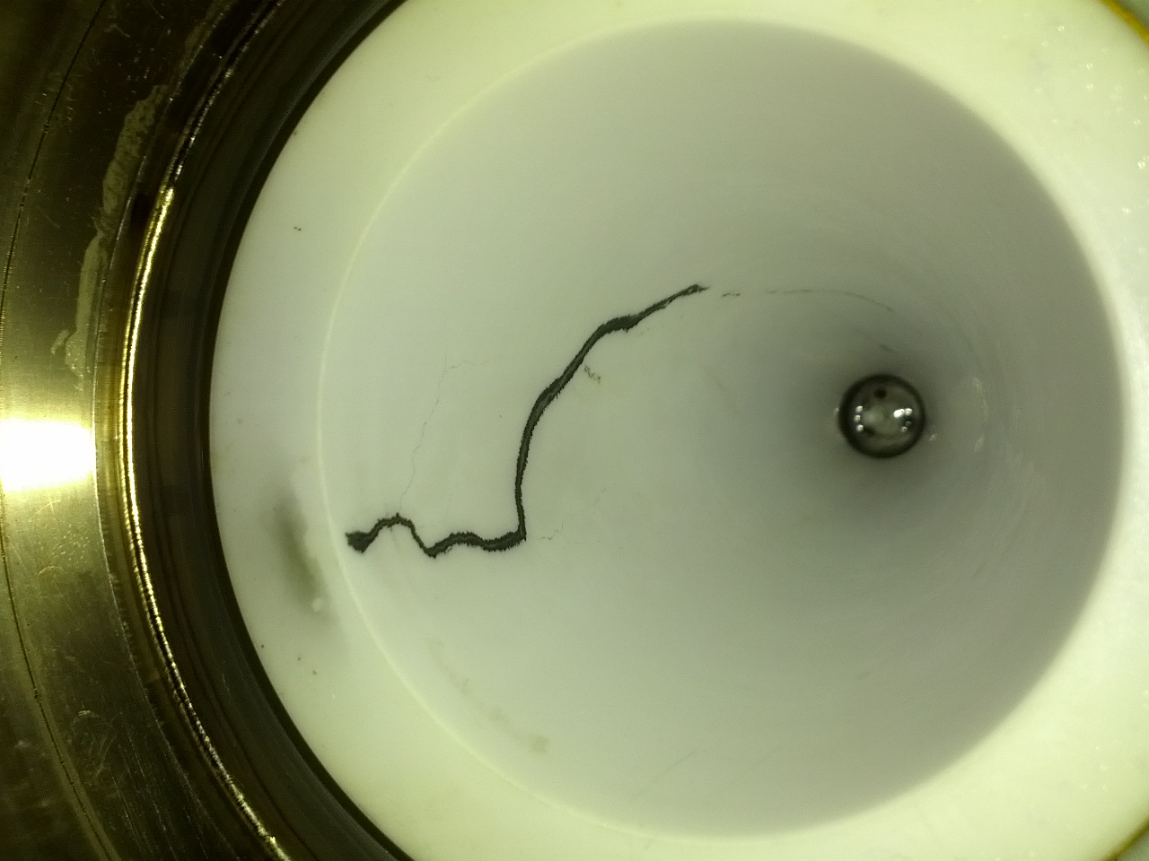
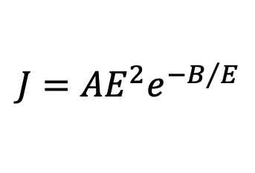
Compensating for space charge forces in the electron bunch and improving injector transmission imposes challenging requirements on the electron gun
The photocathode accelerating field must be sufficiently high, but no higher than ~ 10 MV/m to minimize field emission
Electrodes must be free of field emission at the operating voltage to preserve the vacuum conditions necessary for long photocathode lifetime
$$J=AE^{2}e^{{−B}/E}$$
BAD
BETTER
High voltage must be applied to the electrodes and HV feedthroughs without breakdown
J
E
C. Hernandez-Garcia IVESC 2023. Tsukuba, 25-29 September

Slide 6

Field emission is a harsh opponent. The electrodes:
Material with the least amount of inclusions and defects to reduce potential field emitters
Small size to minimize surface area for better vacuum, but shape and size designed to minimize gradient
Mirror finish polishing to minimize surface roughness and thus potential field emitters
Vacuum heat treatments to reduce outgassing for vacuum performance
UHV ultrasonic chemical cleaning to minimize potential field emitters from particulates
Assembly in best possible clean room conditions to minimize number of foreign particulates
High voltage conditioning, using Kr gas helps processing field emitters
$$E∝\frac{q}{r^{2}}$$
Similar practices apply to the vacuum chamber and anode electrodes to minimize voltage induced gas desorption, typically observed > 200 kV
W. Diamond, “A model of gas desorption and radiation during initial high voltage conditioning in vacuum”, J. Appl. Phys. 126, 193303 (2019)
C. Hernandez-Garcia IVESC 2023. Tsukuba, 25-29 September

Slide 7
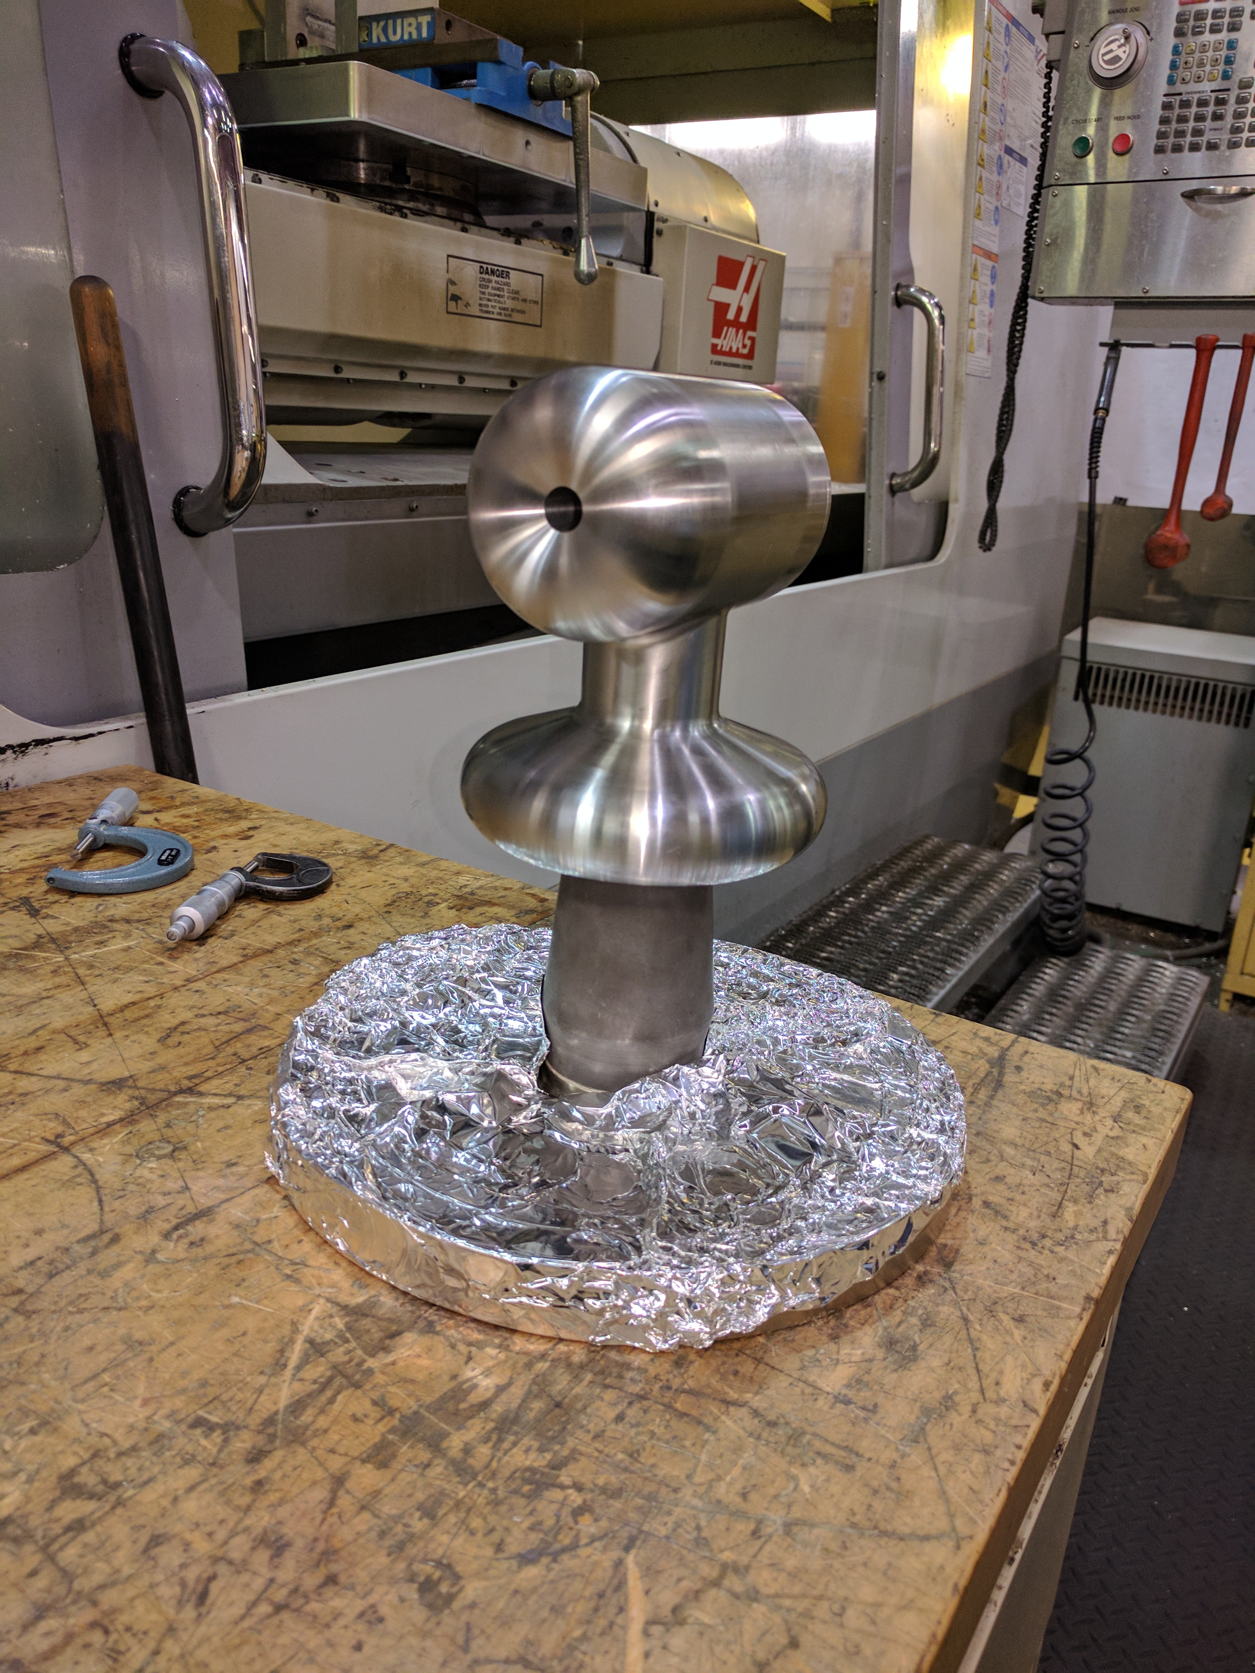
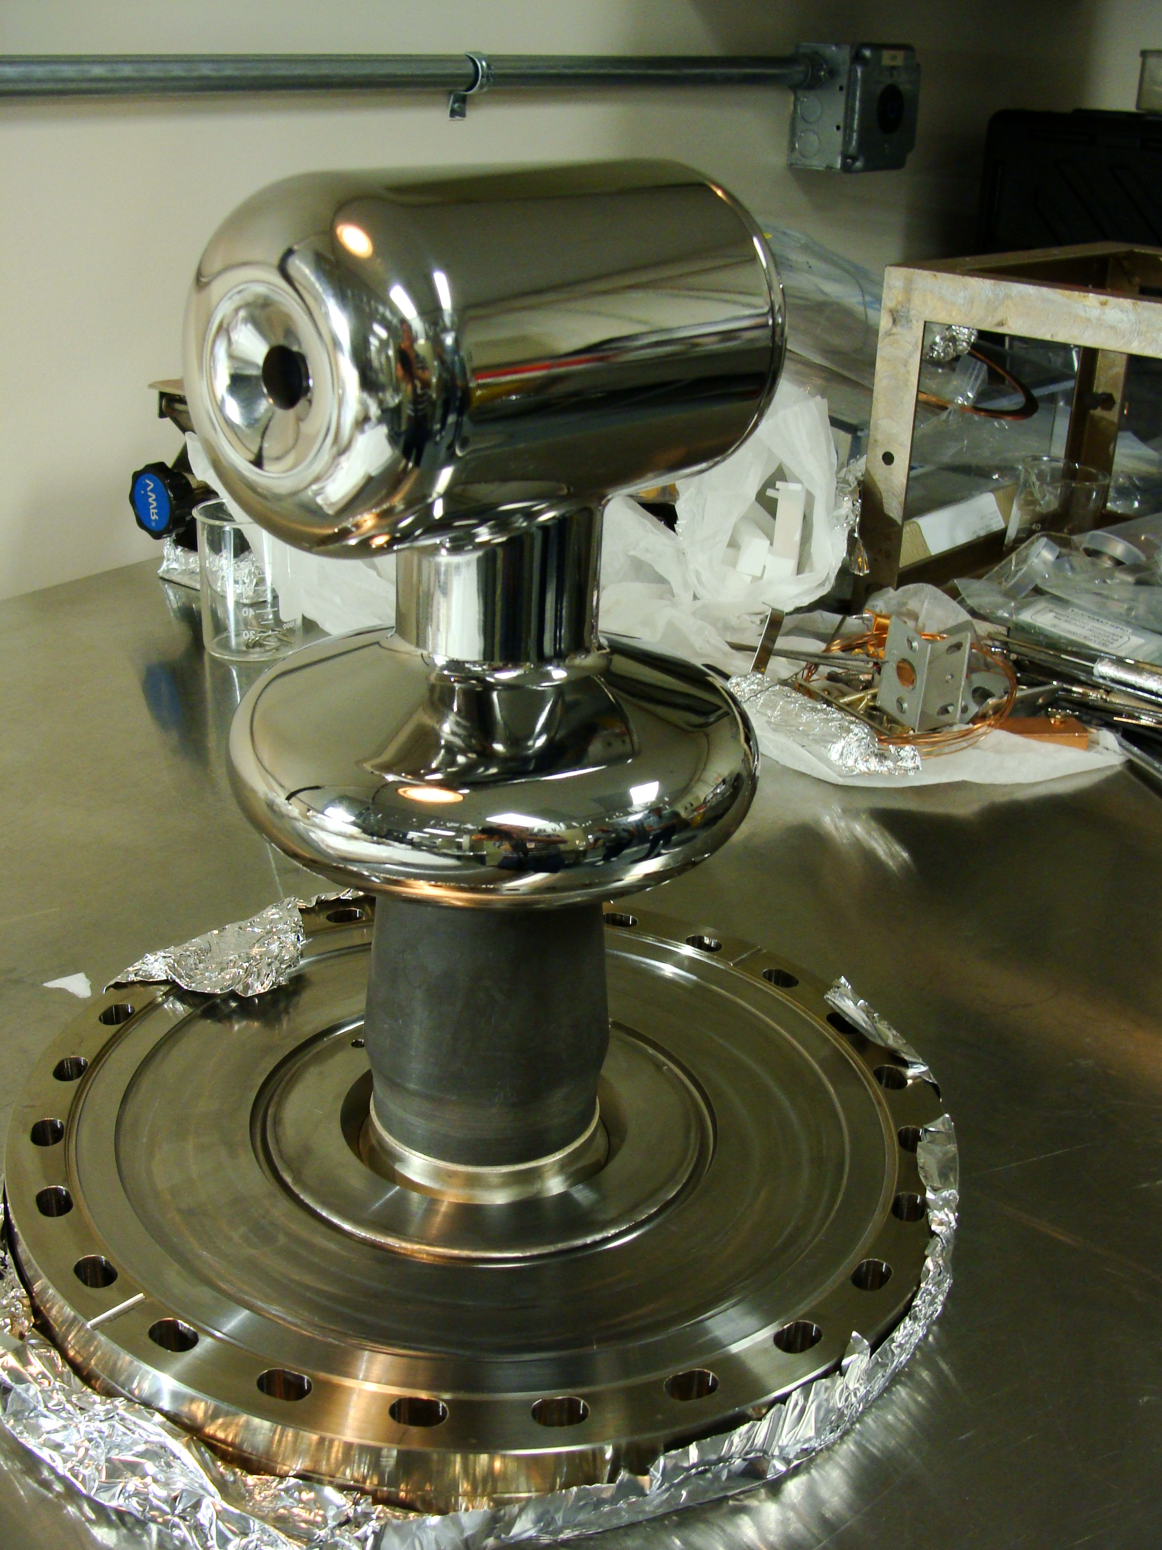
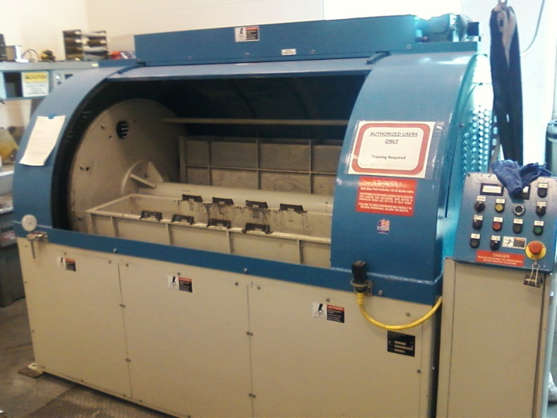
The electrodes must be mirror polished to minimize field emission
After barrel polishing
60 min. plastic cones
60 min. crushed corncob
  From machine shop
Lapping with sandpaper and diamond paste polishing is a labor intensive process that takes about 3 weeks
Implementing centrifugal barrel polishing has reduced polishing time from weeks to hours
  Barrel polishing machine at JLab SRF
C. Hernandez-Garcia, D. Bullard, F. Hannon, Y. Wang and M. Poelker, Review of Scientific Instruments 88, 093303 (2017)
C. Hernandez-Garcia IVESC 2023. Tsukuba, 25-29 September

Slide 8
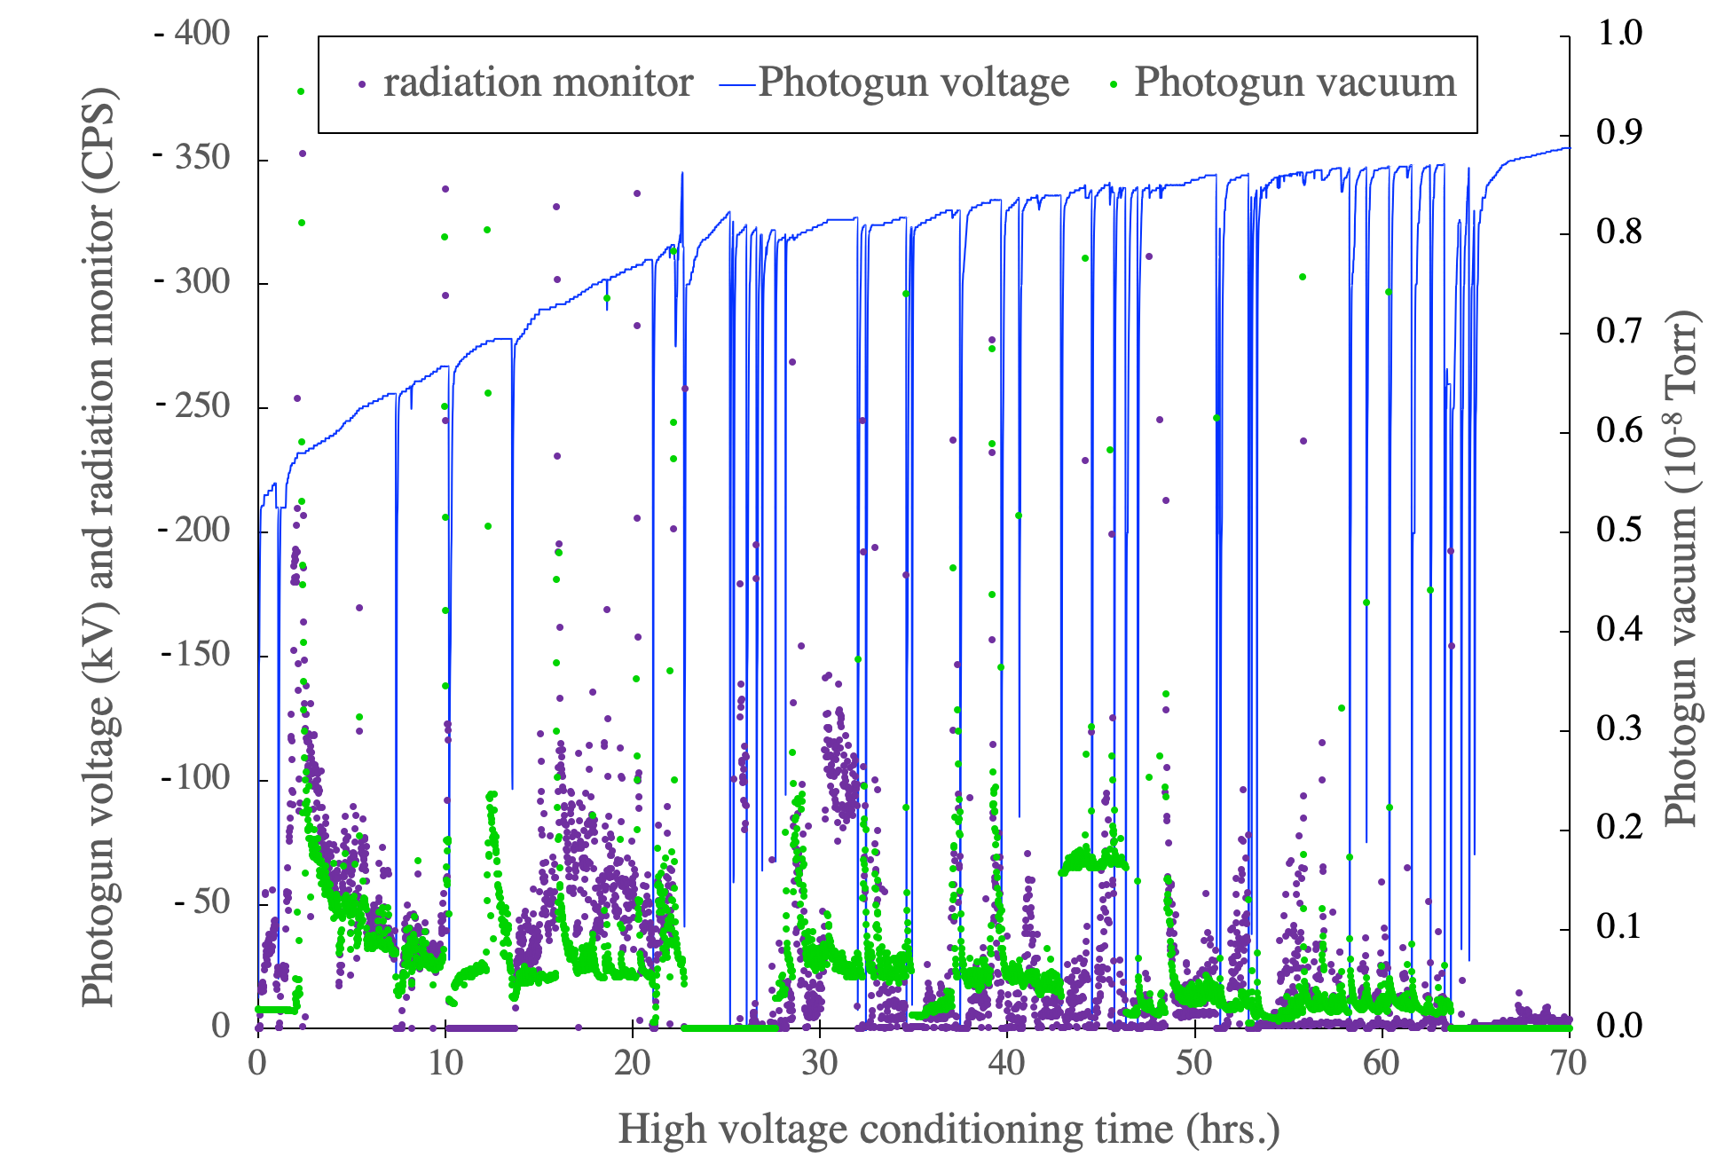
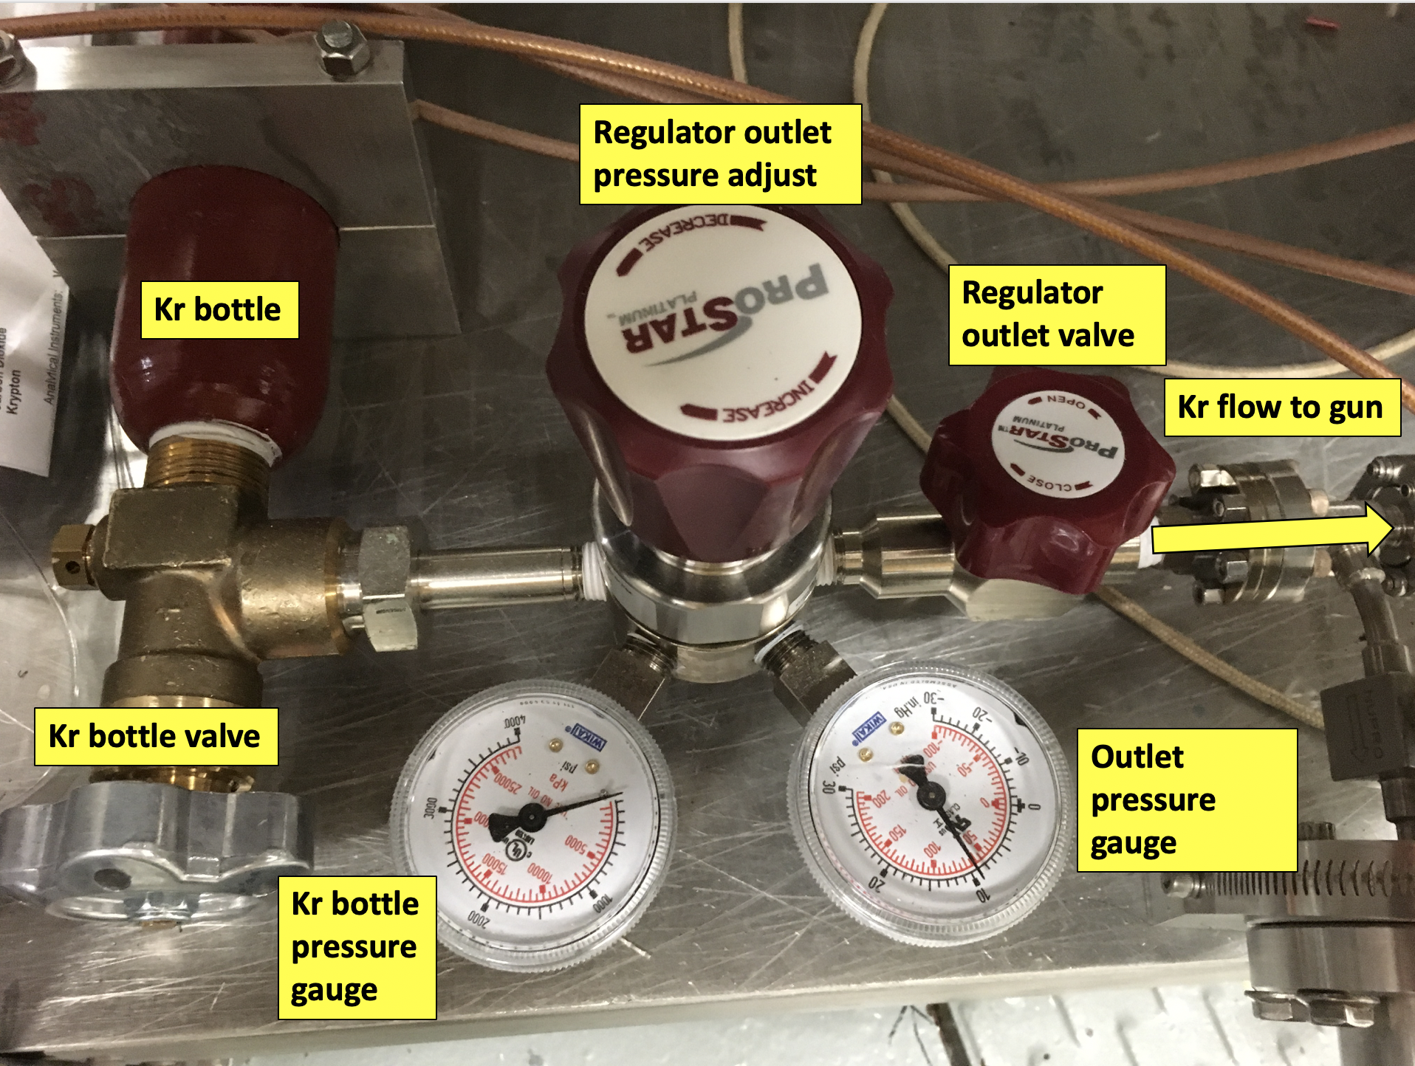
High voltage conditioning with Kr gas serves to eliminate field emission
The purpose of high voltage conditioning is to achieve vacuum and radiation levels indistinguishable from background at operating voltage
Kr gas facilities field emitter ‘burn out’ by ion back bombarding and by increasing stainless steel work function as it is implanted at the gun electrode bias voltage
M. BastaniNejad, et al., “Improving the performance of stainless-steel DC high voltage photoelectron gun cathode electrodes via gas conditioning with helium or krypton”, Nucl. Instr. and Meth. in Phys. Res. A, Vol. 762, pp. 135–141, 2014

Slide 9
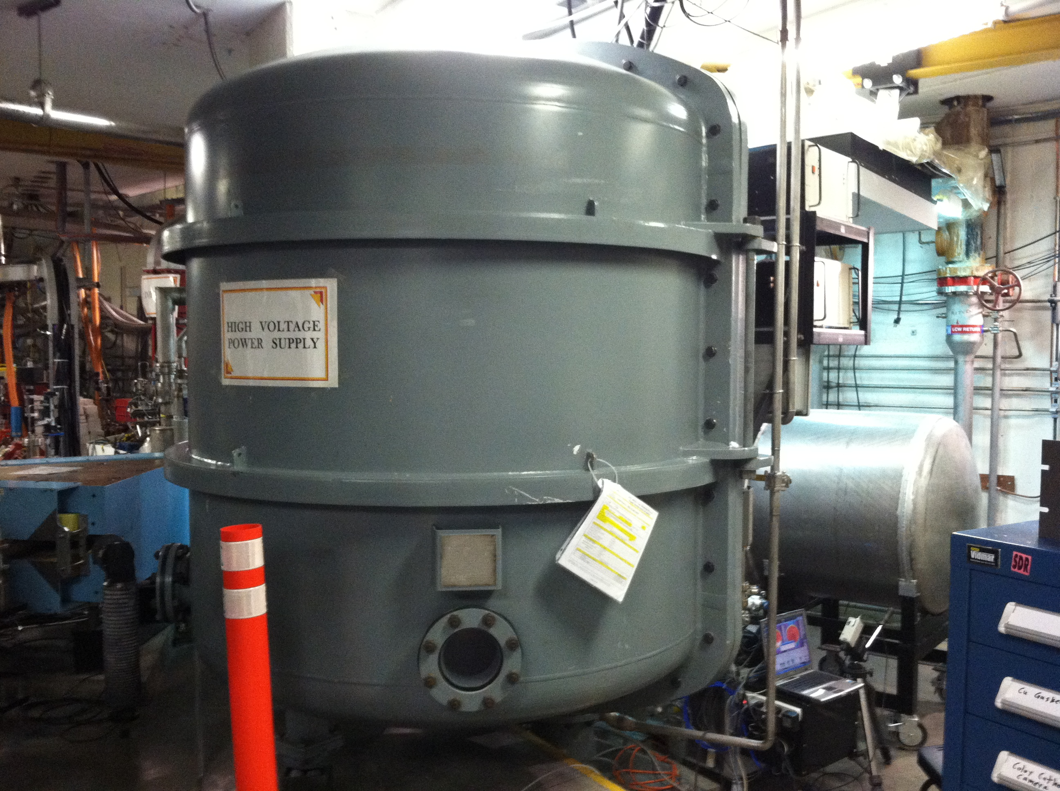
The high voltage power supply is often based on a Cockcroft-Walton generator inside a vessel filled with compressed sulfur hexa-fluoride (SF₆)
Voltage ranges from 100 to 500 kV DC,
and current from 1 to 10 mA
C. Hernandez-Garcia IVESC 2023. Tsukuba, 25-29 September

Slide 10
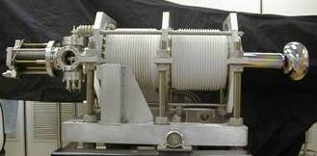
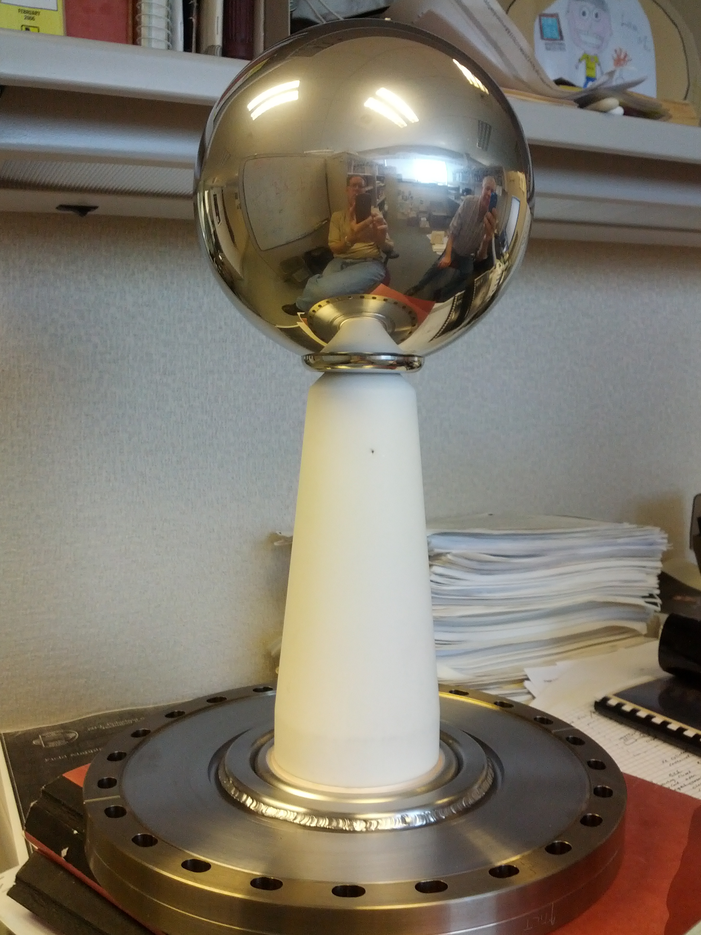
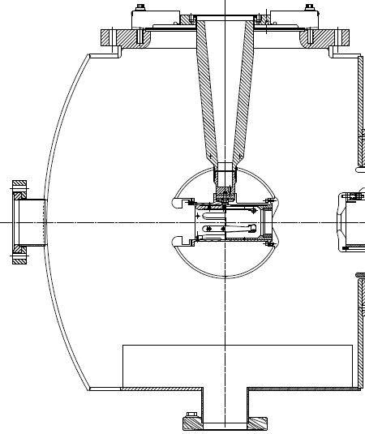
The inverted-geometry insulator photogun design has a number of advantages over the large-bore insulator photogun design
helps achieving exceptional vacuum because there is less surface area to contribute a gas load
serves to reduce field emission because there is less metal biased at high voltage, and
a large SF6 tank is not required at the photogun, because a high voltage cable is used to apply high voltage
Cylindrical insulator
Conical insulator
15 cm
20 cm
Electrode
Electrodes
C. Hernandez-Garcia IVESC 2023. Tsukuba, 25-29 September

Slide 11
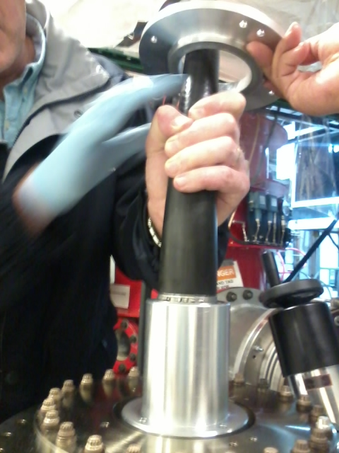
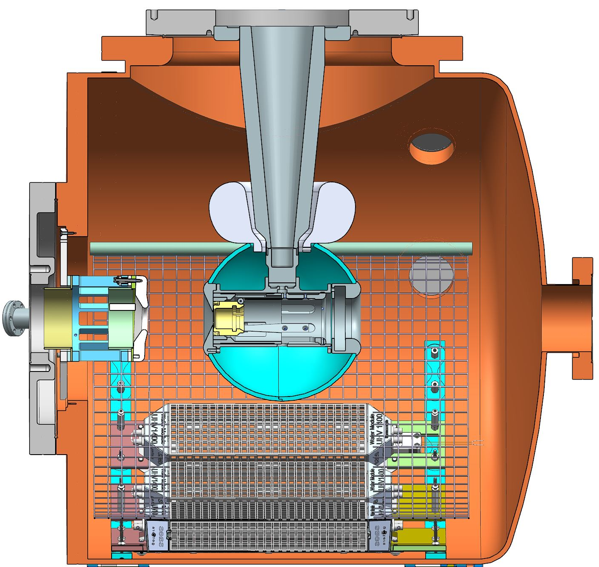
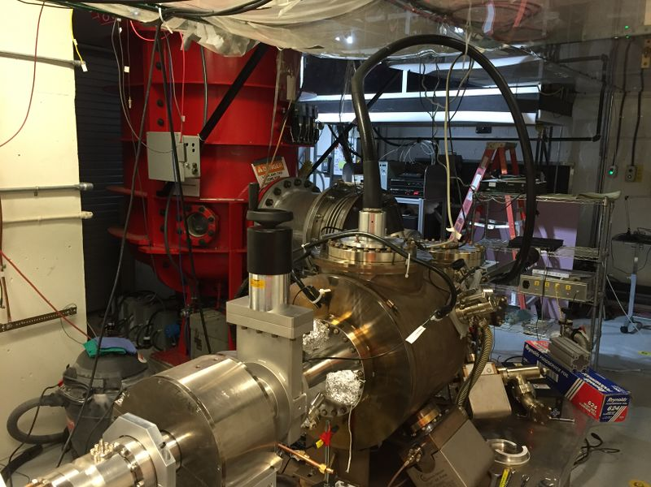
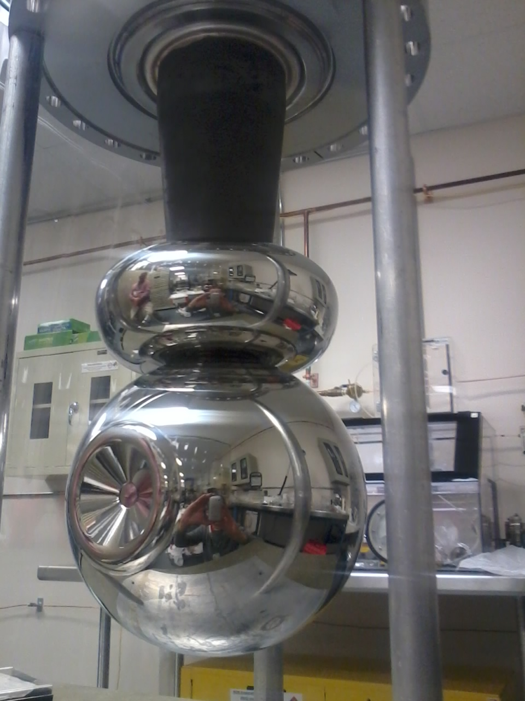
In photogun with inverted-geometry ceramic insulators:
The cathode is isolated from the vacuum chamber at ground potential with a conical (inverted geometry) insulator feedthrough
The cathode is connected to the high voltage power supply via the feedthrough using a commercial HV cable
C. Hernandez-Garcia IVESC 2023. Tsukuba, 25-29 September
15 cm

Slide 12
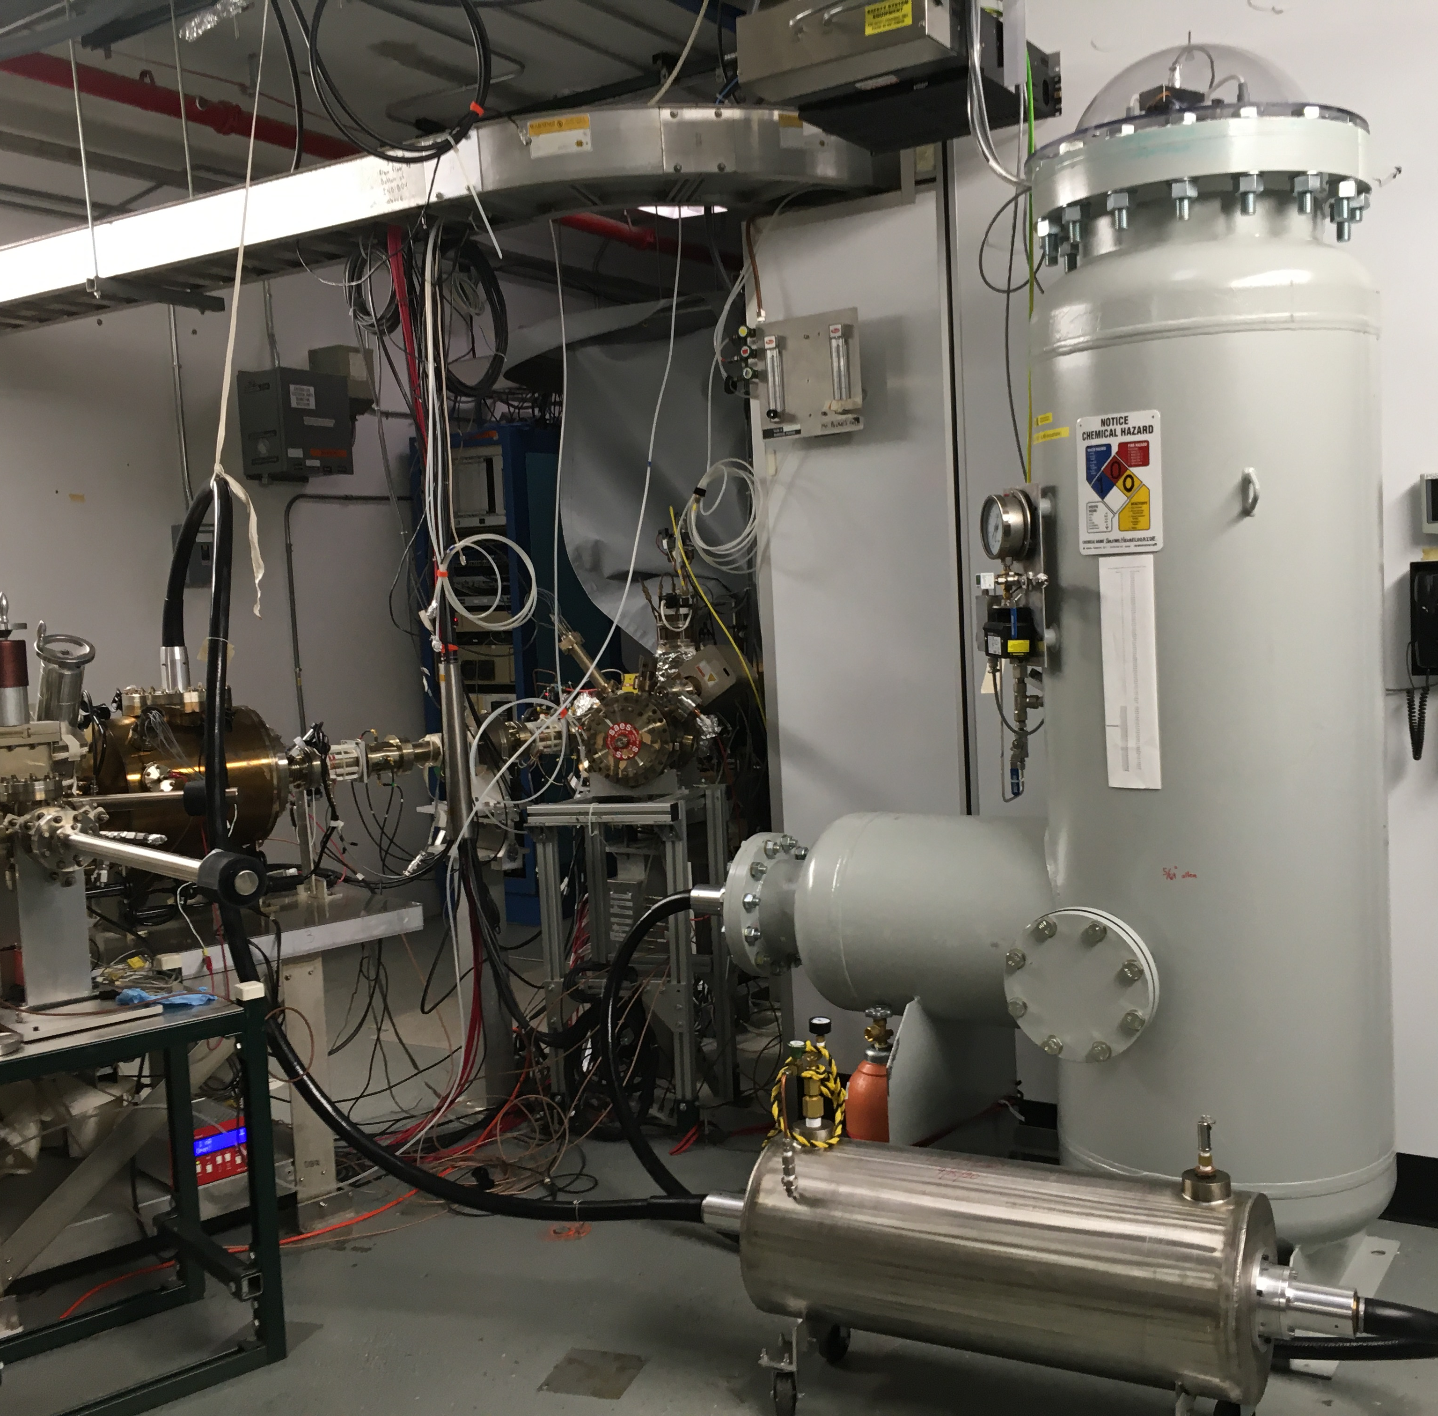
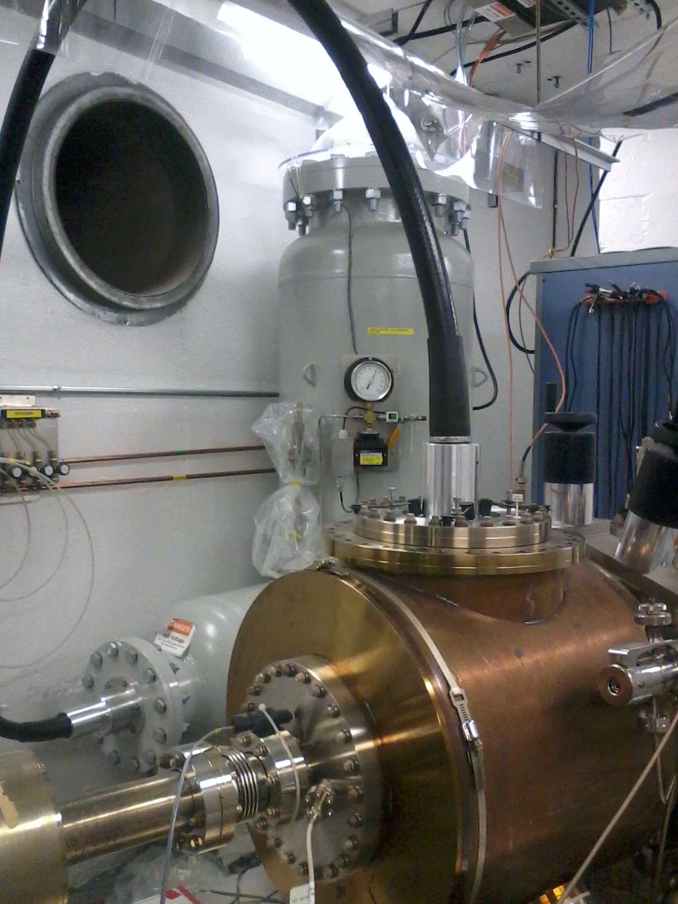
JLab currently operates 3 inverted-geometry ceramic insulator photoguns that use commercial high voltage cables
180 kV CEBAF
Nuclear Physics program
200 kV Beam
Test Accelerator
350 kV Gun Test Stand
450 kV power supply
500 kV power supply
HV cable
HV cable
HV cable
photogun
350 kV power supply
photogun
photogun
C. Hernandez-Garcia IVESC 2023. Tsukuba, 25-29 September

Slide 13
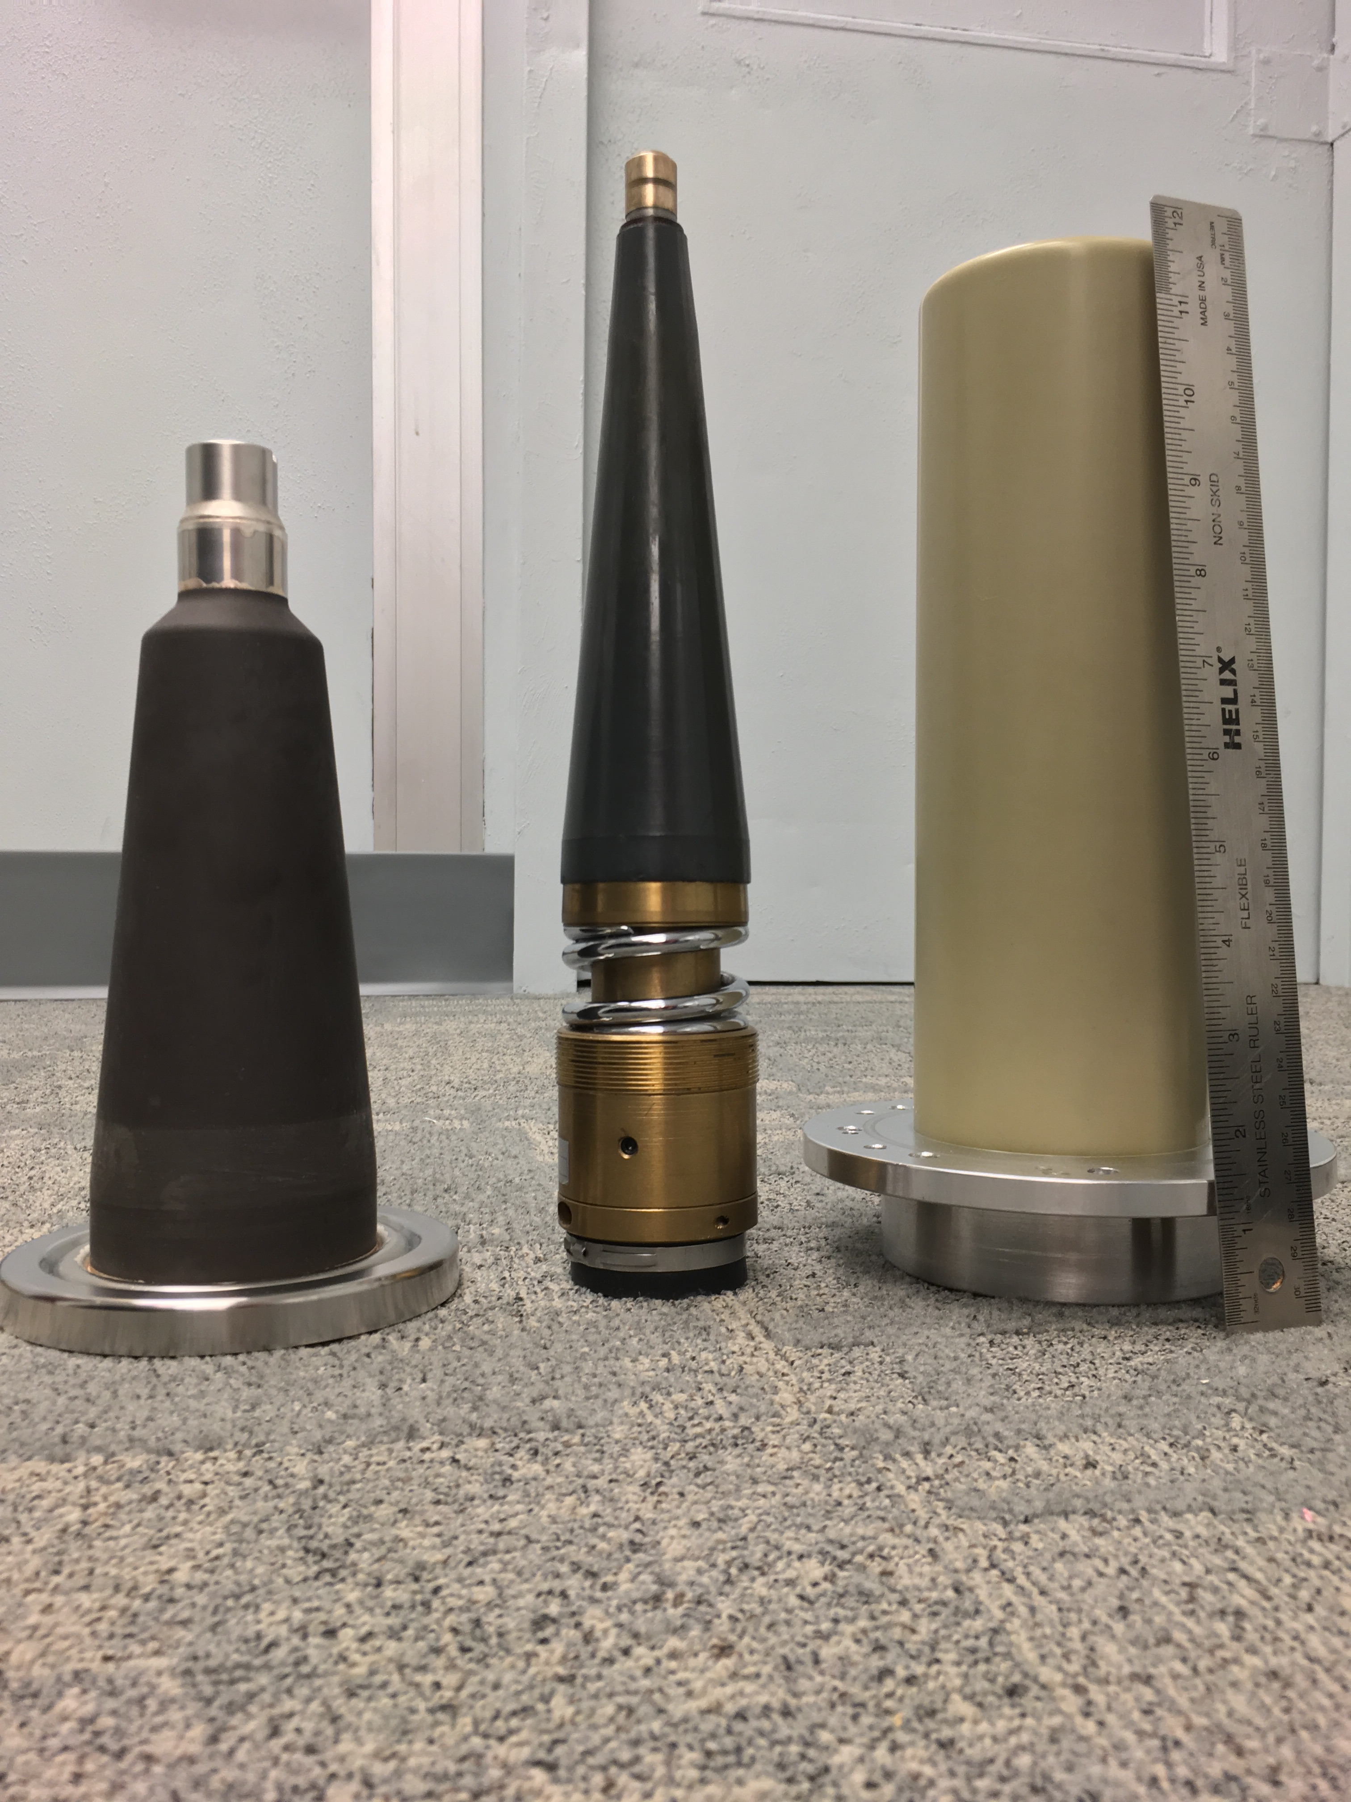
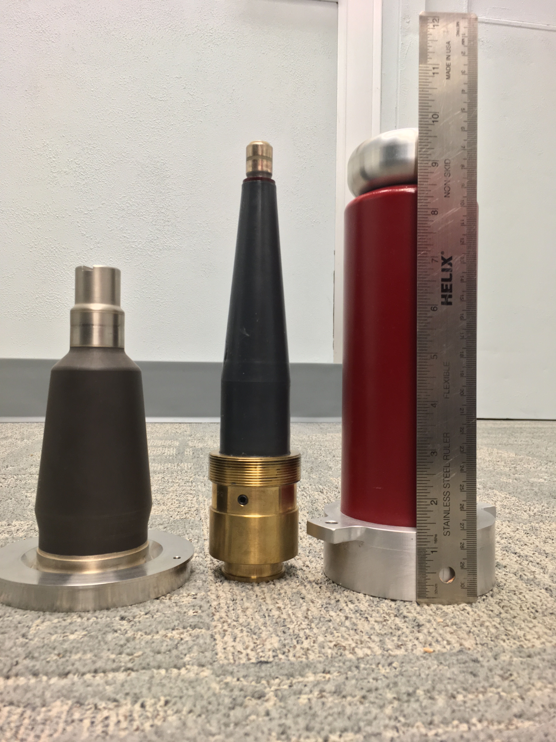
The ceramic insulators were developed in collaboration with SCT (France) in two sizes that fit commercial cable terminations
Cable terminations are standard for X-Ray commercial sources, with two size denominations
Ceramic insulators must sustain 250º C vacuum bake cycles, and have extremely low outgassing
Epoxy receptacles do not meet these requirements
30 cm
30 cm
R30
R28
Ceramic
Insulator
Cable
Termination
Epoxy
Receptacle
Ceramic
Insulator
Cable
Termination
Epoxy
Receptacle
C. Hernandez-Garcia IVESC 2023. Tsukuba, 25-29 September

Slide 14
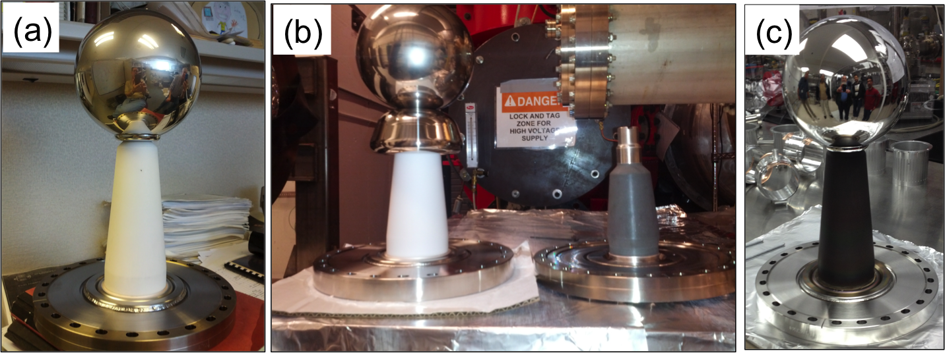
Developing a 350 kV photogun based on inverted-geometry ceramic insulator design
Research started in 2013 by testing different insulator designs with a test spherical cathode and triple-point junction screening electrode
15 cm
Doped alumina
~8x10¹¹ Ω-cm
Pure alumina
~5x10¹⁵ Ω-cm
ZrO coated alumina
~2x10¹³ Ω-cm
R30
R28
R30
R30
C. Hernandez-Garcia, M. Poelker, and J. Hansknecht, “High Voltage Studies of Inverted-geometry Ceramic Insulators for a 350kV dc Polarized Electron Gun,” IEEE Transactions on Dielectrics and Electrical Insulation, Vol. 23, No. 1; February 2016
C. Hernandez-Garcia IVESC 2023. Tsukuba, 25-29 September

Slide 15
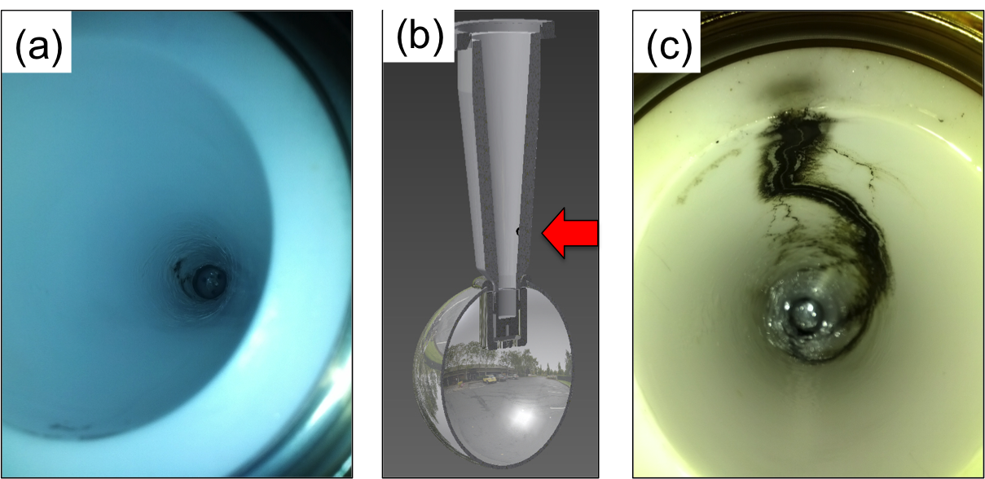
The reality of HV breakdown
The first test with R30 pure alumina ceramic suffered breakdown at ~315kV with subsequent puncture at 330kV.
A second test with a new R30 pure alumina suffered breakdown at ~315 kV.
Field emission managed by krypton-processing*, i.e., voltage was applied with ~10⁻⁵ Torr krypton added to gun chamber
* M. BastaniNejad, A. A. Elmustafa, E. Forman, J. Clark, S. Covert, J. Grames, J. Hansknecht, C. Hernandez-Garcia, M. Poelker and R. Suleiman, “Improving the performance of stainless-steel DC high voltage photoelectron gun cathode electrodes via gas conditioning with helium or krypton,” Nucl. Instr. and Meth. in Phys. Res. A, Vol. 762, pp. 135–141, 2014
C. Hernandez-Garcia IVESC 2023. Tsukuba, 25-29 September

Slide 16
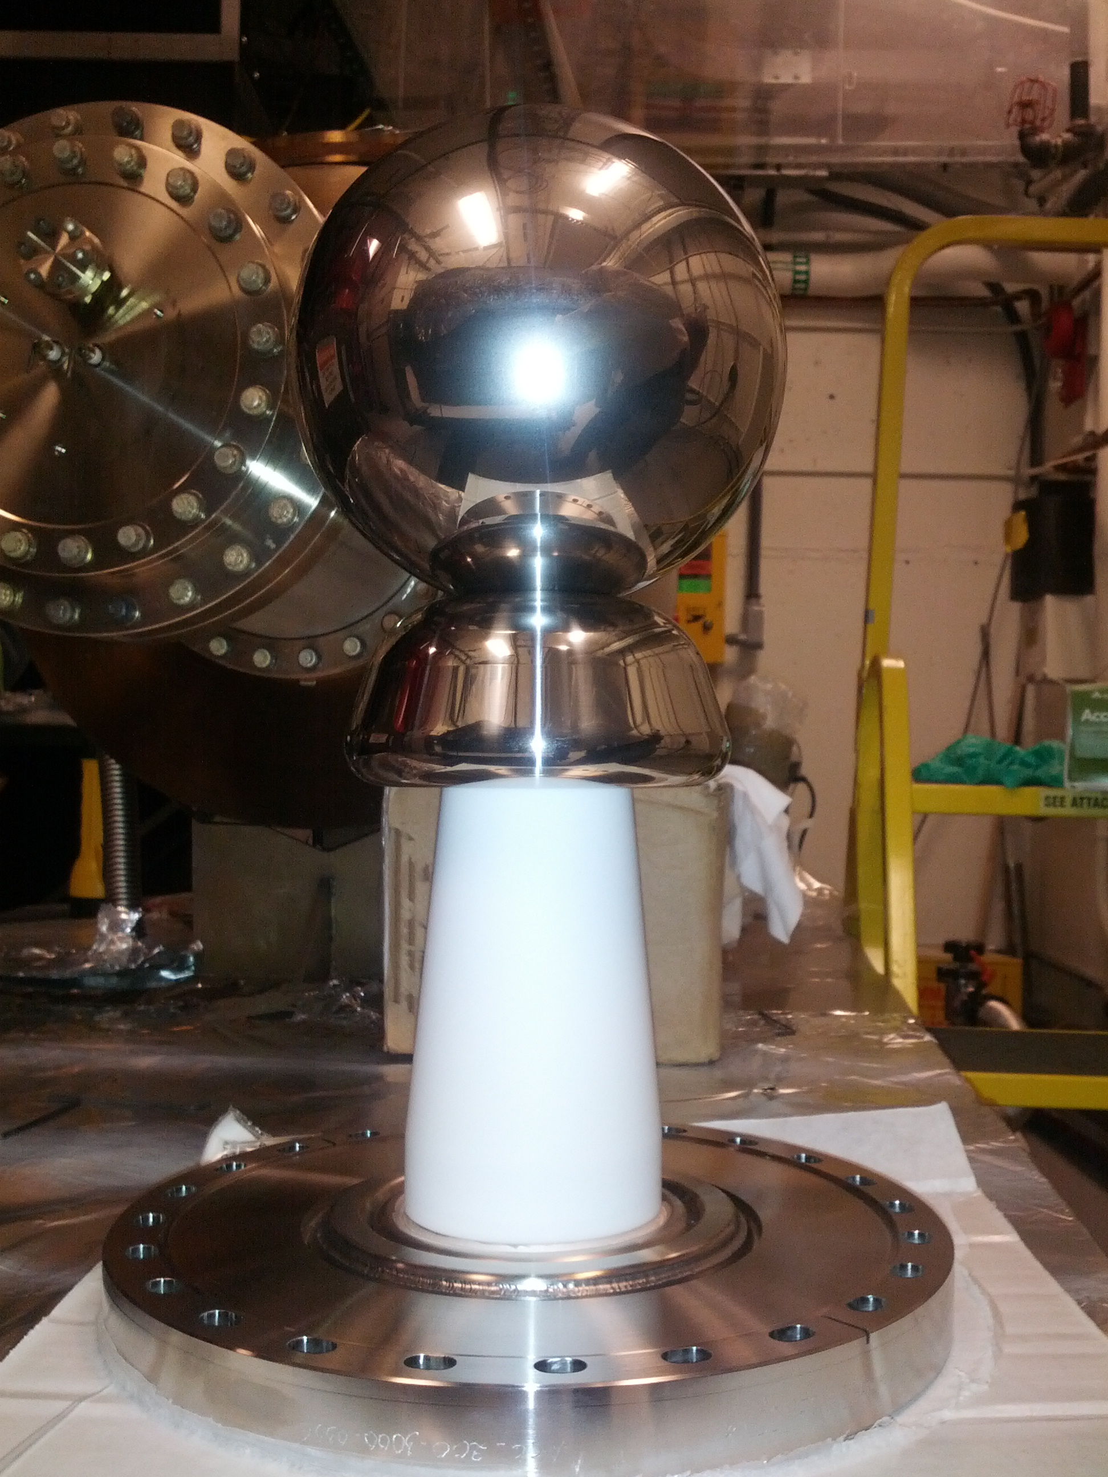
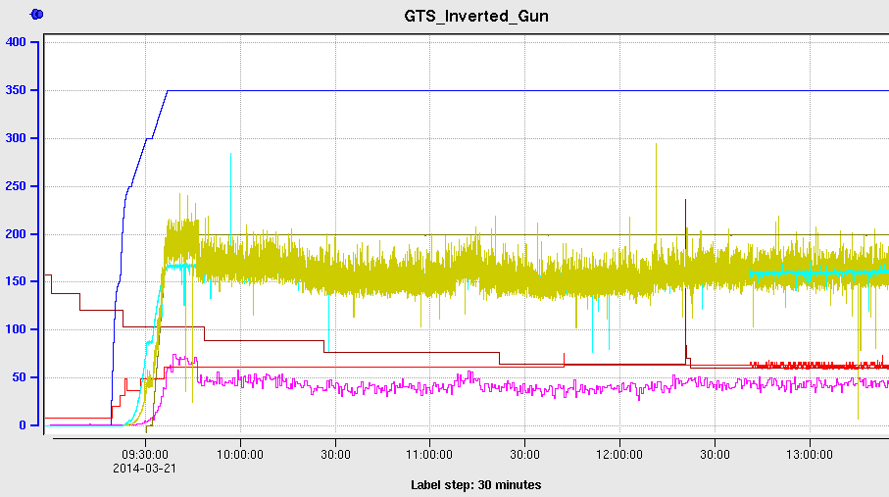
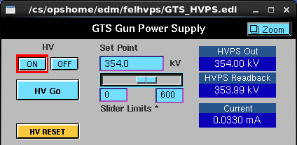
Using a triple point junction shield was key for reaching 350 kV with no breakdown using the pure alumina R30 insulator
C. Hernandez-Garcia IVESC 2023. Tsukuba, 25-29 September

Slide 17
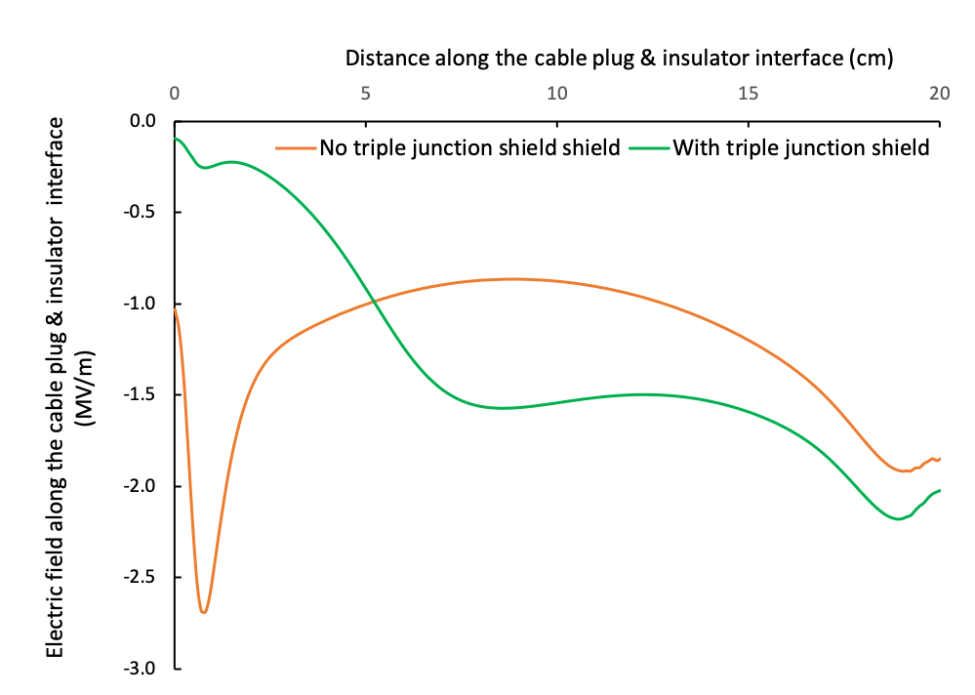
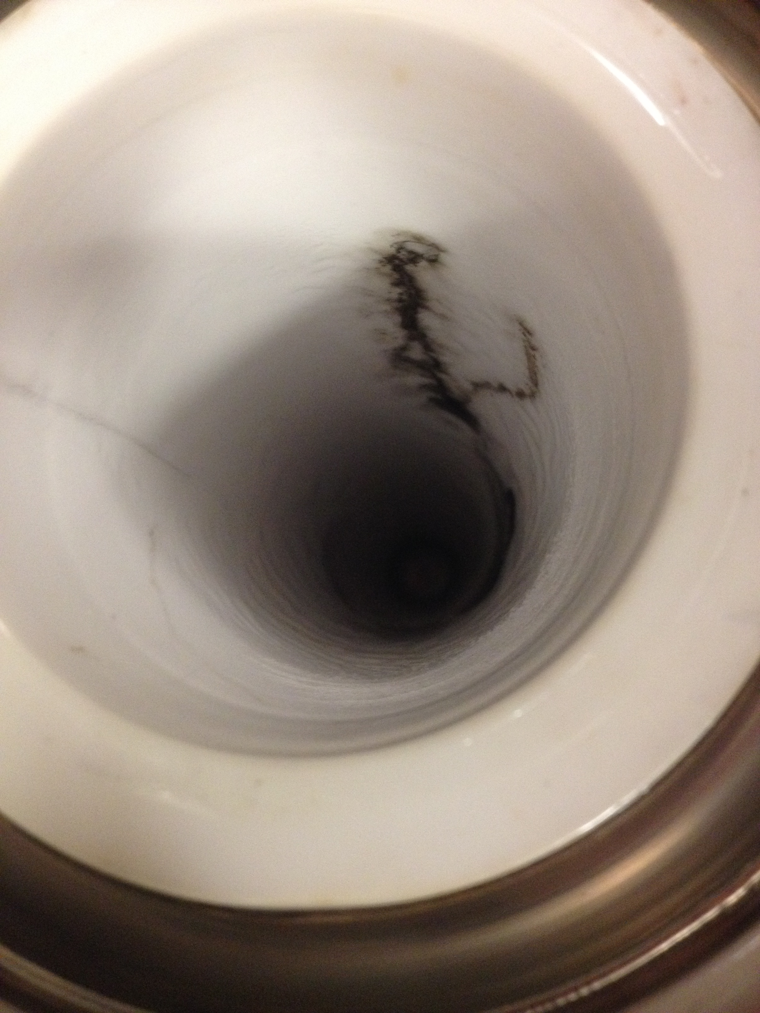
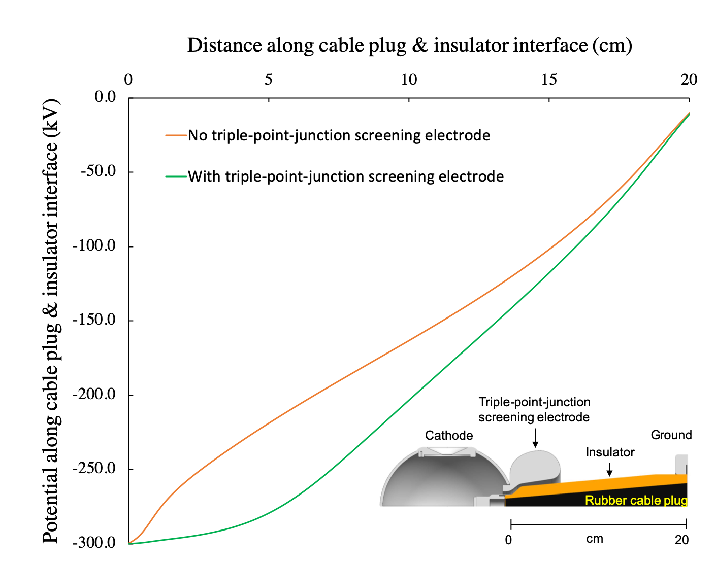
Triple junction shield optimization: vacuum, metal and insulator interface
To reduce risk of vacuum breakdown:
Minimize gradient along the insulator
Minimize gradient at triple junction
Make the potential along the insulator as linear as possible
Iterative process
To reduce risk of field emission:
Adjust electrode size and radius to maintain 10 MV/m maximum desired operating voltage
To attain a radially symmetric electric field in the anode-cathode gap (beam dynamics):
Keep anode-cathode gap away from the line of sight to insulator
CST simulations: Gabriel Palacios-Serrano, JLab

Slide 18
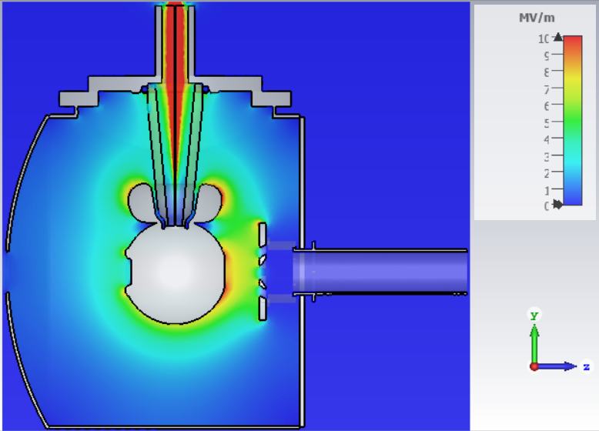
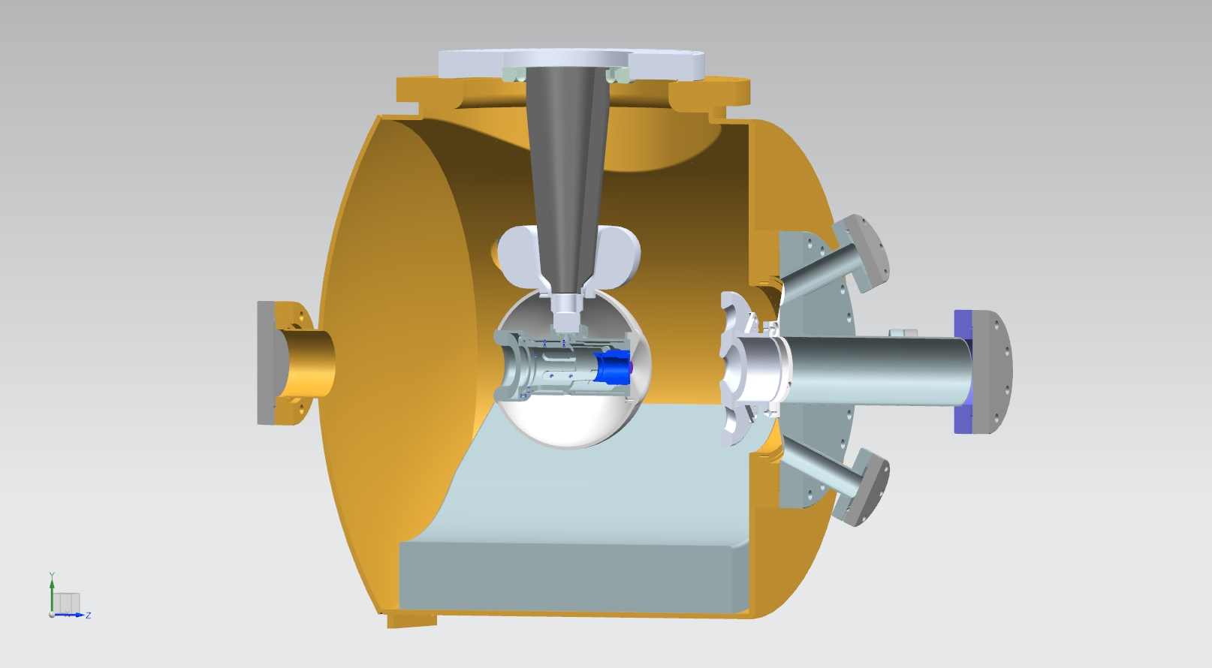
The engineering design evolves from the electrostatic optimization
Un-polarized beam gun design
(polarized beam guns use laser beam normal to photocathode)
Electron gun electrostatic fields at 350 kV
Laser beam in
Insulator
Anode
Triple point junction shield
Electron beam
Photocathode
Laser beam out
NEG array
15 cm
15 cm
C. Hernandez-Garcia IVESC 2023. Tsukuba, 25-29 September

Slide 19
The fully assembled photogun:
Was connected with a HV cable to a 500 kV, 5 mA DC SF₆ gas insulated power supply
Was conditioned to 350 kV using Kr gas
Delivered over 1000 hours of un-polarized beam operating at 300 kV with no measurable field emission
C. Hernandez-Garcia, et al., “Compact -300 kV dc inverted insulator photogun with biased anode and alkali-antimonide photocathode,” Phys. Rec. Acc. And Beams, 22, 113401 (2019)
C. Hernandez-Garcia IVESC 2023. Tsukuba, 25-29 September

Slide 20
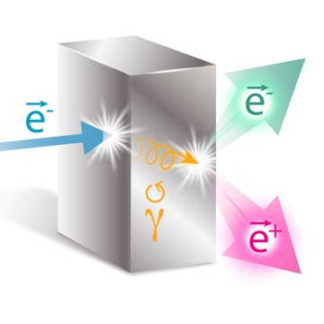
The quest for higher operating voltage inverted geometry insulators continues toward developing a reliable 500 kV inverted insulator feedthrough
Motivation: A future photogun based a 500 kV feedthrough design could then be used in a 400 kV photogun with margin for high voltage conditioning to generate high bunch charge spin-polarized electron beam as driver for generating positron beams on a target
No field emission at 400 kV!
~ 1x10⁻¹² Torr while delivering beam!
Physical Review Letters – Editor’s Suggestion and Focus Story: D. Abbott et al. (PEPPo Collaboration), “Production of Highly Polarized Positrons Using Polarized Electrons at MeV Energies” Phys. Rev. Lett. 116, 214801 – Published 27 May 2016
J. Grames et al."Status of Ce+BAF: Polarized Positron Beam Capability at CEBAF 12 GeV”, in proceedings of the 14th International Particle Accelerator Conference, Venice, Italy, May 7-12, 2023.
There is no inverted insulator feedthrough capable of 500 kV that fits commercial cable connectors
Commercial cable connectors are rated to ~ 400 kV max in SF₆, and have never been tested > 375 kV connected to inverted insulators in vacuum. But JLab is making progress!!!
C. Hernandez-Garcia IVESC 2023. Tsukuba, 25-29 September

Slide 21
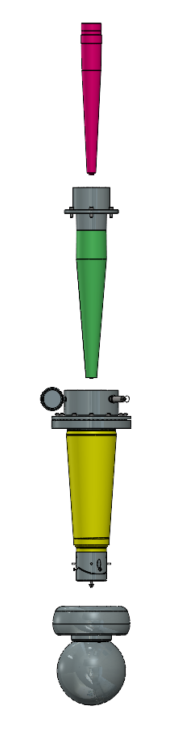
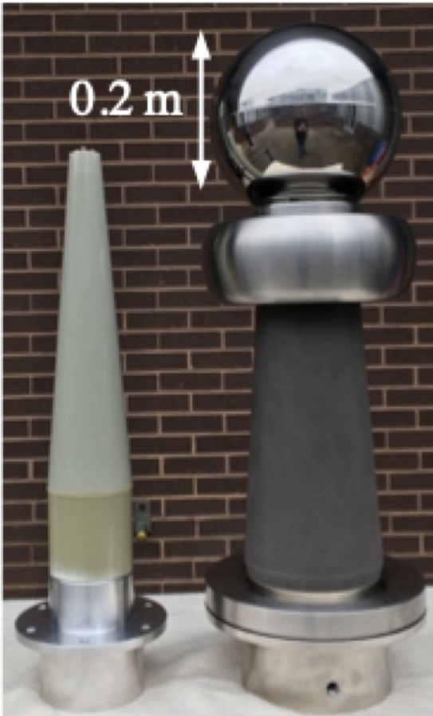
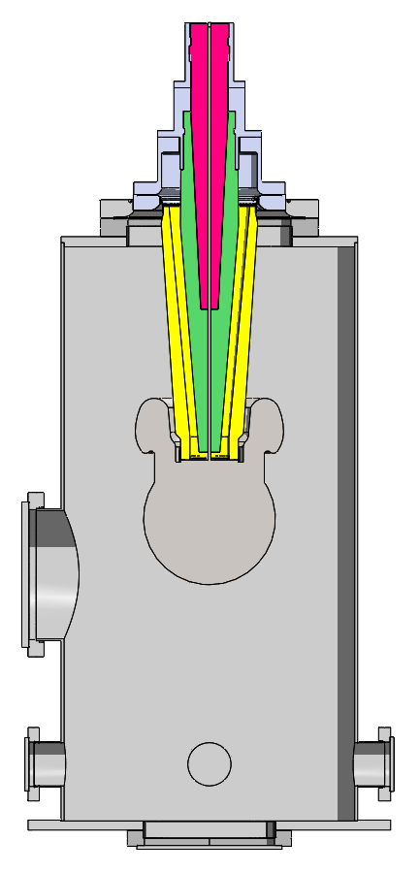
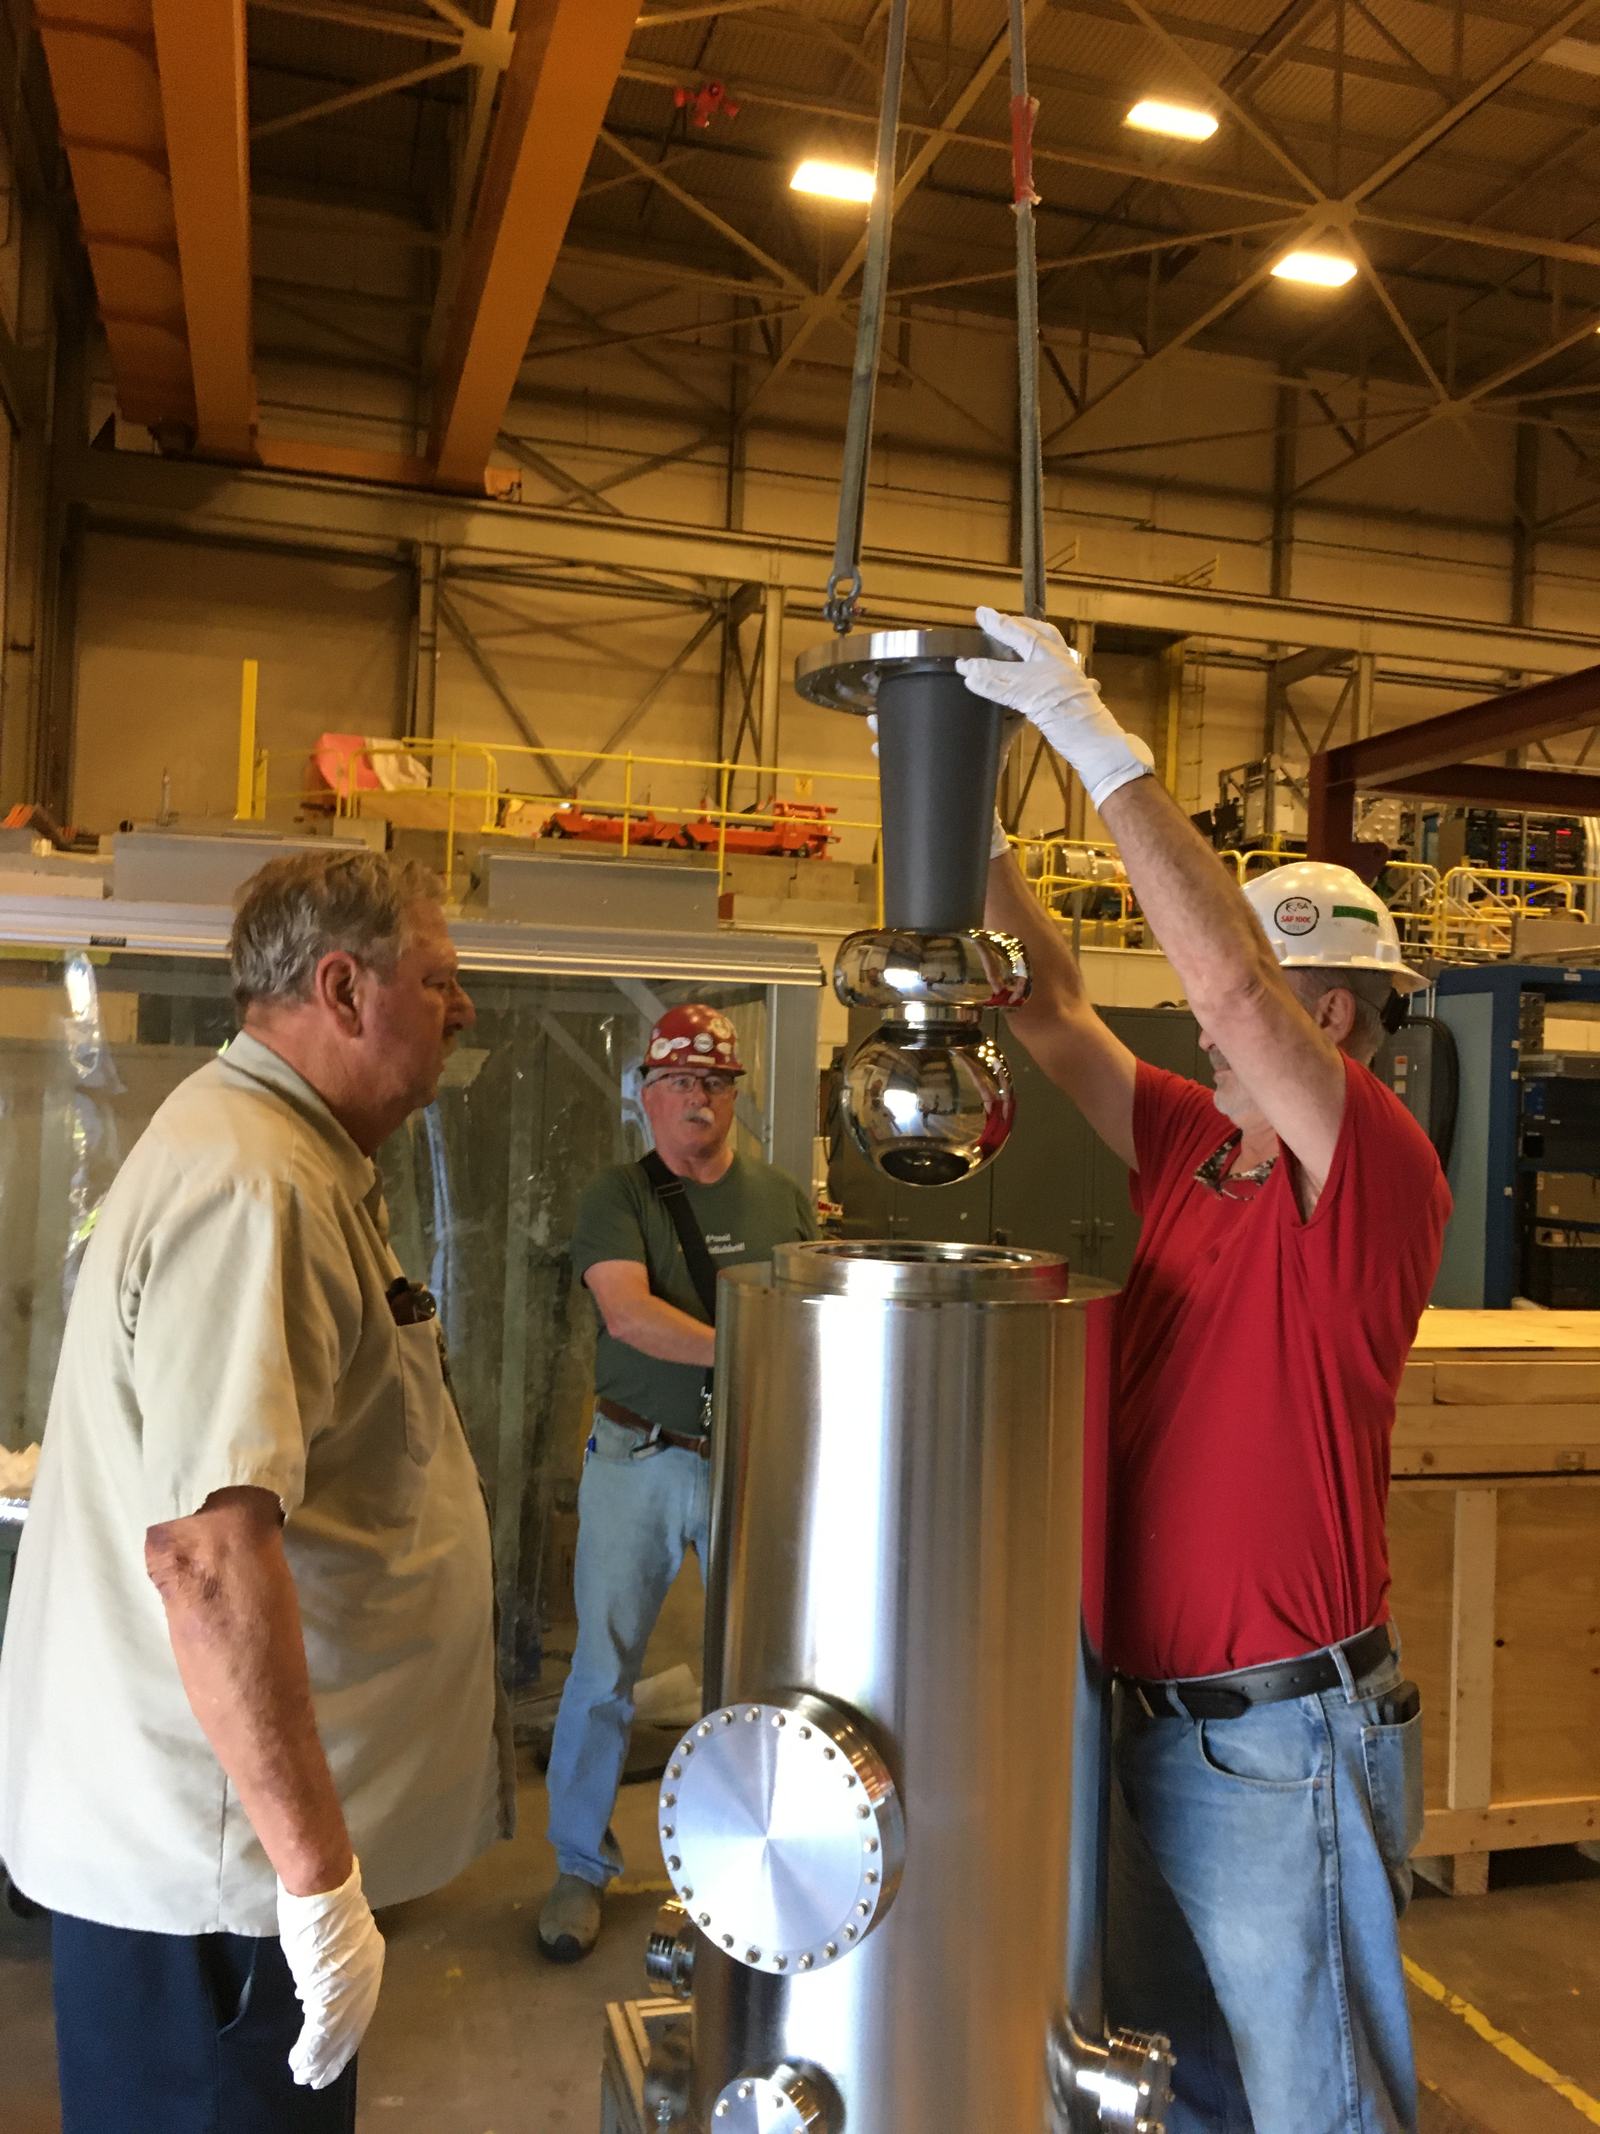
The 500 kV feedthrough concept is based on a commercial epoxy receptacle connected to a cable, but modified to fit the insulator with intervening SF₆ volume
3.7 bar SF₆ intervening volume
HV cable
Receptacle
Insulator
Cathode & shield
1.7 bar SF₆ in test chamber
C. Hernandez-Garcia IVESC 2023. Tsukuba, 25-29 September

Slide 22
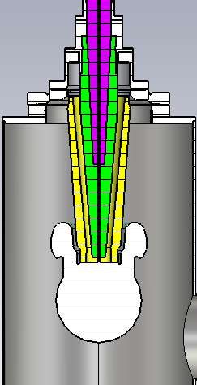


The test electrode and triple point junction shielding electrode were designed in CST EM to keep the maximum gradient at ~ 10 MV/m at 500 kV
Gradients shown at 500 kV with test chamber in vacuum conditions
Spherical test electrode with triple point junction shielding electrode
Model and simulations by G. Palacios-Serrano, JLab
C. Hernandez-Garcia IVESC 2023. Tsukuba, 25-29 September

Slide 23

Two connector options were modeled, but only the SF₆ intervening volume was implemented. The cable termination manufacturer was not willing to make the solid rubber connector
Solid rubber cable termination
Varying dielectric constants in each material component induce discontinuities in the radial electric field
The radial electric field discontinuities are more drastic in the SF₆ intervening volume design
SF₆ intervening volume termination
Simulations by G. Palacios Serrano, JLab
C. Hernandez-Garcia IVESC 2023. Tsukuba, 25-29 September

Slide 24


Electrostatic simulations: Potential and vertical electric fields along the insulator
Electrostatic potential
Electric field vertical component
The potential along the insulator is more linear with the triple point junction shielding electrode
The vertical vertical component of the electric field magnitude is significantly reduced at the triple point junction with the shielding electrode
C. Hernandez-Garcia IVESC 2023. Tsukuba, 25-29 September
Simulations by G. Palacios-Serrano

Slide 25



The assembled test apparatus was connected to a SF₆ gas insulated Glassman 500 kV DC power supply using a commercial high voltage cable
Volume between insulator and receptacle: 3.7 bar
Commercial epoxy connector
1.9 bar
1.7 bar
1.7 bar
Modified commercial epoxy connector coupled to HV cable and connected to the conical insulator
C. Hernandez-Garcia IVESC 2023. Tsukuba, 25-29 September

Slide 26

Achieved 500 kV !!!
3.7 bar SF₆ intervening volume
HVPS voltage (kV)
500 kV
HVPS current (mA)
HVPS average current (mA)
1.7 bar SF₆ in test chamber
7 hours
The HVPS was manually limited to 1 mA to protect high voltage cable terminations
Current stability limited by SF₆ pressure and suspect contamination by air in the HVPS tank
C. Hernandez-Garcia IVESC 2023. Tsukuba, 25-29 September

Slide 27

The HVPS current is more stable at 475 kV
HVPS voltage (kV)
475 kV
HVPS current (mA)
HVPS average current (mA)
22 hours
The HVPS was manually limited to 1 mA to protect high voltage cable terminations
Current stability limited by SF₆ pressure and quality in the HVPS tank
C. Hernandez-Garcia IVESC 2023. Tsukuba, 25-29 September

Slide 28
Next test will be performed under vacuum conditions in the test chamber
3.7 bar SF6 intervening volume
Is charge distribution along insulator different between SF6 and vacuum conditions in the test chamber?
1.9 bar
Vacuum
Vacuum in test chamber
C. Hernandez-Garcia IVESC 2023. Tsukuba, 25-29 September

Slide 29



The next objective is to design and fabricate a 500 kV insulator compatible with commercial high voltage cable
Finding ceramic manufacturers capable and willing to engineer and fabricate such an insulator has been very challenging!!!
Commercial
HV cable termination
Ceramic insulator yet to be designed, fabricated and tested
C. Hernandez-Garcia IVESC 2023. Tsukuba, 25-29 September

Slide 30

Conclusions, and thank you for your attention!
JLab has demonstrated custom 500 kV feedthrough with SF₆ intervening volume using commercial HV cable termination
Custom 500 kV feedthrough with SF₆ intervening volume has yet to be tested with electrode in vacuum conditions
Inverted geometry ceramic insulator photoguns have provided highly polarized electron beam at 130 keV and 0.2 mA CW for nuclear physics experiments at JLab for over a decade, and have demonstrated up to 300 keV and 5 mA CW un-polarized beam
Achieving 200-300 kV operations w/o field emission in inverted insulators photoguns is still challenging
Finding manufacturers capable and willing to engineer and fabricate custom 500 kV inverted insulator feedthroughs has been very challenging. This is slowing down progress in developing next generation of high polarization high intensity electron guns for ILC and proposed positron sources
Acknowledgement:
  IVESC2023 organizers for their kind invitation!
  DOE US-Japan HEP award, and Office of Science Funding Opportunity Award PAMS-254442
C. Hernandez-Garcia IVESC 2023. Tsukuba, 25-29 September

