Slide 1
Using a TE011 Cavity to Measure the Magnetic Momentum of a Magnetized Beam
Jiquan Guo

Slide 2
Acknowledgements
This work is a part of JLab LDRD “Generation and Characterization of Magnetized Bunched Electron Beam from DC Photogun for MEIC Cooler”, so far with contribution from (but not limited to) F. Fors, G. Hays, J. Henry, R. Li, D. Machie, M. Poelker, R. Suleiman, R. Rimmer, L. Turlington, H. Wang, S. Williams, S. Zhang

Slide 3
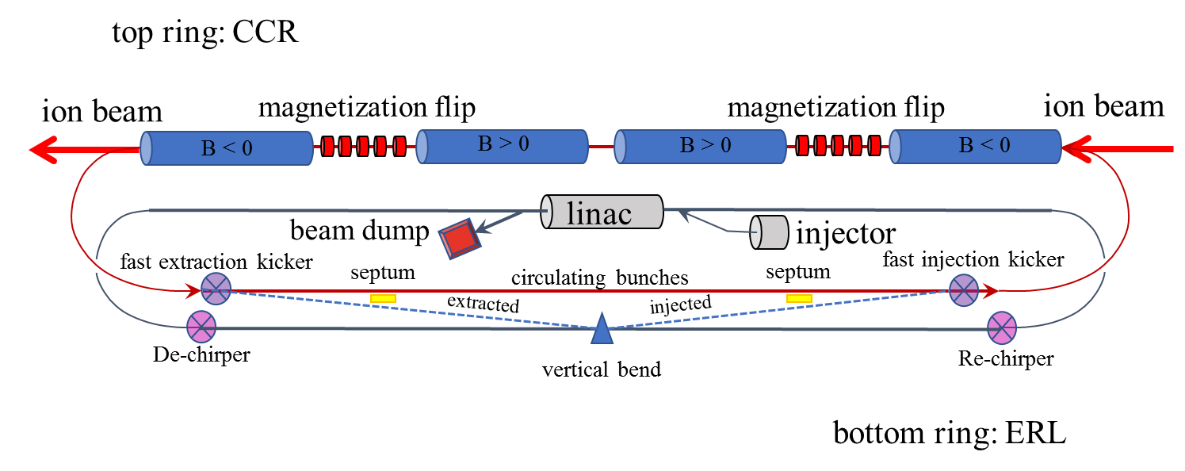
Background: JLEIC 55MeV e-Cooler
JLEIC bunched beam cooler requires a magnetized electron beam from the injector, so when the electron beam enters the cooling channel, the cooling solenoid’s edge field will cancel the rotation of the beam and the beam will be almost rotation free in the channel.
Non-invasive measurement of the magnetic momentum of such electron beam is highly desired.

Slide 4
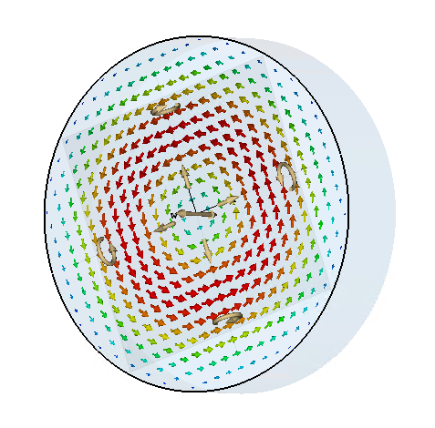
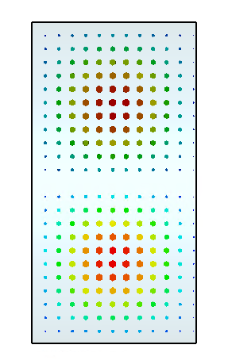
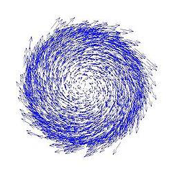
TE011 Cavity as a Possible Magnetic Momentum Monitor
Canonical angular momentum of a charged particle
$$L=γmρ^{2}\dot{φ}$$
Magnetic Momentum
$$M=L\frac{e}{2mc}$$
Typical JLab GTS beam
$$\left\langle L\right\rangle =200neV, E_{k}=300keV,$$
$I=5−10mA$
(~140mA for JLEIC CCR)
a.
b.
Transverse cross-section of a beam with longitudinal magnetic momentum
E-field of a pillbox cavity in TE011 mode
a. Transverse cross-section. b. x-z cross section with zero longitudinal field
The angular momentum and magnetic momentum of a charged particle is determined by its motion in azimuthal direction
Electric field of TE011 mode in a perfect pillbox cavity has only azimuthal component, and will be zero in other directions (radial or longitudinal).
(Perfect) TE011 mode will only have energy exchanging interaction with the azimuthal motion of a particle, making it an ideal candidate for magnetic momentum monitor.

Slide 5
Analytical Solution: Cavity w/o Beampipe
The field of TE011 mode in a pillbox cavity with radius a and length d was solved in textbooks.
$E_{φ}=\frac{{jakηH}_{0}}{{p′}_{01}}J_{0}^{′}\left(\frac{{p′}_{01}ρ}{a}\right)\cos{\frac{πz}{d}}e^{jωt}≅\frac{{jηρkH}_{0}}{2}\cos{\frac{πz}{d}}e^{jωt}$
Stored energy $U=J_{0}^{2}\left({p′}_{01}\right)\frac{εk^{2}{η^{2}a^{4}H}_{0}^{2}πd}{4∗{{p′}_{01}}^{2}}=0.162215\frac{εk^{2}{η^{2}a^{4}H}_{0}^{2}πd}{4∗{{p′}_{01}}^{2}}$
Energy exchange (normalized to H0 and charge) after the particle passing through the cavity
$\frac{{ΔE}_{k}}{H_{0}e}=\int{\frac{E_{φ}ρ}{H_{0}}dφ}=\int{\frac{E_{φ}\left(z\left(t\right),t\right)\dot{φ}\left(z\left(t\right)\right)ρ\left(z\left(t\right)\right)}{H_{0}}dt}=cosφ_{0}cos\frac{ωd}{2βc}\left(\frac{\frac{π}{d}}{{\left(\frac{π}{d}\right)}^{2}−{\left(\frac{ω}{βc}\right)}^{2}}\right)\frac{ηk\dot{φ}ρ^{2}}{βc}$, assuming the field in the cavity is weak so $\dot{φ}(z)ρ^{2}(z)$ can be considered conservative
For a passive cavity, $cosφ_{0}≈1$, and the excited voltage will be
$V=\frac{{ΔE}_{kφ}}{e}=\frac{ηk\dot{φ}ρ^{2}}{βc}H_{0}cos\frac{ωd}{2βc}\left(\frac{\frac{π}{d}}{{\left(\frac{π}{d}\right)}^{2}−{\left(\frac{ω}{βc}\right)}^{2}}\right)=\frac{ηk\dot{φ}ρ^{2}}{βc}H_{0}\frac{d}{π}×TTF$
$\frac{R}{Q}=\frac{V^{2}}{ωU}=\frac{{\left(\frac{1}{βc}cos\frac{ωd}{2βc}\left(\frac{\frac{π}{d}}{{\left(\frac{π}{d}\right)}^{2}−{\left(\frac{ω}{βc}\right)}^{2}}\right)\right)}^{2}{\left(\dot{φ}ρ^{2}\right)}^{2}}{ωJ_{0}^{2}\left(3.832\right)\frac{εa^{4}πd}{4∗{3.832}^{2}}}$
The Hamiltonian solution in cylindrical coordinates is not found yet.

Slide 6
Analytical Solution: Cavity w/o Beampipe
${P_{tot}=\frac{R}{Q}I^{2}Q_{loaded}=〈{\left(\dot{φ}ρ^{2}\right)}^{2}〉I^{2}Q_{loaded}\frac{{\left(\frac{1}{2βc}cos\frac{ωd}{2βc}\left(\frac{1}{\left(\frac{π}{d}−\frac{ω}{βc}\right)}+\frac{1}{\left(\frac{π}{d}+\frac{ω}{βc}\right)}\right)\right)}^{2}}{ωJ_{0}^{2}\left(3.832\right)\frac{εa^{4}πd}{4∗{3.832}^{2}}}}_{}$
$P_{emitted}=P_{tot}\frac{Q_{loaded}}{Q_{ext}}$ will be maximized to half of Ptot with critical coupling
The measured RF signal will be proportional to $I^{2}\left\langle {\left(M/γ\right)}^{2}\right\rangle$
An example cavity with length d=0.147m, a=0.1668m, f=1497MHz, β=0.78
For particle with y=0.01m, x’=50mrad, resulting R/Q=0.995mΩ analytically, Q0=65330 (assuming ideal Cu conductivity).
For particle with L=200neVs and I=5mA, transverse R/Q=8.8μΩ; with critical coupling, emitted power will be Pe=3.38μW (-24.7dBm)
Dimensions approximately optimized for RF power given frequency and material conductivity
Transit Time Factor (TTF) for such a cavity (d=0.73λ) is 0.387 at β=0.78
Shorter cavities have higher TTF, but will also result in larger cavity diameter, and lowers Q0 (L=0.11m r=0.295m cavity will have Q0=37471). TE011 cavity can’t be shorter than λ/2

Slide 7
Potential Challenges for TE011 Monitor
Maximizing signal
The transverse velocity of the beam is low compared to longitudinal.
The canonical angular momentum of the beam is limited by the solenoid in the source, and conserved as the beam being accelerated. The transverse motion is inversely proportional to γ.
With 300keV electron beam, the signal could be strong enough to be detected for low β particles after cavity optimization
Minimizing noise
Any remnant longitudinal impedance in TE011 mode will generate background signal in the cavity and can’t be differentiated. For GTS beam with L=200neV, longitudinal R/Q needs to be controlled to the order of 100nΩ or lower, even at 1-2cm off beam center.
Assure azimuthal symmetry and longitudinal symmetry in design (especially coupler design) and fabrication process
The cavity detects $\dot{φ}ρ^{2}$ of the beam. The signal can’t differentiate the RF signal excited by beam trajectory off cavity center vs by beam magnetization.
Align the electric center of the cavity
Careful beam orbit correction

Slide 8
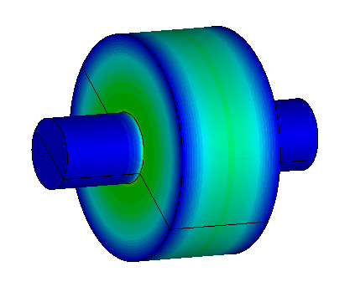
Cavity with Beampipe
Simulated the d=0.147m cavity
R/Q=0.45×10⁻³Ω for x’=50mrad, y0=0.01m, β=0.78 calculated by CST with cavity rotation. R/Q=0.438×10⁻³Ω calculated by spreadsheet with CST field data (no rotation). More than ½ reduction to the pillbox.
TTF drops to 0.23 as the fringe field extends, contributing to most of the R/Q reduction.
Q also dropped slightly to 62208
For L=200neV beam, R/Q=3.87μΩ
Tangential E-field seen by beam with x’=50mrad, y0=0.01m

Slide 9
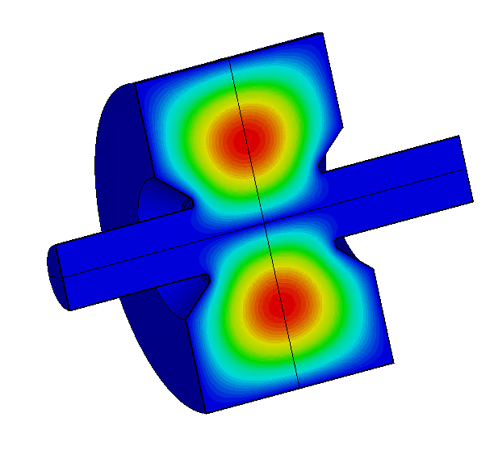
Cavity with Beampipe and nosecone
a=166.4mm, d=147mm
A nosecone reduces the effective length of the cavity, and recovers TTF to 0.4 with slightly lower Q0=60782
R/Q=1.08mΩ for x’=50mrad, y0=0.01m, β=0.78 beam (Q0= R=65.6Ω)
For L=200neV beam, R/Q=9.55μΩ, R=579mΩ
Tangential E-field seen by beam with x’=50mrad, y0=0.01m

Slide 10
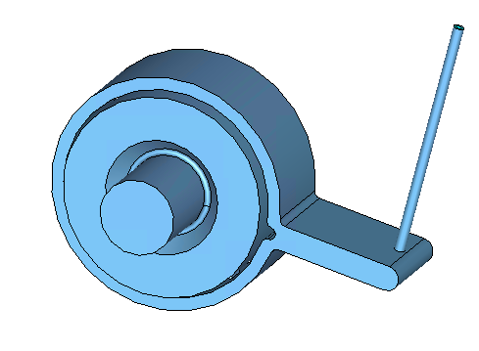
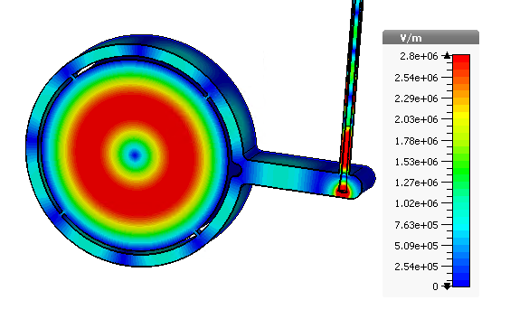
Coupler Design
E-field in the center plane
Preserves azimuthal and longitudinal symmetry to minimize longitudinal E-field
Coupler should not break the azimuthal and longitudinal symmetry to bring in longitudinal E-field.
Similar to the SLAC X-band wrap-around rect WG TE10 to circular TE01 mode launcher
4 equally (90º) spaced slots coupling to wrap-around waveguide; waveguide width adjusted so slot spacing equals λg.
Two branches of the wrap-around waveguide combine into one, matched by a lip.
A matched coax pickup will couple to instruments.
Slot size designed to be slightly overcoupled, leaving some room for conductivity loss and missmatch in the coax pickup.
Coupling to TM and most TE modes (other than TE(4N)xx) will be negligible.
For all the TE(4N)xx modes, the frequencies should avoid the excitation lines; high R/Q TM modes also need to be off excitation to avoid heating and possible instability

Slide 11
Scaling
${P_{tot}=I^{2}R=〈{\left(\dot{φ}ρ^{2}\right)}^{2}〉I^{2}Q_{loaded}\frac{{\left(\frac{1}{2βc}cos\frac{ωd}{2βc}\left(\frac{1}{\left(\frac{π}{d}−\frac{ω}{βc}\right)}+\frac{1}{\left(\frac{π}{d}+\frac{ω}{βc}\right)}\right)\right)}^{2}}{ωJ_{0}^{2}\left(3.832\right)\frac{εa^{4}πd}{4∗{3.832}^{2}}}}_{}$
With a given cavity aspect ratio, $P_{emit}∝ω^{1.5}ρ^{4}{\dot{φ}}^{2}$($Q_{l}=Q_{0}/2∝ω^{−0.5}$)
If the beam angular momentum stays constant, $P_{emit}∝ω^{1.5}$, higher frequency cavity is more sensitive
If the beam size (ρ) is limited by and scales with the cavity size but $\dot{φ}$ is constant, $P_{emit}∝ω^{−2.5}$, lower frequency cavity is preferred to allow beam with larger angular momentum.
If both the beam size (ρ) and the max beam transverse displacement within cavity length ($ρ∙∆φ=\frac{ρ\dot{φL}}{βc}$) are limited by and scale with the cavity size (focusing elements available at both ends of the cavity) , $ρ\dot{φ}$ is constant, $P_{emit}∝ω^{−0.5}$
Although we started the cavity design at 1497MHz, the fabrication is difficult with the combination of cavity size (13-14” diameter), dual layer wall, the precision required to avoid longitudinal E-field, and the wall thickness required for vacuum pressure
We re-design the cavity to 2994MHz with the same beampipe size as the 1497MHz version. The cavity size makes the vacuum pressure a non-issue, and is much easier to fabricate.

Slide 12
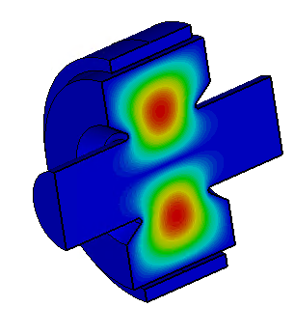
2994MHz Cavity
Due to larger beampipe to cavity size ratio, TTF drops to 0.23 even with nosecone
Q=36647, dropped slightly more than factor of $\sqrt{2}$
R/Q=1.77mΩ for x’=50mrad, y0=0.01m, β=0.78 beam (R=65.0Ω)
For L=200neV beam, R/Q=15.6μΩ, R=573mΩ
a=79mm, d=95mm
Tangential E-field seen by beam with x’=50mrad, y0=0.01m

Slide 13
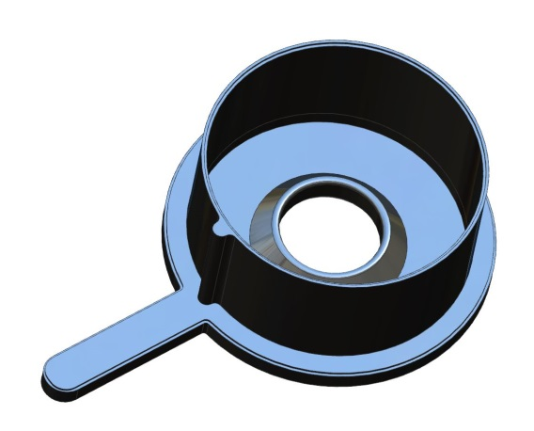
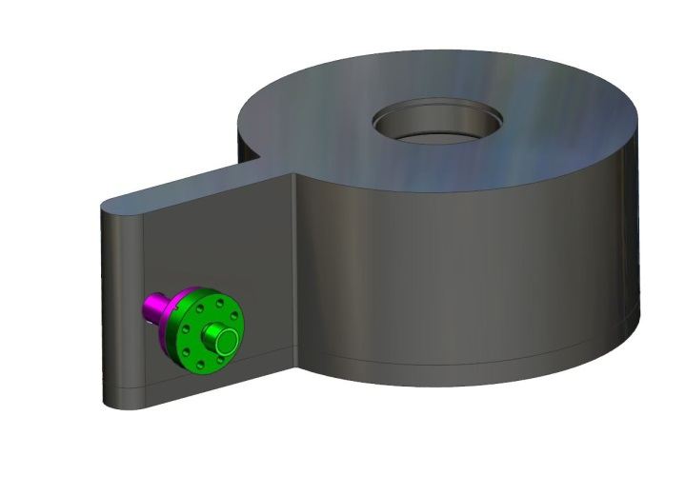
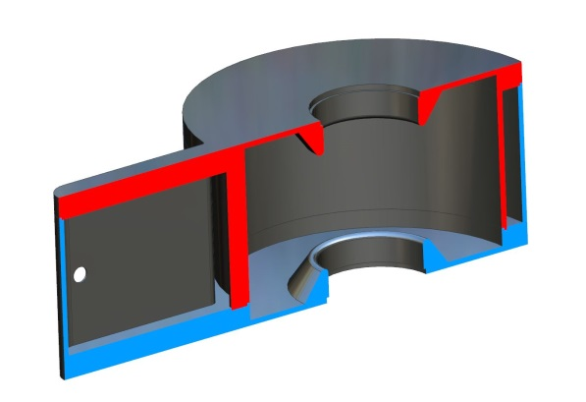
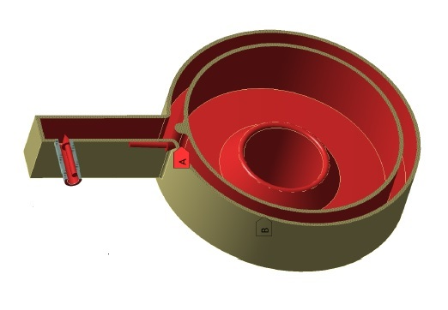
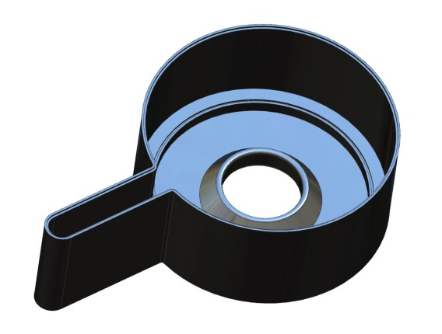
Mechanical design
Two braze joints
Two piece braze
Cut view after braze
Two cavity parts machined from OFHC copper block, one with the inner cavity wall, one with the outer wrap-around waveguide wall
SS beampipe will be brazed to the two halves
RF bench measurement can be done by clamping parts together before the final braze.
The two halves of the cavity will be brazed together.
Frequency tuning is not included in the prototype, as we can adjust the bunch rep-rate to fit the actual frequency.

Slide 14
Vacuum Pressure Analysis (F. Fors) 2994MHz cavity with 3mm wall thickness

Slide 15
Vacuum Pressure Analysis (F. Fors) 2994MHz cavity with 3mm wall thickness

Slide 16
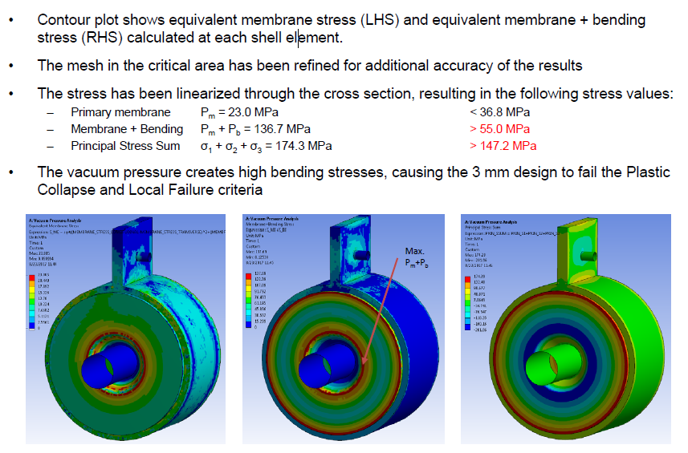
Vacuum Pressure Analysis (F. Fors) 1497MHz cavity with 3mm wall thickness - will fail

Slide 17
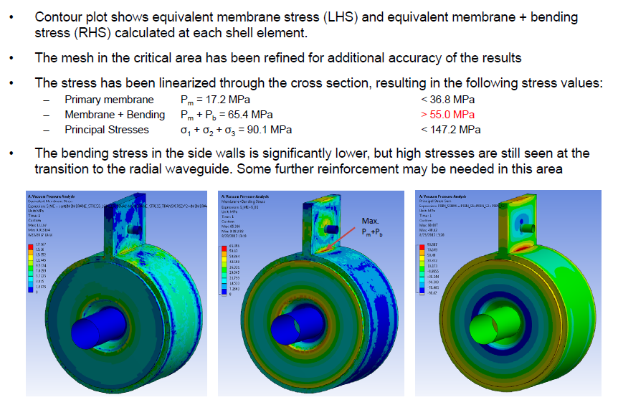
Vacuum Pressure Analysis (F. Fors) 1497MHz cavity with 5mm end-plate thickness

Slide 18
Summary
We proposed and designed a Beam Magnetic Momentum Monitor using an RF cavity in TE011 mode.
The cavity could be able to provide sufficient signal strength and S/N ratio, with the slotted coupler.
The 2994MHz cavity and coupler design can easily pass the vacuum pressure strength requirements and comparably easy to fabricate.
The design is being finalized and fabrication will start soon.

Slide 19
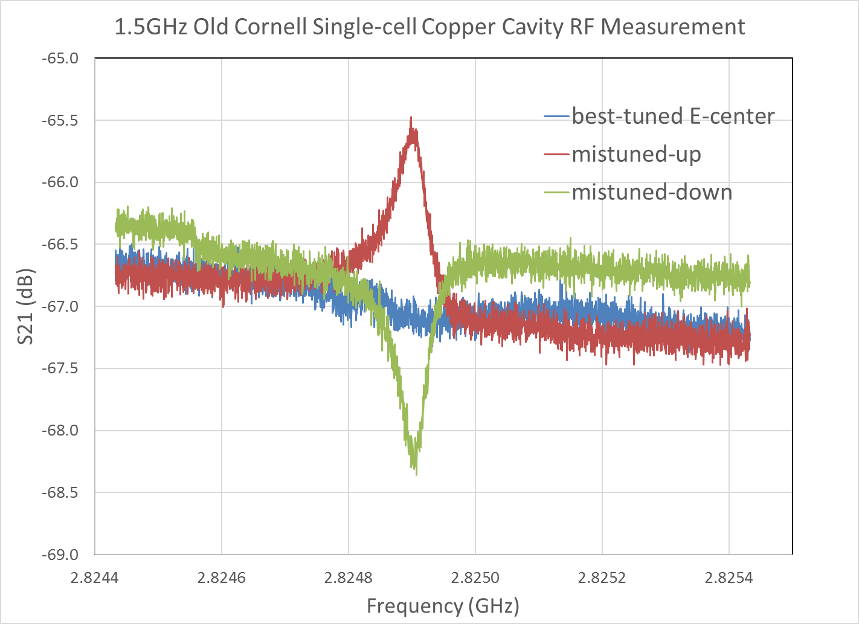
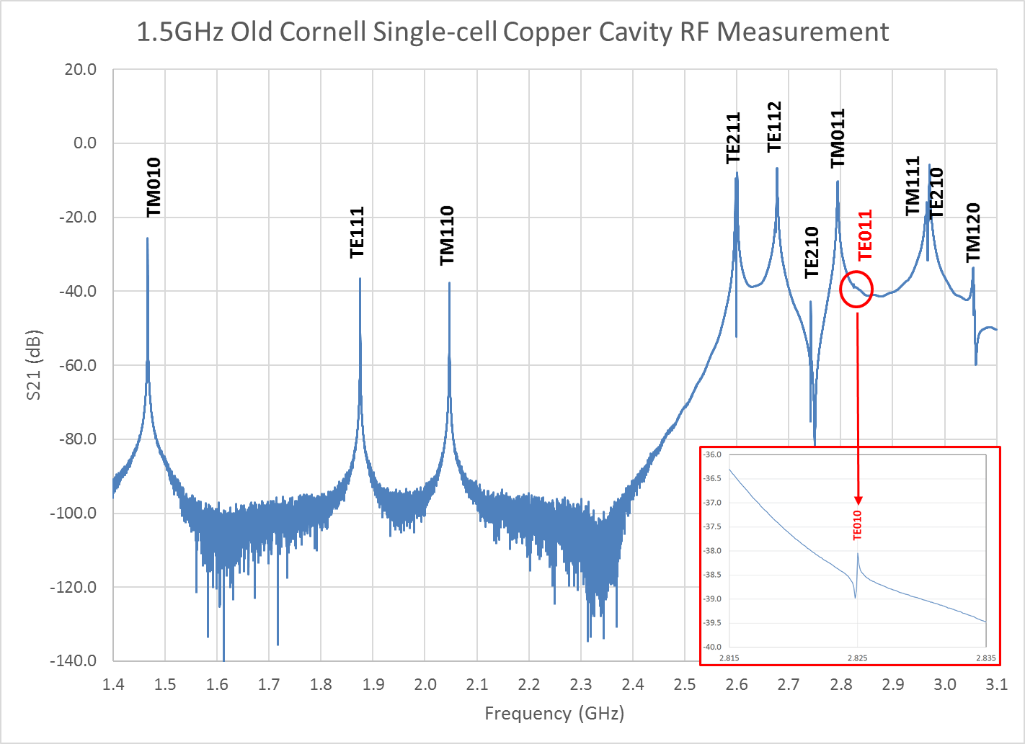
Wire-stretching to detect E-center of TE011 Cavity (H. Wang)
Fine tune E-center by rotating L shape coupling antenna,
Using it as the c-center tuner in this demo
S21 signal is more sensitive to the wire-scan angle relative to the E-center change comparing to dipole cavity due to high Q₀, less degeneration, less wire stretching in tangential direction
Can be used for the charge induced calibration when using TE011 cavity for the beam magnetization measurement
The 3-stub tuner shown has been used to tune the S21 signal by transforming line to cavity impedance for the best signal-to-noise ratio
Phase measurement could be more sensitive to the amplitude measurement, to be further demonstrated

Slide 20
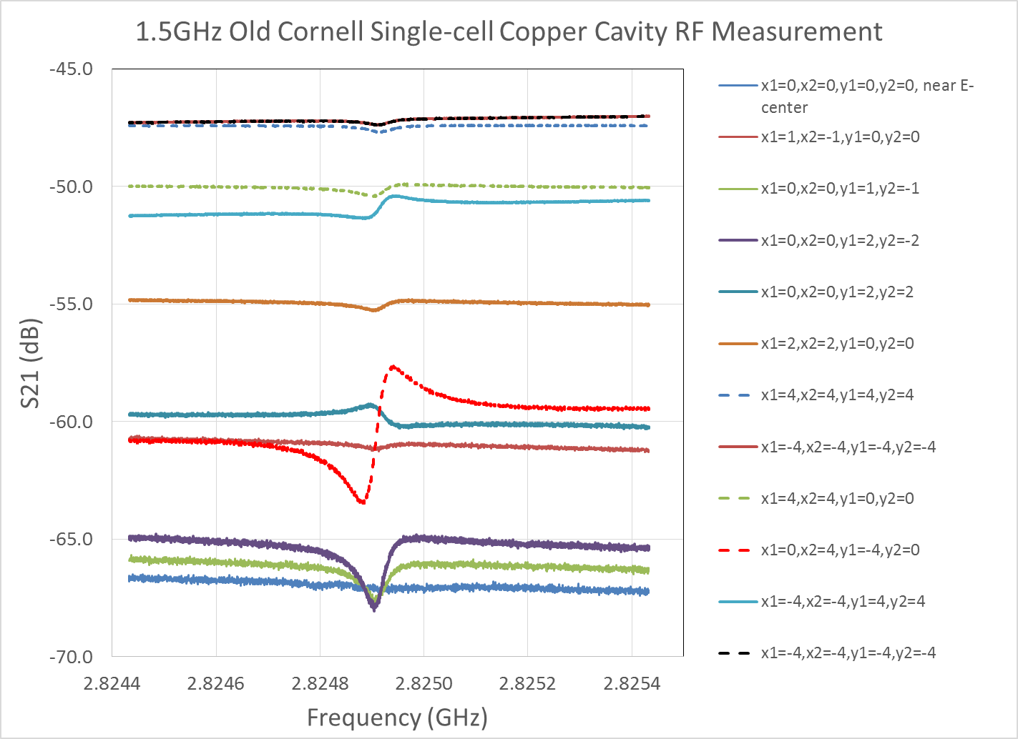
S21 Amplitude Responses to E-center Deviations
E-center has a signature of the lowest dB in baseline and a flat response through resonance
Higher offset, higher dB baseline
Larger tilting angle, larger amplitude variation crossing resonance
Phase transition crossing the E-center indicates by the resonance sweep from “dip” to “bump” with the bipolar shape from “down-to-up “ to “up-to-down” or vice versa
Large offset reduces the bipolar amplitude and increases the bias baseline
Dipole cavities have the similar response in amplitude
The E-center finding procedure can be developed by following the same clues
All offsets are in mm

Slide 21
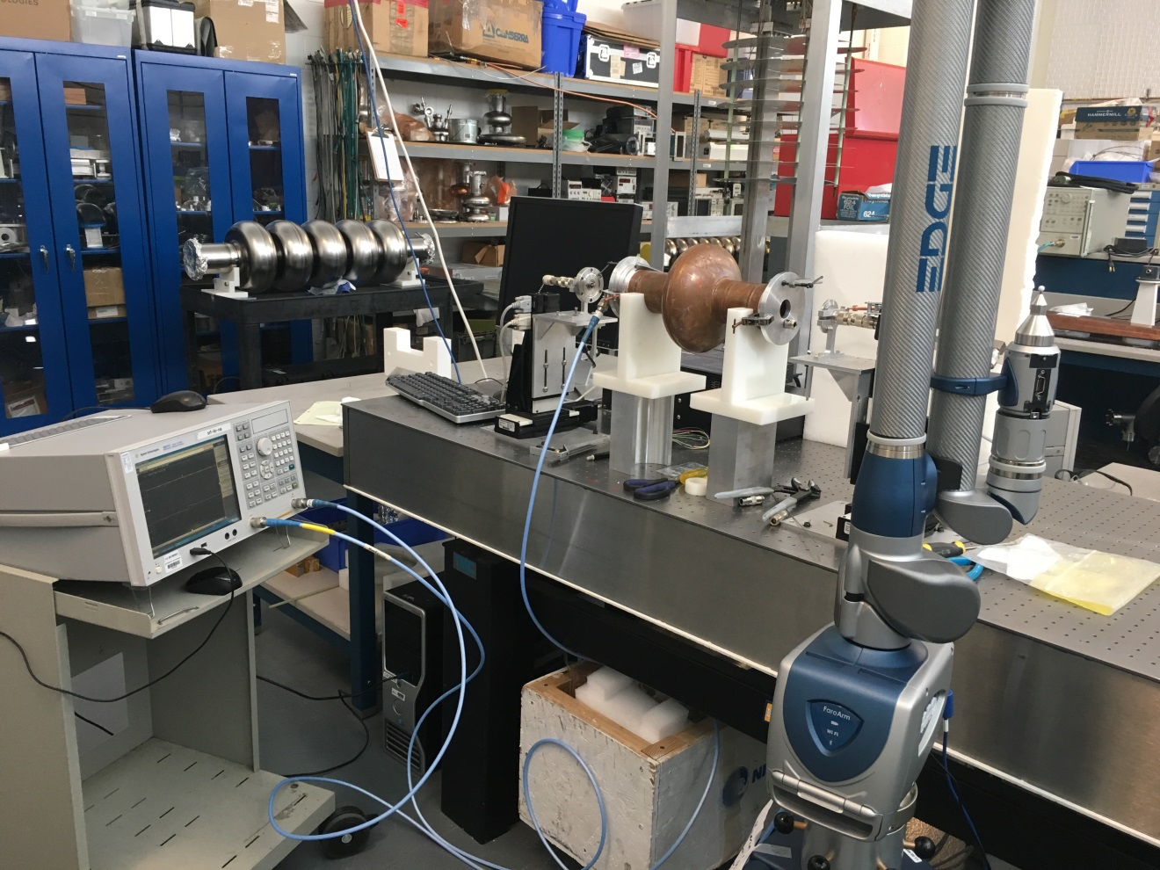
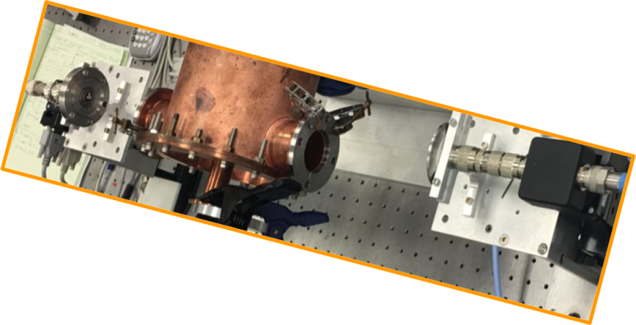
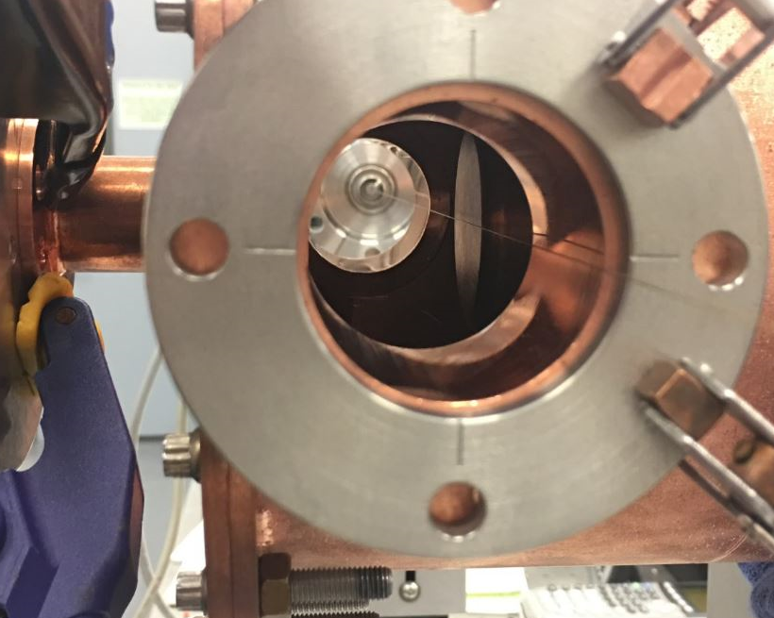
Procedure development on the bench measurement from wire-stretching to Faro laser scanning for E-center registry
Use S21 amplitude and phase signals to find E-center-line
Confirm the true E-center by moving x1=-x2 ot y1=-y2, the S21 should has a minimum change
Confirm moving x1/y1=x2/y2 and –x1/y1=-x2/y2 have the same S21 amplitude response but opposite phase bipolar flipping
Calibrate out K₂(a)
Using Faro laser scanner to located wire two end centers
Establish the E-center-line with two wire ends at feedthrough anchor points
Translate the E-center-line coordinates to beam pipe flange alignment balls
Translate alignment balls to other beam-line alignment reference
Tracking the BPM (BCM or Faraday cup) signal with alignment reference

Slide 22
Wire-Stretching Technique Principle to Detect TE011 Cavity E-center
Principle of detecting e-center of TE011 mode cavity is very similar to the deflecting/crabbing cavities, except:
E-field direction is in azimuth E_{φ} than transverse
True e-center line can not have any offset in azimuthal direction, which minimized S21 signal would tell the truth
The S21 signal sensitivity to the radial offset error depends on the dEφ/dr in the TE011 cavity, which perturbation of the coupling antenna would tell the difference
The sensitivity of radial offset has been measured on OC single-cell cavity up to 20dB/2mm.
Mathematical confirmation of such measurement technique is under development for the bench calibration of the TE011 cavity

