Slide 1
Error Analysis II
Monte Carlo Technique
02 October 2013

Slide 2
Statistical Error – No Background
Calculate the yield
Allow for statistical fluctuations:
Unfold cross section
Repeat for 1000 tries
y_{i}= gRandom->Gaus( y_{i}, Sqrt(y_{i}) )

Slide 3
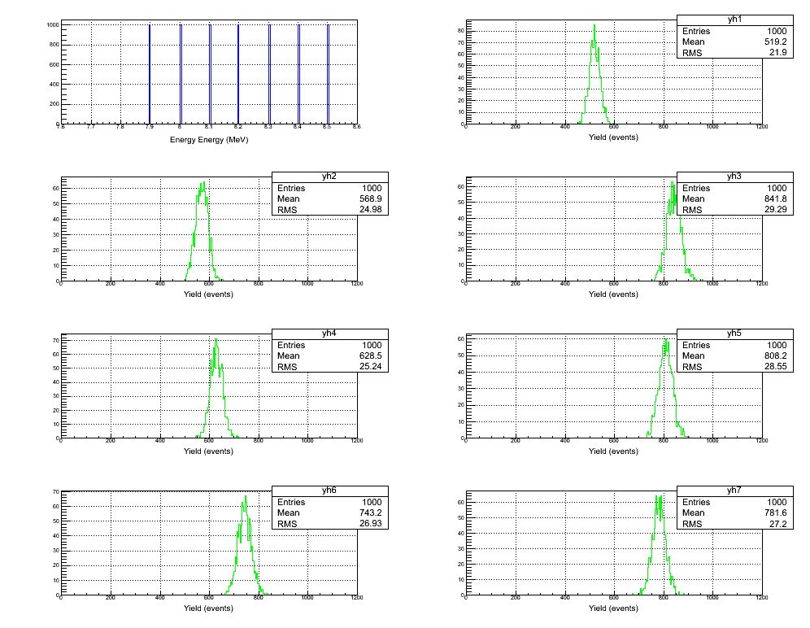

Slide 4
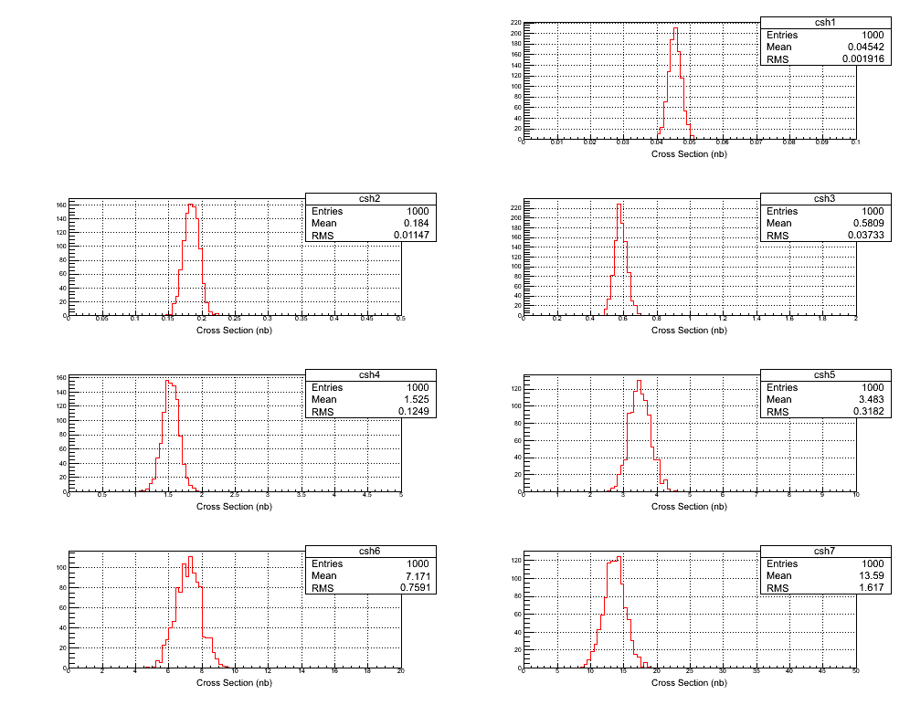

Slide 5
Electron Beam K. E. | Beam Current (µA) | Time (hour) | y_{i} | dy_{i} (no bg) | dy_{i}/y_{i} (no bg, %)
7.9 | 100 | 100 | 519 | 22 | 4.2
8.0 | 100 | 20 | 569 | 25 | 4.4
8.1 | 80 | 10 | 842 | 29 | 3.5
8.2 | 20 | 10 | 629 | 25 | 4.0
8.3 | 10 | 10 | 808 | 29 | 3.5
8.4 | 4 | 10 | 743 | 27 | 3.6
8.5 | 2 | 10 | 782 | 27 | 3.5
Electron Beam K. E. | Cross Section (nb) | Stat Error (no bg, %)
7.9 | 0.045 | 4.2
8.0 | 0.184 | 6.2
8.1 | 0.58 | 6.4
8.2 | 1.53 | 8.2
8.3 | 3.48 | 9.1
8.4 | 7.2 | 10.6
8.5 | 13.6 | 11.9

Slide 6
Statistical Error – With Background
Calculate the yield
Calculate the background yield from ¹⁸O
Allow for statistical fluctuations:
Unfold cross section
Repeat for 1000 tries
y_{i}= gRandom->Gaus( y_{i}, Sqrt(y_{i}+2y_{i} ^{bg}) )

Slide 7
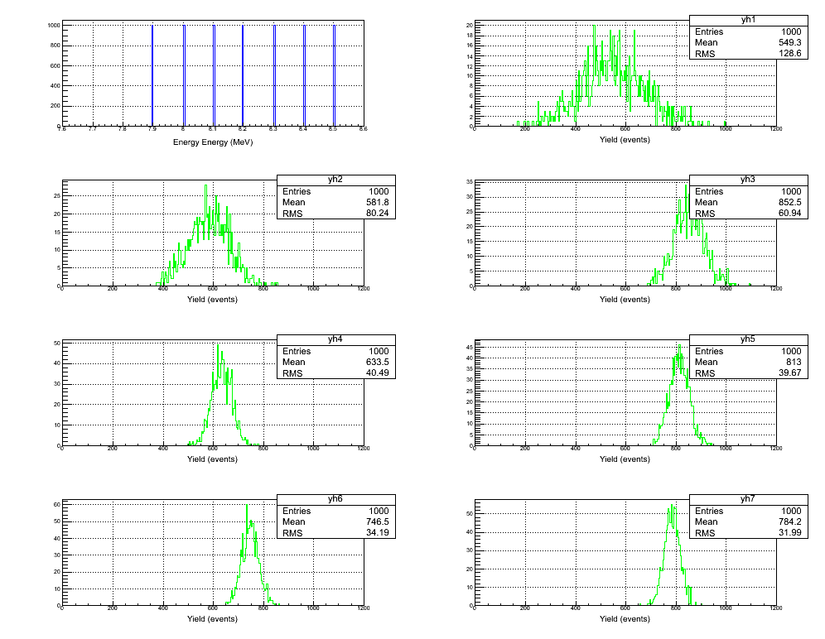

Slide 8
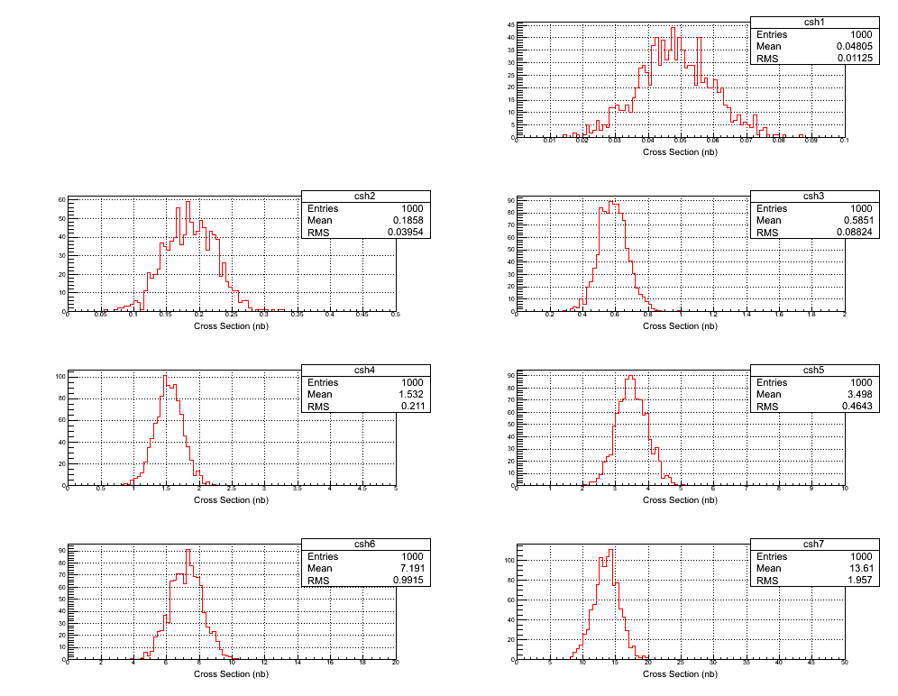

Slide 9
Electron Beam K. E. | Beam Current (µA) | Time (hour) | y_{i} | dy_{i} (with bg) | dy_{i}/y_{i} (with bg, %)
7.9 | 100 | 100 | 549 | 129 | 23.4
8.0 | 100 | 20 | 582 | 80 | 13.8
8.1 | 80 | 10 | 852 | 61 | 7.1
8.2 | 20 | 10 | 633 | 40 | 6.4
8.3 | 10 | 10 | 813 | 40 | 4.9
8.4 | 4 | 10 | 747 | 34 | 4.6
8.5 | 2 | 10 | 784 | 32 | 4.1
Electron Beam K. E. | Cross Section (nb) | Stat Error (with bg, %)
7.9 | 0.048 | 23.4
8.0 | 0.186 | 21.3
8.1 | 0.59 | 15.1
8.2 | 1.53 | 13.8
8.3 | 3.50 | 13.3
8.4 | 7.2 | 13.8
8.5 | 13.6 | 14.4

Slide 10
Systematic Error – Beam Energy
Calculate the N_{ij} for each nominal beam energy, E_{i} (since we will use GEANT4)
Allow for absolute beam energy to change by:
Calculate the yield
Unfold cross section
Repeat for 1000 tries
E_{i}= E_{i} * gRandom->Gaus(1, 0.001 )

Slide 11
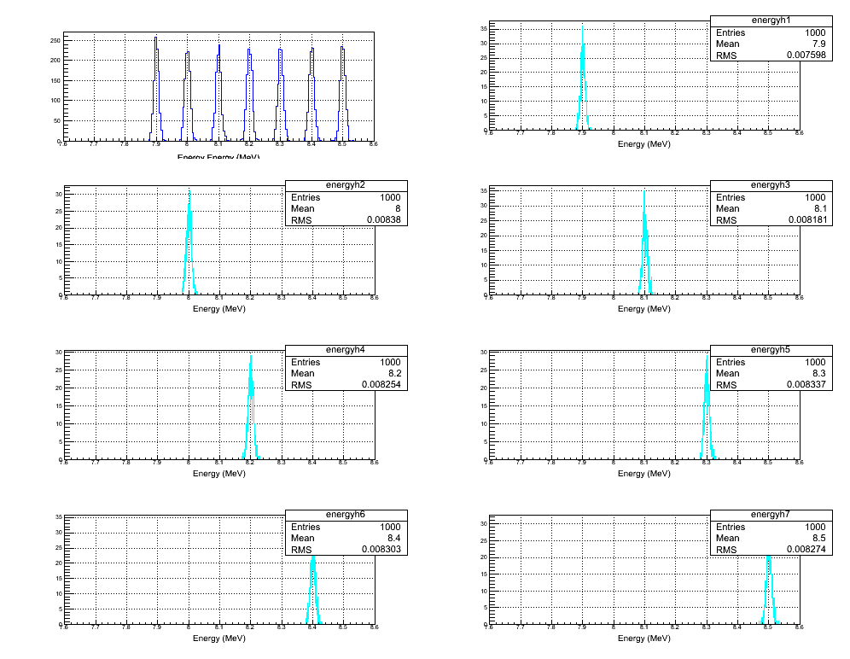

Slide 12
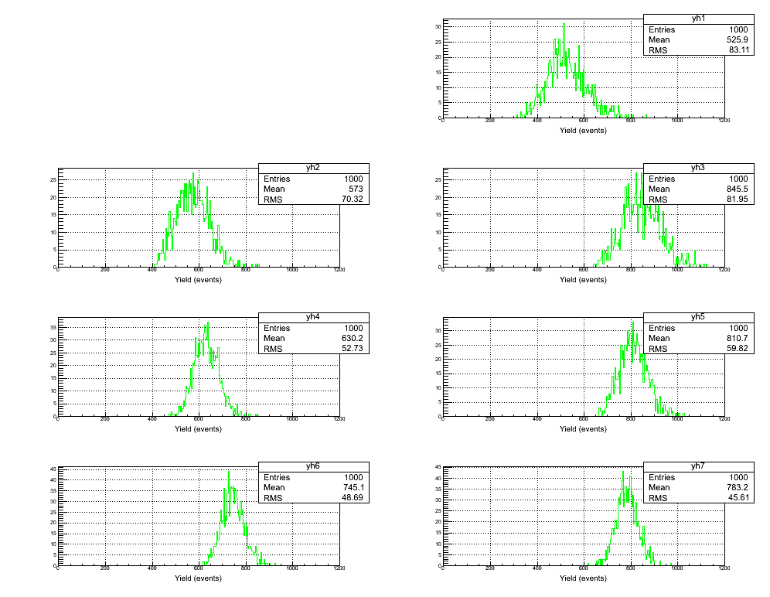

Slide 13
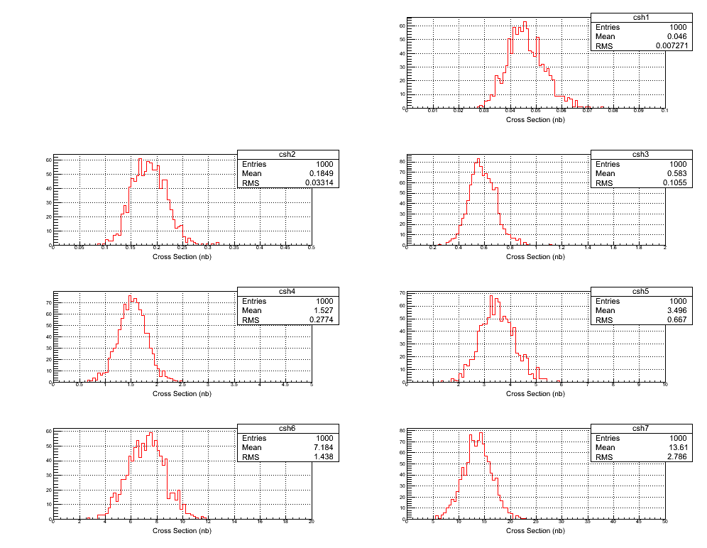

Slide 14
Electron Beam K. E. | Beam Current (µA) | Time (hour) | y_{i} | dy_{i}/y_{i} (%)
7.9 | 100 | 100 | 526 | 15.8
8.0 | 100 | 20 | 573 | 12.3
8.1 | 80 | 10 | 846 | 9.7
8.2 | 20 | 10 | 630 | 8.4
8.3 | 10 | 10 | 811 | 7.4
8.4 | 4 | 10 | 745 | 6.5
8.5 | 2 | 10 | 783 | 5.8
Electron Beam K. E. | Cross Section (nb) | Sys Error (Energy, %)
7.9 | 0.046 | 15.8
8.0 | 0.185 | 17.9
8.1 | 0.58 | 18.1
8.2 | 1.53 | 18.2
8.3 | 3.49 | 19.1
8.4 | 7.2 | 20.0
8.5 | 13.6 | 20.5

Slide 15
Systematic Error – Relative Beam Energy
Calculate the N_{ij} for each nominal beam energy, E_{i} (since we will use GEANT4)
Allow for absolute beam energy 7.9 MeV to change by:
Higher energies has zero relative error,
Calculate the yield
Unfold cross section
Repeat for 1000 tries
E₁= 7.9 * gRandom->Gaus(1, 0.001 )
E_{i}= E₁ + i*Δ
Now, we have to worry about beam stability (RF stability). Need injector FFB system to maintain relative beam stability

Slide 16
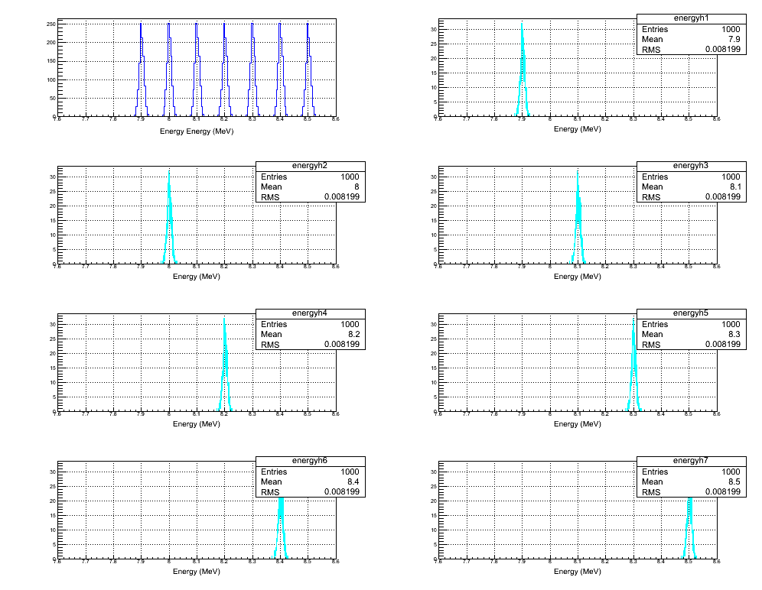

Slide 17
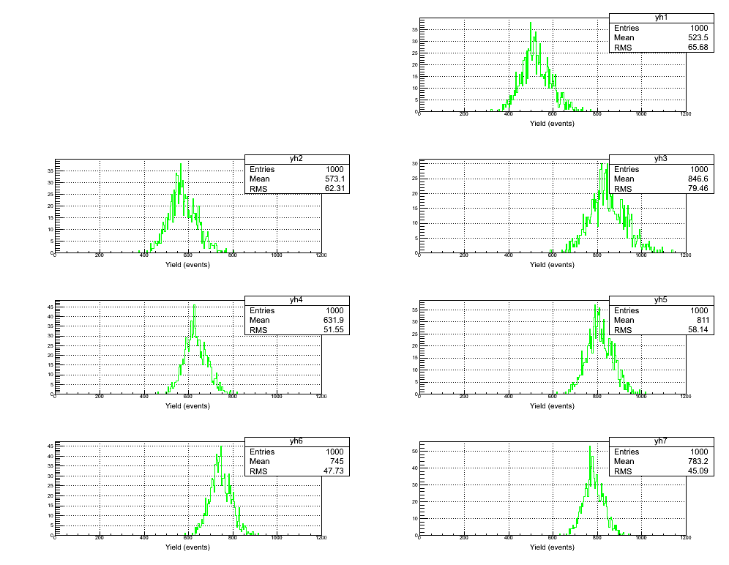

Slide 18
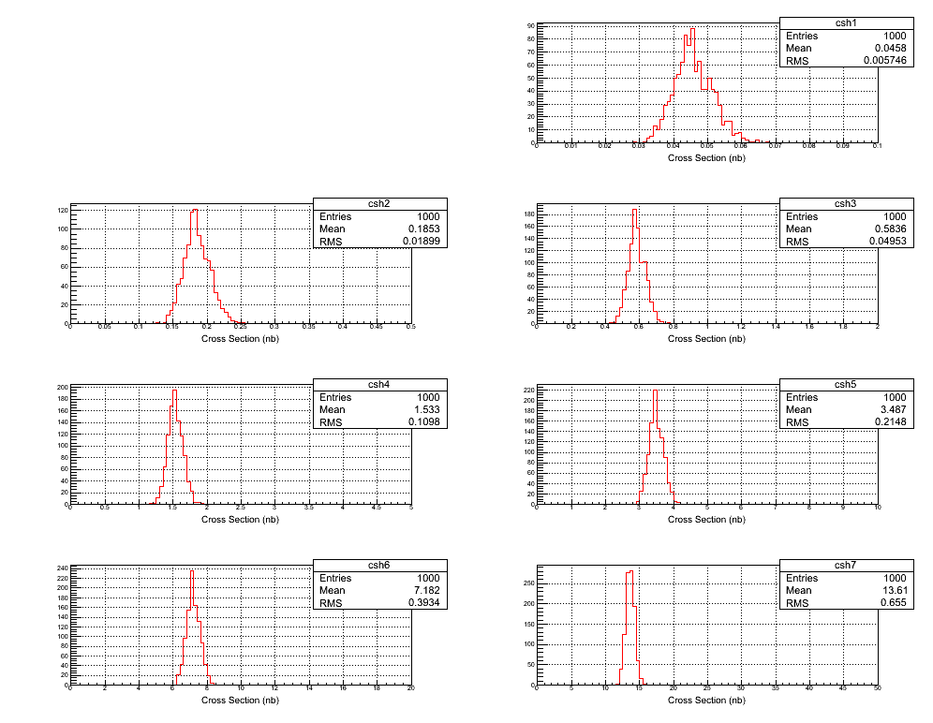

Slide 19
Electron Beam K. E. | Beam Current (µA) | Time (hour) | y_{i} | dy_{i}/y_{i} (%)
7.9 | 100 | 100 | 524 | 12.5
8.0 | 100 | 20 | 573 | 10.9
8.1 | 80 | 10 | 846 | 9.4
8.2 | 20 | 10 | 632 | 8.2
8.3 | 10 | 10 | 811 | 7.2
8.4 | 4 | 10 | 745 | 6.4
8.5 | 2 | 10 | 783 | 5.8
Electron Beam K. E. | Cross Section (nb) | Sys Error (Energy, %)
7.9 | 0.046 | 12.5
8.0 | 0.185 | 10.2
8.1 | 0.58 | 8.5
8.2 | 1.53 | 7.2
8.3 | 3.49 | 6.2
8.4 | 7.2 | 5.5
8.5 | 13.6 | 4.8

