Slide 1
First Half of the Experiment
Energy Measured (MeV) | Superheat Pressure (psi) | Superheat Temperature (°C) | Beam Current (μA)
7.7 | 325 | -10 | 0.4
8 | 325 | -10 | 0.4
8 | 325 | -10 | 0.04
8 | 310 | -10 | 0.035

Slide 2
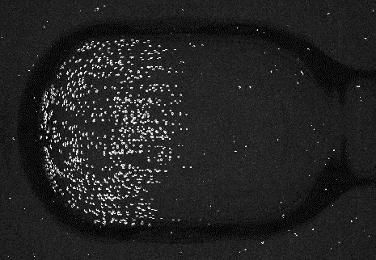
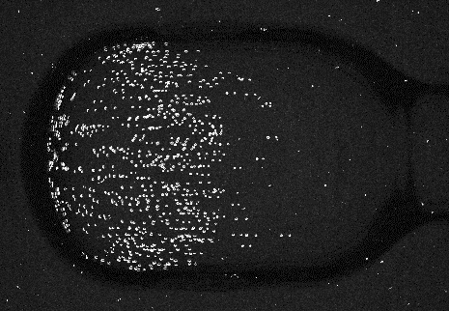
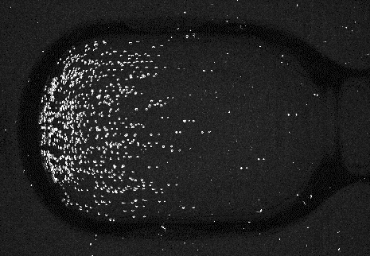
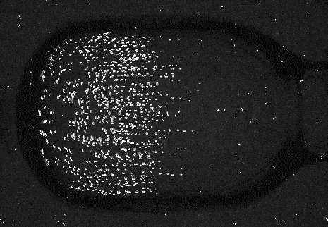
Beam Position Test
Original Position
Left by 4 mm
Right by 5 mm
Down by 6 mm
Up by 4 mm

Slide 3
Second Half of The Experiment
Energy Measured (MeV) | Superheat Pressure (psi) | Superheat Temperature (°C) | Beam Current (μA)
8 | 325 | -10 | 0.4
8.2 | 325 | -10 | 0.4
6.5 | 325 | -10 | 1
4 | 325 | -10 | 10

