Slide 1


Positron Target Design and Fatigue Studies
e⁺ Production by Polarized e‒ Beam
Radiation Damage and Heat Load in Target
Design of High Power Target
Target Material Tests with e‒ Beam and Laser
A. Ushakov (Ce⁺BAF WG)
This project has received funding from the European Union’s Horizon 2020 research and innovation program under grant agreement STRONG-2020 No 824093

Slide 2
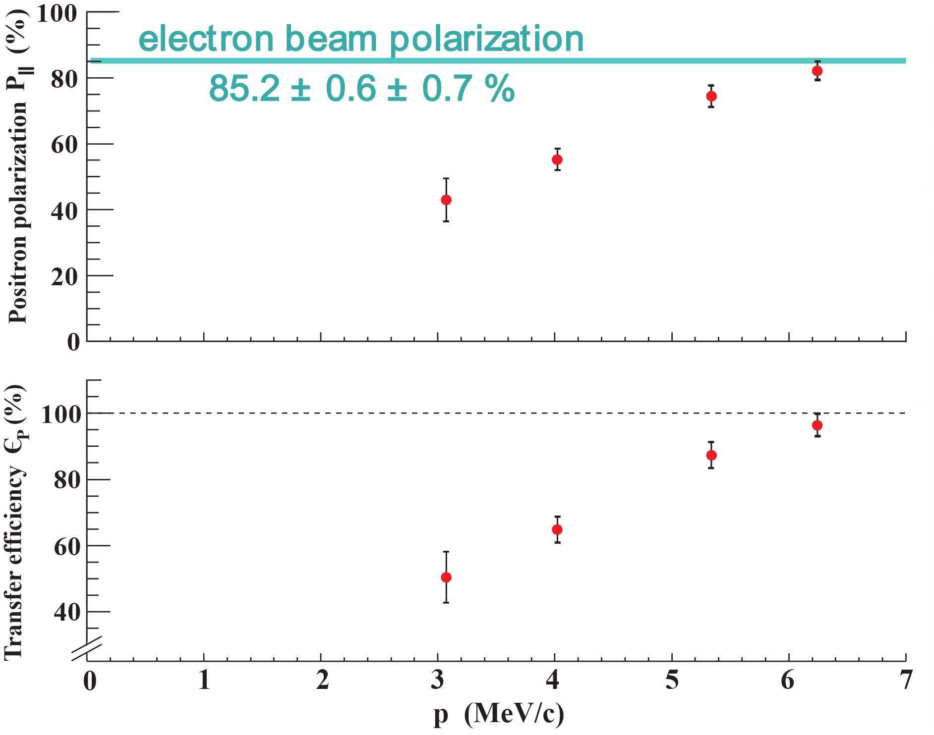
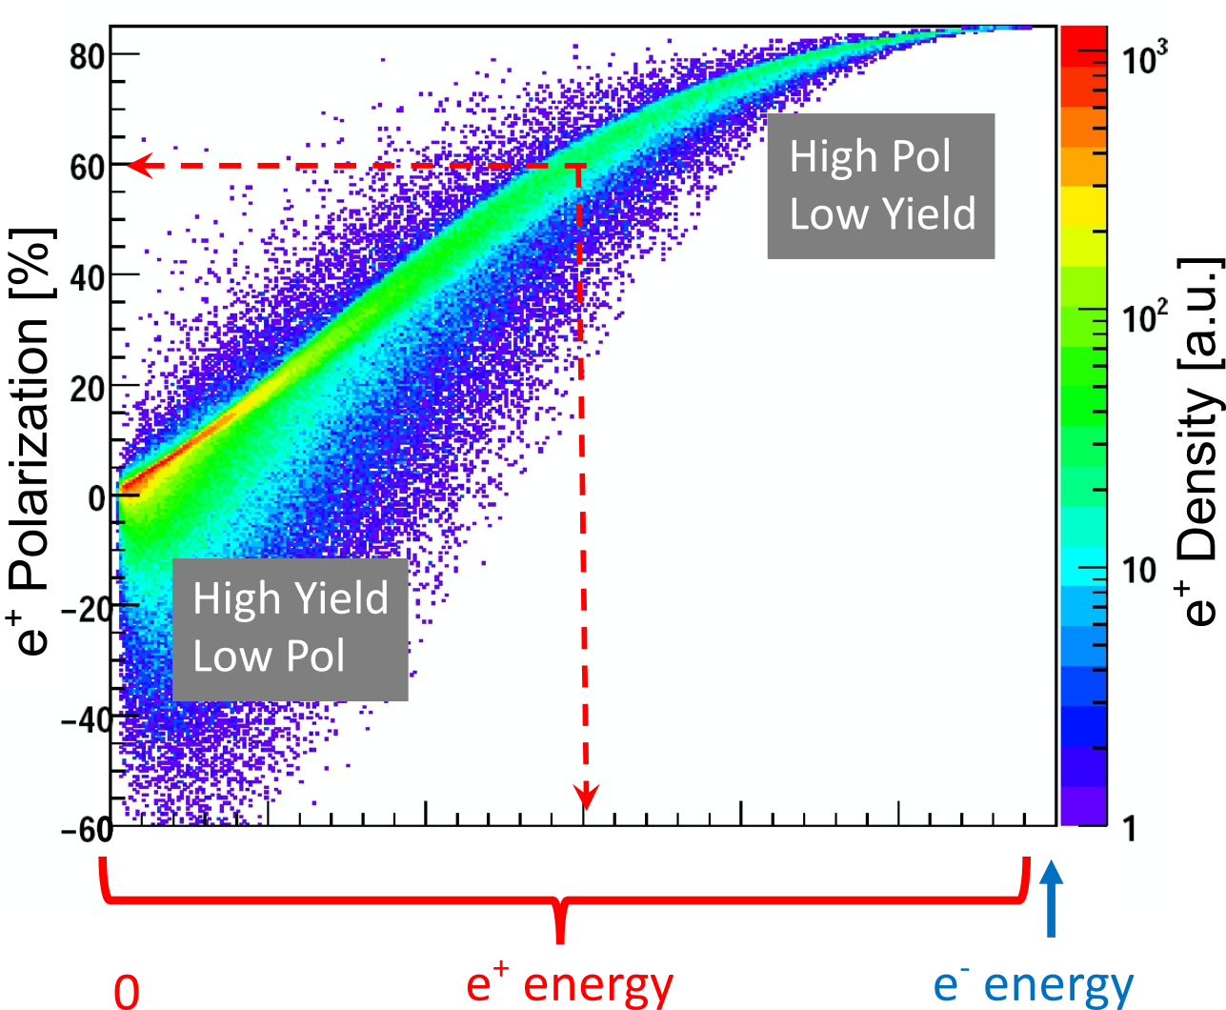
Polarization Transfer from e‒ to e⁺ in a Single High-Z Target
PEPPo (Polarized Electrons for Polarized Positrons) experiment demonstrated the feasibility of using bremsstrahlung of MeV Polarized Electrons for production of Positrons with a high level of polarization.
e⁺ Polarization vs Energy
1 μA @ 8.2 MeV e‒, 1 mm W target
(PEPPo Collaboration) D. Abbott et al. Phys. Rev. Lett. 116 (2016) 214801

Slide 3
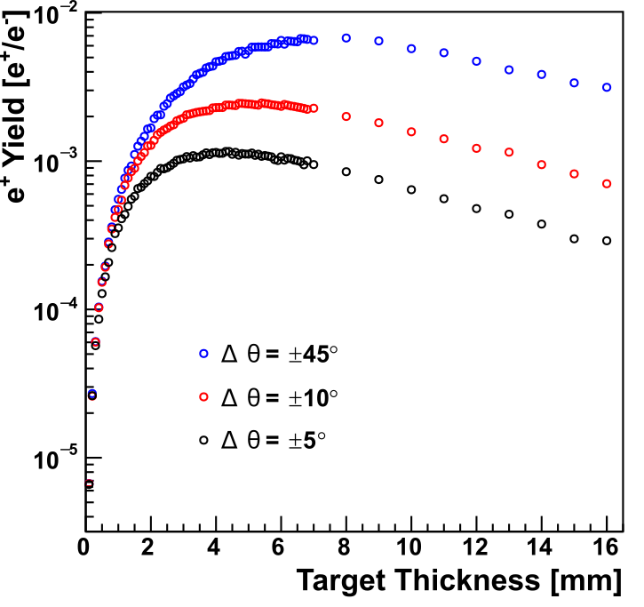
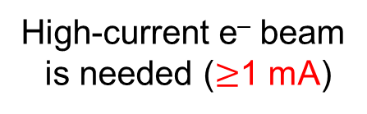
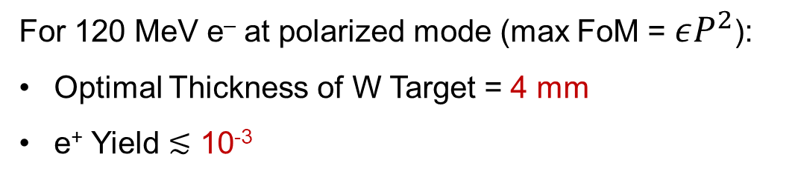
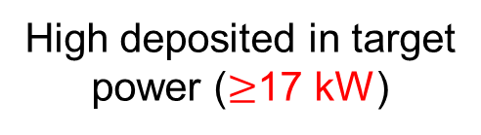
Optimal Target Thickness and e⁺ Yield
Yield vs Target Thickness
For 120 MeV e‒ at polarized mode (max FoM = $εP^{2}$):
Optimal Thickness of W Target = 4 mm
e⁺ Yield $≲$ 10⁻³
Δp_{e+}/p_{e+} = ±0.05
High-current e‒ beam
is needed ($≥$1 mA)
High deposited in target
power ($≥$17 kW)
Tungsten

Slide 4
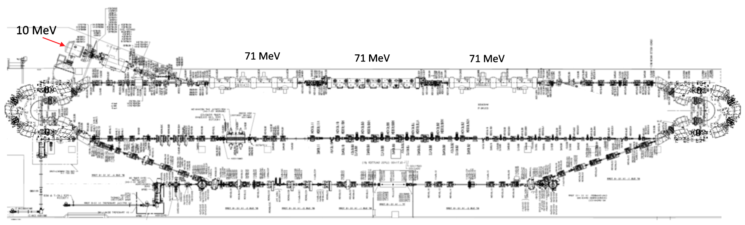
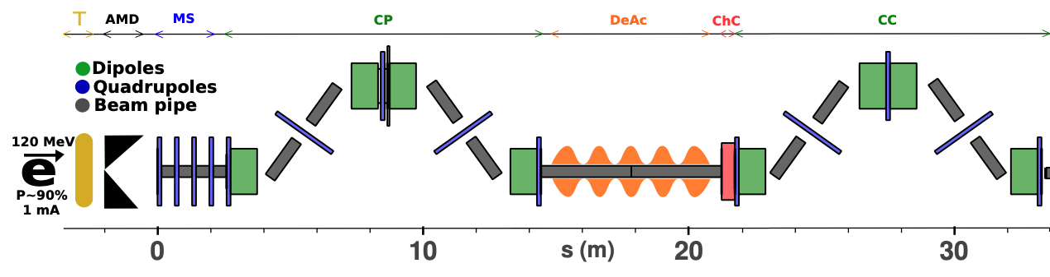
LERF Polarized Positron Injector Concept
Focus is developing a technical report on a polarized e⁺ injector at LERF
  High current polarized electron injector (10 MeV/10 mA)
  High current 1-3 mA LINAC (two C75 CM)
  Positron conversion target (~100 kW)
  Positron bunch collection and momentum selection
  Positron bunch compression and acceleration to 123 MeV
#1 – Compact 10 mA P-Gun, Wien filter, 10 MeV e- injector
#6 – SRF accelerate e+ to 123 MeV
#2 - SRF accelerate to 120 MeV
#5 – Transport e+
#3 – Extract e- to target
#4 - Produce and collect e+ 20 to 60 MeV
#7 – Evaluating 123 MeV spin rotator concept
#8 – Transport e+ at 123 MeV to CEBAF

Slide 5
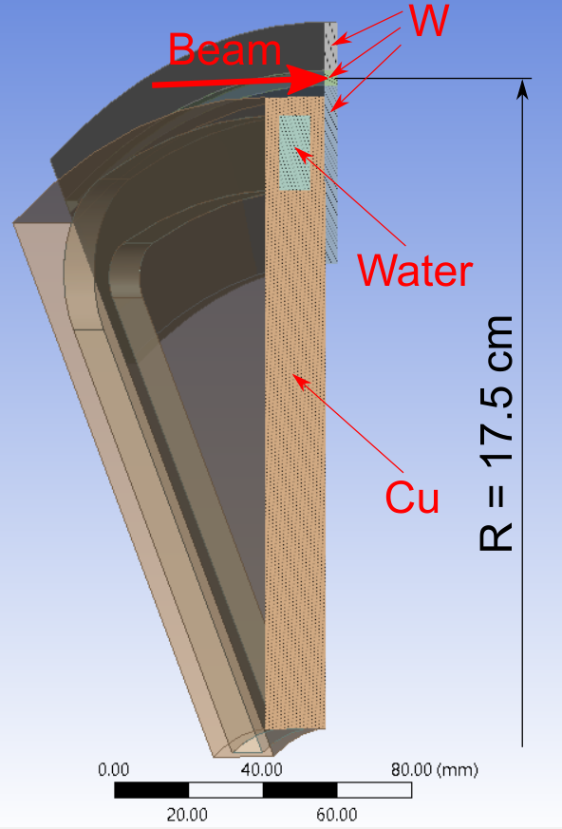
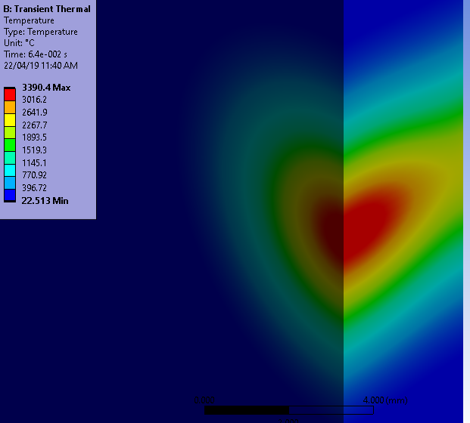
Concept and Challenges of High-Power Target
Target Concept
1/12 Segment of Rotated Target
Target Challenges:
High (average) heat → cool and rotate
Radiation damage → rotate
Material fatigue cause by cycling temperature → study material properties under realistic conditions
Temperature in Stationary Target
1 mA @ 120 MeV cw e‒ beam
σ_{beam} = 1.5 mm
Some parameters of currently considered model of e⁺ target:
Beam passes through the target at R of 17.5 cm
4 m/s target tangential speed at R of 17.5 cm
10x20 mm² cross-section of water channel inside Cu disk
24 l/min rate of water flow
Static target would melt in 64 ms

Slide 6
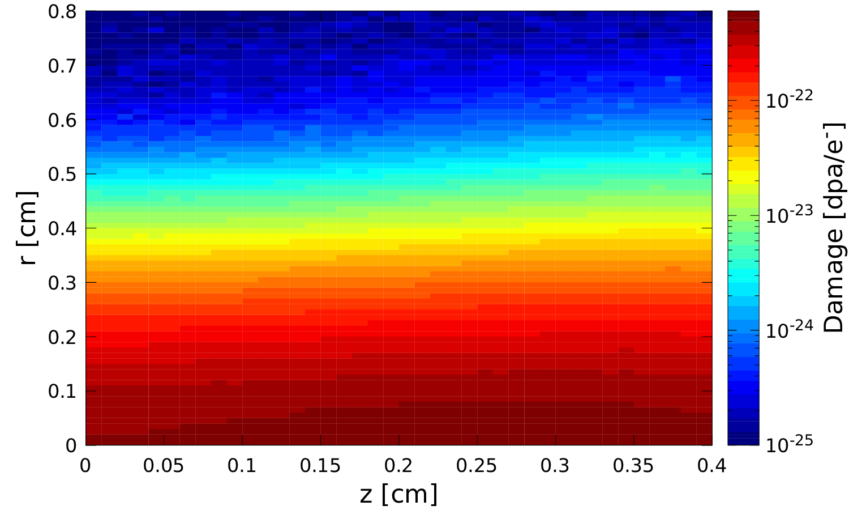
Radiation Damage of 17 kW Tungsten Target
Radiation Damage of Stationary Target
Radiation Damage of Rotated Target
Ø35 cm W Target
1 mA @ 120 MeV e‒
1.5 mm rms spot size σ
Max Rad. Damage of Tungsten = 1.02E-19 dpa/e‒
Radiation Damage < 0.5 dpa

Slide 7
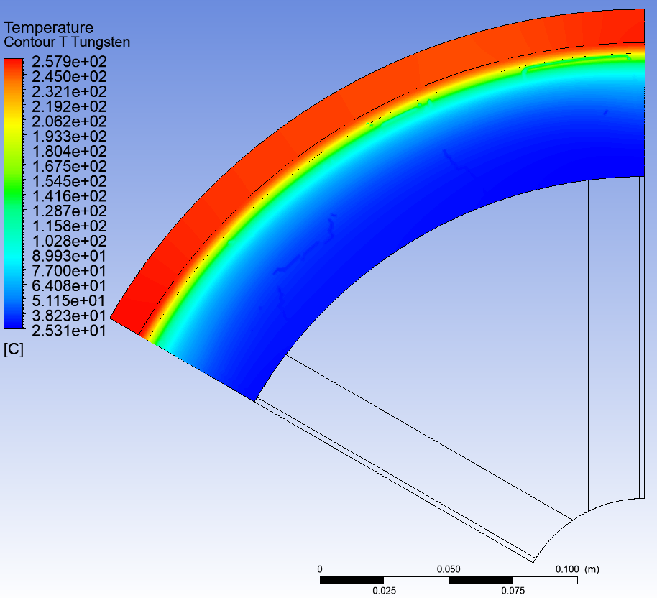
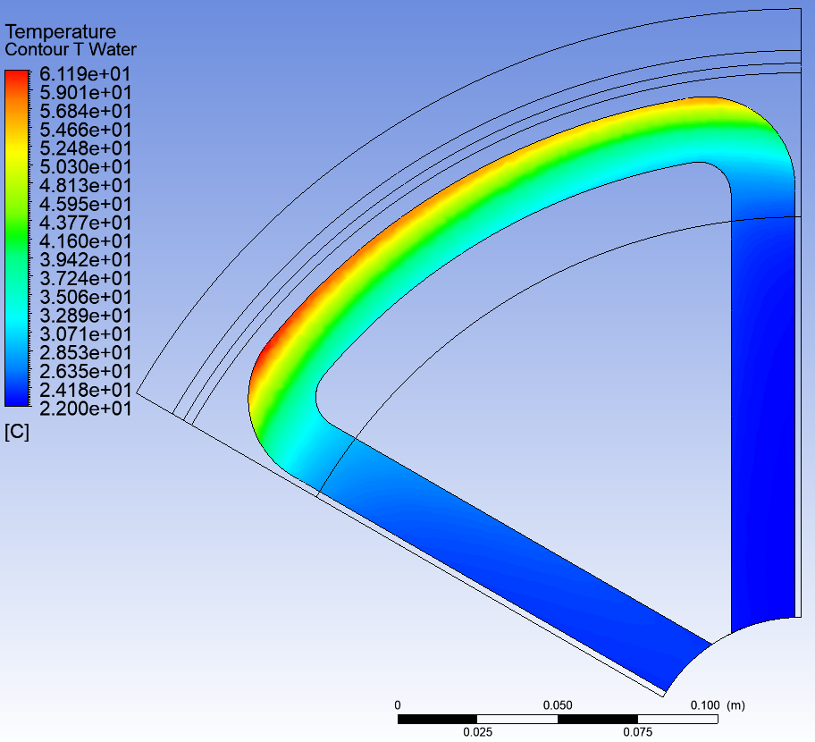
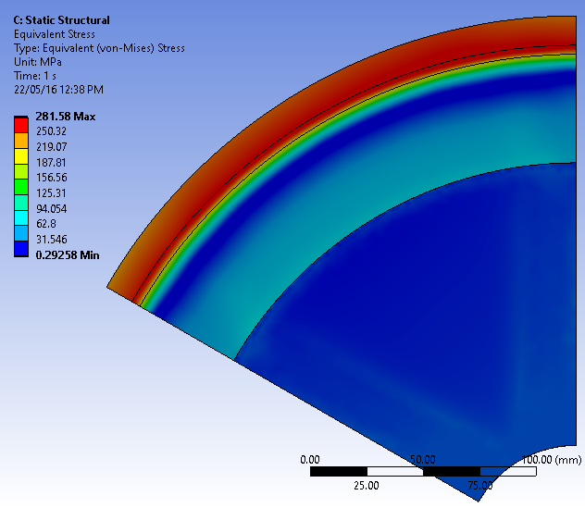
Average Temperature and Radiation Damage in 17 kW Tungsten Target
Average Temperature in Tungsten
Temperature of Water
Average Thermal Stress
T_{max} = 258 °C
T_{max} = 61 °C
σ_{vM max} = 282 MPa

Slide 8
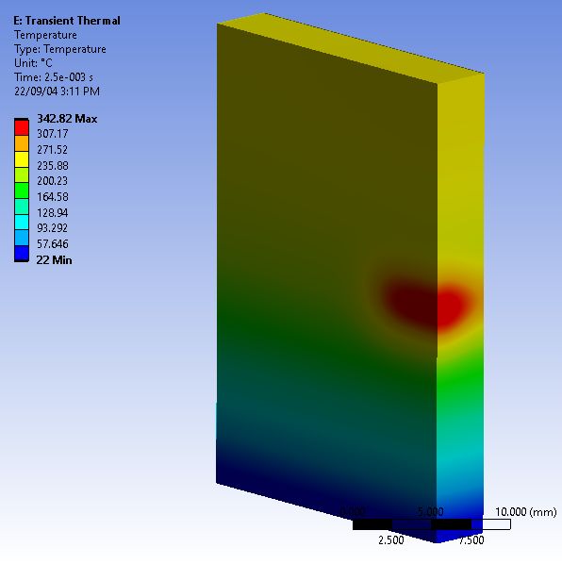
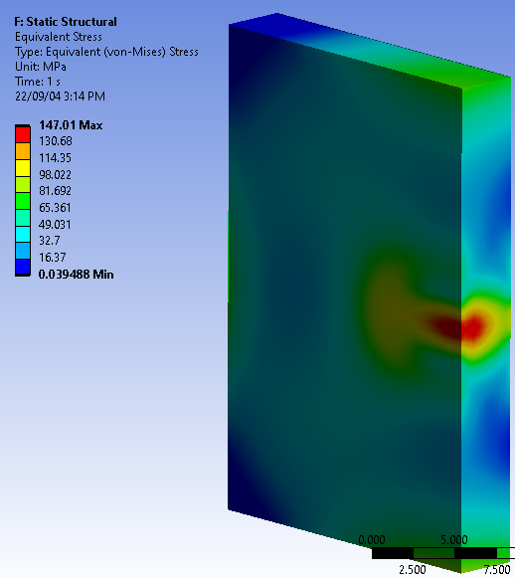
Thermal Cycling in 17 kW Tungsten Spinning Target (Ø35 cm, v_{rot} = 4 m/s)
Thermal Cycle
Temperature and Stress at the End of Heating Phase
Heating Phase
T_{max} ≈ 340°C
σ_{vM max} ≈ 150 MPa
+ 280 MPa due to T_{ave} = 258°C
ΔT_{max} ≈ 120°C
σ_{fatigue} = ? MPa
Duration of Heating ≈
2.5 ms
Check fatigue limits experimentally
Period of Cycles =
275 ms

Slide 9
Fatigue Limit (Plansee and ANSYS Granta Data)
High temperature reduces the yield strength
Material fatigue under cyclic thermal loading can initiate and grow cracks (fracture)
Yield Strength σ_{0.2} vs Temperature
Max Alternating Stress vs Number of Cycles
For 17 kW Tungsten Target
Ø35 cm, 4 m/s rot. speed
Tungsten
(Plansee)
Tungsten at 22°C
(ANSYS Granta)
6.5E+7 cycles/5000h
T_{max} ≈ 340°C
σ_{vM max} ≈ 430 MPa
k (6.5E+7 cycles) = 0.52
σ_{0.2} (340°C) = 1020 MPa
σ_{fatigue} (6.5E+7 cycles; 340°C) ≈ 530 MPa
Fatigue Limit = k (Number of Cycles) * Yield Strength (T), where k = < 1

Slide 10
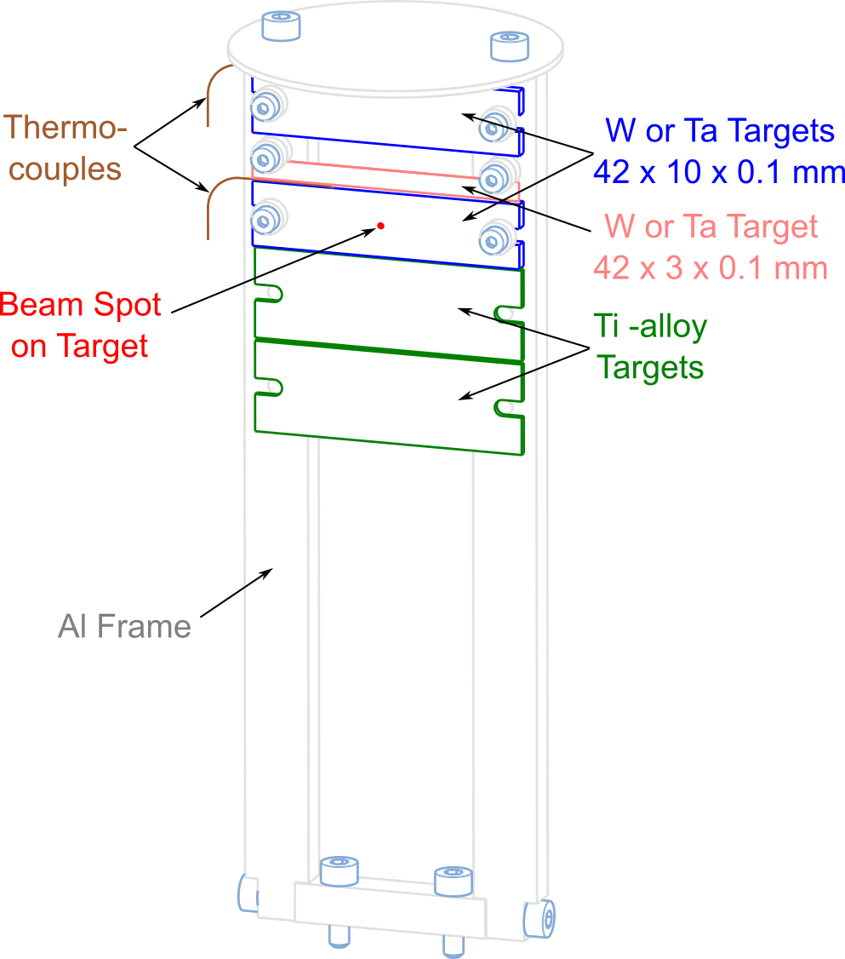







Test of Target Materials with e‒ Beam at Mainz Microtron (MAMI)
Sketch of Targets and e‒ Beam
Test changes/degradation of target properties after 10⁶-10⁷ thermal cycles. Check target fatigue at average elevated temperature of about 300°C
Investigate impact of radiation damage on target material properties between 0.1 and 0.5 dpa at expected elevated temperatures
Test different high Z materials: W, Ta, W-alloys, to evaluate candidate target materials
3.5 MeV e‒
I < 50 μA
σ > 50 μm

Slide 11
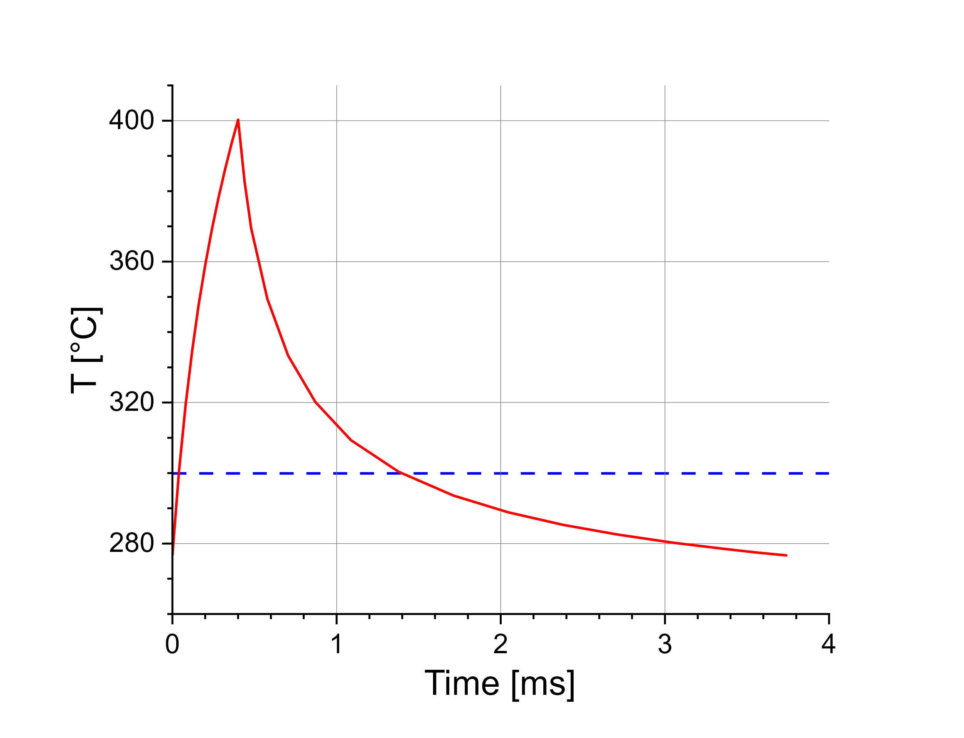
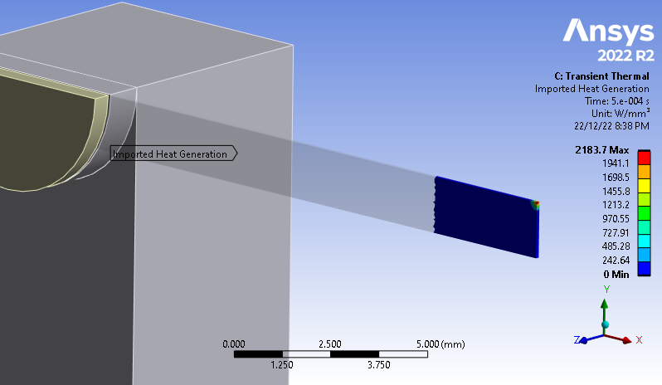
Peak Heat Density and Cycling Temperature in Tungsten for 3.5 MeV e‒ Beam
Cycling Temperature
Deposited Power Density in 0.1 mm W Foil
Pulse Length = 0.4 ms
Pulse Period = 3.74 ms
Average T
50 μA @ 3.5 MeV e‒ beam, σ = 0.1 mm
Peak Heat Density = 2.18 kW/mm³
T_{ave} = 300 °C
T_{max} = 400 °C
ΔT = 120 °C

Slide 12
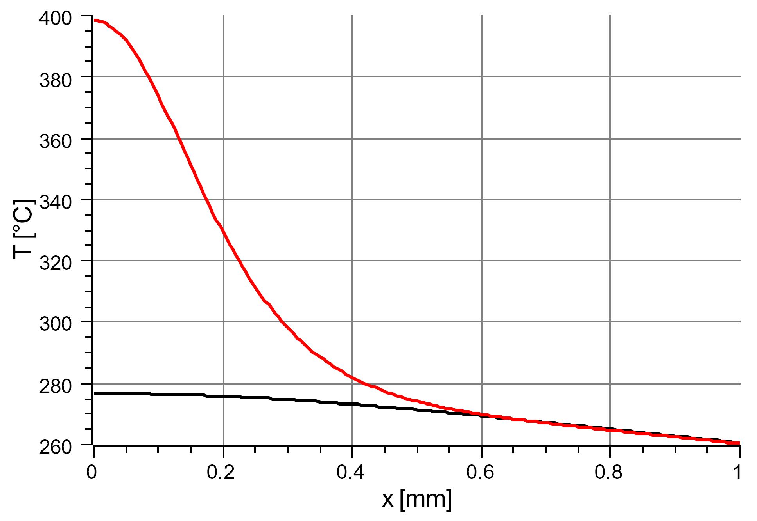
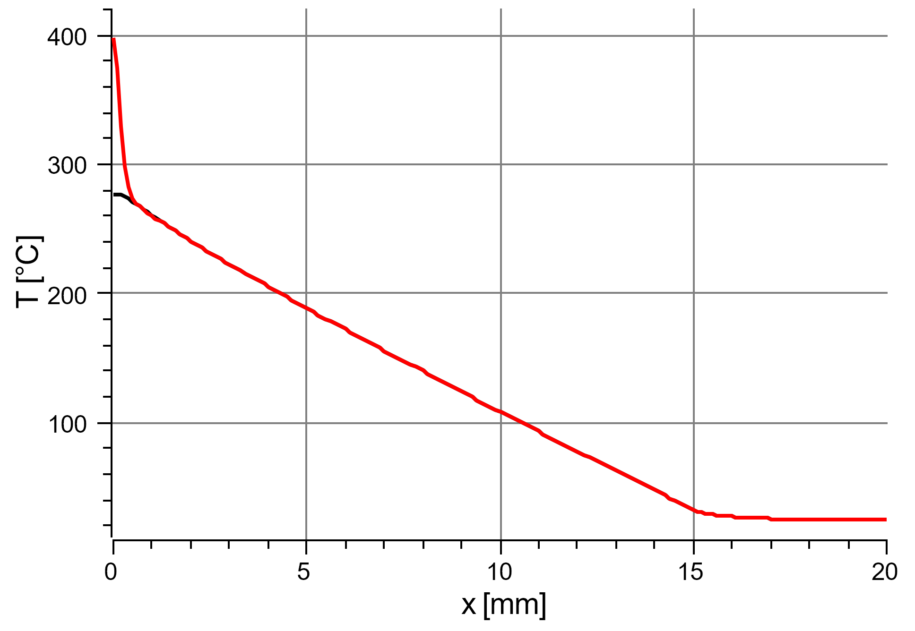
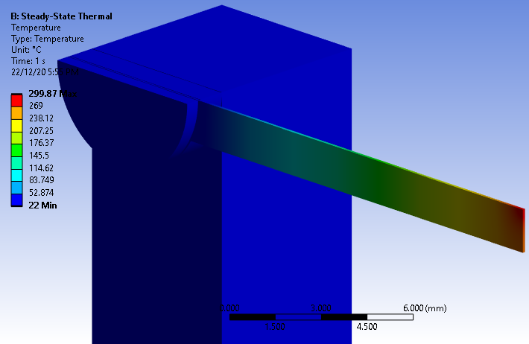
Temperature of Tungsten Foil. 3.5 MeV e‒ Beam with Duty Cycle of 0.107
Thickness of W target: 100 μm
Length of W target: 42 mm
Width of W target: 3 mm
Profiles of Max and Min Cycling Temperatures
0.4 ms pulse length
3.74 ms pulse periodi
Average Temperature
T_{max} = 300 °C

Slide 13
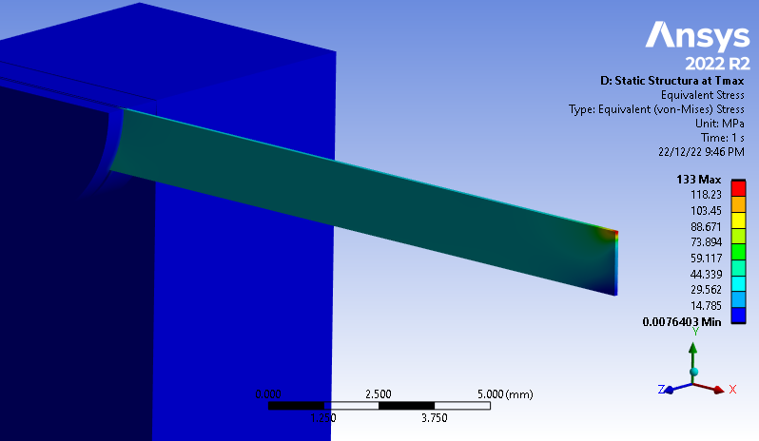
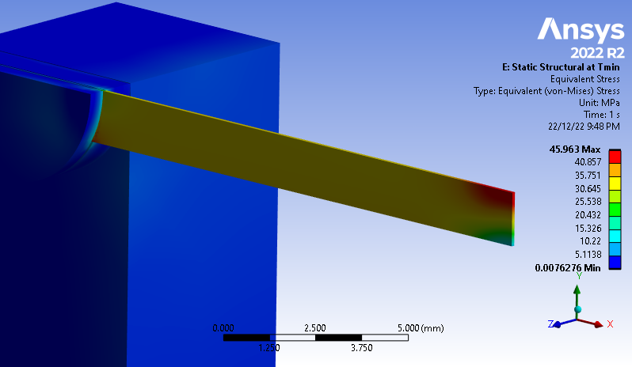
Thermal Stress in Tungsten Foil. 3.5 MeV e‒ Beam with Duty Cycle of 0.107
0.4 ms pulse length, 3.74 ms pulse periodi
Max Thermal Stress at t = 0.4 ms
Max Thermal Stress at t = 3.74 ms
Average Temperature
σ_{vM} ≈ 133 MPa
σ_{vM} ≈ 46 MPa

Slide 14

Radiation Damage by 50 μA @ 3.5 MeV e‒ Beam with Spot Size σ = 50 μm
Radiation Damage in the Middle of Beam
50 μA $→$ 3.125E+14 e‒/s
For radiation damage of 0.23 dpa:
Pulsed e‒ beam with 50% duty cycle (1 ms pulse length and 2 ms pulse period):
  4 hours of beam time
  Average temperature of 700 °C
or/and
Pulsed e‒ beam with 22% duty cycle (1.1 ms pulse length and 5 ms pulse period):
  9.1 hours of beam time
  Average temperature of 300 °C
Max Rad. Damage of Tungsten = 1.02E-19 dpa/e‒

Slide 15
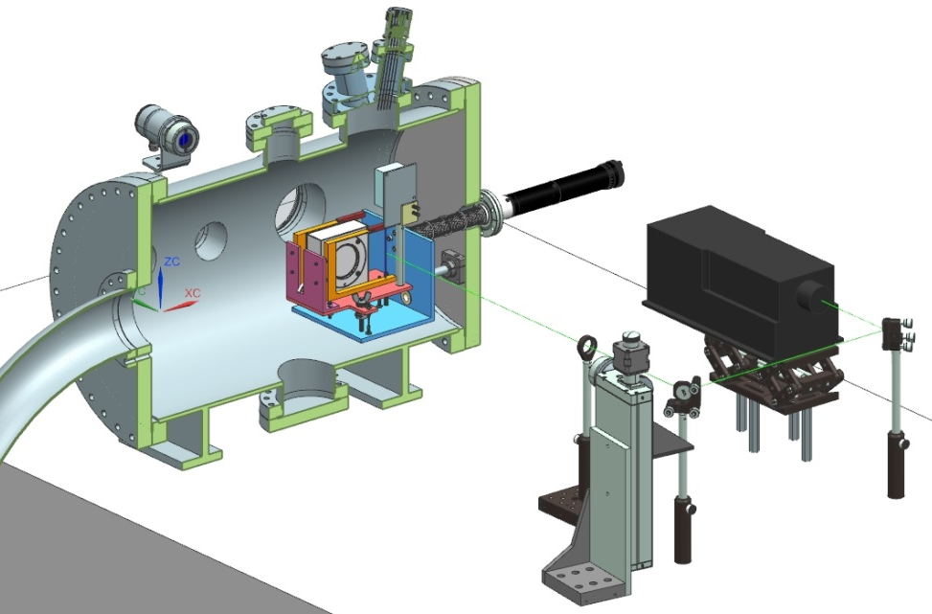
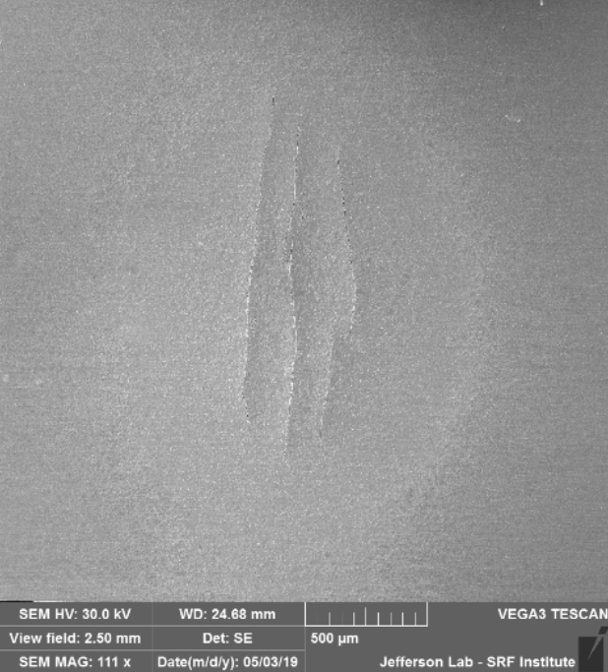
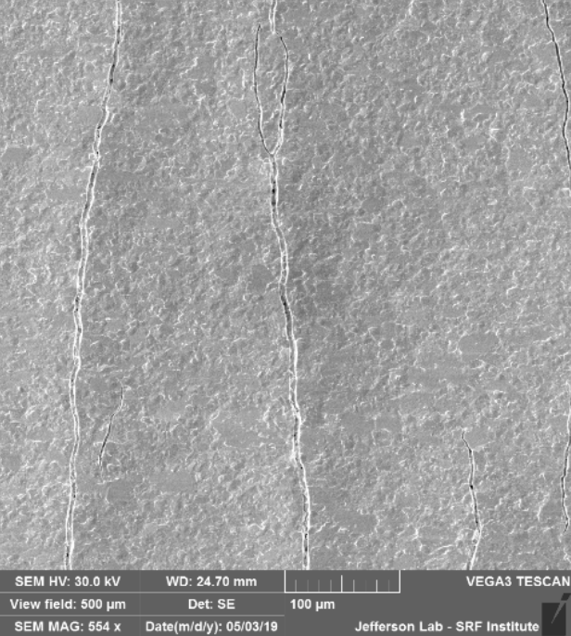
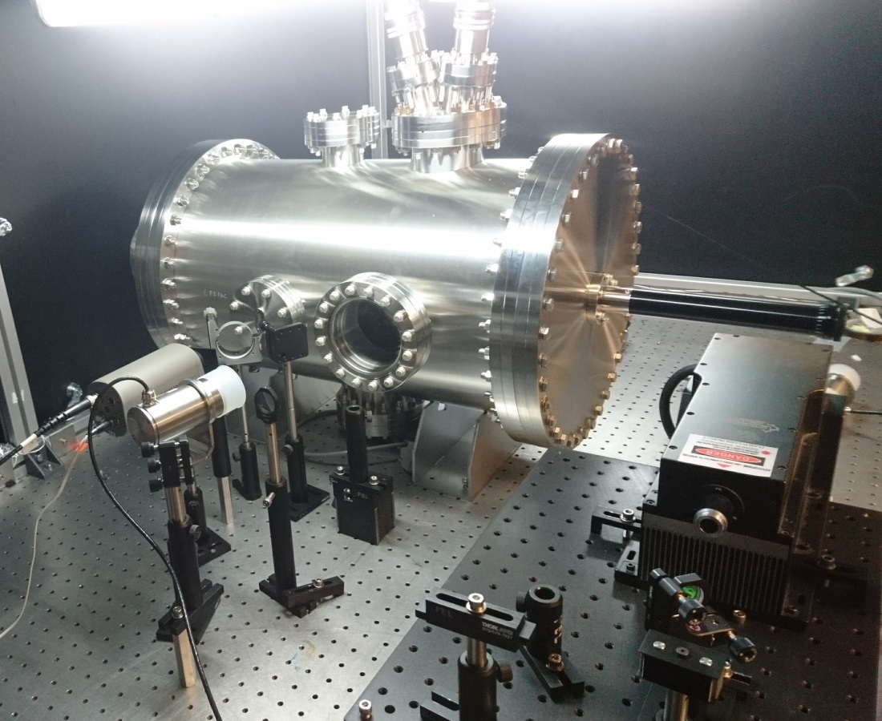
Test of Target Materials with Laser at JLab LERF Laser Lab 6
Existing laser setup will be used for testing e⁺ target materials
10 W lasers (532 nm) were used for testing 18 µm W foils to their limits and beyond [S. Gopinath, S. Covrig “APEX Target Thermal Assessment”, PMAG0000-0001-A0001, 10/29/2020]:
CAD assembly
S. Gopinath
SEM Images of APEX Target with Micro-Fractures at Beam Spot
Experimental Setup

Slide 16
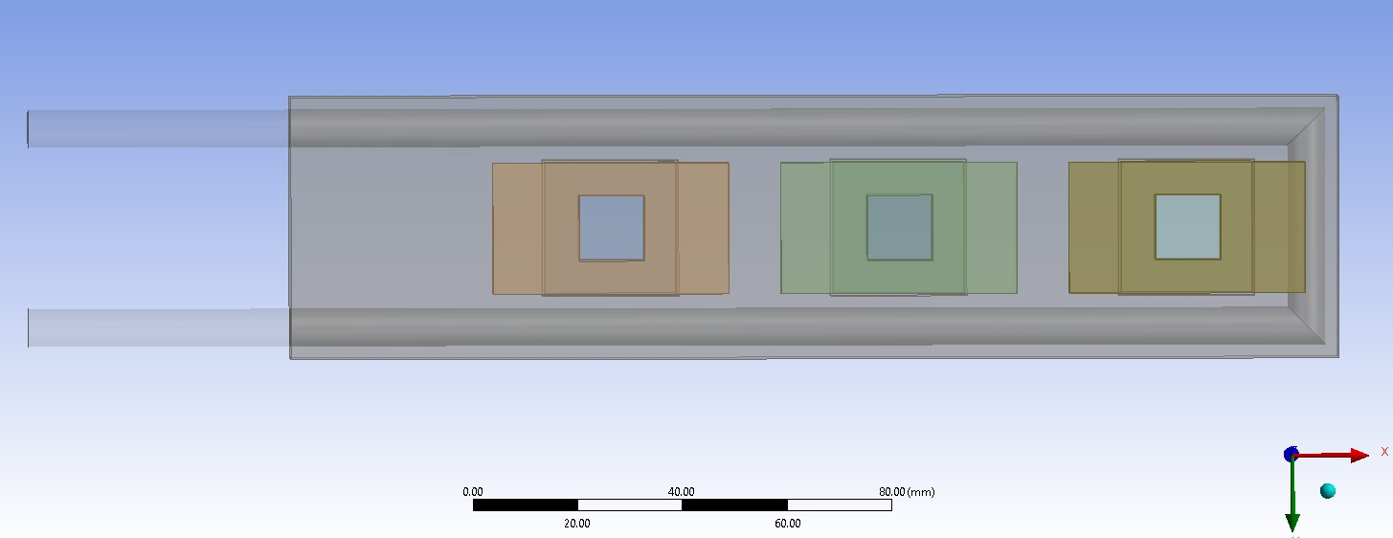
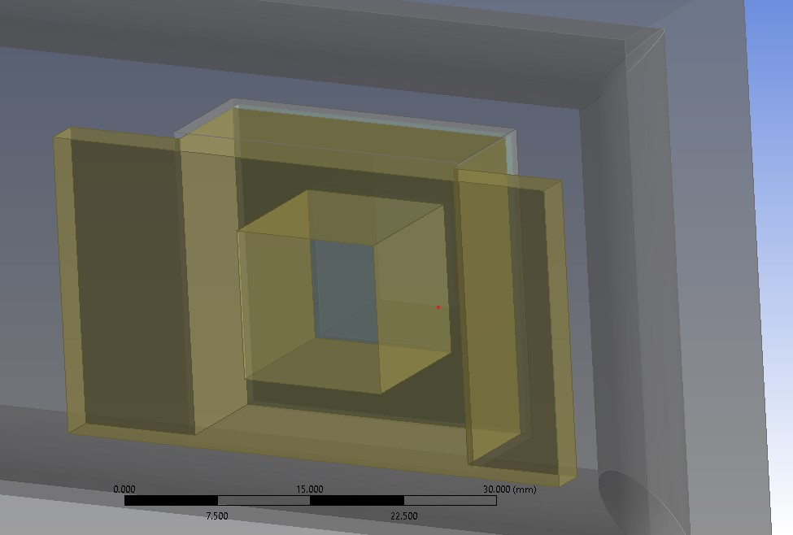
Test of Target Materials with Laser at JLab LERF Laser Lab 6
Target Design (Silviu Covrig)
Experimental setup at LERF Laser Lab 6 would allow us to test the high peak heat loads (significantly higher than could be achieved with MAMI e‒ beam) and fatigue of target materials in the wide temperature range
Test of thermal contact conductance between high-Z materials and Cu or Al (Ce⁺BAF and ILC targets)
Possibility of testing low-power stationary target is being studied
Targets
Cu
Frame
Cooling Tube
Beam Clearance
12.5x12.5 mm²
Target (25x25 mm)
Cu
Washer

Slide 17
Summary and Outlook
We are focused on developing 123 MeV e⁺ injector at LERF
By the end of the year we want to complete a technical design report on e⁺ injector
Development and test of e⁺ targets:
  JLab Phase I: Prototype/proof-of-principle of low-power stationary solid water-cooled target (< 4 kW)
  JLab Phase II: High-power rotated solid water-cooled target (17 ‒ 20 kW)
  Xelera Research LLC is exploring (DOE SBIR) liquid metal targets (Ga-In-Sn /
  Pb-Bi)
Target material tests:
  Radiation damage and fatigue of target materials with pulsed 3.5 MeV e⁺ beam at MAMI on Mar 31 – Apr 5, 2023 (W, Ta) and in Fall 2023 (W-alloys)
  Study of irradiated targets with PETRA X-rays at DESY
  Fatigue target tests with a laser at JLab LERF Laser Lab 6 (Summer 2023)
This project has received funding from the European Union’s Horizon 2020 research and innovation program under grant agreement STRONG-2020-No 824093

Slide 18
Acknowledgments
I would like to acknowledge those who have contributed to this presentation
Silviu Covrig
Christine Le Galliard
Sandesh Gopinath
Joe Grames
Sami Habet
Eric Voutier
Shukui Zhang

Slide 19
Backup Slides

Slide 20
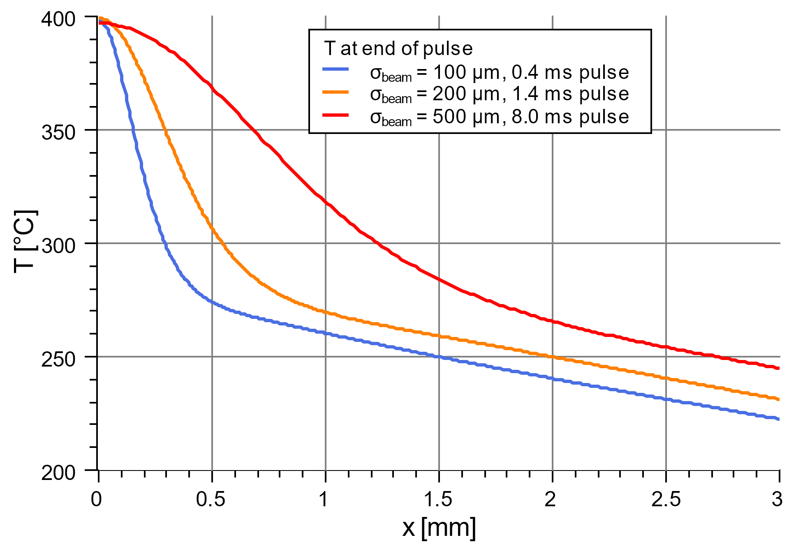
Temperature Profiles at the End of Pulse for Different Sizes of Beam Spot
50 μA @ 3.5 MeV e‒ beam, 100 μm W foil
Thermocouples have to be placed very close to the beam in order to be able to measure cycling temperature

