Slide 1
MEIC Polarized Electron Source & Magnetized source for MEIC Electron Cooler
MEIC Collaboration Meeting
Spring 2015
Riad Suleiman
March 31, 2015

Slide 2
MEIC Polarized Electron Source

Slide 3
MEIC Polarized Source
Bunch Charge
26 pC – 6.6 pC
Helicity Reversal
220 bunches
at 68.05 MHz
(14.69 ns)
72.07 µs
700 ms – 12 ms
…
…
…
…
3.233 µs
Damping Time
3 GeV – 12 GeV

Slide 4
Source Parameter Comparison
Parameter | CEBAF | JLab/FEL | EIC eRHIC | EIC MEIC | Cornell ERL | LHeC | CLIC | ILC
Polarization | Yes | No | Yes | Yes | No | Yes | Yes | Yes
Photocathode | GaAs / GaAsP | Bulk GaAs |  |  | K₂CsSb
Width of microbunch (ps) | 50 | 35 | 100 | 50 | 2 | 100 | 100 | 1000
Time between microbunches (ns) | 2 | 13 | 106 | 14.69 | 0.77 | 25 | 0.5002 | 337
Microbunch rep rate (MHz) | 499 | 75 | 9.4 | 68.05 | 1300 | 40 | 1999 | 3
Width of macropulse | - | - | - | 3.233 µs | - | - | 156 ns | 1 ms
Macropulse repetition rate (Hz) | - | - | - | 2x83 | - | - | 50 | 5
Charge per microbunch (pC) | 0.4 | 133 | 5300 | 26 | 77 | 640 | 960 | 4800
Peak current of microbunch (A) | 0.008 | 3.8 | 53 | 0.52 | 38.5 | 6.4 | 9.6 | 4.8
Laser Spot Size (cm, diameter) | 0.1 | 0.5 | 0.6 | 0.3 | 0.3 | 0.5 | 1 | 1
Peak current density (A/cm²) | 1 | 19 | 188 | 7.4 | 500 | 32 | 12 | 6
Average current from gun (mA) | 0.2 | 10 | 50 | 0.001 | 100 | 25 | 0.015 | 0.072
Proposed
* Unpolarized: Bulk GaAs (Cs,F), K₂CsSb, Na₂KSb, …
Polarized: GaAs/GaAsP (Cs,F).
Notes:
Why multi-alkali (bulk material, Eg = 1.5 eV) photocathodes are not sensitive to ion bombardment?
No NEA activation layer.
eRHIC: electron Relativistic Heavy Ion Collider
LHeC: Large Hadron electron Collider
CLIC: Compact Linear Collider
ILC: International Linear Collider
---
Why Laser Spot Size? to reduce space-charge emittance growth and suppress surface charge limit.
---
eRHIC: 20 photocathodes, 2.5 mA from each
---
How to fill the numbers:
Microbunch rep rate = 1.0/Time between microbunches
Number of microbunches = Width of macropulse / Time between microbunches
For CW machines: Duty Factor = 100% (for CW machines)
For pulsed machines: Duty Factor = Width of macropulse * Macropulse repetition rate
Charge per microbunch = Number electrons/microbunch * Electron Charge(1.6e-19 C)
Peak current of microbunch = Charge per microbunch / Width of microbunch
Peak current density = Peak current of microbunch / ( (Laser Spot Size/2)**2 * Pi)
Average Current = Charge per microbunch * Microbunch rep rate * Duty Factor

Slide 5
Managing Large Bunch Charge
Larger Laser Size (reduces space-charge emittance growth and suppresses surface charge limit)
Higher Gun Voltage:
Reduce space-charge emittance growth, maintain small transverse beam profile and short bunch-length; clean beam transport
Compact, less-complicated injector
To accelerate large bunch charge in CEBAF: use RF feedforward system for C100 cryomodules

Slide 6
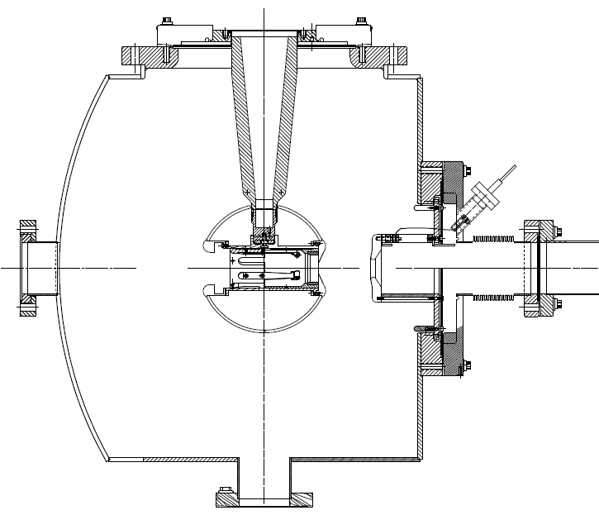
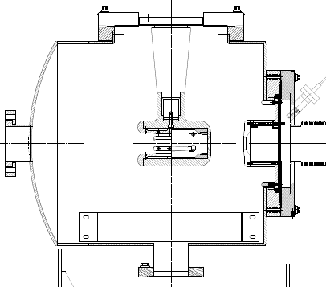
JLab 500 kV Inverted Gun
7”
5”
200 kV Inverted Gun
Longer insulator
Spherical electrode

Slide 7
Magnetized Source for MEIC Electron Cooler
MEIC Electron Beam Cooling Requirements
Thermionic Gun
Photogun
Magnetized (Angular-momentum-dominated) Beam
Summary

Slide 8
Bunched Magnetized Electron Beam for Cooling
Bunch Length | 100 ps (3 cm)
Repetition Rate | 748.5 MHz
Bunch Charge | 267 pC
Peak Current | 2.67 A
Average Current | 200 mA
Emitting Area | 6 mm ɸ
Transverse Normalized Emittance | 10s microns
Solenoid Field at Cathode | 2 kG

Slide 9
Source Performance & Dependencies
Thermal Emittance: Intrinsic property of a cathode. Depends on work function, surface roughness, laser wavelength, temperature.
Achievable Current: QE, laser wavelength, laser power, laser damage, heating, temperature.
Bunch Charge: laser peak power, repetition rate, active cathode area.
Cathode Lifetime: ion back bombardment, dark current, contamination by residual gas, evaporation, beam loss, halo beam.

Slide 10
Thermionic Gun
Example 1: TRIUMF e-Linac for photo-fission of actinide target materials to produce exotic isotopes:
BaO: 6 mm diameter, 775˚C
Grid at 650 MHz
Gun HV: 300 kV
Average beam current: 25 mA
Bunch charge: 38 pC
Normalized emittance: 30 microns. Emittance is dominated by the electric field distortion caused by the grid.
Production target sets no requirement on beam emittance

Slide 11
Example 2: MAX-LAB Thermionic – Photocathode RF Gun. Thorin et al., NIM A 606, 291 (2009):
Thermionic: for storage ring injection
BaO: 6 mm diameter, 1100˚C
Bunch charge: 0.2 nC, 3 GHz
Bunch length: 1 ps after energy filter
Peak current: 200 A. Average beam current: 600 mA
Normalized emittance: 35 microns
To switch, reduce T=1100˚C to T=700˚C
Photocathode: for FEL
Bunch charge: 0.2 nC
Laser: 9 ps, 10 Hz, 263 nm
Average beam current: 2 nA
Normalized emittance: 5.5 microns
QE: 1.1 x 10⁻⁴

Slide 12
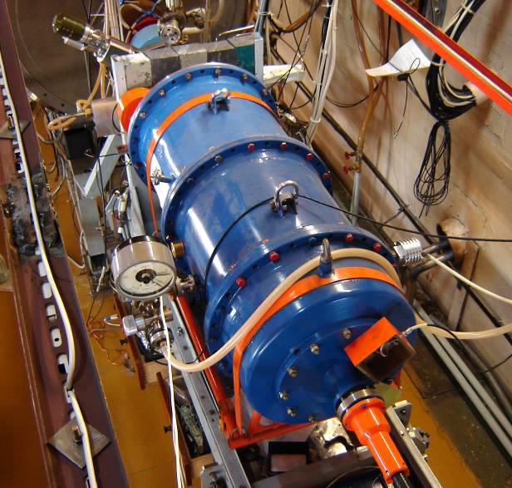
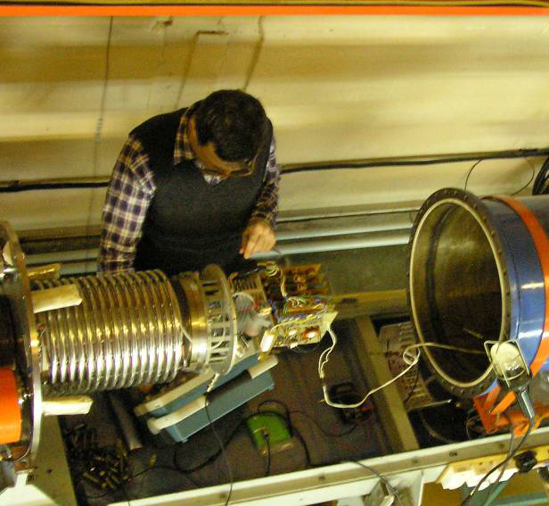
Example 3: Thermionic Gun and 1.5 MeV Injector of BINP’s NovoFEL. B.A. Knyazev et al., Meas. Sci. Tech. 21, 054017 (2010):
Gun HV | 300 kV
Maximum peak current | 1.8 A
Maximum average current | 30 – 45 mA
Maximum bunch repetition rate | 22.5 MHz
Bunch length | 1.3 ns
Bunch charge | 1.5 – 2 nC
Normalized emittance | 10 microns

Slide 13
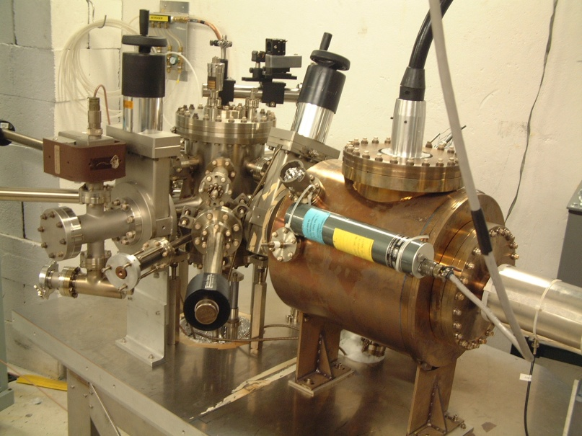
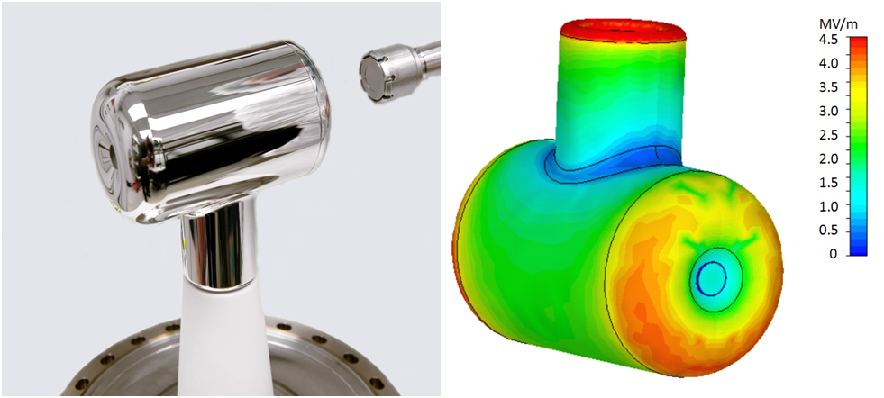
Photogun
Example 1: JLab 200 kV Inverted dc Gun with K₂CsSb photocathode:
Average beam current: 10 mA
Laser: 532 nm, dc
Lifetime: very long (weeks)
Thermal emittance: 0.7 microns/mm(rms)
Mammei et al., Phys. Rev. ST AB 16, 033401 (2013)

Slide 14
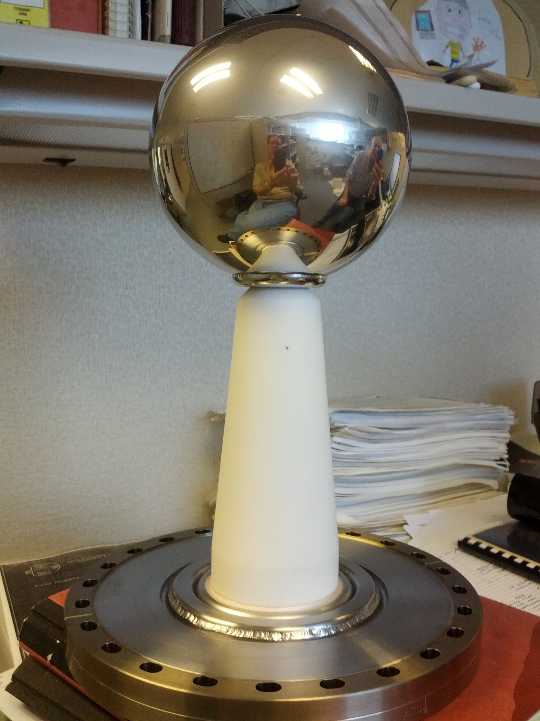
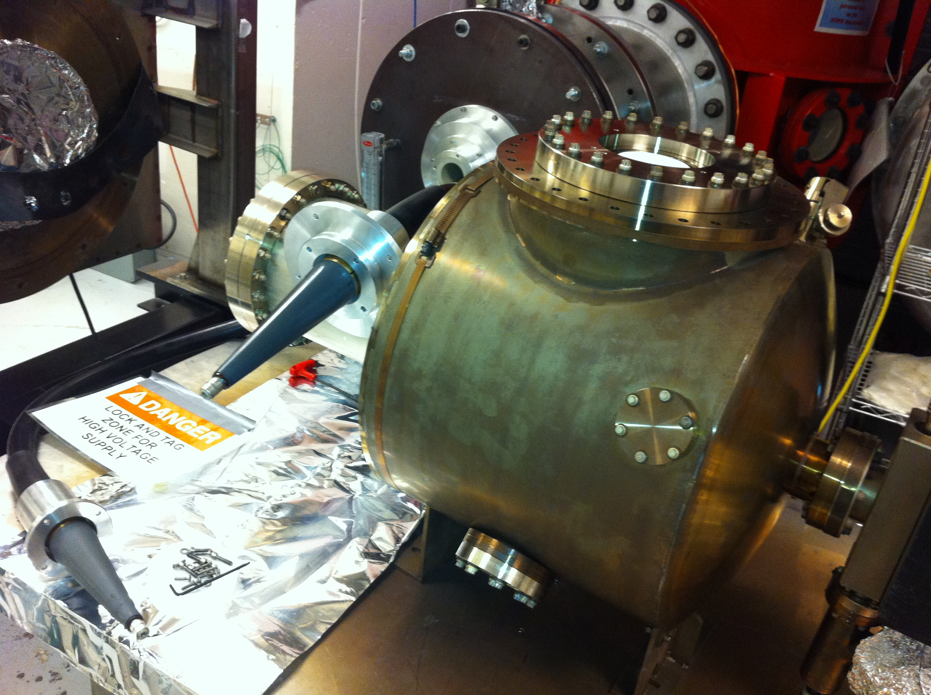
Example 2: JLab 350/500 kV Inverted Gun:
 | 200 kV Gun | 350/500 kV Gun
Chamber | 14” ɸ | 18’’ ɸ
Cathode | 2.5” T-shaped | 6” ɸ Ball
Cathode Gap | 6.3 cm | 6.3 cm
Inverted Ceramic | 4” long | 7” long
HV Cable | R28 | R30
HV Supply | Spellman 225 kV, 30 mA | Glassman 600 kV, 5 mA
Maximum Gradient | 4 MV/M | 7 (10) MV/m
Achieved 350 kV with no FE (December 2013), next:
Keep pushing to reach 500 kV
Run beam with K₂CsSb photocathode

Slide 15
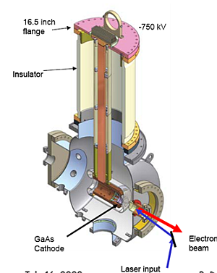
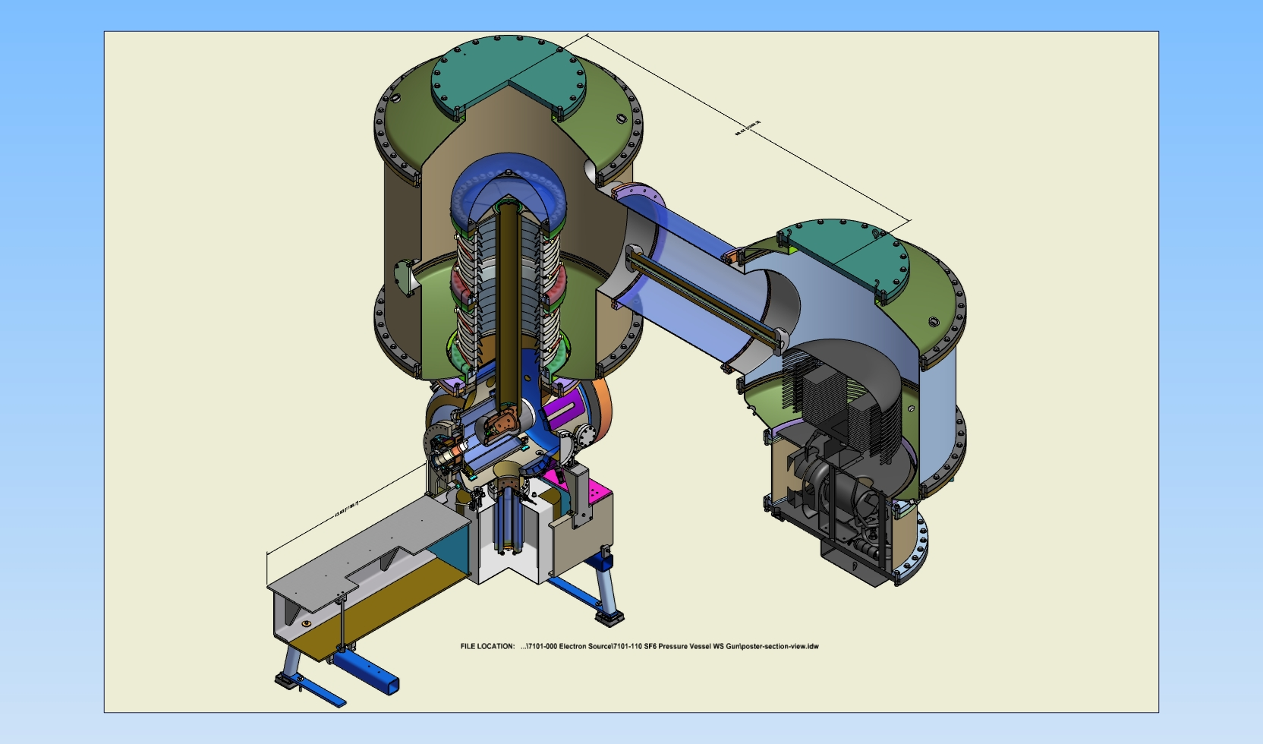
Example 3: Cornell dc Gun with K₂CsSb photocathode:
Gun HV: currently operating at 350 kV (designed 500-600 kV)
Average beam current: 100 mA
Bunch charge: 77 pC
Bunch length: 10 ps, 1.3 GHz
Normalized emittance: <0.5 microns

Slide 16
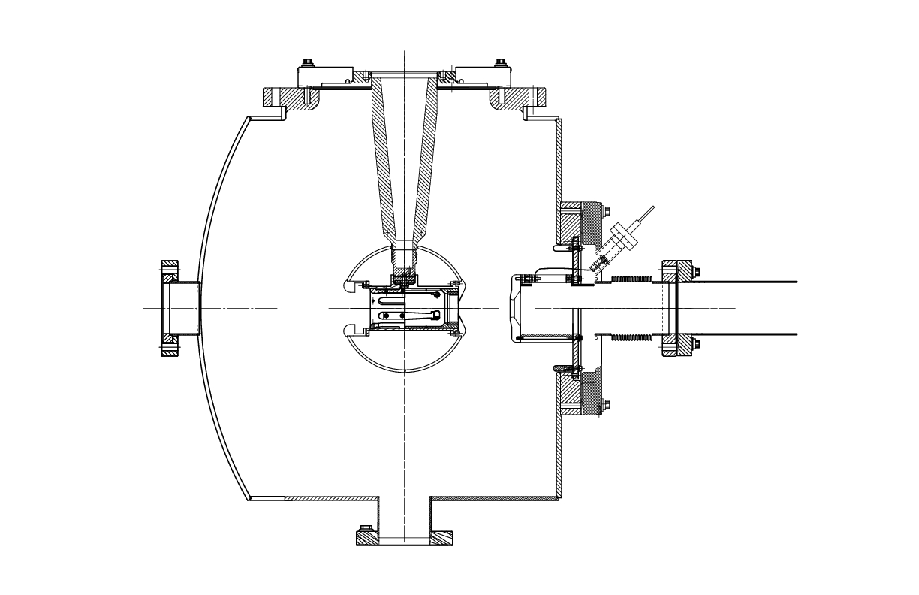
Magnetized Beam and Emittance Compensation
Solenoid (B_{z}~2kG)
(magnetized beam)
Magnetized Cathode:
To produce magnetized electron beam to ensure zero angular momentum inside cooling-solenoid section)
Magnetized Injector:
To compensate space-charge emittance growth
Solenoids (B_{z}~2kG)
(space-charge emittance growth compensation)

Slide 17
Summary
Thermionic gun would be our first choice (less maintenance but may need complicated injector):
TRIUMF/BINP Gun with Inverted Ceramic
To allow for laser pulse shaping, a photogun could be an option:
JLab 350/500 kV Inverted Gun and JLab K₂CsSb
If one gun cannot provide 200 mA, then use two or three guns and combine beams using RF combiner or dipole magnet

Slide 18
LDRD: 200 mA Magnetized Beam
Use JLab 350/500 kV Inverted Gun and JLab K₂CsSb
Design and build Cathode Solenoid
Generate magnetized beam
Measure beam magnetization:
Measure beam emittance vs. beam size
Measure directly using slit and screen
Study transportation of magnetized beam (must preserve magnetization)
Measure magnetized photocathode lifetime at high currents

Slide 19
Magnetized Electron Cooling

Slide 20
Busch’s Theorem
On entering or exiting solenoid, beam acquires a kick that makes beam to rotate
Busch’s Theorem: Canonical angular momentums is conserved,
Canonical angular momentum:
Magnetic emittance:
ε_{mag}[microns] ~ 30 B[kG] σ_{e}[mm]²

Slide 21
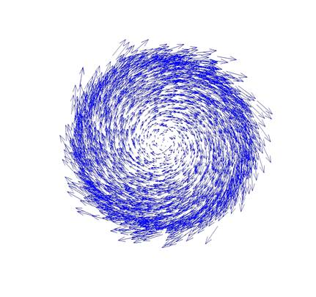
Magnetized Cooling
Cathode Solenoid
Cooling Solenoid
Cathode
Ion Beam
B=0
Electron
Beam
B_{Cath_Sol} = 2 kG
B_{Cool_Sol} = 2 T
Electrons born in uniform B_{z}
Upon exit of Cathode Solenoid
Upon entering Cooling Solenoid
σ_{e}= R_{laser} = 3 mm
σ_{e}= 1 mm

Slide 22
Why: Magnetized beam?
Magnetic field limits transverse motion of electrons; cooling is determined by longitudinal velocity spread
Cooling time for non-magnetized beam:

Slide 23
Cooling Solenoid
Cooling solenoid: 30 m long and 2 T field
Electron and ion are moving at same speed in cooling section (solenoid)
Inside cooling solenoid, electron beam is calm: not to have any angular motion
Cooling solenoid must have high parallelism of magnetic field lines:

Slide 24
Cooling Rate: Dependencies on Electron Beam Properties
Proportional to average beam current (does not depend on peak current)
Independent of ion beam intensity
Proportional to cooler length
Magnetized cooling is less dependent on electron beam transverse emittance
Cooling rates with magnetized electron beam are ultimately determined by electron longitudinal energy spread only, which can be made much smaller than transverse one.
Non-magnetized beam depends on transverse electron velocity (a weak field may be used for focusing –i.e., FNAL dc cooler, 100 G)

Slide 25
Electron – ion Recombination Suppression
Suppresses ion-electron recombination in cooling section
(for non-magnetized cooling, a small magnetic field maybe required to suppress recombination)

Slide 26
Paraxial Beam Envelope Equation
Acceleration Damping
Injector Solenoids
(for space-charge emittance growth compensation)
Space Charge
Cathode Solenoid
Cooling Solenoid
Cathode Emission
B_{z}~2 kG
B_{z}~20 kG

