Slide 1
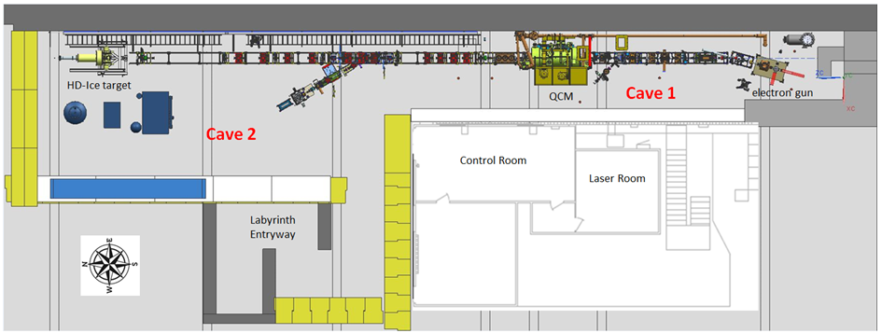
UITF Operator Training – SAF160
Matt Poelker, March 5, 2020

Slide 2
SAF 160 Training Outline: PowerPoint slides + Tour
UITF overview: capabilities and uses
About UITF: geographic location, regions Cave1 Cave2 rooftop, fire extinguishers, pull stations, phones, dosimeter requirements, etc.,
Rooftops Cave1 and Cave2: electronics racks, names and locations, access restrictions
ODH
UOD, ASE and FSAD
Commissioning, then Operating the UITF accelerator
Beam Authorization
Credited Controls and Defense in Depth: current limits at UITF
PSS description, including Sweeping the enclosure
Gun modes
Gun HV
Drive laser
Valves and vacuum
Viewers
Magnets used at UITF including field maps and dipole calibrations (I versus B)
Beam position monitors
Current monitoring: cups, dumps, apertures, BCMs
RF systems: field control chassis, drive laser, choppers, buncher, two cell, seven cell

Slide 3
SAF 160 Training Outline: PowerPoint slides + Tour
Booster: SRF and Cryo features related to CTF
MPS description, including clearing faults, masking FSD nodes
Save and restore
Archiver
UED
Channel Access
User accounts, logging on
UITF utilities: electrical power, LCW, GN2 and compressed air
Signs!
Emergency response

Slide 4
UITF, what can it be used for?
from a workshop December 12, 2018
Application | Beam Energy | Beam Current | Experiment Duration | Notes | Presenter
Commission QCM for CEBAF | 6 MeV, but prefer up to 10 MeV | up to 100 uA | three or four 1-week long tests | tests complete before long shutdown of 2020, when QCM to be installed at CEBAF | R. Kazimi
Commission HDIce for CEBAF | ~ 8 MeV | up to 100 nA for tuning, 0.25 to 5 nA for production | four or five run periods, two-weeks long each | target provides transverse polarization required for 3 A-rated Hall B experiments | A. Sandorfi
Manufacturing polarized targets for CEBAF via DNP | 10 to 18 MeV | 1 to 10 uA | hours, days | likely some R&D to determine optimum polarizing conditions | C. Keith
Bubble Chamber astrophysics | 4 - 10 MeV | 0.01 to 100 uA | 3 weeks, ~ 3 runs/year | UITF better location than CEBAF injector, when CEBAF shutdowns are short | R. Suleiman
MeV parity violation experiment | 10 MeV | milliamps preferred, will reduce experiment duration | months to years | requires polarized electron beam, transmission geometry offers advantages | R. Carlini
Testing Nb₃Sn-coated cavities | determining the beam energy of test cavity is point of test | up to 100 uA | as many tests as possible | Nb3Sn cavities require only 4K Helium | G. Eremeev
Wastewater treatment | 2- 10 MeV | 100 uA | imagine week-long test durations over three years | together with local partners | G. Ciovati
Polarized positron source | 5 - 10 MeV | up to 100 uA | staged tests, likely many required, 1-week long duration | requires polarized electron beam | J. Grames
EIC: fast kicker tests | 5 - 10 MeV | up to 100 uA | two 1-week long tests | together with sbir-partner | H. Wang
EIC: testing high bunch charge | 5 - 10 MeV | up to 100 uA | two 1-week long tests | requires polarized electron beam | J. Grames and J. Guo

Slide 5
UITF is a 10 MeV spin-polarized electron accelerator
Today, UITF is used as a test bed to evaluate new hardware destined for CEBAF. Examples include Wien filters, 200 kV photogun, new booster to replace CEBAF ¼ CM, HDIce target, PSS beam current monitor, new ItoV amplifier system, non-invasive polarimeter, etc.,

Slide 6
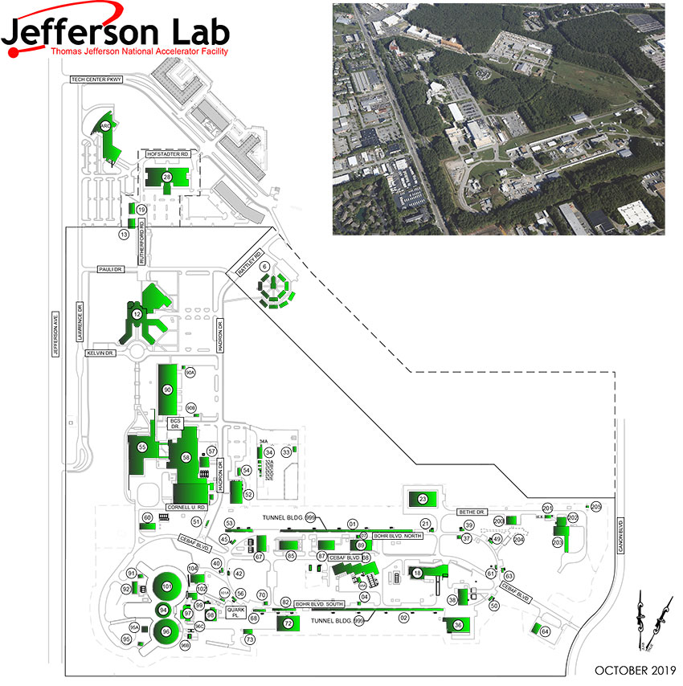
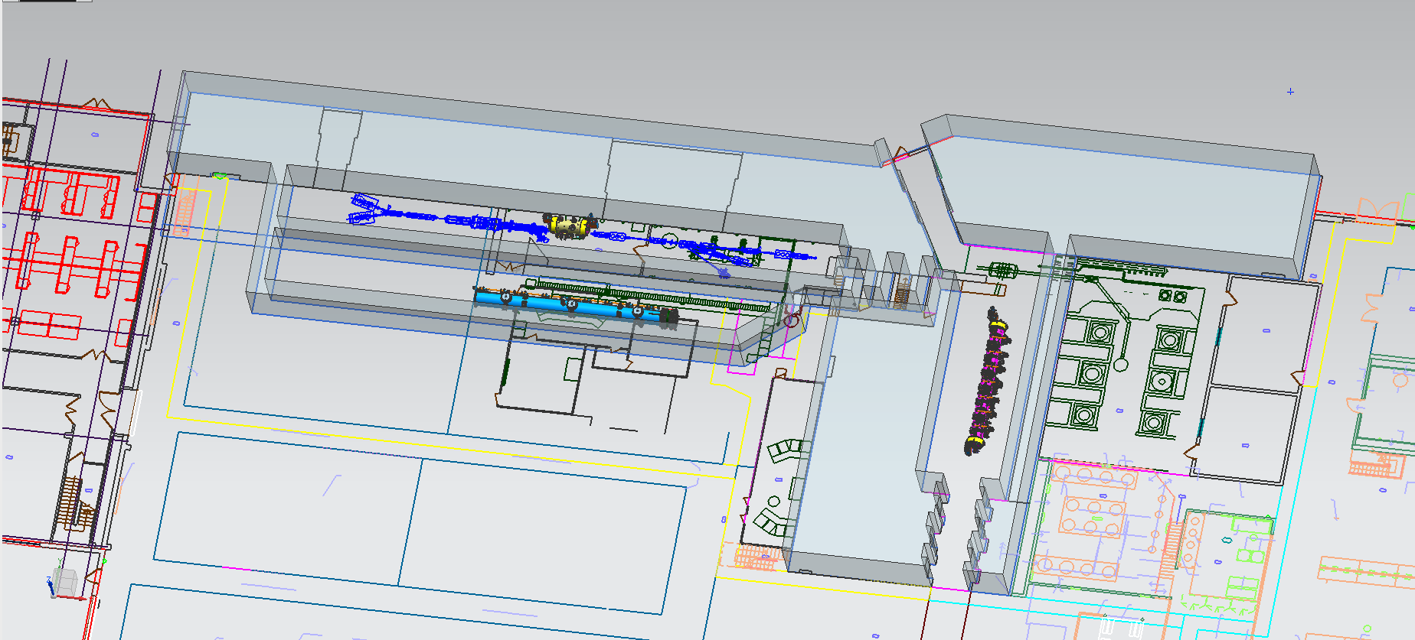
Geographic Features of UITF
Located inside Test Lab building 58 high bay
TL1137
CTF refrigerator
CMTF
VTA
Physics workspace
CM fabrication

Slide 7
Cave1, Cave2, Control Room, Laser Room, Mechanical Room, Labyrinth
Room 1127
Room 1126A
Room 1126B
Bubba’s office
Room 1125
There is fire suppression inside these rooms, and in the UITF enclosure, i.e., sprinklers

Slide 8
Cave1, Cave2, Control Room, Laser Room, Mechanical Room, Labyrinth
Room 1127
Room 1126A
Room 1126B
Bubba’s office
Room 1125
there’s good cell phone reception in these areas

Slide 9
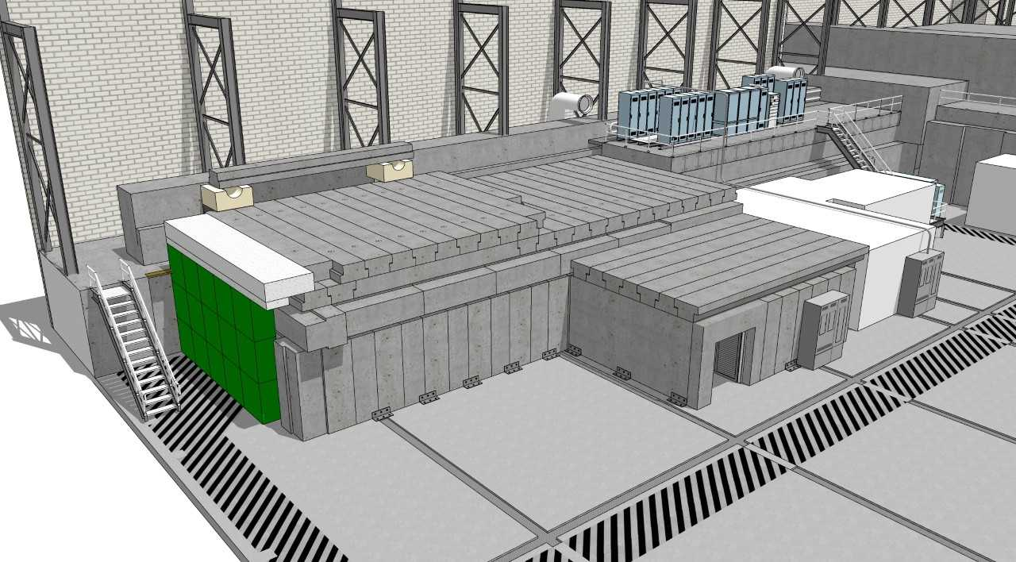
Cave1 rooftop, Cave2 rooftop, moveable shielding
Cave1 rooftop
Helium vent
Cave2 rooftop
Tiles are movable!
labyrinth
There is NO fire suppression in building 58 Test Lab High Bay, there are NO spinklers

Slide 10
See how roof tiles are moved? Test the spin-polarized target “HDIce”
Roof tiles are “credited control”: must lockout radiation sources when tiles are moved. There’s an OSP for this

Slide 11
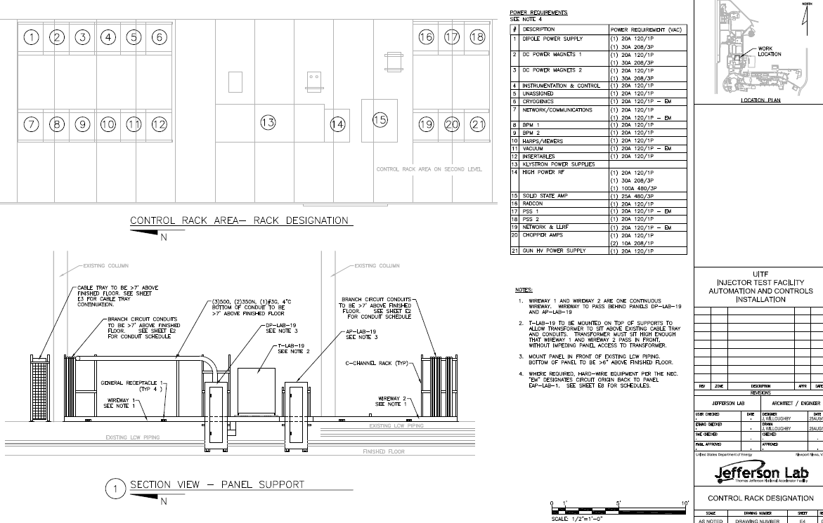
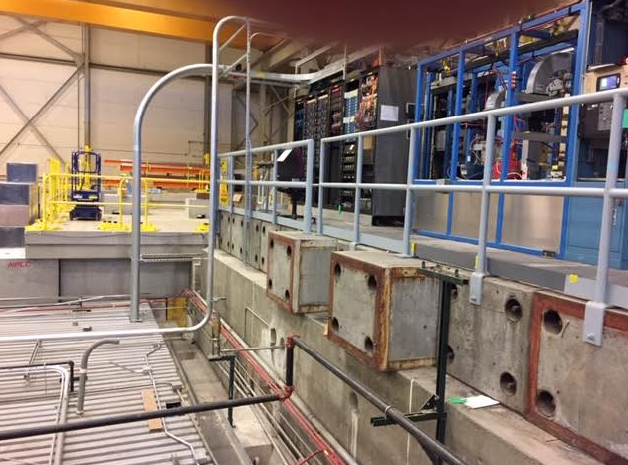
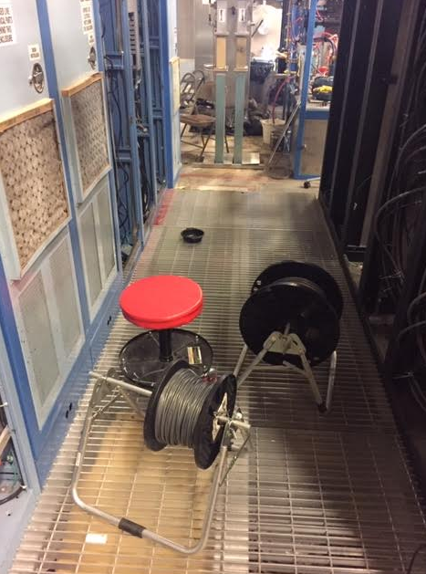
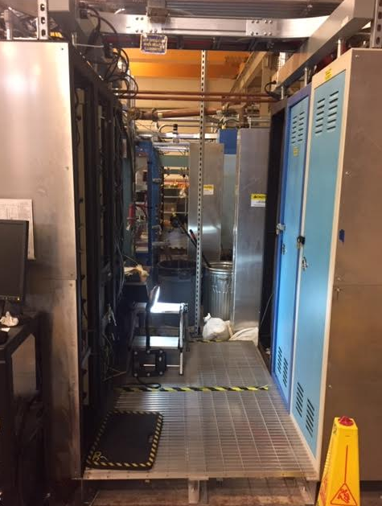
UITF rooftop, electronics and storage….
Cave2 rooftop
Cave1 rooftop
In between rows of racks, there are penetrations in the roof tiles, for the electrical cable to devices inside the enclosure

Slide 12
Access Restrictions, dosimeter requirements
Inside UITF enclosure:
no dosimetry required inside UITF
Signs indicate no drilling into mildly radioactive concrete walls
UITF Rooftops
Cave1 rooftop can be accessed even during operation but must have Lab issued dosimeter
No access permitted to Cave2 rooftop during accelerator operation
Magenta beacons flashing = Accelerator in operation

Slide 13
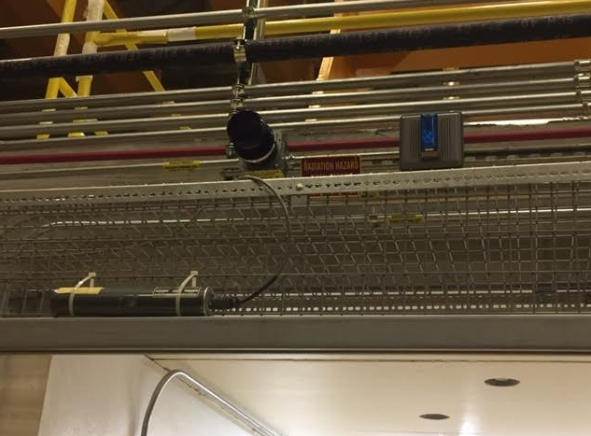
Entering the Enclosure when OPEN, no dosimetry required
Of course, access permitted only when the Enclosure is OPEN
Magenta beacon OFF

Slide 14
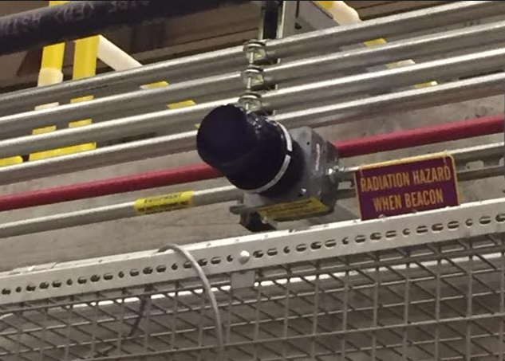
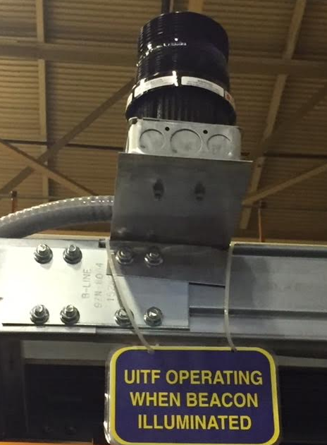
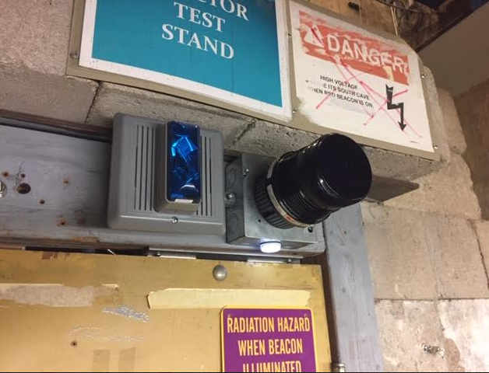
Magenta Beacons
There are four magenta beacons: at each entrance, and two on the Cave1 rooftop between electronics racks
SAF 160: UITF Operator Training

Slide 15
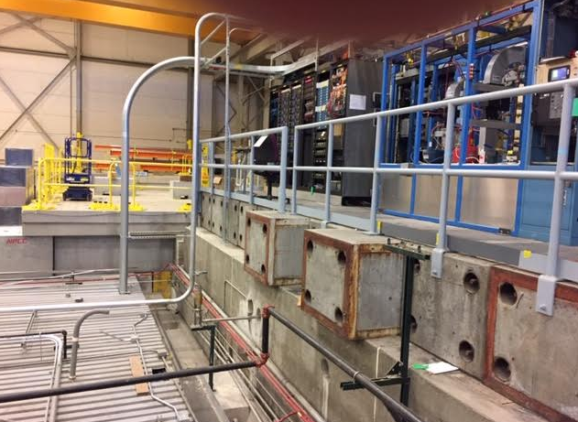
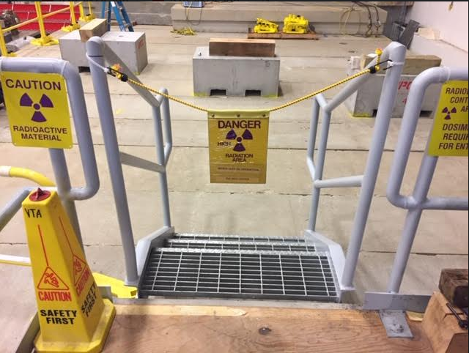
UITF Rooftops when Magenta Beacons are ON
Cave1 rooftop access to electronics racks: YES with dosimeter
Cave2 rooftop
Cave1 rooftop
but NO access to Cave2 rooftop

Slide 16
Oxygen Deficiency Hazards (ODH) at UITF
ODH is a serious concern at UITF
There are two cryogenic liquids inside UITF enclosure: LHe and LN2
There are two noteworthy room temperature gases: GN2 and SF6
For elevation < 9’, the enclosure was designed to ensure ODH0 conditions unless u-tubes are being stabbed, or when HDIce brings large dewars of LHe into the enclosure
We don’t “take credit” for the two exhaust fans inside UITF
The booster vent stack is plumbed outside the UITF enclosure
In case of large LHe spill, passive vents ensure safe ODH0 conditions inside UITF enclosure
Chimney stacks ensure safe ODH0 conditions at Cave1 rooftop electronics racks
Flow limiting orifice installed in the room temperature GN2 gas supply lines
Memory foam inserted in ceiling penetrations and trenches
Safety System Group has installed an ODH monitoring system: (3) heads for helium, (1) head for nitrogen
There‘ is not enough SF6 inside the high voltage power supply tank to pose a problem

Slide 17
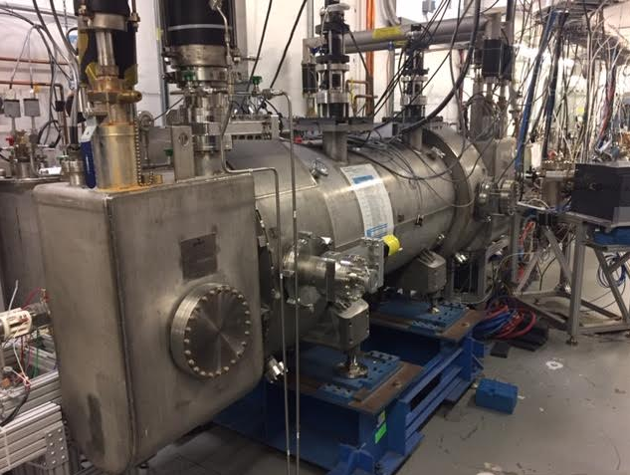
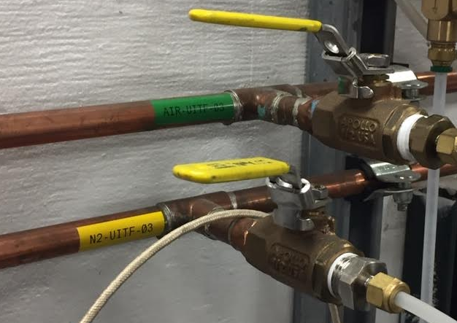
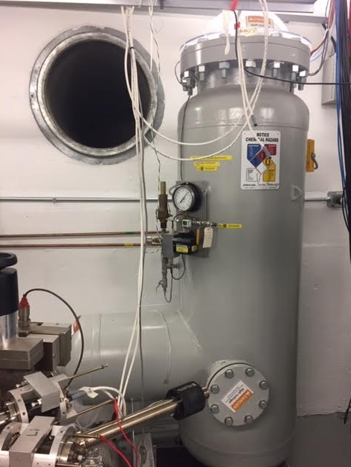
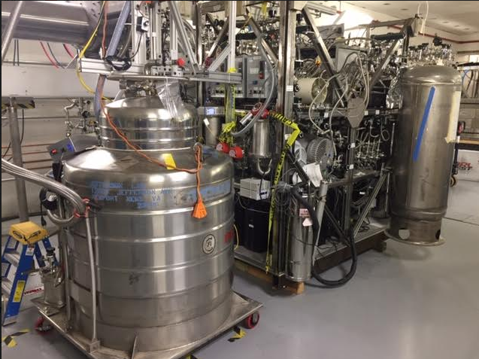
Oxygen Deficiency Hazards (ODH) at UITF
Liquid Helium (LHe): ~ 100 L in the booster cryostat, ~ 500 L in HDIce dewar
Liquid Nitrogen (LN2): 50 L HDIce
Gaseous Nitrogen (GN2): boil off from dewar outside Test Lab
Sulfur Hexaflouride SF6, gun HV power supply tank to suppress corona and HV discharge

Slide 18
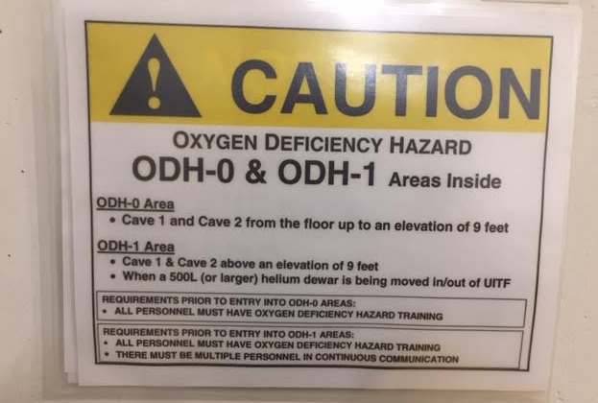
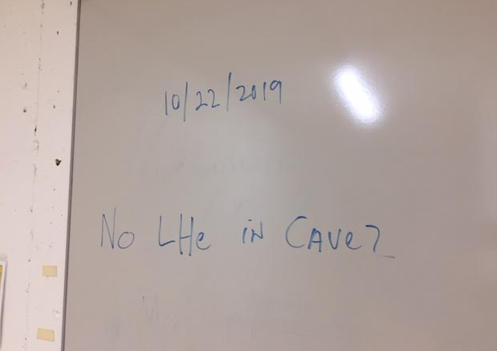
Oxygen Deficiency Hazards (ODH) at UITF
and ODH 1 when u-tubes are being stabbed
Conditions are described on white board at entryway

Slide 19
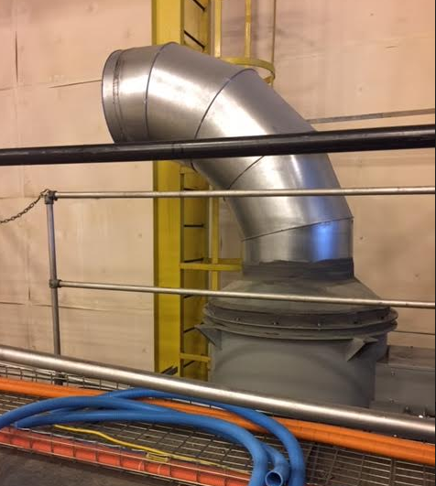
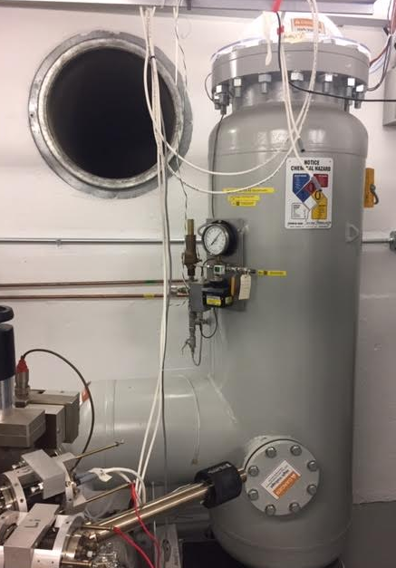
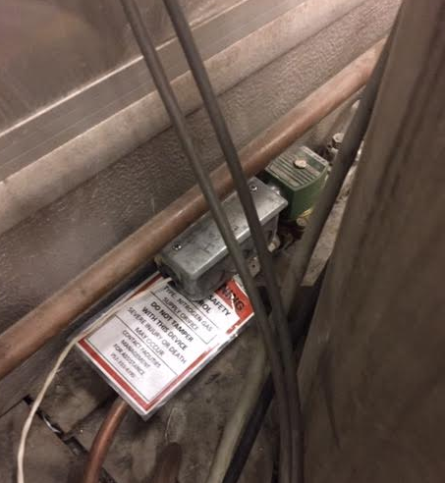
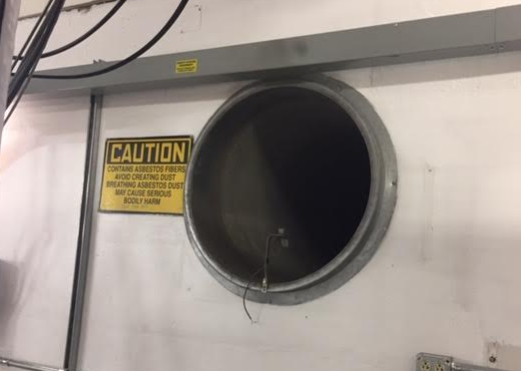
Oxygen Deficiency Hazards (ODH) at UITF
We don’t “take credit” for ventilation
Blower needs electricity and this might not be available when things go wrong
Volume of SF6 is small compared to volume of room
SF6 is heavy compared to air, it would occupy space < 1” thick on floor
Orifice used to restrict GN2 flow to UITF

Slide 20
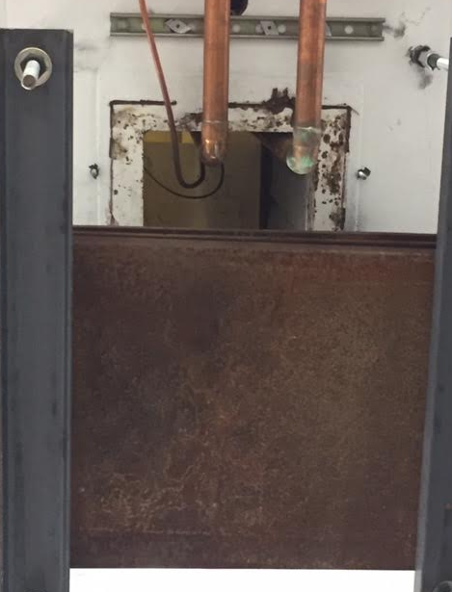
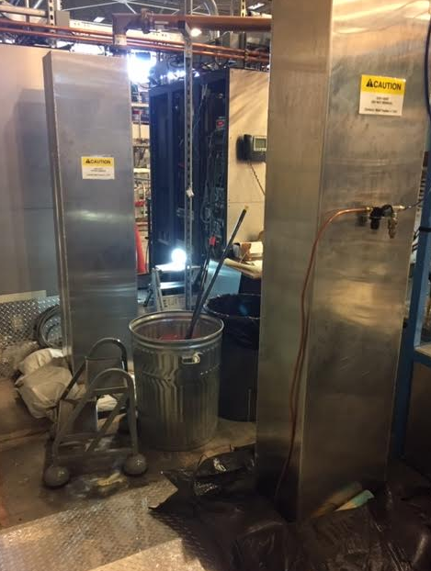
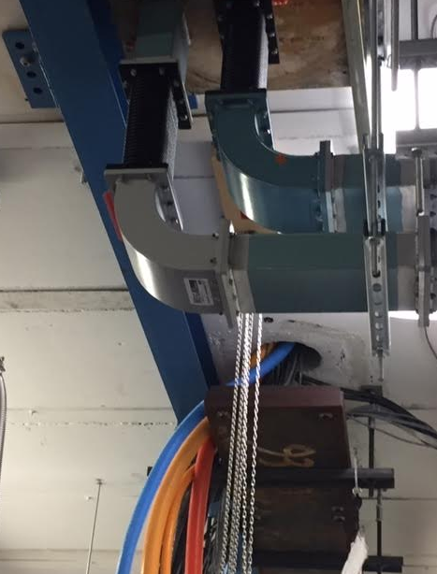
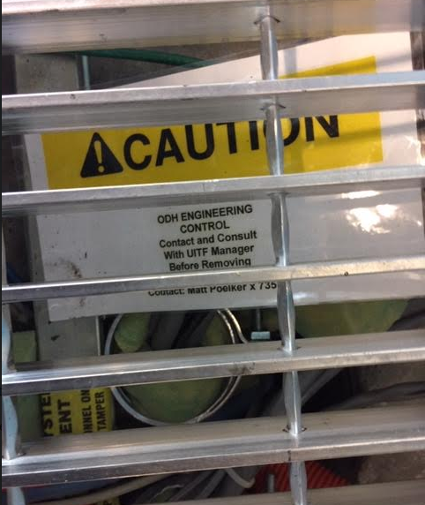
Oxygen Deficiency Hazards (ODH) at UITF
Cave1: two penetrations provide passive venting, note tall chimneys to keep workers on Cave1 rooftop safe
Cave1: the other penetrations are blocked to provide safety for people working on Cave1 rooftop, inside the racks

Slide 21
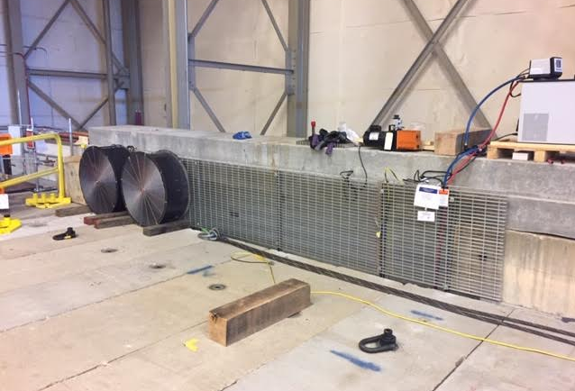
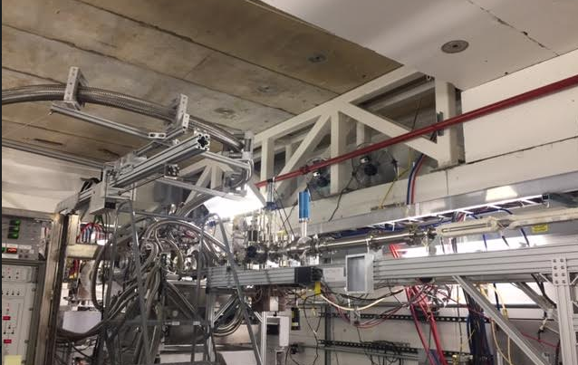
Oxygen Deficiency Hazards (ODH) at UITF
Large passive vent inside Cave2 (fans in photo not required for ODH safety)

Slide 22
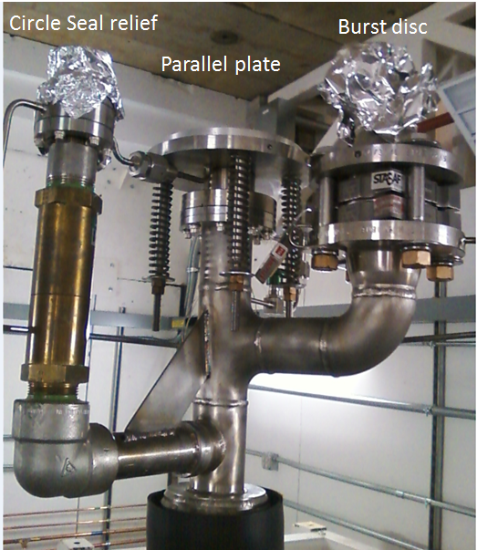
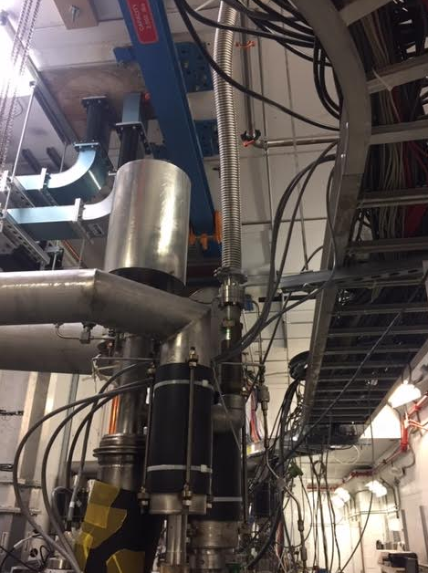
Oxygen Deficiency Hazards (ODH) at UITF
We vent the circle-seal relief valve out of the UITF enclosure, and we direct the flow of gas from parallel plate relieve valve upward

Slide 23
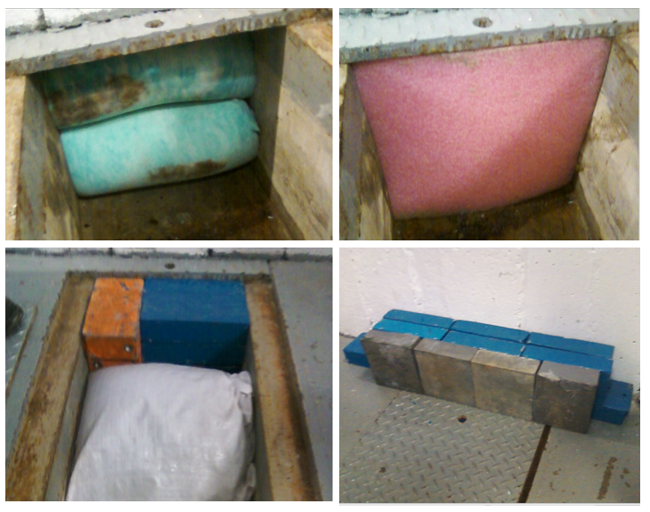
Oxygen Deficiency Hazards (ODH) at UITF
All of the trenches are packed with foam to restrict the flow of heavy gasses to occupied areas, like the control room
(trenches also packed with sand and lead brick, to provide radiation shielding)

Slide 24
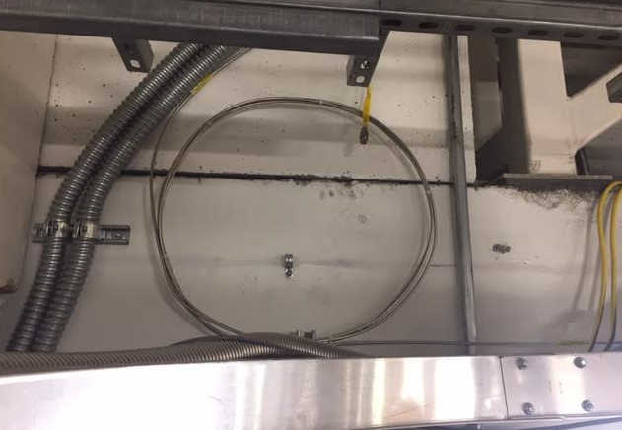
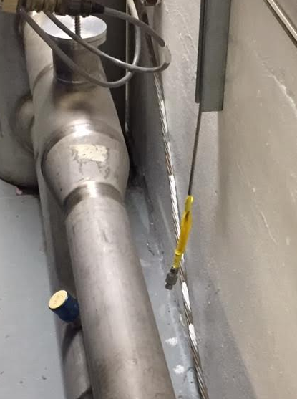
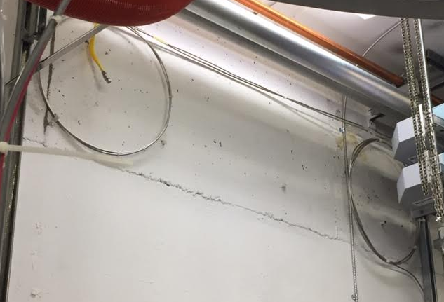
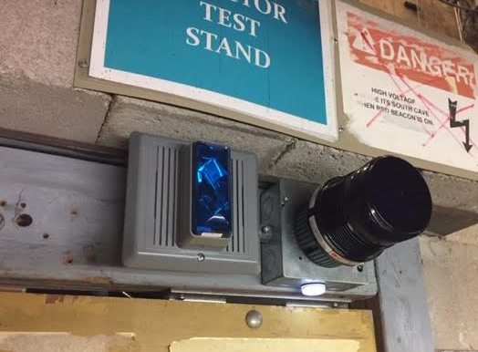
Oxygen Deficiency Hazards (ODH) at UITF
ODH monitoring system, built and maintained by Safety System Group
Periodic checks of the heads
Three heads for helium, one head for nitrogen
ODH beacons and sirens

Slide 25
UITF Accelerator…also a “Gun Test Stand”
keV
Gun Test Stand here…..
MeV
“accelerator” over here…..
The “mode” matters, Gun Test Stand versus Accelerator. How will you know which mode we are in? More on this topic later when we discuss “beam authorization”

Slide 26
Official Documentation
https://wiki.jlab.org/ciswiki/index.php/UITF_Official_Documents
These documents were approved by Lab Leadership and TJSO
https://www.jlab.org/eshq/ProgramDocs

Slide 27
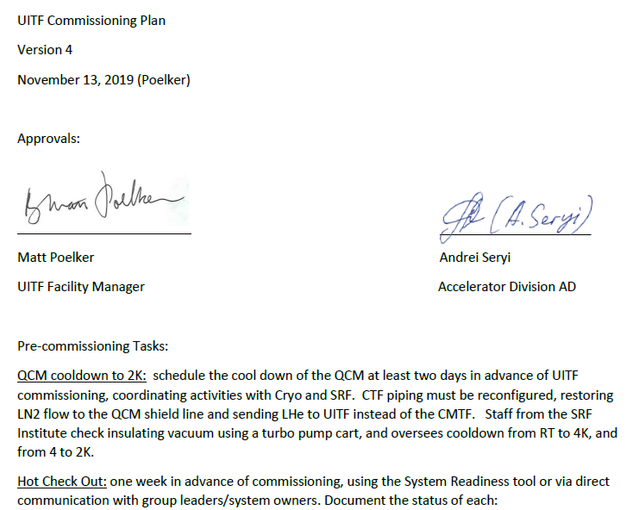
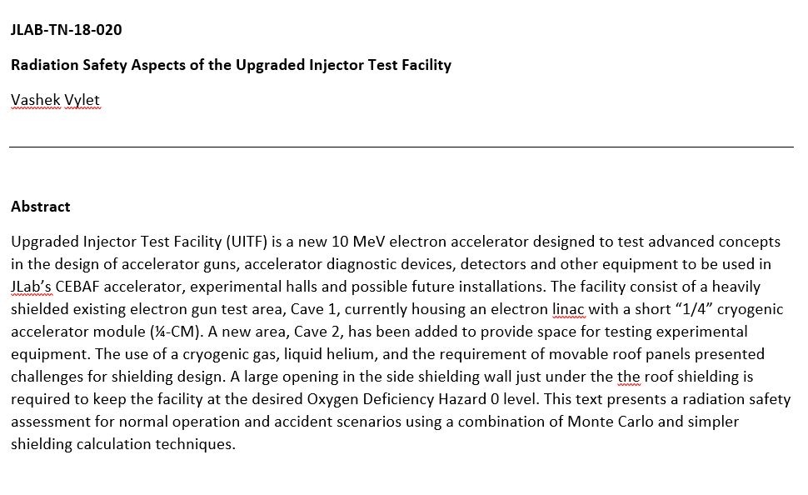
Radiation Shielding Assessment and Commissioning Plan
https://wiki.jlab.org/ciswiki/index.php/UITF_Safety_Documents
Shielding is adequate for 100 uA CW beam
https://wiki.jlab.org/ciswiki/index.php/UITF_Official_Documents

Slide 28
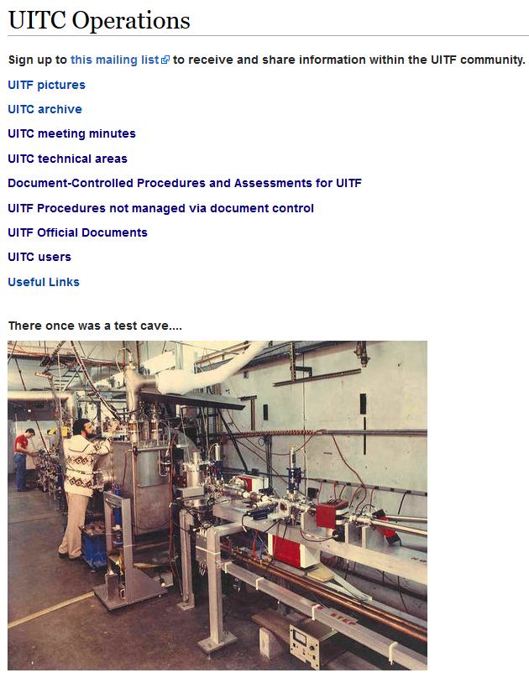
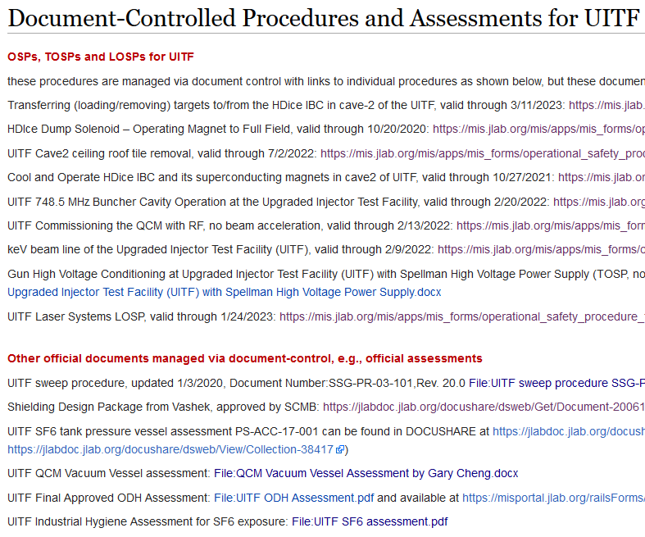
Procedures: preferred way of doing business
https://wiki.jlab.org/ciswiki/index.php/UITC_Operations
https://wiki.jlab.org/ciswiki/index.php/Document-Controlled_Procedures_and_Assessments_for_UITF

Slide 29
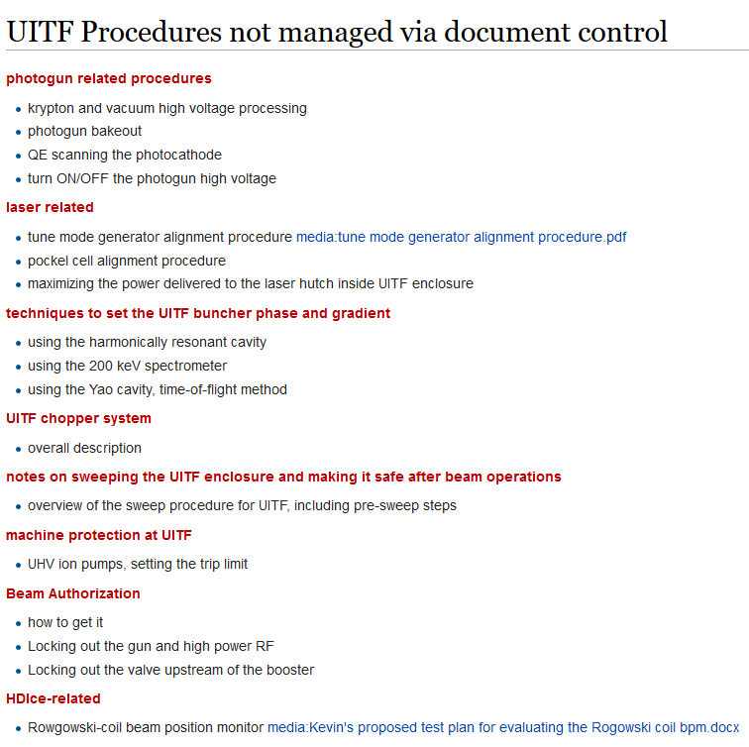
Procedures: preferred way of doing business
https://wiki.jlab.org/ciswiki/index.php/UITF_Procedures_not_managed_via_document_control
if you Operate UITF, you are going to contribute procedures

Slide 30
UITF Accelerator…also a “Gun Test Stand”
keV
Gun Test Stand here…..
MeV
“accelerator” over here…..
The “mode” matters, Gun Test Stand versus Accelerator. How will you know which mode we are in?

Slide 31
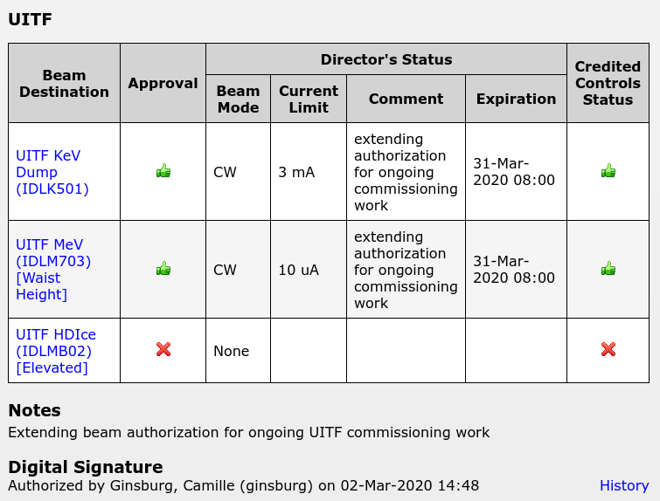
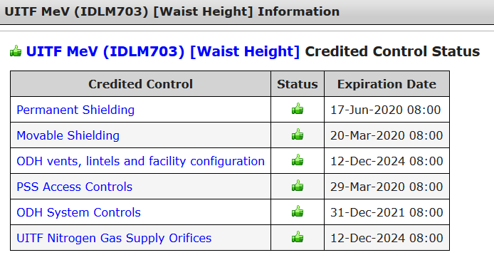
Beam Authorization

Slide 32
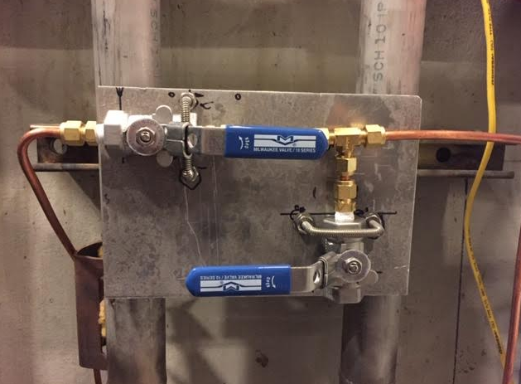
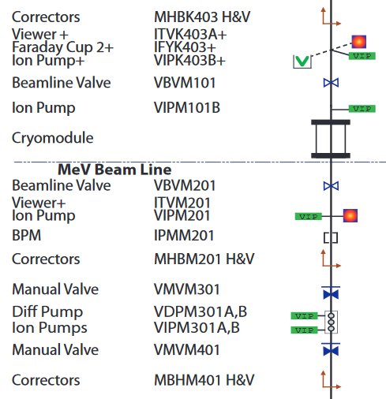
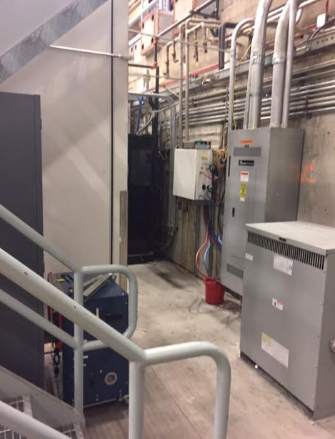
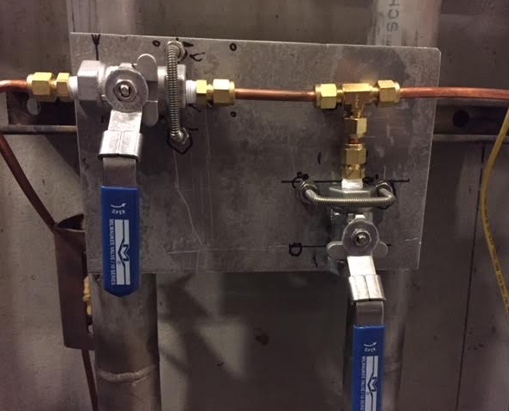
Beam Authorization: Lock-out the valve upstream of booster

Slide 33
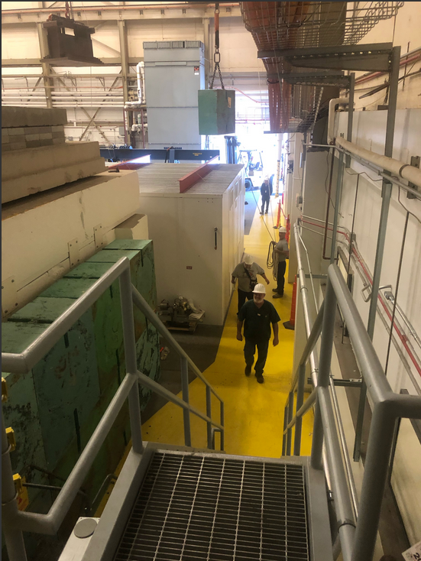
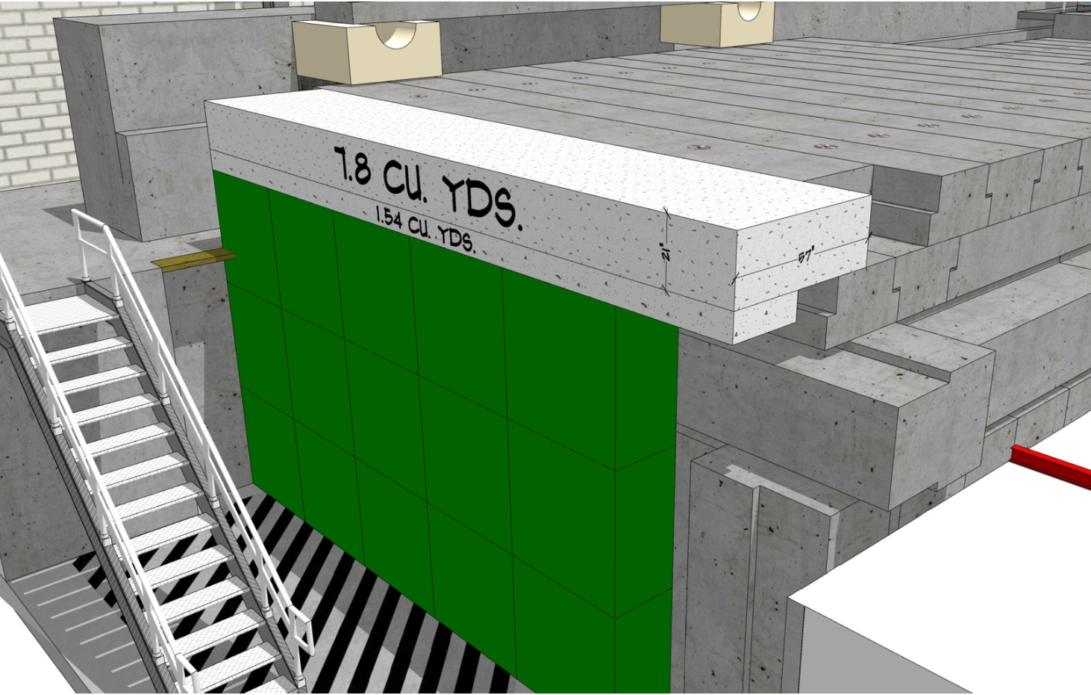
Credited Control: Radiation Shielding

Slide 34
Credited Control

Slide 35
Credited Control

Slide 36
Personnel Safety System (PSS)
PSS chassis inside the UITF Control Room. No computer console, no epics readback
Modes: OPEN, SWEEP, RUN
Lights on the PSS chassis display status and system alarms
Laser bypass mode

Slide 37
Sweeping the Cave

Slide 38
Laser Bypass Mode

Slide 39
UITF Hardware and Controls
UITF overview: capabilities and uses
About UITF: geographic location, regions Cave1 Cave2 rooftop, fire extinguishers, pull stations, phones, dosimeter requirements, etc.,
Rooftops Cave1 and Cave2: electronics racks, names and locations, access restrictions
ODH
UOD, ASE and FSAD
Commissioning, then Operating the UITF accelerator
Beam Authorization
Credited Controls and Defense in Depth: current limits at UITF
PSS description, including Sweeping the enclosure
Gun modes
Gun HV
Drive laser
Valves and vacuum
Viewers
Magnets used at UITF including field maps and dipole calibrations (I versus B)
Beam position monitors
Current monitoring: cups, dumps, apertures, BCMs
RF systems: field control chassis, drive laser, choppers, buncher, two cell, seven cell
Control of these items is mostly identical to controls at CEBAF, by design

