Slide 1
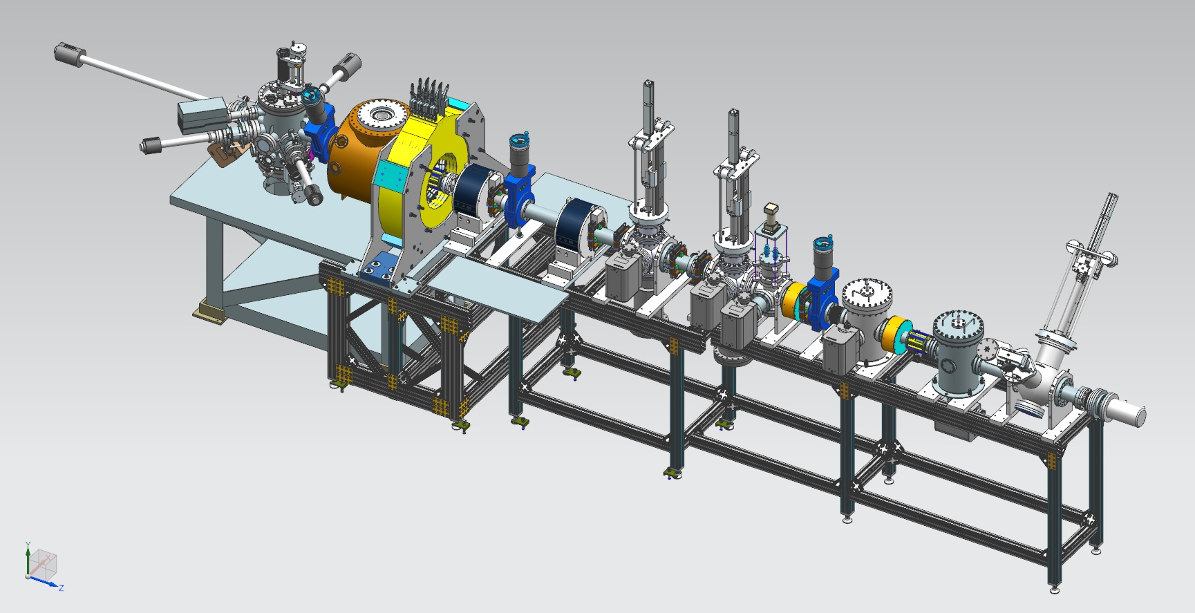

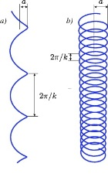
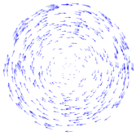
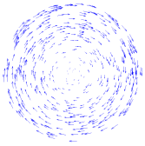

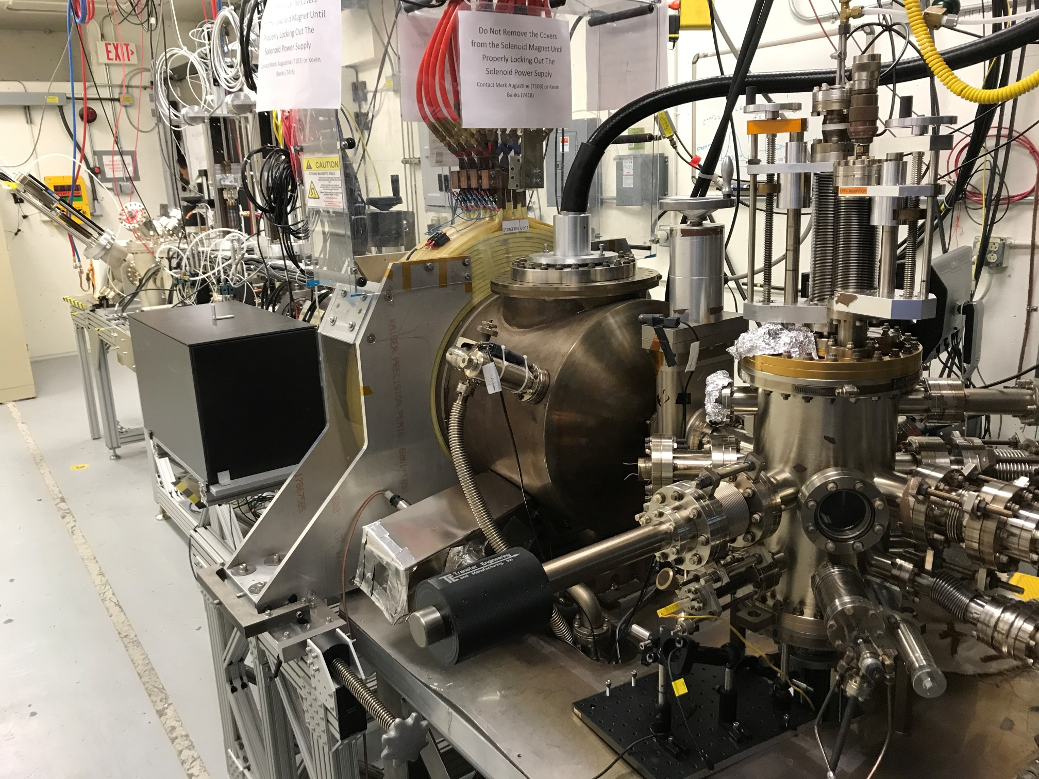
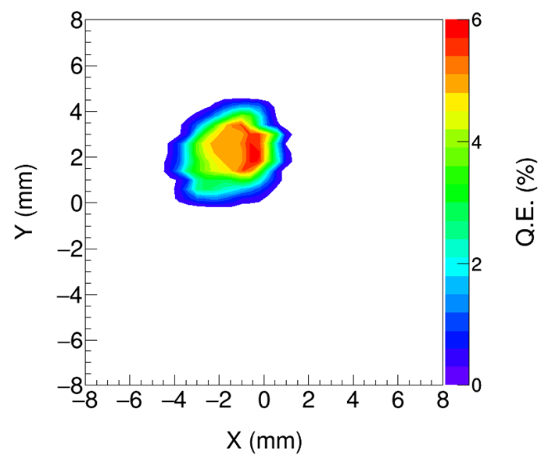
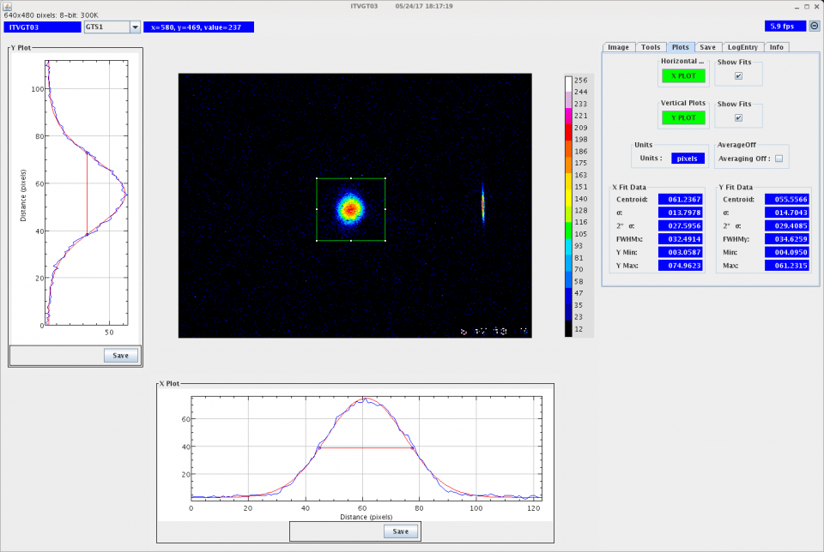
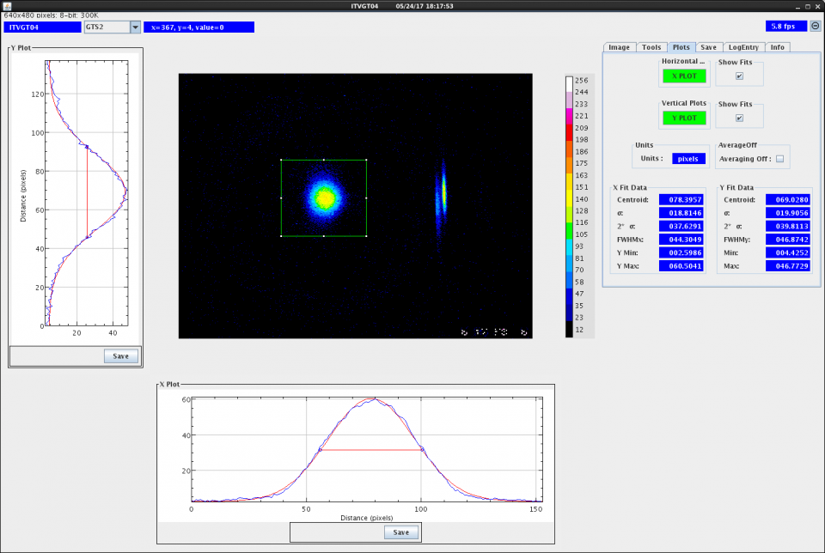
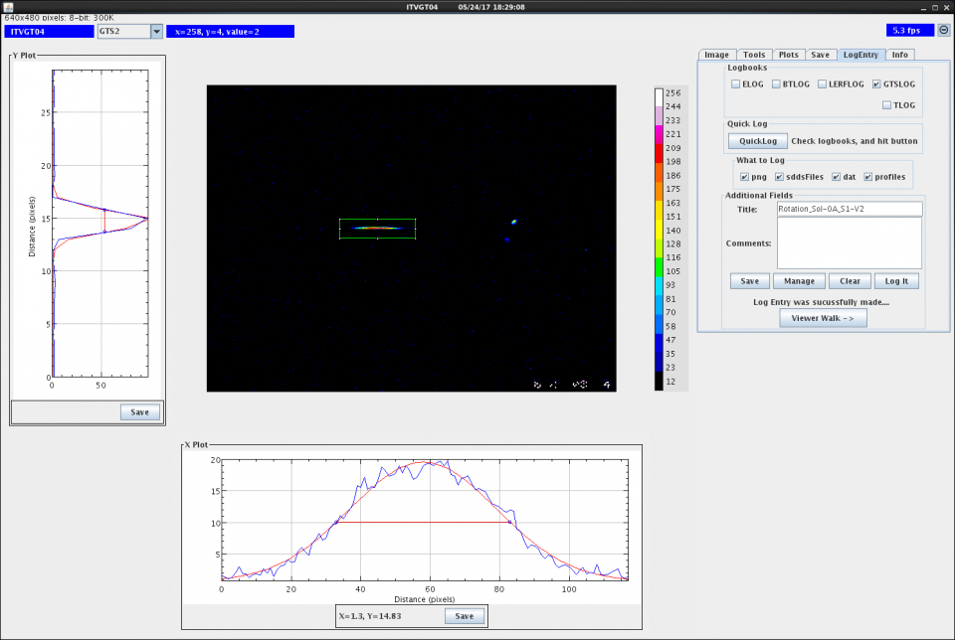
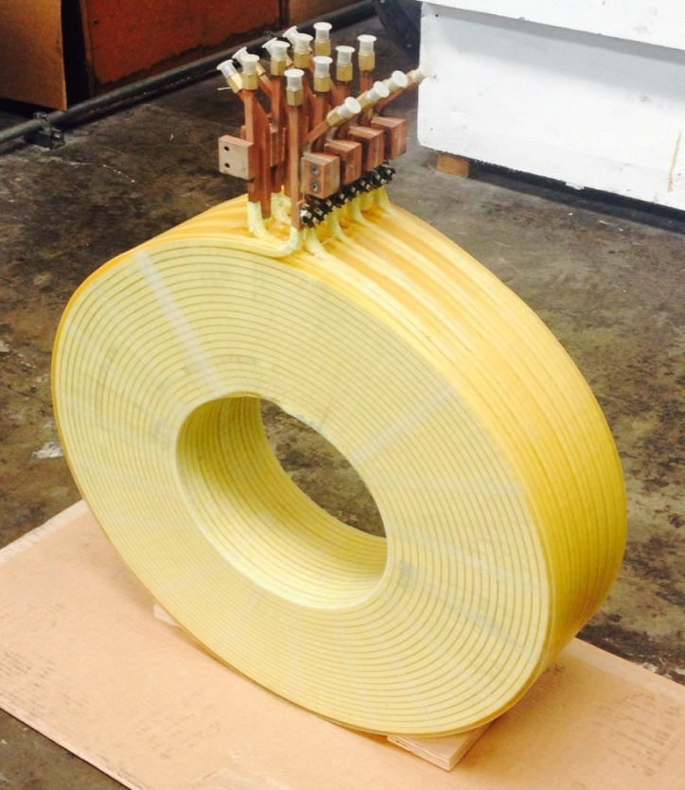
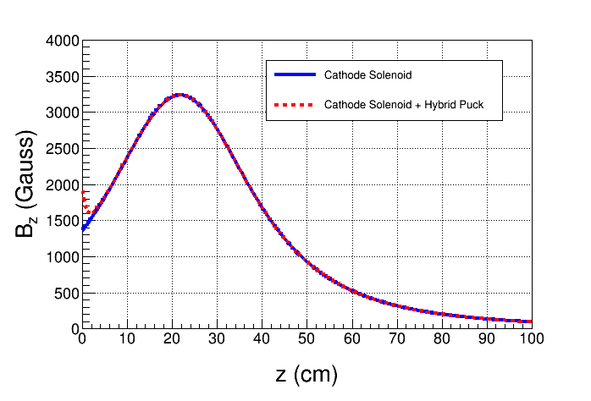
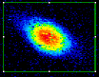
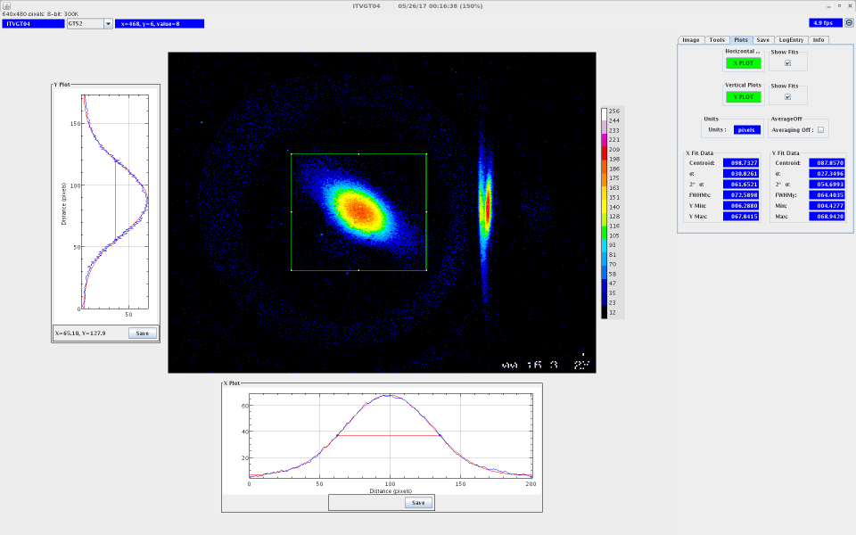
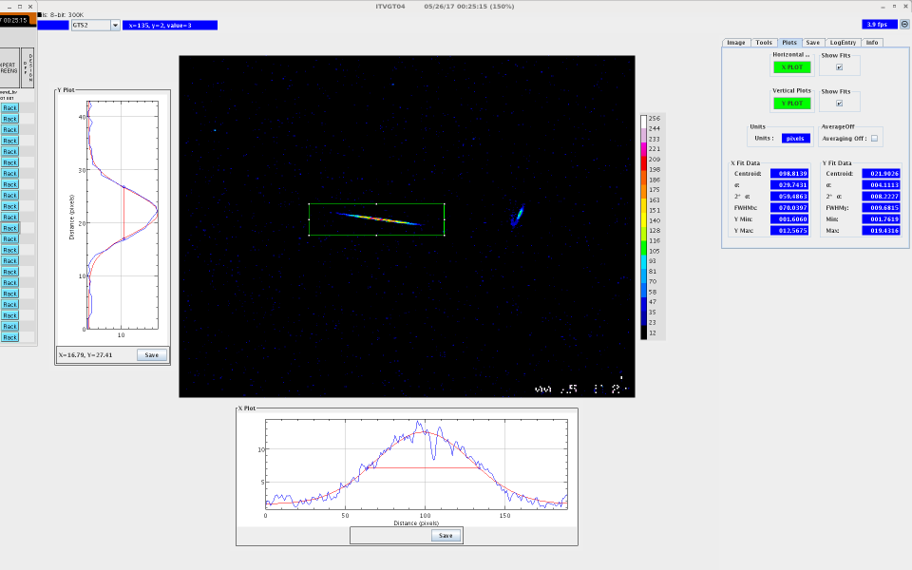
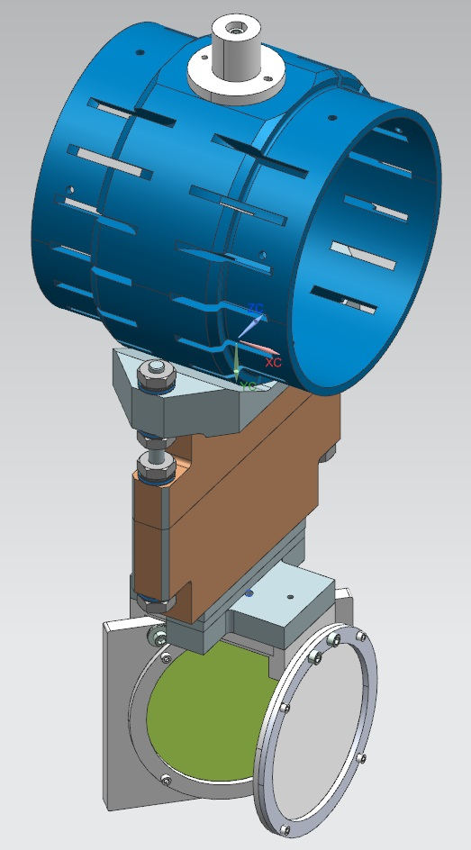
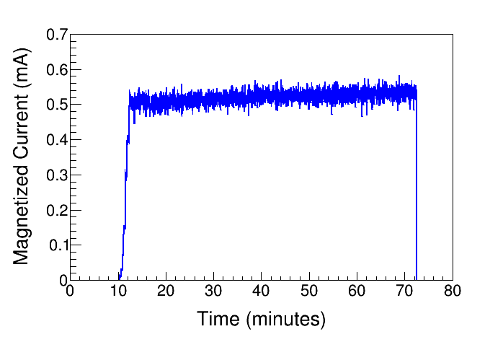
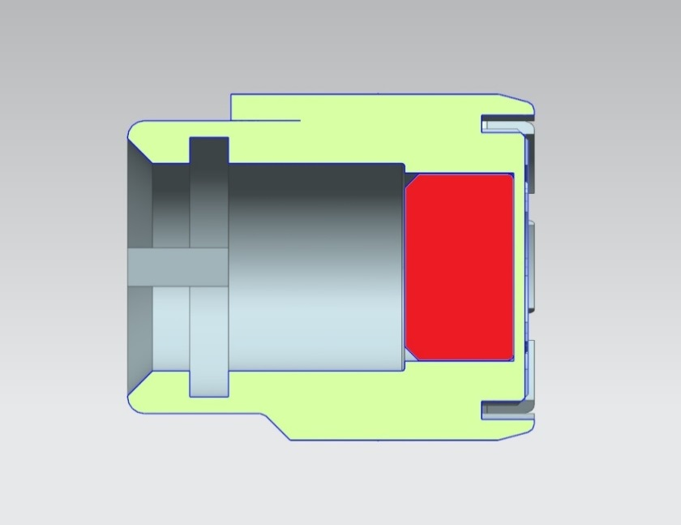
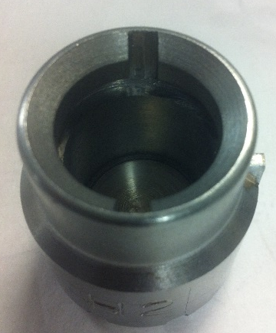

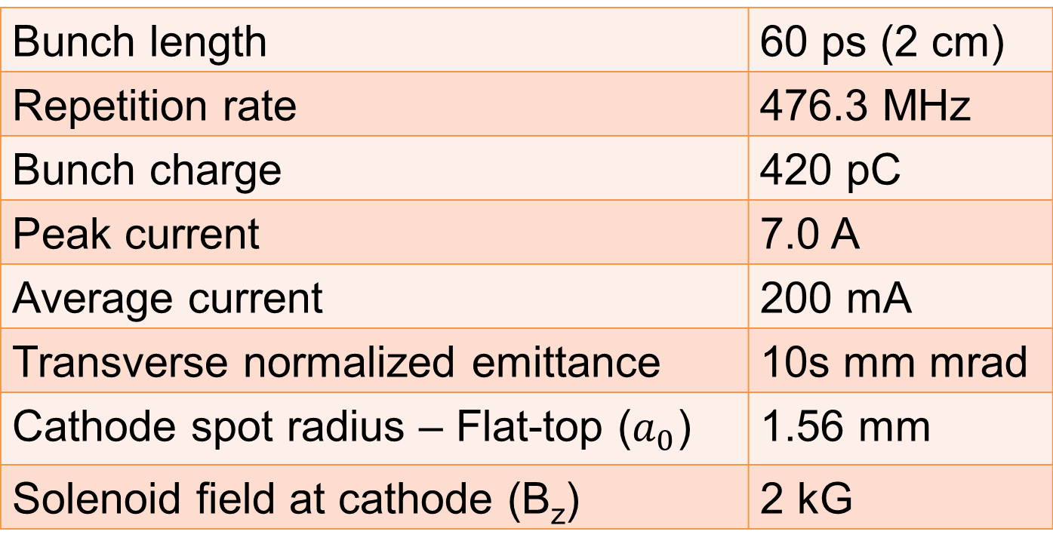

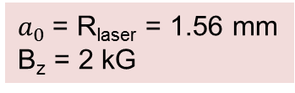
Magnetized Electron Beam for Ion Cooling at JLEIC
Y. Wang, P. Adderley, J. Benesch, B. Bullard, J. Grames, F. Hannon, J. Hansknecht, C. Hernandez-Garcia,
R. Kazimi, G. Krafft, M. A. Mamun, M. Poelker, R. Suleiman, S. Wijiethunga, J. Yoskovitz, S. Zhang
Jefferson Lab Users Group Annual Meeting June 19, 2017
Gun Test Stand
JLEIC
(Jefferson Lab Electron Ion Collider)
Cooling With
Magnetized Electron Beam
Electron beam suffers an azimuthal kick at entrance of cooling solenoid. But this kick can be cancelled by an earlier kick at exit of photocathode. That is
the purpose of large solenoid near the photogun.
Electron Cooler
Long solenoid of cooling ring provides desired cooling effect, containing ion beams and enhancing cooling efficiency, suppressing electron-ion recombination, and counteracting emittance degradation induced by intra-beam scattering, but putting electron beam into cooling solenoid represents a challenge.
Cathode Solenoid
Cooling Solenoid
SRF LINAC
electron
ion
Six meter beamline consist of photocathode pre-paration chamber, gun chamber, cathode solenoid to magnetize beam, four lenses, three viewers and two slits, vacuum pumps and beam dump
Cooling Solenoid
Electrons born in strong uniform B_{z}
Upon exit of Cathode Solenoid
Upon entering Cooling Solenoid
Electron Cooling
To achieve required luminosity of 10³⁴ cm⁻² s⁻¹, ion beams at JLEIC must be cooled. In general, this is accomplished when an electron beam co-propagates with ion beam moving at same average velocity, but different temperatures (𝑇_{𝑒}≪𝑇_{i}), where energy of chaotic motion of the ion beam is transferred to cold electron beam.
JLEIC proposal relies on
Magnetized Beam Cooling
ion bunch
electron bunch
= 36 µm
$a_{0}$= R_{laser} = 1.56 mm
B_{z} = 2 kG
r_{e}= 0.7 mm
B_{cool} = 1 T
energy recovery
Bunch length | 60 ps (2 cm)
Repetition rate | 476.3 MHz
Bunch charge | 420 pC
Peak current | 7.0 A
Average current | 200 mA
Transverse normalized emittance | 10s mm mrad
Cathode spot radius – Flat-top ($a_{0}$) | 1.56 mm
Solenoid field at cathode (B_{z}) | 2 kG
injector
SRF Linac
dump
Utilizes Energy-Recovery-Linac (ERL) (11MW)
Cooling Uses a Bunched Electron Beam
Cathode Solenoid
Power supply voltage 72 V
Maximum current 400 A
Field at photocathode 1.4 kG
K₂CsSb photocathodes provide
stable QE and lifetime
Beam on viewers
Summary & Plan
Cathode Solenoid Off
Photogun operates reliably at 300 kV
Cathode solenoid can trigger field emission but we have learned how to prevent this
Have successfully magnetized electron beam and measured rotation angle of magnetized beam
Continue to characterize magnetized beam
- Different laser sizes
- Impact on beam emittance
- High beam current run, 5mA
Cross check beam-based measurements with simulation
Install an RF-pulsed laser
Use magnetic puck to increase beam magnetization
Cathode Solenoid On
One hour run with cathode solenoid at 400 A
Use slit and viewscreens to measure mechanical angular momentum
New Photocathode Holder
Enhance the magnetic field at cathode to 2.0 kG
slit
Molybdenum
$B_{z}$: field at photocathode
$a_{0}$: laser rms size
Φ: rotation (sheering) angle
Steel
Acknowledgement: This work is supported by the Department of Energy, Laboratory Directed Research and Development funding, under contract DE-AC05-06OR23177

