Slide 1
GPT Simulations: Centering Beam through 1.5m
Josh Yoskowitz

Slide 2
Simulation Specs: Parameters used
Input Particle Distribution File: “dataimputbeam3.txt”
Simulation Time: tϵ[0,10ns], timestep=50ps
Space Charge ON (spacecharge3D)
Max Radius: Global maximum of R=0.034m. Local maximum of R=0.01m in the range zϵ[0.0614m,0.0744m] (where anode is).
Ionization OFF

Slide 3
Simulation Specs: Magnet Strengths and Specs
MBH2I01 (BField.txt)
Center: z=0.297m
Field Map Range: zϵ[0.257m,0.337m]
Field Map Scaling Factor:
H: -6e-8 (Peak Field ≈ -6mG, Flux Gradient ≈ -0.065Gcm)
V: 1.9e-4 (Peak Field ≈ 19G, Flux Gradient ≈ 205.2Gcm)
MBH2I02 (BField.txt)
Center: z=0.5m (formerly z=0.646m)
Field Map Range: zϵ[0.46m,0.54m]
Field Map Scaling Factor
H: 4e-8 (Peak Field ≈ 4mG, Flux Gradient ≈ 0.043Gcm)
V: 1.9e-4 (Peak Field ≈ -11.5G, Flux Gradient ≈ -124.2Gcm)
MFH2I01 (Solenoid_FieldMap_XYZ.txt)
Center: z=0.760m
Field Map Range: zϵ[0.560m,0.960m]
Field Map Scaling Factor: 1.4e-3 (Peak Field ≈ -193.1G, Flux Gradient ≈ -1931Gcm)
MBH2I03 (BField.txt)
Center: z=0.970m
Field Map Range: zϵ[0.930m,1.10m]
Field Map Scaling Factor:
H: -3e-6 (Peak Field ≈ -0.3G, Flux Gradient ≈ -3.2Gcm)
V: 5.5e-6 (Peak Field ≈ 0.55G, Flux Gradient ≈ 5.9Gcm)

Slide 4
GPT Simulation: Side View
MBH2I01
MBH2I02
MFH2I01
MBH2I03

Slide 5
GPT Simulation: Front View

Slide 6
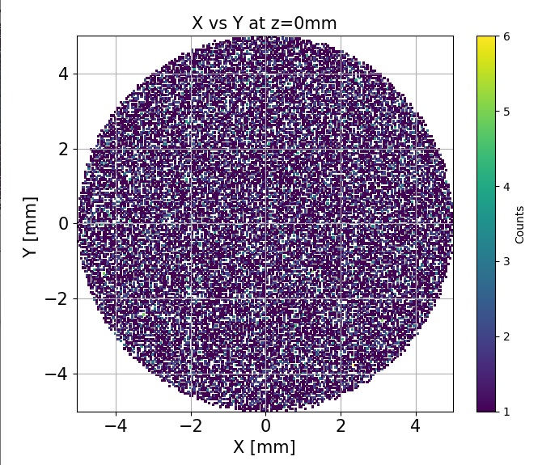
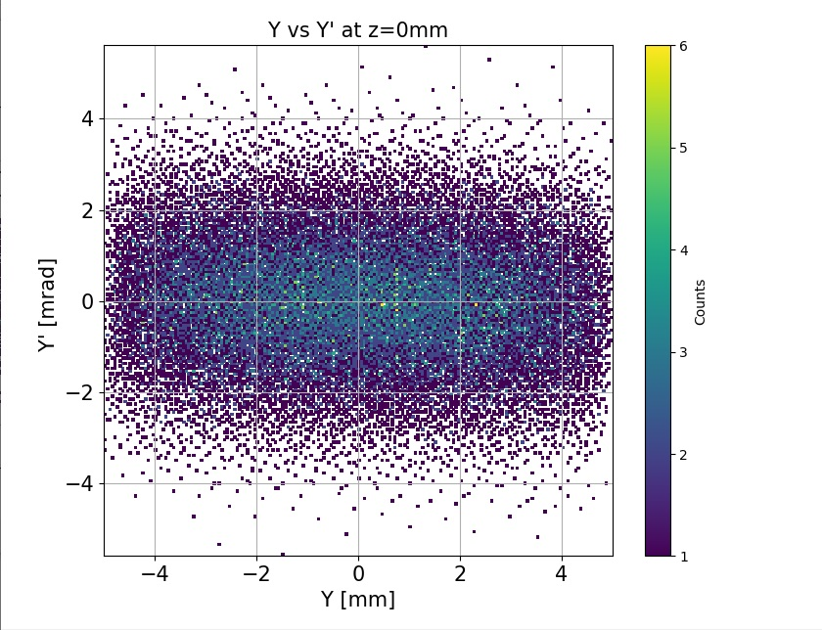
Screen Plots: 0m

Slide 7
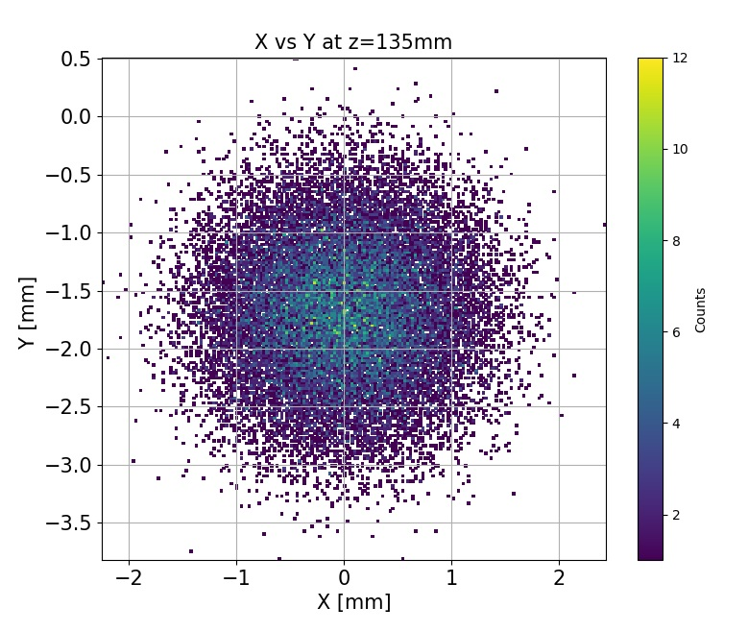
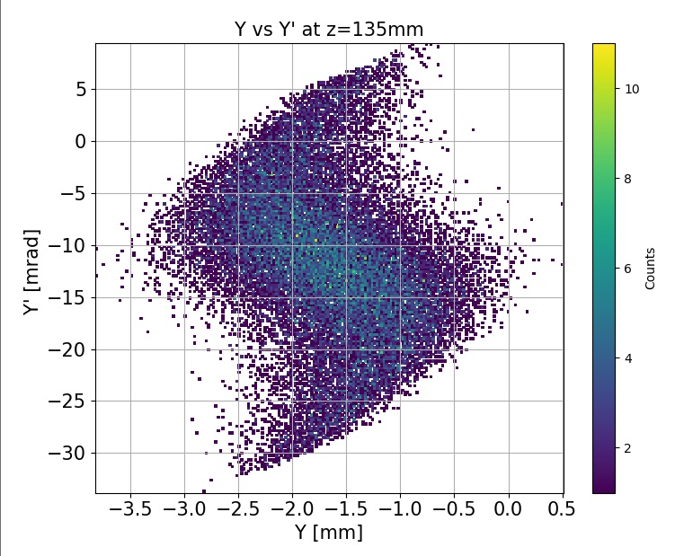
Screen Plots: 135mm

Slide 8
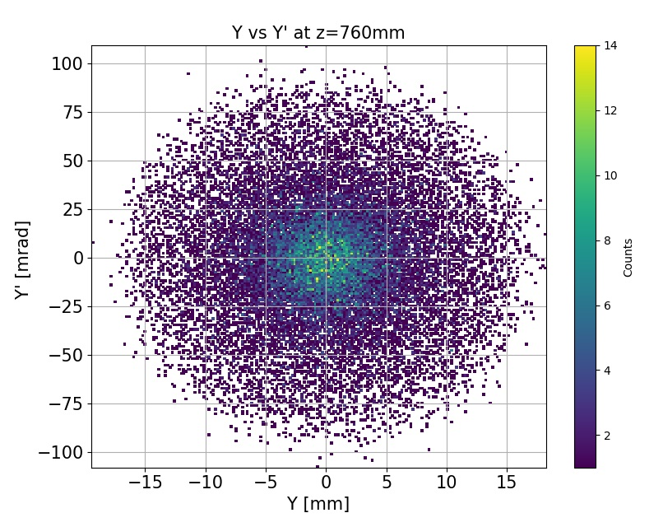
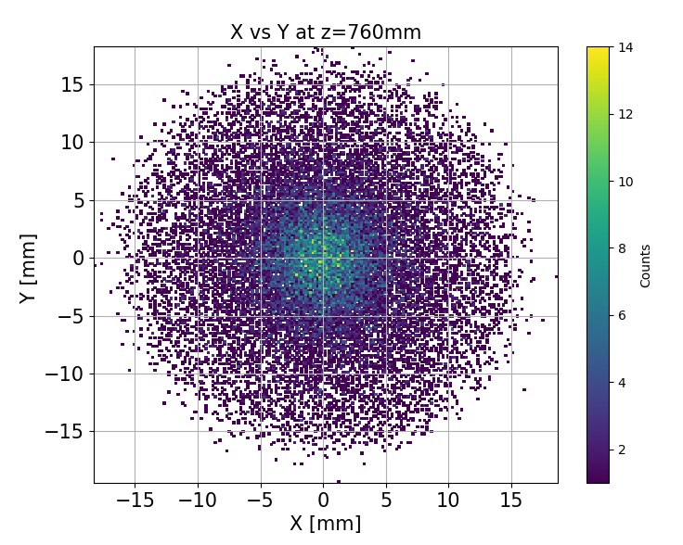
Screen Plots: 760mm

Slide 9
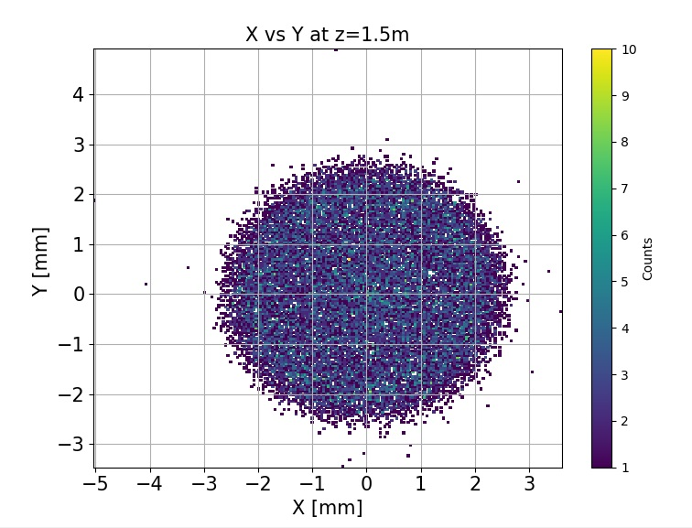
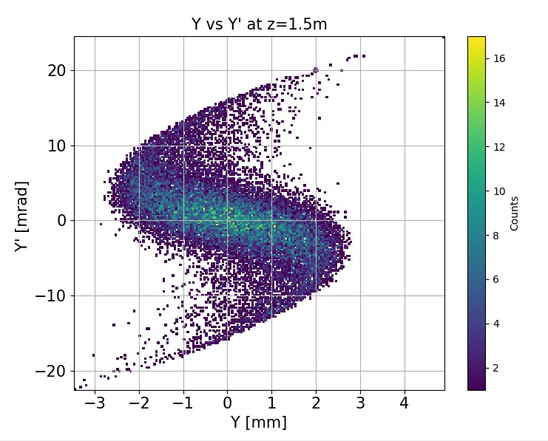
Screen Plots: 1.5m

Slide 10
Result Plots: RMS Beam Size vs Z

Slide 11
Result Plots: RMS Transverse Emittance vs Z (note logscale)

Slide 12
Result Plots: RMS Longitudinal Emittance vs Z (note the units)

Slide 13
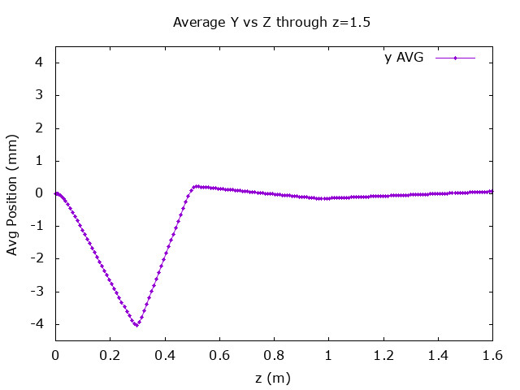
Result Plots: Avg Position vs Z

Slide 14
Result Plots: Avg Norm Momentum vs Z

Slide 15
Result Plots: Avg Kinetic Energy vs Z

