Slide 1
Magnetized Beam LDRD: Design Tasks
February 19, 2016

Slide 2
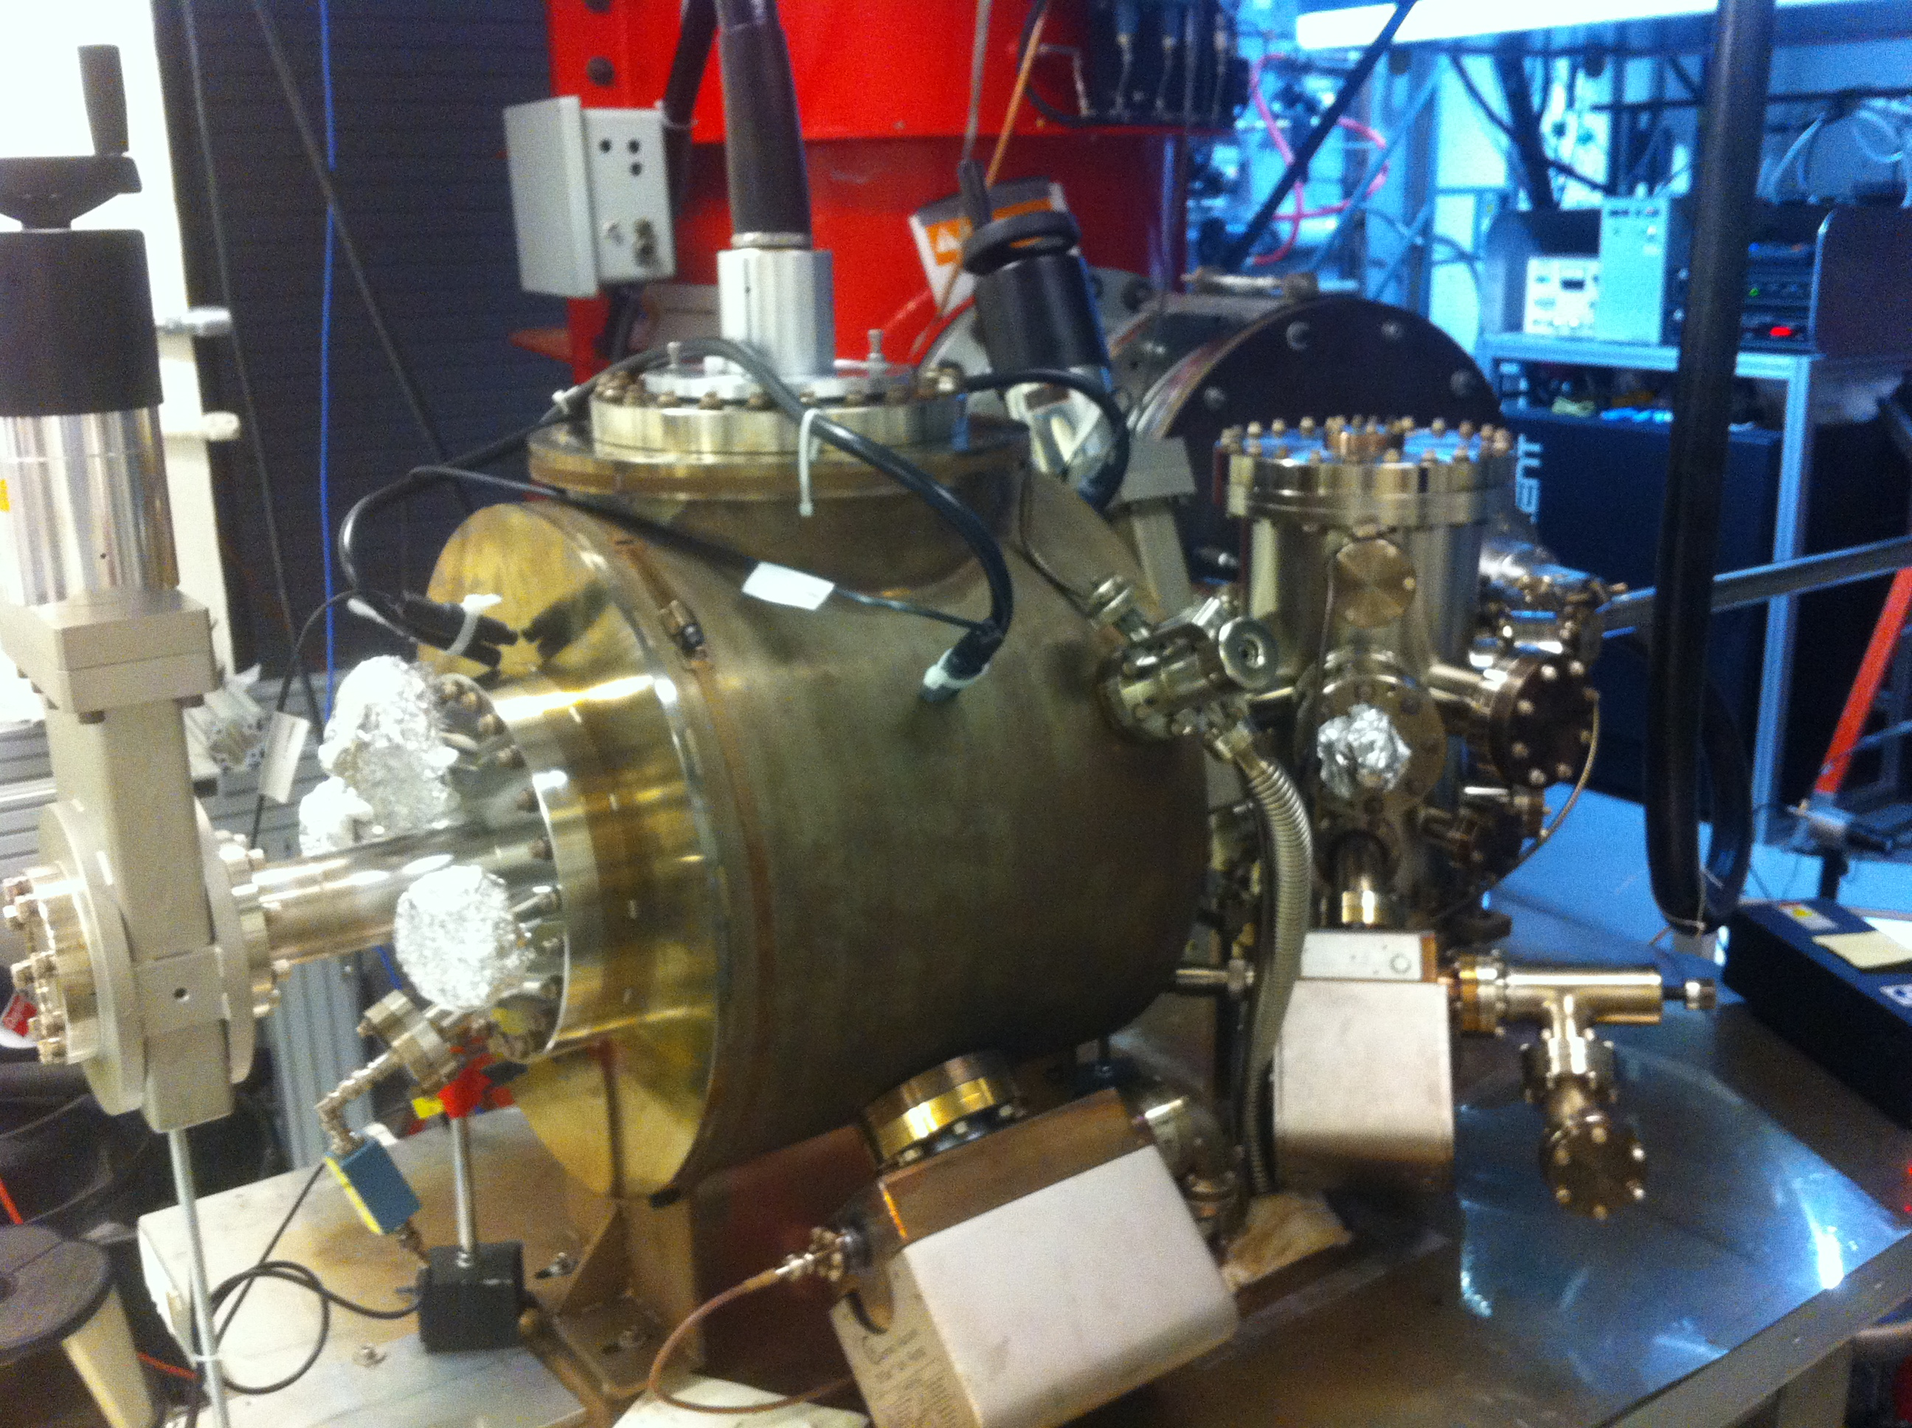
Magnetized Gun
K₂CsSb Preparation Chamber
HV Chamber

Slide 3
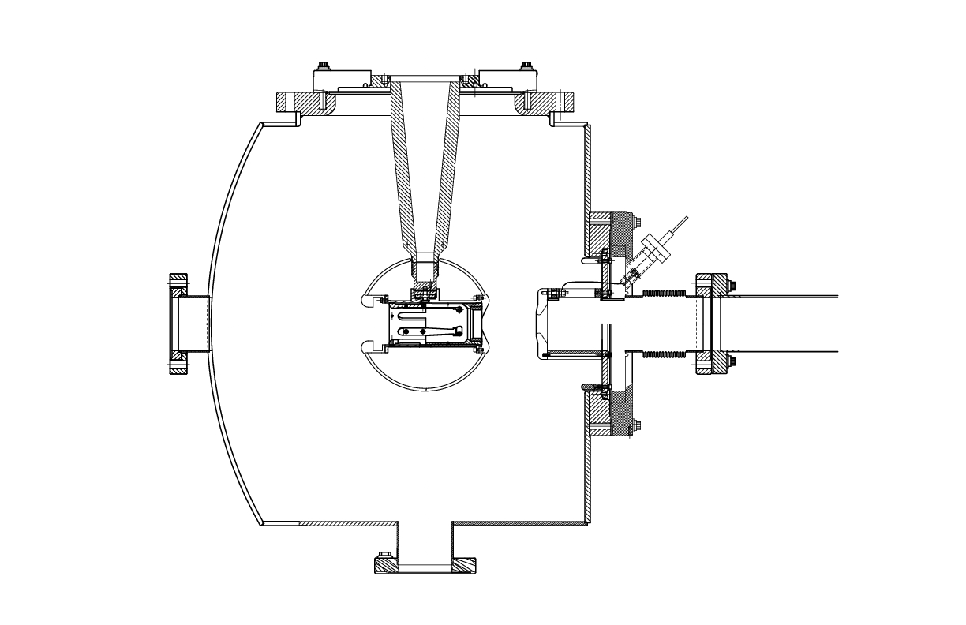
Solenoid + Steel Puck
Cathode-Anode Gap
6”
Steel Puck
9.0 cm
12”
18”
10”
Moly
6.4 cm
8”
7.5”
Gun Table
0.5”

Slide 4
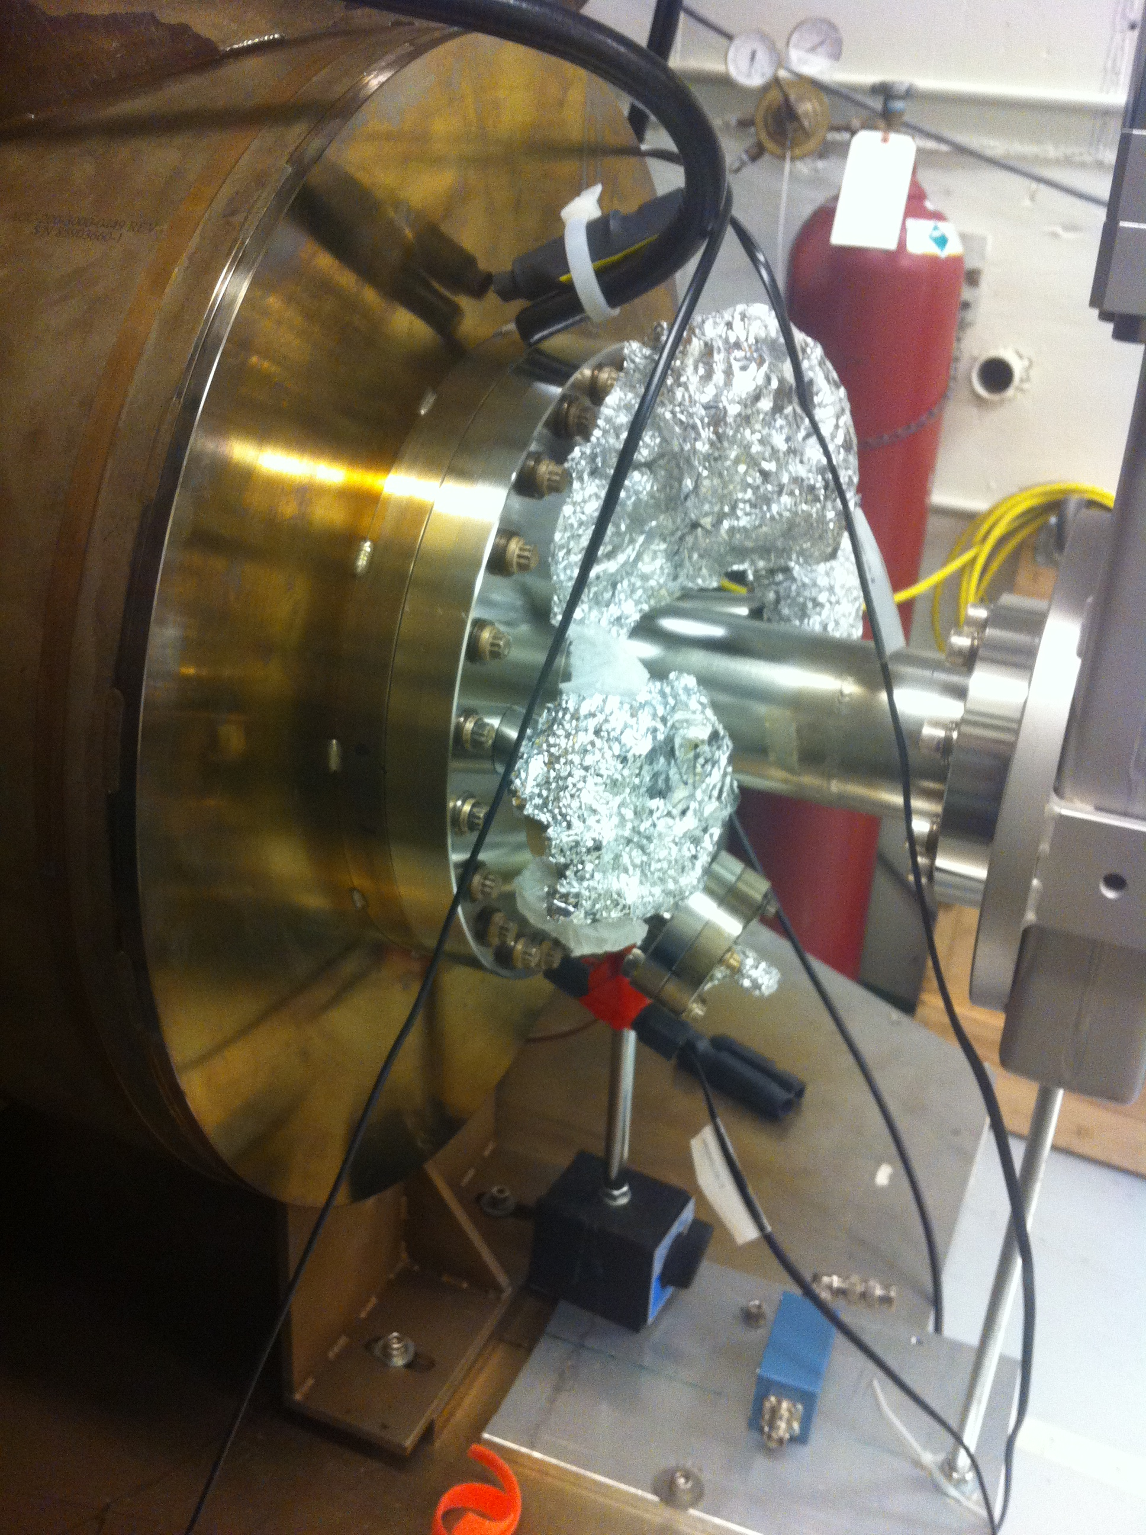
Update Cathode, Anode, and 10’’ flange
in drawing

Slide 5
Steel Puck
Molybdenum and Steel hybrid puck
Use 1010 carbon steel
New Puck Manipulator End Adapter

Slide 6
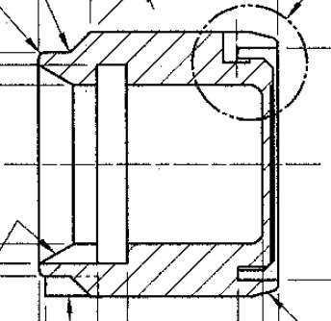
Design I
Moly
10 mm
6 mm
Steel
Brazed – not screwed

Slide 7
Design II
Stainless Steel
2 mm
4 mm
10 mm
2 mm
Steel

Slide 8
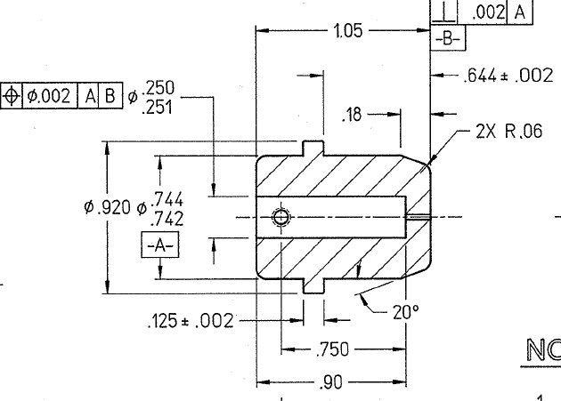
2 mm
Cut this part

Slide 9
Solenoid
Not bakable – will be mounted on rails. To bake gun: push downstream out of oven and run LCW through. Move gate valve after beamline solenoid (in place of BPM). Move HV Chamber front foot upstream
Bare coil – no cylindrical steel shield/return
Procurement (with help from T. Hiatt):
Everson Tesla
Buckley Systems
Alpha Magnetics
JLab Machine shop

Slide 10
Solenoid Specs
One water cooled magnet coil
Inside diameter 30 cm, round to 0.2 cm
Outside diameter roundness: 0.5 cm
Flatness, each side, 0.3 cm
Eight double pancakes of 20 turns each using Luvata 6092 or equivalent copper conductor, 9 mm square with 6 mm round hole for water cooling. These may be soldered or bolted together as vendor prefers, see also potting options below. Vendor should propose input/output flags suitable for 450A.
Eight parallel water cooling circuits, one per double pancake, with 37° flare JIC tube fittings. All eight water connections shall be located on the coil outer diameter within a 15 degree region of the assembly. Vendor shall provide a cooling water specification (flow rate and pressure) for each water circuit assuming 450A current and water inlet temperature of 35°C.
Coil cross-section shall be less than 16 cm Z by 20 cm R.
Vendor shall propose insulation system. Glass-epoxy with at least 110°C capability preferred. Potting may be done as a “bag job”. Tooling could also be built to pot four double pancakes as a coil half with four water circuits and two leads. Bolted jumper plate to electrically join the two halves shall be provided in this case. Or full depth tooling can be built.
Power supply is 500A, 80V and we plan to operate at 450A and 72V.

Slide 11
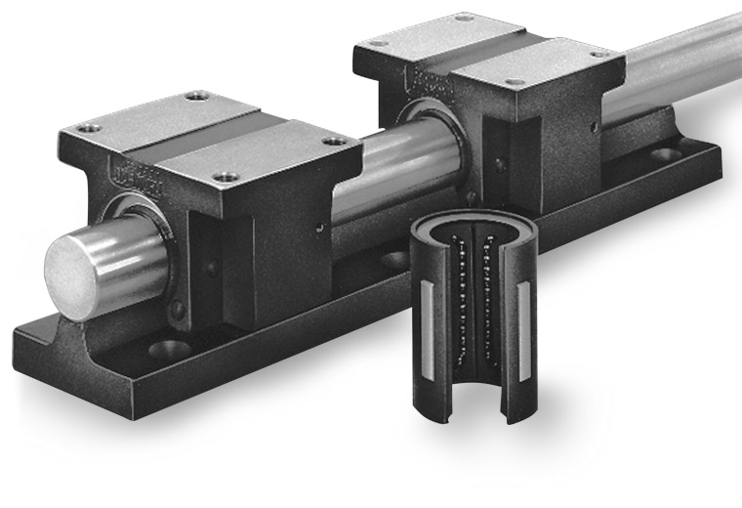
Solenoid Mounting
Allow for small adjustments to center solenoid on beam
Gun Table
Rails

Slide 12
Design Tasks
HV Chamber: update cathode, anode and 10’’ flange
Beamline: draw up to 3 feet downstream
Magnet Coil:
Fit to 10’’ flange, laser ports, gun table
Drawing for machine shop
Mounting
Steel puck and puck manipulator

