Slide 1
DAQ Map of
Electronic Components
R. Suleiman
January 29, 2013

Slide 2
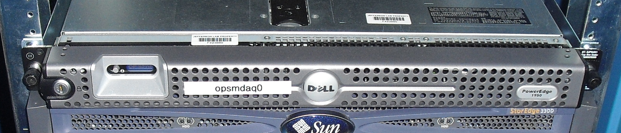
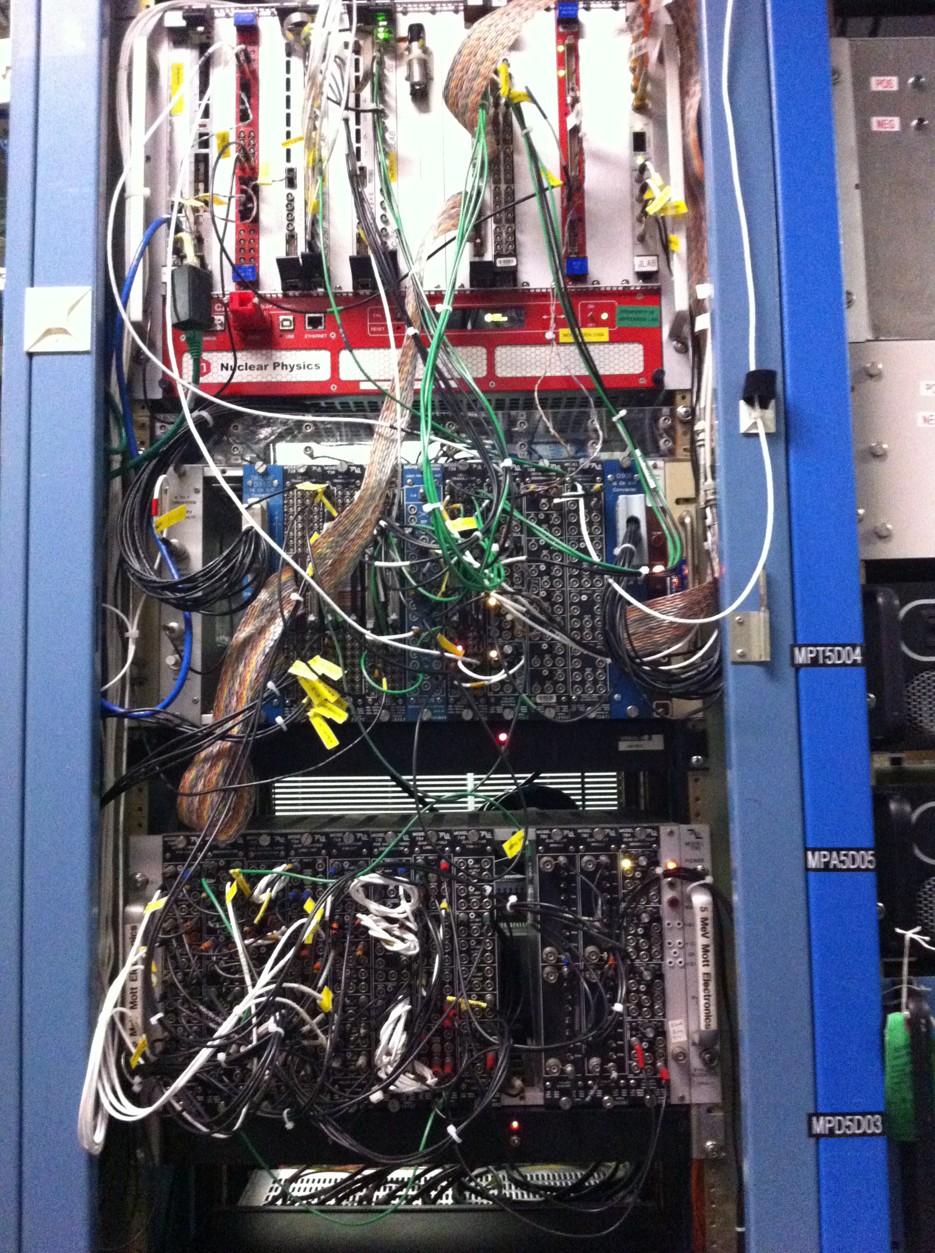
Mott DAQ
Module | Rack
opsmdaq0 | IN03B24
Mott VME Crate | IN02B21
Mott NIM Crate 1 | IN02B21
Mott NIM Crate 2 | IN02B21

Slide 3
Mott DAQ crates
VME Crate
Mott NIM Crate 1
Mott NIM Crate 2
Slot | Board
1 | MVME 6100
2 | TID
3 | Empty
4 | LEMO/ECL translator CAEN V538A
5 | Empty
6 | Distribution Board 1
7 | Mott FADC
8 | Empty
9 | Distribution Board 2
10 | INT FADC
11 | Empty
12 | Empty
13 | Empty
14 | Scaler S1
15 | Scaler S2
16 | Empty
17 | Empty
18 | TDC CAEN V775
19 | Empty
20 | Empty
21 | FT
Slot | Board
1 | OCTAL LINEAR FAN IN/OUT PS748
2 | OCTAL DISCRIMINATOR PS705
3 | FIVE CHANNEL TIMING DISCRIMINATOR PS715
4 | QUAD FOUR-FOLD LOGIC UNIT PS754
5 | OCTAL LINEAR FAN IN/OUT PS748
6 | FIVE CHANNEL TIMING DISCRIMINATOR PS715
7 | QUAD FOUR-FOLD LOGIC UNIT PS754
8 | OCTAL LINEAR FAN IN/OUT PS748
9 | Empty
10 | DUAL DELAY MODULE PS792
11 | DUAL DELAY MODULE PS792
12 | QUAD GATE/DELAY GENERATOR PS794
Slot | Board
1 | VtoF (Single Chan) 10 V
2 | Empty
3 | VtoF (+/-7 V)
4 | LEVEL TRANSLATOR PS726 (LT1)
5 | LEVEL TRANSLATOR PS726 (LT2)
6 | LEVEL TRANSLATOR PS726 (LT3)
7 | LOGIC FAN IN/OUT LeCroy 429A
8 | LEVEL TRANSLATOR PS726 (LT4)
9 | QUAD GATE/DELAY GENERATOR PS794
10 | DISCRIMINATOR PS708
11 | LINEAR FAN IN/OUT PS740
12 | VtoF (+/-10 V)

Slide 4
VME CRATE
VME 6100 – iocmdaq1 | TID |  | CAEN V538A |  | DB 1 | Mott FADC |  |  | DB 2 | INT FADC |  |  |  | S1 | S2 |  |  | TDC CAEN V775 |  |  | FT
1
1
1 In
Gate
17 BFM
18 Mott
DetTr
L1A
LEMO
4
LN1
Common
L1A
ECL
4
TRG IN
TRG IN
Opsmdaq0
nT_Settle

Slide 5
Mott NIM Crate 2
VtoF 1 MHz 0–10 V |  | VtoF 2 MHz - 7 – +7 V | LT1 726 | LT2 726 | LT3 726 | FAN 429A | LT4 726 | QD 794 | DISC 708 | LIN 740 | VtoF 2 MHz 0 – +10 V
→ BCM 0L02 Output2 ← VtoF LT2 – Ch1 |  | → LEMO Patch Panel ← LT1 |  | ← S1 Ch1 –CH16 |  | → Delayed Helicity |  | → nT_Settle ← 428 ns nT_Settle Trigger | → BMF -145 mV ← LT4 – Ch1 | → BFM -140 mV ← Ch8 FADC ← DISC | → BPM Ch1 – 16 ← S1 Ch17 – 32
 |  |  |  |  |  | → T_Settle |  | → nT_Settle ← 180 ns S1 LNE
 |  |  |  |  |  | → Pattern Sync |  | → 4 MHz Clock 8.16 us ← 121.2 kHz Clock LT2 Ch4
 |  |  |  |  |  | → Pair Sync |  | → Mott DetTr ← 322 ns LT4 – Ch15

Slide 6
Mott NIM 2 – LEVEL TRANSLATOR 726
 | LT1
 | NIM IN | ECL IN | NIM OUT | NIM OUT
1 |  | VtoF (+/- 7 V)
2
3
4
5
6
7
8
9
10
11
12
13
14
15
16

Slide 7
Mott NIM 2 – LEVEL TRANSLATOR 726
 | LT2
 | NIM IN | ECL OUT | NIM OUT | NIM OUT
1 | BCM0L02 – OUTPUT2 | S1 Ch1-16
2 | Mott DetTr
3 | L1A
4 | 121.2 kHz Clock
5
6
7 | Scaler – Mott 4
8 | Scaler – Mott 5
9 | E LEFT
10 | E RIGHT
11 | E UP
12 | E DOWN
13 | ΔE LEFT
14 | ΔE RIGHT
15 | ΔE UP
16 | ΔE DOWN

Slide 8
Mott NIM 2 – LEVEL TRANSLATOR 726
 | LT3
 | NIM IN | TTL/ECL OUT | NIM OUT | NIM OUT
1
2 | Delayed Helicity |  | Mott FADC – Ch12 | INT FADC – Ch12
3
4 | T_Settle |  | Mott FADC – Ch13 | INT FADC – Ch13
5
6 | nT_Settle |  |  | DB2 TRG IN
7
8
9 | Pattern Sync |  | Mott FADC – Ch14 | INT FADC – Ch14
10
11 | Pair Sync |  | Mott FADC – Ch15 | INT FADC – Ch15
12
13 | L1A | LT2 – Ch3
14
15
16

Slide 9
Mott NIM 2 – LEVEL TRANSLATOR 726
 | LT4
 | NIM IN | TTL/ECL OUT | NIM OUT | NIM OUT
1 | BFM | TDC – Ch17
2 | Delayed Helicity |  | S1 Control – Ch2 | S2 – Ch13
3
4 | T_Settle |  |  | S2 – Ch14
5
6 | nT_Settle |  | QUAD DELAY – Ch1 | QUAD DELAY – Ch2
7 | nT_Settle |  |  | S1 Control – Ch4 (GATE)
8
9 | Pattern Sync |  |  | S1 Control – Ch3
10
11 | Pair Sync |  |  | S2 – Ch16
12
13 | Mott DetTr | LT2 – Ch2 | QUAD DELAY – Ch4 | CAEN V538A – Ch1
14
15 | Delayed Mott DetTr | TDC – Ch18
16

Slide 10
Mott NIM 2 – QUAD FAN IN/OUT 429A
QUAD FAN IN/OUT
Delayed Helicity – IN
LT3 – Ch2 |  | LT4 – Ch2
T_Settle – IN
LT3 – Ch4 | LT4 – Ch6 | LT4 – Ch4
 | LT3 – Ch6
Pattern Sync – IN
LT3 – Ch9 | S2 – Ch15 | LT4 – Ch9
Pair Sync – IN
LT3 – Ch11 |  | LT4 – Ch11

Slide 11
CHANNEL ASSIGNMENT – CAEN V538A LEVEL TRANSLATOR
Chan | IN LEMO
7
6
5
4
3
2
1 | Mott DetTr
0 | Delayed (0.4 µs) nT_Settle
Chan | OUT ECL
7
6
5
4 |  | DB1 TRG IN
3
2
1 | TID TS#1
0 | TID IN TRG
Chan | IN ECL
7
6
5
4 | TID OUT TRG (L1A)
3
2
1
0
Chan | OUT LEMO
7
6
5
4 | LA1 (Mott NIM) | LA1 (TDC COMM)
3
2
1
0

Slide 12
CHANNEL ASSIGNMENT – TRIGGER INTERFACE (TID)
TID Chan | IN Signal
7
6
5
4
3
2
1 | TS#1 (Mott DetTr)
0 | TRG ( Delayed nT_Settle)
TID Chan | OUT Signal
7
6
5
4
3
2
1 | TRG (L1A)
0

Slide 13
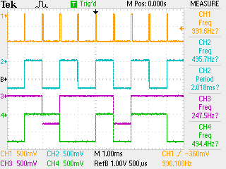
HELICITY SIGNALS
T_Settle
Pair -Sync
Pattern-Sync
Delayed Helicity

Slide 14
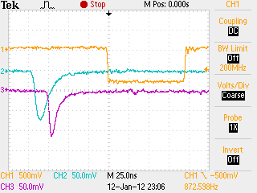
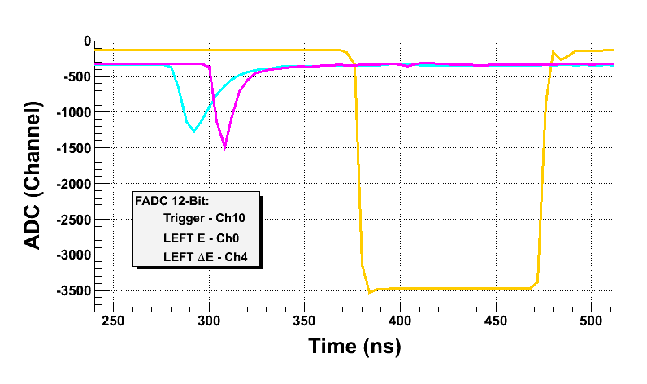
CHANNEL ASSIGNMENT – MOTT FADC
Mott Trigger
Left E
Left ∆E

Slide 15
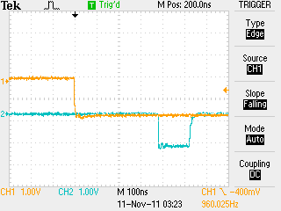
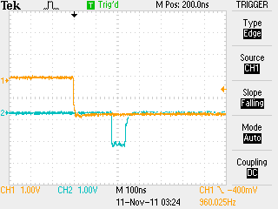
CONTROL CHANNEL ASSIGNMENT – GATED SCALER S1
S1 CONTROL Chan | Signal
1 | Load-Next-Event (LNE)
2 | Delayed Helicity
3 | Pattern Sync
4 | GATE (nT_Settle)
nT_Settle Trigger Setup:
  nT_Settle Trigger is delayed by 0.4 µs
  LNE is delayed by 0.2 µs
nT_Settle
nT_Settle
LNE
Delayed
TID nT_Settle
Trigger (Scalers )

Slide 16
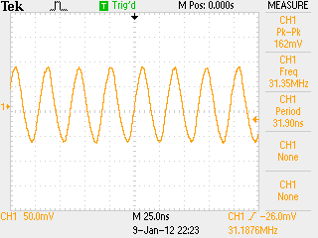
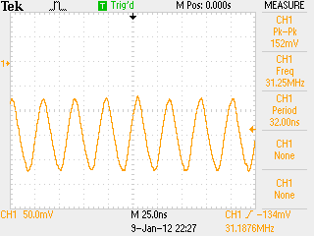
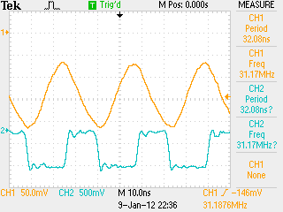
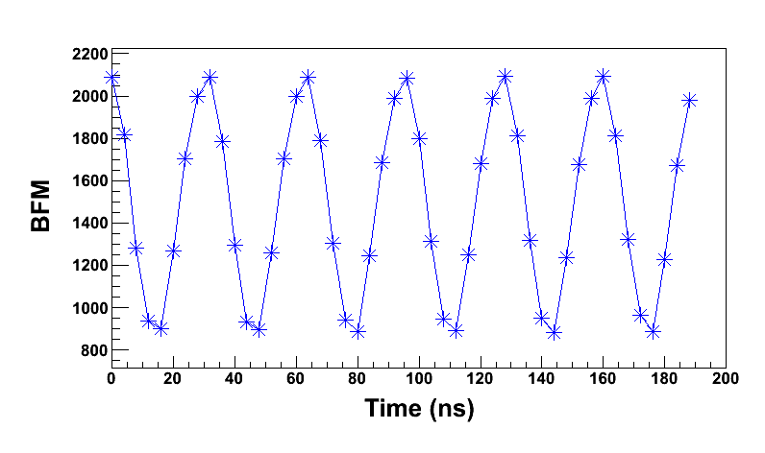
Beat Frequency Modulation (BFM)
BFM after
-140 mV offset
BFM
BFM after
-145 mV discrimination (TDC)
BFM in FADC

Slide 17
Data Taking Modes
Name | Readout | Output | Trigger
Scalers | Scaler S1 (helicity gated), S2 (un-gated) | Scalers_%d.dat | Delayed nT_Settle
Mott_Sample | Mott FADC, S1, S2, TDC | Mott_Sample_%d.dat | Mott Detector
Mott_SemiInt | Mott FADC, S1, S2, TDC | Mott_SemiInt_%d.dat | Mott Detector
PEPPo_Int | INT FADC, S1, S2 | PEPPo_Int_%d.dat | nT_Settle

Slide 18
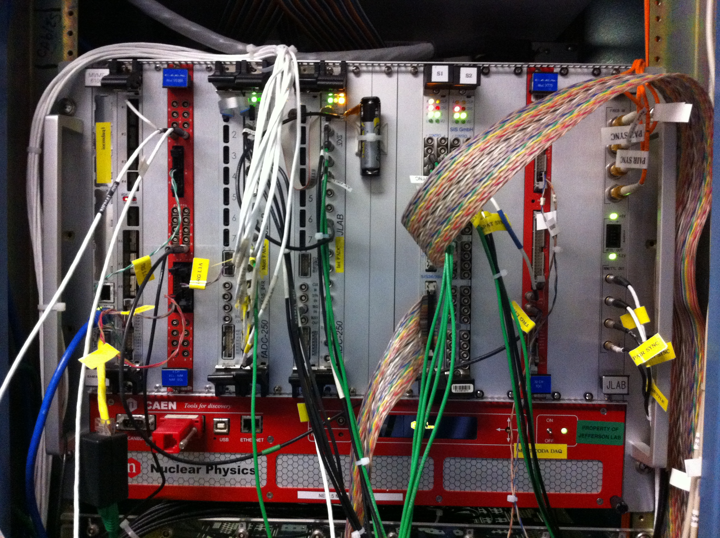
VME Crate

Slide 19
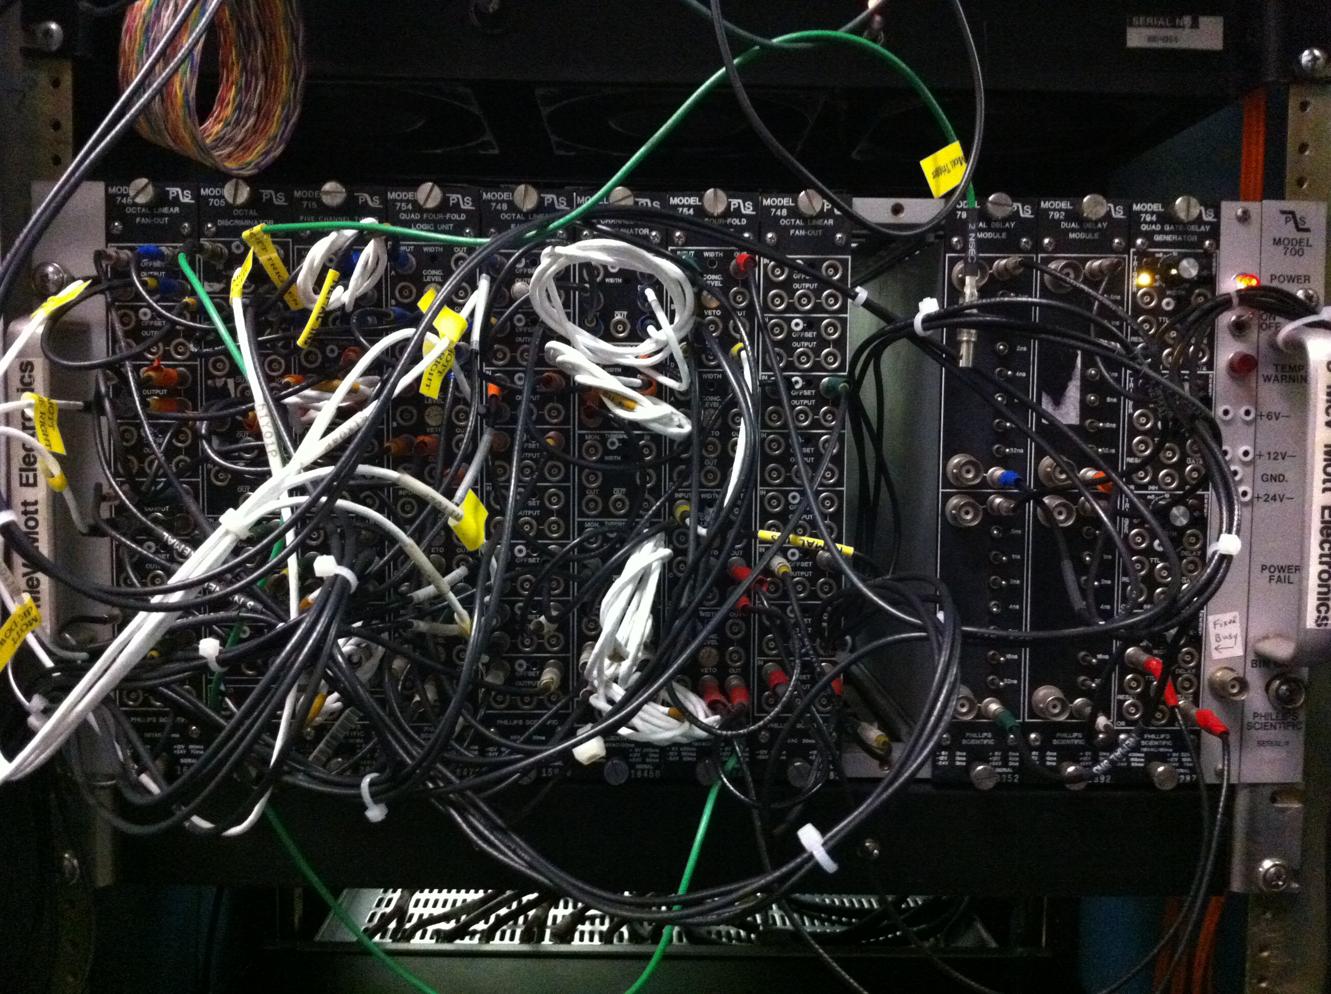
Mott NIM Crate 1

Slide 20
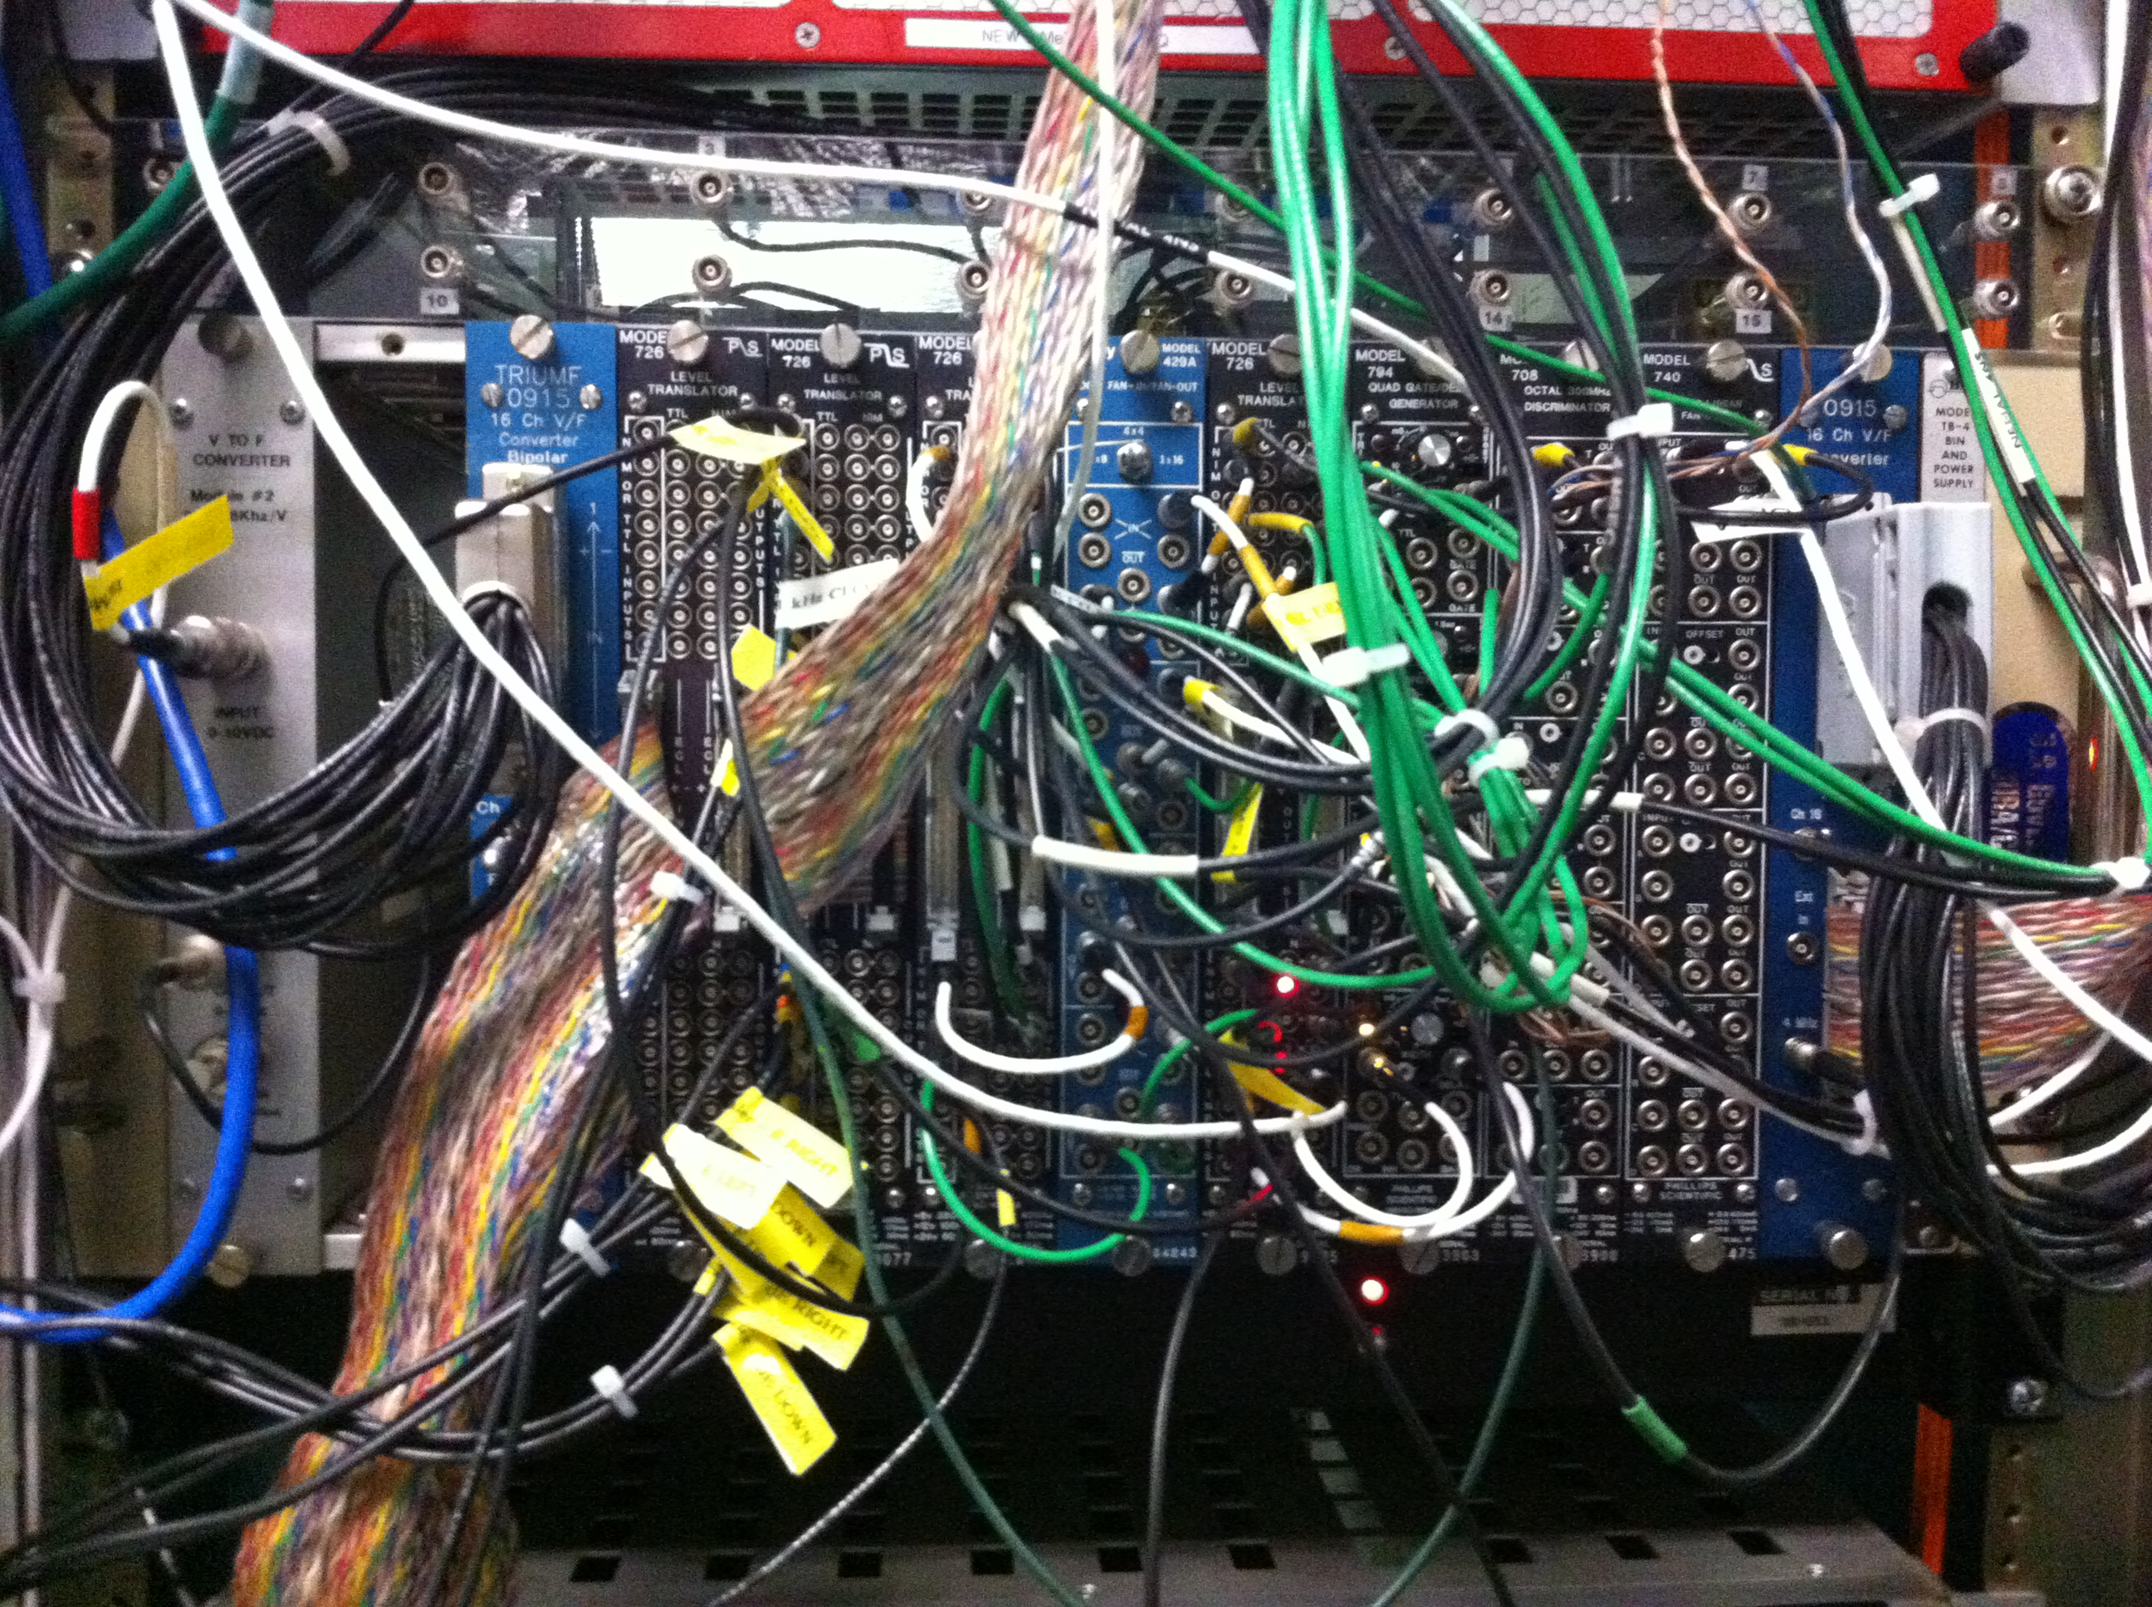
Mott NIM Crate 2

