Slide 1





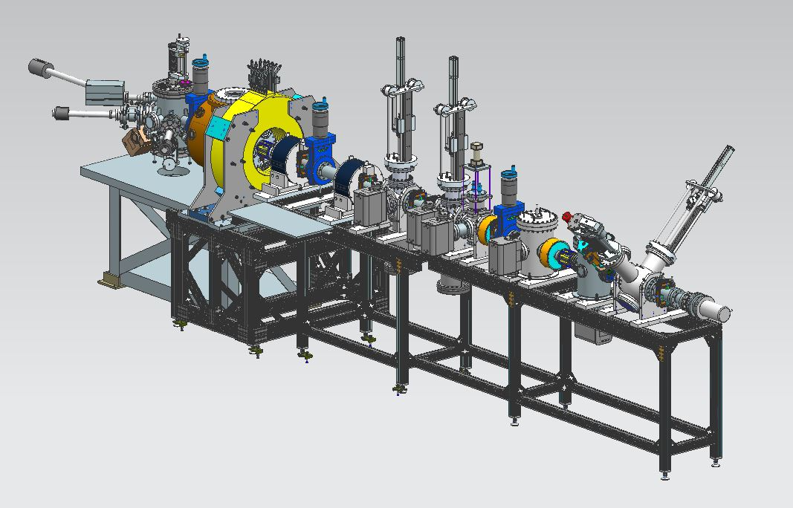
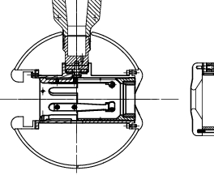
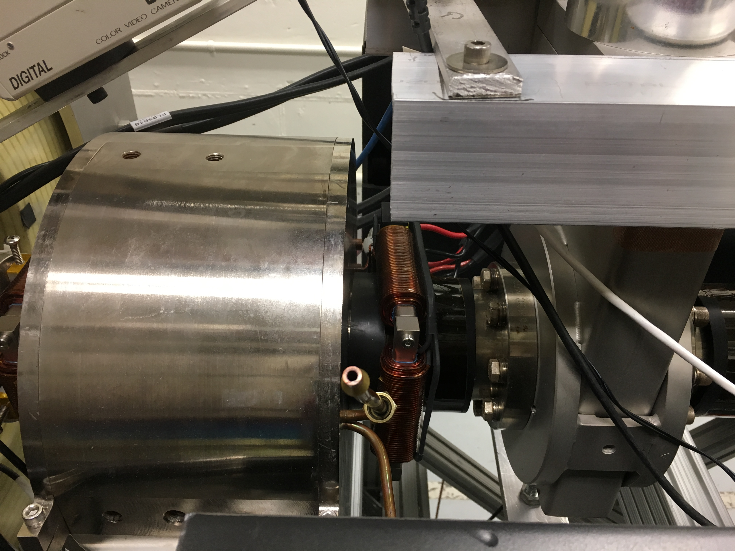
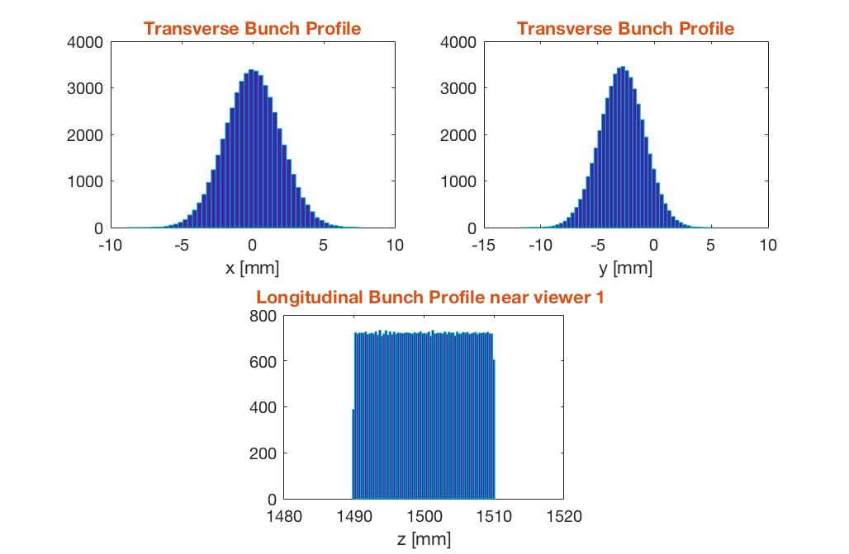
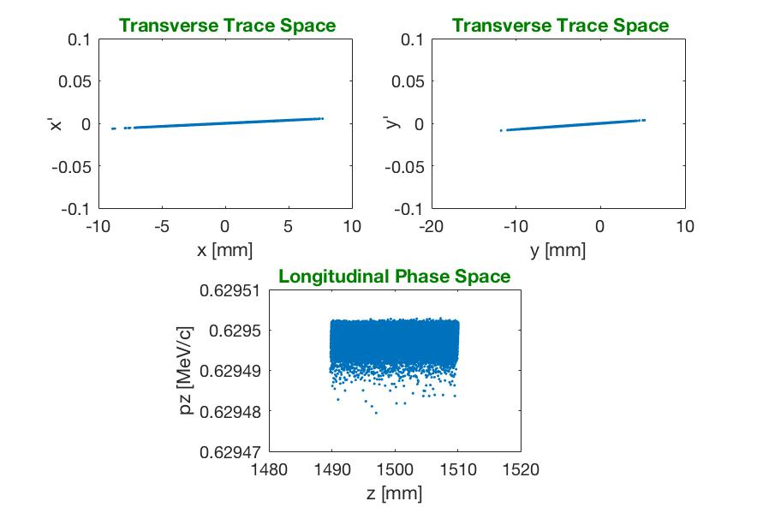
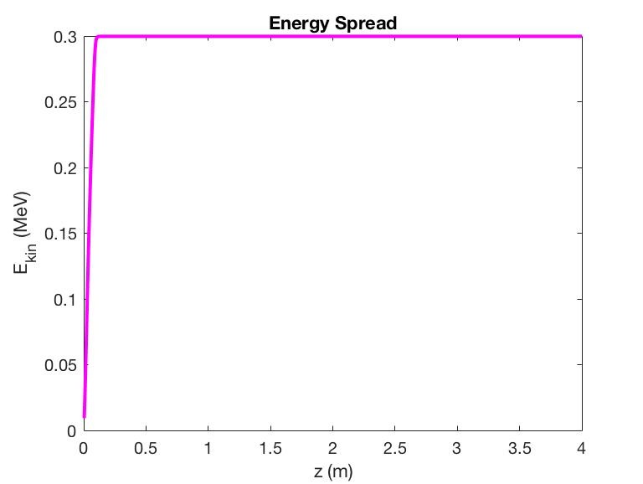
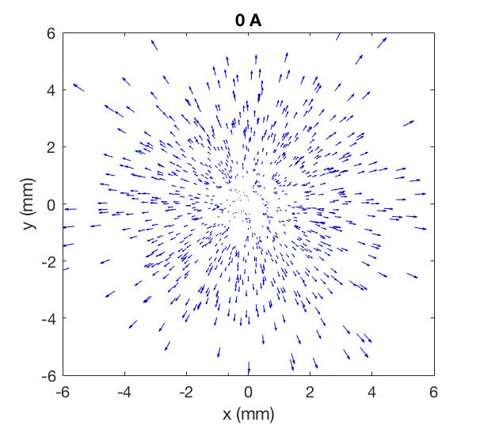
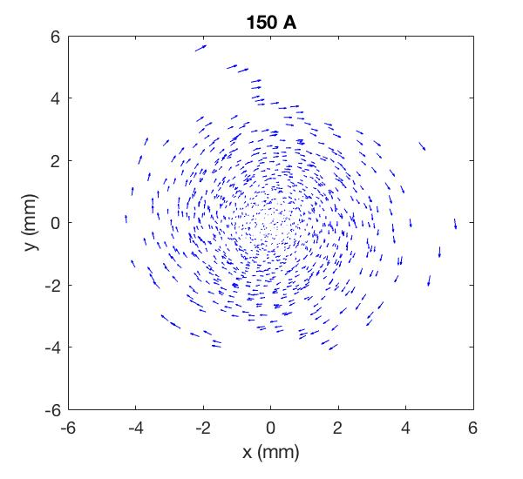
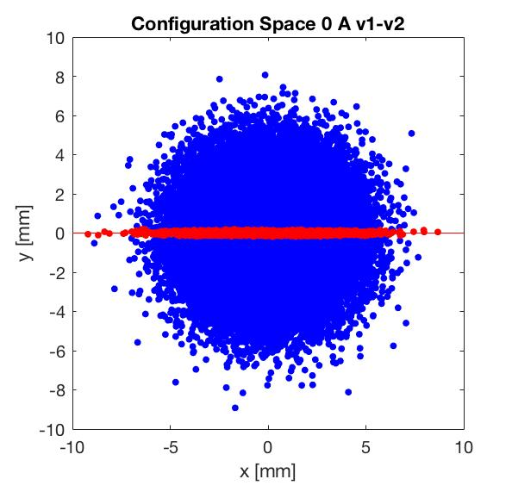
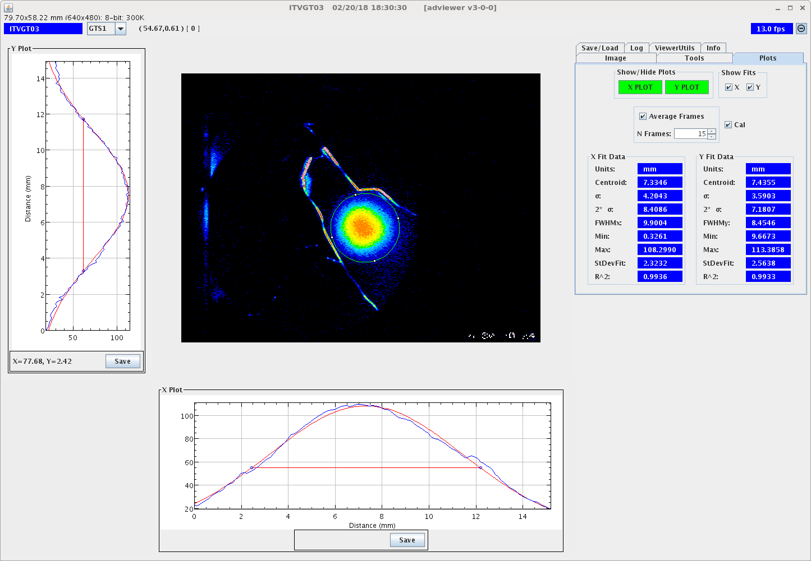
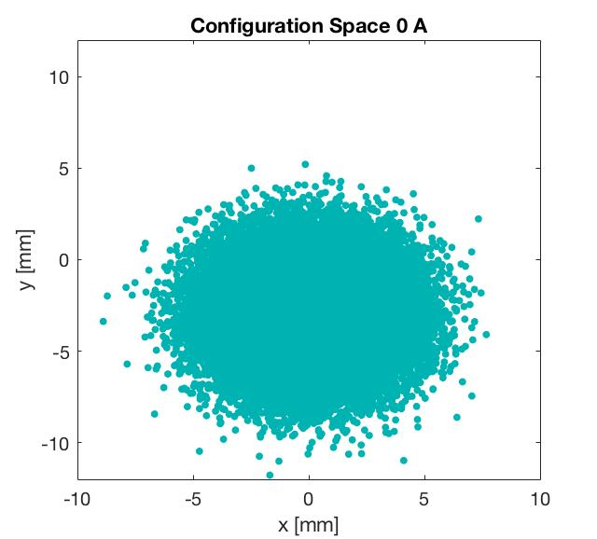
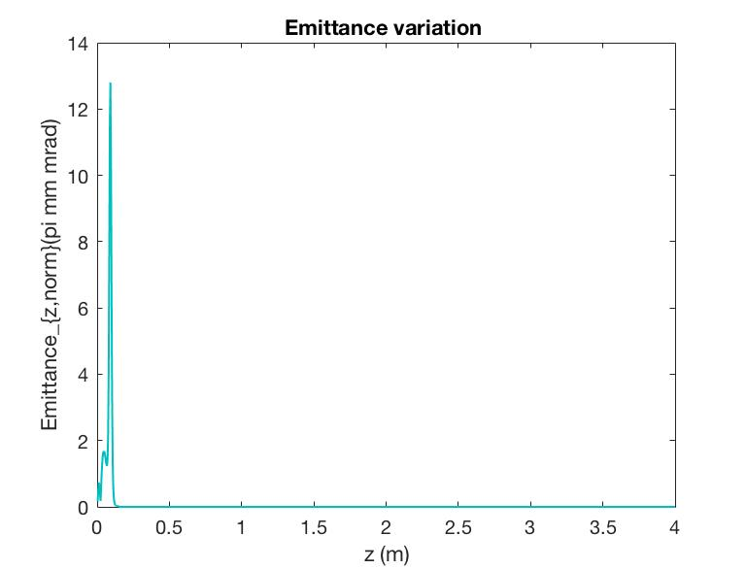
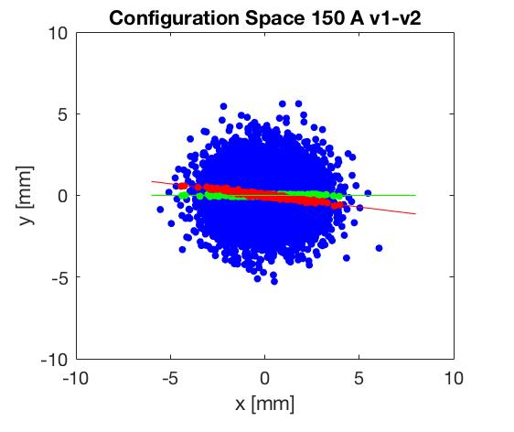
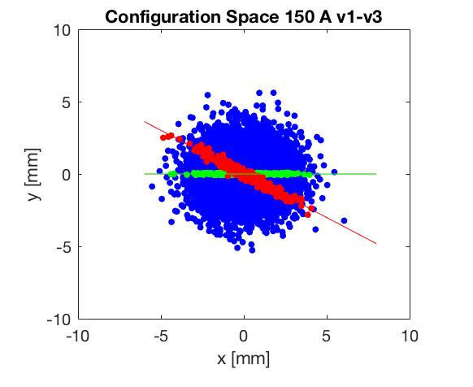
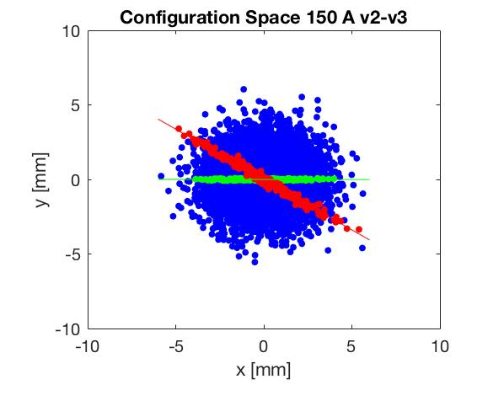
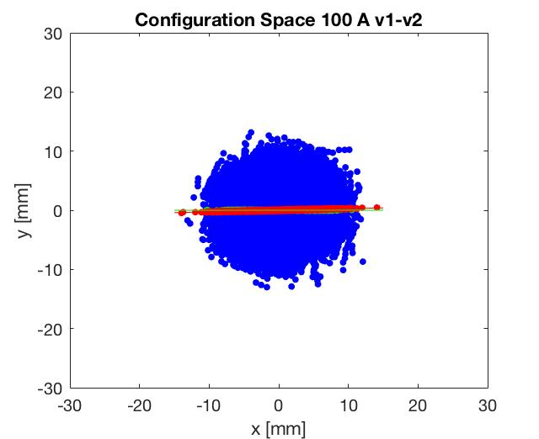
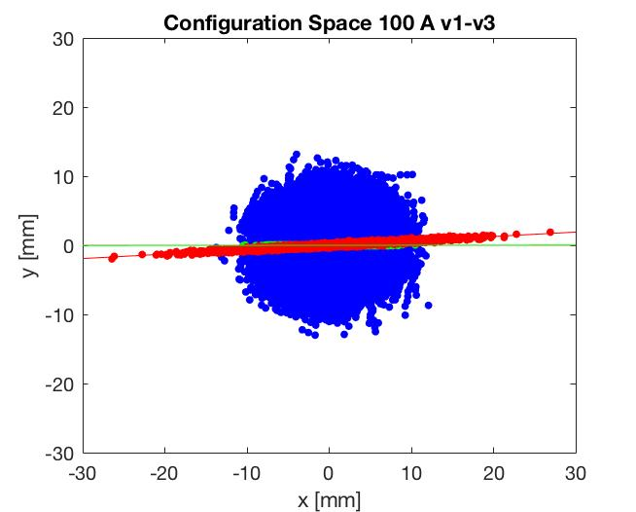
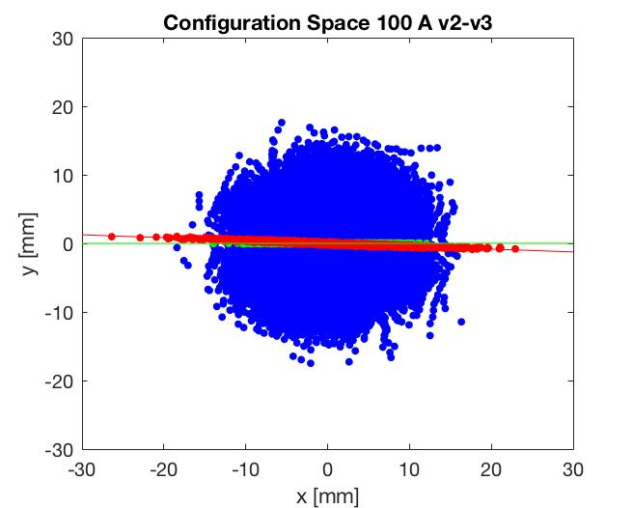
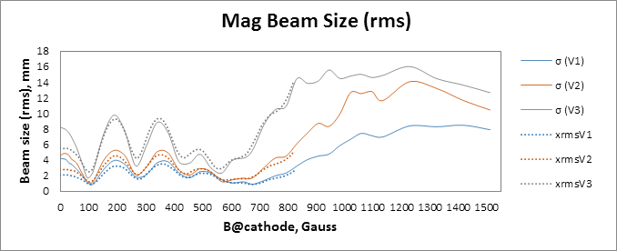
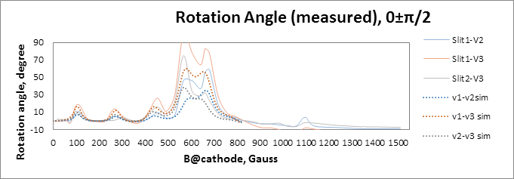

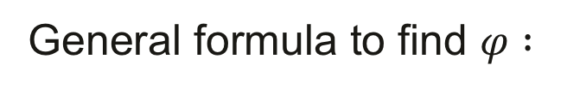
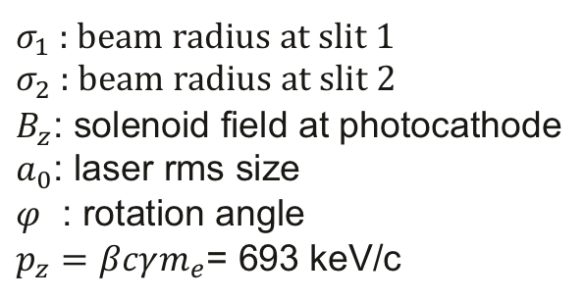

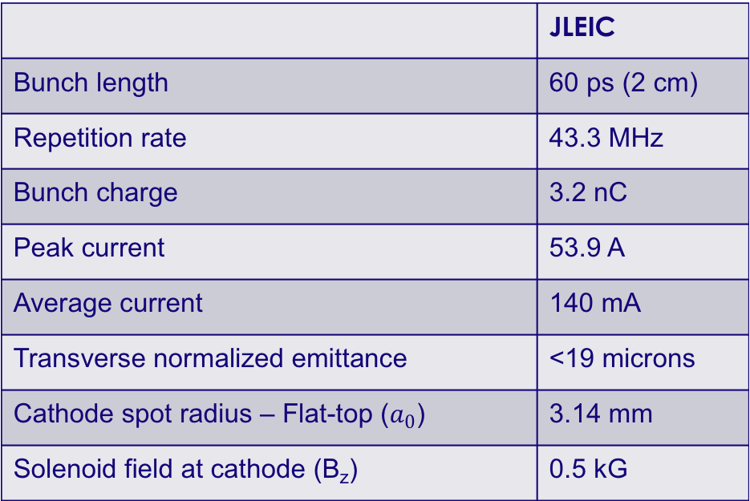

Simulation Study of the Magnetized Electron Beam
Sajini A. K. Wijethunga¹, J. R. Delayen¹, G. A. Krafft², F. E. Hannon², R. Suleiman²,
M. Poelker², J. Benesch², M. A. Mamun²
¹Department of Physics, Old Dominion University, Norfolk, Virginia 23529, USA
²Thomas Jefferson National Accelerator Facility, Newport News, Virginia 23606, USA
ABSTRACT
The proposed Jefferson Lab Electron Ion Collider (JLEIC) must provide ultra-high collision luminosity to achieve promised physics goals. Small transverse emittance at the ion-electron collision point is one of the key requirements of the collider design. Emittance growth that results from electron-ion collisions will be controlled by electron cooling of the ion beam and cooling can be enhanced using a magnetized electron beam, where the cooling process occurs inside a solenoid field. The radial fringe magnetic field at the entrance of the solenoid creates a large additional rotational motion which adversely affects the cooling process. At the electron source, we create the electron beam inside a similar field but inducing rotational motion in the opposite direction to compensate this effect. Beam-based magnetization measurements have been performed and this presentation provides a comparison to predictions based on simulations using ASTRA and GPT software, as a function of beam size variations and rotation angle variations along the beamline, for different solenoid currents and other parameters.
Beam Line
Modelling
Cathode
Cathode
Solenoid
Diagnostic Cross 1
(Slit + YAG Screen)
Diagnostic Cross 3
(YAG Screen)
Anode
Green
Laser
K₂CsSb
Photocathode
Injector Focusing
Solenoid
Diagnostic Cross 2
(Slit + YAG Screen)
 | JLEIC
Bunch length | 60 ps (2 cm)
Repetition rate | 43.3 MHz
Bunch charge | 3.2 nC
Peak current | 53.9 A
Average current | 140 mA
Transverse normalized emittance | <19 microns
Cathode spot radius – Flat-top ($a_{0}$) | 3.14 mm
Solenoid field at cathode (B_{z}) | 0.5 kG
Simulation Parameters
General formula to find $φ :$
Max B_{z} at the cathode | 0.1511 T
xy_rms, top-hat | 0.301 mm
t_rms, Gaussian | 24 ps
Charge | 1 nC
Gun voltage | 300 kV
x_off | 0 mm
y_off | 0.5 mm
Emittance | 0.56 pi mm mrad/ mm
$$φ_{rot}=\tan^{−1}\left(\frac{φ_{z/v_{z}}}{1−z/f}\right)$$
$σ_{1}$ : beam radius at slit 1
$σ_{2}$ : beam radius at slit 2
$B_{z}$: solenoid field at photocathode
$a_{0}$: laser rms size
$φ$ : rotation angle
$p_{z}=βcγm_{e}$= 693 keV/c
When beam converging $α>0 → \frac{π}{2}<φ_{rot}<π$
When beam is at waist $α=0 →$ 0 $<φ_{rot}<\frac{π}{2}$
When beam diverging $α<0 →$ 0 $<φ_{rot}<\frac{π}{2}$
Beam Profile
Mismatch Oscillations
Rotation angle variation of a diverging beam
Rotation angle variation of a converging and diverging beam
Measurements vs Simulations
Summary and Outlook
Beam Size Variations with the Gun Solenoid Currents
ASTRA
GPT
1D Electric Field
1D Magnetic Field
2D Electric Field
1D Magnetic Field
Rotation Angle Variations with the Gun Solenoid Currents
Acknowledgement: This work is supported by the Department of Energy, Laboratory Directed Research and Development funding, under contract DE-AC05-06OR23177
sajini@jlab.org

