Slide 1
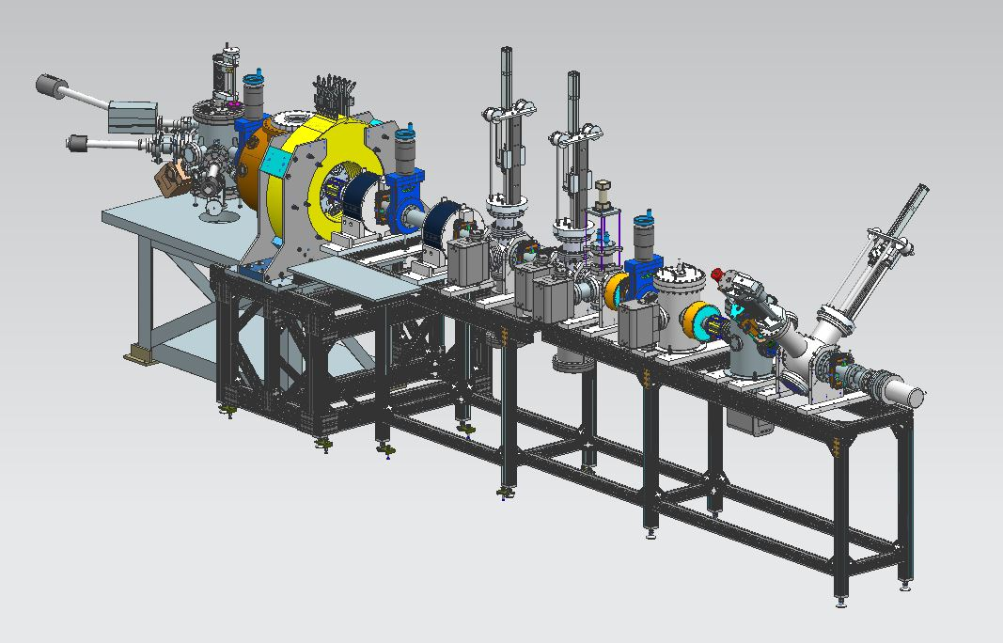
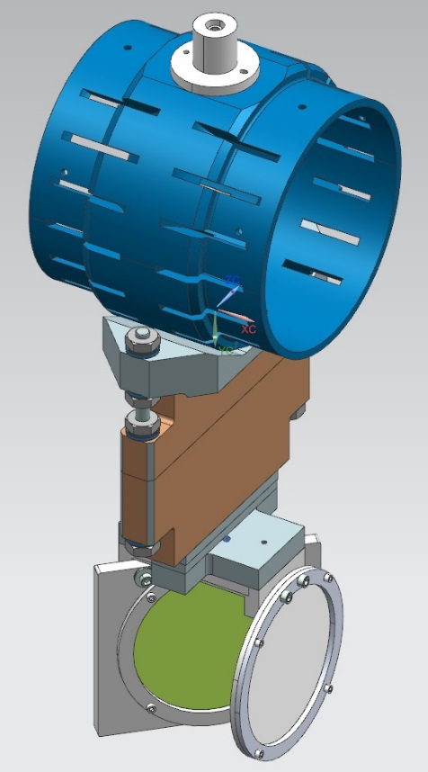
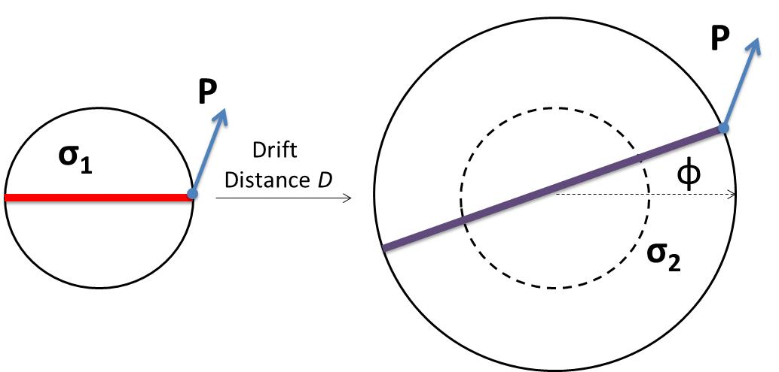
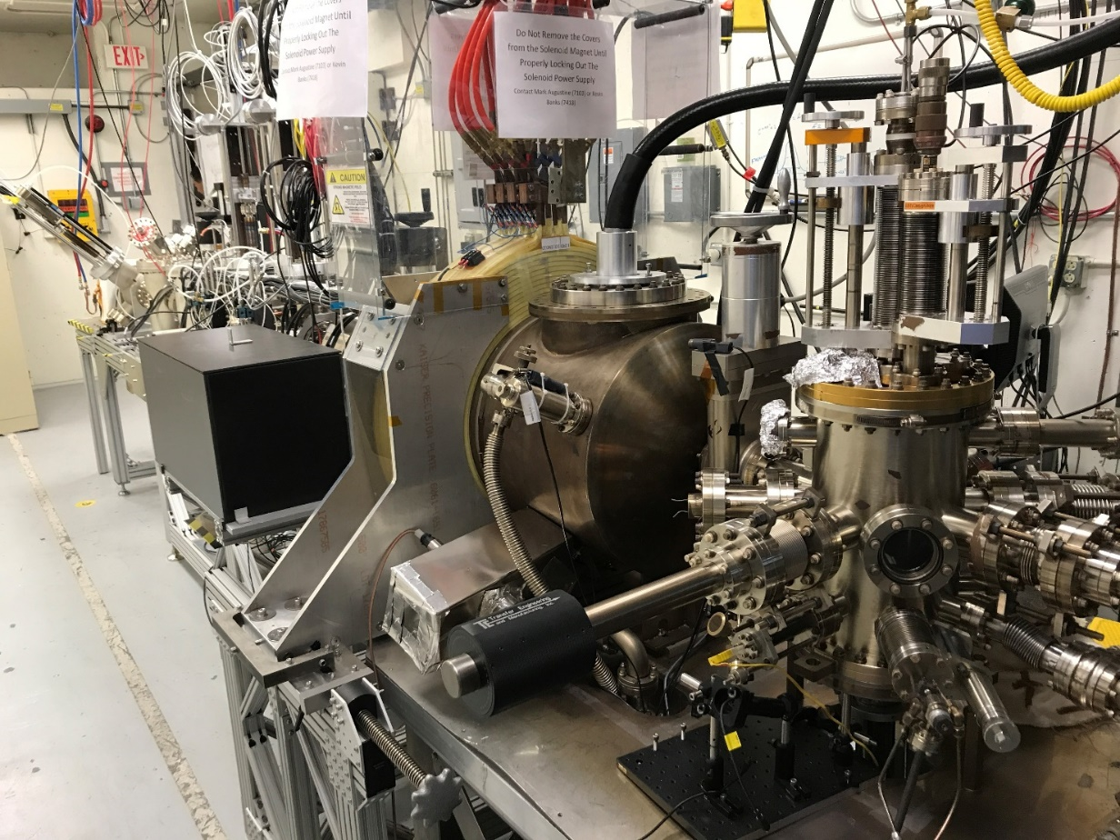
Generation and Characterization of Magnetized Electron Beam from DC High Voltage Photogun
M. A. Mamun, P. Adderley, J. Benesch, B. Bullard, J. Grames, J. Guo, F. Hannon, J. Hansknecht, C. Hernandez-Garcia, R. Kazimi, G. Krafft, M. Poelker, R. Suleiman, M. Tiefenback, Y. Wang, S. Wijiethunga§, S. Zhang
Thomas Jefferson National Accelerator Facility, Newport News, Virginia 23606, USA §Department of Physics, Old Dominion University, Norfolk, Virginia 23529, USA
April 29-May 4, 2018
Motivation
Electron beam suffers an azimuthal kick at entrance of cooling solenoid. But this kick can be cancelled by an earlier kick at exit of photogun. That is purpose of cathode solenoid
Experimental Overview
Jefferson Lab Electron Ion Collider (JLEIC) bunched magnetized electron cooler is part of Collider Ring and aims to counteract emittance degradation induced by intra-beam scattering, to maintain ion beam emittance during collisions and extend luminosity lifetime
Gun HV Chamber
Beamline
Harp wire scanner
Photocathode
Preparation
Chamber
Magnetized Cooling
Ion beam cooling in presence of magnetic field is much more efficient than cooling in a drift (no magnetic field):
Electron beam helical motion in strong magnetic field increases electron-ion interaction time, thereby significantly improving cooling efficiency
Electron-ion collisions that occur over many cyclotron oscillations and at distances larger than cyclotron radius are insensitive to electrons transverse velocity
Cooling rates are determined by electron longitudinal energy spread rather than electron beam transverse emittance as transverse motion of electrons is quenched by magnetic field
Magnetic field suppresses electron-ion recombination
Upon exit of Cathode Solenoid
Gun Solenoid
Electrons born in strong uniform B_{z}
Upon entering Cooling Solenoid
Viewer Screens
$$〈L〉=γm_{e}〈r^{2}〉\dot{φ}$$
r_{e}= 0.7 mm
B_{cool} = 1 T
$a_{0}$= R_{laser} = 3.14 mm
B_{z} = 0.5 kG
= 36 µm
Shield Tube
Beam Dump
$$ε_{d}=\frac{eB_{z}a_{0}^{2}}{2m_{e}c}=\frac{\left\langle L\right\rangle }{2m_{e}c}$$
Bunch length | 60 ps (2 cm)
Repetition rate | 43.3 MHz
Bunch charge | 3.2 nC
Average current | 140 mA
Transverse normalized emittance | <19 microns
Cathode spot radius – Flat-top ($a_{0}$) | 3.14 mm
Solenoid field at cathode (B_{z}) | 500 G
Slit
Viewer Screen
=> $\left\langle L\right\rangle ={2ε}_{d}m_{e}c$
Use slit and viewscreens to measure beam size and rotation angle
Use wire scanner (harp) to measure drift emittance and evaluate beam magnetization
$P$: transverse momentum
σ: beam rms size
Ф: rotation (sheering) angle
$\left\langle L\right\rangle$: canonical ang. momentum
$ε_{d}$: drift/magnetized emittance
$B_{z}$: long. mag. Field at cathode
$a_{0}$: laser rms size
Gun Solenoid
Magnetization Measurements
Summary & Plans
0 G at photocathode
Beamlet observed on downstream viewer
K₂CsSb Photocathode Preparation Chamber, Gun HV Chamber, Gun Solenoid and Beamline are all operational
Photogun operates reliably at 300 kV
Cathode solenoid can trigger field emission but we have learned how to prevent this
Have successfully magnetized electron beam and measured rotation angle
Delivered 4.5 mA DC magnetized beam
Installed Harp to measure emittance
Installed a gain-switched drive laser, to generate mA magnetized beam with RF structure
Run high bunch charge up to 3 nC using the regenerative amplifier laser and characterize the space-charge effect on beam magnetization
Measure drift emittance and angular momentum
Install and test TE₀₁₁ cavity to measure beam magnetization
Switch to 32 mA 225 kV HV power supply
1511 G at photocathode
Using spare CEBAF Dogleg magnet power supply (500 A, 80 V)
Learned that gun solenoid can influence field emission
First trials with gun at high voltage and solenoid ON resulted in new field emission and vacuum activity
Procedure to energize solenoid without exciting new field emitters
Measured beam sizes and rotation angles for different laser spot sizes
Rotation angles are influenced by Larmor oscillation in gun solenoid
Making good progress in simulating magnetized beam using ASTRA & GPT
Acknowledgement: This work is supported by the Department of Energy, Laboratory Directed Research and Development funding, under contract DE-AC05-06OR23177

