Slide 1
Polarization transfer
Bremsstrahlung process

Slide 2
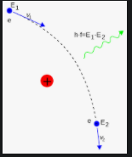
Bremsstrahlung process
The initial electrons loses their kinetic energy, which is converted into radiation:
$$E_{1}→ω+E_{2}$$
Goal: how the polarization is transfered from E₁ to $ω$?
Using interaction matrix :
$\left({I \atop P}\right)=T\left({1 \atop S}\right)$
P_{i} :Photon Linear polarization (i=1,2), circular polarization i=3.
S_{i} : Spin of electron in z, x direction (i=1,2), in y direction (i=3).

Slide 3
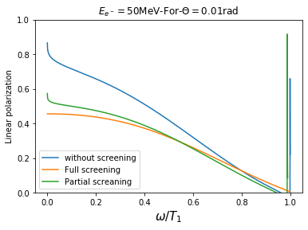
Linear polarization
The emitted photon has two kinds of polarization:
Linear polarization.
Circular polarization.
Using 50 MeV of initial electron striking a target with Z=74, we get:
Linear polarization is decreasing with photon energy.
Lower linear polarization in full screening case.

Slide 4
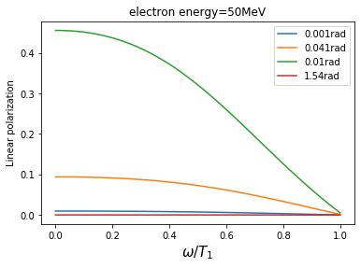
Linear polarization
The emitted photon has two kinds of polarization:
Linear polarization.
Circular polarization.
Using 50 MeV of initial electron striking a target with Z=74, we get:
Linear polarization is decreasing with photon energy.
Lower linear polarization in full screening case.

Slide 5
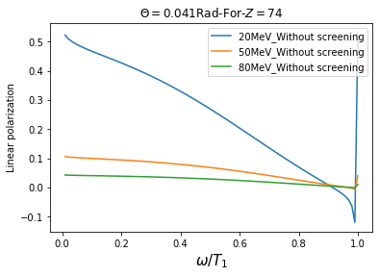
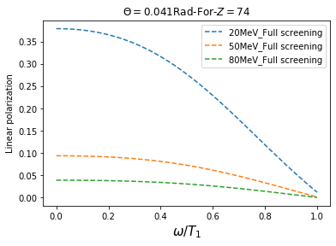
Linear polarization
The emitted photon has two kinds of polarization:
Linear polarization.
Circular polarization.
Using 50 MeV of initial electron striking a target with Z=74, we get:
Linear polarization is decreasing with photon energy.
Lower linear polarization in full screening case.

Slide 6
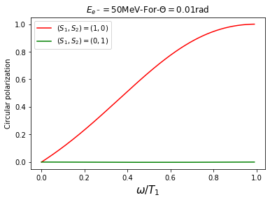
Circular polarization
S₁ : electron spin in the plane of interaction along z axis.
S₂ : electron spin in the plane of interaction along y axis.
Using 50 MeV of initial electron striking a target with Z=74, we get:
The contribution of the incoming polarization from S₁ is dominant.
The circular polarization is increasing with photon energy.

Slide 7
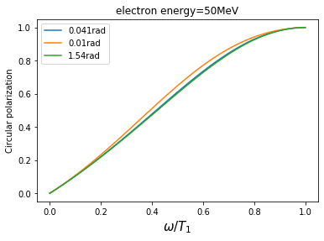
Circular polarization
S₁ : electron spin in the plane of interaction along z axis.
S₂ : electron spin in the plane of interaction along y axis.
Using 50 MeV of initial electron striking a target with Z=74, we get:
The contribution of the incoming polarization from S₁ is dominant.
The circular polarization is increasing with photon energy.
The circular polarization does not depends on the angle.

Slide 8
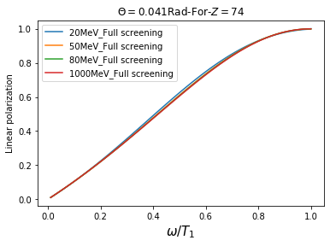
Circular polarization
S₁ : electron spin in the plane of interaction along z axis.
S₂ : electron spin in the plane of interaction along y axis.
Using 50 MeV of initial electron striking a target with Z=74, we get:
The contribution of the incoming polarization from S₁ is dominant.
The circular polarization is increasing with photon energy.
The circular polarization does not depends on the angle.

Slide 9
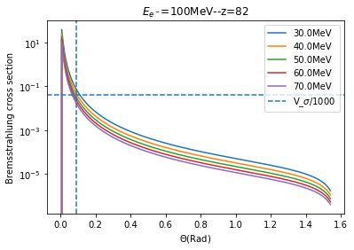
Bremsstrahlung cross section
The bremsstrahlung cross section is decreasing with the angles.
At large angles small probability of producing photons.
At small angle high probability of producing photon.
What is the efficient angle at which the probability of photon production is important?

Slide 10
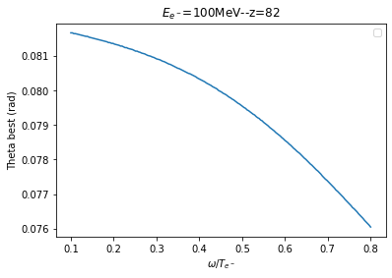
Bremsstrahlung cross section
The bremsstrahlung cross section is decreasing with the angles.
At large angles small probability of producing photons.
At small angle high probability of producing photon.
What is the efficient angle at which the probability of photon production is the best ?
We choose $\frac{σ_{max}}{1000}$ regarding the photon energy.
The best angle which correspond to high probability of photon production is decreasing with photon energy.

