Slide 1
Accelerator Status for PREX/CREX
Feb 15, 2019
Joe Grames
2019 CEBAF Program
CEBAF Energy Reach
Polarized Source
PQB : Aren’t we ready?
Hall A Issues

Slide 2
2019 CEBAF Program
SAD (April 15 – June 17)
First 3 weeks injector is used for Bubble Engineering Run
Need some time in laser room for training (John is retiring by May)
Let’s work up a plan to leverage SAD period for laser-source-injector setup?
PREX Run (June 17 – August 19)
Low energy linacs 450/450 will mean trip rate is low, to your advantage
Hall A @ 70uA is the polarized program, but B & C=50-90uA are running too
Arne would like to use Hall A dump for 150uA to test injector module 0L04
SAD (August 19 – November 1)
An upgrade CM C100-6-R will be installed, to achieve 2.1 GeV/pass
We may vent gun to install a new electrode, but can also delay until 2020
CREX Run (November 1 – December ?)
Linacs will be balanced but high 1050/1050, need margin to manage trip rate
Hall A=150uA, Hall B and Hall C=30uA ALL get polarized beam; Hall D is on too
Period | Start | End | Pol? | Wien* | Linacs | Hall A | Hall B | Hall C | Hall D
Winter Run | Now | 15-Apr | B | 34 deg | 1040/1060 | 1/499/30uA | 5/250 | 5/250/50uA | 5.5/250
SAD | 15-Apr | 7-Jun | OFF
PREX Run | 17-Jun | 19-Aug | A | -16 deg | 450/450 | 1/499/70uA | 5/499 | 3,4,5/499/90uA | OFF
SAD | 19-Aug | 1-Nov | OFF
CREX Run | 1-Nov | 23-Dec | ABC | -36 deg | 1050/1050 | 1/499/150uA | 5/250 | 5/250/30uA | 5.5/250
* Assumes we set machine energy high by +0.25%

Slide 3
Energy Reach Chart
Uses -34 MeV/linac/year
PREX 450/450
Injector Upgrade
CREX 1050/1050

Slide 4
Recent CEBAF performance: Q1FY19
Post Sept. troubles:
Oct/Nov operations at 1050 MeV/linac trippy but productive
Decemeber operations at 930 and 805 MeV/linac demonstrate the wisdom of operating with 100 MeV/linac (or more) of gradient headroom.
Trip rate dropped as expected
Ability to by-pass cavities and even complete cryomodules reduced (eliminated) the need to interrupt the program to fix RF systems.
CREX (C100-6-R Sep’19)
PREX

Slide 5
Q1FY19 DOE Performance Metric: Accelerator Reliability
PREX?
First quarter in 12 GeV era with reliability > 80 %
930 MeV/linac (first half of December) reliability impacted (in a negative way) by the low current operations to B & D which led to many MPS trips.
805 MeV/linac, last eight days of the run, had reliability > 98%

Slide 6
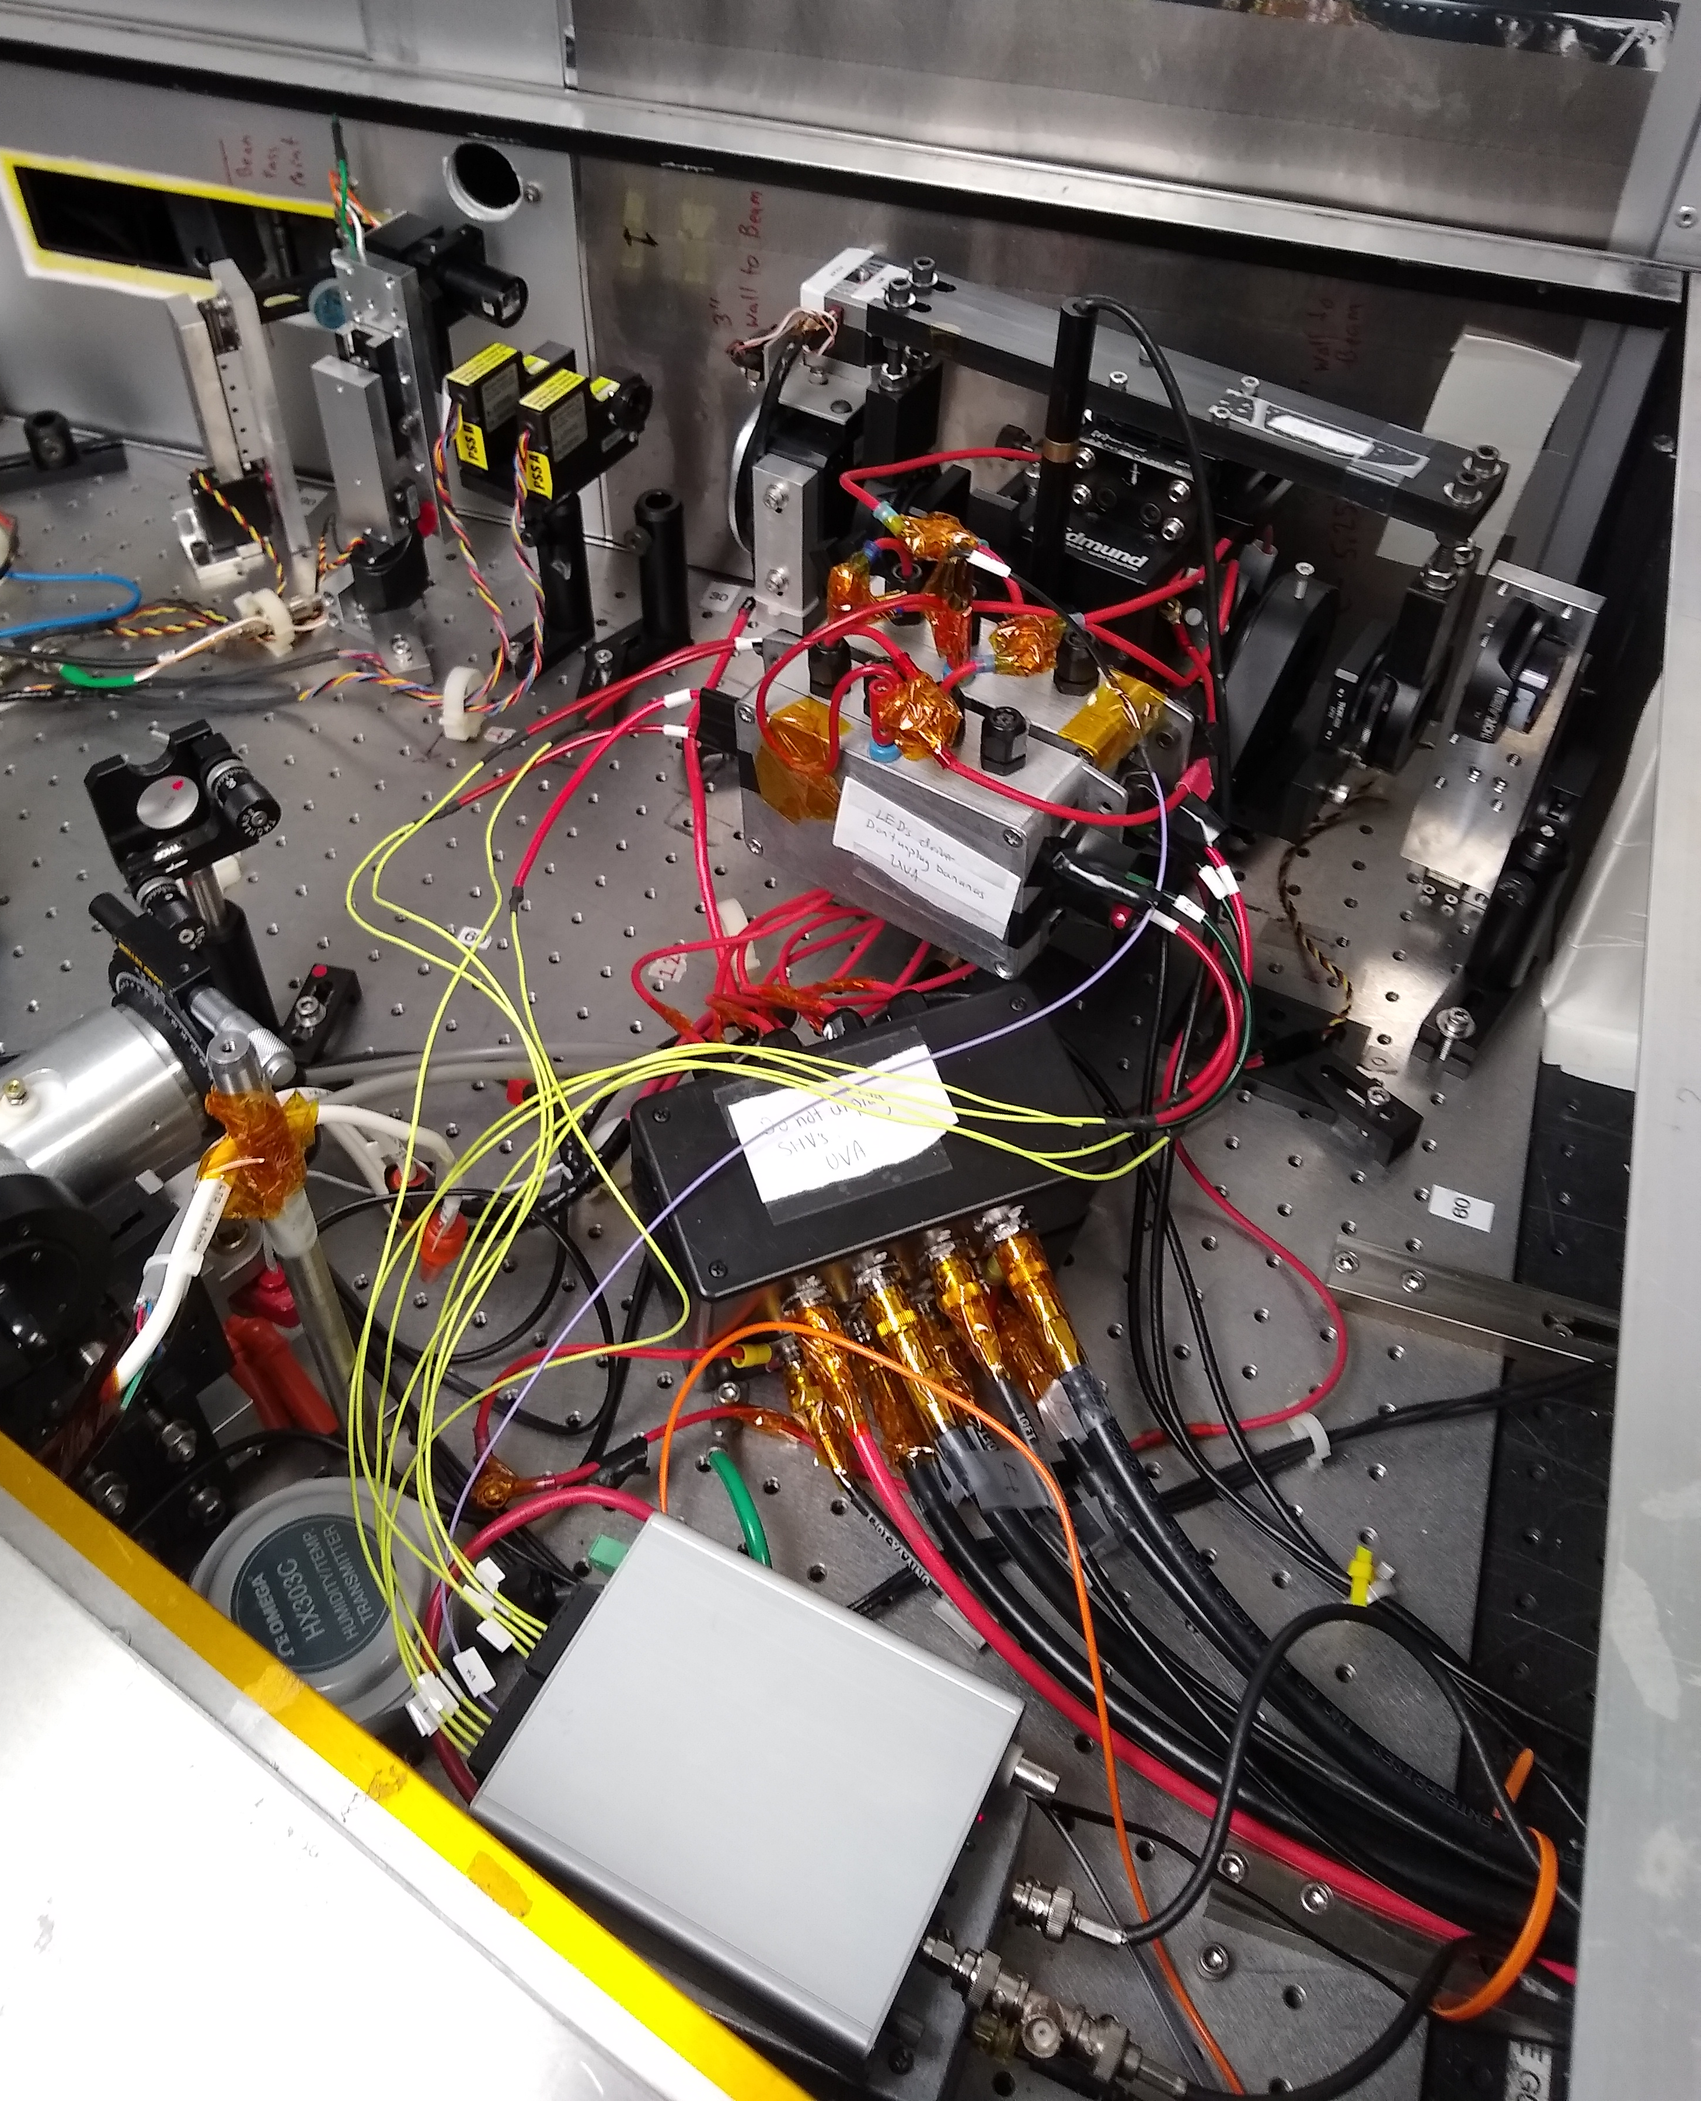
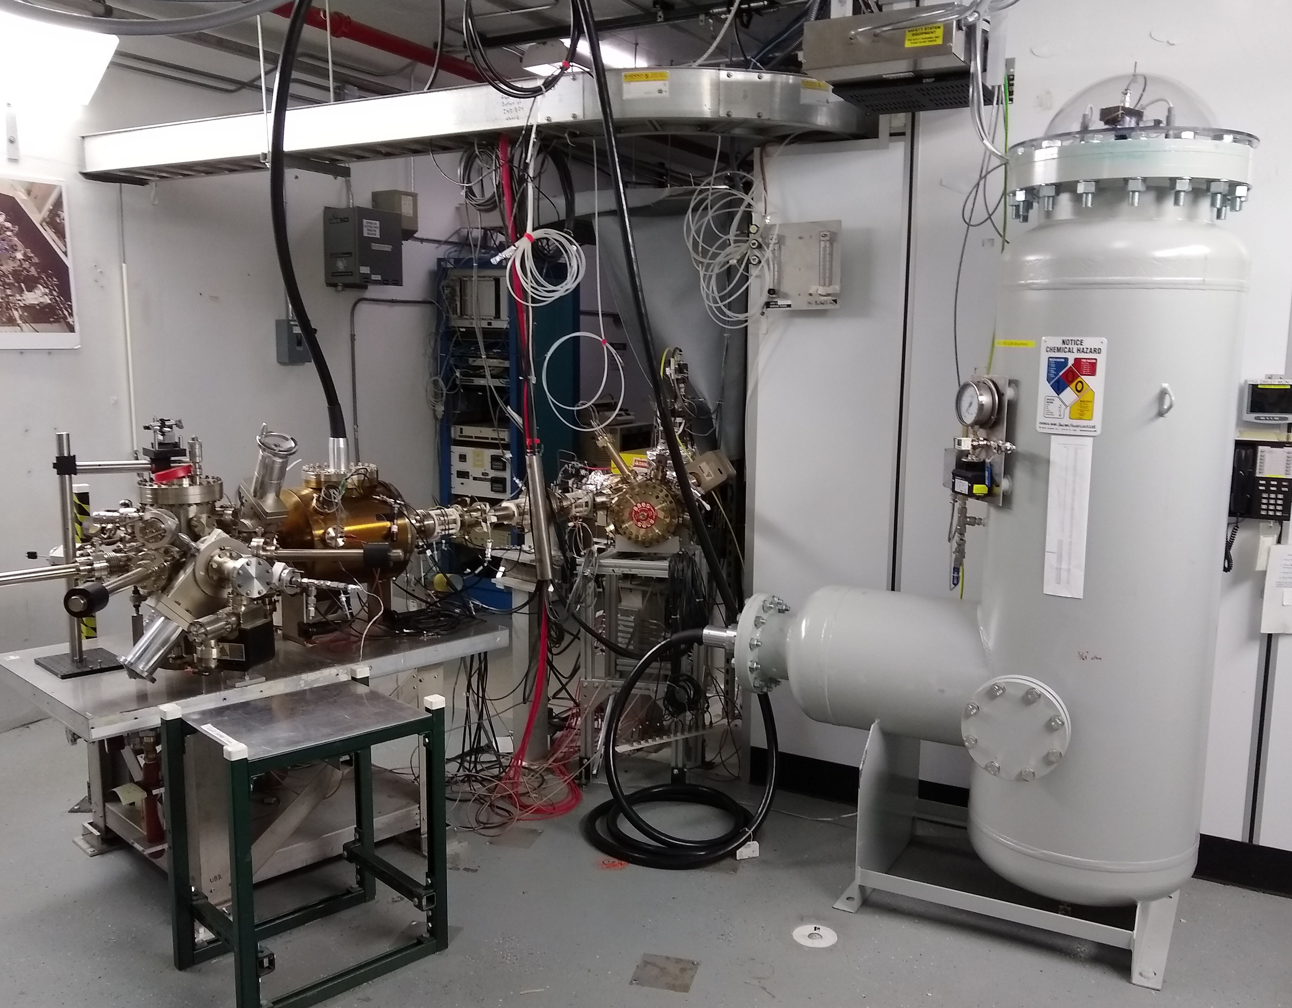
Polarized Source : recently…
Fall Program 2018
Reliable 4-Hall Ops w/ P>85% & good lifetime 50-100uA
Both the new cathode electrode w/ shed & HVPS operated reliably
The two BPM’s after the gun have been used for PQB RTP studies and injector setup
Winter SAD 2019
Photocathode activated (QE ~ 0.7%, P ~ 87%)
UVA RTP cell installed to test position feedback
Helicity magnets re-installed for PREX

Slide 7
Polarized Source : for PREX/CREX…
Photocathode
We’ll use Puck #9 – SLSP-5756-4, in Gun since 2015 w/ P>85%
(Spare Puck #3 – SLSP-5247-4 QWeak sibling available)
Heat/activate prior to PREX & CREX, can then rotate for S2 alignment
Laser Table
RTP cell is being used now, we can optimize Hall A laser profile during upcoming SAD, and retain through PREX/CREX
Second RTP cell to be built (2nd pair of crystals w/ wedge ordered and 2nd mount to be fabricated)
Engineering project started to upgrade RTP driver (in meantime we should assemble spare parts for UVA system)
Plan B: KDP cell remains on laser table
Hall A/B/C have IA cells (Hall D does not)
Helicity Generator Board
Line sync bug identified and fixed
10 MHz clock (vs. 20 MHz) ready to install
PREX can choose any configuration e.g. 120/240 Hz, Octet, etc
CREX runs standard 30Hz Quartet
7

Slide 8
PQB: Aren’t we ready ?
Recommend early PQB check during APEX and/or on Beam Study days:
Test position feedback & damping w/ RTP and HELMAG (APEX/BS)
Test halo with SAM detectors (APEX, BS can be more intrusive)
Monitor HC fluctuations and widths to test stability of RTP/accel (APEX)
Test high transmission setup of Flip LEFT/RIGHT (BS, APEX? If OK for Hall B/C/D)
VWien
Prebuncher
HWien
12 GeV so far: Sets Spin ON OFF
PREX/CREX: 90 ON ON

Slide 9
Hall A Issues
Questions for Yves???
Running at low energy, fringe field effects?
Running through Compton?
Solenoid centering?

