Slide 1
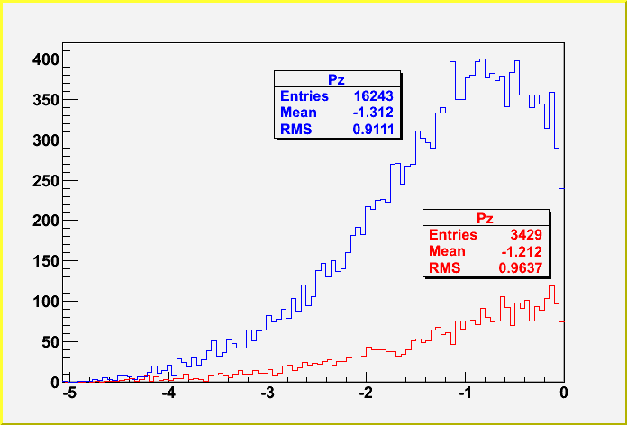
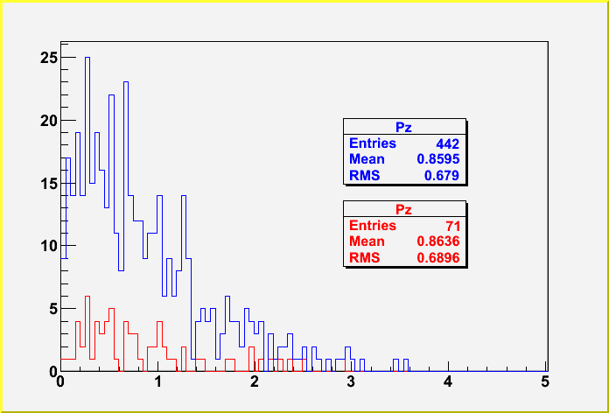
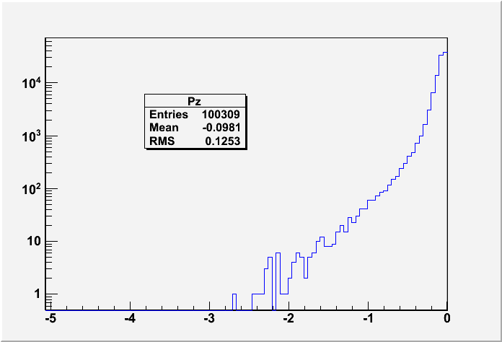
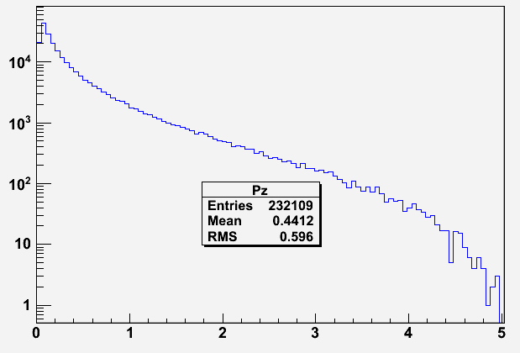
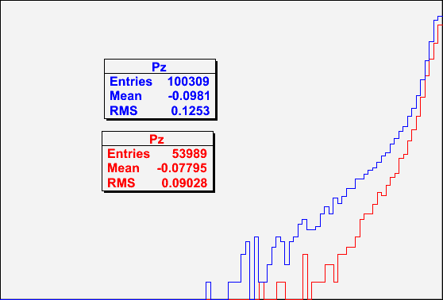
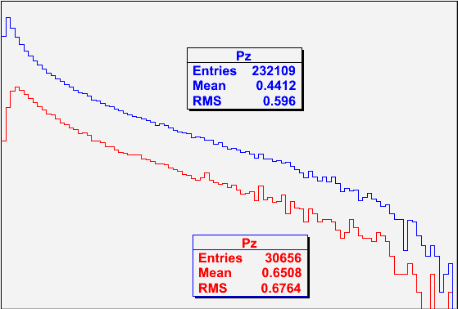
10⁶ 5.5 MeV/c e- on 1um Au illuminate dump face (8hr on my lousy laptop)
Dump case is Al=1” or Be=0.25” + Cu=0.75”
Electrons exit vacuum face Pz<0
Electrons exit air face Pz>0
Photons exit vacuum face Pz<0
Photons exit air face Pz>0

Slide 2
Photons back illuminating from Al=1” vs. Be=0.25” + Cu=0.75”

