Slide 1
Development of High Current Bunched Magnetized Electron DC Photogun
MEIC Collaboration Meeting
Fall 2015
Riad Suleiman and Matt Poelker
October 5 – 7, 2015

Slide 2
Outline
Magnetized Cooling
MEIC Electron Beam Requirements
Magnetized Guns
LDRD Proposal
MEIC Magnetized Gun R&D
Generation of Magnetized Beam
Experimental Overview
  Measurement Plan
  Simulation Plan
Milestones

Slide 3
Magnetized Cooling
MEIC bunched magnetized electron cooler is part of Collider Ring and aims to maintain ion beam emittance and extend luminosity lifetime
Electrons helical motion in strong magnetic field increases electron-ion interaction time, thereby significantly improving cooling efficiency. Electron-ion collisions that occur over many cyclotron oscillations and at distances larger than cyclotron radius are insensitive to electrons transverse velocity.
Cooling rates are determined by electron longitudinal energy spread rather than electron beam transverse emittance as transverse motion of electrons is quenched by magnetic field
This cyclotron motion also provides suppression of electron-ion recombination

Slide 4
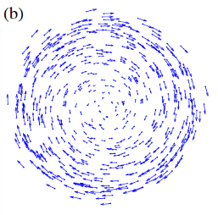
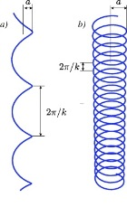
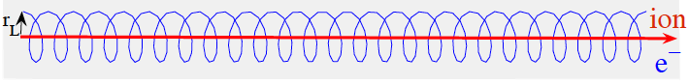
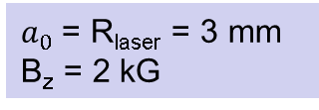
Cooling Solenoid
Cathode Solenoid
SRF Linac
Electrons born in strong uniform B_{z}
Upon exit of Cathode Solenoid
Upon entering Cooling Solenoid
σ_{e}= 0.95 mm
B_{cool} = 2 T
$a_{0}$= R_{laser} = 3 mm
B_{z} = 2 kG
= 528 µm

Slide 5
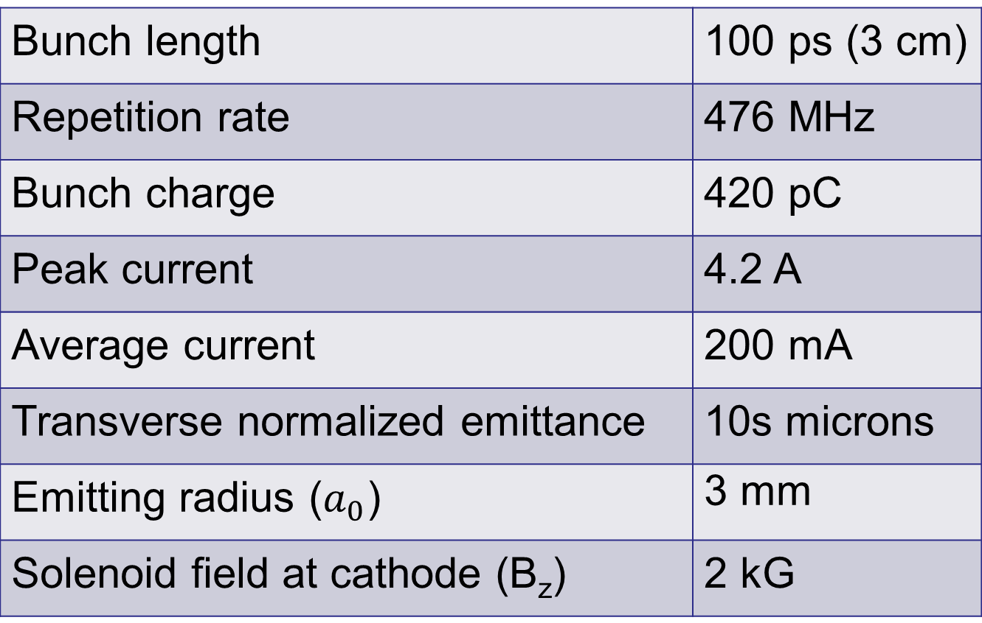
Magnetized Bunched Electron Beam Requirements
Bunch length | 100 ps (3 cm)
Repetition rate | 476 MHz
Bunch charge | 420 pC
Peak current | 4.2 A
Average current | 200 mA
Transverse normalized emittance | 10s microns
Emitting radius ($a_{0}$) | 3 mm
Solenoid field at cathode (B_{z}) | 2 kG

Slide 6
Magnetized Guns
Fermilab Photoinjector Laboratory:
  Pulsed NCRF gun
  Cs₂Te photocathode and UV laser (λ=263 nm)
  Bunch length: 3 ps
  Bunch charge: 0.5 nC
  0.5% duty factor (average current: 7.5 μA)
    Bunch frequency: 3 MHz
    Macropulse duration: 1 ms
    Number of bunches per macropulse: 3000
    Macropulse frequency: 5 Hz
      No CW beam at high average current
Magnetized beam R&D Mainz just started

Slide 7
LDRD Proposal
Laboratory Directed Research and Development (LDRD) proposal: “Generation and Characterization of Magnetized Bunched Electron Beam from DC Photogun for MEIC Cooler” was funded
FY16 | $339,211
FY17 | $265,850
FY18 | $212,025
Total | $817,086
Materials and Supplies:
Solenoid magnet, or Helmholtz coil-pair
Three skew quadrupoles
Components for three diagnostics crosses
Labor:
Gun magnet design and installation
Relocate old CEBAF arc dipole power supply
Mechanical designer for skew quad magnets and slits
ASTRA and GPT modeling
Postdoc

Slide 8
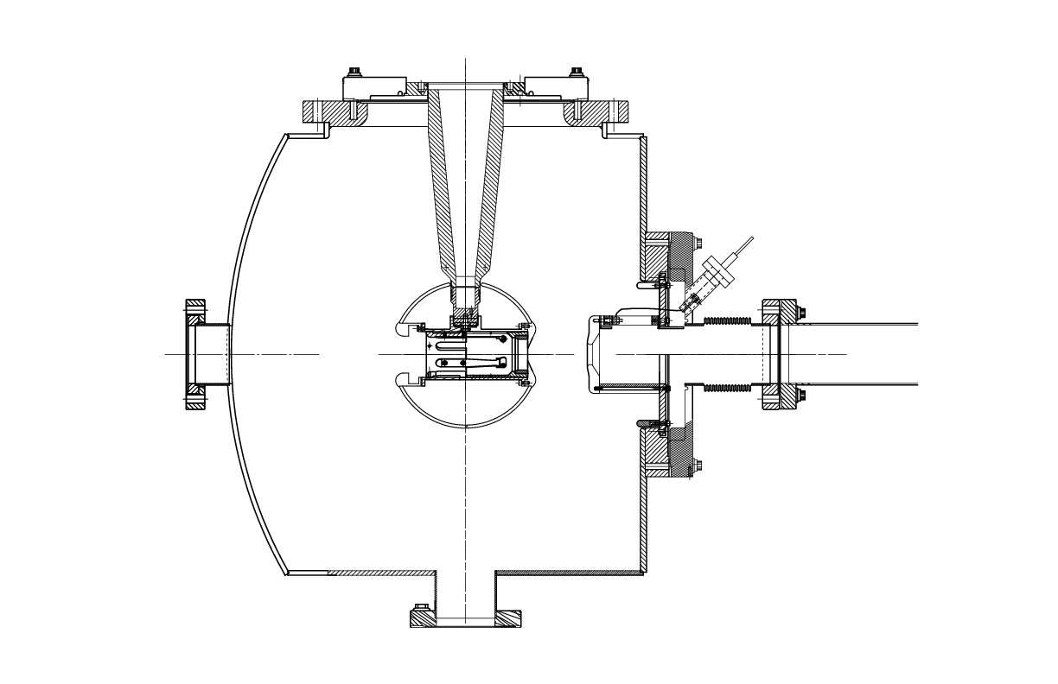
MEIC Magnetized Gun R&D
Generate magnetized electron beam and measure its properties
Explore impact of cathode solenoid on photogun operation
Simulations and measurements will provide insights on ways to optimize MEIC electron cooler and help design appropriate electron source
JLab will have direct experience magnetizing high current electron beam
Cathode Solenoid (B_{z}=2 kG)

Slide 9
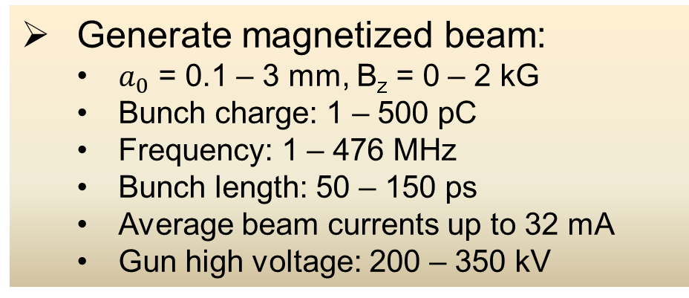
Experimental Overview
Cathode
Solenoid
Diagnostic Cross 3
(YAG Screen)
Cathode
Three Skew Quads
(Round-to-Flat Beam Transformer)
Green
Laser
Anode
K₂CsSb
Photocathode
Injector Focusing Solenoids
Diagnostic Cross 1
(Multislit + YAG Screen)
Diagnostic Cross 2
(H,V slit + YAG Screen)
Generate magnetized beam:
  $a_{0}$ = 0.1 – 3 mm, B_{z} = 0 – 2 kG
  Bunch charge: 1 – 500 pC
  Frequency: 1 – 476 MHz
  Bunch length: 50 – 150 ps
  Average beam currents up to 32 mA
  Gun high voltage: 200 – 350 kV

Slide 10
Simulation Plan
Design beamline to locate magnets and diagnostics at optimum positions
Benchmark simulation (of different operating scenarios of bunch charge, magnetization, bunch shape etc.) against measurements
Quantify how good or complete RTFB transform can be made for different settings – as beams will be space charge dominated, there will be some limit to emittance aspect ratio that can be achieved
These results will guide injector design for MEIC magnetized electron cooler

Slide 11
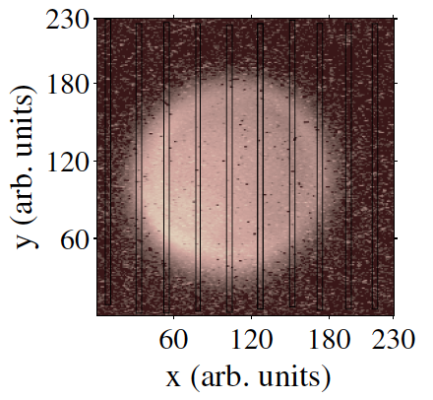
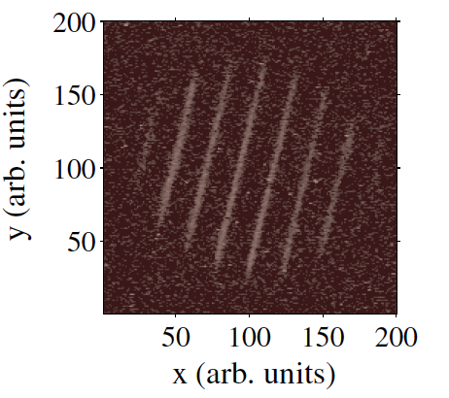
Measurement Plan
Measure mechanical angular momentum
(skew quads off)
σ₁ beam radius measured at Diagnostic Cross 1
σ₂ beam radius measured at Diagnostic Cross 2
D drift between two crosses
p_{z} beam longitudinal momentum
Angular rotation ϕ is measured from beam image at Cross 2 when multislit is inserted at Cross 1
Example of mechanical measurement at Fermilab (Piot et al.)

Slide 12
Use three skew quads – RTFB Transformer – to generate a flat beam with transverse emittance ratios of:
  Measure horizontal and vertical emittances using slit method
Generate very high currents magnetized beam and study beam transport and RTFB transformation versus electron bunch charge
Measure photocathode lifetime versus solenoid field at high currents (up to 32 mA) and high voltages (200 – 350 kV) limited by in-house HV supplies
Study beam halo and beam loss versus magnetization

Slide 13
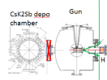
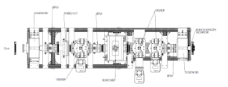
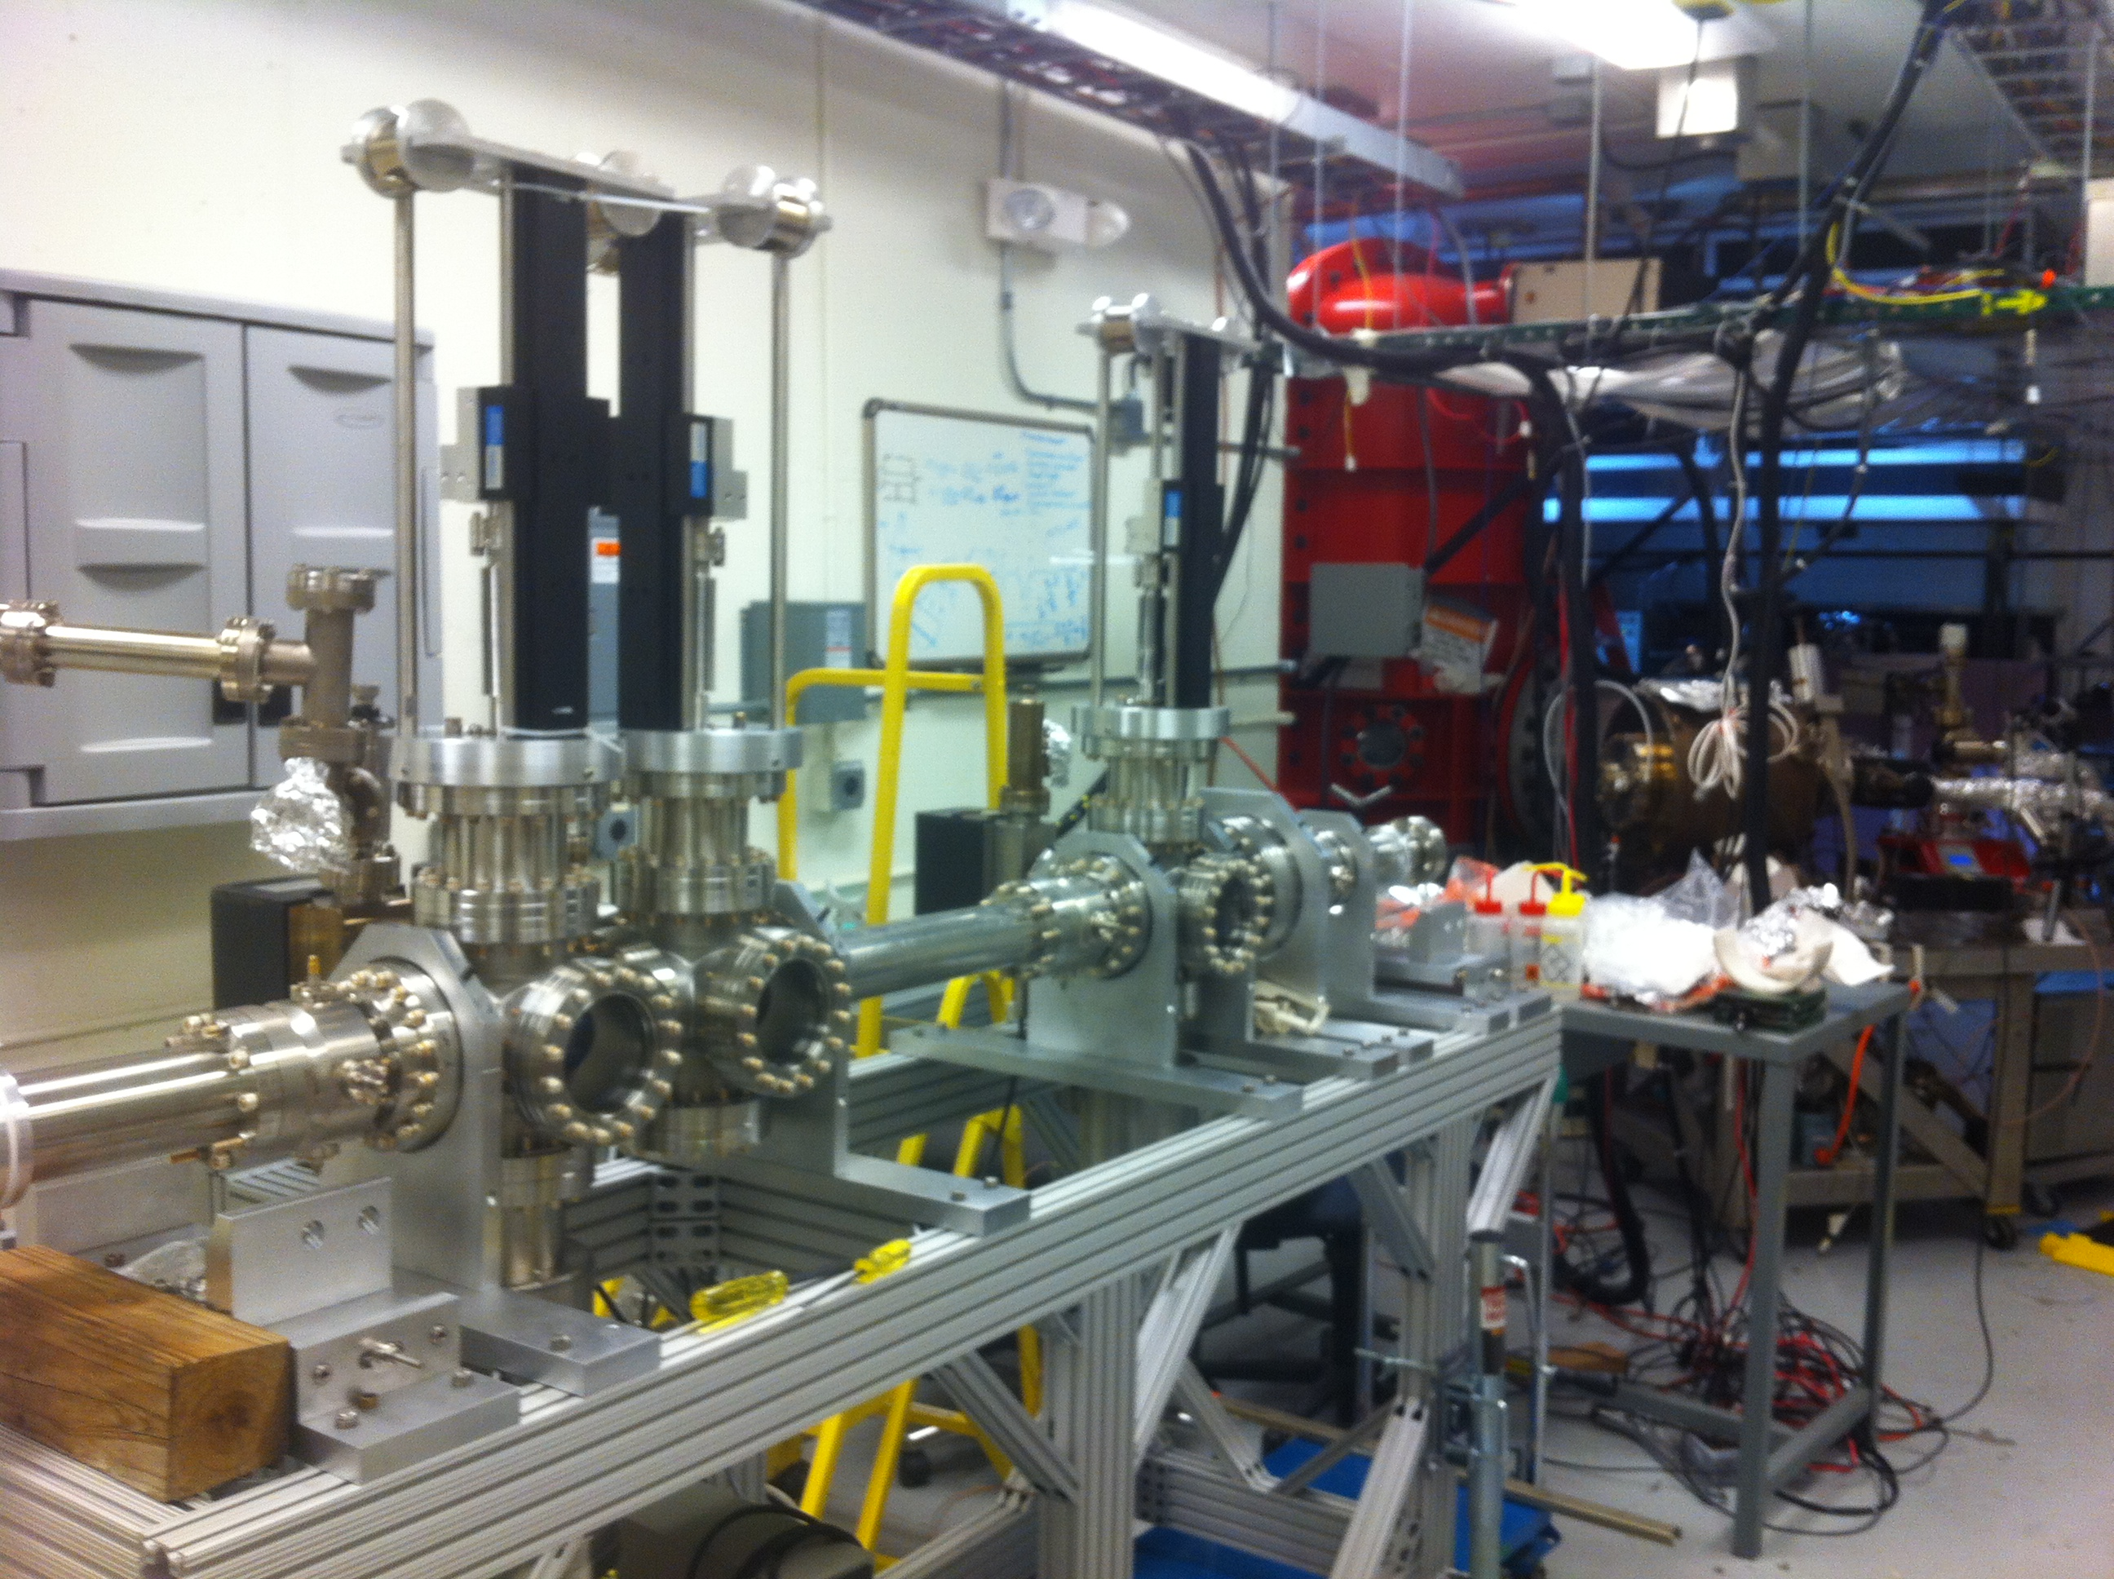
Location of Work: LERF Gun Test Stand

Slide 14
Milestones

Slide 15
Year 1 Milestones
Q1 (Oct, Nov, Dec):
    HV condition gun at 350 kV and commission k₂CsSb preparation chamber
    Design beamline to locate magnets and diagnostics at optimum positions
    Design gun solenoid magnet or Helmholtz coil-pair
    Design skew quad magnets and slits
Q2 (Jan, Feb, Mar):
    Connect existing beamline to gun and complete hot checkout
    Relocate old CEBAF arc dipole power supply to GTS
    Procure gun solenoid magnet or Helmholtz coil-pair
    Procure skew quad magnets and slits
Q3 (Apr, May, Jun):
    Commission exiting beamline with beam
    Measure photocathode lifetime at 5 mA and 350 kV (not magnetized)
Q4 (Jul, Aug, Sep):
    Assemble new beamline and commission with beam
    Install gun solenoid magnet or Helmholtz coil-pair

Slide 16
Year 2 Milestones
Q1 (Oct, Nov, Dec):
    Generate magnetized beam
    Measure mechanical angular momentum vs magnetization and laser size
    Benchmark simulation against measurements
Q2 (Jan, Feb, Mar):
    Measure mechanical angular momentum vs bunch charge and bunch length
    Benchmark simulation against measurements
Q3 (Apr, May, Jun):
    Generate very high currents magnetized beam and study beam transport vs electron bunch charge
Q4 (Jul, Aug, Sep):
    Measure photocathode lifetime vs magnetization at 5 mA and 350 kV
    Study beam halo and beam loss vs magnetization

Slide 17
Year 3 Milestones
Q1 (Oct, Nov, Dec):
    Generate flat beam with three skew quads – RTFB Transformer – and measure horizontal and vertical emittances using slit method
Q2 (Jan, Feb, Mar):
    Measure RTFB transformation versus electron bunch charge
    Use simulation to quantify how good or complete RTFB transform
Q3 (Apr, May, Jun):
    Change to HV Supply of 32 mA and 200 kV
Q4 (Jul, Aug, Sep):
    Measure photocathode lifetime vs magnetization at 32 mA and 200 kV
    Study beam halo and beam loss vs magnetization

