Slide 1

General Particle Tracer (GPT) Simplified Simulations
A. Hofler
May 24, 2017

Slide 2
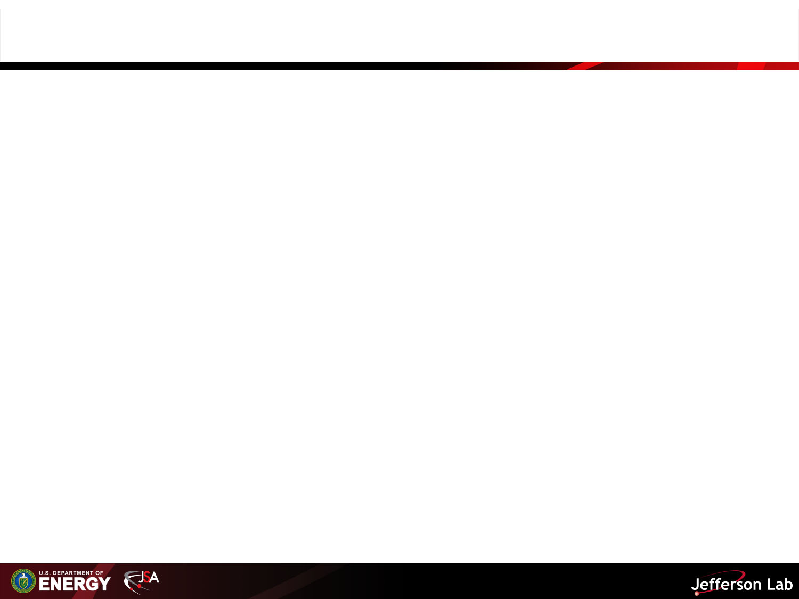
Summary of Elegant Model
Beam characteristics
  p_{central}= 1.732 m_{e}c ⇒ E_{k}=507.7 keV
  Q=0.65 nC ⇒ 325 mA at 499 MHz
  𝛔_{x,y}=7 mm
  𝛔_{t}=1.16 ps
  𝛆_{n(x,y)}=1 mm mrad
Beam line element | Length (cm) | Setting | Center location (m)
Solenoid | 5 | 0.0293 T | 0.1860
Permanent Magnet Quadrupole (PMQ)* | 0.6* | K1=-133333 1/m² ⇒ -400 T/m* | 1.0029
Solenoid | 5 | 0.0293 T | 1.8198
Solenoid | 5 | 0.0293 T | 2.1918
PMQ | 0.6* | K1=133333 1/m² ⇒ 400 T/m* | 3.0087
Solenoid | 5 | 0.0293 T | 3.8256
*R. K. Li and P. Musumeci, Phys. Rev. Applied 2 024003 (2014)

Slide 3
Summary of GPT Model
Analytical magnet models
  Solenoid
    does not remove particles
    setpoint in nI (A turns/m)
  Quadrupole
    no fringe fields
    does not remove particles
    Horizontally defocussing quad in first cell
Beam characteristics
  ϒ=2
  Line of charge
    21 particles
    Evenly distributed
    1 mm long in +x direction
    (0,0,0) to (1,0,0) mm
Space charge off
Beam line element | Length (cm) | Aperture (cm) | Attempted Setting | Center location (m)
Solenoid (S1) | 5 | 5.4 | 0.0293 T ⇒ 34363 A turns/m | 1.1
PMQ (Q1) | 0.6* | 0.3* | 400 T/m* | 1.9169
Solenoid (S2) | 5 | 5.4 | 0.0293 T ⇒ 34363 A turns/m | 2.7338
Solenoid (S3) | 5 | 5.4 | 0.0293 T ⇒ 34363 A | 3.1058
PMQ (Q2) | 0.6* | 0.3* | -400 T/m* | 3.9227
Solenoid (S4) | 5 | 5.4 | 0.0293 T ⇒ 34363 A turns/m | 4.7396
*R. K. Li and P. Musumeci, Phys. Rev. Applied 2 024003 (2014)

Slide 4
Solitary Quad Q1 On
Without focusing the beam at the quad location, particles on the edge of beam will be driven into the beam pipe and not transport through the quad.

Slide 5
Process
For canned and fieldmap singlewound solenoid models:
Find solenoid setting to focus beam at center of quad
  All solenoids have same setting with quads off
With quads on, find a solenoid setting for all solenoids that restores the exit orbit
With quads on and focus setting for the outer solenoids, adjust center solenoid setting to restore exit orbit
With quads on, the solenoid setting from step 2 t for the outer solenoids, adjust center solenoid setting to restore exit orbit
Optional, with the quads on, find outer and center solenoid settings that maintains the orbit at the entrance and exit of all cells

Slide 6
Canned Solenoid Field Extent
Solenoid S1 Only
Solenoid S1 Only
2 Cells (S1, S2, S3, S4)
1 Cell (S1 and S2)
The solenoid is 5 cm long, but the residual field extends much further.

Slide 7
Solenoid Focused at Quad (Quads Off)
1 Cell
1 Cell
2 Cells
S1=S2=S3=S4=S_{focus}
Step 1
Adjusted solenoid S1
to focus at center of Q1
S_{design}=0.0293 T
S_{focus}=1.020171918S_{design}

Slide 8
Solenoid Focused at Quad (Quads On)
1 Cell
1 Cell
2 Cells
S1=S2=S3=S4=S_{focus}
Same solenoid setting as previous slide, S_{focus}.

Slide 9
Solenoid Adjusted r_{initial}=r_{middle} (Quads On)
1 Cell
1 Cell
Step 2
Adjusted solenoid setting to make r_{initial}=r_{middle} with quad on.
S_{design}=0.0293 T
S_{Cell1}=1.0199975S_{design}
2 Cells
S1=S2=S3=S4=S_{Cell1}

Slide 10
Solenoid Focused at Quad (Quads On)
2 Cells
2 Cells
Step 3
S1=S4=S_{focus}
S2=S3=𝛂_{focus}S_{focus}
𝛂_{focus}=1.000323
Step 4
S1=S4=S_{Cell1}
S2=S3=𝛂_{Cell1}S_{Cell1}
𝛂_{Cell1}=1.000047
Adjusted middle solenoid settings (𝛂) to make r_{initial}=r_{final} with quad on.

Slide 11
Solenoid Focused at Quad (Quads On)
2 Cells
2 Cells
Step 5
S_{design}=0.0293 T
S_{Outer1}=1.0199925S_{design}
S1=S4=S_{Outer1}
S2=S3=𝛂_{Outer1}S_{Outer1}
𝛂_{outer1}=1.000048
Step 5
S_{design}=0.0293 T
S_{Outer1}=1.0208109375S_{design}
S1=S4=S_{Outer2}
S2=S3=𝛂_{Outer2}S_{Outer2}
𝛂_{Outer2}=0.9987236
Adjusted outer (S_{Outeri}) and middle solenoid settings (𝛂_{Outeri}) to make r_{initial}=r_{middle}=r_{final} with quad on.

Slide 12
2.5D Fieldmap Solenoid Field Extent
Solenoid S1 Only
Solenoid S1 Only
2 Cells (S1, S2, S3, S4)
1 Cell (S1 and S2)
Field extent is finite but overlaps between S2 and S3.

Slide 13
2.5D Fieldmap Solenoid Field Extent
2 Cells (S1, S2, S3, S4)
Shifted Cell 2 0.1 m downstream.
Cell 2 is shifted 0.1 m in following slides.

Slide 14
2.5D Fieldmap Solenoid Focused at Quad (Quads Off)
1 Cell
1 Cell
2 Cells
S1=S2=S3=S4=S_{focus}
Step 1
Adjusted solenoid S1
to focus at center of Q1
S_{design}=0.0293 T
S_{focus}=1.02276S_{design}

Slide 15
2.5D Fieldmap Solenoid Focused at Quad (Quads On)
1 Cell
1 Cell
2 Cells
S1=S2=S3=S4=S_{focus}
Same solenoid setting as previous slide, S_{focus}.

Slide 16
2.5D Fieldmap Solenoid Adjusted r_{initial}=r_{middle} (Quads On)
1 Cell
1 Cell
Step 2
Adjusted solenoid setting to make r_{initial}=r_{middle} with quad on.
First of 2 Solutions
S_{design}=0.0293 T
S_{Cell1a}=1.02251S_{design}
2 Cells
S1=S2=S3=S4=S_{Cell1a}

Slide 17
2.5D Fieldmap Solenoid Adjusted r_{initial}=r_{middle} (Quads On)
1 Cell
1 Cell
Step 2
Adjusted solenoid setting to make r_{initial}=r_{middle} with quad on.
Second of 2 Solutions
S_{design}=0.0293 T
S_{Cell1b}=1.0233199S_{design}
2 Cells
S1=S2=S3=S4=S_{Cell1b}

Slide 18
2.5D Fieldmap Solenoid Focused at Quad (Quads On)
2 Cells
2 Cells
Step 3
S1=S4=S_{focus}
S2=S3=𝛂_{focusa}S_{focus}
𝛂_{focusa}=0.99996
Step 3
S1=S4=S_{focus}
S2=S3=𝛂_{focusb}S_{focus}
𝛂_{focusb}=1.001465
Step 3: Two solutions for S_{focus}

Slide 19
2.5D Fieldmap Solenoid Focused at Quad (Quads On)
2 Cells
2 Cells
Step 4
S1=S4=S_{Cell1a}
S2=S3=𝛂_{Cell1a}S_{Cell1a}
𝛂_{Cell1a}=1.000214
Step 4
S1=S4=S_{Cell1b}
S2=S3=𝛂_{Cell1b}S_{Cell1b}
𝛂_{Cell1b}=0.99911
Step 4: One solution each for S_{Cell1a} and S_{Cell1b}

Slide 20
Conclusion
GPT canned quad and solenoid models behave correctly
Canned single-wound solenoid model residual field problematic
  Crosstalk between solenoids and quads
  Shifting Cell 2 not viable
More realistic cylindrically symmetric single-wound solenoid model exhibits same set up sensitivities despite having finite field extent
  Shifting Cell 2 to remove crosstalk did not appreciably change results (unshifted results not provided here)
Attempted to using 3D counter-wound solenoid model (not provided here)
  20% increase in solenoid setting to focus beam at quad
  Multi-cell set ups did not converge (perhaps with more effort?)
Multi-cell system set up is very sensitive to solenoid settings.
  Single-wound or counter-wound solenoids?
    Beam will have net change in orbit with single-wound solenoids

Slide 21
Conclusion/Questions
GPT canned quad and solenoid models behave correctly
Multi-cell system set up is very sensitive to solenoid settings.
  Canned single-wound solenoid model residual field problematic
    Crosstalk between solenoids and quads
    Shifting Cell 2 not viable
  More realistic cylindrically symmetric single-wound solenoid model exhibits same set up sensitivities despite having finite field extent
    Shifting Cell 2 to remove crosstalk did not appreciably change results (unshifted results not provided here)
Single-wound or counter-wound solenoids?
  Beam will have net change in orbit with single-wound solenoids
  Attempted to use 3D counter-wound solenoid model (not provided here)
    20% increase in solenoid setting to focus beam at quad
    Multi-cell set ups did not converge (perhaps with more effort?)
  CEBAF single- and counter-wound solenoids believed to be capable of focusing 500 keV beam

