Slide 1
Bubble Chamber Superheated Detector System

Slide 2
ANL Bubble Chamber
Lead designer and fabricator Brad DiGiovine (ANL)
April 2009 Chamber Received Full Operation Authorization for (C₄F₁₀)
February 2010 First Bubble Chamber Received Upgrade Authorization for Superheated H₂O
Two runs at HIγS
Modifications: N2O with Hg as buffer fluid
Modifications were reviewed at ANL
Extensive testing and operations ANL using N2O and mercury (neutron source)
Brought to JLAB for testing with photons
JLAB Design Authority: Dave Meekins
First user built pressure system (non-vacuum) post 10 CFR 851

Slide 3
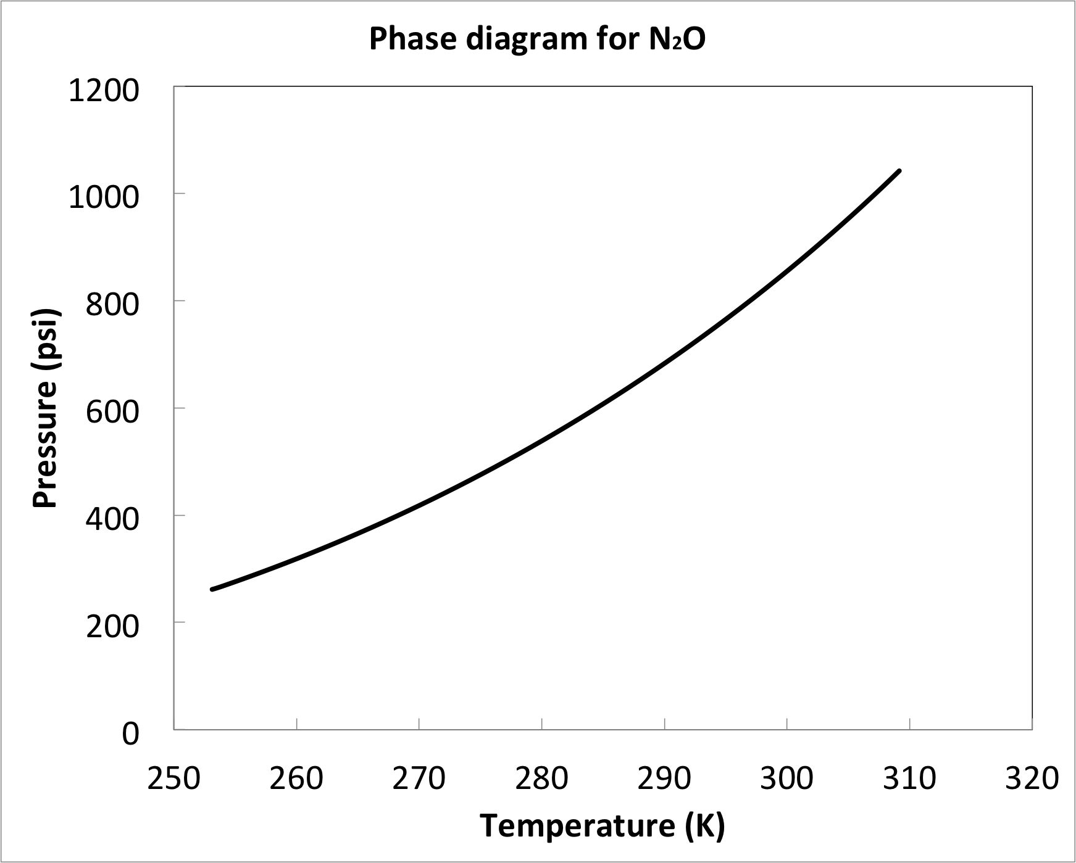
Theory of Operation
1 Cell is cooled then filled with room temperature gas
2 Gas is cooled and condenses into liquid
3 Once cell is completely filled with liquid, pressure is reduced creating a superheated liquid
3 Nuclear reactions induce bubble nucleation
2 High speed camera detects bubble and repressurizes
3 System depressurizes and ready for another cycle
1051
Critical point
Liquid
2
1
Vapor
3
309

Slide 4
Systems and Components
Bubble Chamber
40-60 ml
Pressure Vessel
Max operating pressure 1000 psi
Viewport, Camera and Lighting
Hydraulic Control
Cooling circuit/refrigerator
-20C to room temp.
DAQ/Control and Instrumentation

Slide 5
Basic Components
Heavy Wall Stainless Steel Pressure Vessel
Thin Wall Glass Active Liquid Volume
Thin Pressure Transfer Bellows
Cooling Coils
Pressure Supply
Solenoid Valves
High Speed Camera
Pressure Vessel
Active Liquid Volume
Cooling Coils
High Speed Camera
Solenoid Valves
Pressure Equalizing Bellows
Pressure Supply
P1
P2

Slide 6
Bubble Chamber
Thin Glass Vessel Holds Active Liquid, N₂O
N₂O 40-60 ml Floats on Mercury 150 ml, Which Fills Remaining Inner Volume
Superheated Liquid Only in Contact With Smooth Surfaces
Thin Sensitive Edge Welded Bellows Equalize Pressure
Stainless Tube Facilitates External Connection of Pressure Transducers and Filling Valves
Wetted Materials: Stainless Steel, Kovar, Glass
Copper cooling coils (not shown) supplied by commercial refrigerator.

Slide 7
Pressure Vessel
Houses Bubble Chamber
One Piece Construction
No Welding
Minimal Internal Volume
Machined From a Solid 304 S.S. Forging
Flanges Machined From 316 S.S.
Utilize a Plug Design to Reduce Inner Volume
Maximum allowable design pressure 1700 psi.
Component has 5.75” bore
Treated as B31.3 (using 304.7.2)
Div 2 analysis using elastic plastic
Plastic collapse/local failure
Fatigue screening indicates cycles required to squish bubbles not deep enough to consider for 500 psi ∆P maximum. Div 2 Part 5.5.2.4

Slide 8
Viewport, Camera, and Lighting
Two Custom Designed and Fabricated by Industry Leader in High P&T Viewports
Design Paramaters:
– 260ºC Operating temperature
– 88 ATM (1300 psi) Operating pressure
One Houses High Speed 100FPS Camera
One Houses High Intensity LED Back Lighting

Slide 9
Hydraulic Control System
Constructed of standard fittings and components with minimum working ratings of 1500 psi.
Piping is SST tube and flex lines with lowest design P=2500 psi
Accumulators are charged with N2 circuit design P=1000 psi
Pump supplies 1 gpm
Multiple hydraulic regulators and reliefs
Vented reservoir
Screened for cyclic loading

Slide 10
Hydraulic Control System
Capped

Slide 11
Overpressure Protection
Two separate circuits
Sources of overpressure
Fire (not considered)
Pump run away
N2 circuit
ASME relief directly on bottle
Orifice restricted flow to system piping
1000 psi ASME relief with adequate flow capacity
Hydraulic circuit
Multiple hydraulic reliefs non ASME below 1000 psi.
ASME relief on chamber 1100 psi (12.7 gpm)
N2O is liquid at room temp at this pressure
Detailed in TGT-CALC-502-003

Slide 12
HazMat
Two materials of note:
Mercury (Hg)
Nitrous Oxide (N2O)
Admin and Eng controls in place
Procedures for filling/operating/venting
Hg not “handled” at JLAB under normal conditions
Volume of N2O in chamber is 17 liters at STP
Filters are in place to prevent Hg liquid and vapor from escaping confinement.

Slide 13
Mercury
Prolonged or intense acute exposure can be very hazardous.
Active fluid is removed through
Phase separator
Droplet Filter
Vapor Filter
This prevents Hg from escape.
There is secondary containment under the chamber should a mistake occur
Two step error: Removing VCR Cap and opening valve
Monitor personnel for exposure using SKC Elemental Mercury Passive Sampler.
IH to monitor filling/venting
Filling and venting procedures shall only be performed by Brad DiGiovine (ANL).

Slide 14
N2O
Occupational exposure limit of 50 ppm
2000 hr/year
If all in chamber is released to injector 25 ppm
Monitor personnel for exposure using Assay Technology 575 N2O sampler.
IH to monitor filling/venting
Filling and venting procedures shall only be performed by Brad DiGiovine (ANL).
Supply bottle is removed immediately after fill procedure is complete. (Total of 17 STPL in injector)

Slide 15
Electrical Safety
System requires 208VAC power
Custom components were developed by ANL
Detailed schematics can be found in pressure systems folder
The system was inspected by both ANL and JLAB
All components can be disconnected from the power source with plug and secured.

Slide 16
Control and Instrumentation Chassis
Temperature Monitoring and Heater Control
Pressure and Temperature Transducer Retransmission to Computer
Solenoid Valve Manual Operation and Computer Interface
Hydraulic System Logic and Interlocks
Two Remote Override Control Interfaces
Electrical Safety Inspection Completed on All Chasses

Slide 17
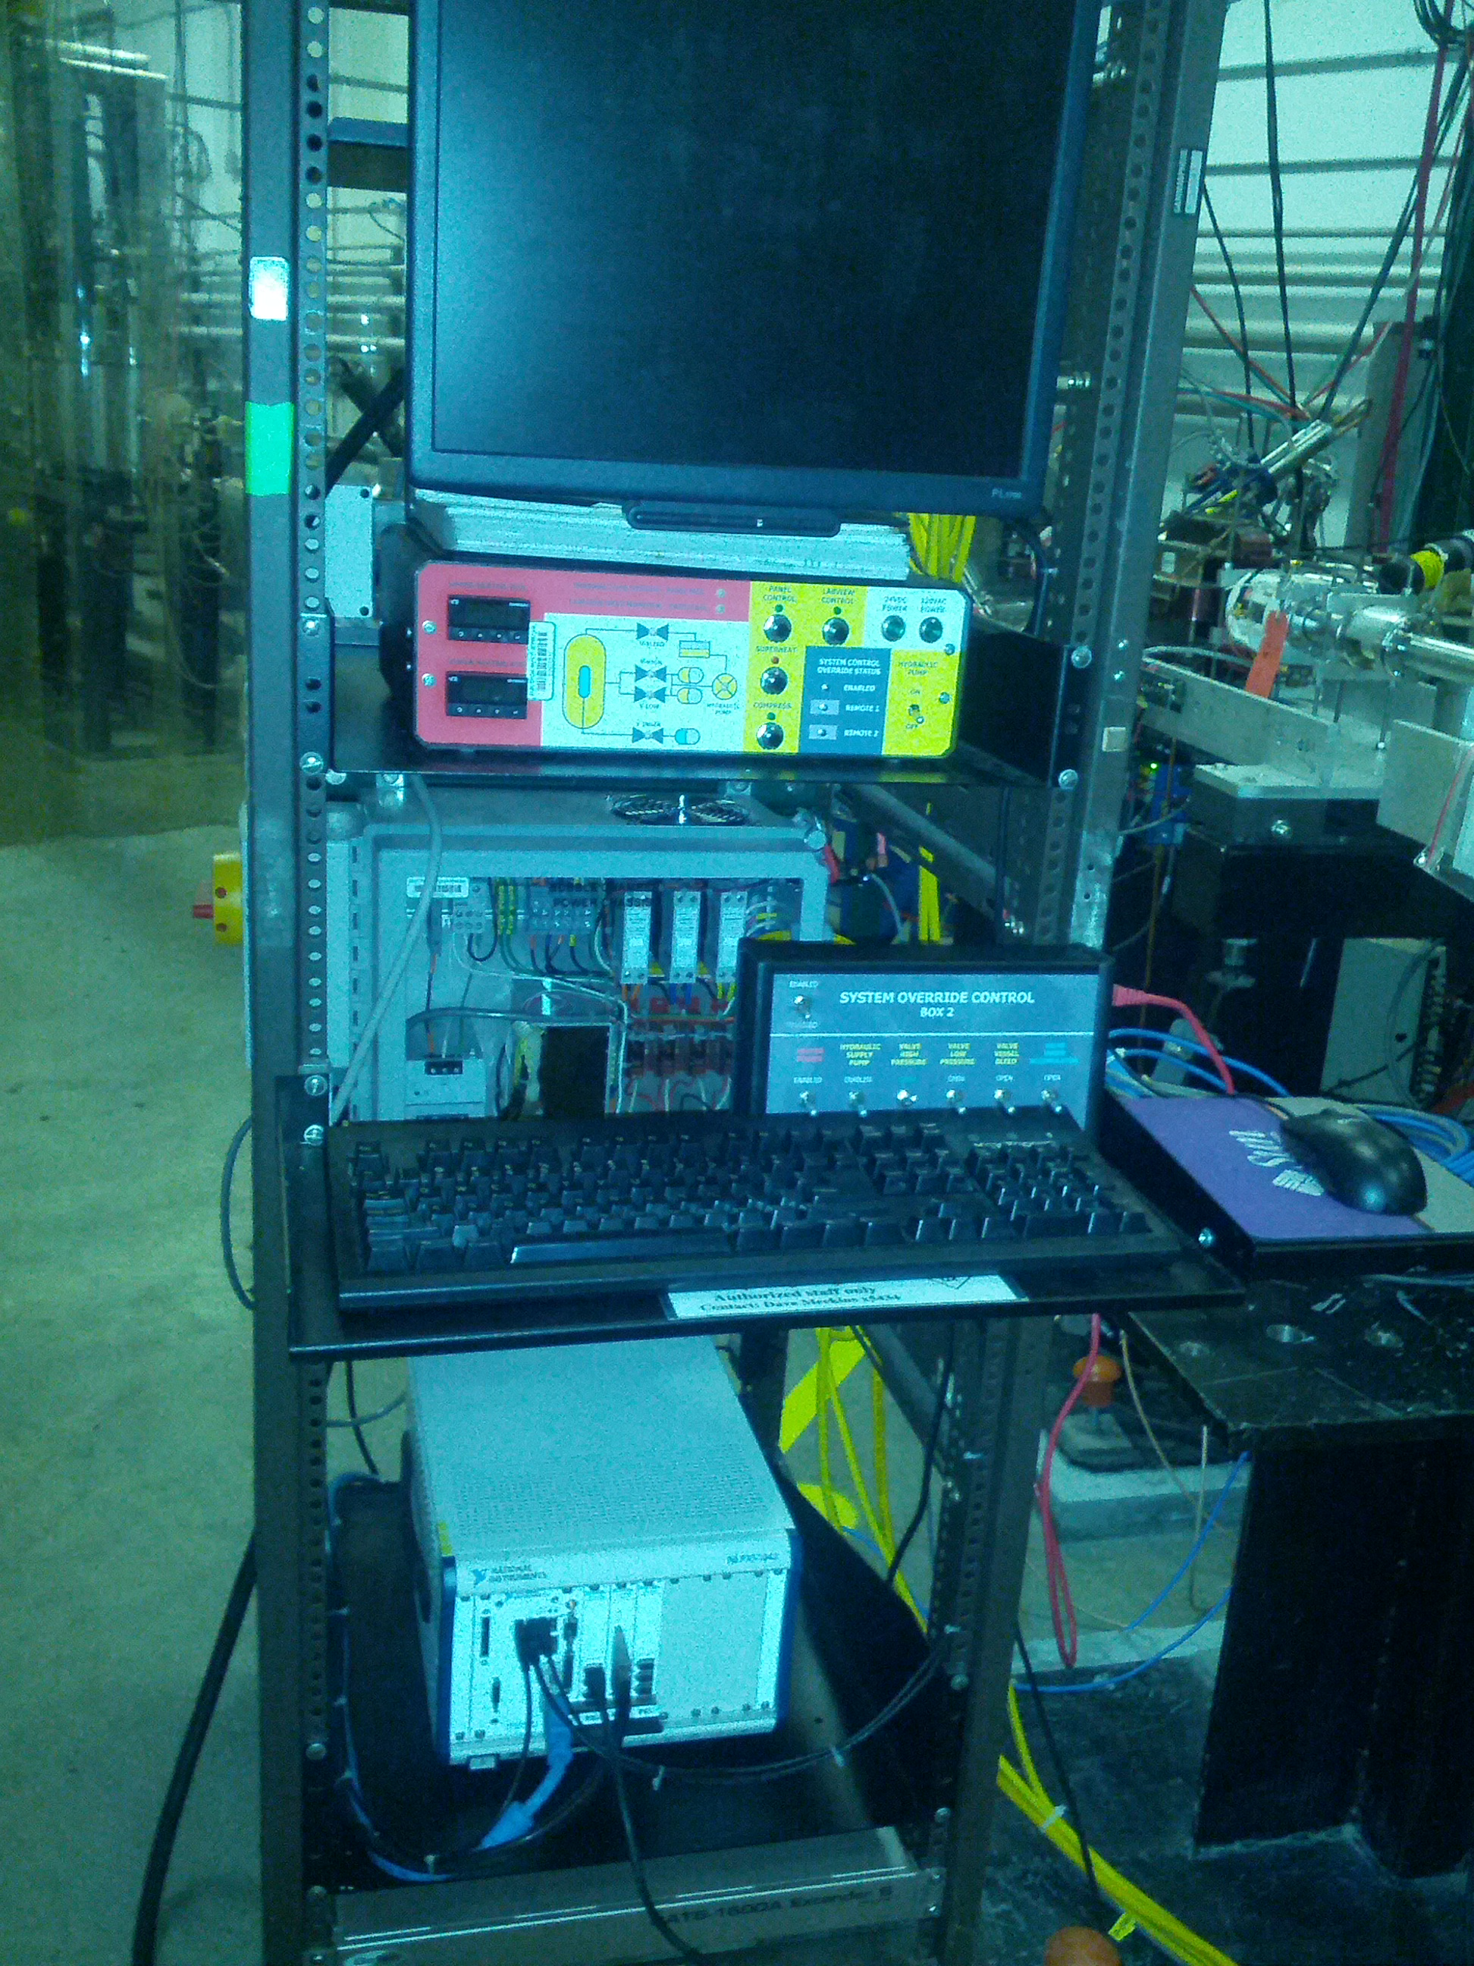

Slide 18
Failure Modes and Effects
Failure of glass bubble chamber
Failure of pump cut off switch
Accumulator failure
Regulator failure
Refrigerator failure
Power failure

Slide 19
Failure of glass bubble chamber
Failure can be detected by camera remotely or by direct observation.
N2O (or C2F6) and Hg may be released into hydraulic fluid.
The integrity of the system is not lost.
The fluid mix can be drained back to reservoir and shipped back to ANL for recovery.

Slide 20
Failure of Pump Cut off
Pump is controlled by pressure switch
Failure causes pump to run continuously at 1 gpm
Multiple relief devices and control regulators will relieve pressure/excess flow back to reservoir
ASME relief set at 1100 psi will blow down entire system should other relief paths fail.
ΔP across glass will stay low due to equalizing bellows

Slide 21
Accumulator Failure
This mode is considered very unlikely due to working pressure rating 3x higher than operating
Accumulators are diaphragm style.
There will be DAQ and control issues but system integrity will be maintained.
ΔP across glass will stay low due to equalizing bellows

Slide 22
Regulator Failure
N2 regulator failure only affects accumulator filling actions. This is very rare.
Orifice limits flow and ASME relief with excess capacity is set at 1000 psi.
N2 bottle is disconnected after charging the accumulators

Slide 23
Refrigerator Failure
DAQ system will alarm unless full power failure.
Interlocks will open CV-2 (high pressure valve) and close CV-4 (low pressure valve).
Active fluid will stay in liquid state while system warms to room temperature
No damage will occur to bubble chamber.
System expert shall address issues and repair as needed.

Slide 24
Power Failure
During power failure DAQ, control, pump and refrigerator stop
CV-2 opens (default state) and CV-4 closes (default state)
Chamber is returned to high pressure “standby” mode which is stable.
The system will slowly warm.
The system will stay down until reset
Only system expert may perform reset.

Slide 25
Required Training
To operate the detector users shall be trained by Brad DiGiovine
Only system expert shall perform fluid handling procedures or adjustments to controls
SAF 801 Rad worker I
SAF 103 ODH
SAF 130 Oil Spill Training (not required for all personnel and only if needed)
SAF 132 Tunnel worker safety
SAF 801kd RWP for tunnel access
SAF 100 General safety

Slide 26
Operating Procedures
Following procedures are developed
Fill procedure
Venting
Power loss
Fire (leave area call 911)
Basic user operation
Start/stop runs
Only available after system is placed in standby mode by expert
DAQ failure procedure
Emergency de-energize procedure is available for all personnel but, will require that the system be shipped back to ANL for repair.

Slide 27
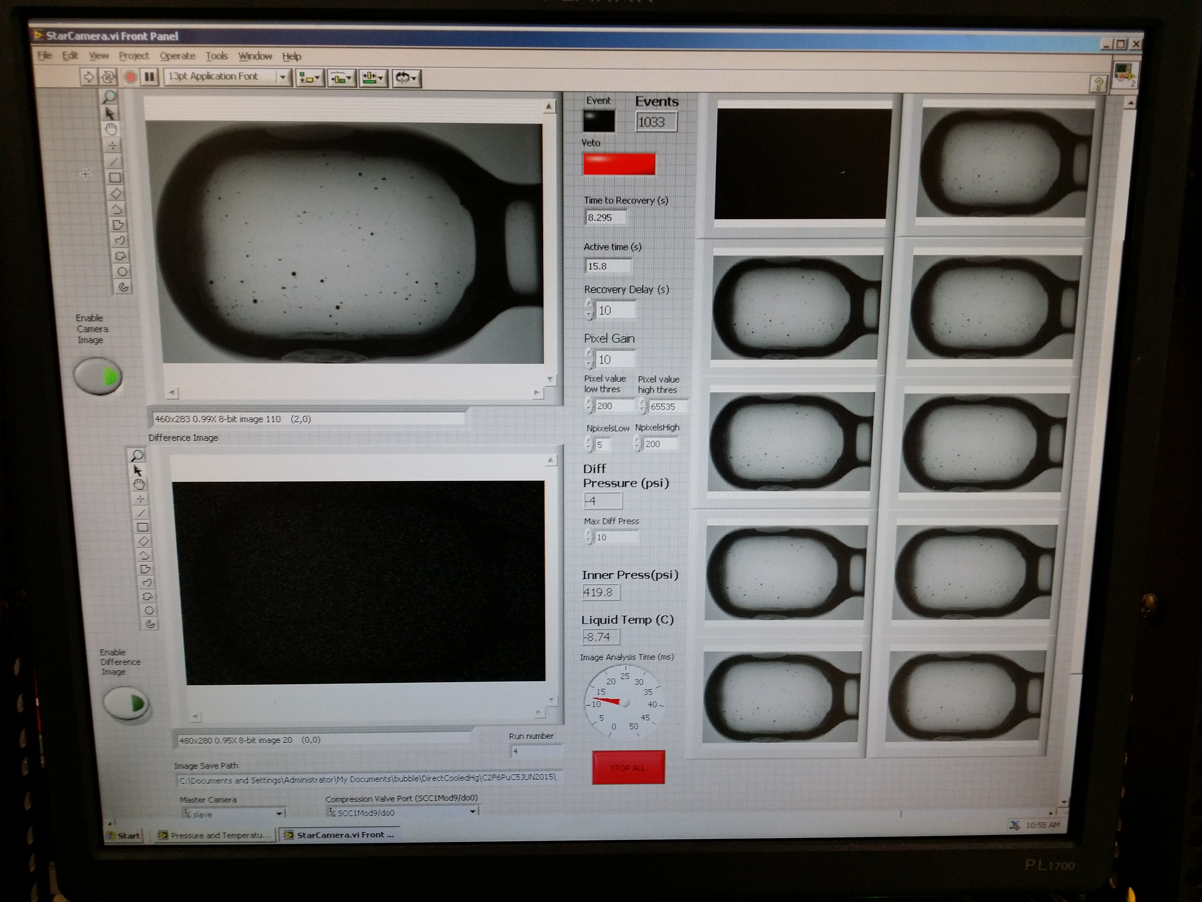
User Interface

Slide 28
Running Adjustments
Test is to understand and optimize the detector performance.
Only system expert shall make/approve changes to the fluid system
Possible adjustments include
Operating pressure/temperature
Quench pressure
Fluid levels
Dead time

