Slide 1
Mott DAQ Speed
February 16, 2015

Slide 2
VME CRATE (VME8200 9U 21Slot - VME64x backplane with no P0 connector)
VME SBC – sbcmdaqo | TID |  | CAEN V538A |  | DB 1 | Mott FADC |  |  | DB 2 | INT FADC |  |  |  | S1 (SIS3801) | S2 (SIS3801) |  |  | TDC CAEN V775 |  |  | FT
1
1
1 In
Gate
17 BFM
18 Mott
DetTr
L1A
LEMO
4
LN1
Common
L1A
ECL
4
TRG IN
TRG IN
INH
BUSY
Opsmdaq0
nT_Settle

Slide 3
Data Taking Configurations
Name | Readout | Trigger
Scalers | Scaler S1 (helicity gated), S2 (un-gated) | Delayed nT_Settle
Mott_Sample | Mott FADC (Mode=1), S1, S2, TDC | Mott Detector
Mott_SemiInt | Mott FADC (Mode=7), S1, S2, TDC | Mott Detector
PEPPo_Int | INT FADC, S1, S2 | nT_Settle
SemiIntFast | Mott FADC (Mode=7), BlockLevel=1 | Mott Detector
SemiIntBlock | Mott FADC (Mode=7), BlockLevel=50 | Mott Detector

Slide 4
Use Faster DAQ Mode
For DAQ to be faster:
No Readout of CAEN V775 TDC or SIS3801 Scalers; only FADC readout
Use block readout
FADC has a mode with smaller data size and time readout: Pulse Integral and High Resolution Time Mode
What about scalers?
We took data with this mode … results are shown next …

Slide 5
Comparison of:
Raw ADC Data Samples Mode
vs.
Pulse Integral and High Resolution Time Mode

Slide 6
Raw ADC data samples – Run 8222

Slide 7
Raw ADC Data Samples
PTW = 100 ns – 2 µs
PL = 100 ns – 8 µs
Mott Settings:
Programmable Latency (PL) = 60 samples
Programmable Trigger Window (PTW) = 50 samples
Threshold = 0
Each Sample = 4 ns (250 MHz), 0 – 4096 (2¹²)
Mott Readout:
50 samples

Slide 8
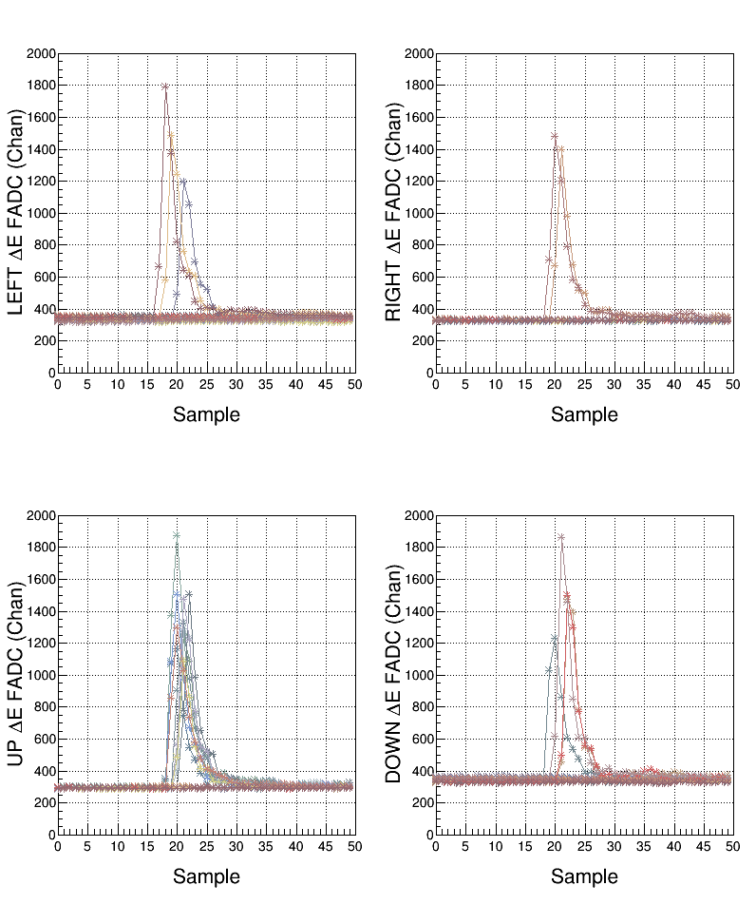
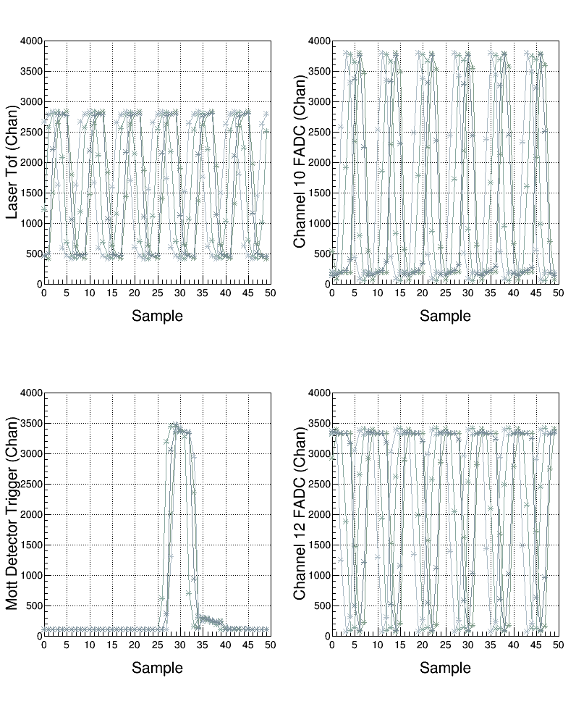
Samples

Slide 9
Analysis: Pedestals

Slide 10
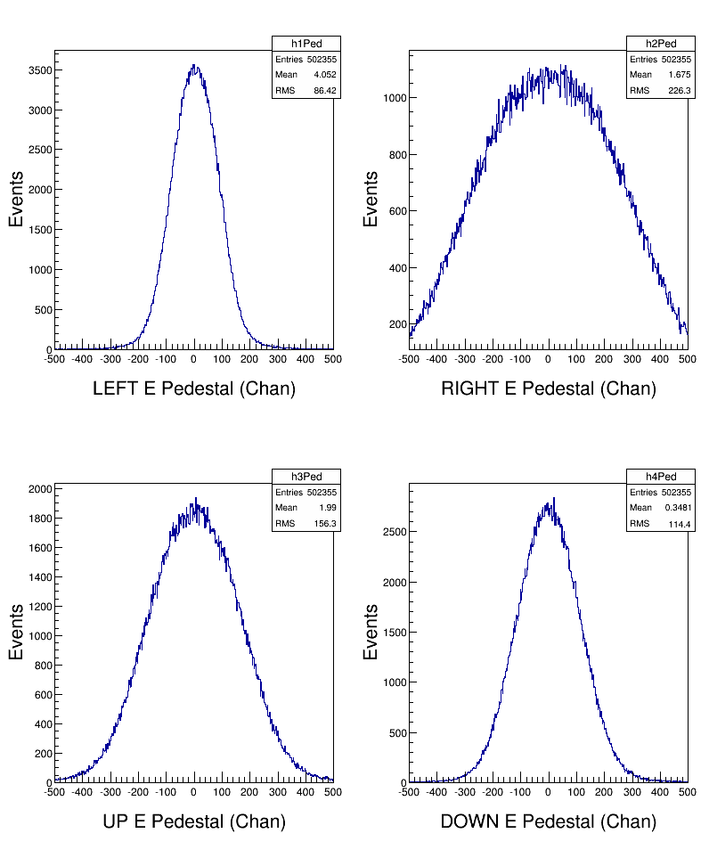
Analysis: Energy
σ_{E} ~ 3.0%

Slide 11
Analysis: Time-of-flight
σ_{t} ~ 0.3 ns

Slide 12
Pulse Integral and High Resolution Time – Runs 8224, 8235

Slide 13
Pulse Integral & High Resolution Time
NSB
NSA
TET
PTW
PL
Mott Settings:
PL = 60 samples, PTW = 50 samples, NW = NSB + NSA
Programmable Trigger Energy Threshold (TET)
Number of pulses (NP) in PTW = 1 (up to 3 pulses)
Number of Samples Before threshold crossing (NSB) = 5
Number of Samples After threshold crossing (NSA) = 28

Slide 14
TET
Threshold was 100 for Run 8224

Slide 15
Pulse Integral & High Resolution Time
V_{P}
V_{mid}
NSB
NSA
TET
Pedestal
TC
PTW
PL
See
Note 1
Mott Readout:
Pedestal = Average of first 4 samples of window
Peak Value (V_{P})
Pulse Integral = Sum of raw samples MIN(NSB+NSA, PTW)
Pulse Coarse Time = Sample number N1 such that V(N1) ≤(V_{p}-Ped)/2)<V(N2)
Pulse Fine Time = 64 ( V_{mid} – V(N1) )/( V(N2)-V(N1) ). From 0 to 63 in steps of 62.5 ps
See
Note 2

Slide 16
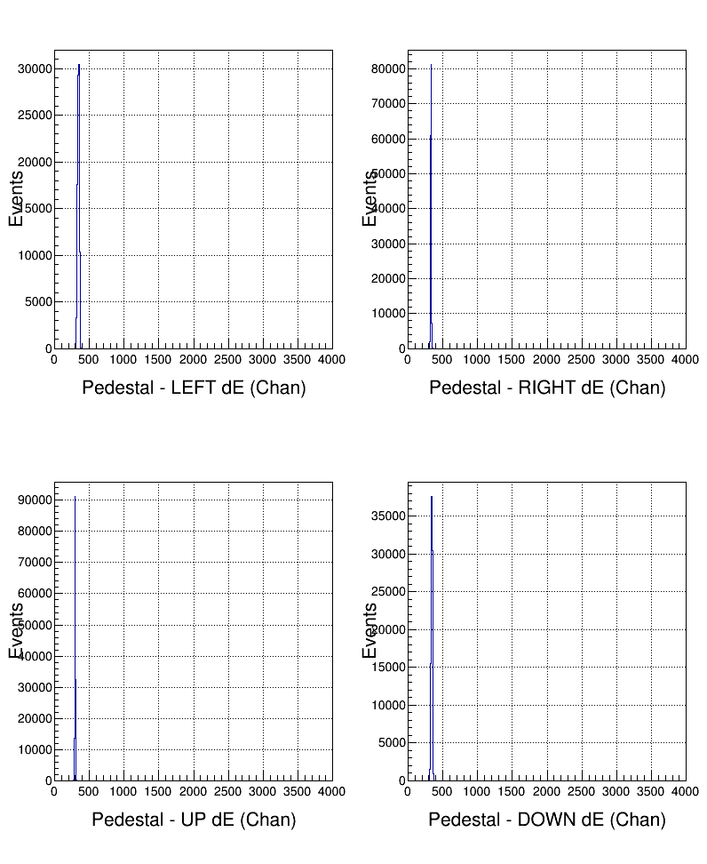
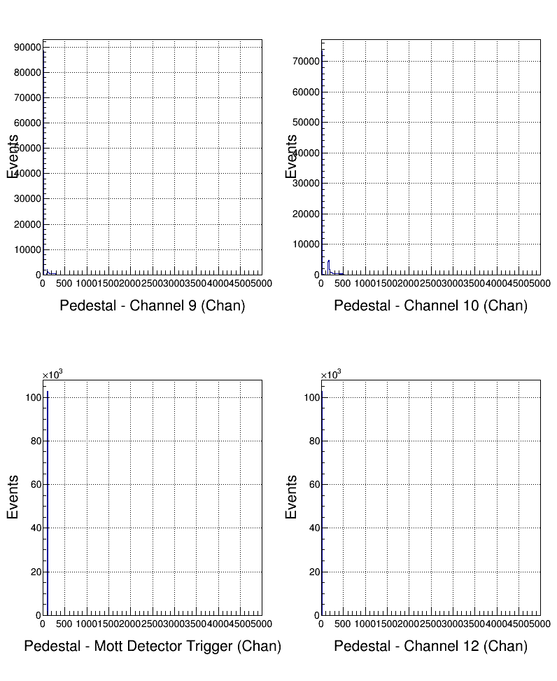
Pulse Pedestal

Slide 17
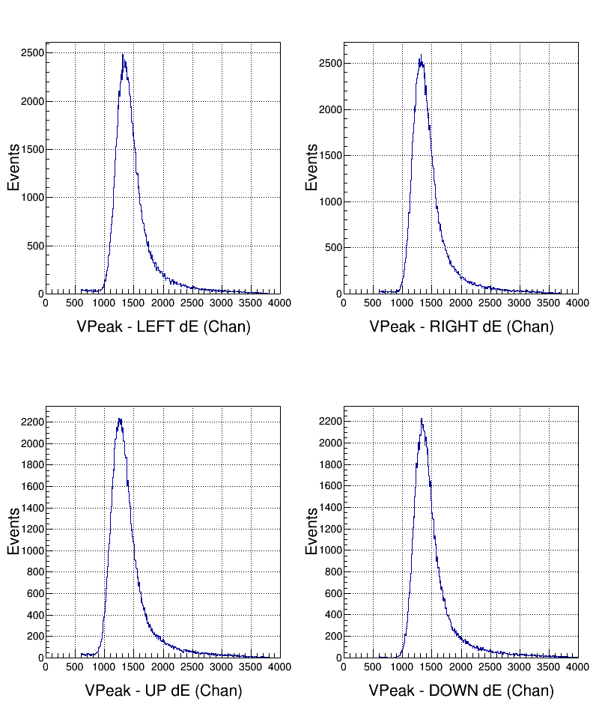
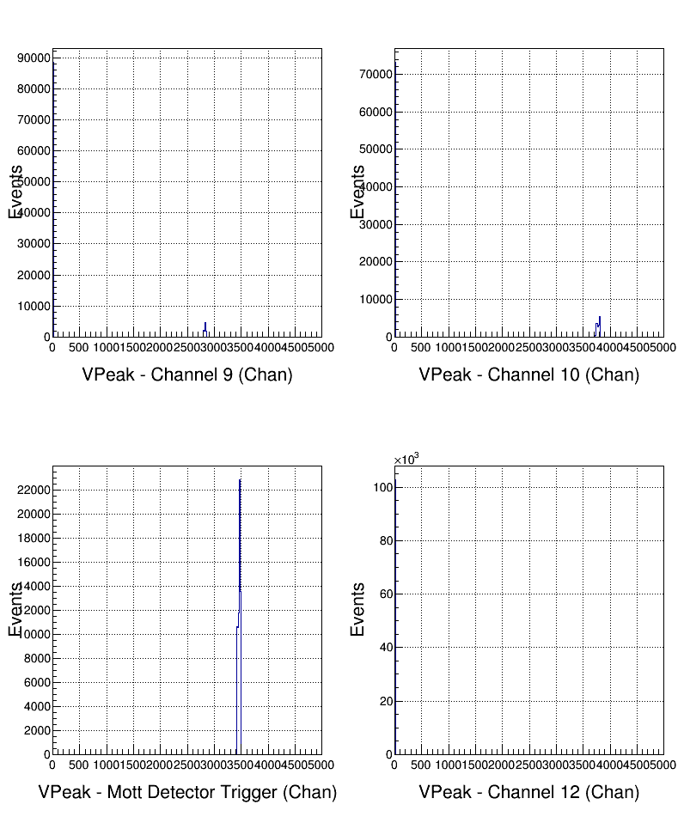
Pulse Peak Value (VP)

Slide 18
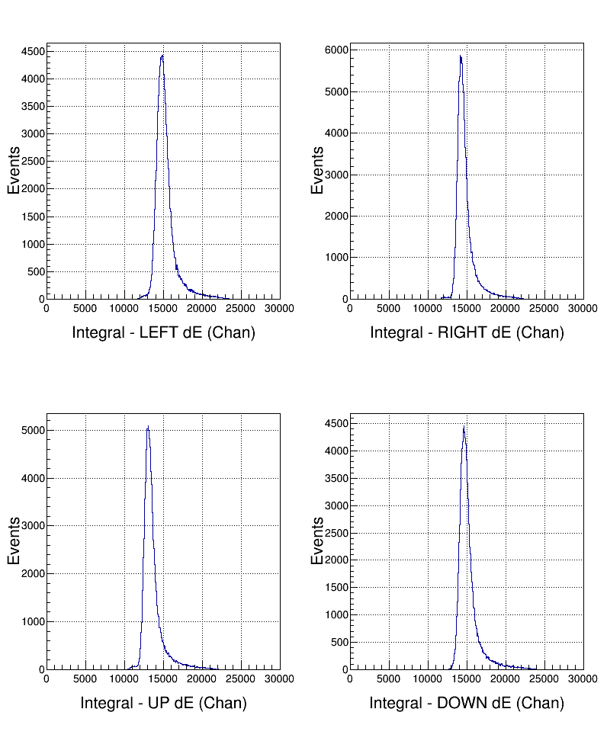
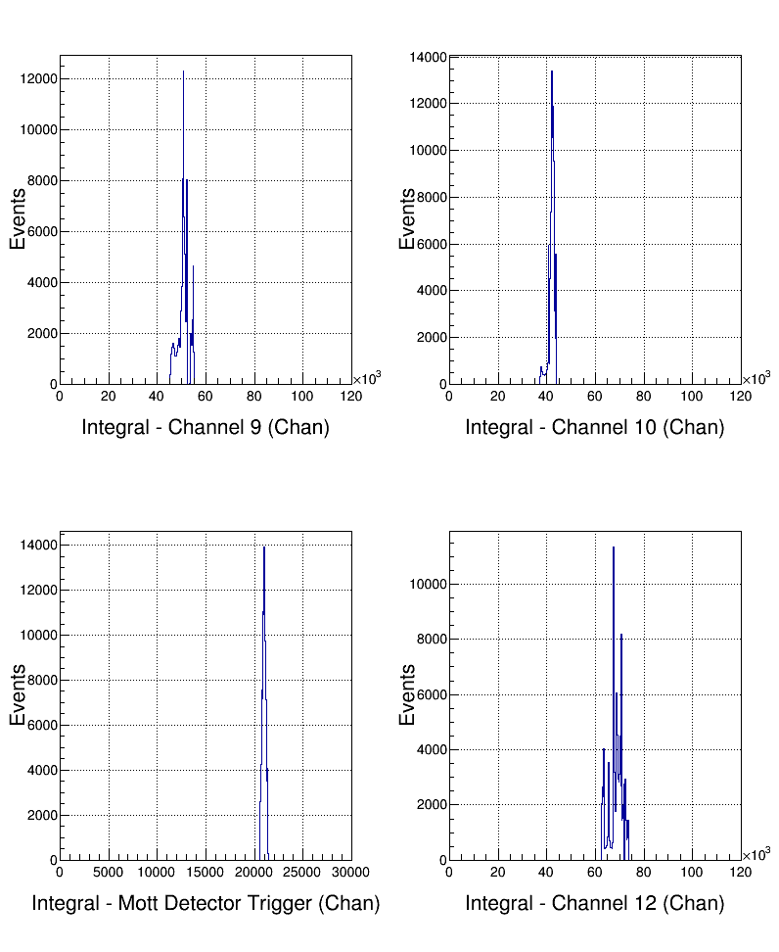
Pulse Integral

Slide 19
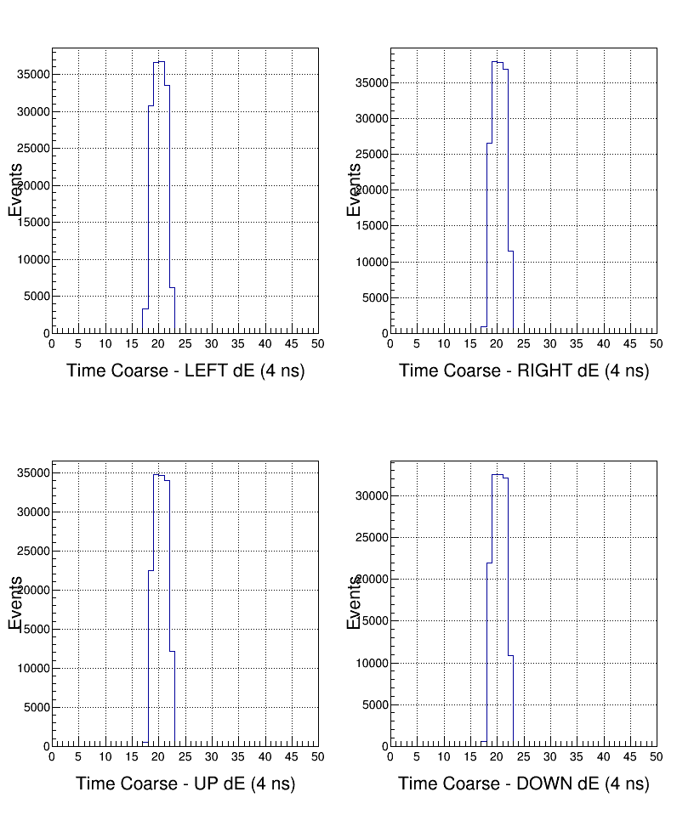
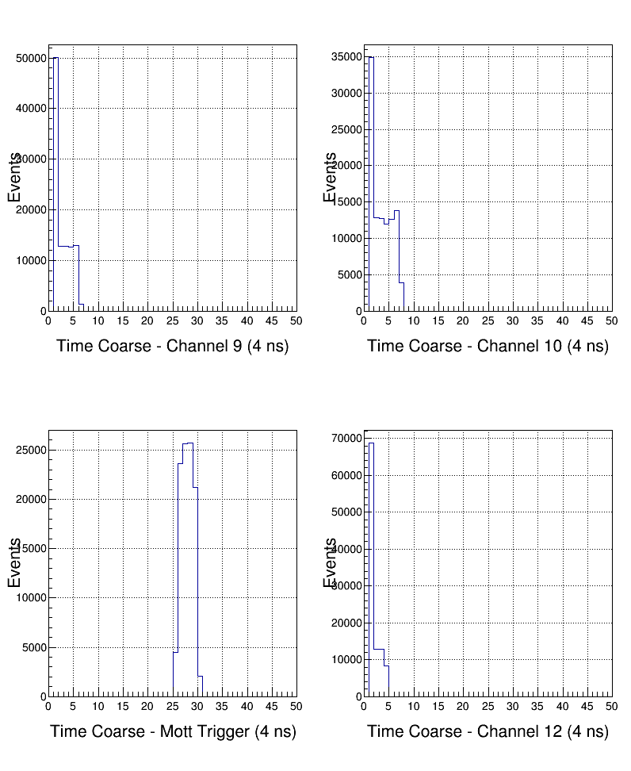
Pulse Coarse Time
See
Note 3

Slide 20
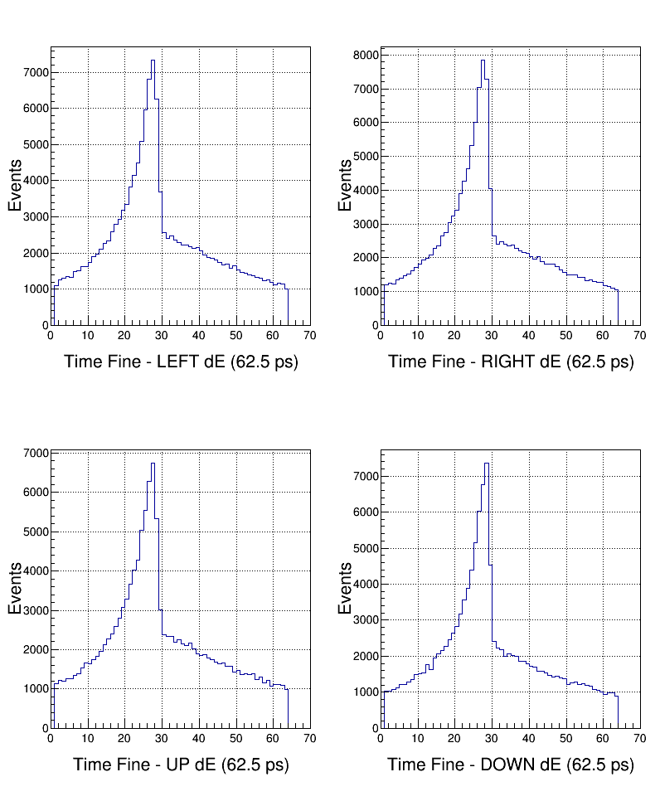
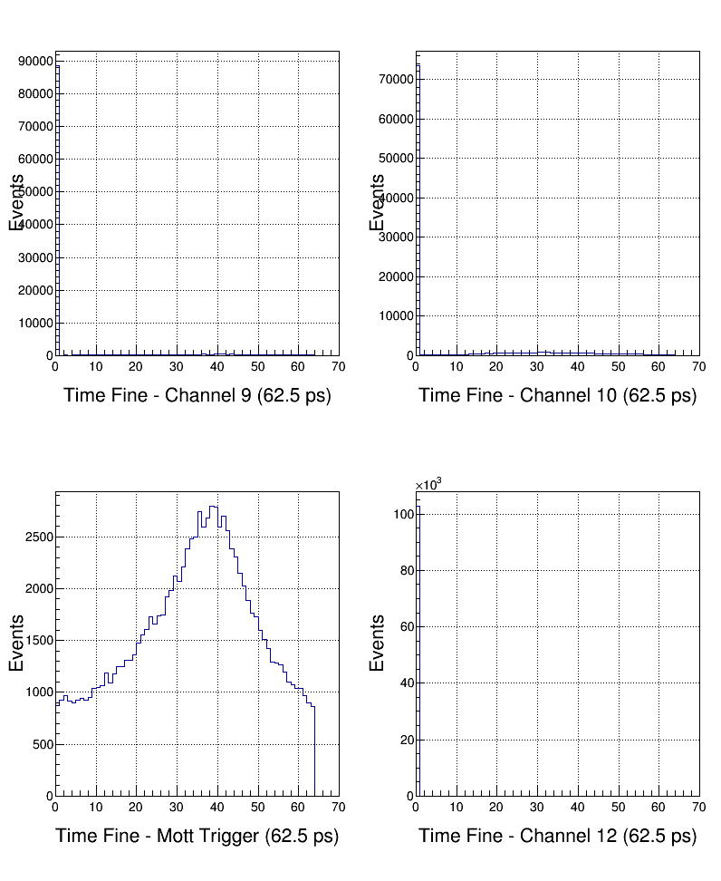
Pulse Fine Time

Slide 21
Analysis: Pedestals

Slide 22
Analysis: Energy
σ_{E} ~ 3.0%

Slide 23
Analysis: Self Timing Peak
T->Draw("(TimeCoarse11*4.0 + TimeFine11*0.0625) - (TimeCoarse1*4.0 + TimeFine1*0.0625) >> h1", "TimeCoarse1>1.0 &&TimeCoarse11 >1.0")
σ_{t} ~ 0.3 ns

Slide 24
Analysis: E-dE Timing Peak
T->Draw("(TimeCoarse5*4.0 + TimeFine5*0.0625) - (TimeCoarse1*4.0 + TimeFine1*0.0625) >> h1", "TimeCoarse1>1.0 &&TimeCoarse5 >1.0")
σ_{t} ~ 0.40 ns

Slide 25
Analysis: Time-of-flight
T->Draw("(TimeCoarse1*4.0 + TimeFine1*0.0625) - (TimeCoarse9*4.0 + TimeFine9*0.0625) >> h1", "TimeCoarse1>1.0 &&TimeCoarse9 >1.0")
Use CH1-CH4

Slide 26
Analysis: Time-of-flight
T->Draw("(TimeCoarse11*4.0 + TimeFine11*0.0625) - (TimeCoarse9*4.0 + TimeFine9*0.0625) >> h1", "TimeCoarse1>1.0 &&TimeCoarse9 >1.0 ")
Use CH11

Slide 27
Analysis: Time-of-flight
T->Draw("(TimeCoarse11*4.0 + TimeFine11*0.0625) - (TimeCoarse9*4.0 + TimeFine9*0.0625) >> h1", "TimeCoarse1>1.0 &&TimeCoarse9 >1.0 &&VPeak9>0.0")
Use CH11

Slide 28
Three Timing Signals
Added two more laser timing signals to FADC.
From Disc 708, OUT signal was connected to FADC Ch10 and OUT_bar was connected to Ch12.
Original laser timing signal is still connected to Ch9.

Slide 29
Analysis: Time-of-flight - 8235
T->Draw(“(TDC17-TDC18)>>h1”,”VPeak1>600”)

Slide 30
Analysis: Time-of-flight - 8235
T->Draw("(TimeCoarse1*4.0 + TimeFine1*0.0625) - (TimeCoarse10*4.0 + TimeFine10*0.0625) >> h1", “VPeak1>600&&VPeak10>0.0")
T->Draw("(TimeCoarse1*4.0 + TimeFine1*0.0625) - (TimeCoarse12*4.0 + TimeFine12*0.0625) >> h1", “VPeak1>600&&VPeak12>0.0")
Use CH10
or
Ch12

Slide 31
Notes
Note 1
If first sample above threshold then:
course time =1, fine time = 0, ped = 0, and VPeak = 0
Note 2
MIN(NSB+NSA, PTW): Make sure NSB+NSA is less than PTW.
Otherwise from CODA readout, cannot tell how many samples
were summed; this is needed for pedestal subtraction.
How FADC deal with a periodic square wave. Possible Solutions:
Use signal and signal_bar – Run 8235 (does not seem to
work; still analyzing)
Add same signal to another channel delayed by ½ period
Note 3
bad
good
PTW
PL

Slide 32
Conclusions – so far …
Pulse Integral and High Resolution Time Mode has good energy and time resolutions. Must have:
Correct FADC parameters: Threshold, NSB, NSA
How to deal with a periodic signal?
Again, what about scalers?
A new CODA Configuration was created with this mode (no CAEN v775 TDC and no SIS3801 Scalers) with block readout. Next …

Slide 33
Conclusions – so far …
Measure deadtime with 2.2 uA on 1 um gold foil:
Run 8225: Mott_SemiInt configuration (FADC+TDC+Scalers), Deadtime = 28% at 5.1 kHz.
Run 8227: SemiIntFast configuration (only readout of FADC, Blocklevel = 1) , Deadtime = 17% at 5.1 kHz.
Run 8228: SemiIntBlock configuration (only readout of FADC, Blocklevel = 50) , Deadtime = 1% at 5.1 kHz.
Learn how to unblock and analyze

