Slide 1
ASY-R30-3: Slots
Gabriel Palacios Serrano
03/14/2022
gabrielp@jlab.org

Slide 2
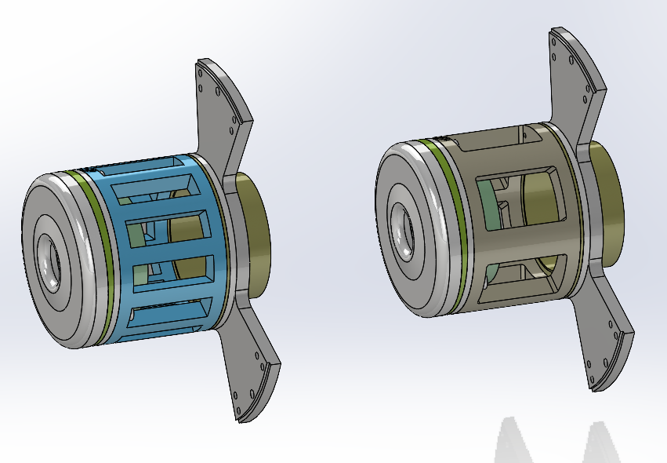
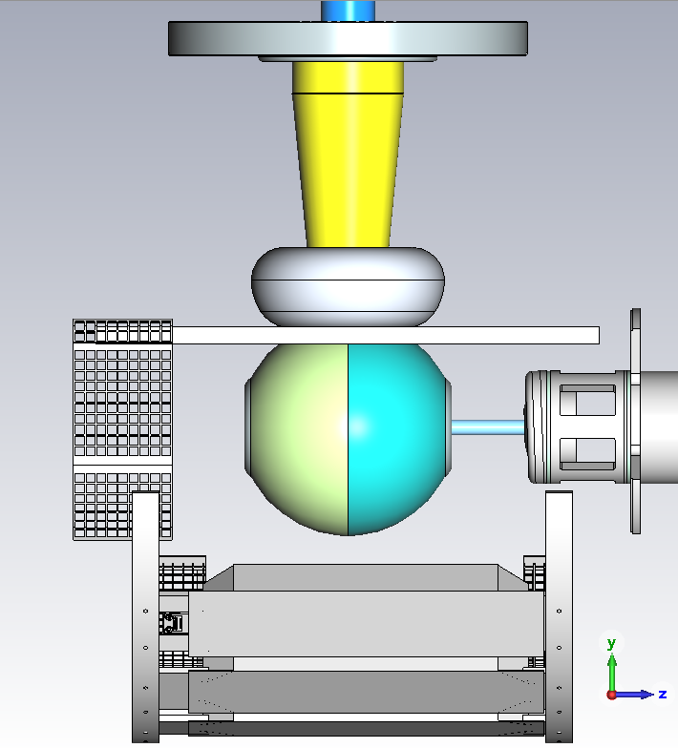
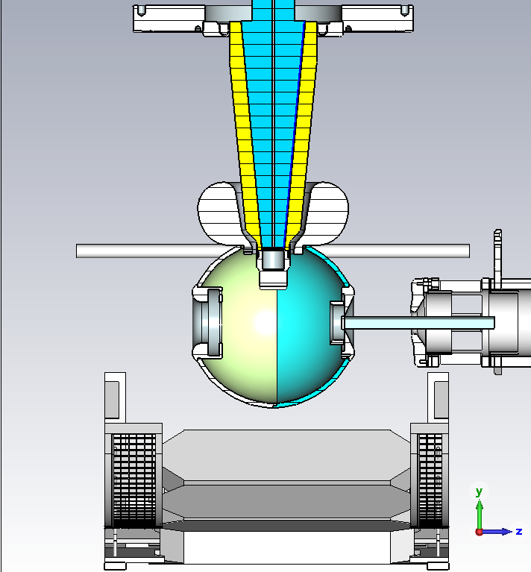
3D model: skewed anode

Slide 3
Average field Ex

Slide 4
Average field Ey

Slide 5
Average horizontal position

Slide 6
Average vertical position

Slide 7
Angle on the horizontal plane

Slide 8
Angle on the vertical plane

