Slide 1
Cooler e-source
Magnetized Beam LDRD Progress Report
June 1, 2017

Slide 2
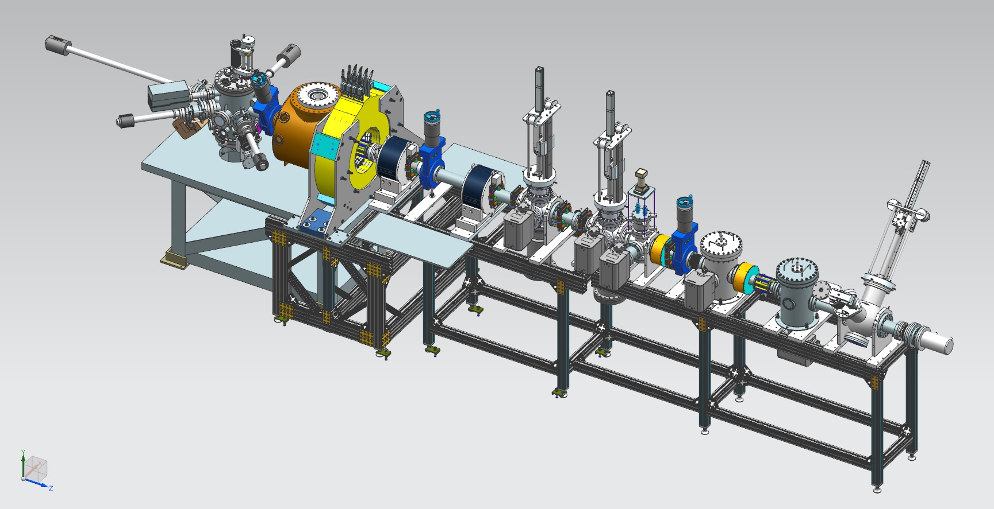
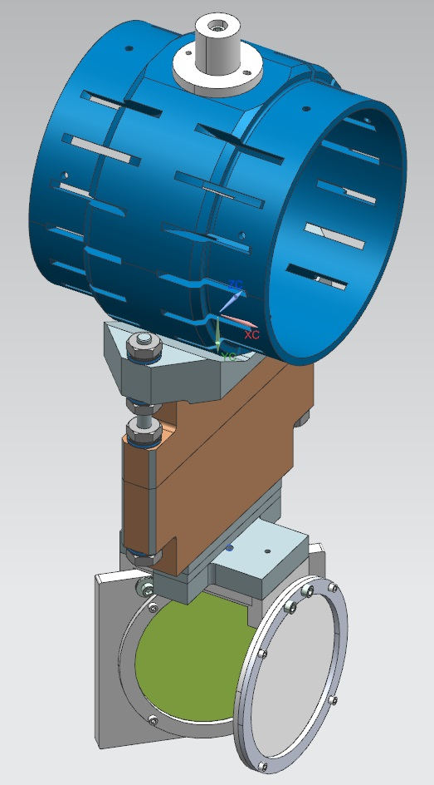
Magnetized Electron Source at GTS
Gun HV Chamber
Photocathode
Preparation
Chamber
Beamline
Gun Solenoid
Shield Tube
Viewer 3 Screen
Beam Dump
Slit
Viewer Screen

Slide 3
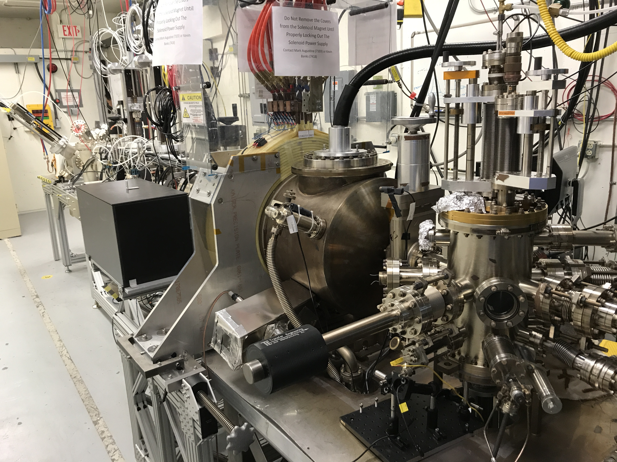

Slide 4
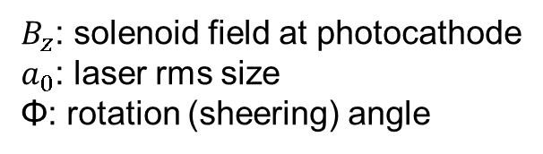
Measuring Beam Magnetization
Use slit and viewscreens to measure mechanical angular momentum:
$B_{z}$: solenoid field at photocathode
$a_{0}$: laser rms size
Φ: rotation (sheering) angle

Slide 5
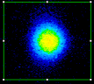
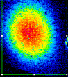
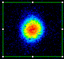
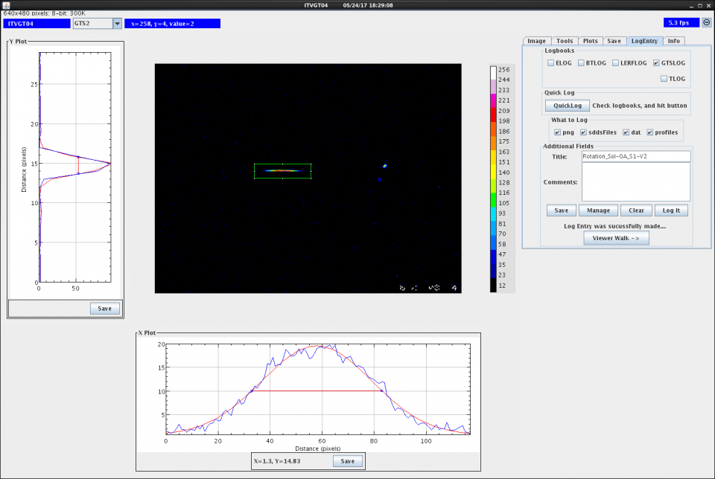
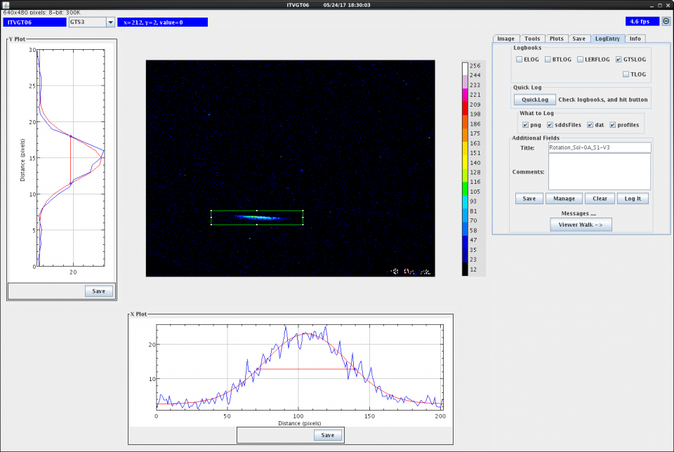
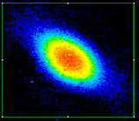
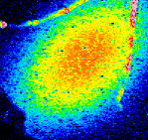
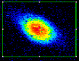
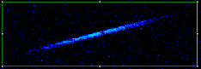
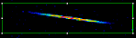
0 G
at photocathode
1088 G
at photocathode

Slide 6
Magnetized Beam Sizes
Solenoid Current (A) | Field (G) | σ₁ (mm) | σ₂ (mm) | σ₃ (mm)
0 | 0 | 1.66 | 2.18 | 4.84
25 | 91 | 0.35 | 0.44 | 0.71
50 | 181 | 1.39 | 2.10 | 4.09
75 | 272 | 1.82 | 0.67 | 1.46
100 | 363 | 4.36 | 1.43 | 2.40
150 | 544 | 0.35 | 0.49 | 1.02
200 | 725 | 0.46 | 0.95 | 4.22
250 | 907 | 1.08 | 2.02 | 6.54
300 | 1088 | 1.88 | 3.28 | 7.11
All beamline solenoids are off

Slide 7
Magnetized Beam Rotation Angles
Solenoid Current (A) | Field (G) | ɸ₂ (deg) | ɸ₃ (deg) | ɸ₂- ɸ₃ (deg)
0 | 0 | 0 | 0 | 0
25 | 91 | 3.6 | 18.9 | 15.3
50 | 181 | -1.7 | -5.7 | -4.0
75 | 272 | 5.8 | 11.7 | 5.9
100 | 363 | -3.6 | -7.5 | -3.9
150 | 544 | -30.1 | -54.1 | -24.0
200 | 725 | 5.7 | 8.8 | 3.1
250 | 907 | -4.1 | -8.5 | -4.4
300 | 1088 | -7.6 | -18.8 | -11.2

Slide 8
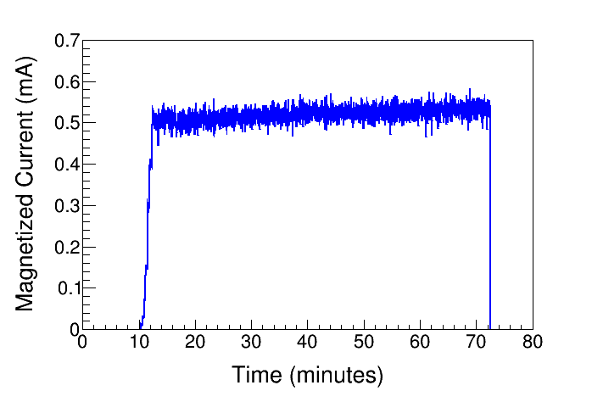
High Current Magnetized Beam
1450 G
Delivered 0.5 mA
Plan for 5 mA by end of summer

Slide 9
Summary of Progress
Submitted LDRD proposal for 3rd year funding
Delivered 0.5 mA magnetized beam with 1450 G on photocathode
Measured beam sizes and rotations with magnetic fields up to 1088 G on photocathode
Filed patent disclosure entitled “Non-invasive RF Cavity to Measure Beam Magnetization”

Slide 10
Outlook: June – September
Measure beam sizes and rotations with magnetic fields up to 1450 G on photocathode
Simulation of magnetized beam sizes and rotation angles
Run 5 mA magnetized beam
Build and install a TE₀₁₁ cavity at GTS to measure beam magnetization in collaboration with Brock and SRF Institute

