Slide 1
LDRD Brainstorming Session
Joe Grames
April 8, 2016
Example : 7 MeV e- on 1 mm W
Concept for JLPIC ?
Test Idea for UITF ?

Slide 2
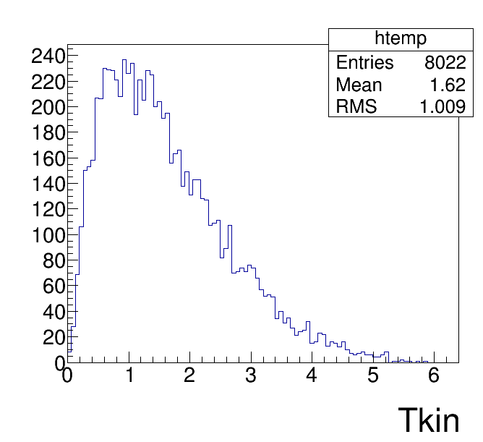
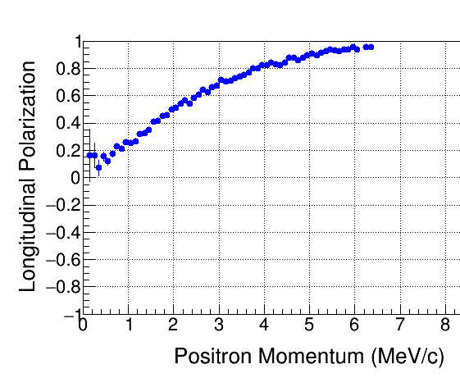
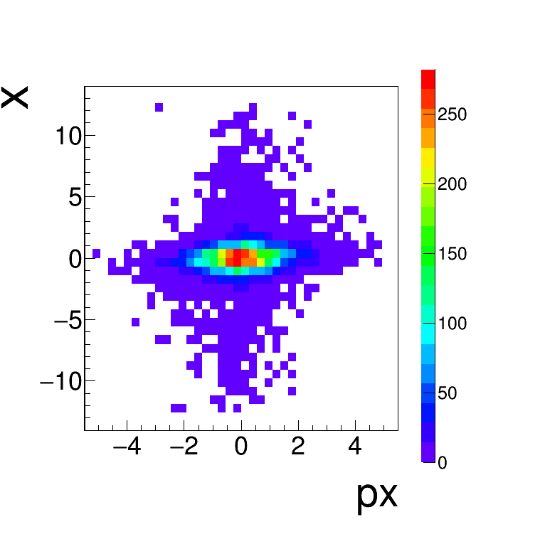
N = 10M
E = 7 MeV
P = 100% long.
W
1 mm
(mm)
KE (MeV)
(MeV/c)

Slide 3
Dare to dream !!!!
Step 1:
Produce 817uA polarized e- and accelerator to 10 MeV
Step 2:
Collide 8kW of beam power in 1.2 mm W target (1e+/1250e-)
Step 3:
Collect e+ beam in accumulator (1e+/100,000e-) for 6192 revol.
Step 4:
Dump 3.23 us train of 2.2pC e+ bunches (73) every 20 ms with frequency 22.7 MHz
Electrons
f = 22.7 MHz
DF=100%
Q_{b} = 36 pC
10 MeV
CW Positrons
f = 22.7 MHz
DF=100%
“Q_{b}” = 0.28 fC
5 MeV?
Accumulated Positrons
f = 22.7 MHz
DF= 3.23us / 20ms
Q_{b} = 2.2 pC
5 MeV?
Accumulations = 20 ms / 3.23 us = 6192
But 3.23us is lengthy=962m (150m), maybe do this 10x @ 0.323us (R=15m)???

Slide 4
But think small first !!!
Accumulated Positrons
Bunch space = 1.33 ns = 0.4 m
10 bunches => C=4 m (D=1.3m) = 13.3 ns
Accumulate for 100 ms => 7.5E6
Qe+ = 14E-15 / 1E5 * 7.5E6 = 1.0 pC
Electrons
f = 750 MHz
Q_{b} = 14 fC
<I>=10 uA
10 MeV
Diagnostic Line
Sing : 110 pA : 11E-18C @ 750 MHz (DF=100%)
Accu: <110 pA> : 1E-12C @ 750 MHz (DF=13.3ns/100ms)
CW Positrons
f = 750 MHz
DF=100%
Q_{b} Tot = 11E-18 C
5 MeV?

