Slide 1

Milliampere beam studies using high polarization photocathodes at the CEBAF Photoinjector
Joe Grames, Phil Adderley, John Hansknecht, Reza Kazimi, Matt Poelker, Daniel Moser, Marcy Stutzman, Shukui Zhang
PSTP, Daejeon South Korea
October 15-20, 2017

Slide 2
Outline
PEPPo – an application requiring milliampere polarized electron beams
Ion bombardment, the dominant lifetime limiting mechanism of polarized photocathodes
To operate at mA current without interruption, requires kC charge lifetime
R&D to extend the charge lifetime of polarized electron sources

Slide 3

Polarization Studies at mA Beam Current
First measurement of polarization from superlattice photocathode at milliampere current
CEBAF 5 MeV Mott polarimeter: on-going effort to ascribe sub-percent accuracy (collaborators D. Moser, X. Roca-Maza, Charles Sinclair, M.J. McHugh, and Tim Gay)
CEBAF 5 MeV Mott Polarimeter

Slide 4


Polarized Electrons for Polarized Positrons
electron beam polarization
85.2 ± 0.6 ± 0.7 %
Bremsstrahlung produced by polarized electrons results in efficient production of polarized positrons
PEPPo’s success suggests useful polarized positron current benefits from milliamperes of polarized electrons
D. Abbott et al, "Production of Highly Polarized Positrons Using Polarized Electrons at MeV Energies", Phys. Rev. Lett, 116, 214801 (2016)
(PEPPo Collaboration) D. Abbott et al., Phys. Rev. Lett. 116 (2016) 214801

Slide 5
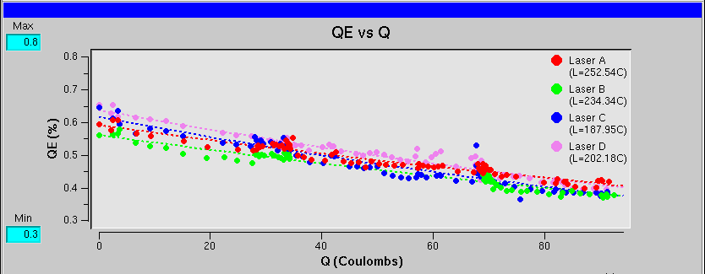
Recent CEBAF Polarized Source Performance
Gun2 Photocathode (Fall 2016 – Spring 2017)
  Strained Superlattice GaAs/GaAsP #5756-4
  Good Polarization 85-87% (measured at Mott)
  Good QE > 1% after activation
  Lifetime about 200C, sufficient for 12 GeV CEBAF program
5

Slide 6

  CEBAF Load Lock Photogun (-130kV)
CEBAF Polarized Inverted Load Lock Gun (Spring 2017)
1 mA 86 C/day
5 mA 432 C/day
10 mA 860 C/day
50 mA 4320 C/day

Slide 7

Ion Bombardment

Slide 8
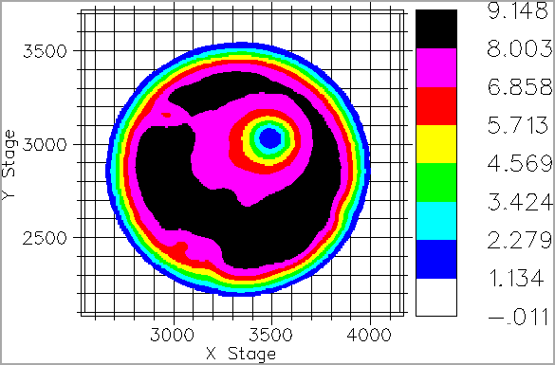
Ions Bombarding the Electrostatic Center
Ionized gas focused at electrostatic center
electrons OUT
laser IN
anode
cathode

Slide 9
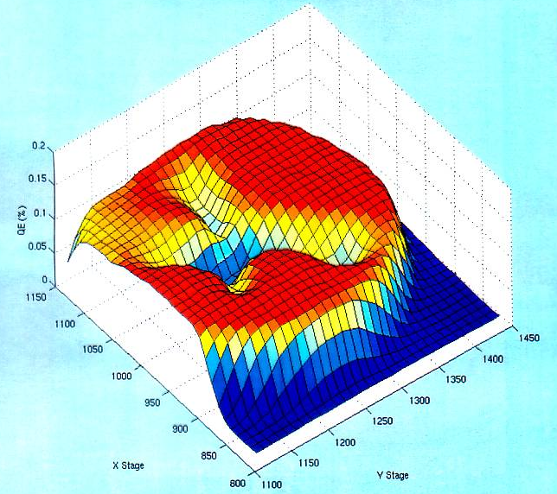
Pragmatically Avoiding the “EC”
We don’t run beam from electrostatic center
Laser spot diameter ~0.5 mm and can be moved to different locations on the photocathode.
electron beam
OUT
laser light IN
Ions create QE trough to electrostatic center

Slide 10


Improving Lifetime with Larger Laser Size
J. Grames, et al, Phys. Rev. ST Accel. Beams 14 043501 (2011)
GaAs @ 532nm

Slide 11

Improving charge lifetime with GaAs/GaAsP
Indeed, we enhanced the Charge Lifetime for Qweak by a factor of four when doubling the laser spot size from 0.5mm to 1.0 mm (diameter)
but milliampere applications require kiloCoulomb charge lifetime to provide uninterrupted operation of reasonable duration

Slide 12
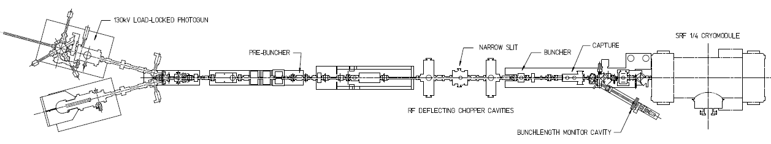
Lifetime Studies at mA Beam Current
CEBAF 130kV polarized “inverted gun” with load lock
Polarized positrons for CEBAF, and on-going discussions with BNL related to high current eRHIC EIC, prompted experiments at CEBAF to characterize lifetime vs. laser spot size using high-polarization photocathodes
Make beam here
Deliver it here
Monitor vacuum and radiation
Vary the laser beam size

Slide 13
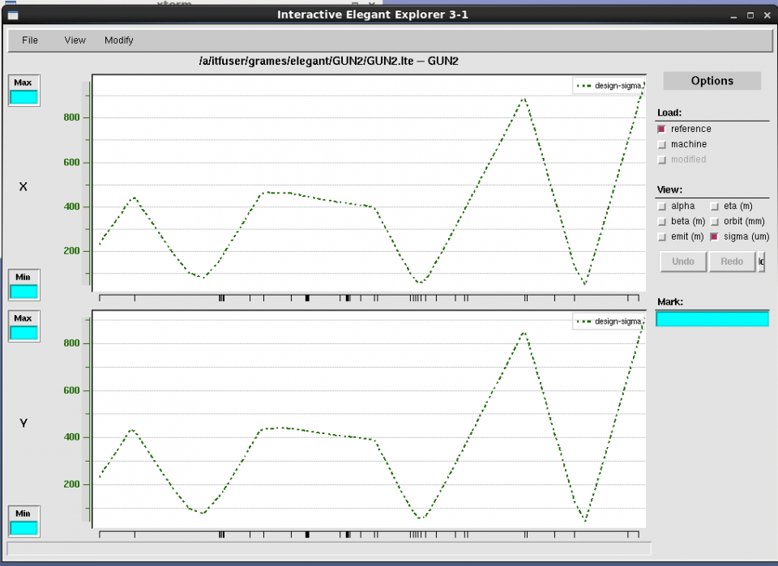
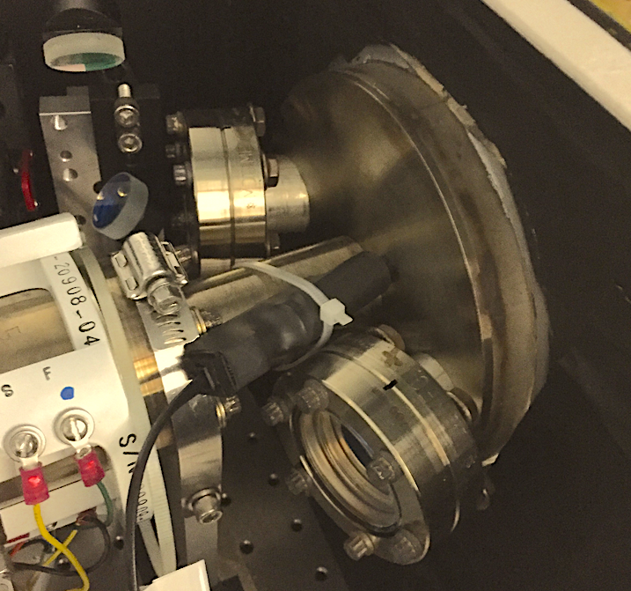
Lifetime Studies at mA Beam Current
X-ray detectors were distributed along beam line at locations of likely beam loss, e.g. apertures (where beam pipe size changes or intentional apertures).

Slide 14
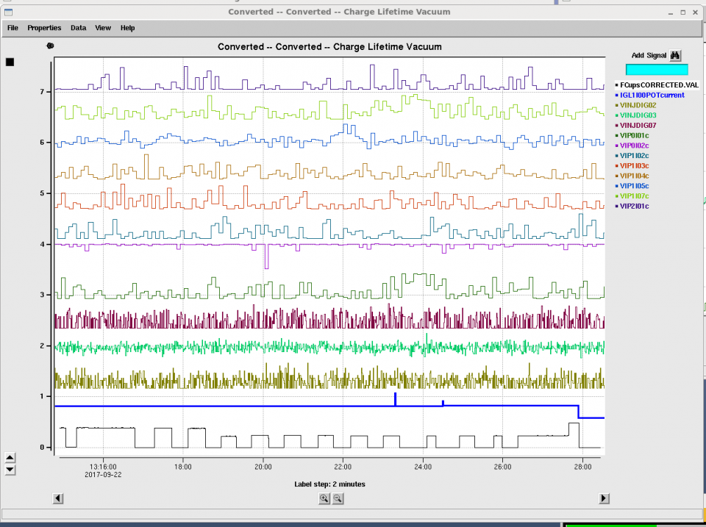
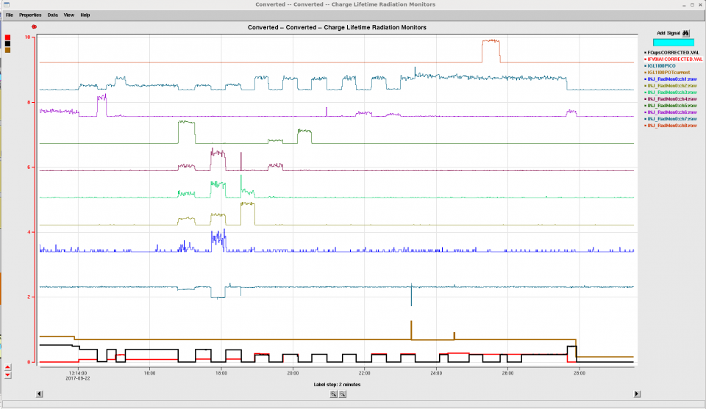
Sensitivity of x-ray detectors for beam loss
Dynamic vacuum level rise remains an excellent indicator of beam loss and is correlated with decreased photocathode lifetime.
In this study x-ray monitors are able to localize about intentional beam loss (500nA) and demonstrate a rapid signal even when vacuum signature is not present.

Slide 15
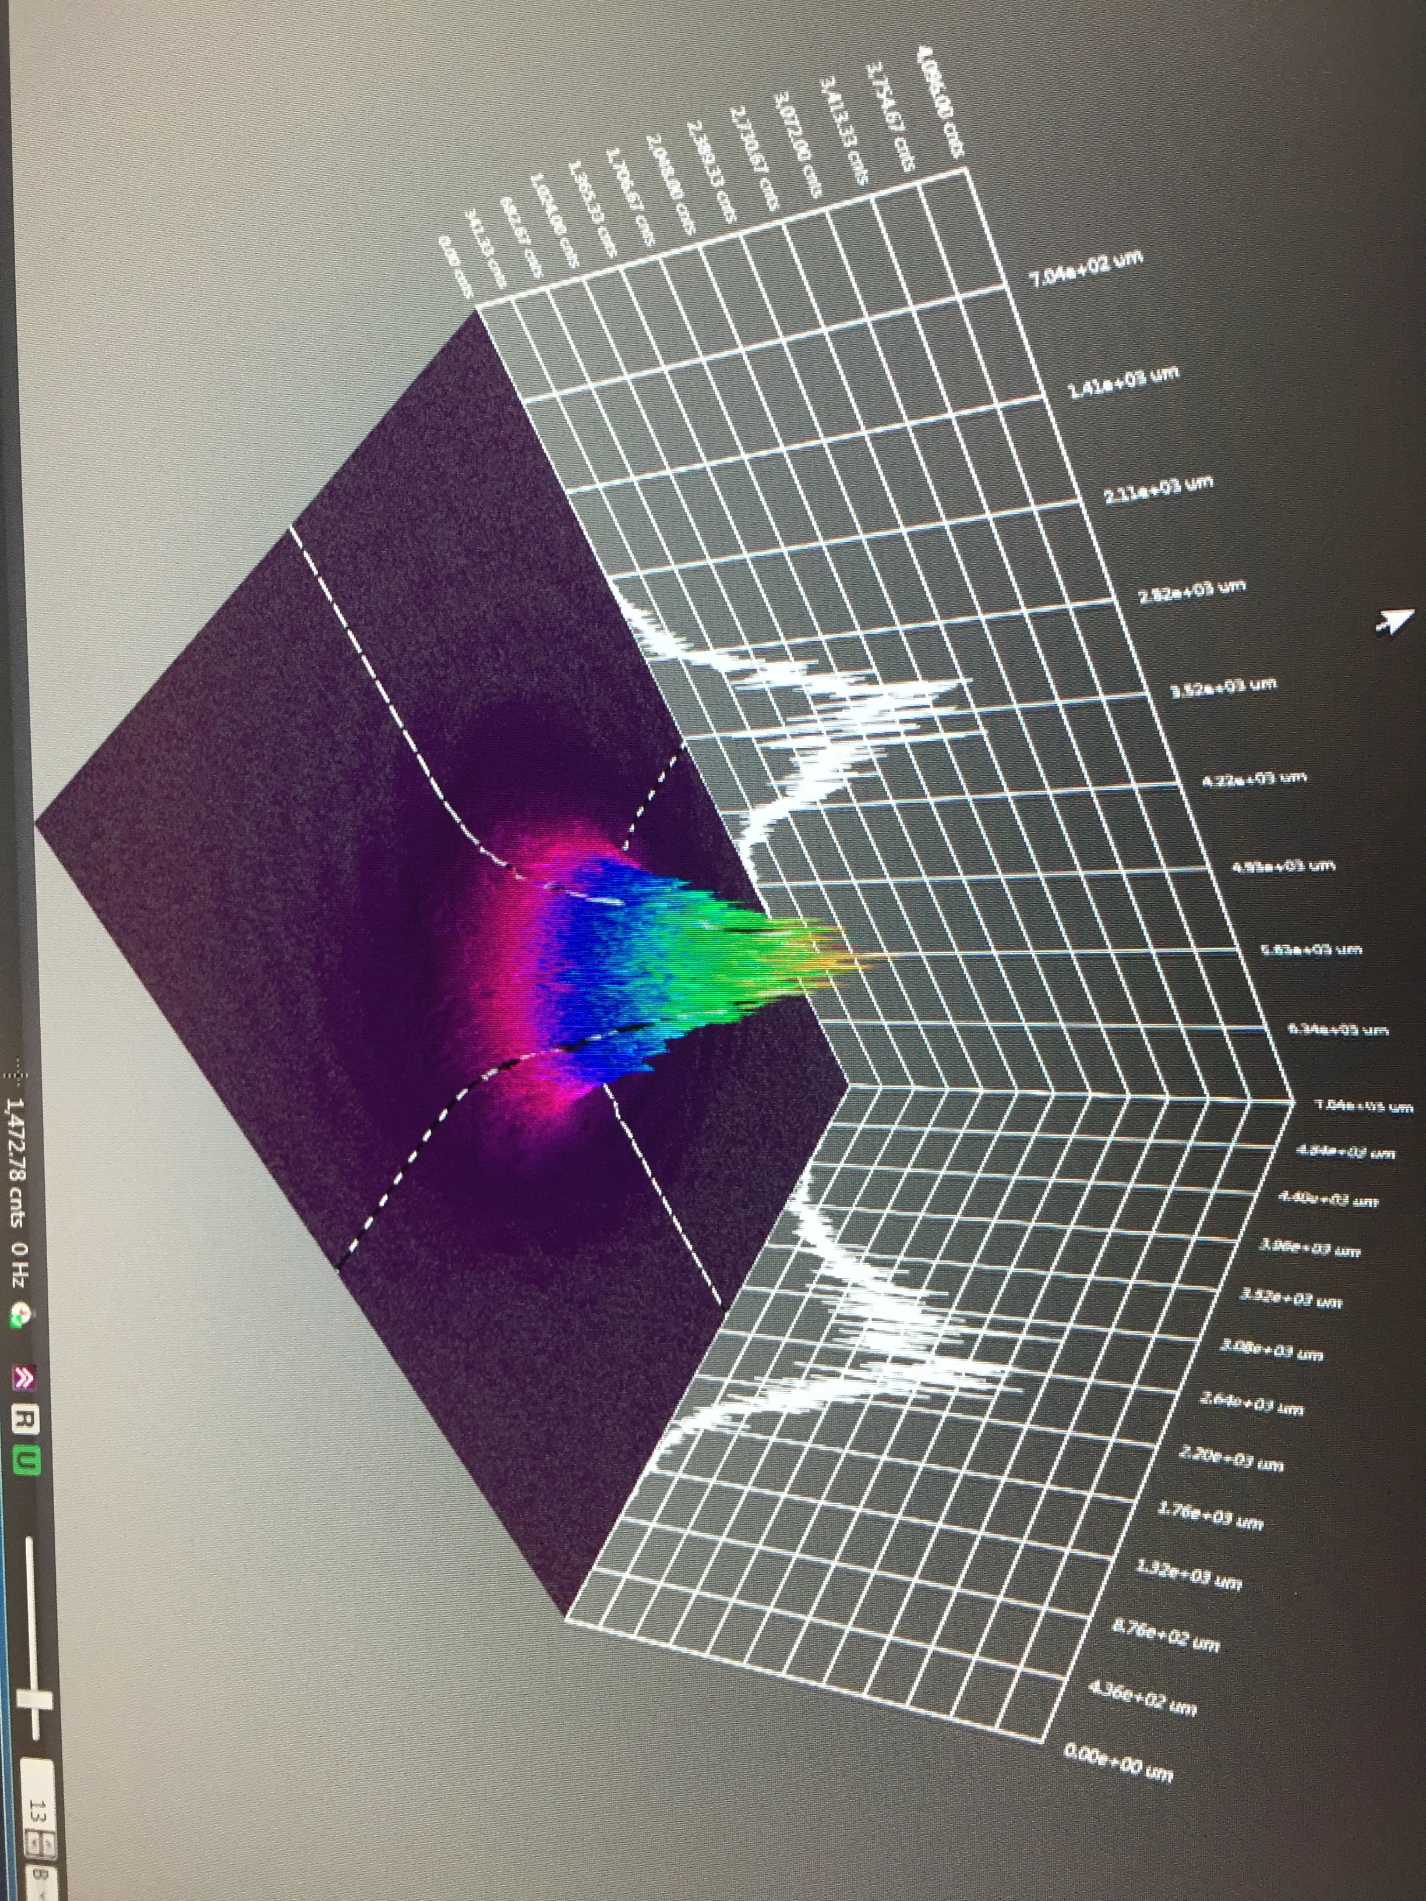

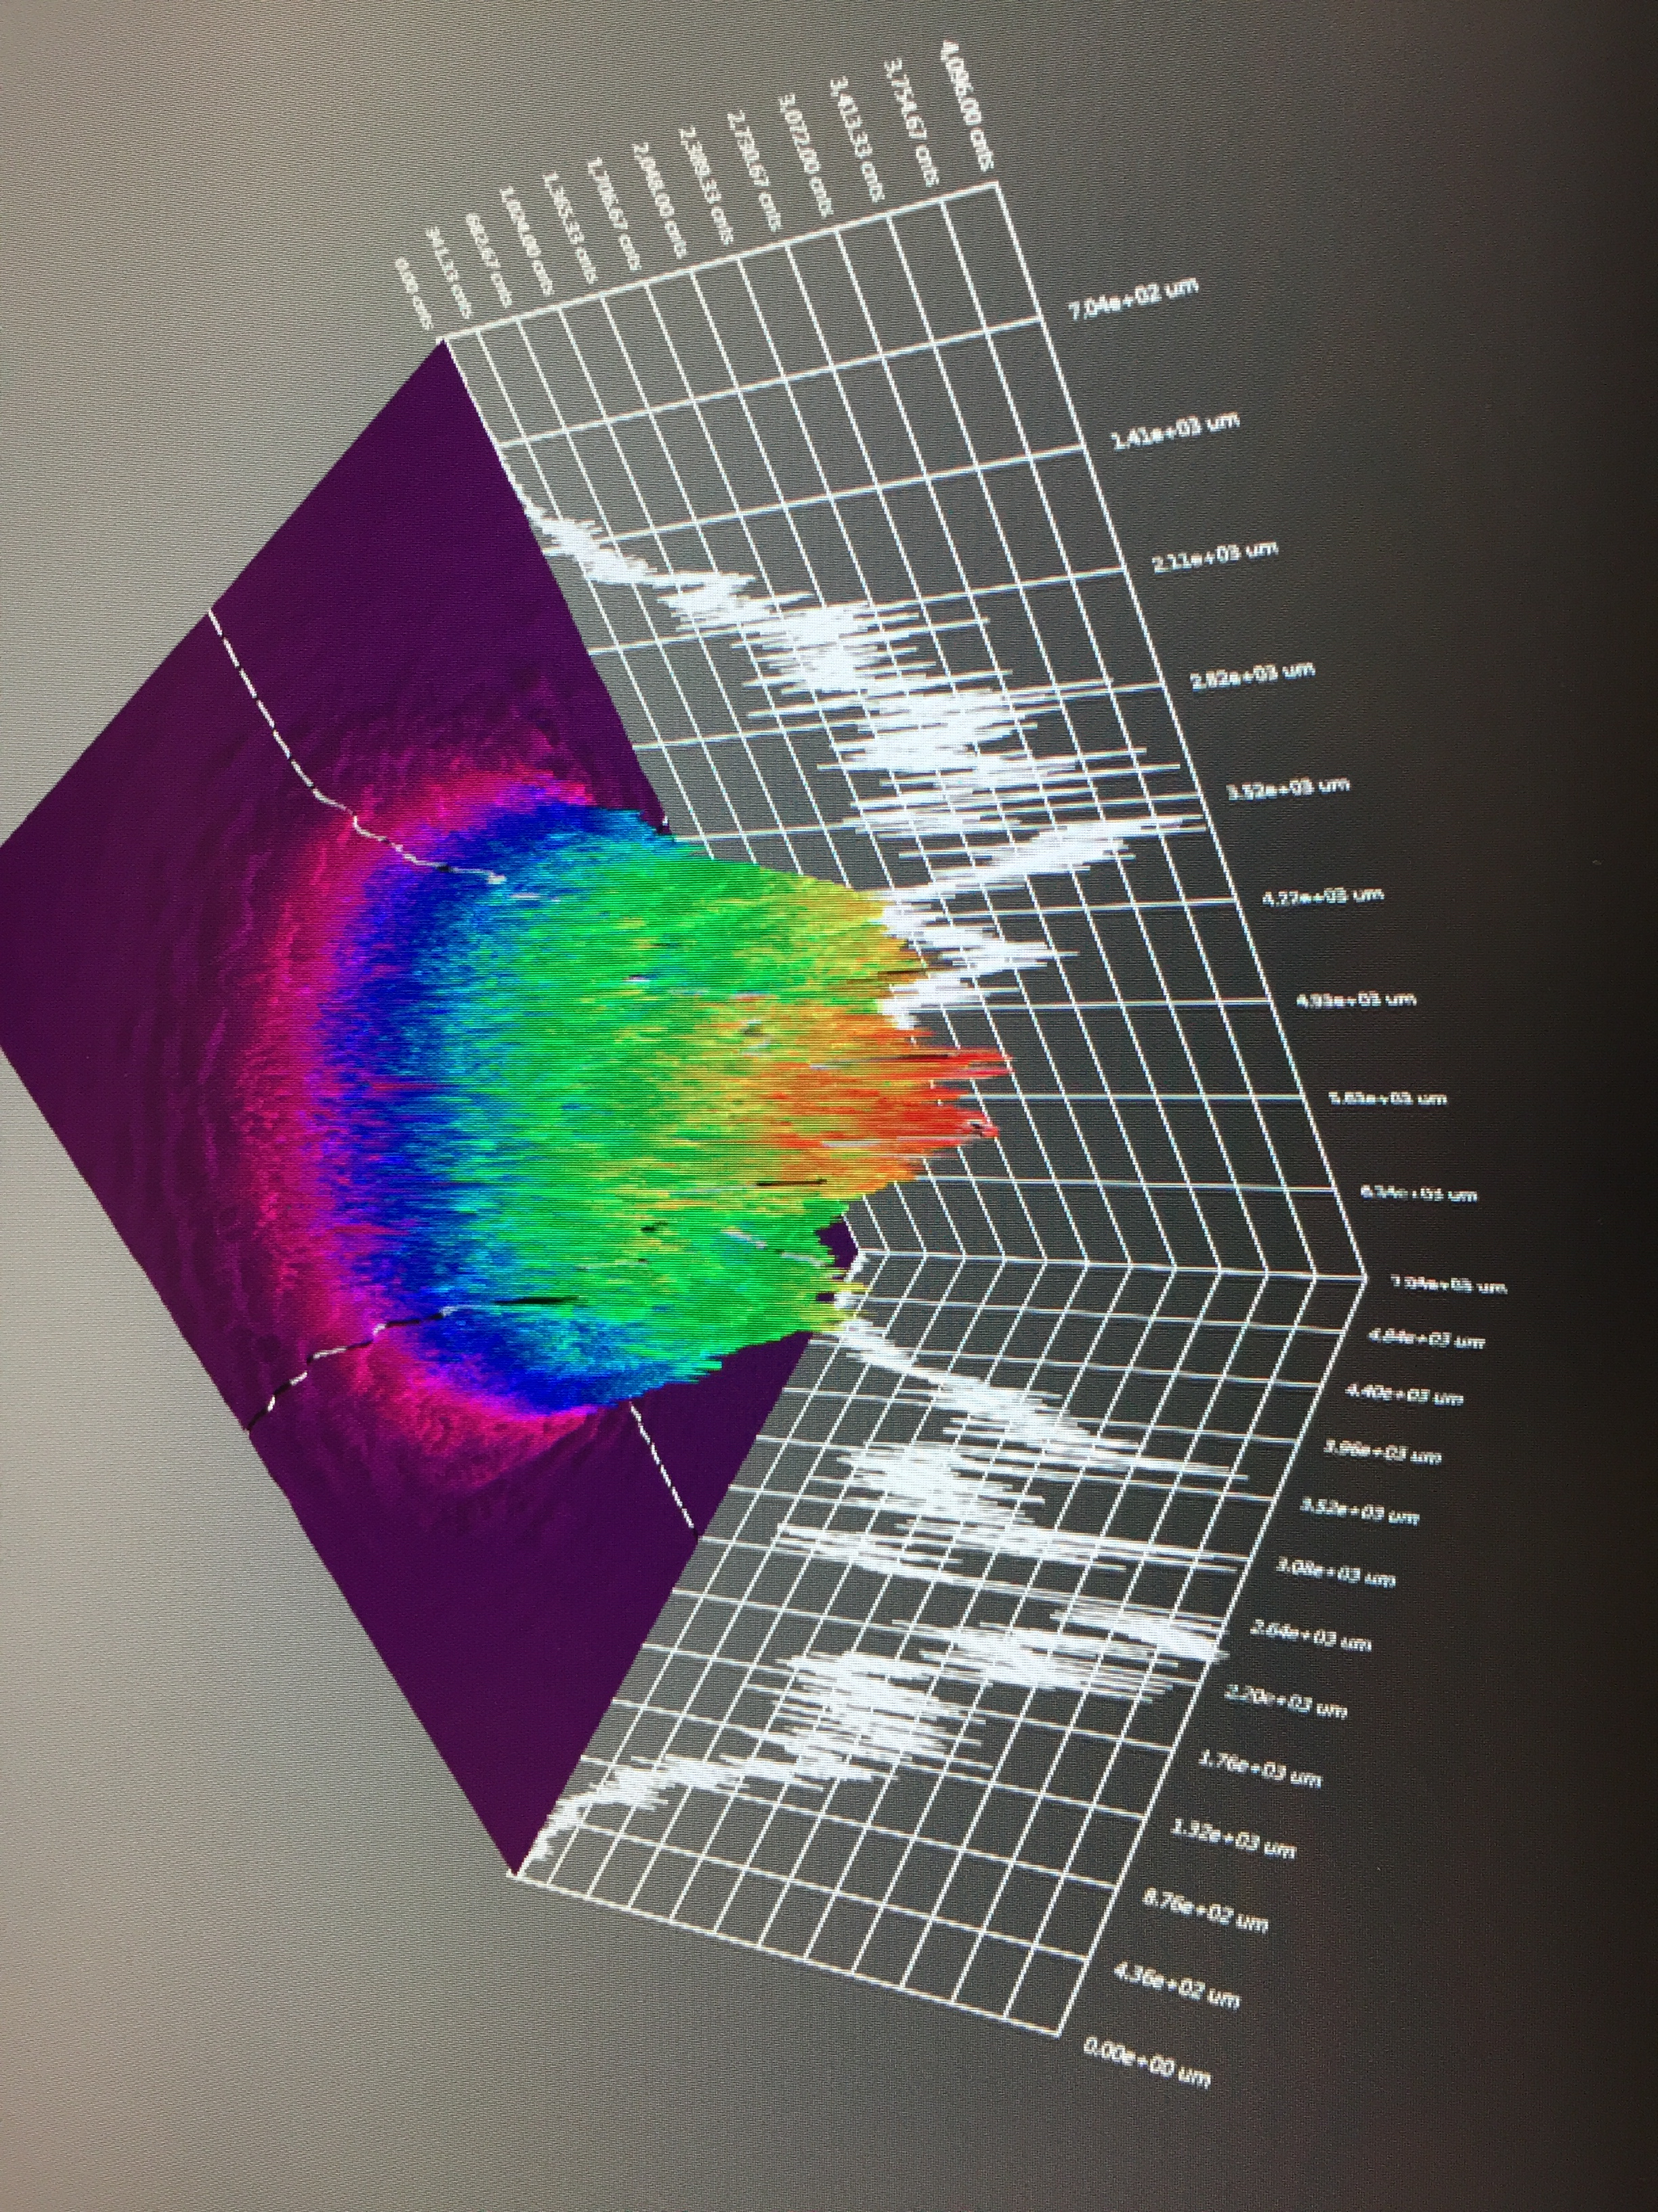
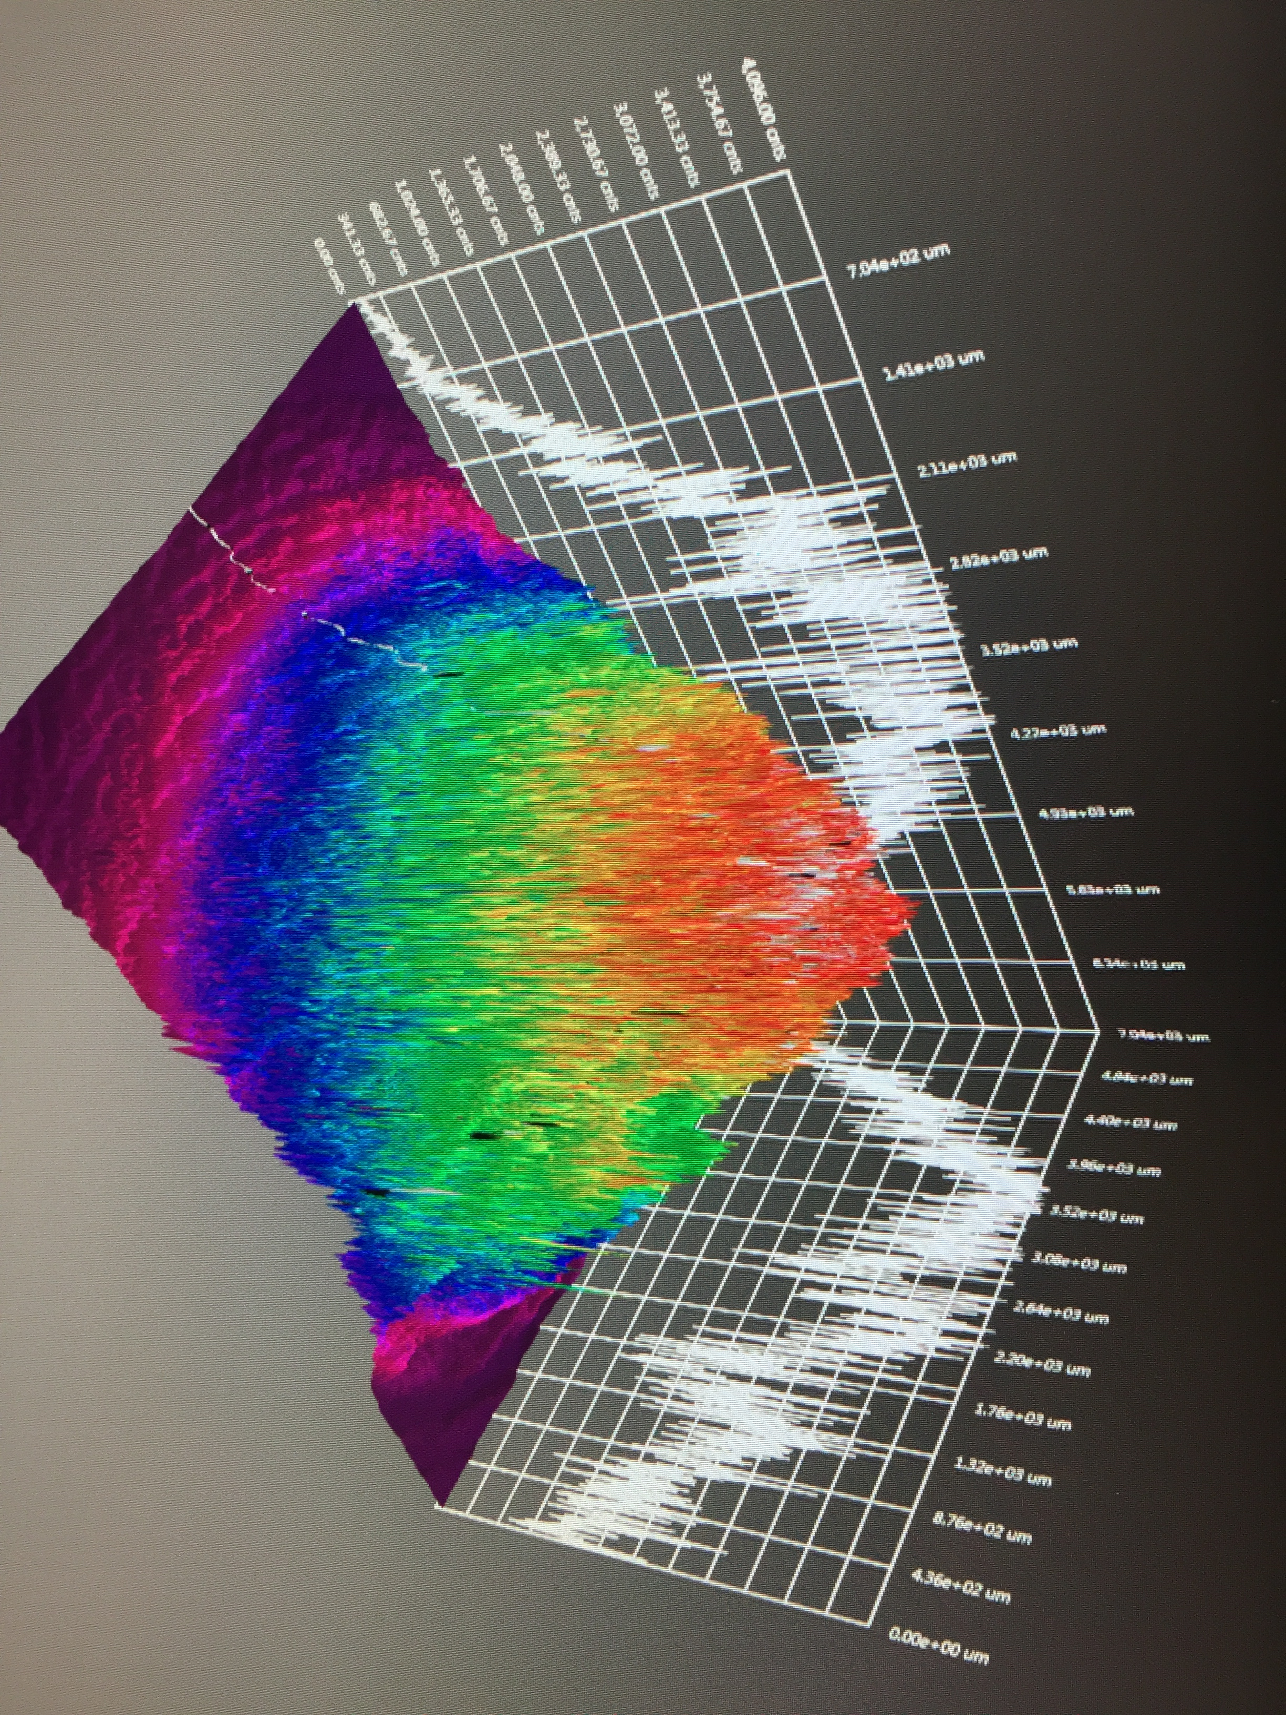
Variation of Laser Spot Size
Photocathode active area is 5mm (defined by a mask)
Varied laser diameter (FWHM) from 1-5 mm (area 3-20 mm²)
Imaged laser profile at photocathode distance

Slide 16

Lifetime Studies at mA Beam Current
Required laser power, slope proportional to QE decay
Increasing laser size reduces QE decay proportionally
1mA

Slide 17
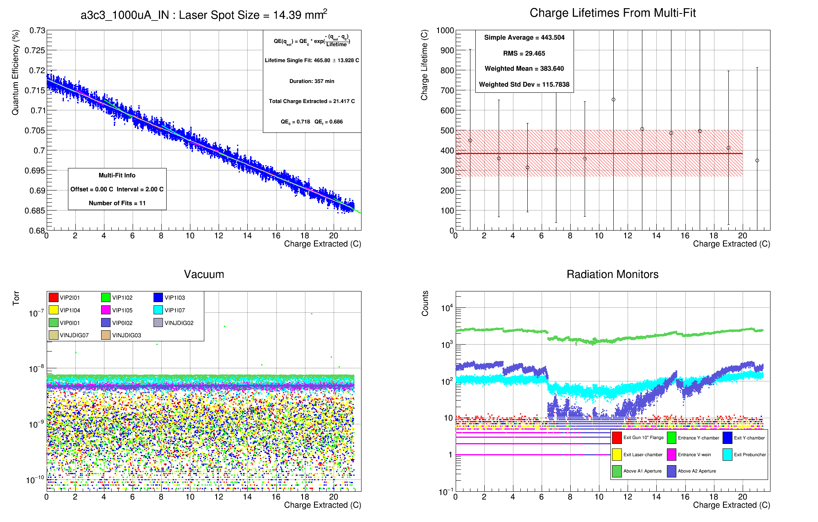
Example Lifetime Run (1 mA and 14mm²)

Slide 18

First Results: GaAs/GaAsP at mA Current
  CEBAF charge lifetime improves with spot size, as expected, but eventually beam size becomes “too large”
  Laser diameters greater than ~4 mm (4 sigma) will require properly designed cathode/anode electrodes, to ensure 100% transmission, to maintain excellent vacuum, to minimize ion bombardment

Slide 19
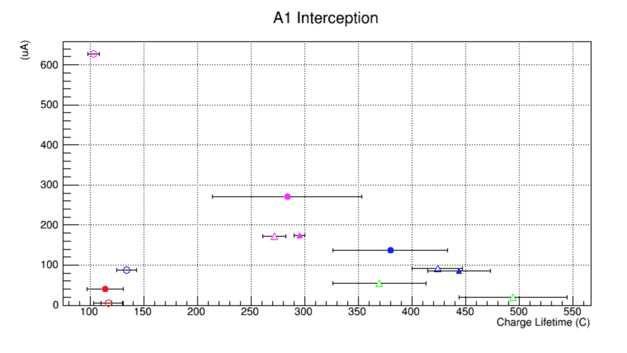
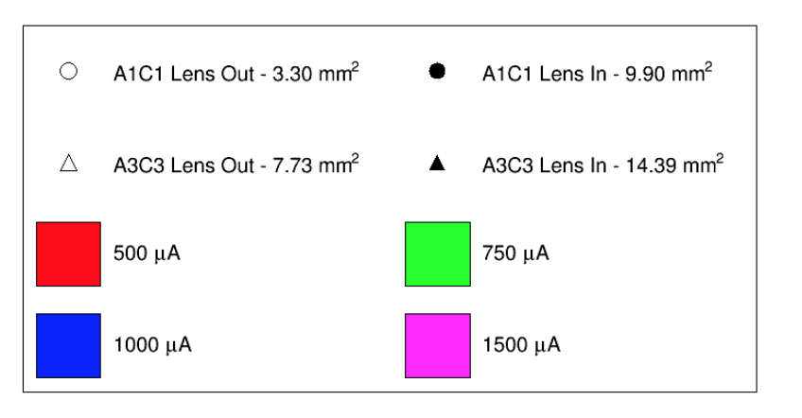
Emittance Aperture Interception vs. Lifetime
Interception on a 4mm aperture measures beam size
Largest interception (circles) occur with smallest laser size (space charge)

Slide 20
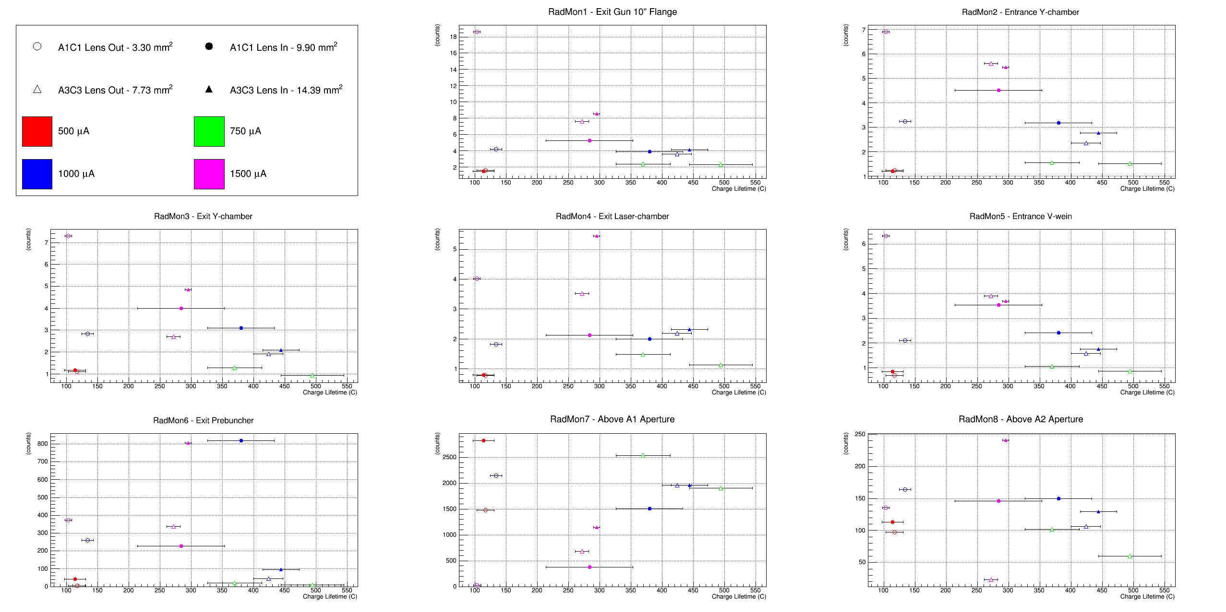
Radiation Level vs. Lifetime
Generally, charge lifetime improves with decreasing x-ray levels
Levels away from apertures (<10 Hz) more revealing than apertures (>250 Hz)

Slide 21
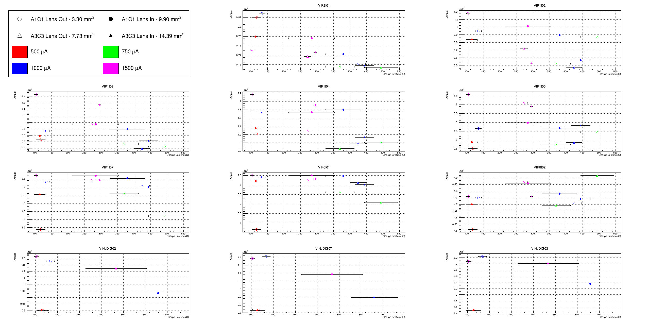
Vacuum vs. Lifetime
Vacuum levels vs. lifetime are not as highly correlated with radiation levels
Still gun vacuum remains (sensibly) the greatest correlation with lifetime

Slide 22
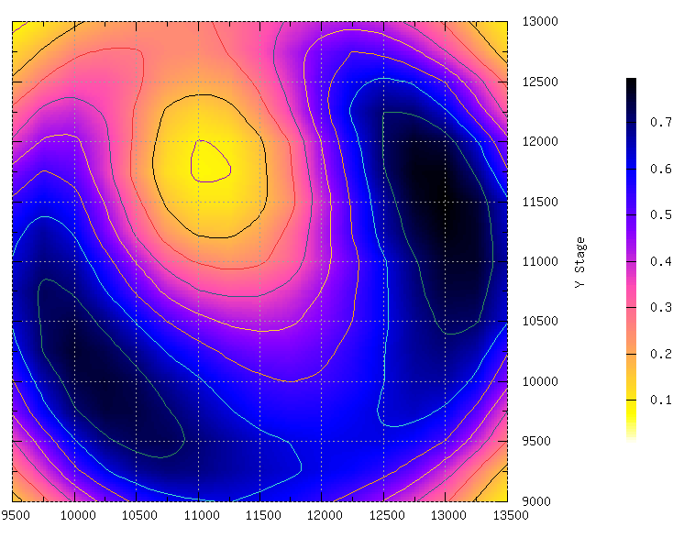
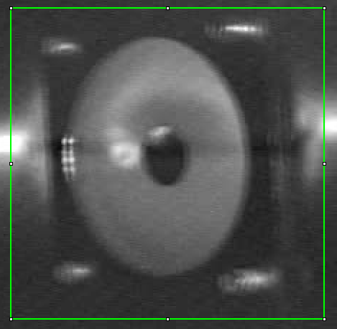
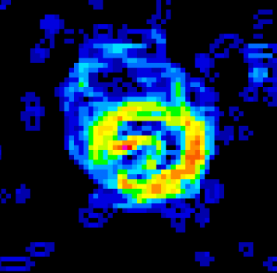
Photocurrent Dependence of Laser Profile
The scaling of photocathode lifetime, however, surely depends on the convolution of the laser profile, the photocathode QE and the ion production and dynamics in the photogun.

Slide 23
Lifetime Dependence of Laser Position/Profile
< SLIDE FROM DANIEL GOES HERE >

Slide 24
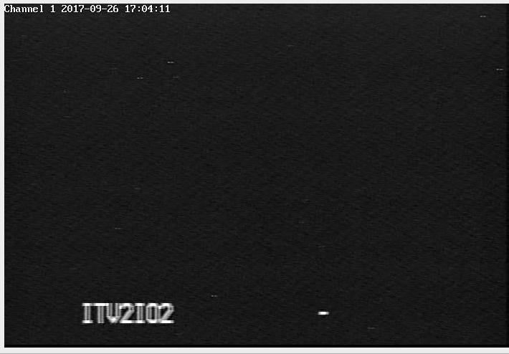
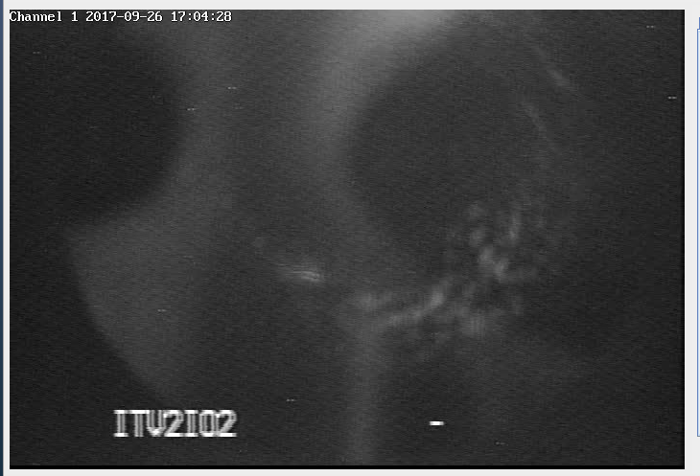
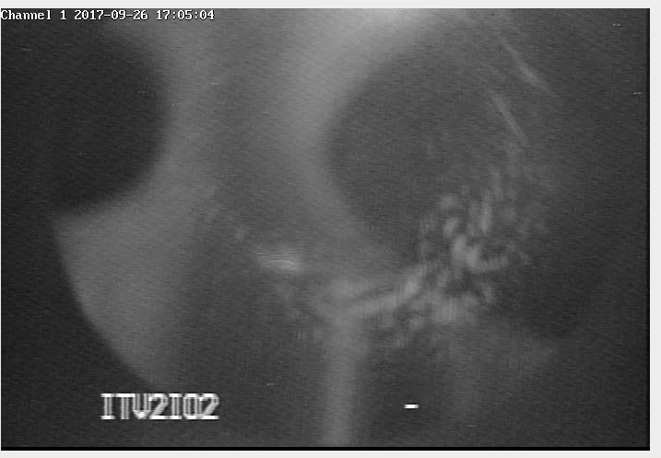
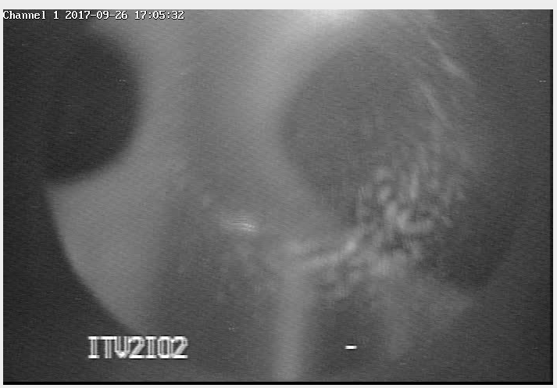
Minimizing Laser Power is a Good Thing
A large fraction of laser light (33%) is reflected from GaAs leading to the possibility of stray electrons
The remaining light is mainly absorbed in GaAs substrate, leading to heating
Laser OFF
100 mW
200 mW
300 mW

Slide 25
GaAs Photocathode Polarization vs. Time
Strained Superlattice GaAs/GaAsP
Bulk GaAs
Strained GaAs
SLSP-DBR
100 nm
100 nm
14 Layers
30 mA/W
1 mA/W
6 mA/W
30 mA/W
?
P_{e-} 35% 35% 75% 75% 85% 89%
I_{e-} 30μA 100μA 50μA 100μA 150μA 200μA
1995 1998 1999 2000 2004 2017
Photocathode capability (polarization and QE) has grown significantly.

Slide 26
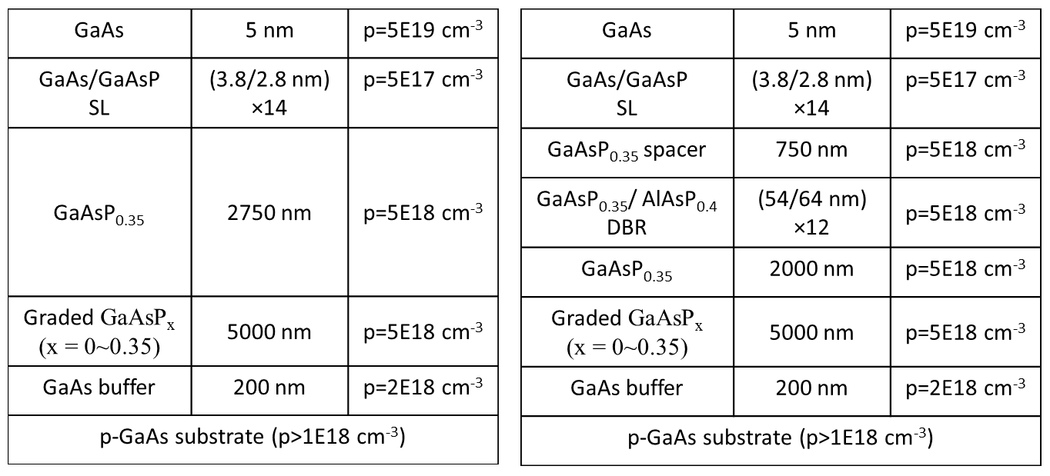
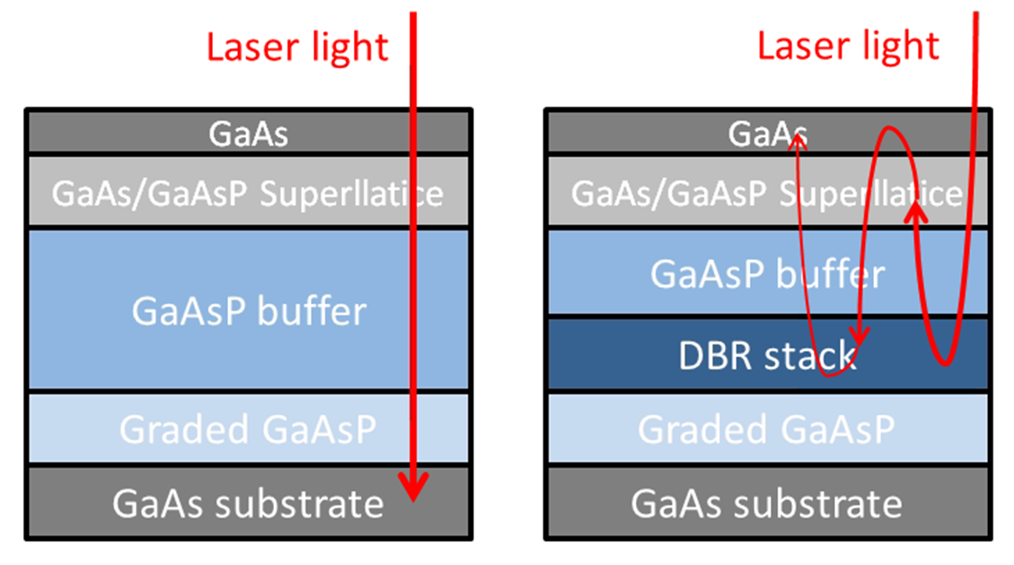
Benefits of Distributed Bragg Reflector
non-DBR Photocathode : absorption in the GaAs/GaAsP superlattice < 5%
  Most light passes into the substrate leading to unwanted heating
DBR photocathode : absorption in the GaAs/GaAsP superlattice > 20%
  Less light required to make required beam, less light means less heat
Great for high current initiatives like polarized positrons at CEBAF and EIC
Enhanced absorption occurs only at specific laser wavelengths
Photocathode without DBR
Photocathode with DBR
(57 layers!)
Non-DBR photocathode
DBR photocathode

Slide 27
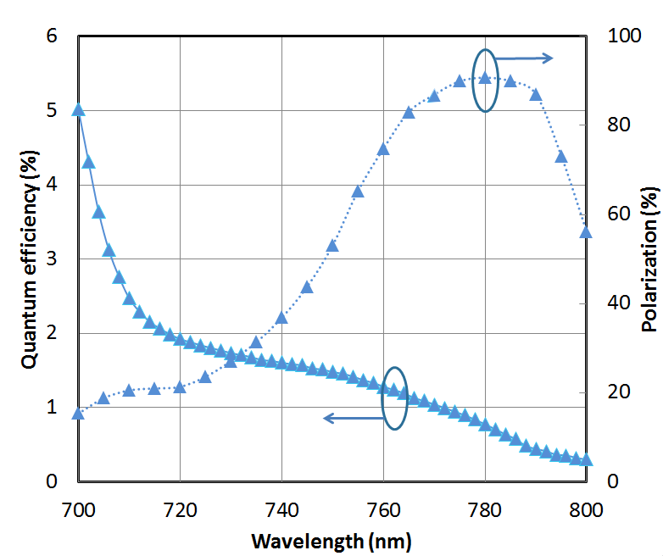
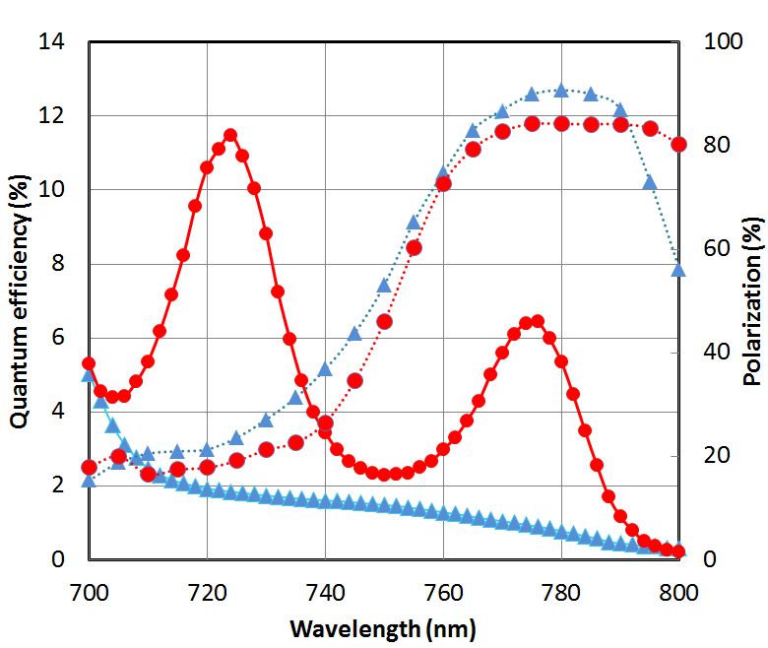
World Record QE from High Polarization Photocathode
Others have tried…but very difficult to obtain QE enhancement at the laser wavelength that also provides high polarization, CEBAF lasers operate at ~ 776 nm (doubled-telecom lasers)
Standard strained-superlattice
  QE = 0.89%
  Polarization = 92%
DBR
  QE = 6.4%
  Polarization = 84%
The highest reported QE of any high polarization photocathode
Excellent candidate for mA operations, will test at CEBAF this shutdown
SBIR partnership
W. Liu, S. Zhang, M. Stutzman, M. Poelker, Y. Chen, W. Lu, and A. Moy, Appl. Phys. Lett. 109, 252104 (2016)

Slide 28
Placeholder slide for Shukui
-0.6°
Origin (3 scan overlap)
CEBAF
Laser
wavelength
0.5°
1°

Slide 29
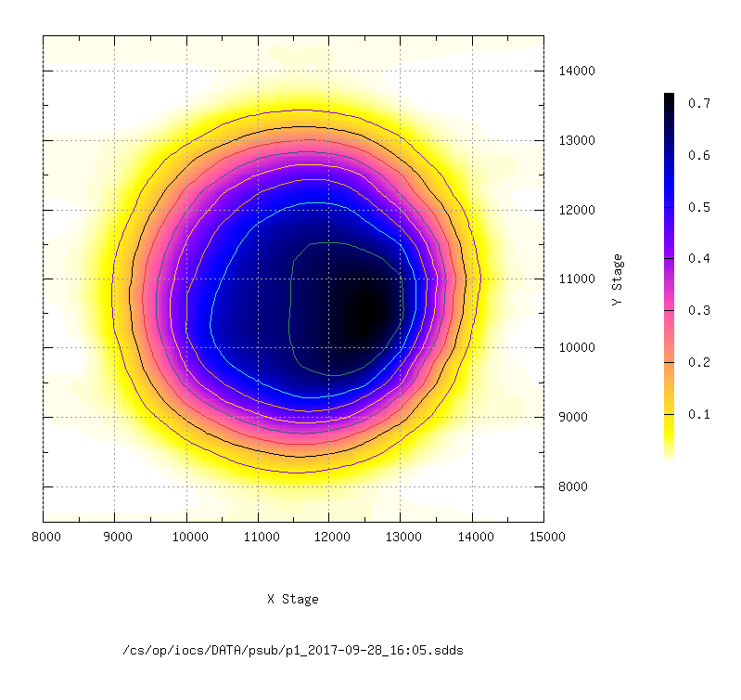
DBR Superlattice in Gun2
We recently moved a DBR superlattice in the CEBAF gun
Initial QE ~0.7% of CEBAF lasers (776nm) is consistent with lab measurement
Future work requires optimizing laser wavelength

Slide 30
Summary
Extending the charge lifetime of today’s spin polarized GaAs photoguns from tens to thousands of Coulombs is a requirement for extended uninterrupted operation at milliampere beam current
These new results demonstrate improved charge lifetime with larger laser spot sizes using GaAs/GaAsP photocathodes at mA current but…
Managing ALL of the beam remains essential. These results suggest CEBAF gun requires larger electrodes for sustainable milliampere operation
New DBR photocathode is an excellent candidate for high current (mA) polarized electron beam initiatives. Lifetime tests at CEBAF to happen soon, during this shutdown
Importantly, realistic dynamic lifetime models are critically needed to to separate and understand the dependencies of operational gun conditions.

