Slide 1
Status of Instrumental Beam Studies and Technical Description of Detectors and DAQ
February 24, 2017

Slide 2
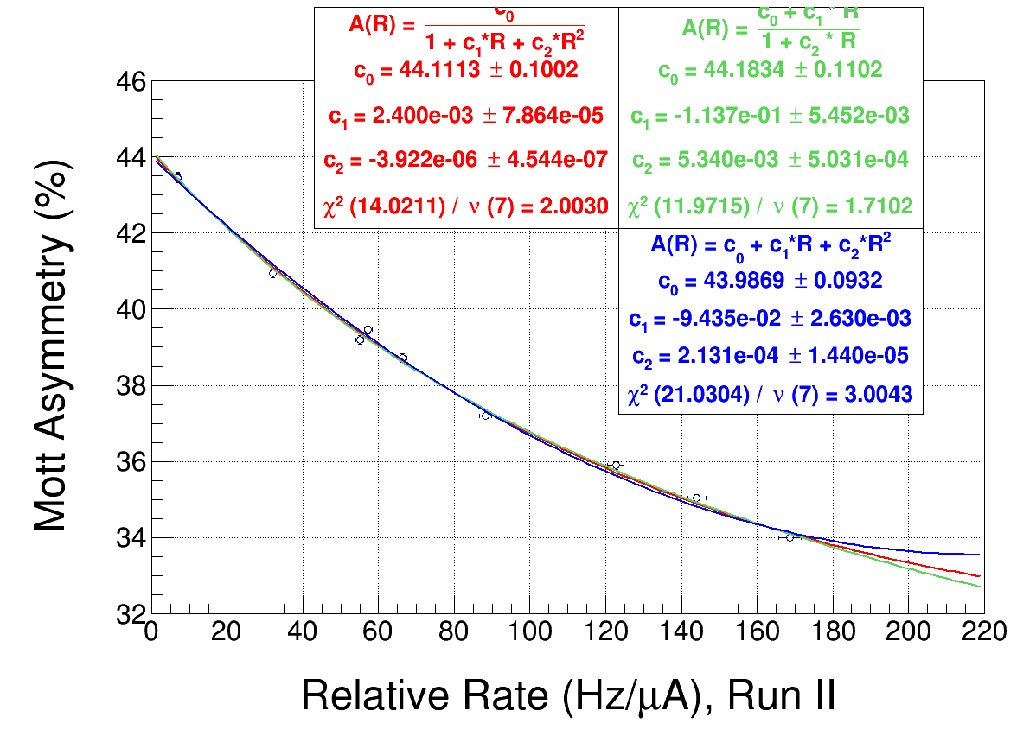
Official Run II

Slide 3
Rate Systematic Studies
Run II:
Relative rate scan of all foils at constant beam current of 1 µA with Pockels Cell OFF: 8413 – 8424
Relative rate scan of all foils at constant beam current of 1 µA and no timing veto: 8548 – 8560

Slide 4
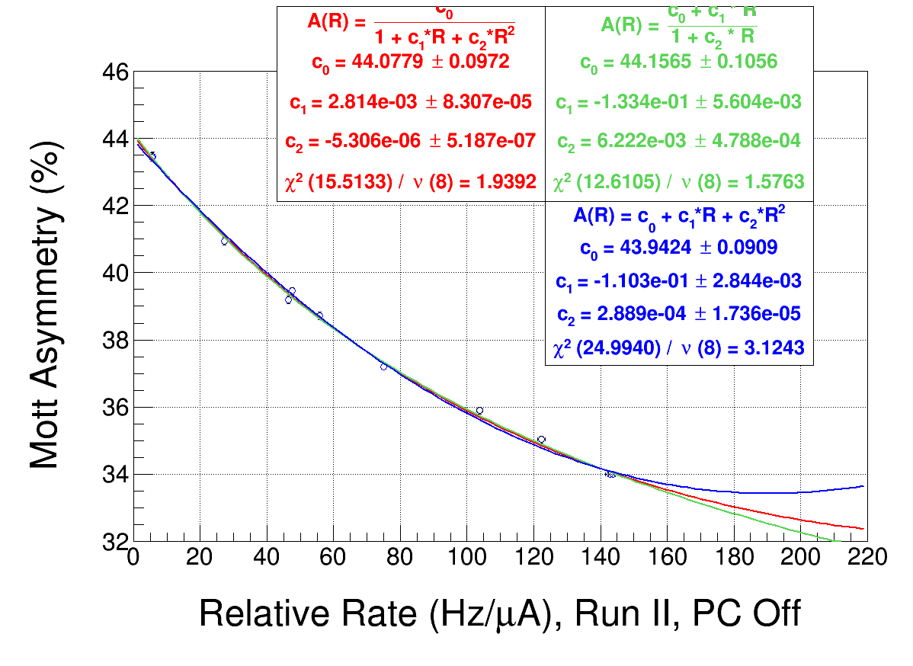
PC Off Rates
With official asymmetries

Slide 5
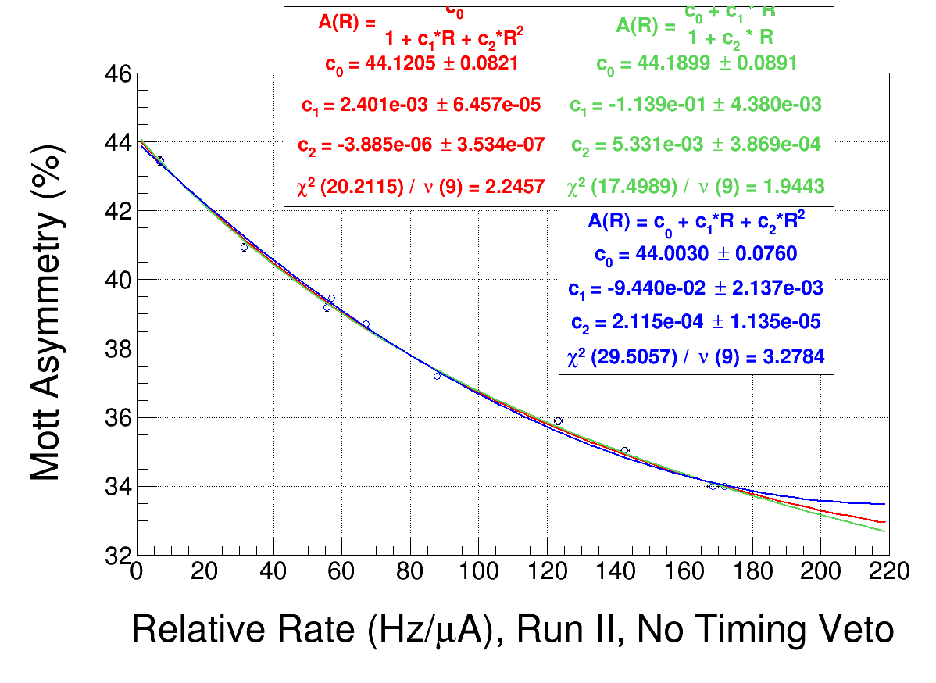
No Timing Veto Rates
With official asymmetries

Slide 6
Summary
Relative rates depend on range of Gaussian fit of energy spectra (i.e., 7500-11000 or 8000-9000) since each fit-range gives different mean and sigma
RUN II rate scan with Pockels Cell Off – taken at start of RUN II with initial beam steering – is very consistent with rates from asymmetry runs and with correction applied
Run II rate scan with no timing veto – taken at end of RUN II – is very consistent with rates from asymmetry runs and with correction applied

Slide 7
DAQ Dead Time Study

Slide 8
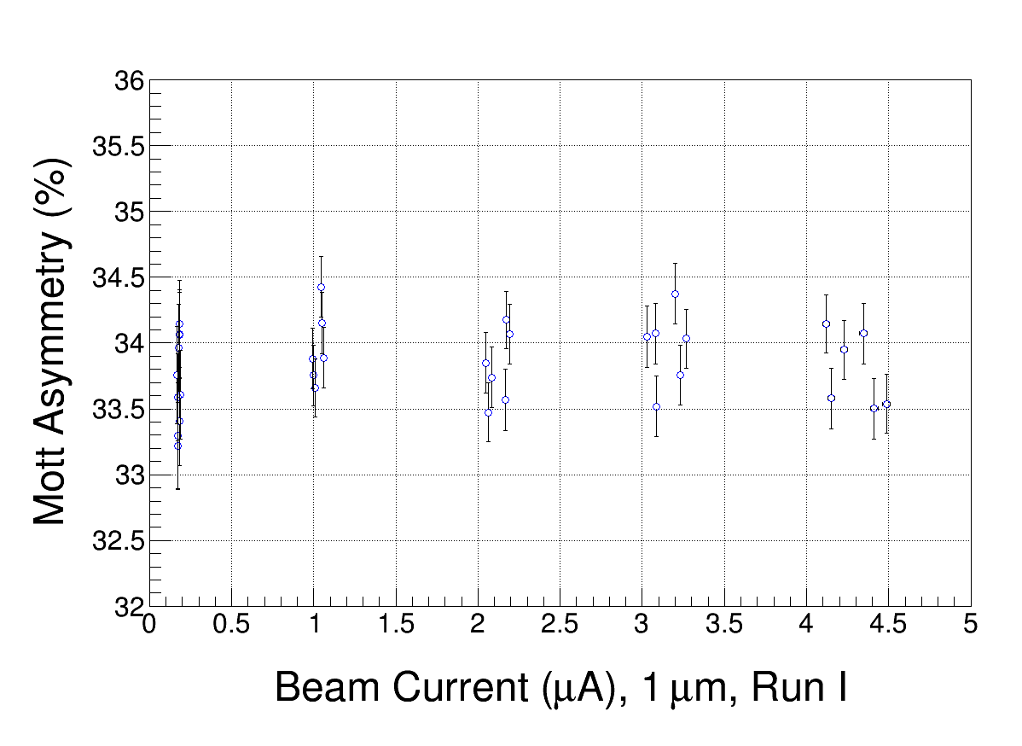

Slide 9
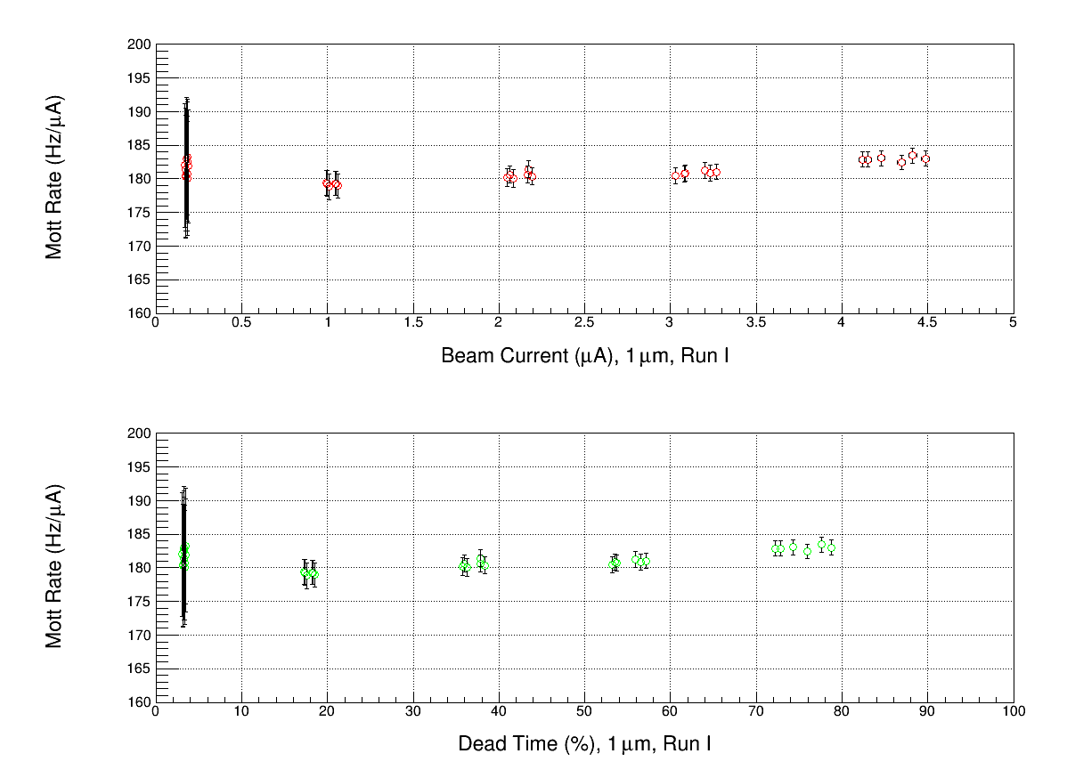

Slide 10
Energy vs Time-of-flight

Slide 11
8545

Slide 12
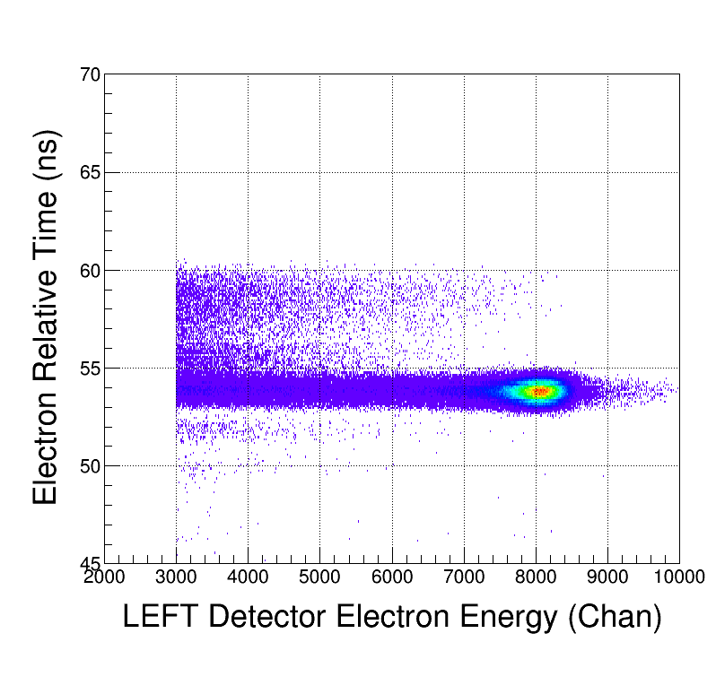

Slide 13
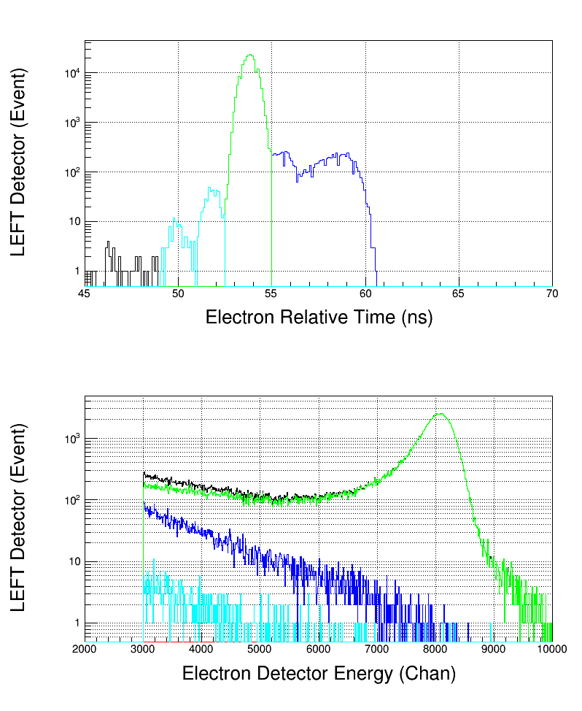

Slide 14
8539

Slide 15
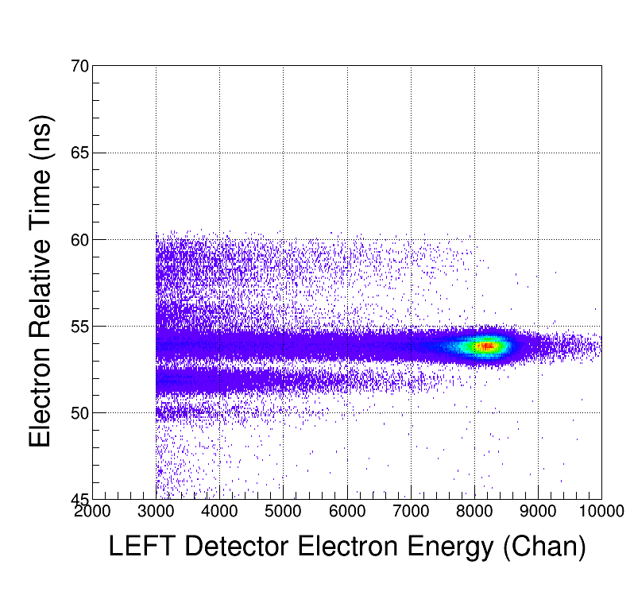

Slide 16
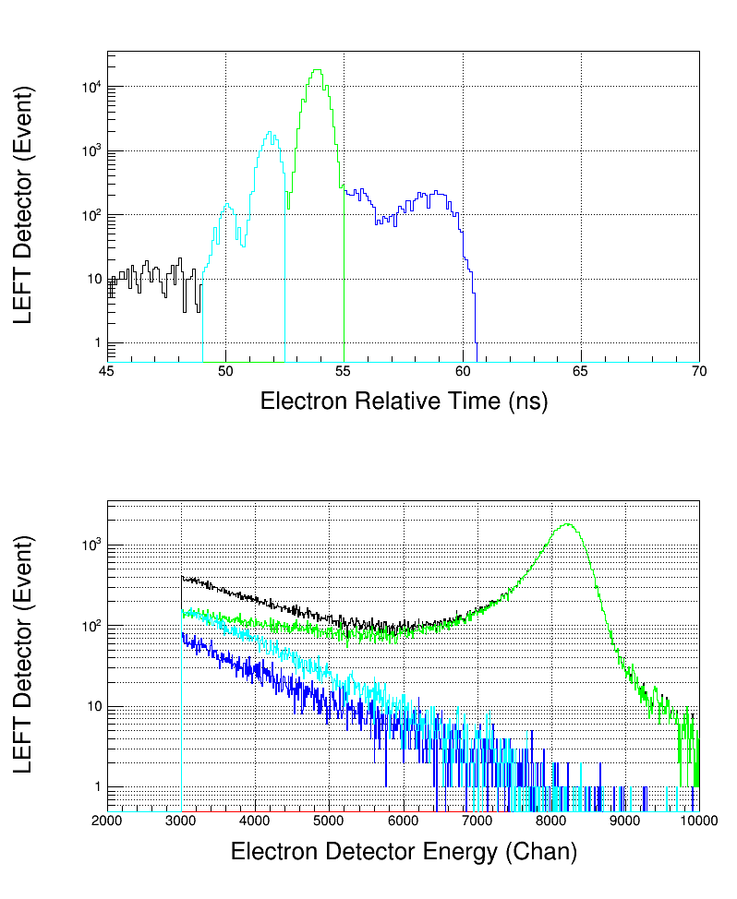

Slide 17
8495

Slide 18
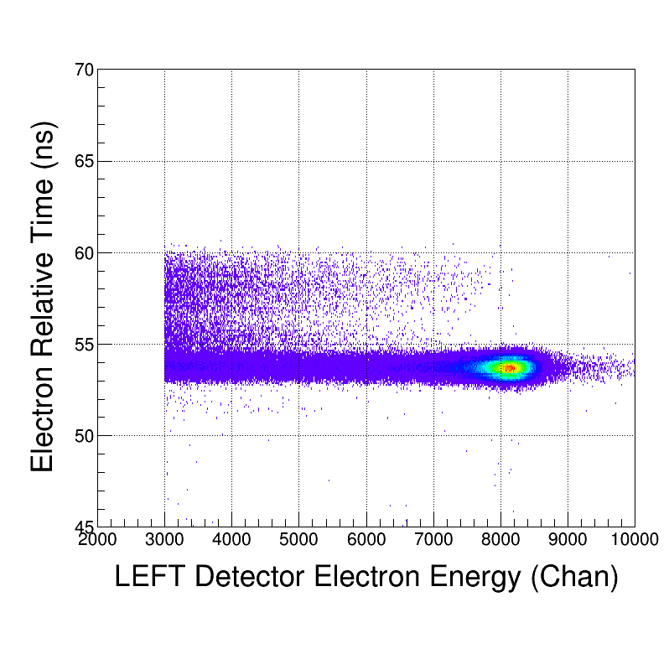

Slide 19
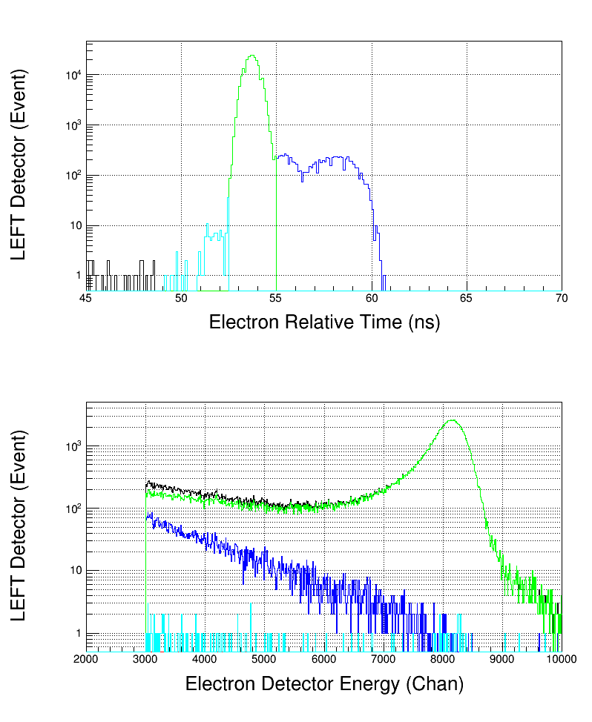

Slide 20
8551

Slide 21
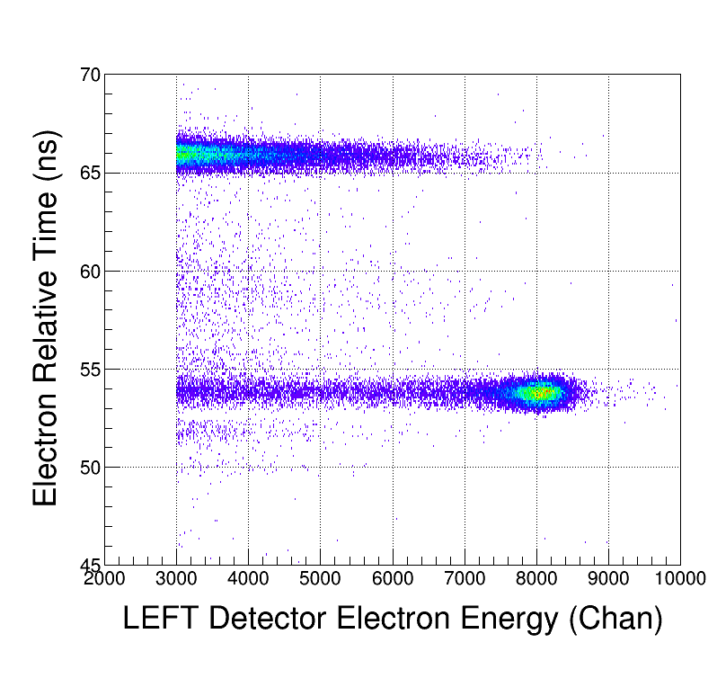

Slide 22
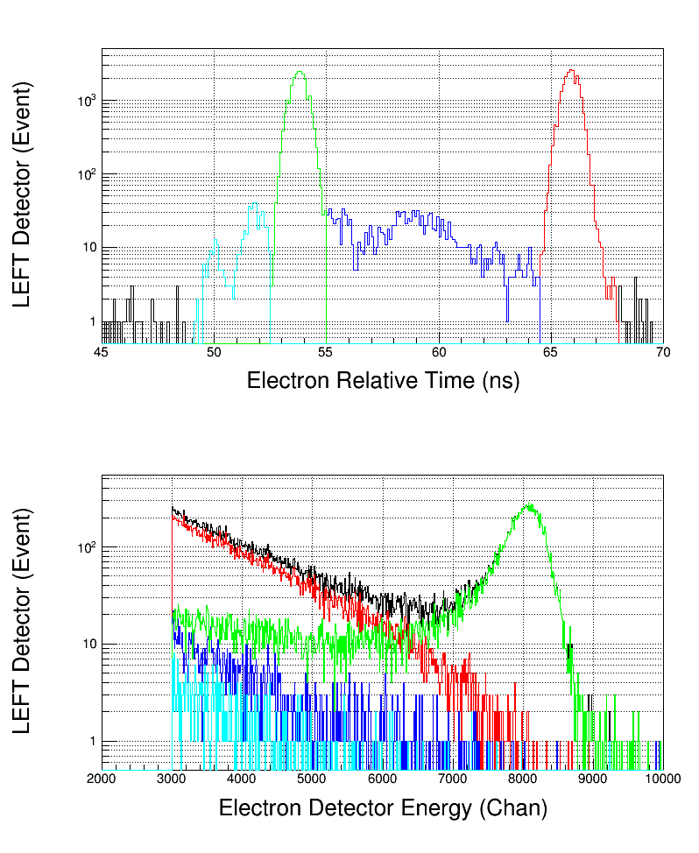

Slide 23
8552

Slide 24
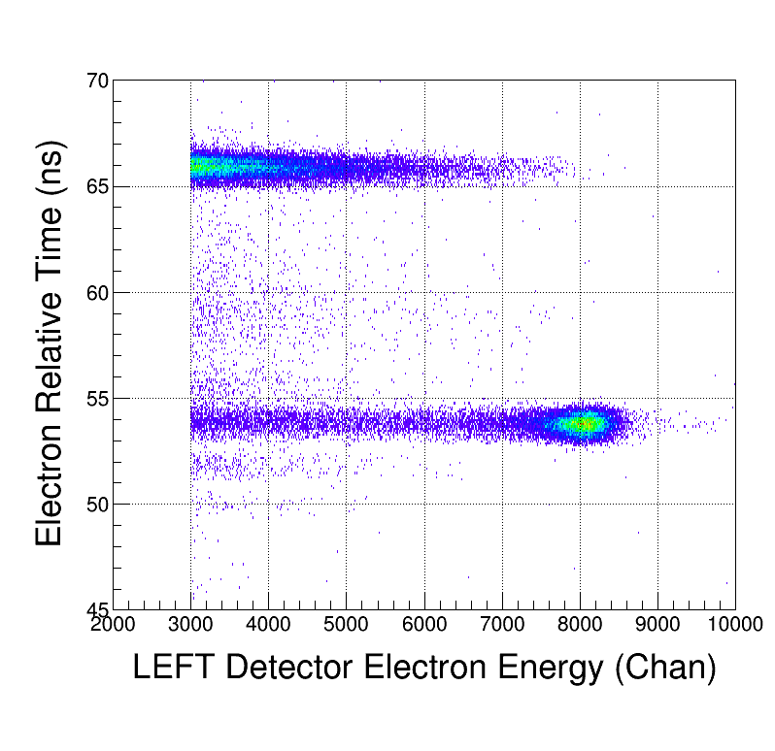

Slide 25
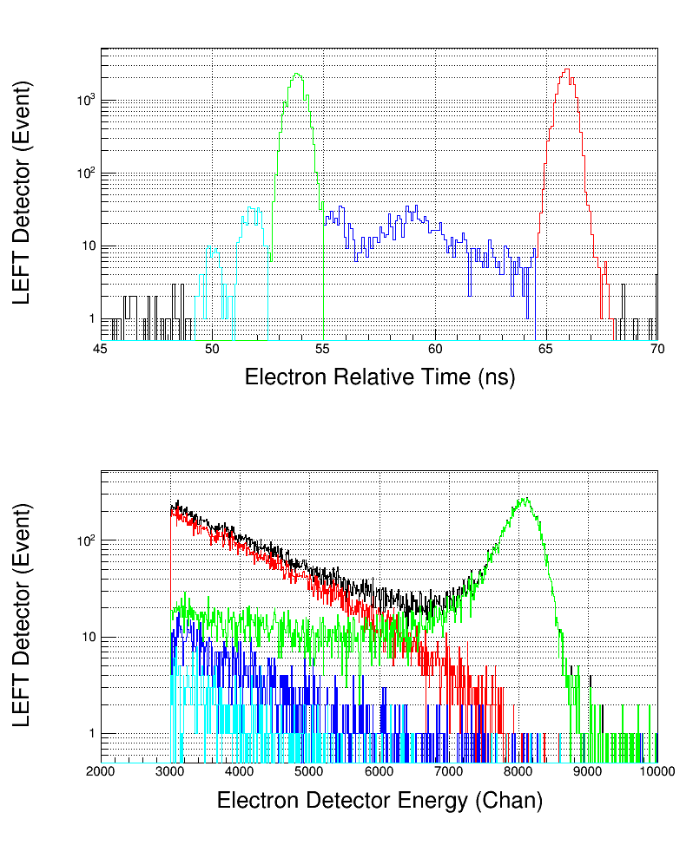

Slide 26
8560

Slide 27
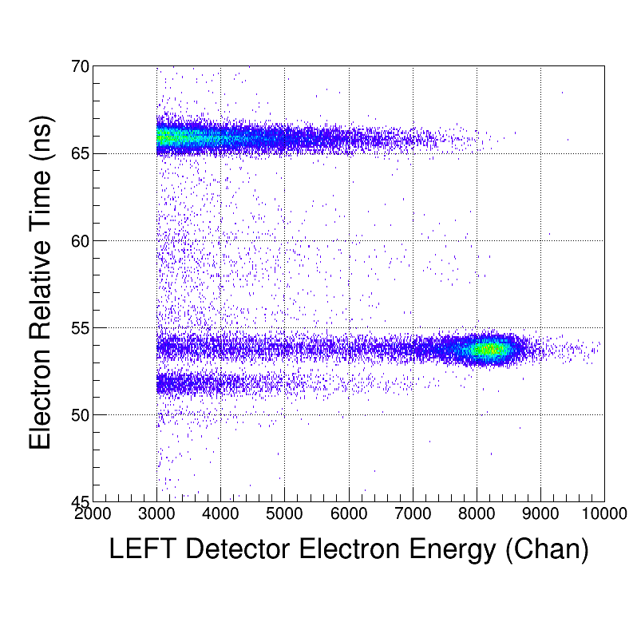

Slide 28
