Slide 1

Measurement of ¹⁶O(γ,α)¹²C with a Bubble Chamber and a Bremsstrahlung Beam at Jefferson Lab Injector
Riad Suleiman
January 9, 2014
Notes:
Title Page

Slide 2
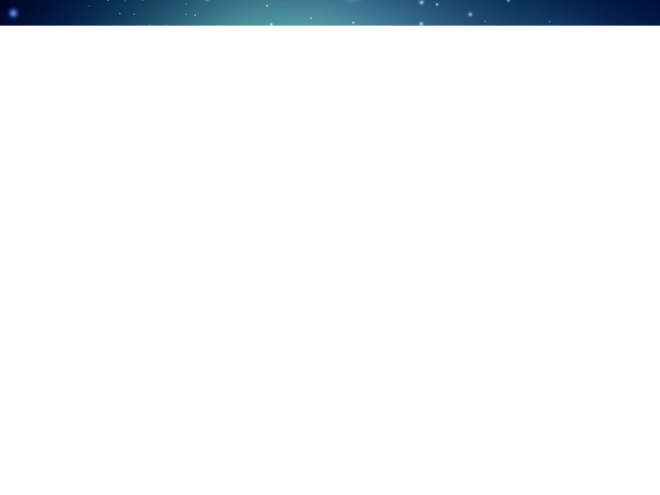




B. DiGiovine
D. Henderson
R. J. Holt
K. E. Rehm
J. Benesch
P. Degtiarenko
A. Freyberger
J. Grames
R. Kazimi
G. Kharashvili
D. Meekins
M. Poelker
Y. Roblin
R. Suleiman
V. Vylet
A. Robinson
C. Ugalde
A. Sonnenschein
Notes:
Interior Page Design 2

Slide 3
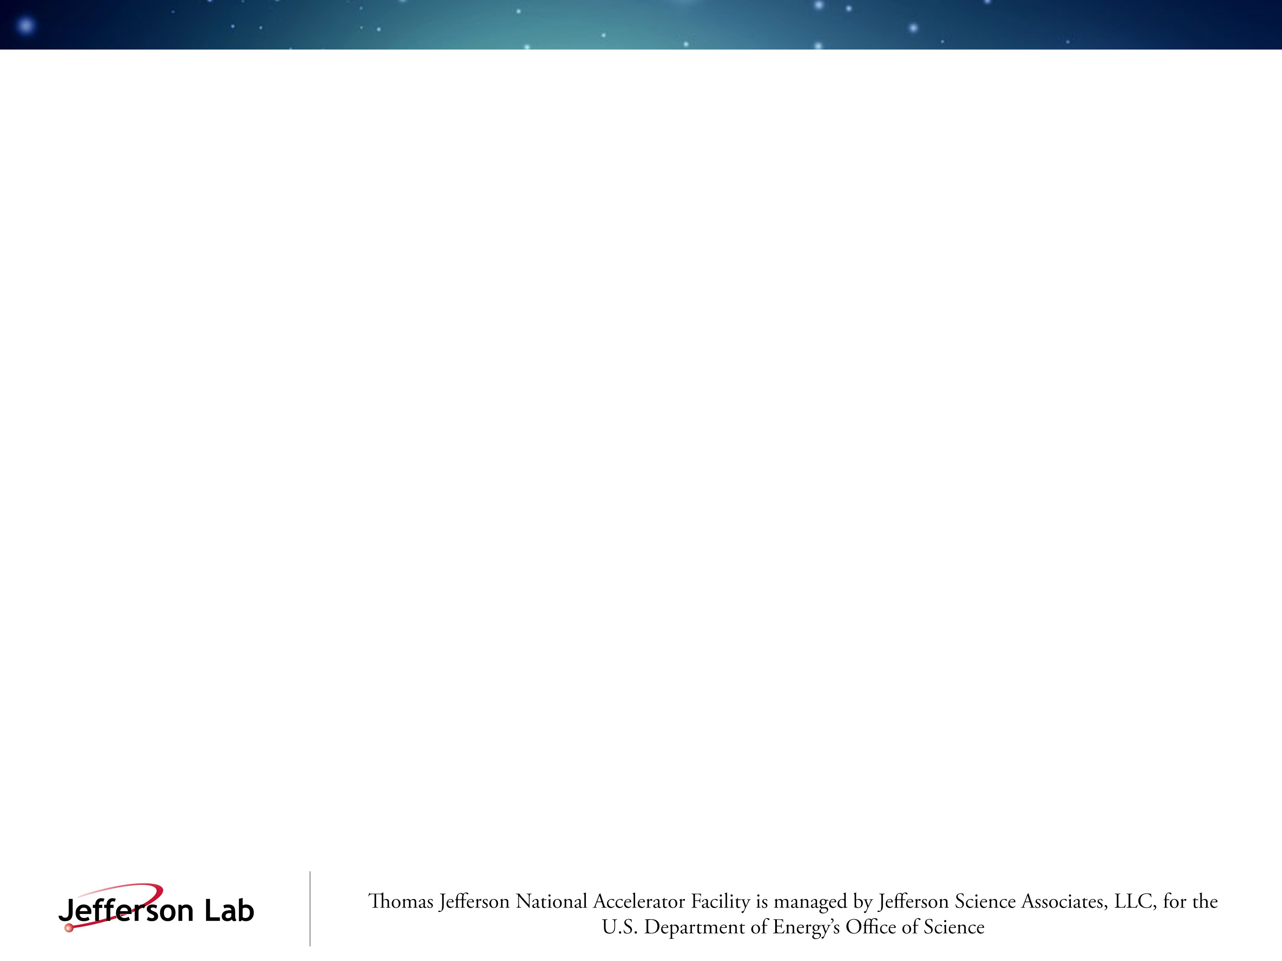
Outline
Nucleosynthesis and the ¹²C(α,γ)¹⁶O Reaction
Time-reversal Reaction: ¹⁶O(γ,α)¹²C
Bubble Chamber Theory and Design
Work at HIGS
Experimental Setup at Jefferson Lab Injector
Bremsstrahlung Beam and Penfold-Leiss Unfolding
Statistical and Systematic Errors
Backgrounds and Ion Energy Distributions
Safety
Summary and Outlook
Notes:
Interior Page Design 1

Slide 4

Relative Abundance of Elements by Weight
Notes:
Interior Page Design 2

Slide 5

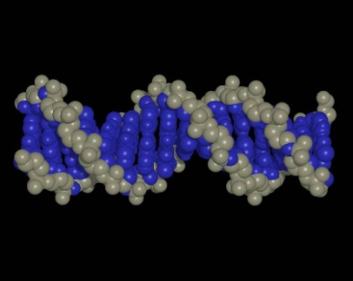

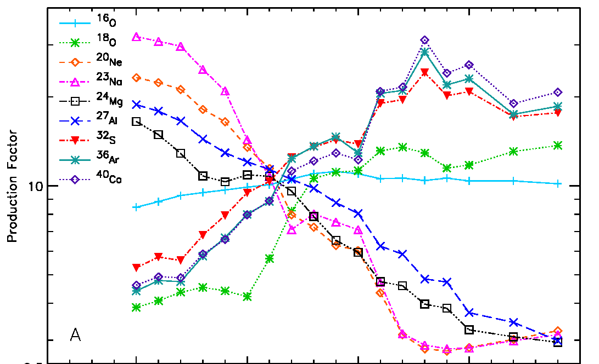
The ¹²C(α,γ)¹⁶O Reaction
The “holy grail” of nuclear astrophysics
Affects the synthesis of most of the elements of the periodic table
Sets the C to O ratio in the universe
Determines the minimum mass a star requires to become a supernova
S. Woosley, A. Heger, Phys. Rep. 442 (2007) 269
Notes:
Interior Page Design 2

Slide 6
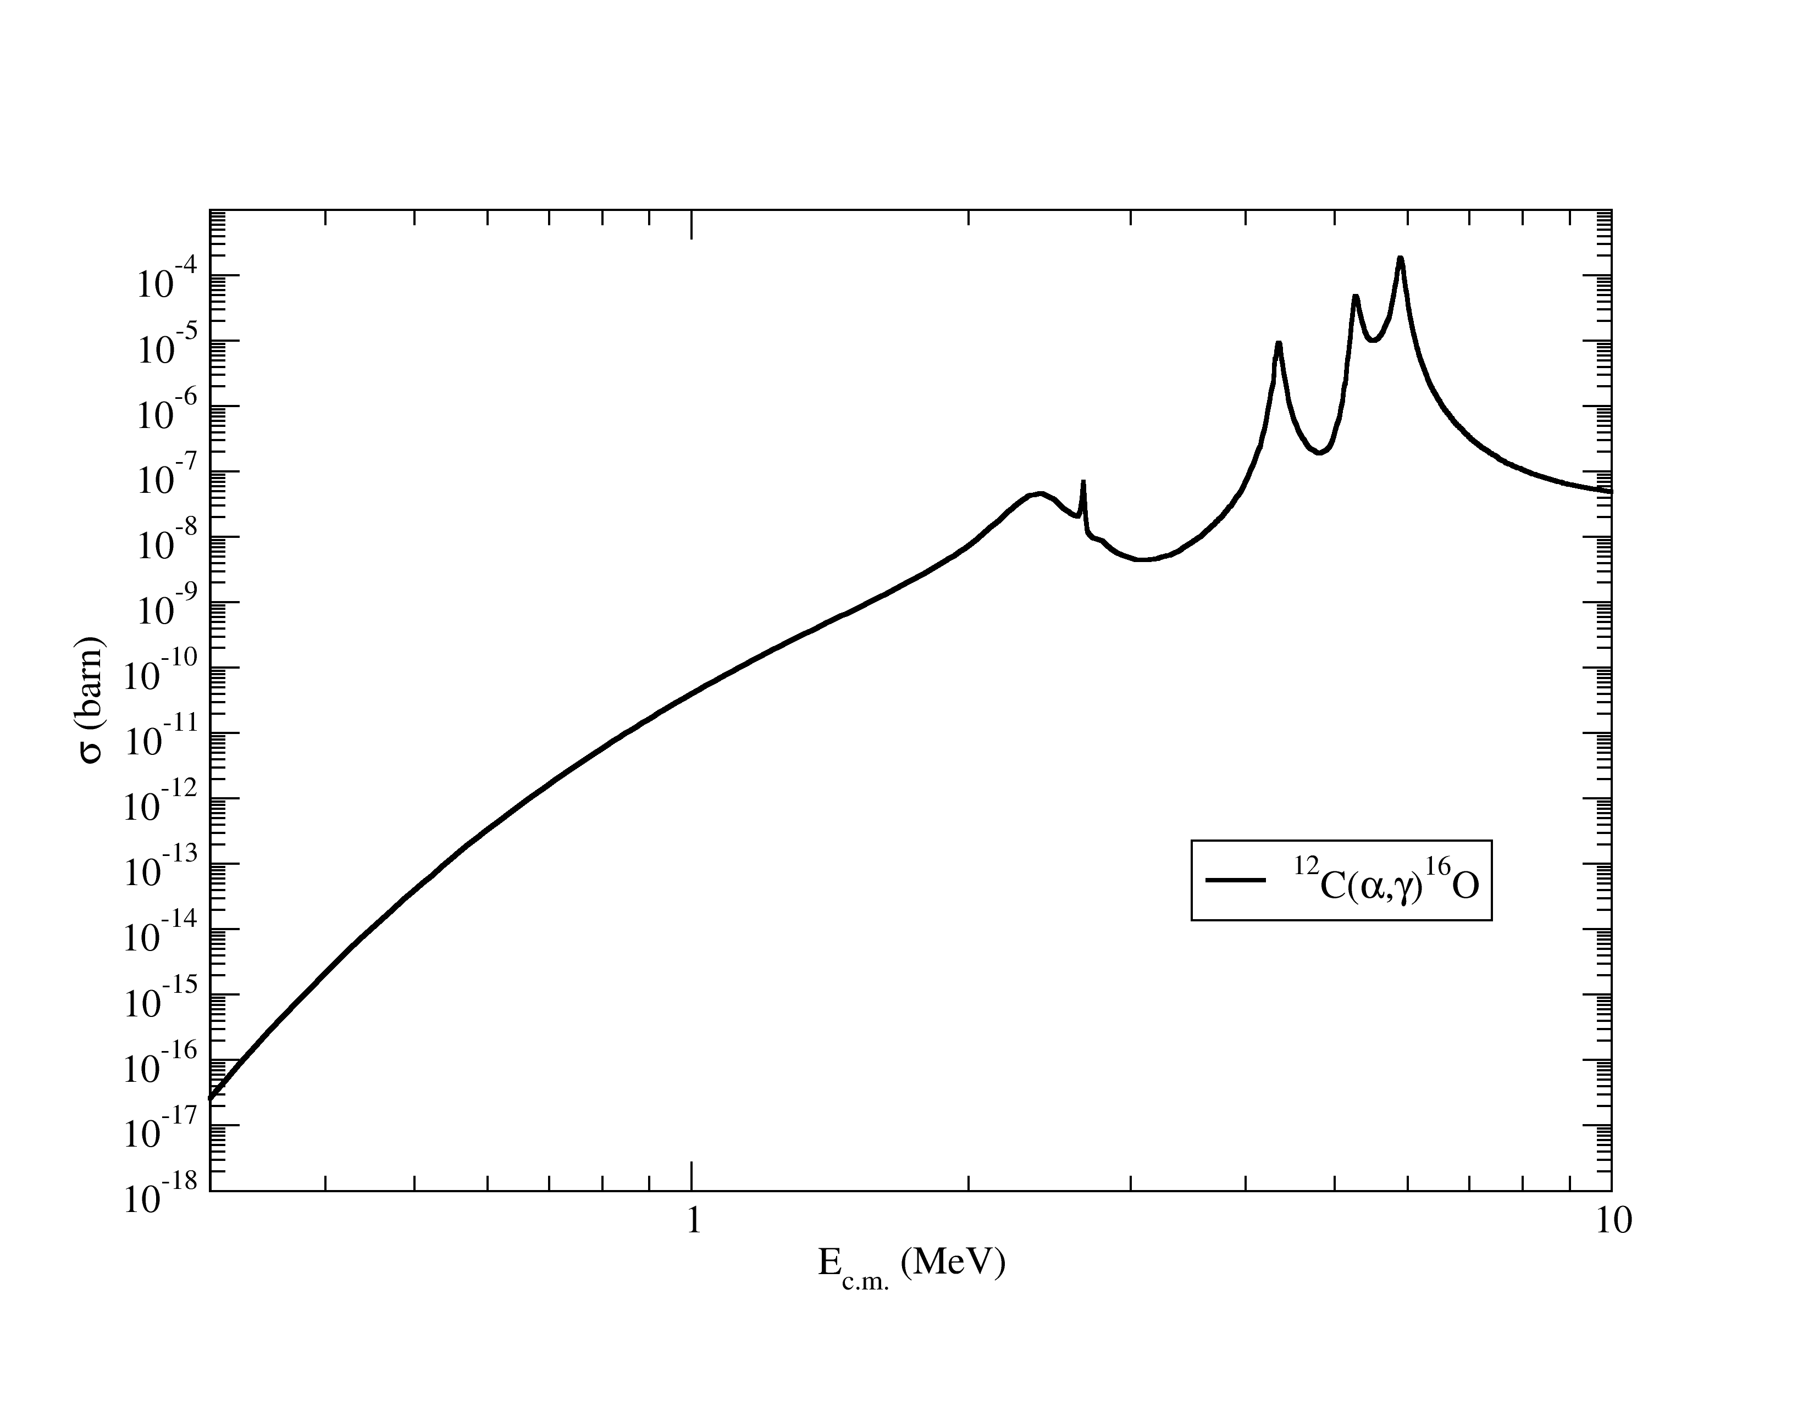
Stellar Helium Burning
Helium burning stage of stellar evolution occurs at T=10⁹ K
Most effective stellar energy, E_{CM} = 0.3 MeV
He burning at cross section σ ~ 10⁻¹⁷ barn
Stellar Energy
0.3
Notes:
Interior Page Design 2

Slide 7
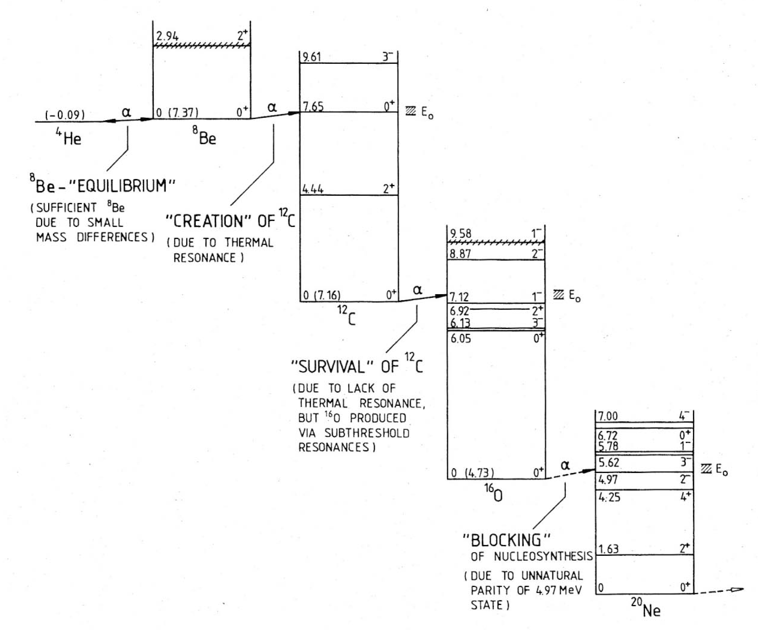
Title Here
Gamow window
Text goes here
Rolfs and Rodney, 1988
Notes:
Interior Page Design 2

Slide 8
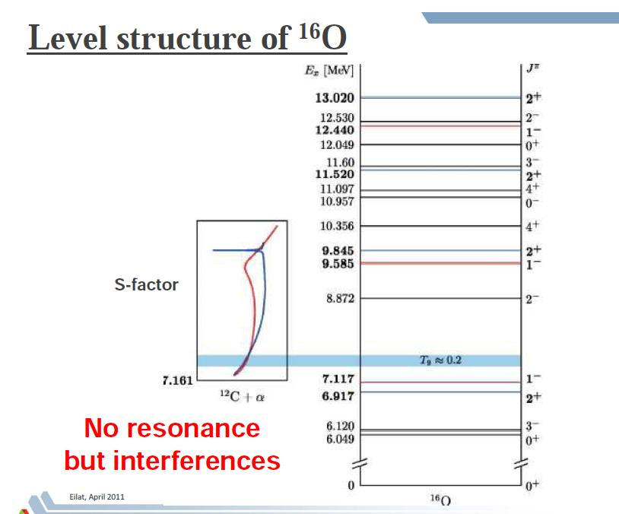
Time Reversal
Notes:
Interior Page Design 2

Slide 9
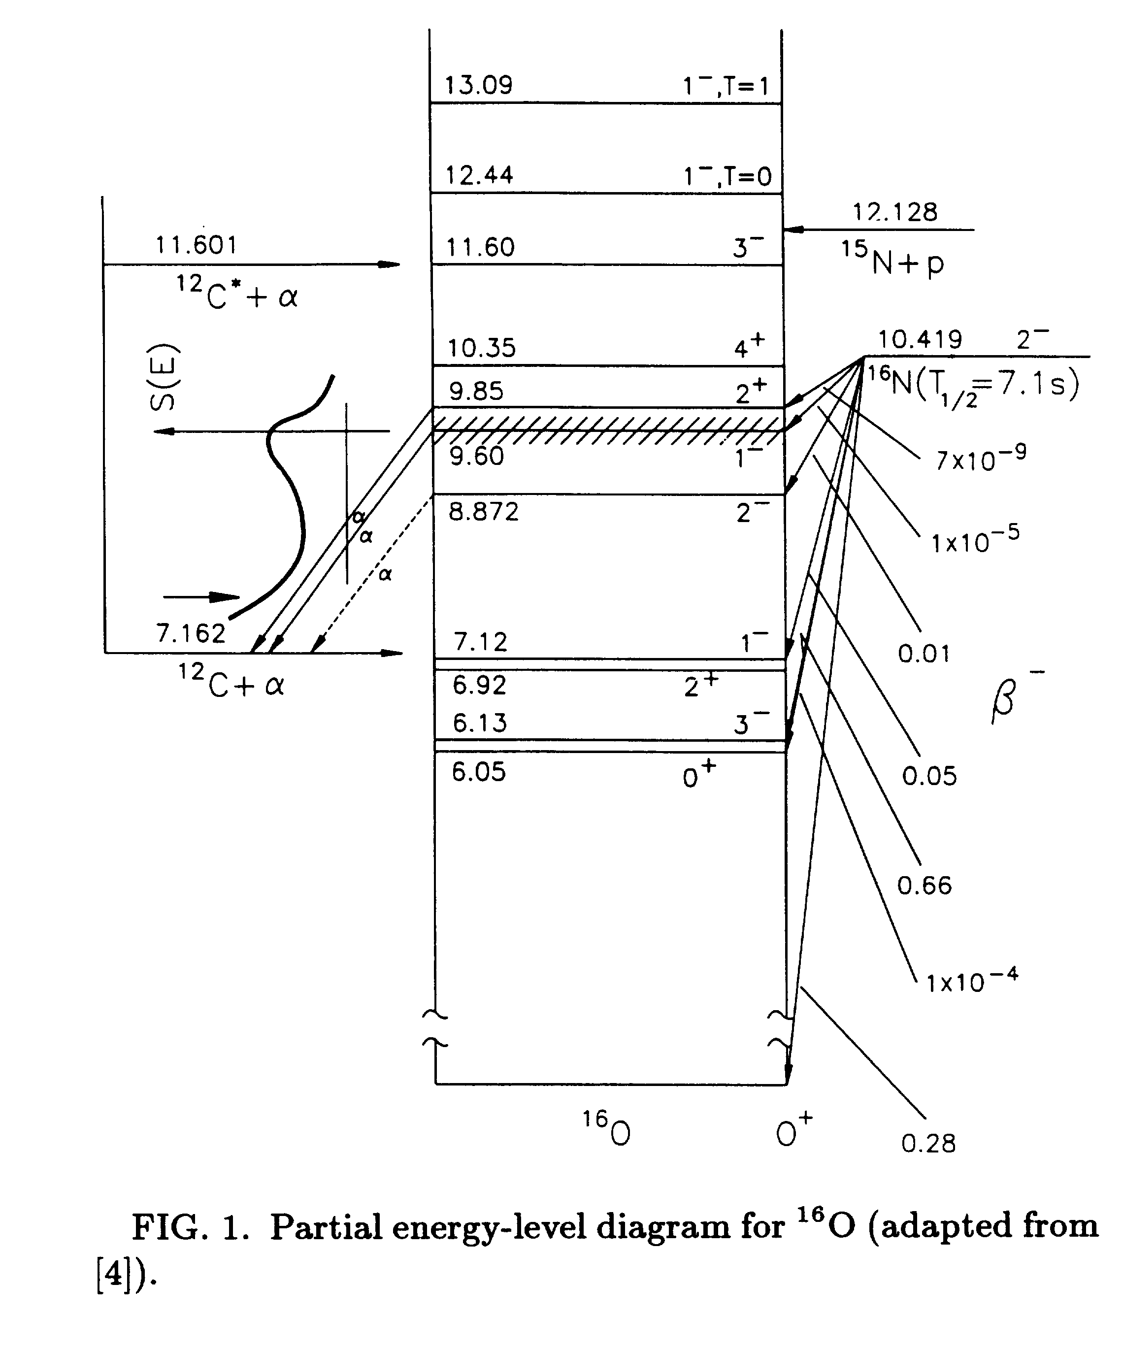
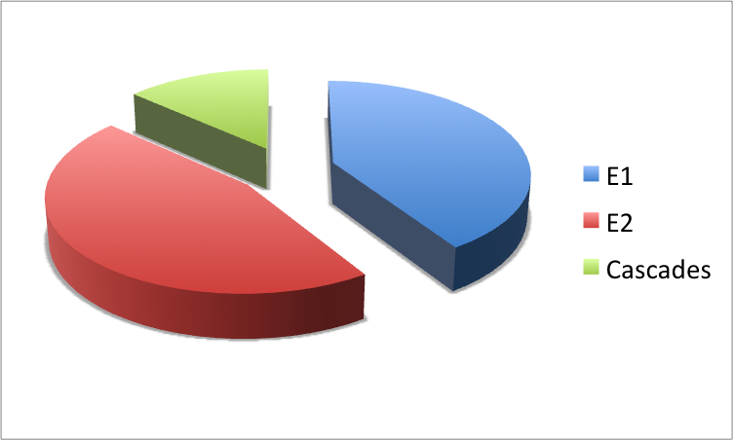
S(300)
Kunz 2001, Matei 2006

Slide 10
Heroic efforts in search of the holy grail of astrophysics: ¹²C(α,γ)¹⁶O
Luminosity ~ 1E34 cm⁻²s⁻¹
Efficiency ~ 1E-3
¹⁶O(γ,α)¹²C
Lum(HIγS) ~ 4E30 cm⁻²s⁻¹
Lum(JLab) ~ 8E31 cm⁻²s⁻¹
10 μA , top 100 keV
λ_{γ}²/λ_{α}² ~ 60
Bubble chamber: solid angle x efficiency = 100%
Expt | Beam current (mA) | Detector Effic. (%) | Target | Meas. Time (h)
Redder | 0.7 | Ge, 35 | 12C, ~3E18 | 900
Ouellet | 0.03 | Ge, 30 | 12C, 5E18 | 1950
Roters | 0.02 | BGO, 270 | 4He, 1E19 | 5000
Kunz | 0.45 | Ge, 100 | 12C, 3E18 | 700
EUROGAM | 0.34 | Ge, 70 | 1E19 | 2100
¹²C(α,γ)¹⁶O
⁴He(¹²C, ¹⁶O)γ
Notes:
Interior Page Design 2

Slide 11
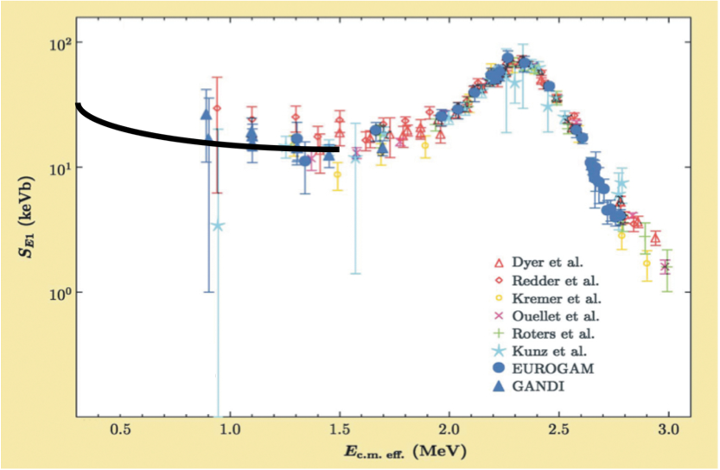
Astrophysical S-Factor ¹²C(α,γ)¹⁶O
Author | S(300keV) (keV-b)
Buchmann (2005) | 102-198
Caughlan and Fowler (1988) | 120-220
Hammer (2005) | 162+-39
Stellar helium burning at E=300 keV
Notes:
Interior Page Design 2

Slide 12
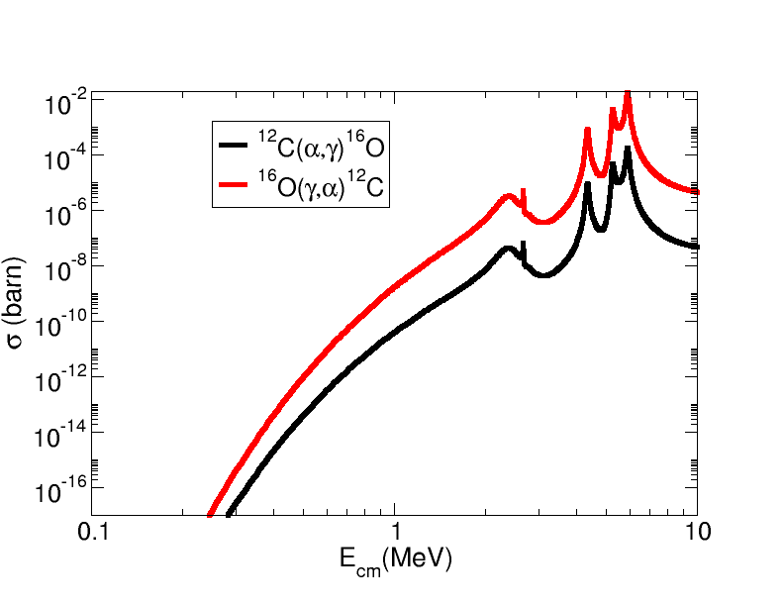
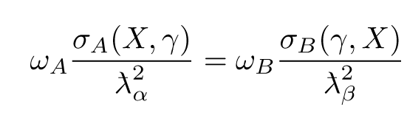
Time Reversal Reaction
¹²C
¹⁶O
α
γ
Notes:
Interior Page Design 2

Slide 13
(γ,α) and (α,γ) – Reciprocity Relation
A(α, γ)B:
σ(γ,α) is over two orders of magnitude larger than σ(α, γ)
Notes:
Interior Page Design 2

Slide 14
New Approach: Inverse Reaction + Bubble Chamber
Extra gain (x100) by measuring time inverse reaction
Target density up to x10⁶ higher than conventional targets
Superheated liquid will nucleate from α and ¹²C recoils
Electromagnetic debris (degraded electrons and gammas, or positrons) that escape the collimator/electron beam do NOT trigger nucleation (detector is insensitive to γ-rays by at least 1 part in 10¹¹).
beam
target
signal
γ + ¹⁶O → ¹²C + α
Monochromatic γ beam at HIγS
~ 10⁷⁻⁸ γ/s
Bremsstrahlung at JLab
~ 4x10⁹ γ/s (top 250 keV)
Notes:
Interior Page Design 2

Slide 15
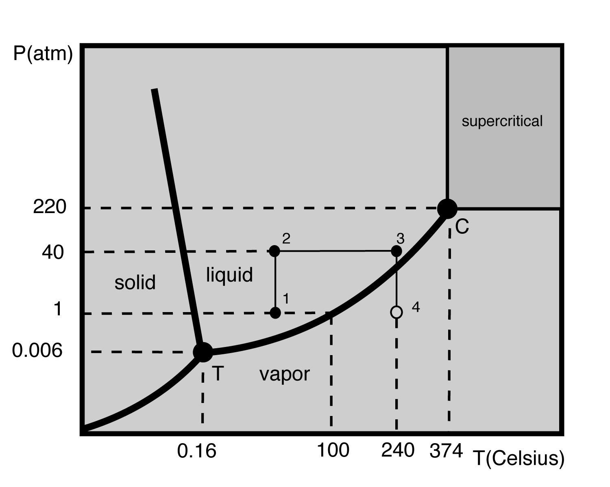
Bubble Chamber Theory and Design
Donald Glaser, 86, won Nobel for inventing chamber to detect subatomic particles (1960)
Dark Matter Search
COUPP PRL106,021203(2011)
PICASSO PLB,682,185(2009)
SIMPLE PRL105, 211301(2010)
Superheat
Notes:
Interior Page Design 2

Slide 16
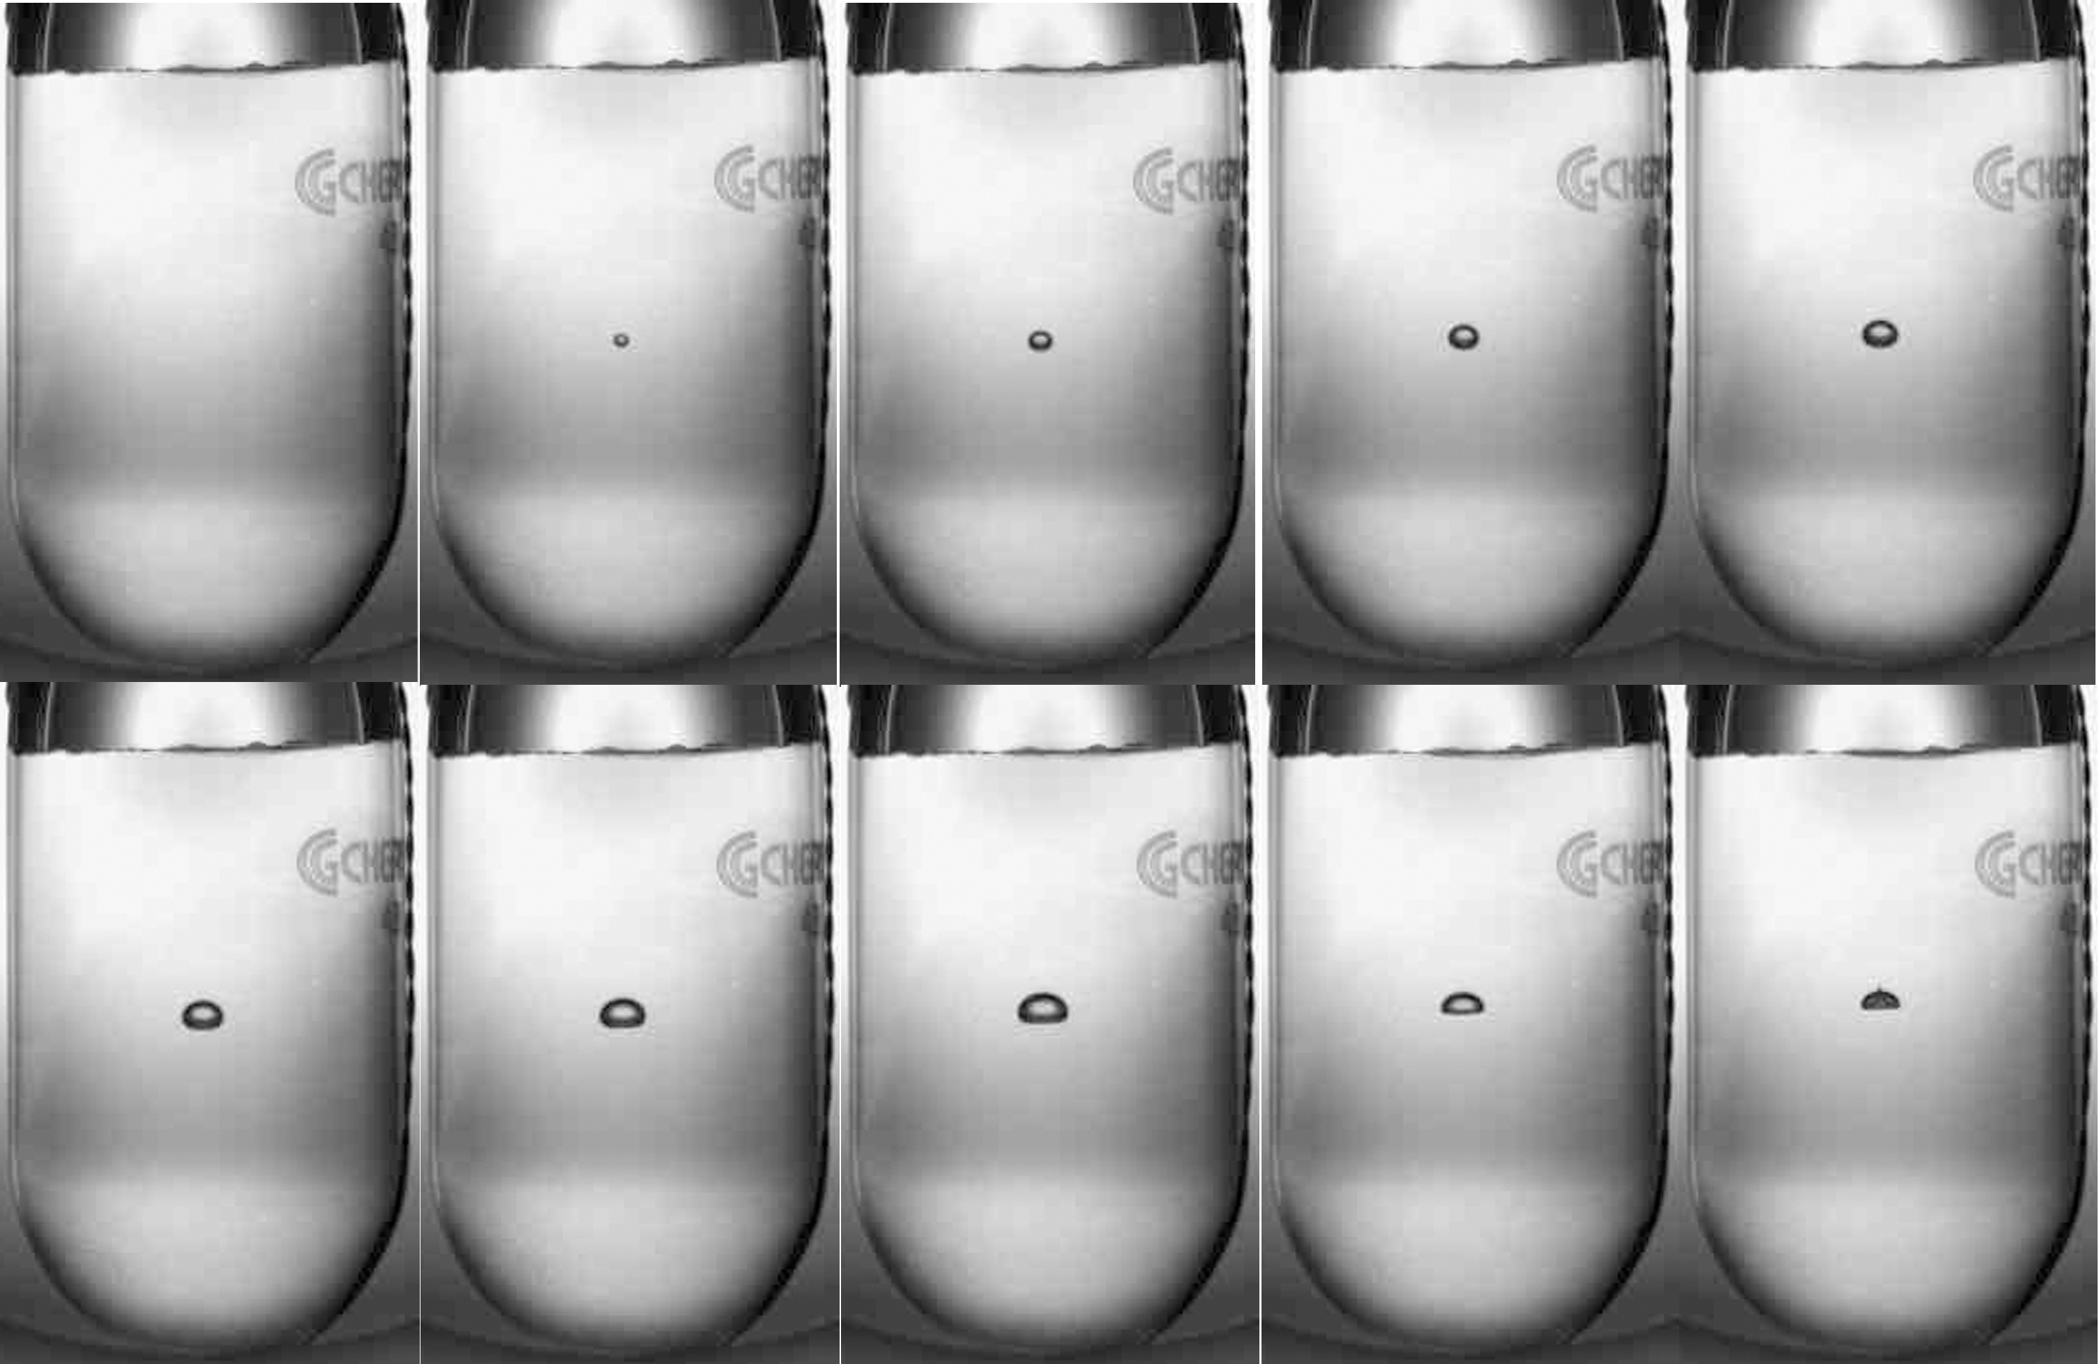
Bubble Growth and Quenching
¹⁹F(γ,α)¹⁵N in R134a
Δt = 10 ms
Notes:
Interior Page Design 2

Slide 17
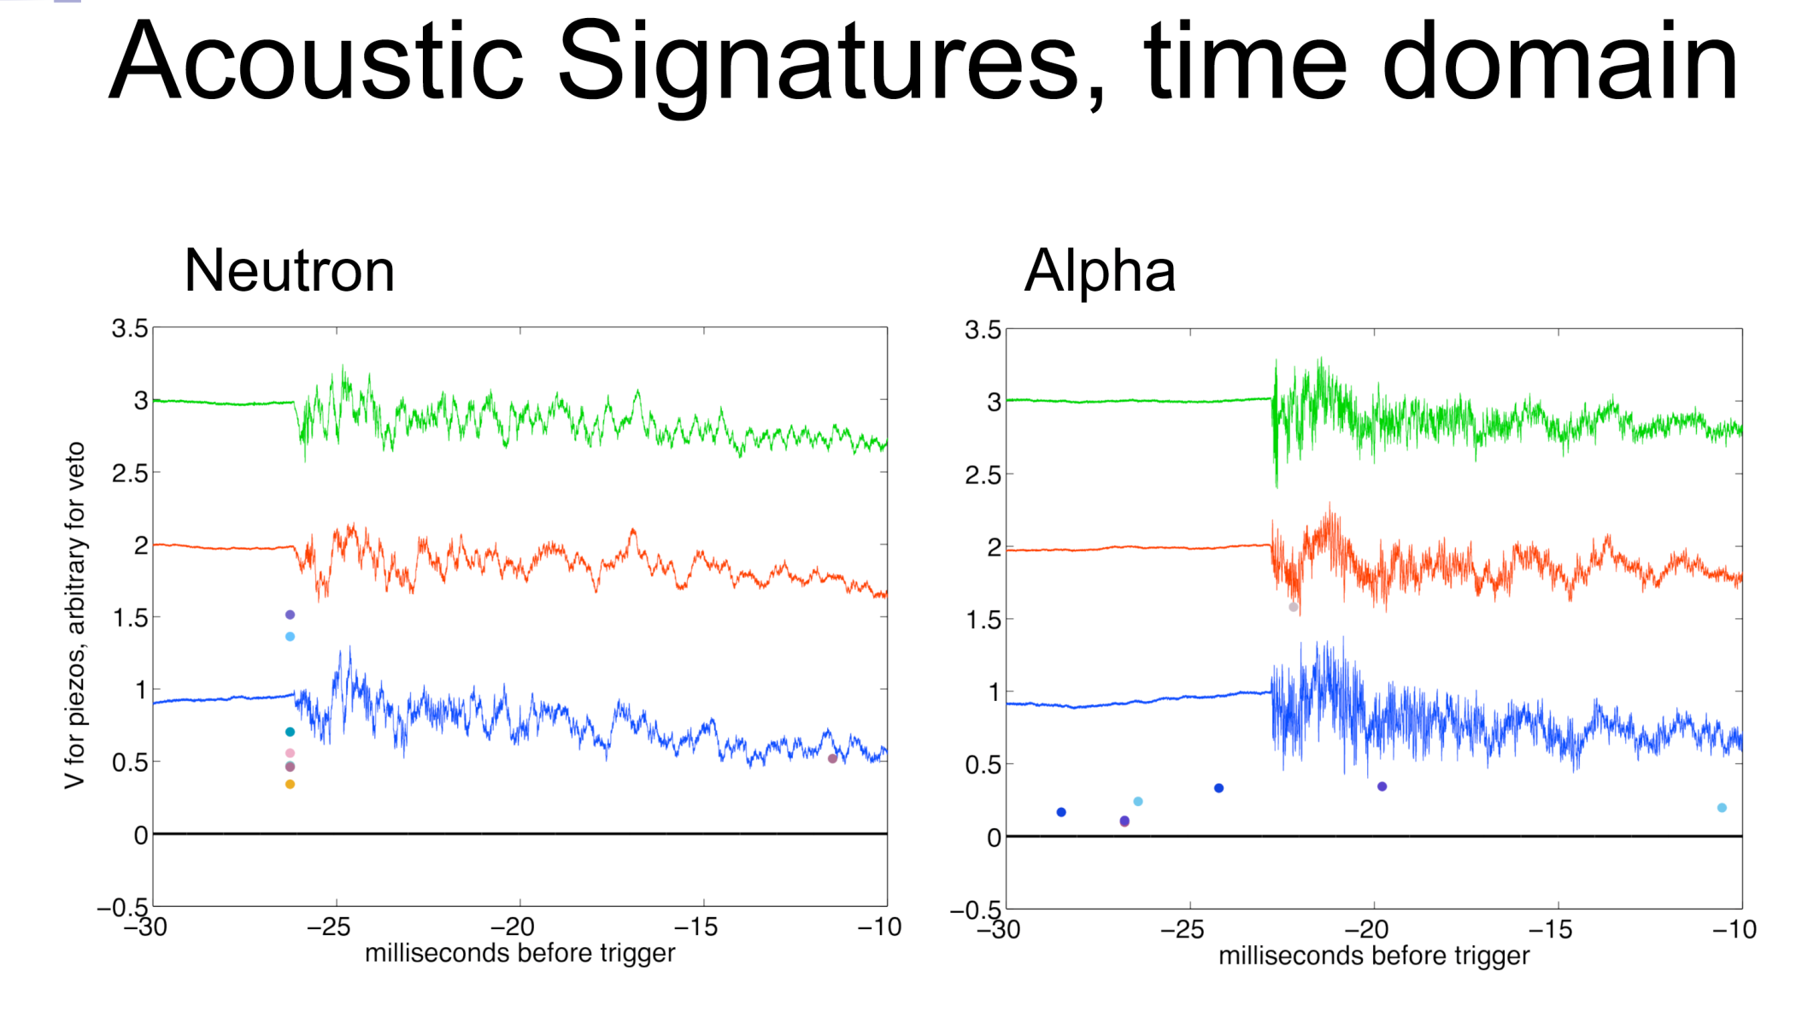
Acoustic Signal: Particle ID
Suppress neutron events by x500 from acoustic signal – FNAL dark matter bubble chambers
COUPP, FNAL, courtesy of A. Sonnenschein
Notes:
Interior Page Design 2

Slide 18
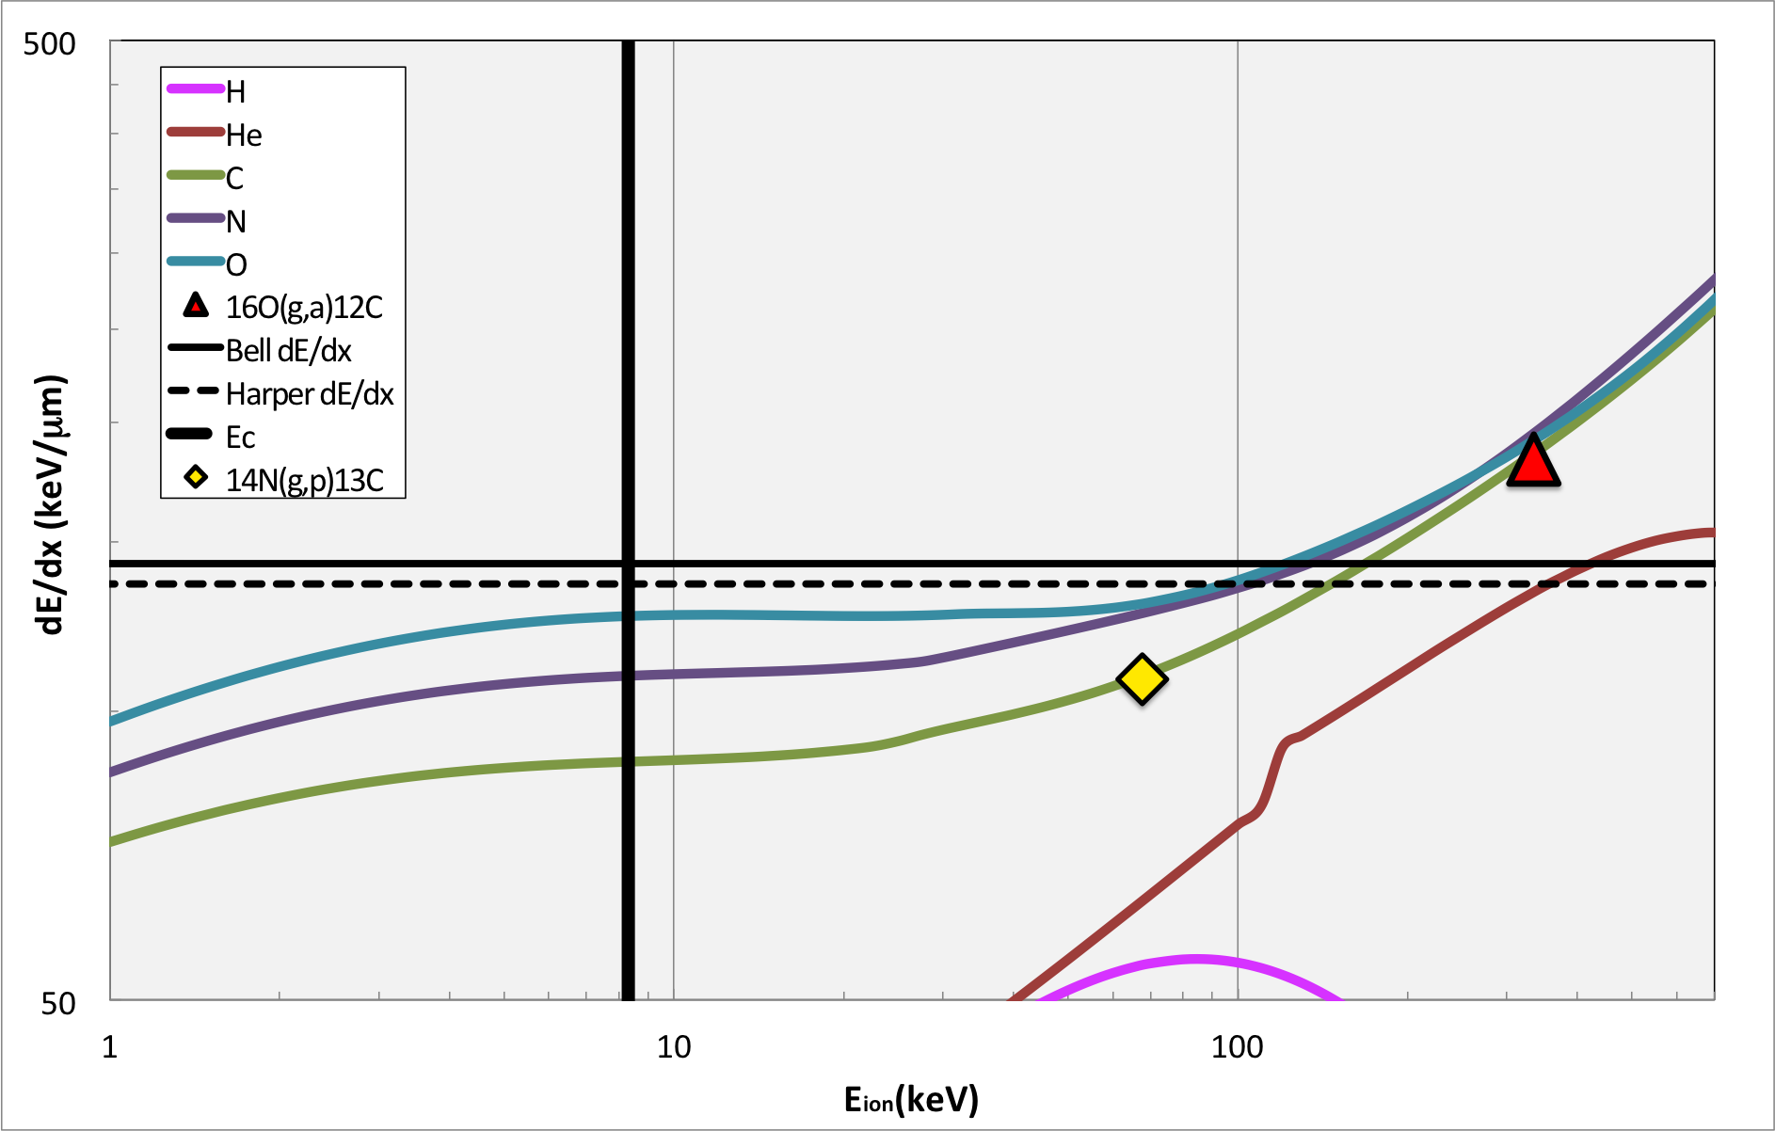
N₂O thresholds, Superheat = 3.3 ^{O}C, Eγ=8.5 MeV

Slide 19
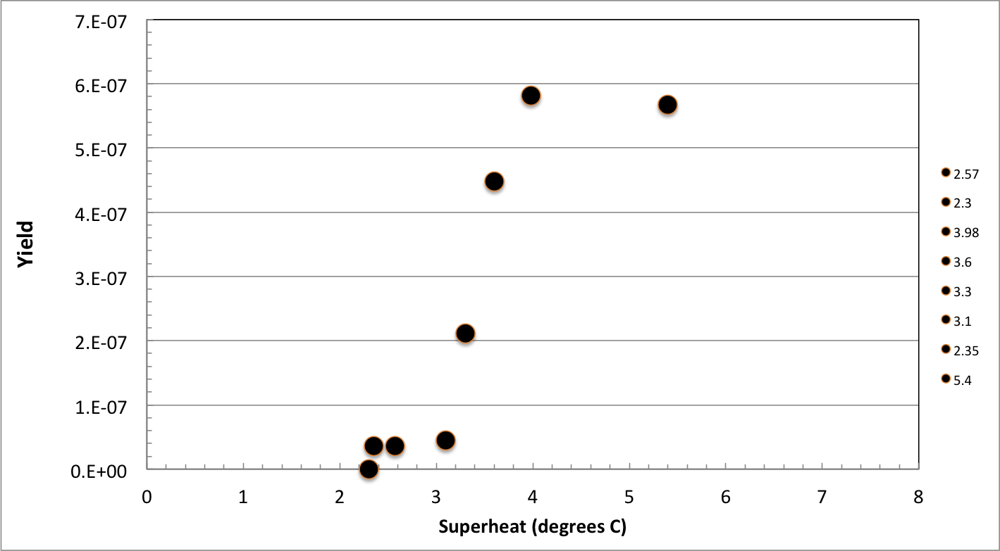
Efficiency Curve
γ+¹⁶O
γ+¹⁴N and γ+¹⁶O
N₂O efficiency curve, HIGS April 2013. E_{γ} = 9.7 MeV
Notes:
Interior Page Design 2

Slide 20
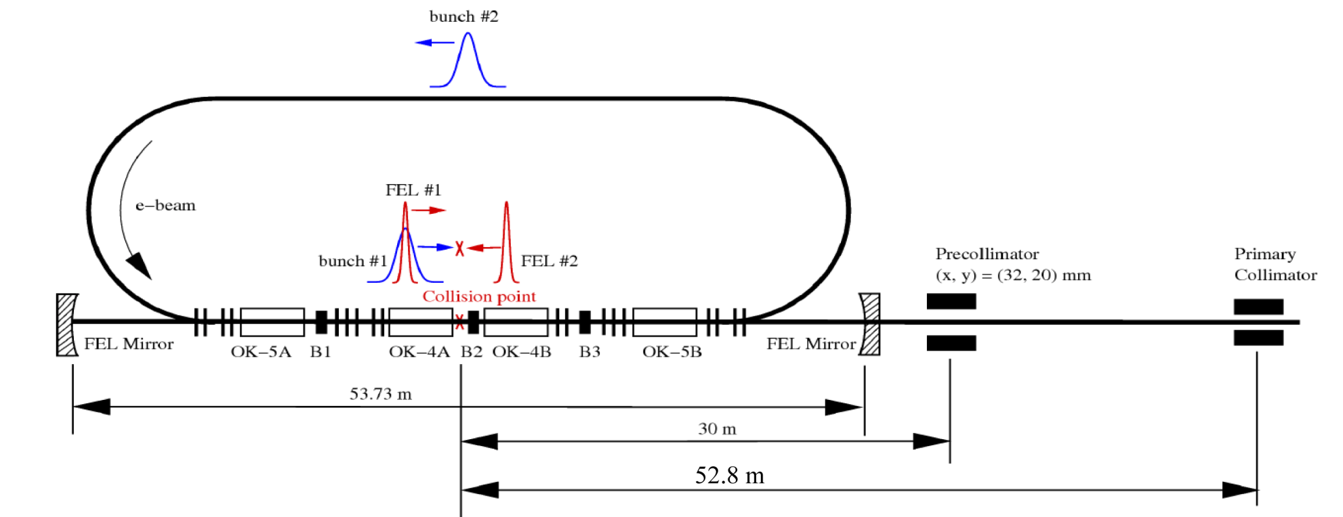
Bubble Chamber at HIGS
γ-rays generated by Compton backscattering of free-electron-laser (FEL) light from high-energy electron beam bunches
Vacuum: 2x10⁻¹⁰ Torr
Electron Beam Energy: 400 MeV
Electron Beam Current: 41 mA
Interaction Length: 35 m
Strong Bremsstrahlung
Background
Notes:
Interior Page Design 2

Slide 21
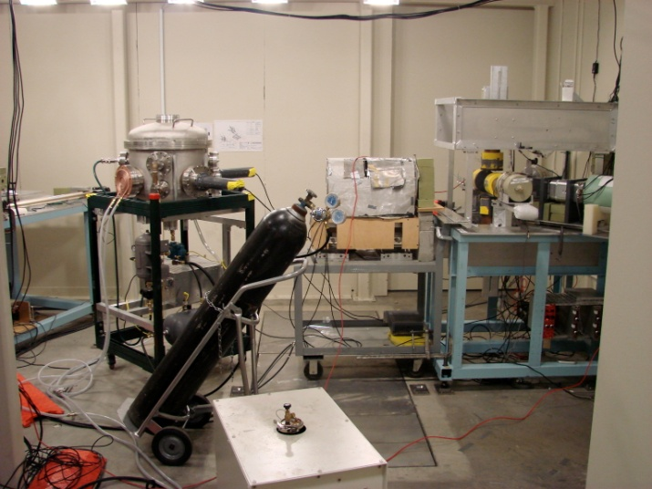
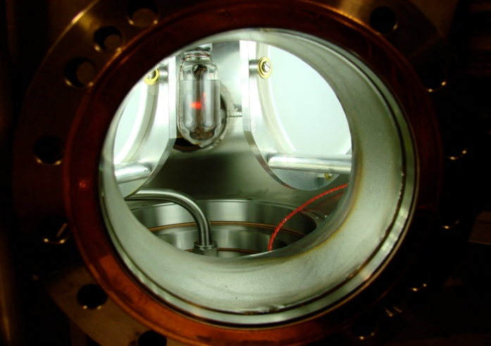
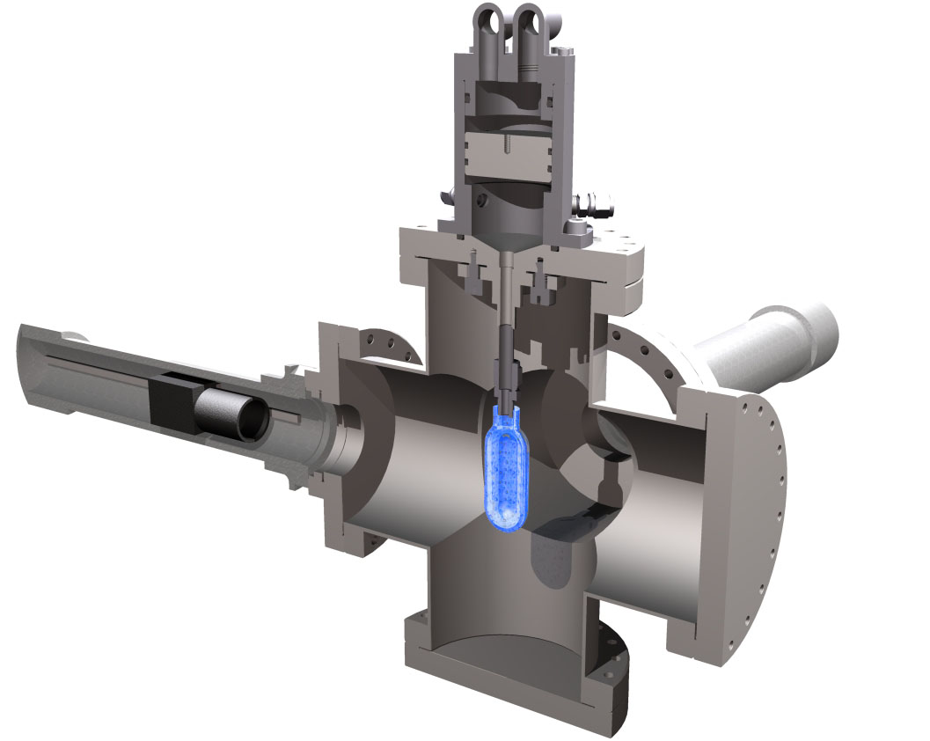
Measuring ¹⁹F(γ,α)¹⁵N at HIGS
2 Fast Cameras
C₄F₁₀ Bubble Chamber
  T=310 K
  P= 160 kPa – 900 kPa
Notes:
Interior Page Design 2

Slide 22
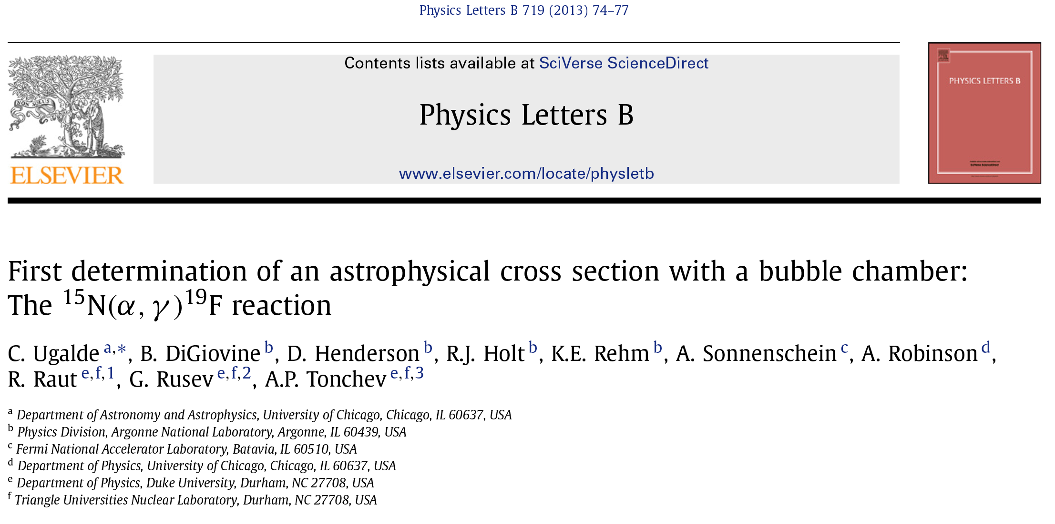
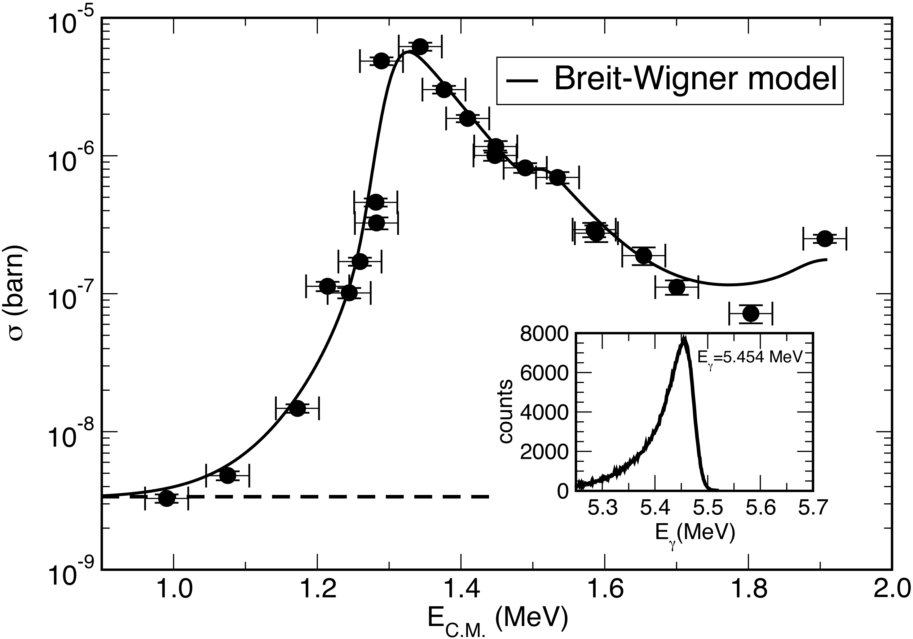
Notes:
Interior Page Design 2

Slide 23
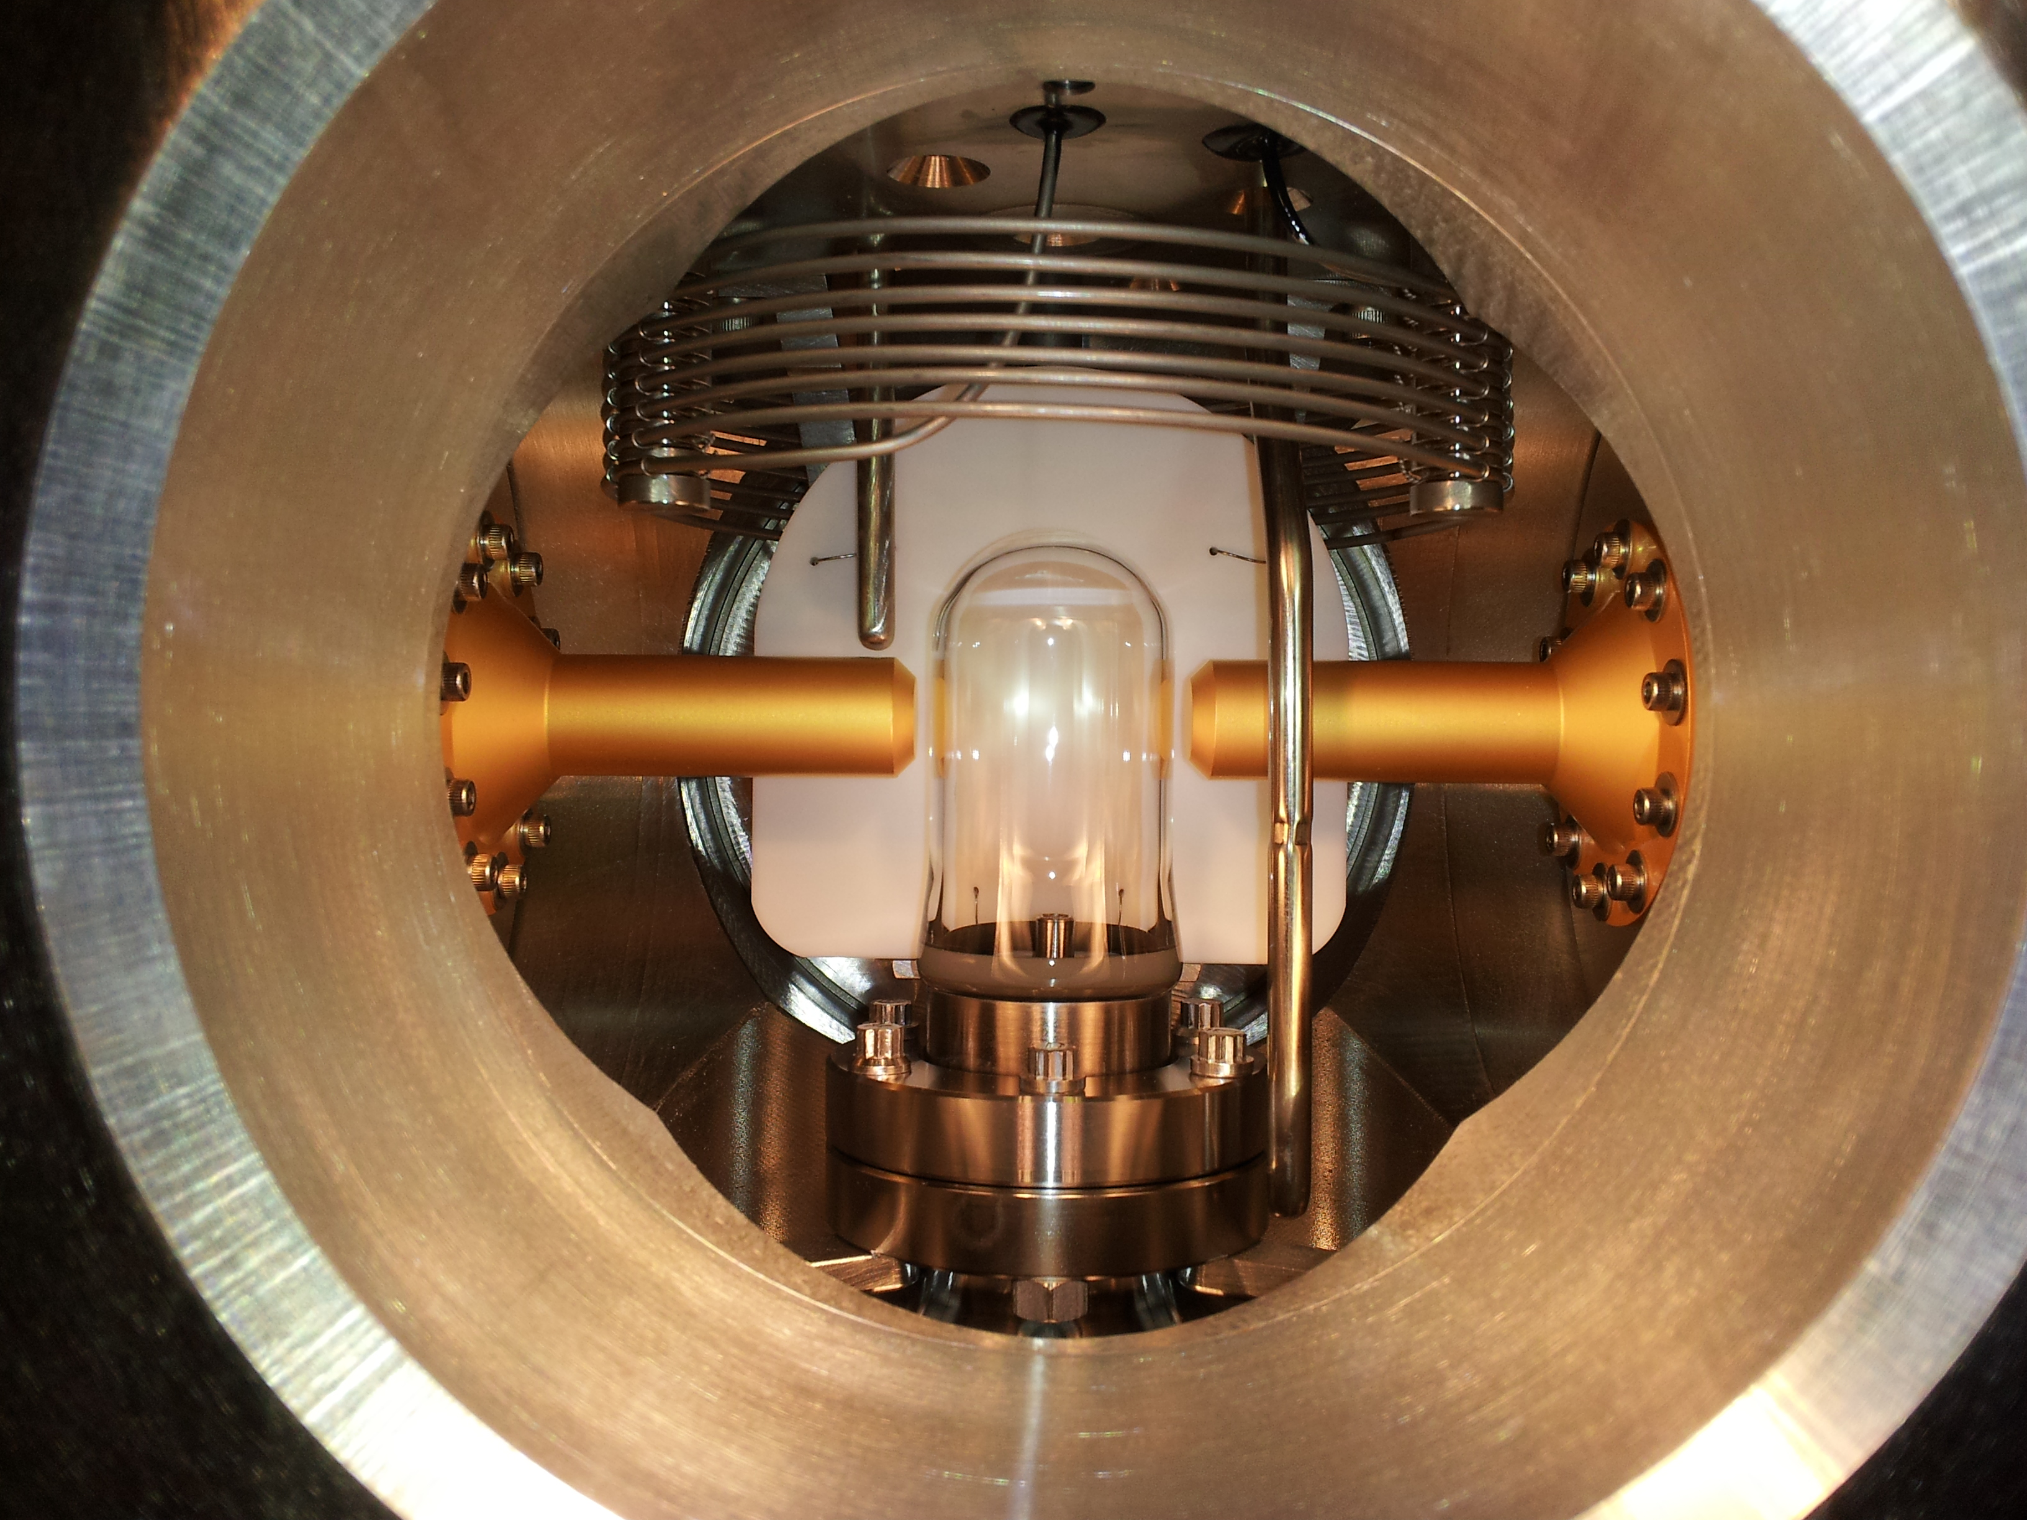
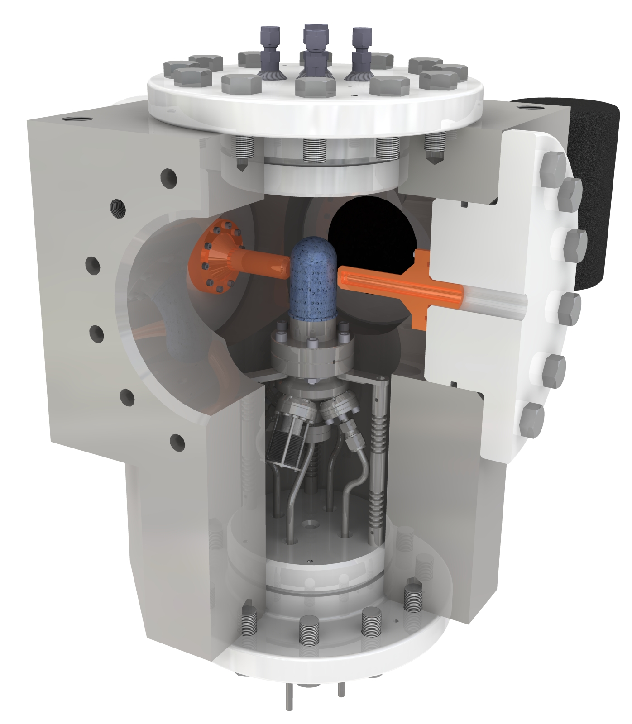
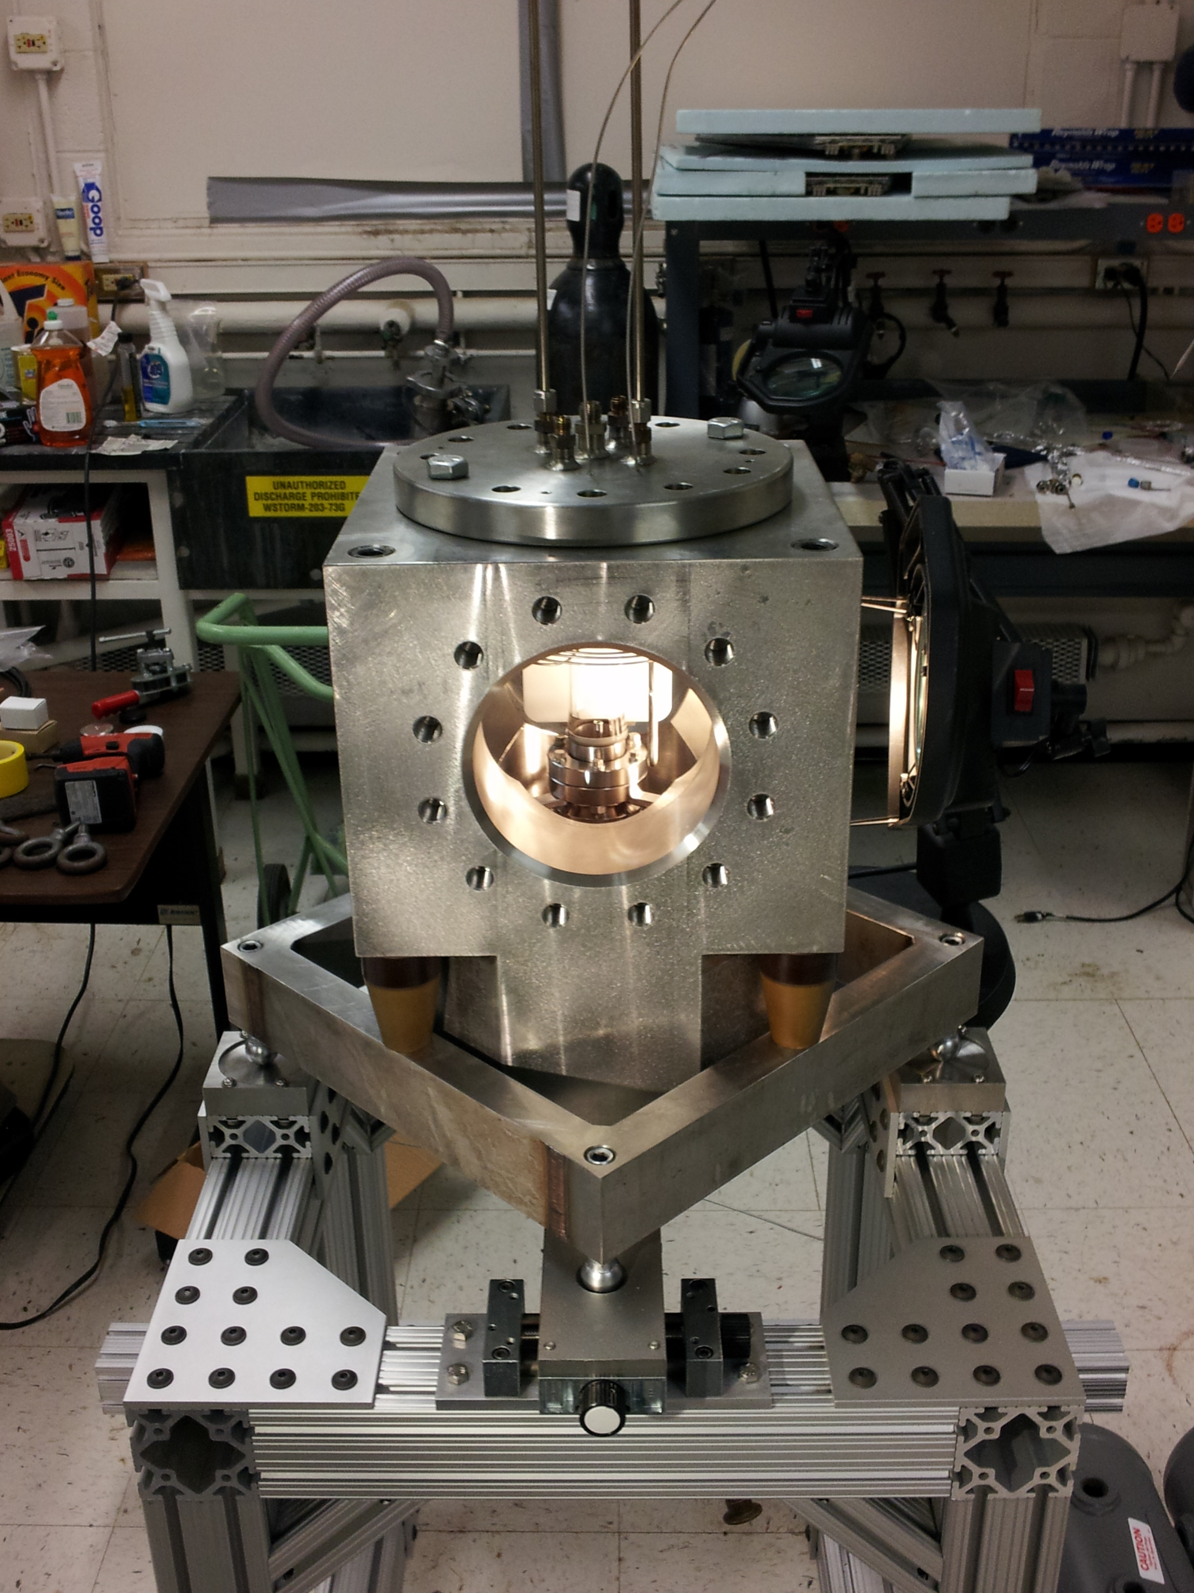

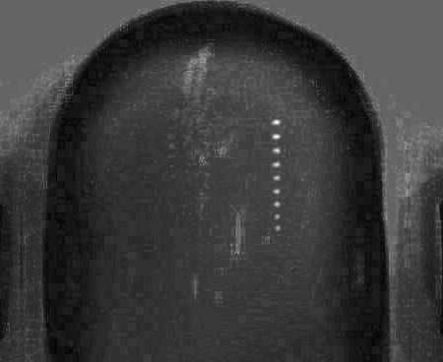
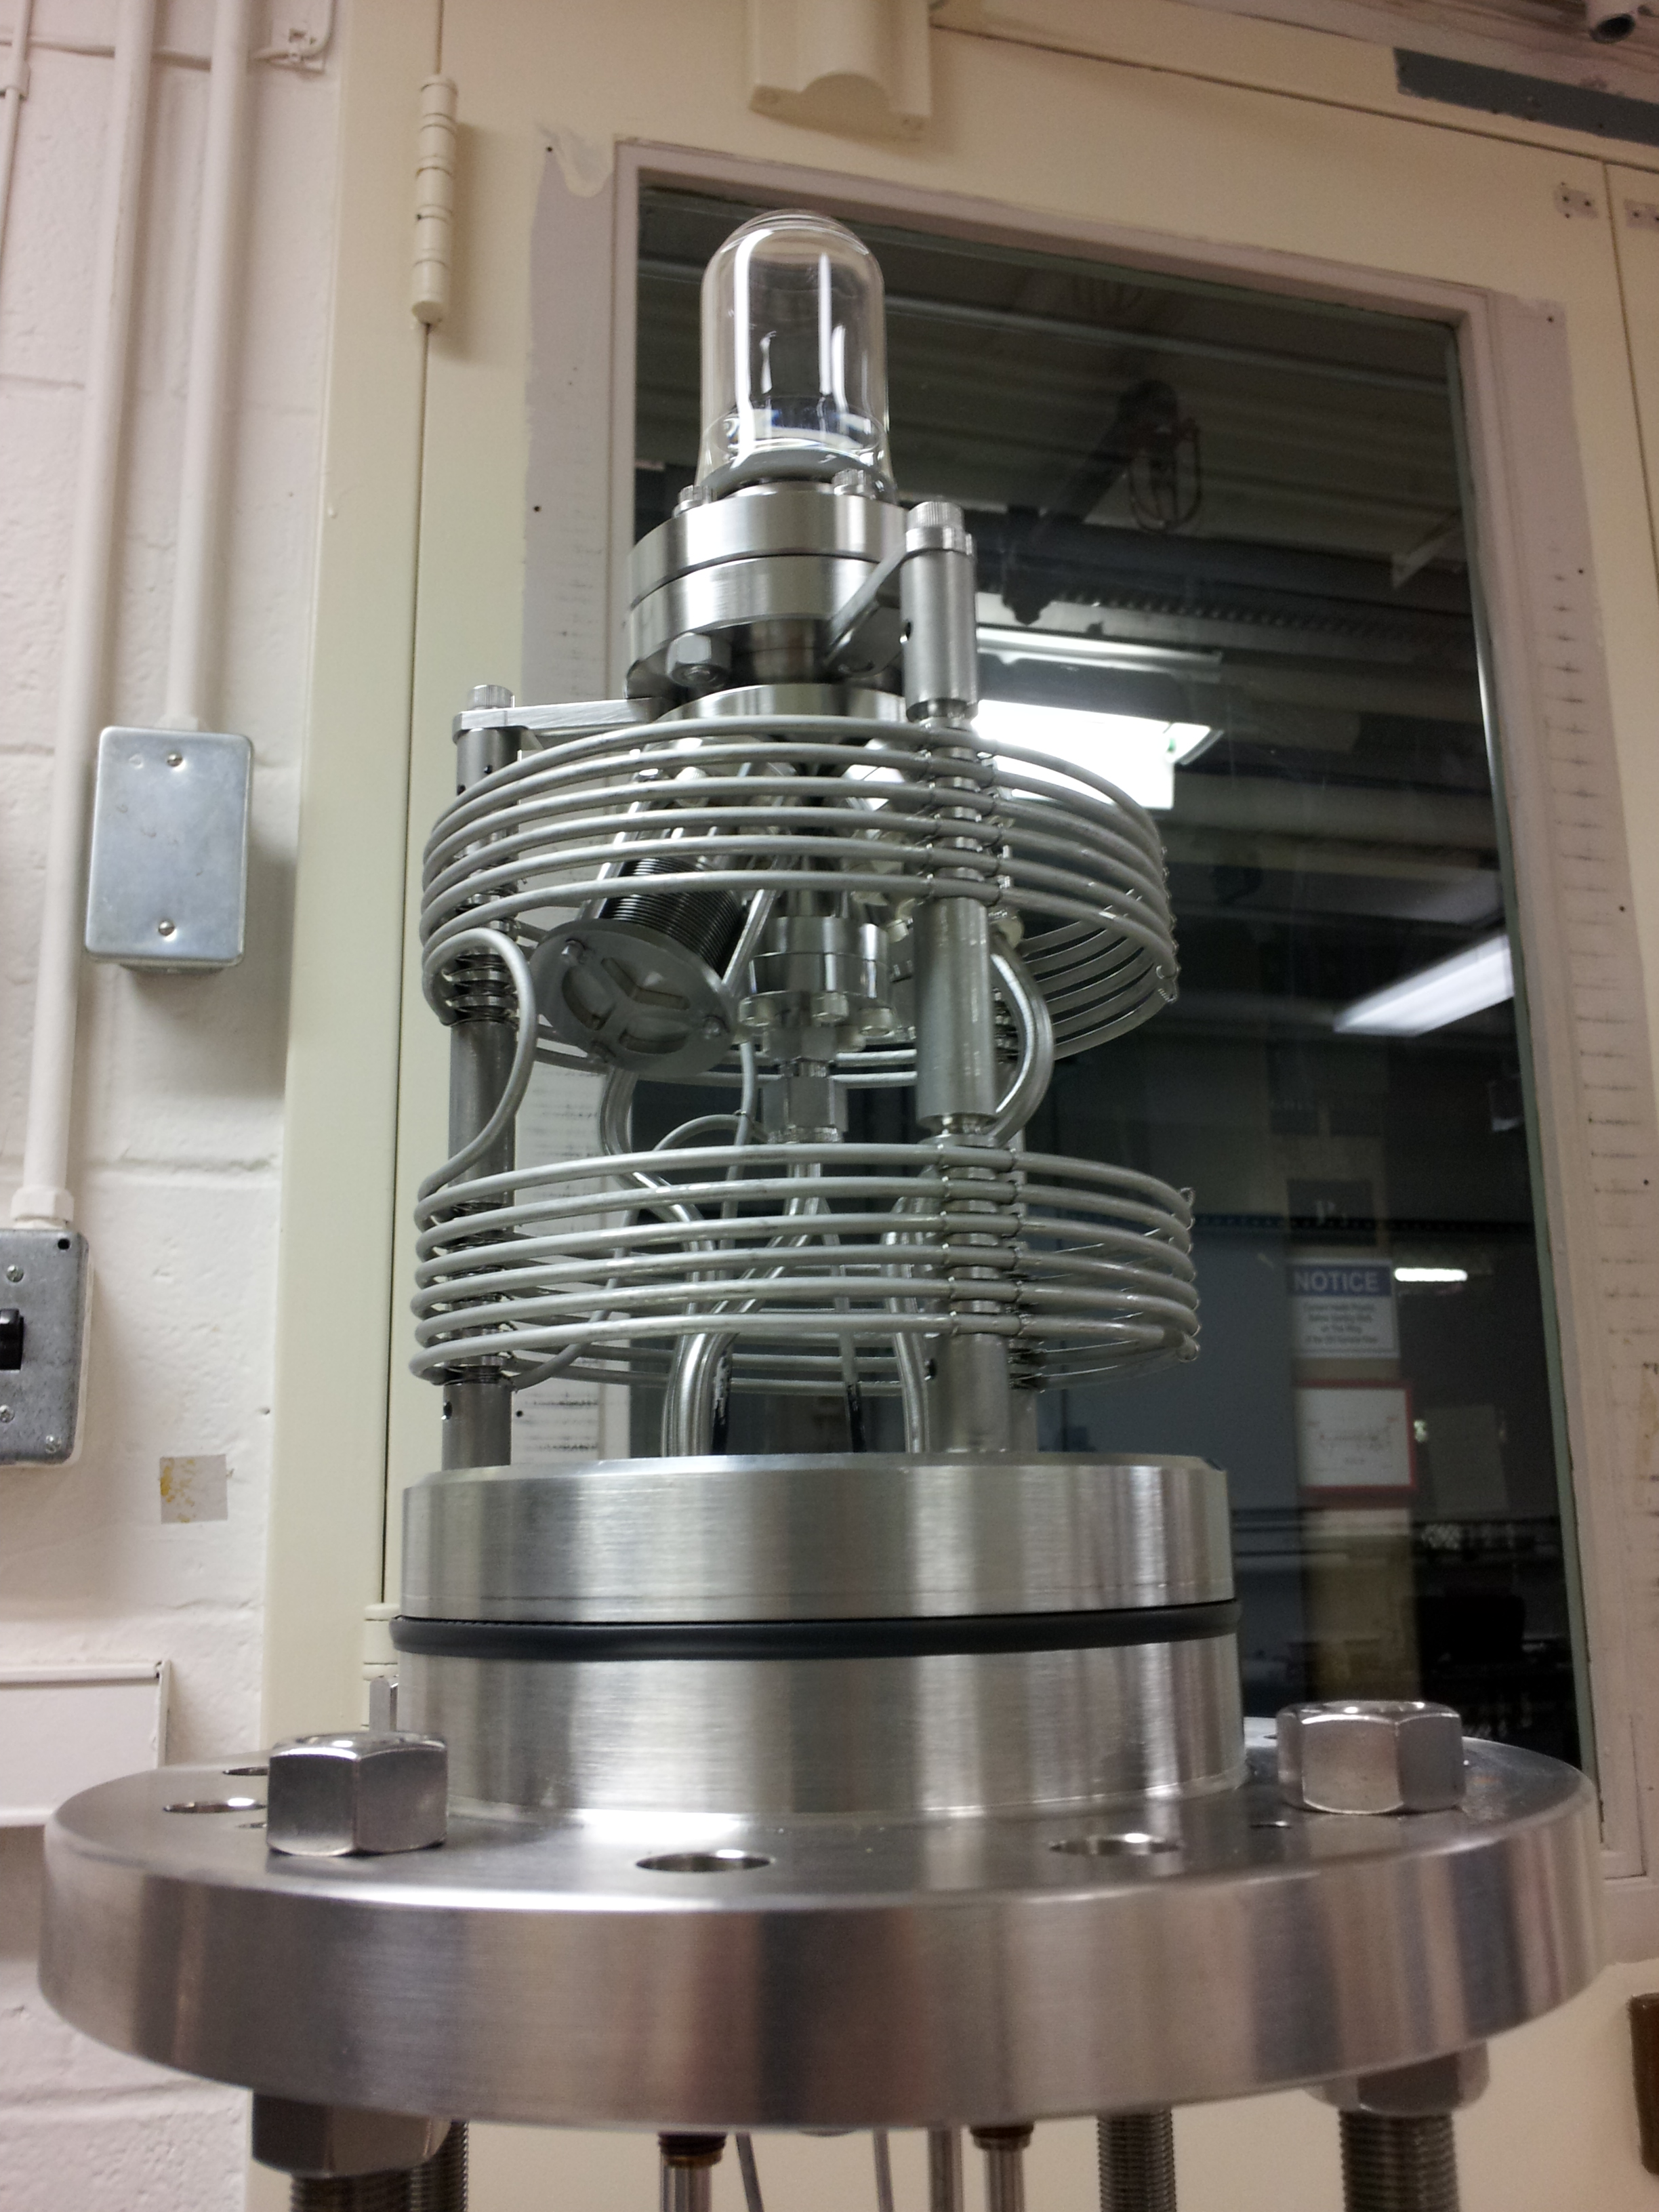
Recent Work
N₂O Bubble Chamber
First γ+O→α+C bubble
April 2013
Notes:
Interior Page Design 2

Slide 24
example
Notes:
Interior Page Design 2

Slide 25
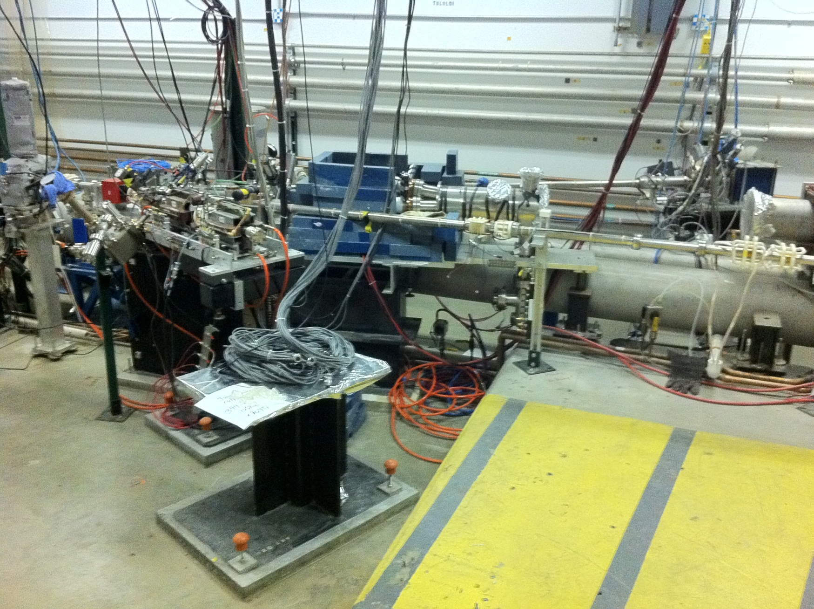
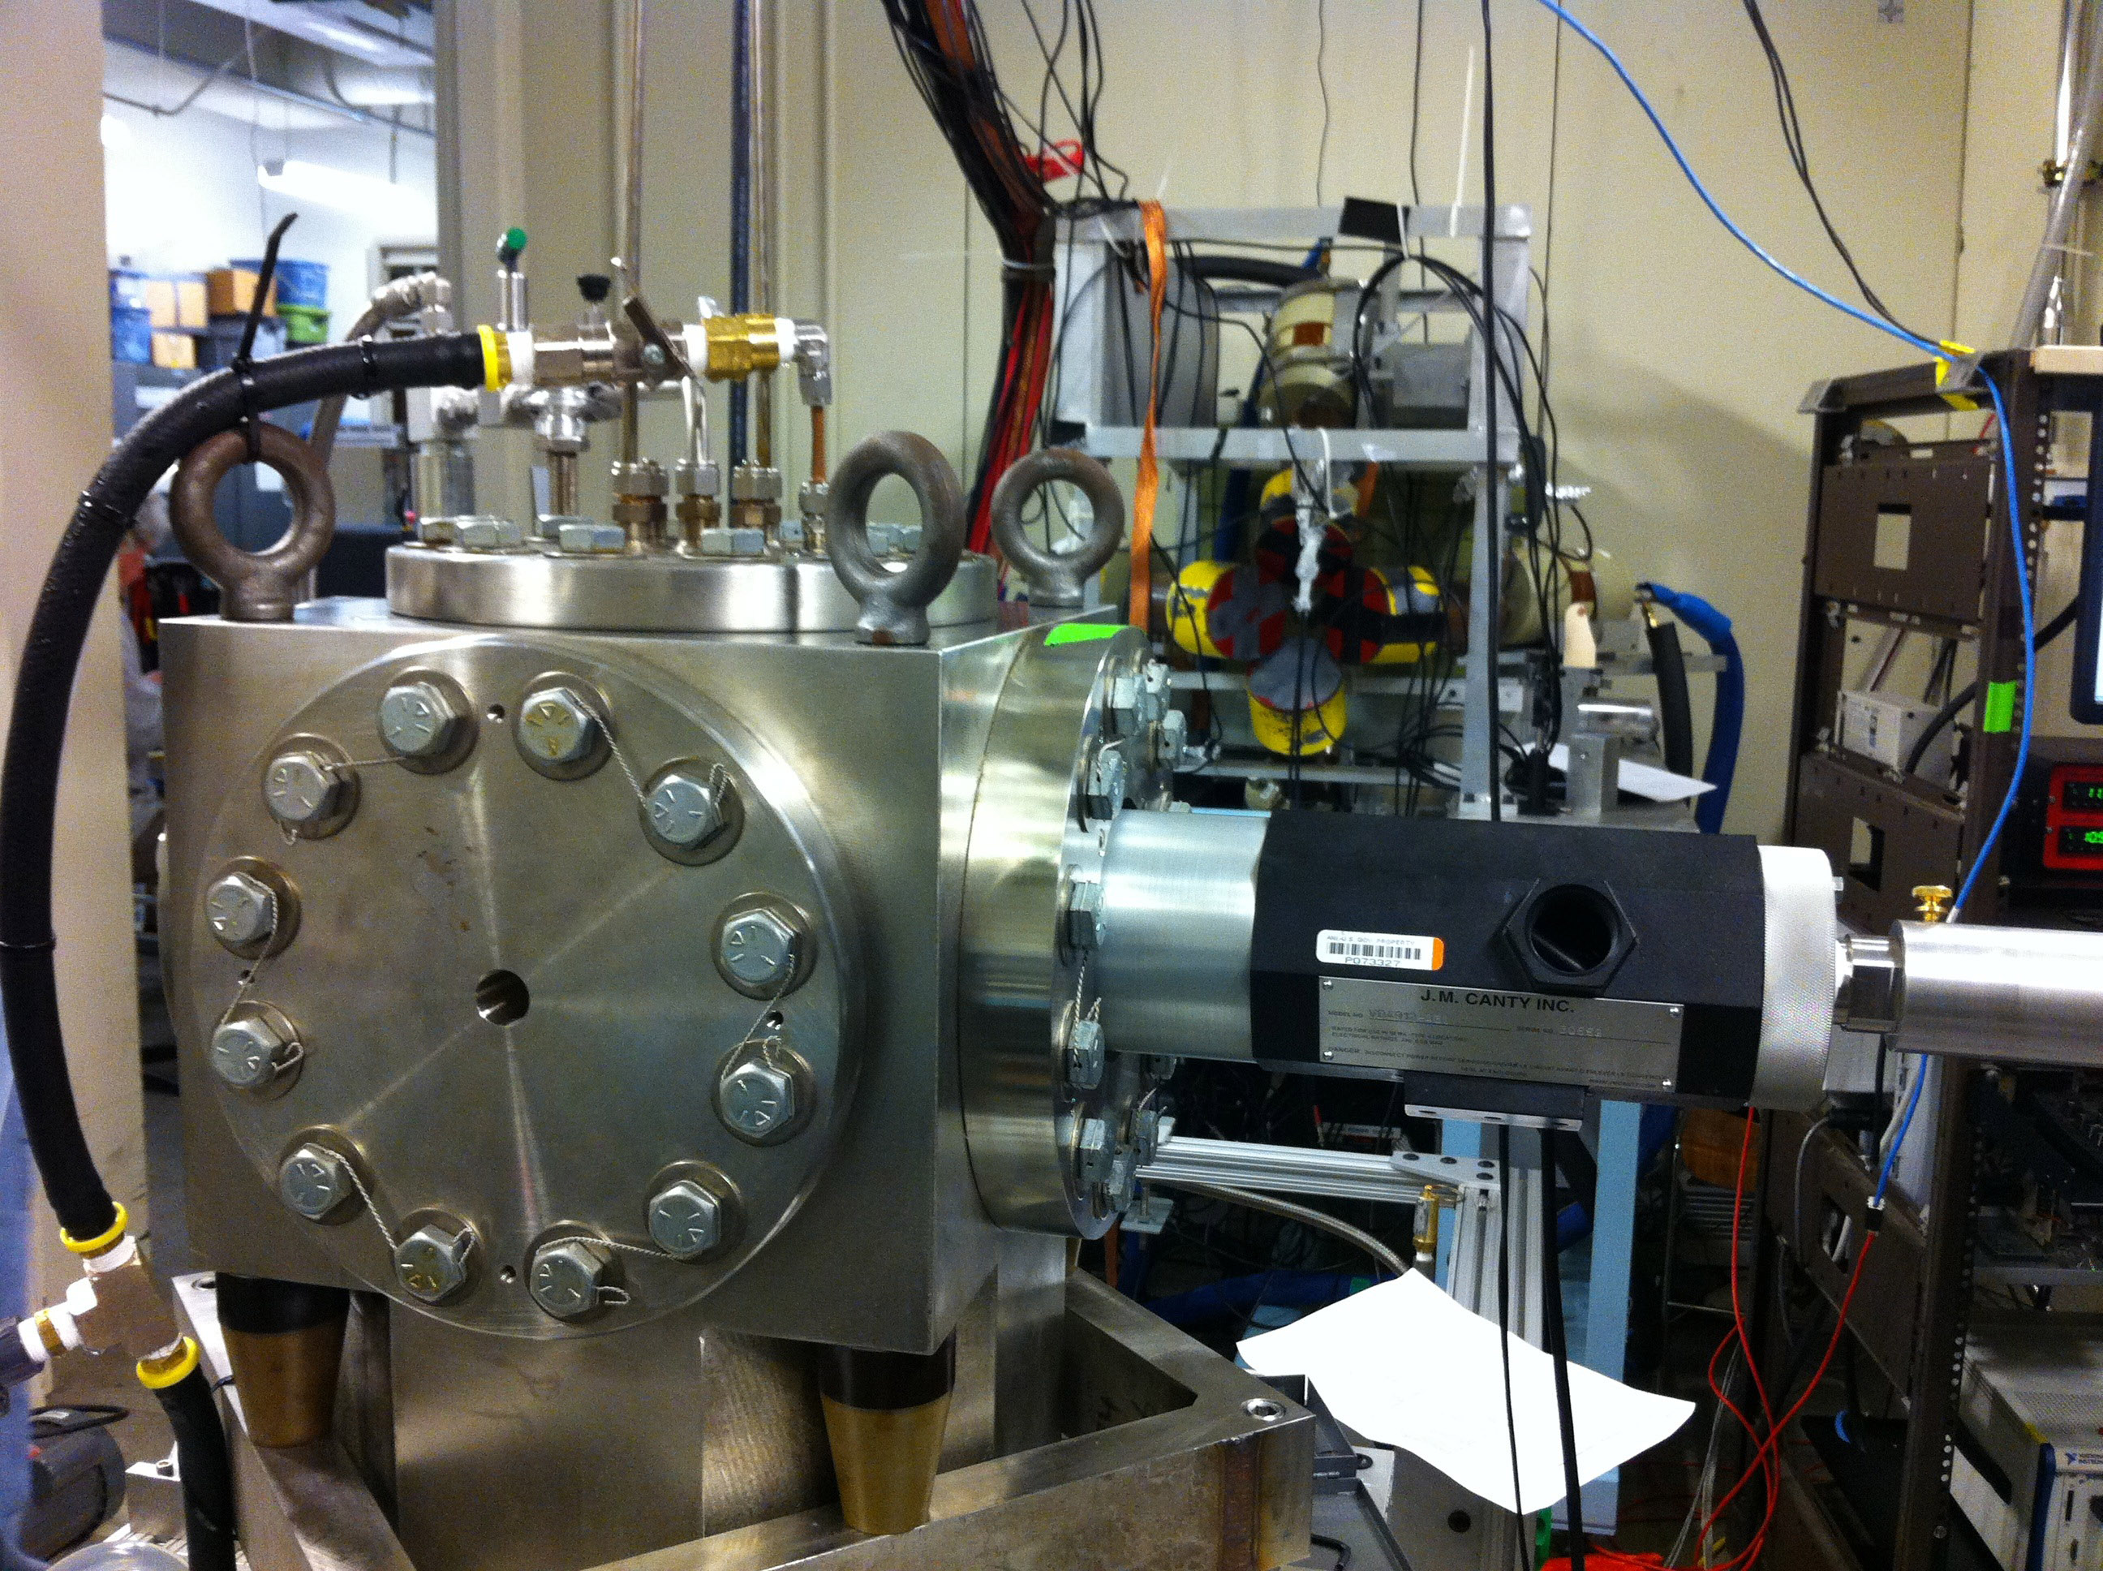
Experimental Setup
BCM
5 MeV
Spectrometer
5 MeV
Dipole
Bubble
Chamber
Beamline
Bubble
Chamber
location
Notes:
Interior Page Design 2

Slide 26
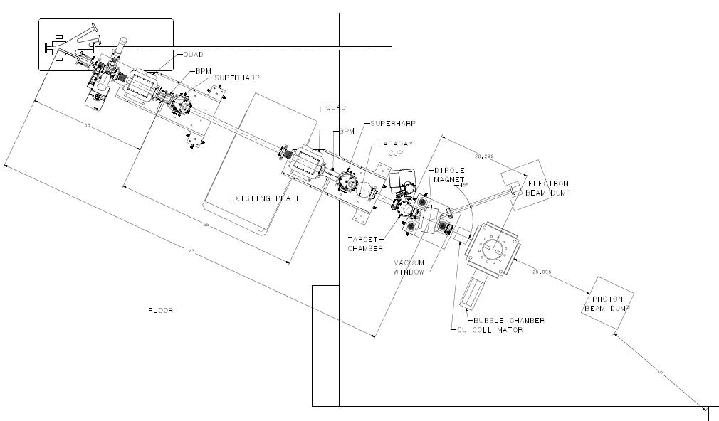
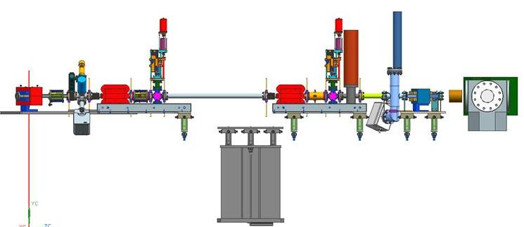
Beamline
2 Super Harps to measure beam profile and absolute beam position
Fast Valve to protect from vacuum failure in front of ¼ Cryo-unit
Notes:
Interior Page Design 2

Slide 27
Schematics
Radiator motion and Sweep Dipole current must be in FSD
BCM0L02 and Electron Dump in Beam Loss Accounting (BLA)
Electron Beam
3.0 – 8.5 MeV
0.01 – 100 µA
Sweep Magnet
Al Photon Dump
10 cm long
20 cm diameter
Cu Vacuum Window 10 mil
Cu Radiator
0.02 mm
Cu Photon
Collimator
20 cm
50 cm
Cu Inner
Pipe
Al Beam Pipe
Bubble Chamber
Superheated N₂O
3 cm long
15°C, 60 atm
Cu Electron Dump
Notes:
Interior Page Design 2

Slide 28
Beam Requirements
Beam Properties at Radiator:
PEPPo achieved p=8.25 MeV/c or K.E.=7.75 MeV. Maximum stable ¼- cryounit cavity gradients achieved: 8.4 MV/m and 6.1 MV/m (7.25 MV/m average). Vacuum in the beam line indicates that field emission and desorbed gas are the most problematic, but improve with processing.
Helium process the ¼-cryounit
Beam Kinetic Energy, (MeV) | 3.0 – 8.5
Beam Current (µA) | 0.01 – 100
Absolute Beam Energy | 0.1%
Relative Beam Energy | 0.05%?
Energy Resolution (Spread), σ_{T} /T | 0.06%
Beam Size, σ_{x,y} (mm) | 1 – 2
Notes:
Interior Page Design 2

Slide 29
Absolute Beam Energy
BPM
5 MeV
Dipole
25°
Electron Beam
Momentum
Notes:
Interior Page Design 2

Slide 30
Absolute beam energy is now known to 1%:
  New larger dipole magnet with better field uniformity
  New and very accurate field map
  Build a detailed TOSCA model
  Add a Hall probe or NMR magnetometer for field monitoring
  Accurate and more stable power supply
  Add mu metal on all beam pipes to shield Earth field
For 8.5 MeV/c: dipole current = 3.3 A, B₀ = 1120 G
Error Budget:
  Bending angle:
  (Δθ/θ) ~ BPM Resolution / distance between BPMs on PEPPo line = 0.5%
  Field uniformity (variation in B across aperture): ΔB/B₀ = 0.5%
  Effective Length: ΔL_{eff}/L_{eff} = 0.13%
  Power supply: ΔI/I = 2 mA / 3.3 A = 0.06%
  Earth field: 0.5 G/ 1116 G = 0.04%
Notes:
Interior Page Design 2

Slide 31
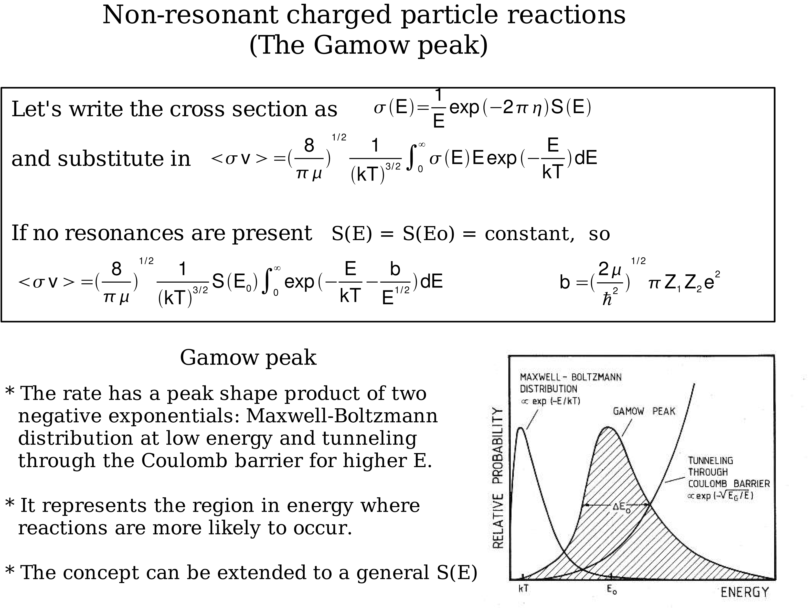

Slide 32
Superheated Liquids
List of superheated liquids to be used in the experiment:
Readout:
  Digital Camera
  Acoustic Signal to discriminate between (γ,α) and (γ,n) events
N₂O Targets | ¹⁶O | ¹⁷O | ¹⁸O
Natural Target | 99.757% | 0.038% | 0.205%
¹⁶O Target |  | Depleted > 5,000 | Depleted > 5,000
¹⁷O Target |  | Enriched > 80% | <1.0%
¹⁸O Target |  | <1.0% | Enriched > 80%

Slide 33
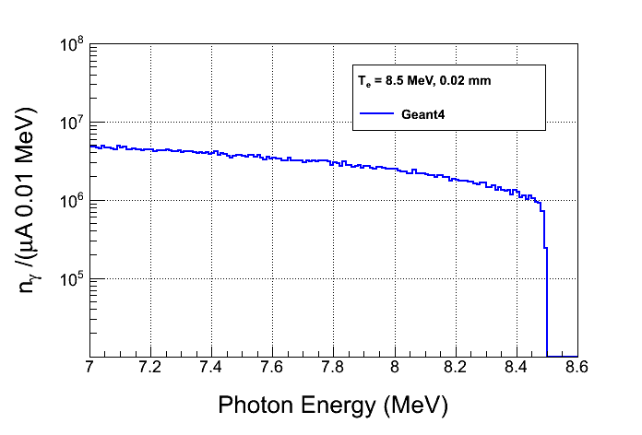
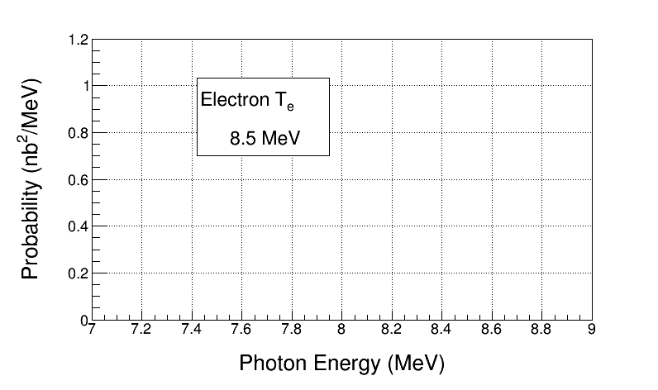
Bremsstrahlung Beam
Notes:
Make the Figure with 7 beam energies.

Slide 34
Penfold-Leiss Cross Section Unfolding
Measure Yields at: where,
The solution can be written in two forms:
Or, Matrix form:

Slide 35
Statistical Error Propagation
Note:
In case of background Subtraction
With:
Then:

Slide 36
Where:
Although,
For mono-chromatic beam

Slide 37
Results
Radiator Thickness = 0.02 mm
Bubble Chamber Thickness = 3.0 cm. Number of ¹⁶O nuclei = 3.474e22 /cm²
Background subtraction of ¹⁸O(γ,α)¹⁴C . ¹⁷O(γ,n)¹⁶O: Still to do
Electron Beam K. E. | Beam Current (µA) | Time (hour) | y_{i} | dy_{i} (no bg) | dy_{i}/y_{i} (no bg, %) | dy_{i} (with bg) | dy_{i}/y_{i} (with bg, %)
7.9 | 100 | 100 | 545 | 23 | 4.2 | 134 | 24.6
8.0 | 100 | 20 | 581 | 24 | 4.1 | 77 | 13.3
8.1 | 80 | 10 | 852 | 29 | 3.4 | 60 | 7.0
8.2 | 20 | 10 | 634 | 25 | 3.9 | 40 | 6.3
8.3 | 10 | 10 | 812 | 28 | 3.4 | 39 | 4.8
8.4 | 4 | 10 | 746 | 27 | 3.6 | 36 | 4.8
8.5 | 2 | 10 | 763 | 28 | 3.7 | 32 | 4.2
Notes:
Interior Page Design 2

Slide 38
Systematic Error Propagation
For absolute beam energy uncertainty of δE (= 0.1%) and zero relative beam energy uncertainty:
E_{i} (MeV) | dy_{i}/y_{i} (%) | dσ_{i}/σ_{i} (%)
7.9 | 12.5 | 12.6
8.0 | 10.8 | 10.5
8.1 | 9.3 | 9.1
8.2 | 8.0 | 7.1
8.3 | 7.0 | 6.3
8.4 | 6.3 | 5.8
8.5 | 5.6 | 5.2
This is the cross section dependence on energy
Accounted for dN_{ij} due to energy error when calculating dy_{i}

Slide 39
With:
Then:

Slide 40
Where:
Note: Correlation Coefficient =1
No point-to-point systematic

Slide 41
Systematic Error Propagation
No point-to-point systematic

Slide 42
Other Relative Systematic Errors
Beam Current, δI/I | 3%
Photon Flux, δφ/φ | 5%
Radiator Thickness, δR/R | 3%
Bubble Chamber Thickness, δT/T | 3%
Bubble Chamber Efficiency, ε | 5%
Simulation
Then:

Slide 43
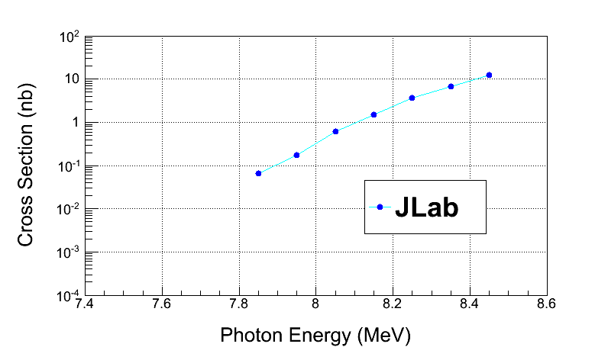
Electron Beam K. E. | Cross Section (nb) | Stat Error (no bg, %) | Stat Error (with bg, %)
7.9 | 0.046 | 4.4 | 24.5
8.0 | 0.185 | 6.0 | 20.7
8.1 | 0.58 | 6.3 | 14.7
8.2 | 1.53 | 8.2 | 13.8
8.3 | 3.49 | 9.1 | 13.3
8.4 | 7.2 | 10.6 | 13.8
8.5 | 13.6 | 12.2 | 14.8
Note: Relative systematic errors do not get amplified in PL Unfolding
Electron Beam K. E. | Cross Section (nb) | Sys Error (Energy, %) | Sys Error (Total, %)
7.9 | 0.046 | 12.5 | 15.3
8.0 | 0.185 | 10.2 | 13.5
8.1 | 0.58 | 8.3 | 12.2
8.2 | 1.53 | 7.0 | 11.4
8.3 | 3.49 | 6.0 | 10.7
8.4 | 7.2 | 5.3 | 10.5
8.5 | 13.6 | 4.7 | 10.1
Notes:
Get the right figure.

Slide 44
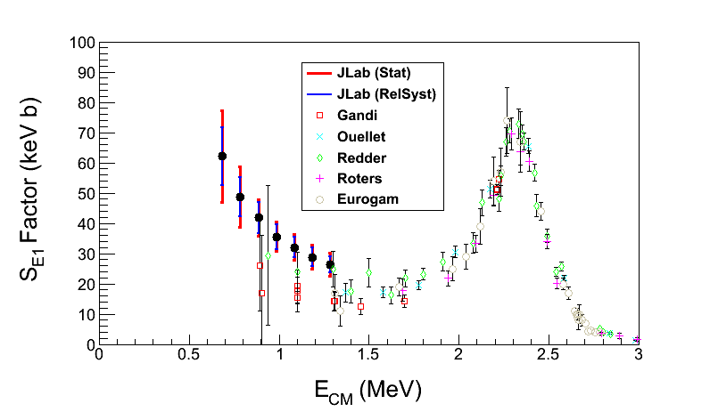
¹²C(α, γ)¹⁶O S-Factor
Statistical Error: dominated by background subtraction from ¹⁸O(γ,α)¹⁴C (depletion = 5,000)
Electron Beam K. E. | Gamma Energy (MeV) | E_{CM} (MeV) | Cross Section (nb) | S_{E1} Factor (keV b) | Stat Error (%) | Sys Error (Total, %)
7.9 | 7.85 | 0.69 | 0.046 | 62.2 | 24.5 | 15.3
8.0 | 7.95 | 0.79 | 0.185 | 48.7 | 20.7 | 13.5
8.1 | 8.05 | 0.89 | 0.58 | 41.8 | 14.7 | 12.2
8.2 | 8.15 | 0.99 | 1.53 | 35.5 | 13.8 | 11.4
8.3 | 8.25 | 1.09 | 3.49 | 32.0 | 13.3 | 10.7
8.4 | 8.35 | 1.19 | 7.2 | 28.8 | 13.8 | 10.5
8.5 | 8.45 | 1.29 | 13.6 | 26.3 | 14.8 | 10.1
S_{E1}(300 keV) = 74±21 keV b

Slide 45
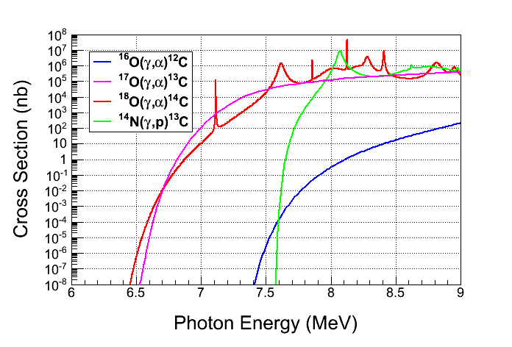
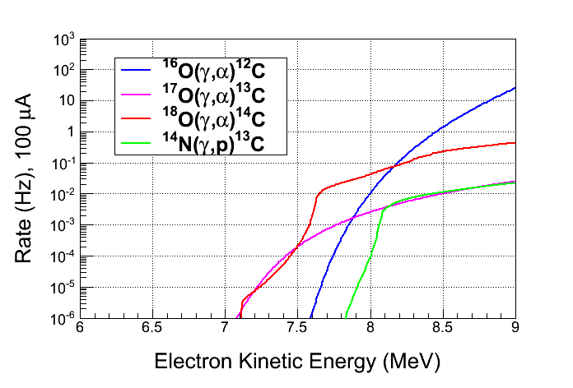
Backgrounds
Background from oxygen
isotopes and nitrogen in N₂O:
  ¹⁸O(γ,α)¹⁴C
  ¹⁷O(γ,α)¹³C
  ¹⁴N(γ,p)¹³C
Natural Abundance:
    ¹⁷O: 0.038%
    ¹⁸O: 0.205%
Expected Rates:
  ¹⁷O(γ,α)¹³C, depletion=5,000
  ¹⁸O(γ,α)¹⁴C, depletion=5,000
  ¹⁴N(γ,p)¹³C, detection eff.= 10⁻⁸
Notes:
Interior Page Design 2

Slide 46
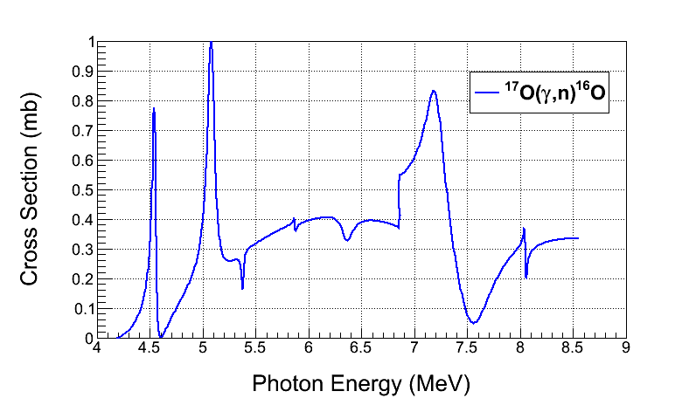
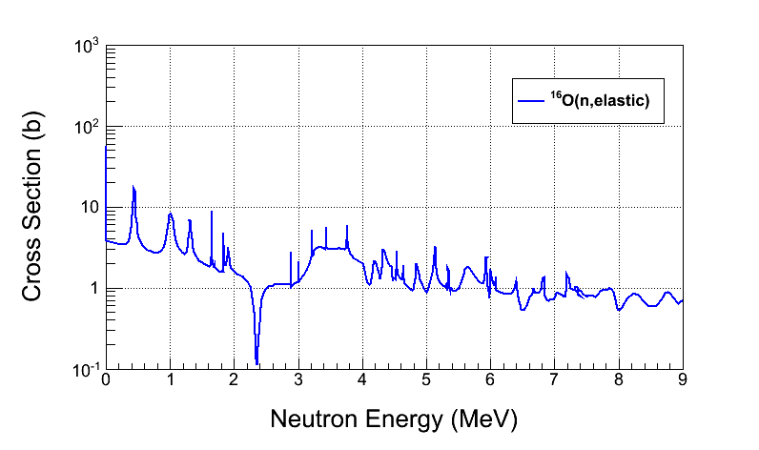
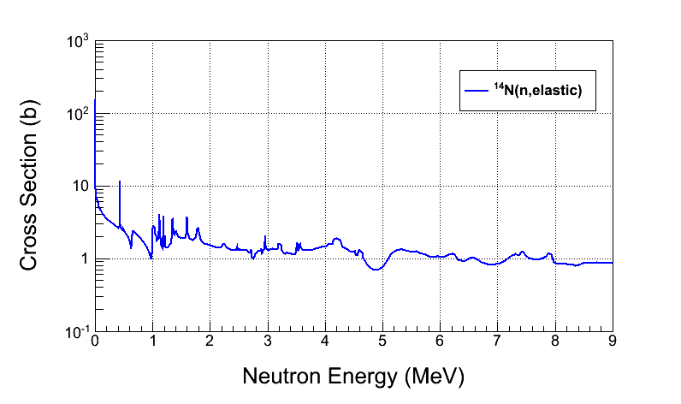
Background from:
  ¹⁷O(γ,n)¹⁶O
Cosmic-ray background:
  µ±-nuclear
  Secondary neutron-nuclear
Reject neutron background using
the acoustic signal (500 factor)
Notes:
Interior Page Design 2

Slide 47
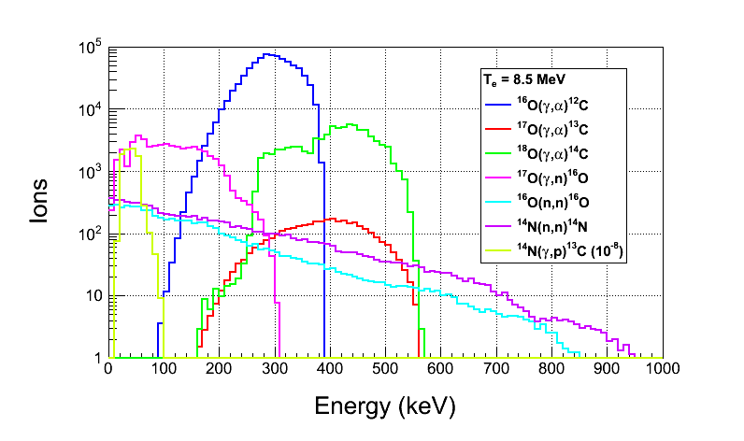
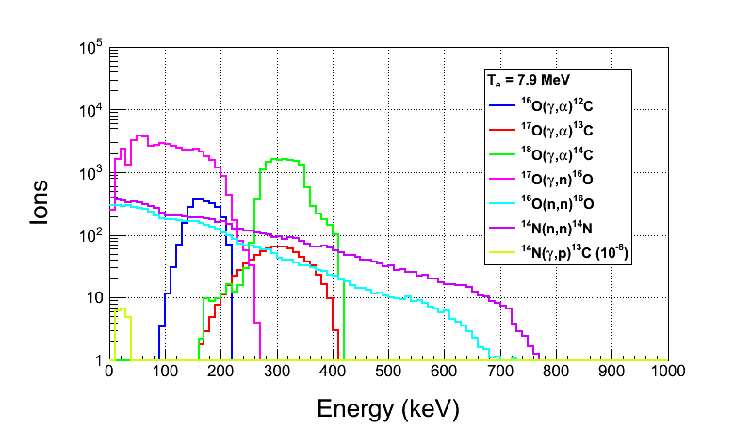
Ion Energy Distributions
Suppress background
with Bubble Chamber threshold
Calculated with Depletion:
  ¹⁷O depletion=5,000
  ¹⁸O depletion=5,000
Threshold Efficiency (function
of superheat):
Particle | Efficiency
e± | <10⁻¹¹
γ | <10⁻¹¹
(γ,n) | 2x10⁻³
Notes:
Interior Page Design 2

Slide 48
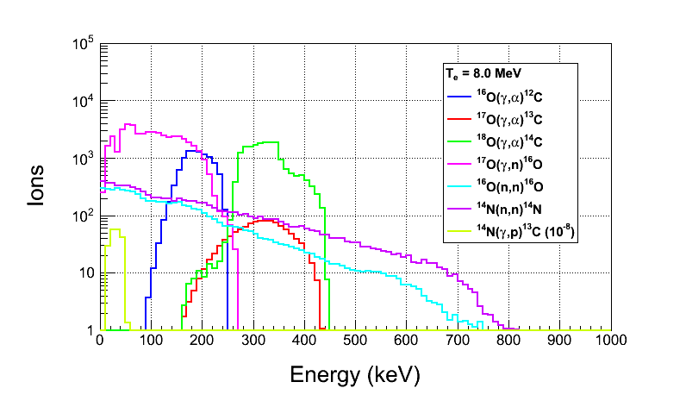
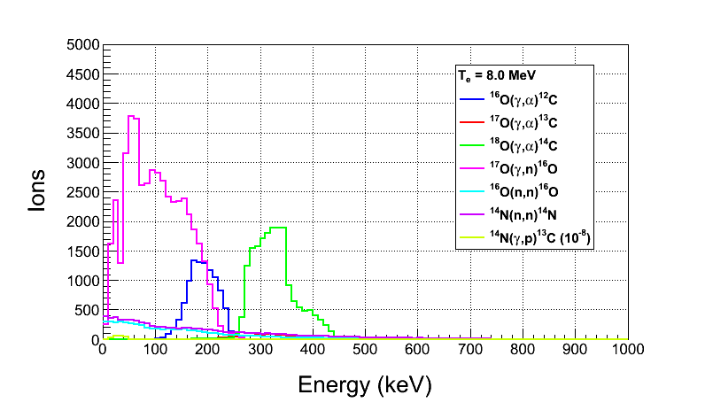
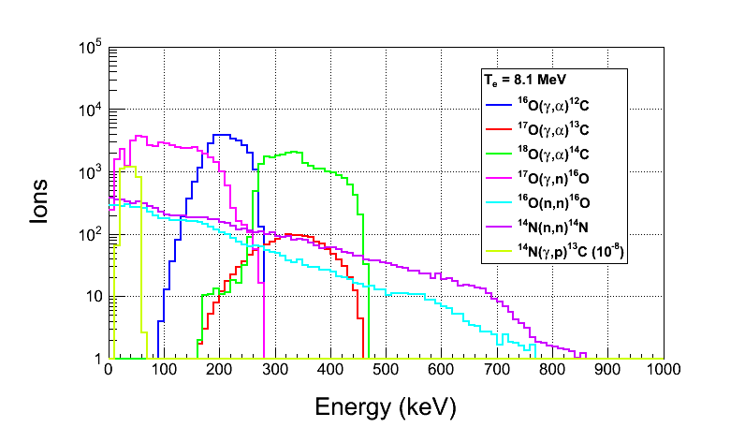
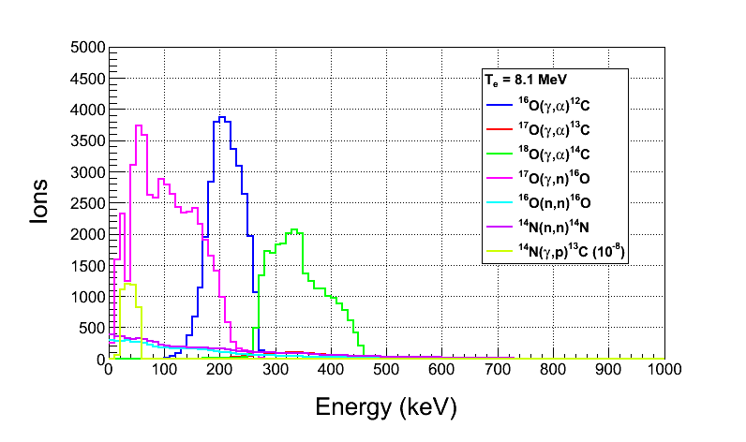
Notes:
Interior Page Design 2

Slide 49
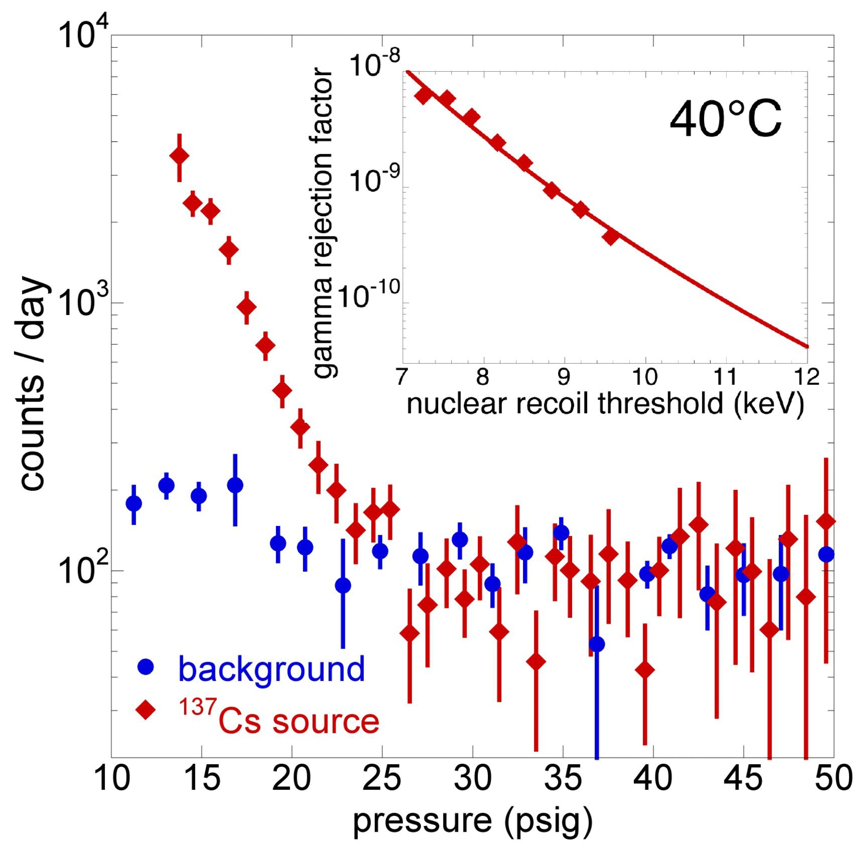
Gamma suppression
COUPP exp. FNAL

Slide 50
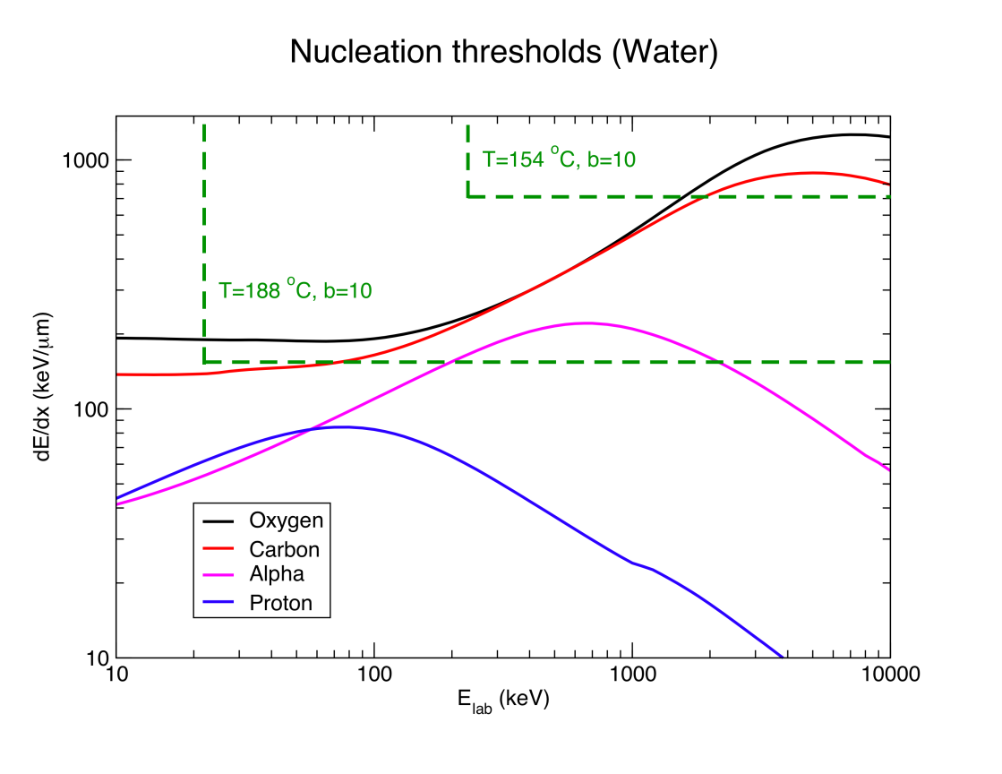

Bubble chamber basics

Slide 52

C₄F₁₀ bubble chamber for JLab
Buffer fluid fill valve
Target fill port
Secondary
containment vessel
Accumulator
Instrumentation and
Relief valve manifold
Fast CCD camera housing
Target cell
C₄F₁₀
180 psi max
Photon beam
entrance window
Buffer fluid
N₂ pressure inlet
Pressure amplifier
Courtesy of B. DiGiovine

Slide 53

Safety
Super heated liquid N₂O, Nitrous oxide (laughing gas)
  At room temperature, it is a colorless, non-flammable gas, with a slightly sweet odor and taste
High pressure system:
  Design Authority: Dave Meekins
  T=
  P=
Buffer liquid: Mercury
  Closed system
  Volume: 135 mL
0
2
0
OX
0
3
0
Notes:
Interior Page Design 2

Slide 54
Summary and Outlook
Test N₂O Bubble Chamber at HIγS (February 2014)
Perform ¹⁸O(γ,α)¹⁴C and ¹⁷O(γ,α)¹³C experiments at HIγS (Summer 2014)
Test Bubble Chamber at JLab with Bremsstrahlung beam (October 2014)
If successful, run depleted N₂O bubble chamber at JLab ¹⁶O(γ,α)¹²C
Bubble Chamber issues:
  Piezo-electric acoustical signal
  10 sec deadtime -> 2 sec deadtime
Background tests:
  Measure cosmic-ray background
  Study chamber efficiency vs. superheat
Notes:
Interior Page Design 1

Slide 55
Backup Slides
Notes:
Interior Page Design 1

Slide 56
Cost Estimate
New beamline components:
  New Dipole Magnet and Hall Probe
  2 Super Harps
  Fast Valve
Summary of labor cost by group:
Group | Labor
Survey & Alignment | 3 wks x 2
Magnet Test | 1 wk x 2
Engineering Design | 16 wks
Software | 3 wks x 2
EES | 6 wk x 2
EH&Q | 4 wks
Notes:
Interior Page Design 1

Slide 57
Item | Material Procurement | Shop | Labor
New Dipole Magnet | Dipole Magnet ($8,000) Hall Probe System ($10,000) |  | Design (2 week) Mapping (1 week) EESDC (1 week) Alignment (2 days)
New Beamline | 2 Super Harps (20,000) Fast Valve ($23,000) | Pipes + Pedestals ($20,000) | Design (6 weeks) Alignment (1 week) Software (6 weeks) EES (6 weeks)
Radiator (cooled ladder, FSD) | 0.02 and 0.10 mm Cu foils ($2,000) | $4,000 | Design (2 week) Alignment (2 days)
Sweep Dipole
Electron Dump | Pure Cu ($5,000) | Dump + Pipes ($15,000) | Design (4 weeks) Alignment (1 day)
Cu Collimator | Pure Cu ($5,000) | Collimator + Stand ($5,000) | Design (1 week) Alignment (1 day)
Photon Dump & Stand | Pure Al ($3,000) | $4,000 | Design (1 week) Alignment (1 day)
Safety Review |  |  | 4 weeks
Install |  |  | 6 weeks
Bubble Chamber |  |  | Alignment (1 week)
Total | $76,000 | $48,000 | $80,000
Indirect G&A (55.65%) | $42,300 | $26,400 | $42,500
Indirect Stat & Fringe (57.15%) |  |  | $45,700
Total | $118,300 | $74,400 | $168,200
Notes:
Accelerator is paying for magnet and Hall Probe.
Accelerator will pay for Fast Valve and its electronics.

Slide 58



CO₂ Superheated Liquid?
Natural Abundance: ¹³C: 1.07%
Depletion: ¹³C depletion=1,000
¹³C(γ,n)¹²C Background
For comparison, ¹⁷O(γ,n)¹⁶O
¹²C(γ,2α)α Background
Notes:
The acoustic signal will suppress neutron events (?). What is the expected background from 3-alpha?

Slide 59
Water Superheated Liquid?
etching of glass due to HF.
Notes:
With the Mercury as a buffer liquid, can we go back to water?

