Slide 1

Measurement of ¹⁶O(γ,α)¹²C with a Bubble Chamber and a Bremsstrahlung Beam at Jefferson Lab Injector
Riad Suleiman
January 9, 2014
Notes:
Title Page

Slide 2
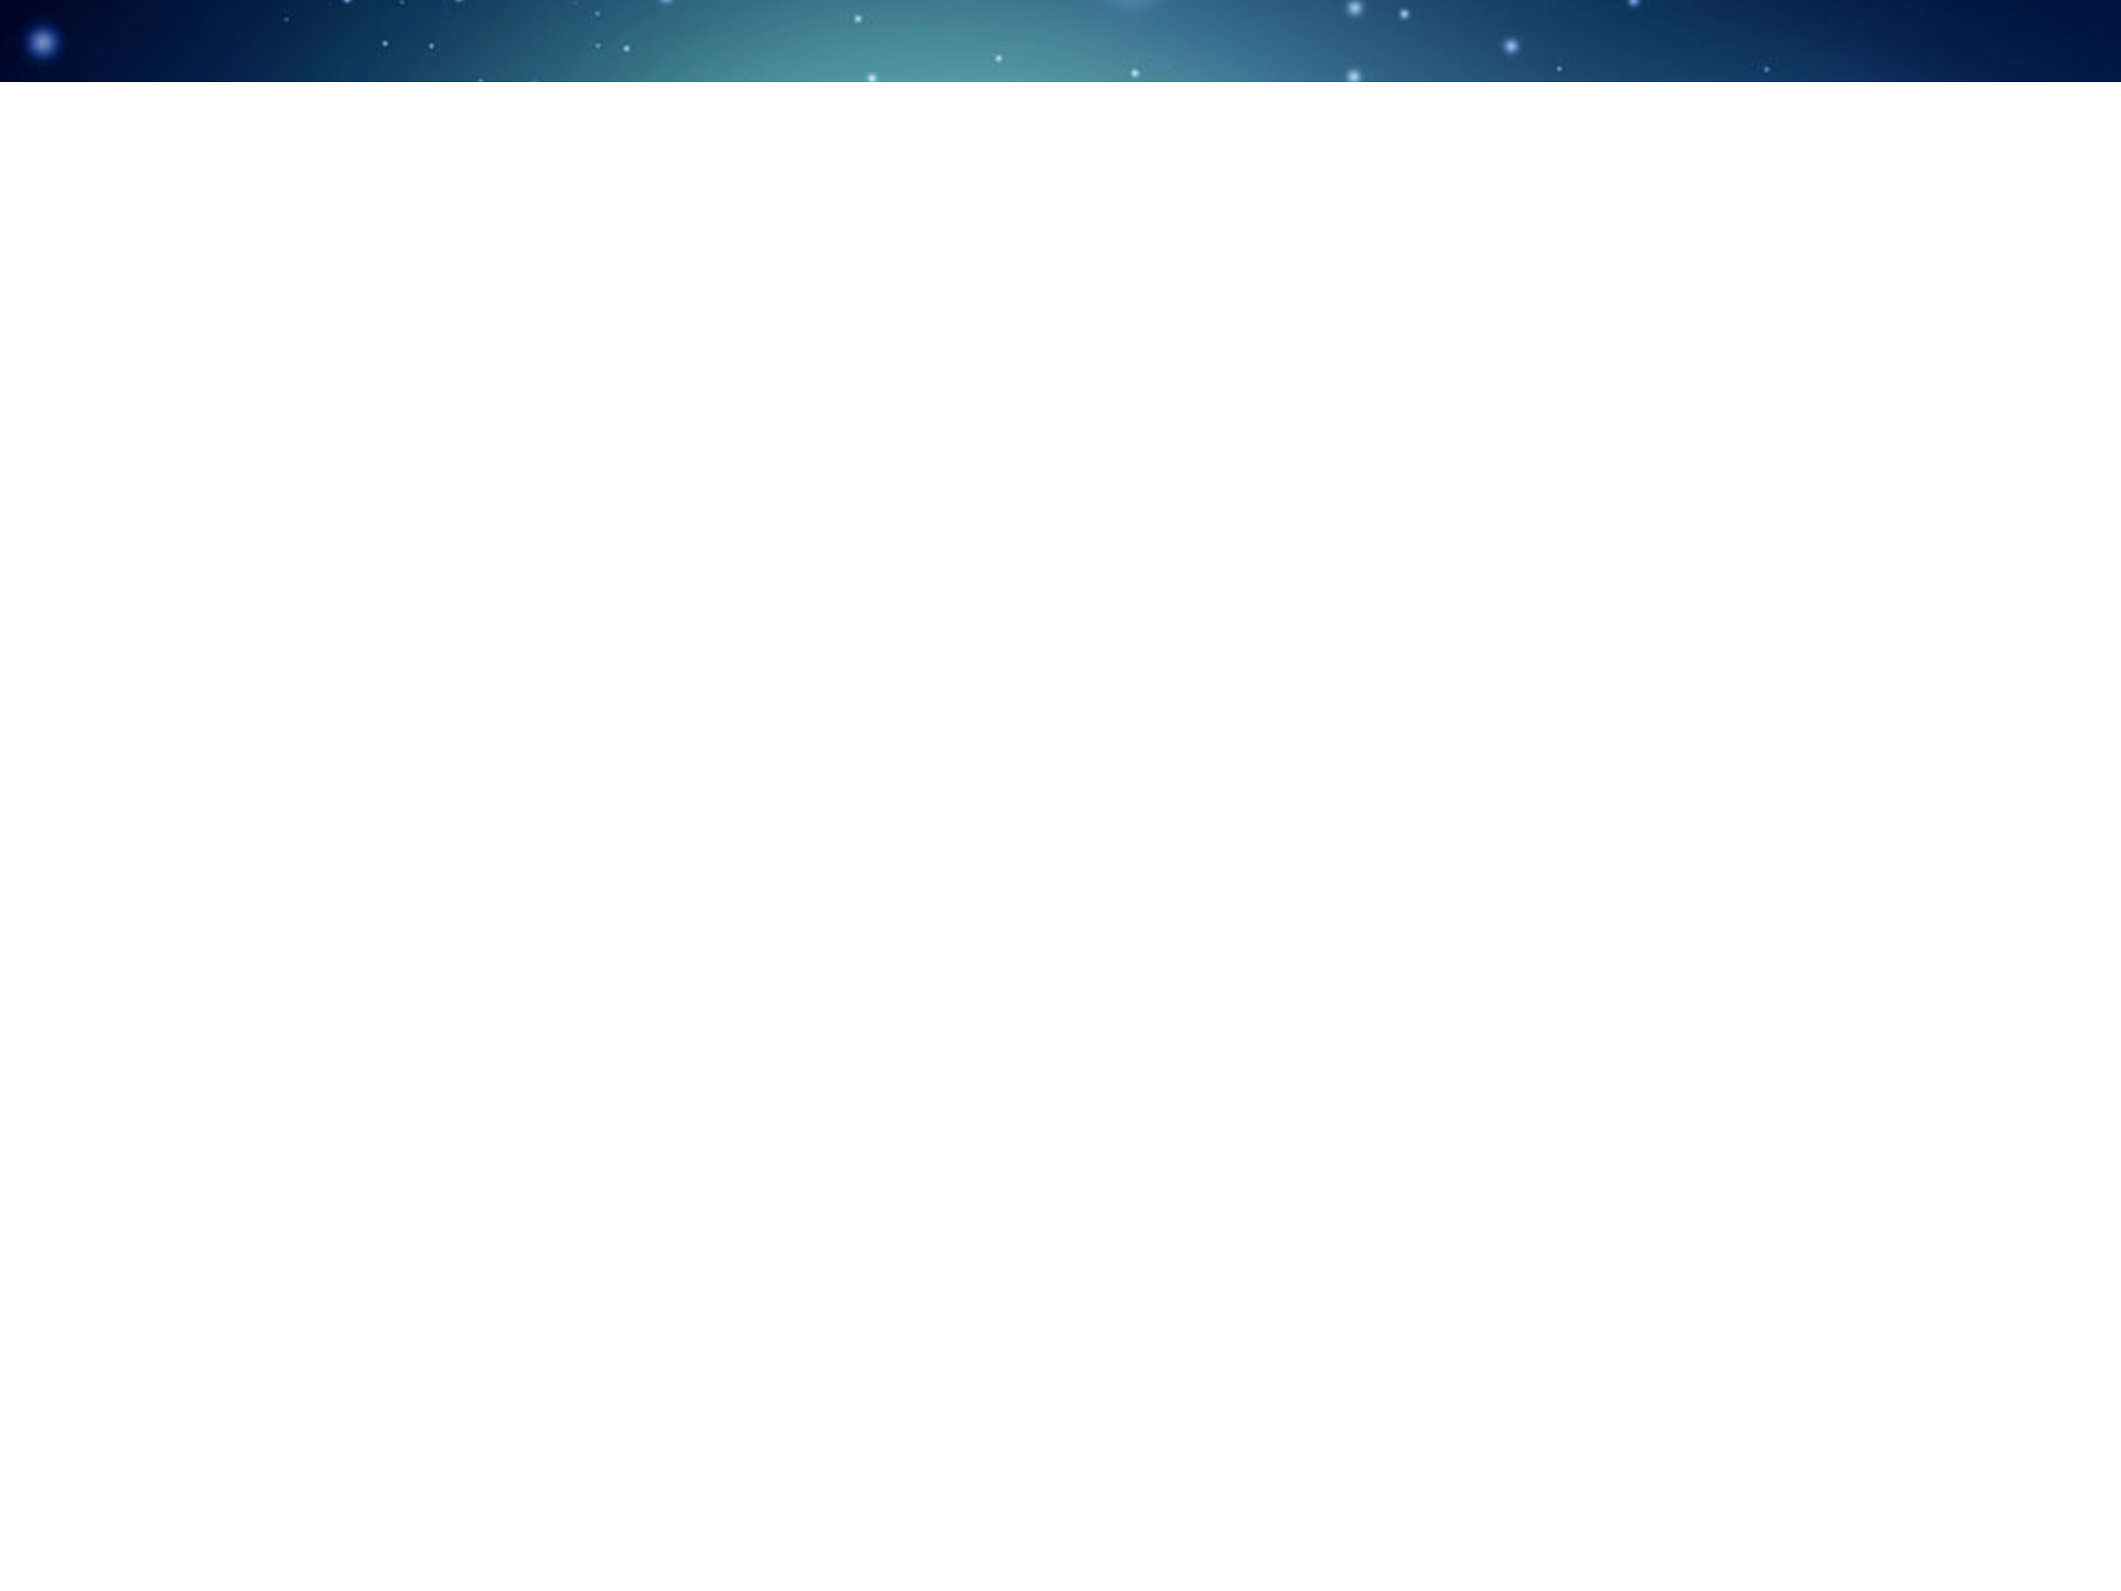




B. DiGiovine
D. Henderson
R. J. Holt
K. E. Rehm
J. Benesch
P. Degtiarenko
A. Freyberger
J. Grames
C. Tennant
G. Kharashvili
D. Meekins
M. Poelker
Y. Roblin
R. Suleiman
V. Vylet
A. Robinson
C. Ugalde
A. Sonnenschein
Notes:
Interior Page Design 2

Slide 3
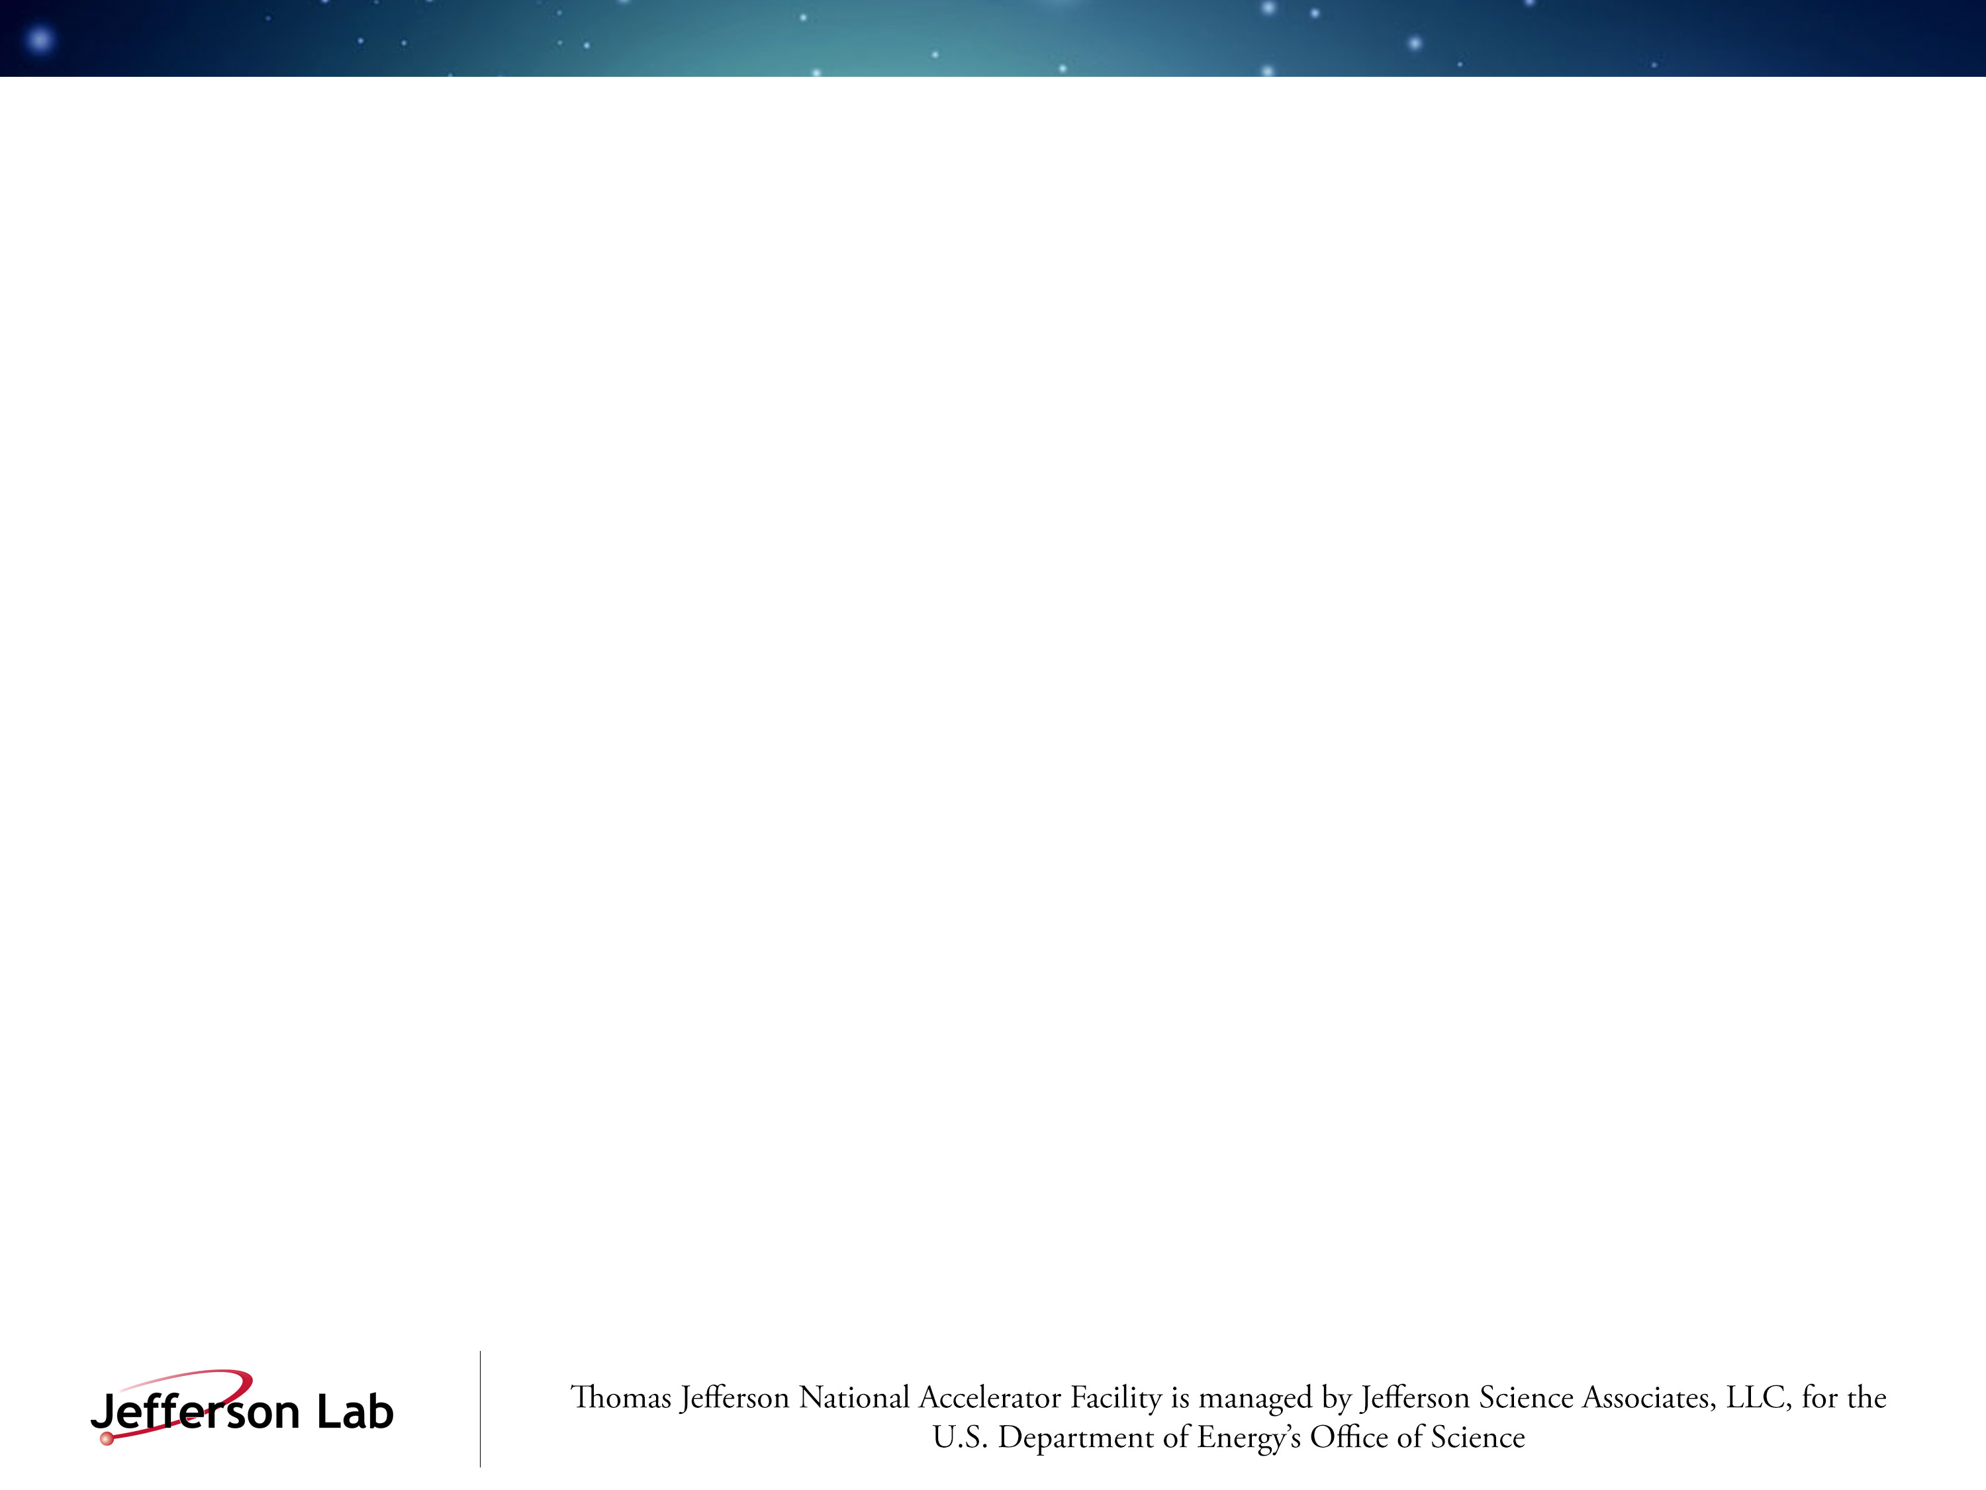
Outline
Nucleosynthesis and the ¹²C(α,γ)¹⁶O Reaction
Time-reversal Reaction: ¹⁶O(γ,α)¹²C
Bubble Chamber Theory and Design
Work at HIGS
Experimental Setup at Jefferson Lab Injector
Bremsstrahlung Beam and Penfold-Leiss Unfolding
Statistical and Systematic Errors
Backgrounds and Ion Energy Distributions
Safety
Summary and Outlook
Notes:
Interior Page Design 1

Slide 4

Relative Abundance of Elements by Weight
Notes:
Interior Page Design 2

Slide 5
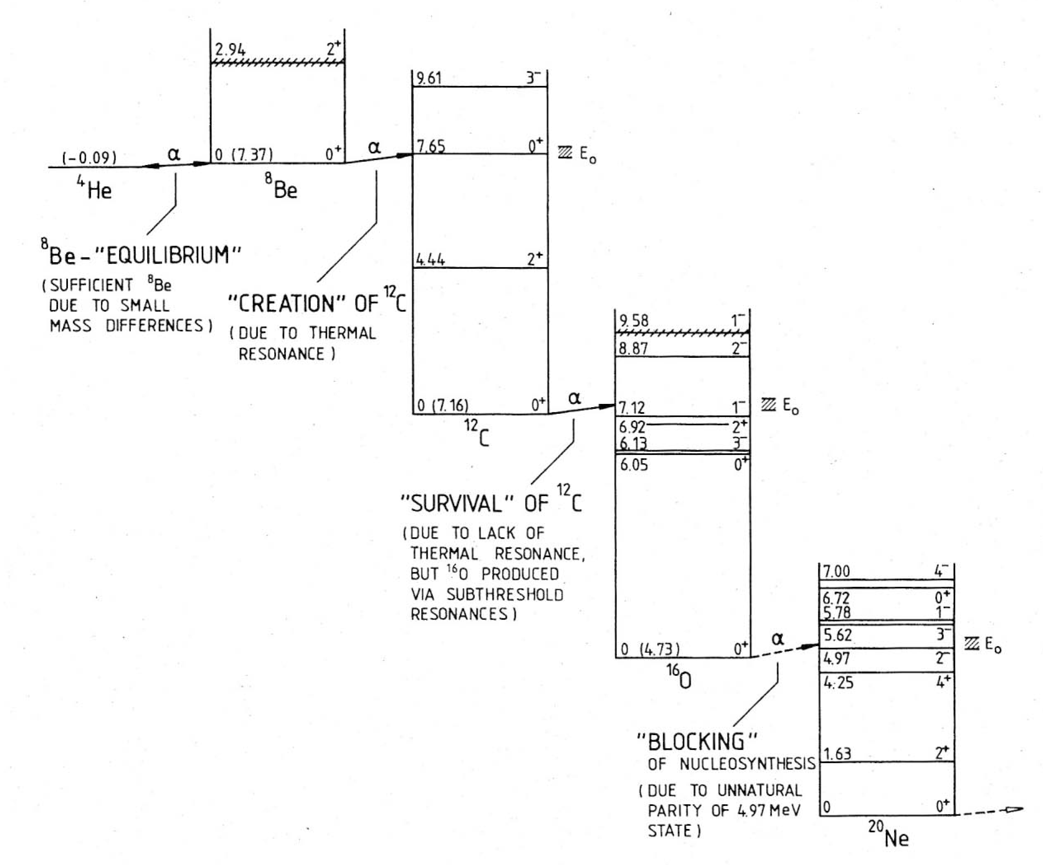
Stellar Helium Burning
Gamow window
Rolfs and Rodney, 1988
Notes:
Interior Page Design 2

Slide 6

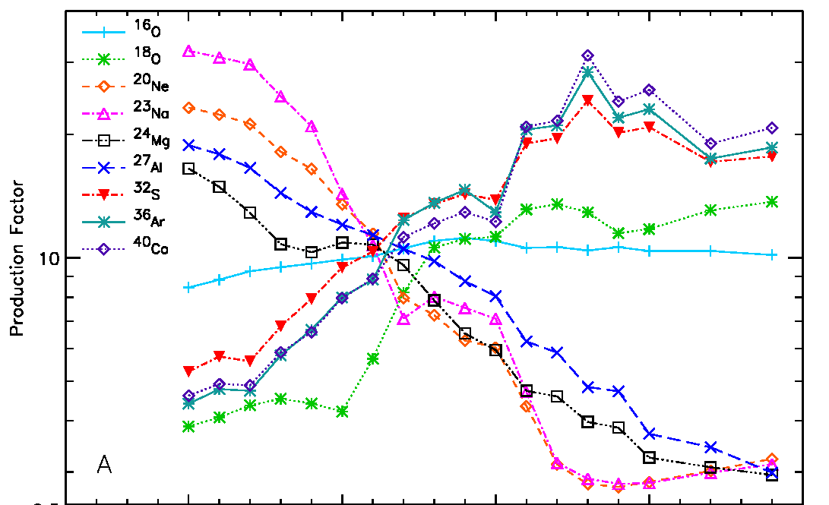
The ¹²C(α,γ)¹⁶O Reaction
The “holy grail” of nuclear astrophysics
Affects the synthesis of most of the elements of the periodic table
Sets the C to O ratio in the universe
Determines the minimum mass a star requires to become a supernova
S. Woosley, A. Heger, Phys. Rep. 442 (2007) 269
Notes:
Interior Page Design 2

Slide 7
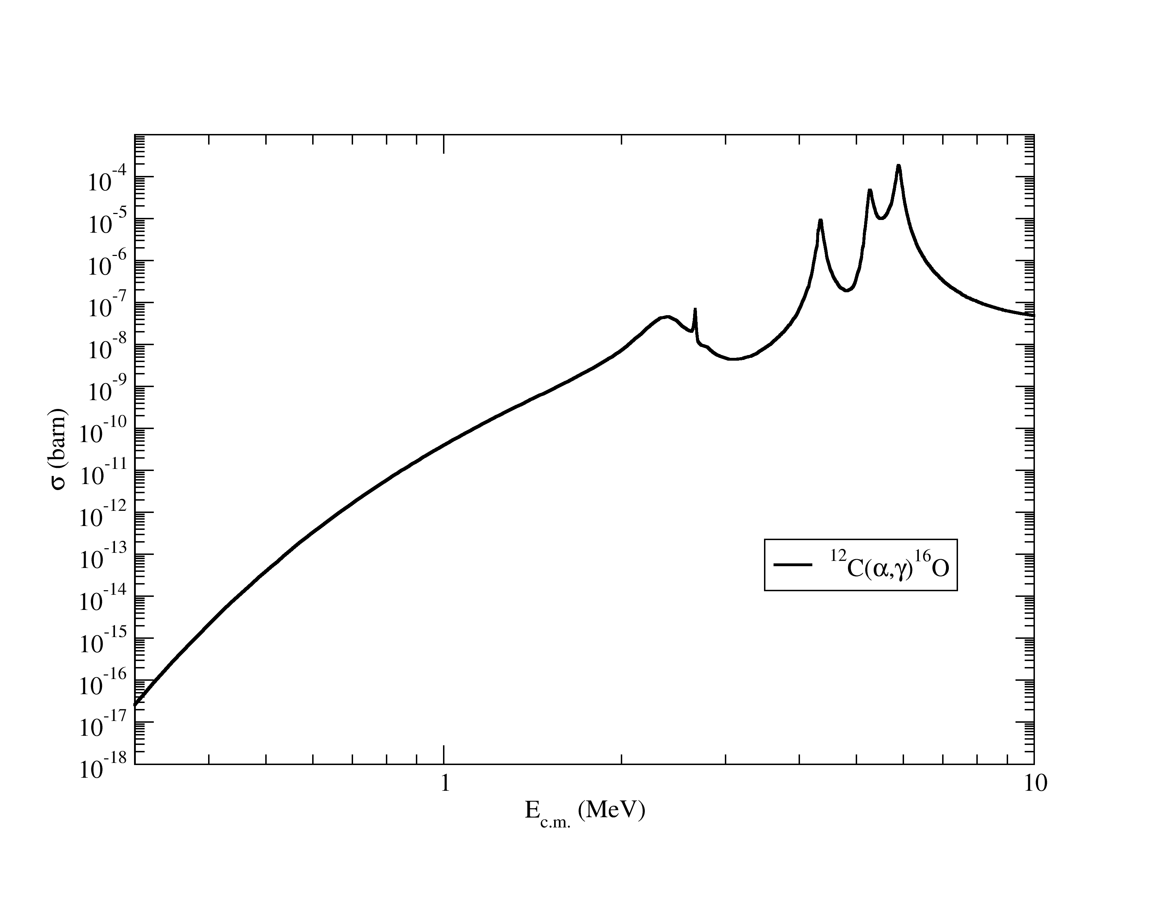
Stellar Carbon Burning
Helium burning stage of stellar evolution occurs at T=10⁹ K
Most effective stellar energy, E_{CM} = 0.3 MeV
He burning at cross section σ ~ 10⁻¹⁷ barn
Stellar Energy
0.3
Notes:
Interior Page Design 2

Slide 8
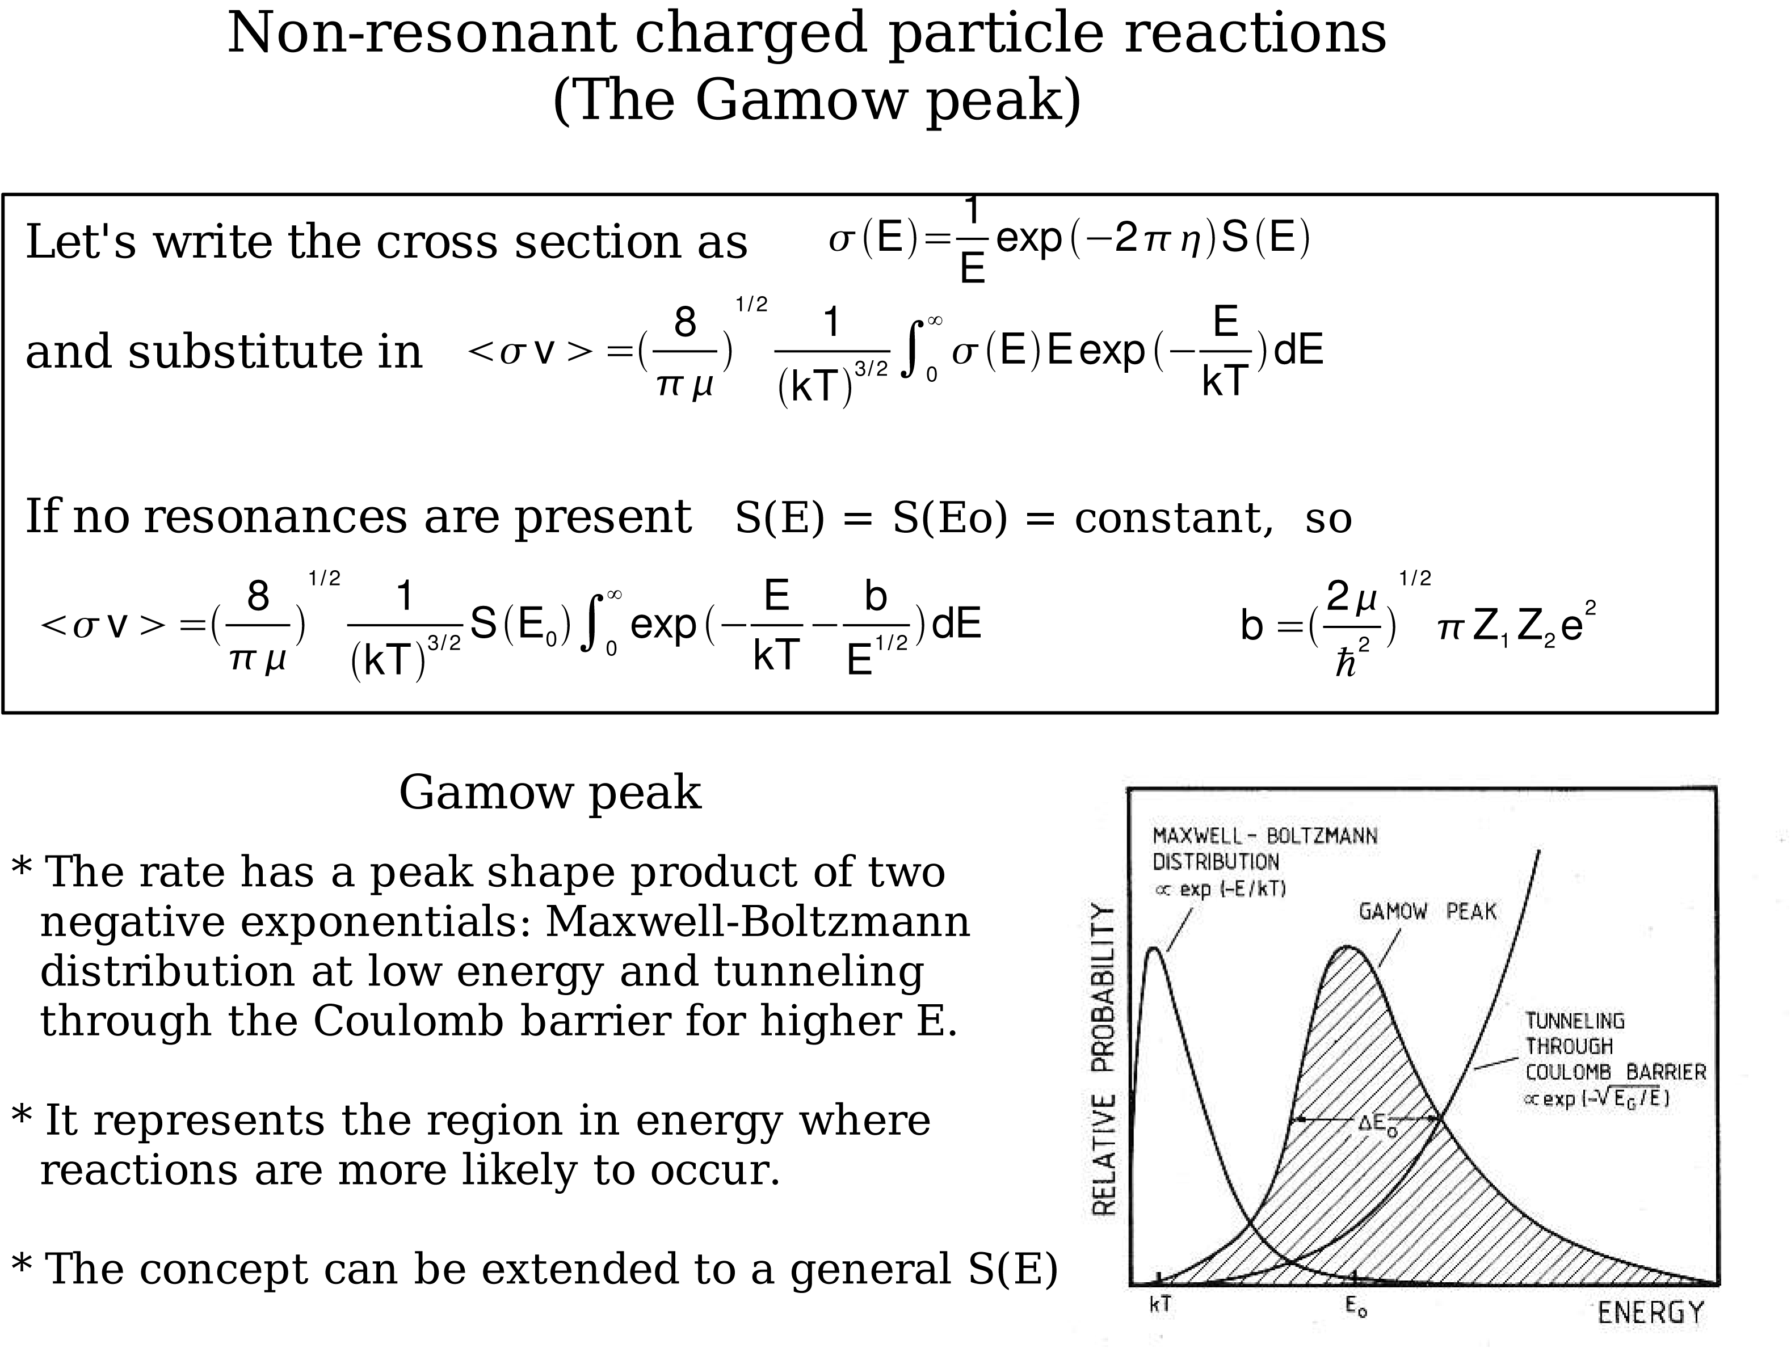

Slide 9
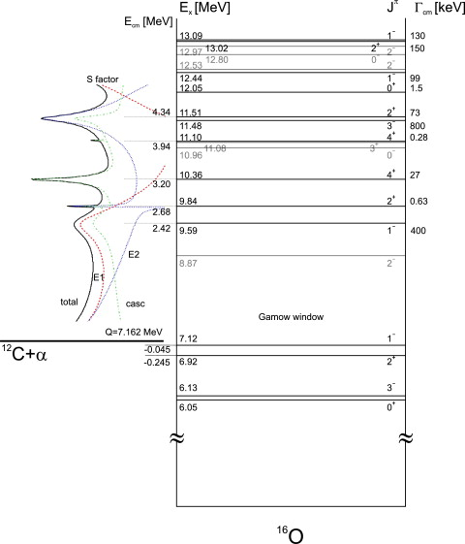
Energy Level-diagram of 16O
No Resonances but interferences
Notes:
Interior Page Design 2

Slide 10
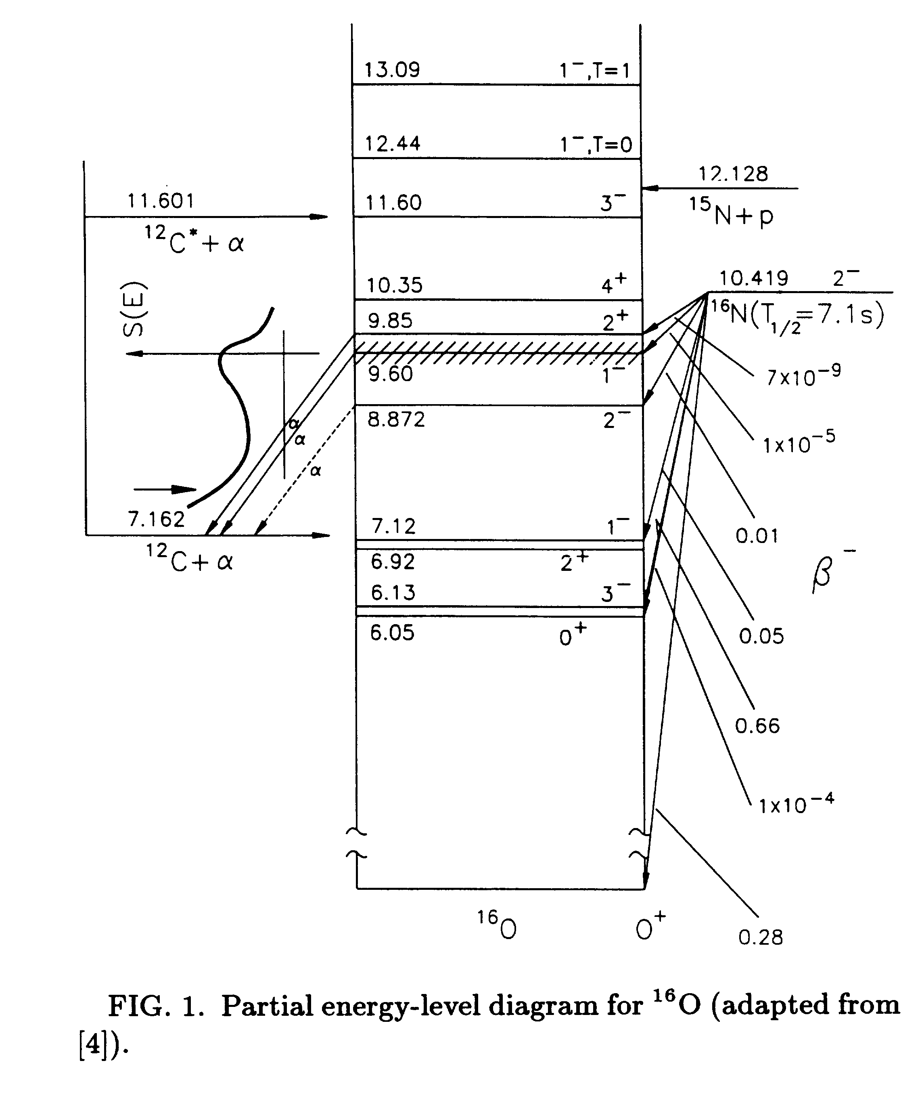
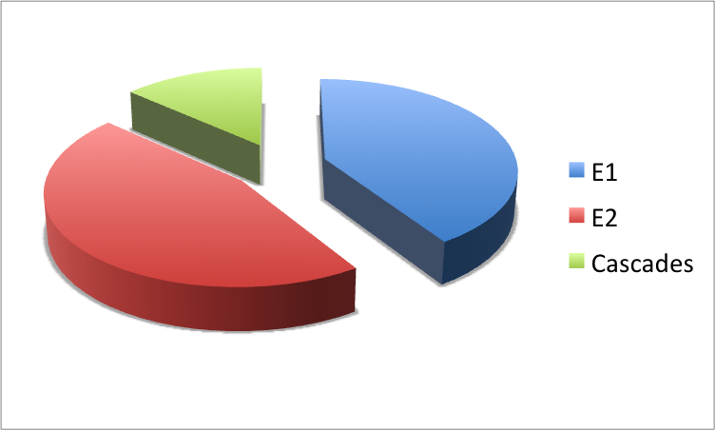
S(300)
Kunz 2001, Matei 2006

Slide 11
Heroic efforts in search of the holy grail of astrophysics: ¹²C(α,γ)¹⁶O
Luminosity ~ 1E34 cm⁻²s⁻¹
Efficiency ~ 1E-3
¹⁶O(γ,α)¹²C
Lum(HIγS) ~ 4E30 cm⁻²s⁻¹
Lum(JLab) ~ 8E31 cm⁻²s⁻¹
10 μA , top 100 keV
λ_{γ}²/λ_{α}² ~ 60
Bubble chamber: solid angle x efficiency = 100%
Expt | Beam current (mA) | Detector Effic. (%) | Target | Meas. Time (h)
Redder | 0.7 | Ge, 35 | 12C, ~3E18 | 900
Ouellet | 0.03 | Ge, 30 | 12C, 5E18 | 1950
Roters | 0.02 | BGO, 270 | 4He, 1E19 | 5000
Kunz | 0.45 | Ge, 100 | 12C, 3E18 | 700
EUROGAM | 0.34 | Ge, 70 | 1E19 | 2100
¹²C(α,γ)¹⁶O
⁴He(¹²C, ¹⁶O)γ
Notes:
Interior Page Design 2

Slide 12
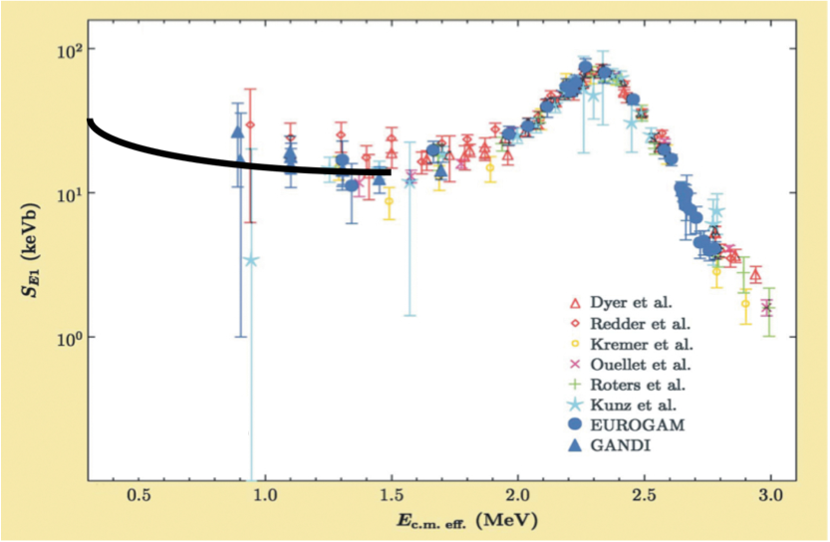
Astrophysical S-Factor ¹²C(α,γ)¹⁶O
Author | S(300keV) (keV-b)
Buchmann (2005) | 102-198
Caughlan and Fowler (1988) | 120-220
Hammer (2005) | 162+-39
Stellar helium burning at E=300 keV
Notes:
Interior Page Design 2

Slide 13
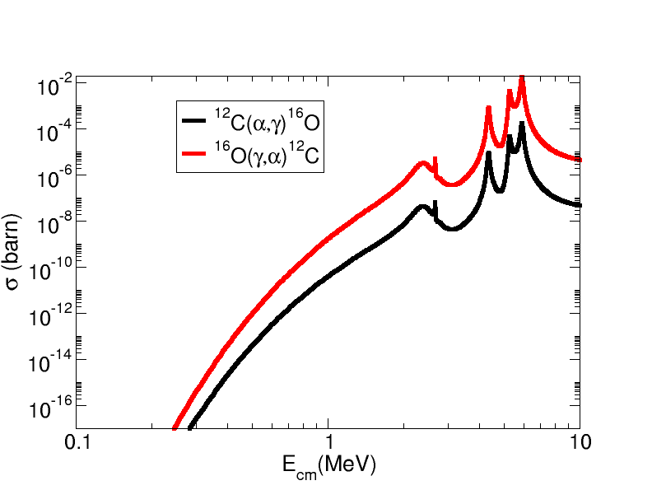
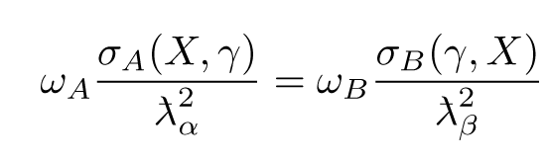
Time Reversal Reaction
¹²C
¹⁶O
α
γ
Notes:
Interior Page Design 2

Slide 14
(γ,α) and (α,γ) – Reciprocity Relation
A(α, γ)B:
σ(γ,α) is over two orders of magnitude larger than σ(α, γ)
Notes:
Interior Page Design 2

Slide 15
New Approach: Inverse Reaction + Bubble Chamber
Extra gain (x100) by measuring time inverse reaction
Target density up to x10⁶ higher than conventional targets
Superheated liquid will nucleate from α and ¹²C recoils
Electromagnetic debris (degraded electrons and gammas, or positrons) that escape the collimator/electron beam do NOT trigger nucleation (detector is insensitive to γ-rays by at least 1 part in 10¹¹).
beam
target
signal
γ + ¹⁶O → ¹²C + α
Monochromatic γ beam at HIγS
~ 10⁷⁻⁸ γ/s
Bremsstrahlung at JLab
~ 4x10⁹ γ/s (top 250 keV)
Notes:
Interior Page Design 2

Slide 16
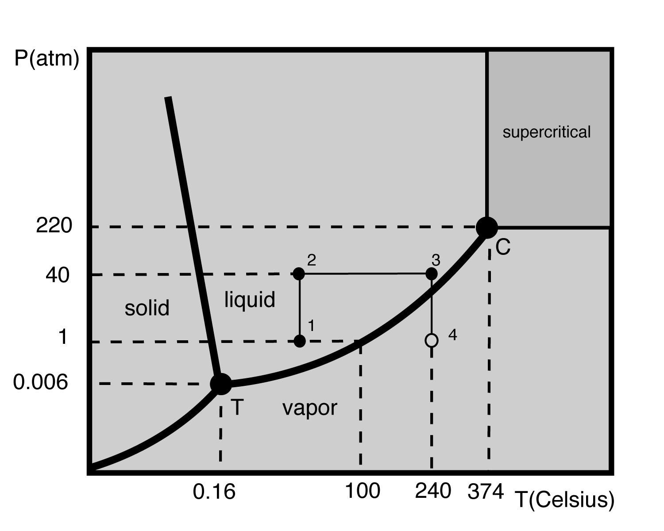
Bubble Chamber Theory and Design
Donald Glaser, 86, won Nobel for inventing chamber to detect subatomic particles (1960)
Dark Matter Search
COUPP PRL106,021203(2011)
PICASSO PLB,682,185(2009)
SIMPLE PRL105, 211301(2010)
Superheat
Notes:
Interior Page Design 2

Slide 17
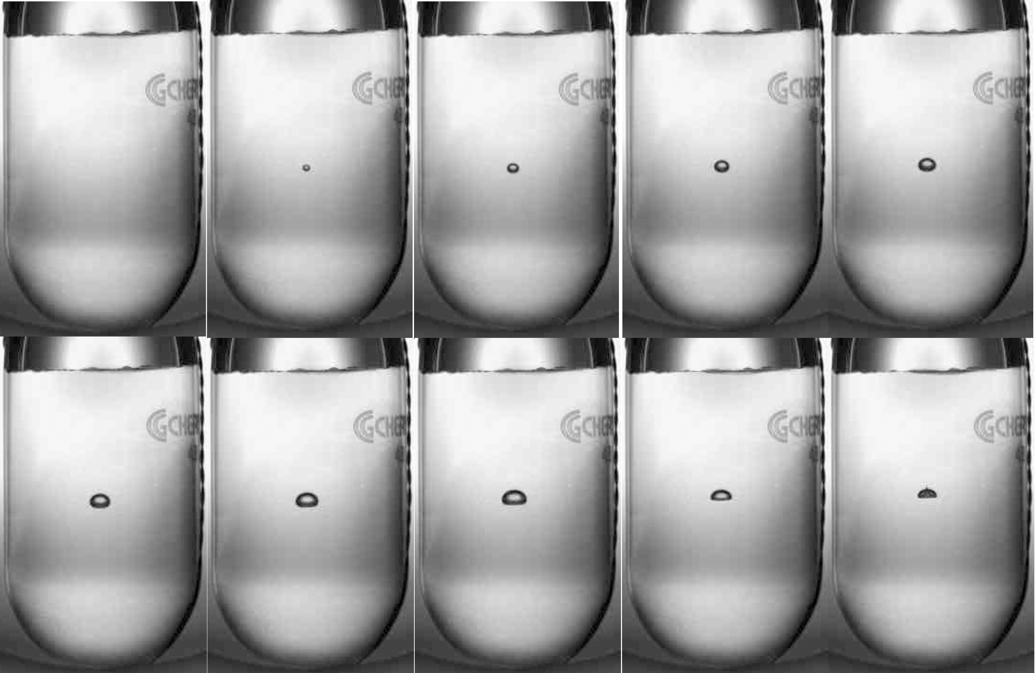
Bubble Growth and Quenching
¹⁹F(γ,α)¹⁵N in R134a
Δt = 10 ms
Notes:
Interior Page Design 2

Slide 18
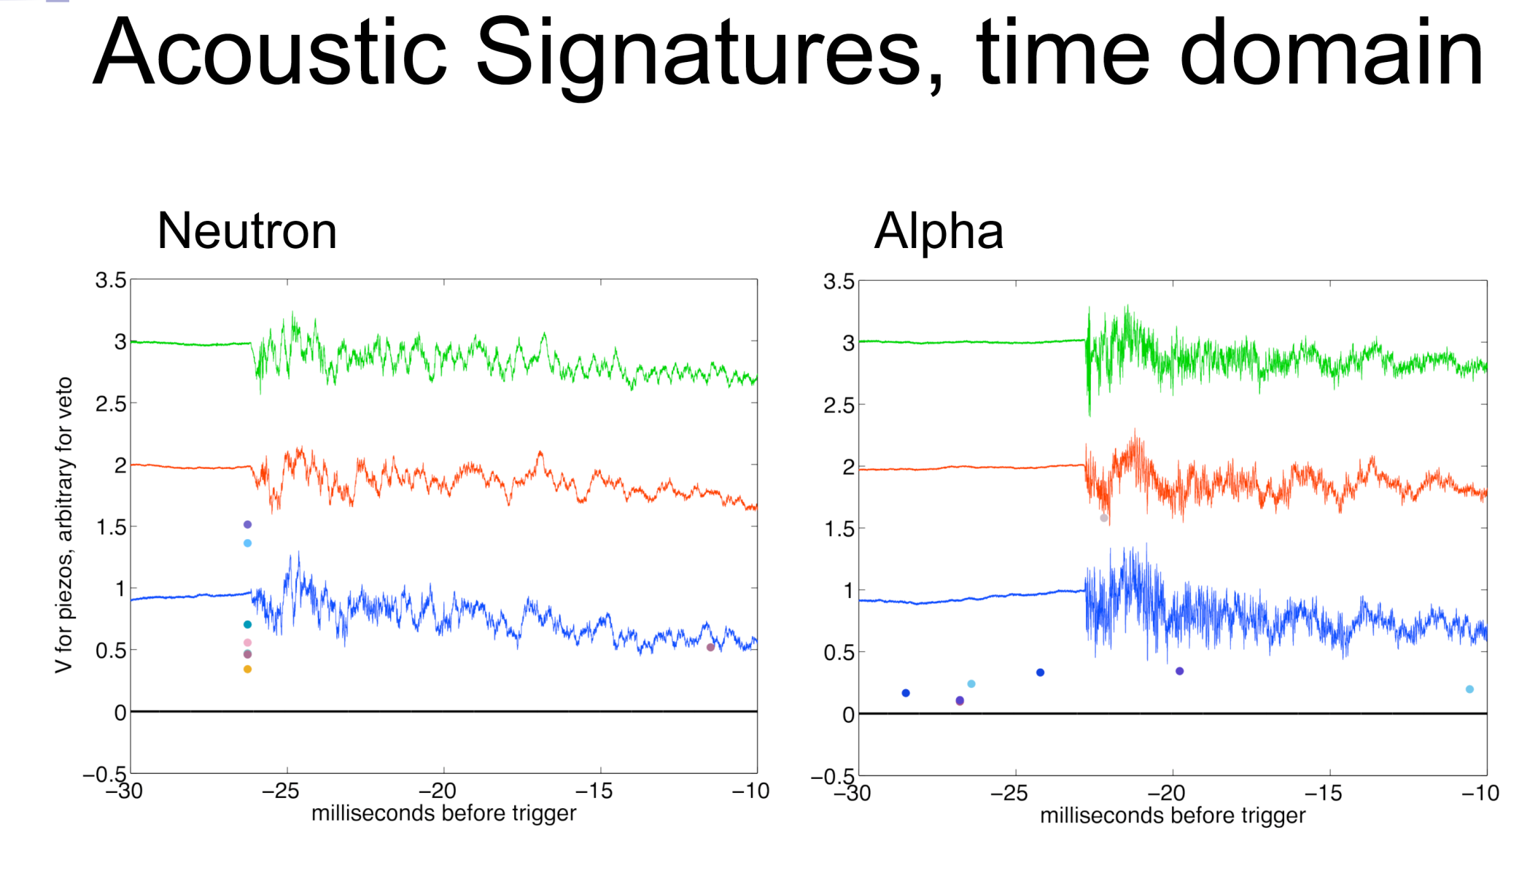
Acoustic Signal: Particle ID
Suppress neutron events by x500 from acoustic signal – FNAL dark matter bubble chambers
COUPP, FNAL, courtesy of A. Sonnenschein
Notes:
What about proton events, i.e, (g,p)?

Slide 19
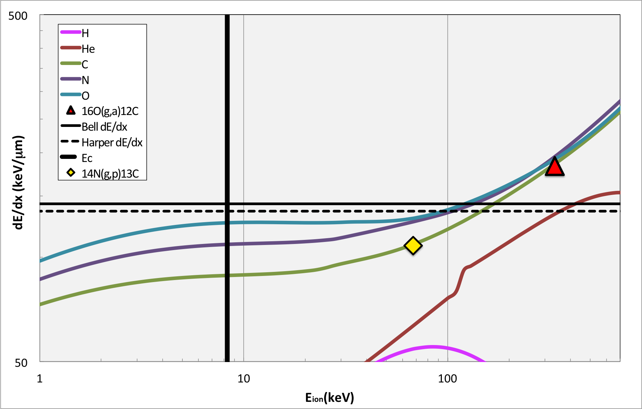
N₂O thresholds, Superheat = 3.3 ^{O}C, Eγ=8.5 MeV

Slide 20
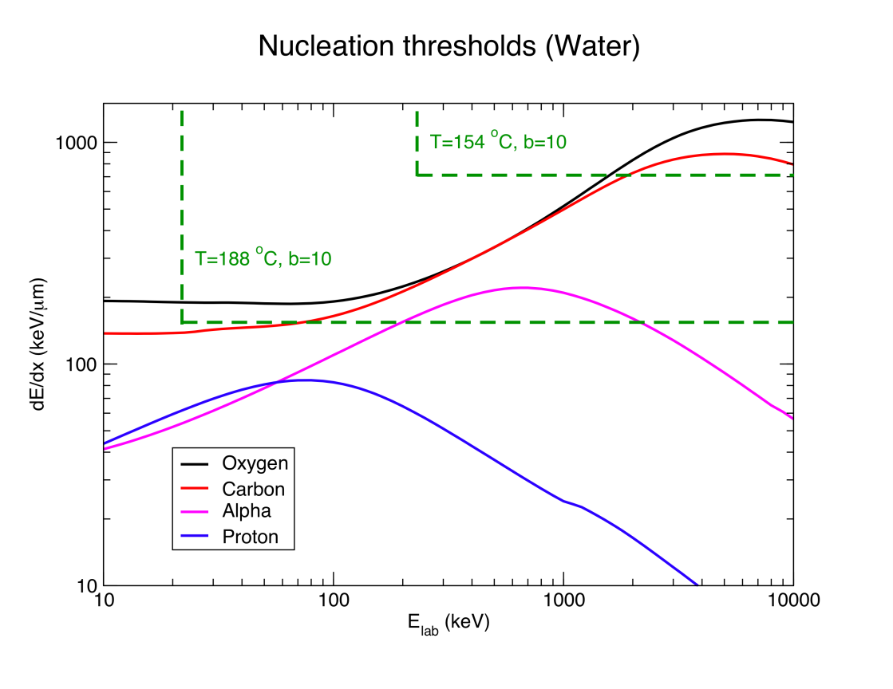
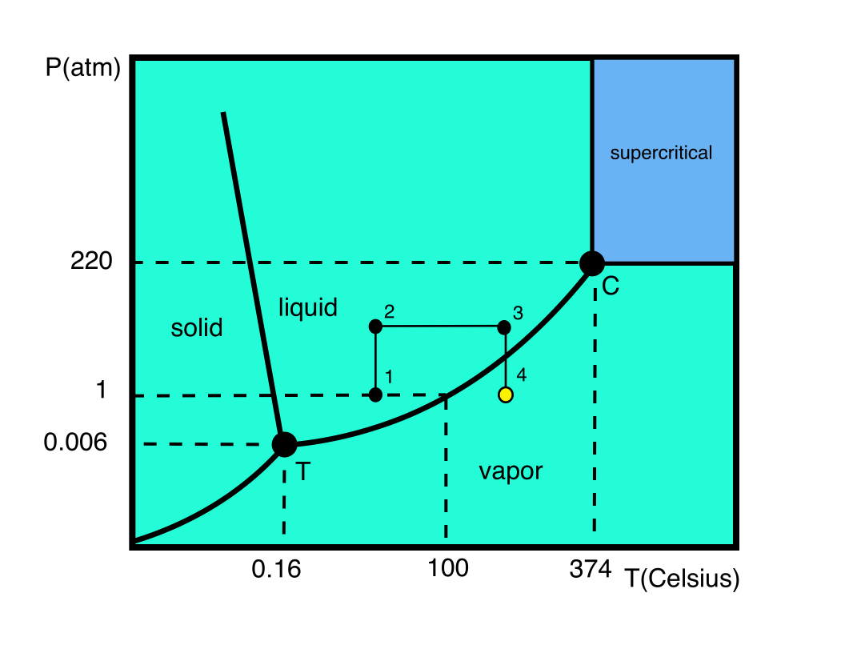
Bubble chamber basics

Slide 21
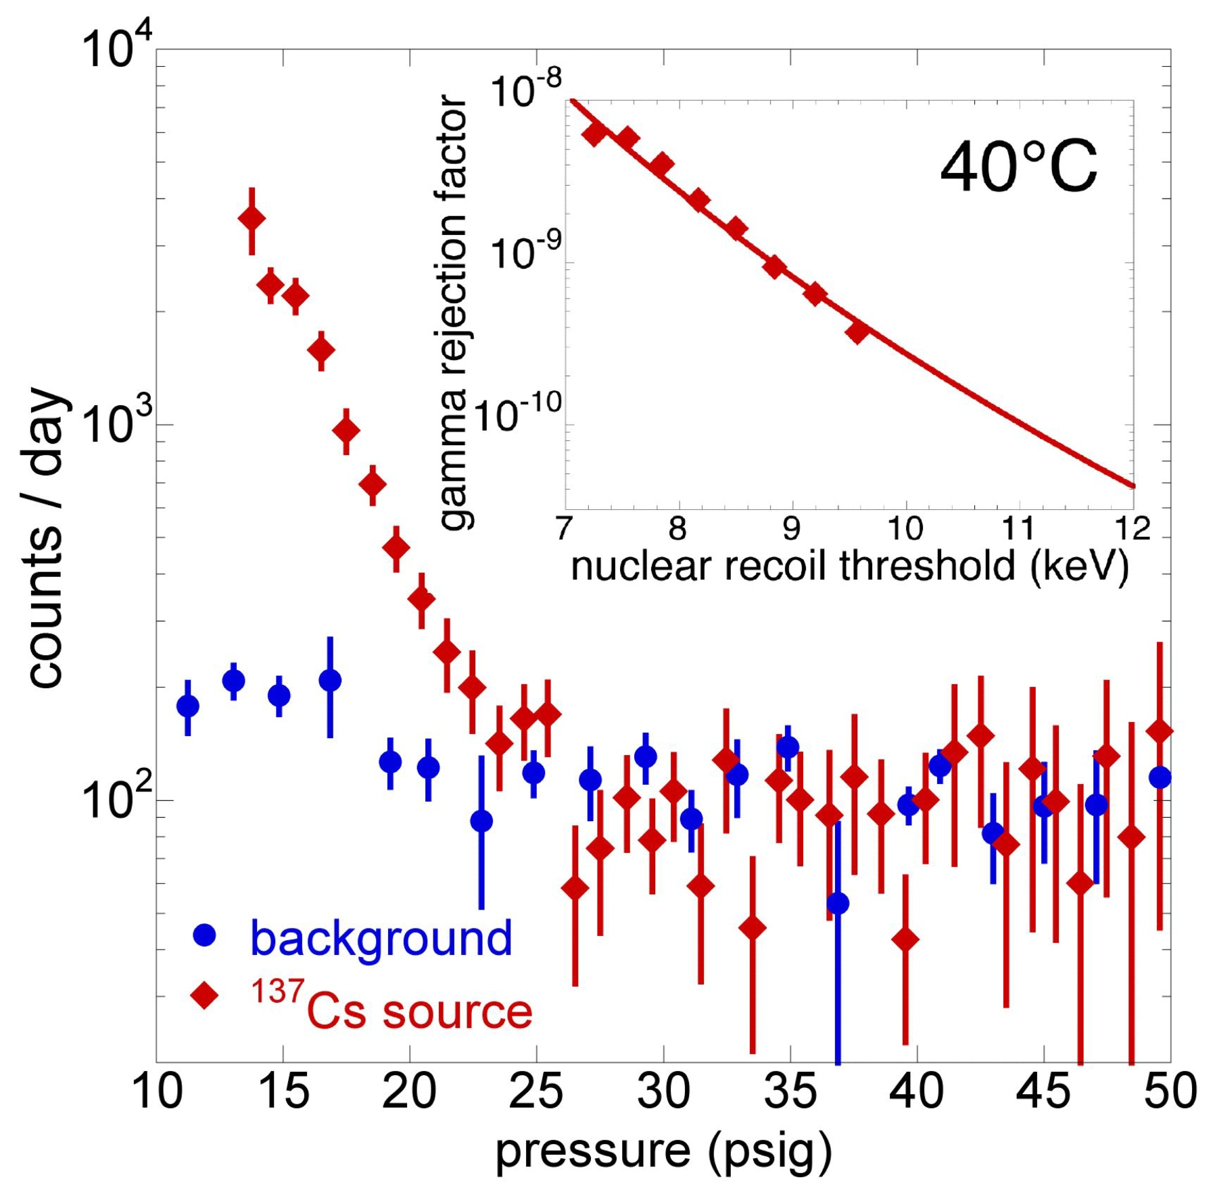
Gamma suppression
COUPP exp. FNAL

Slide 22
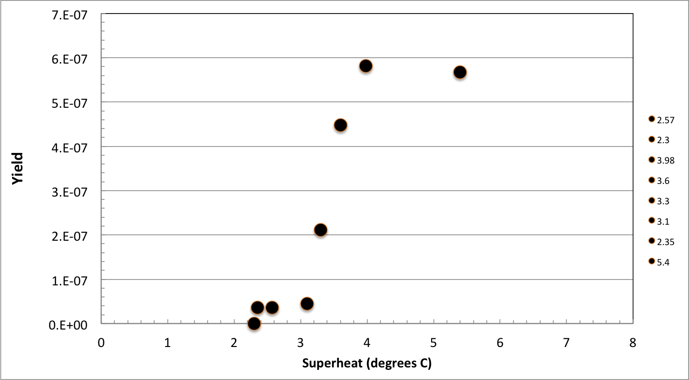
Efficiency Curve
γ+¹⁶O
γ+¹⁴N and γ+¹⁶O
N₂O efficiency curve, HIGS April 2013. E_{γ} = 9.7 MeV
Notes:
Interior Page Design 2

Slide 23
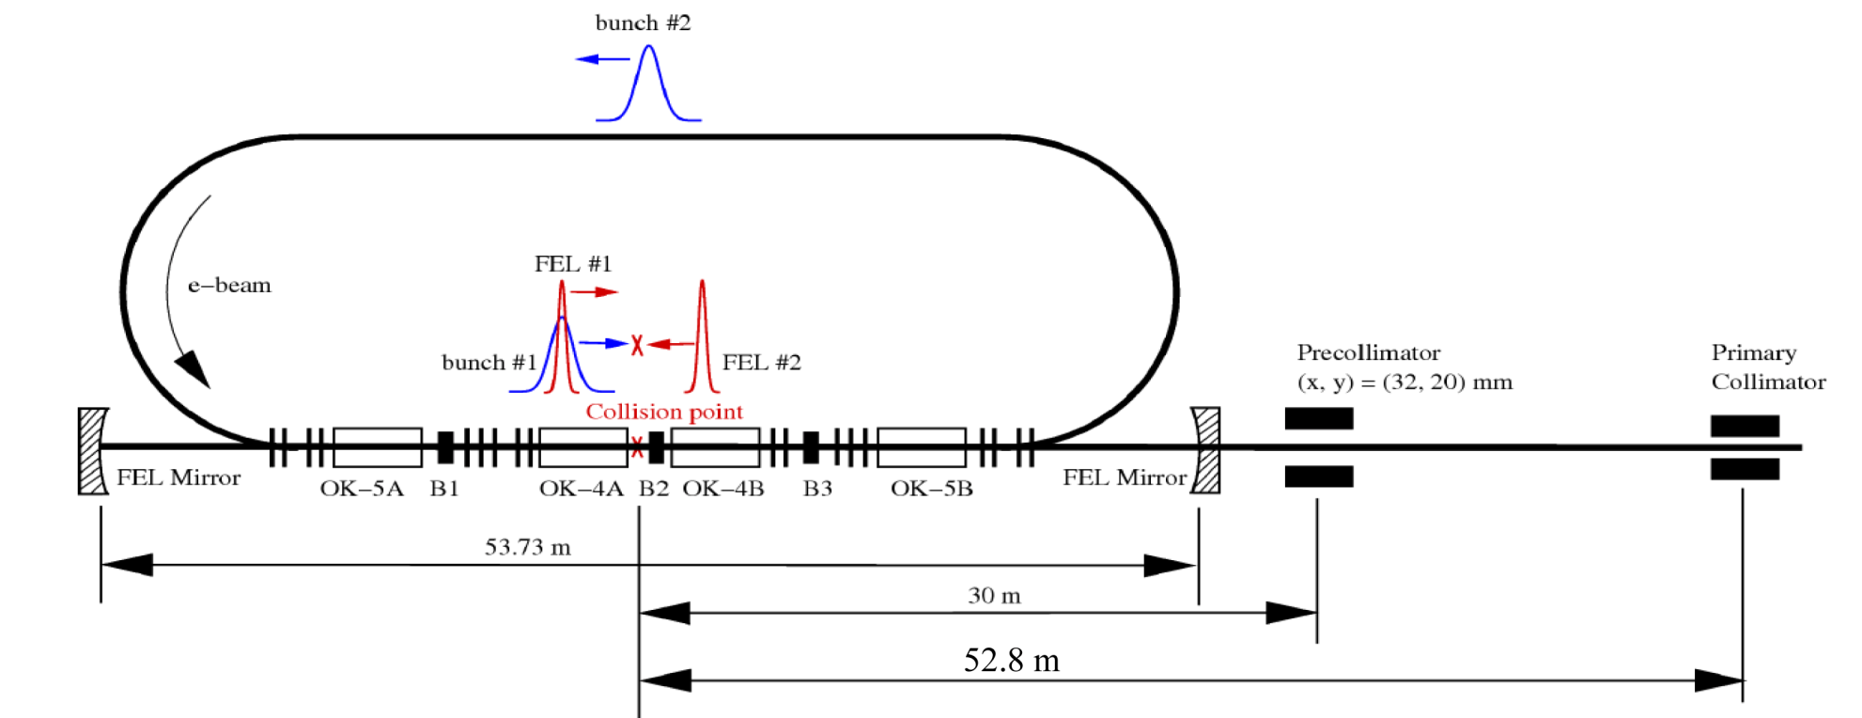
Bubble Chamber at HIGS
High Intensity Gamma Source (HIGS) at Duke University
γ-rays generated by Compton backscattering of free-electron-laser (FEL) light from high-energy electron beam bunches

Slide 24
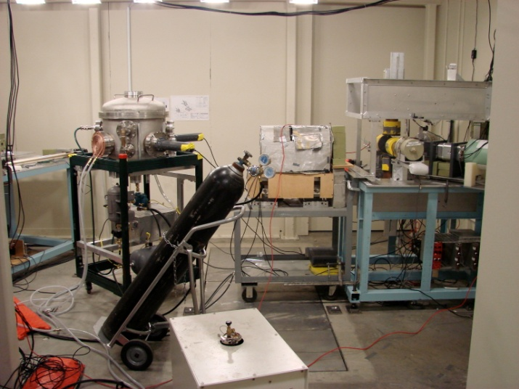
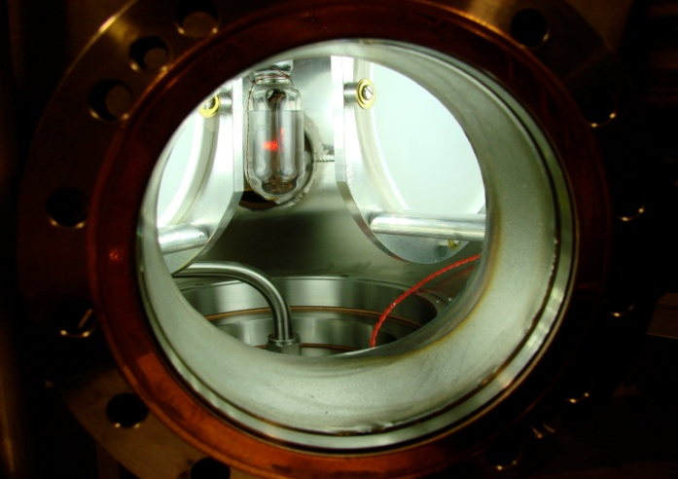
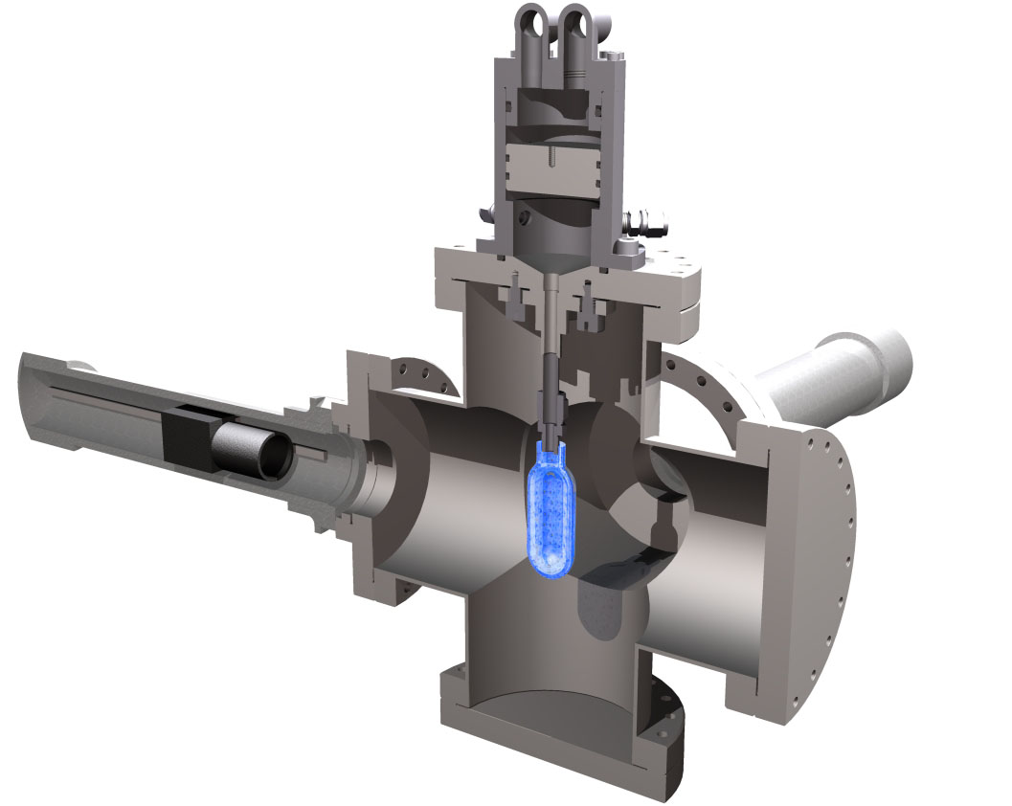
Measuring ¹⁹F(γ,α)¹⁵N at HIGS
2 Fast Cameras
C₄F₁₀ Bubble Chamber
  T = 310 K
  P = 160 kPa – 900 kPa
Notes:
Interior Page Design 2

Slide 25
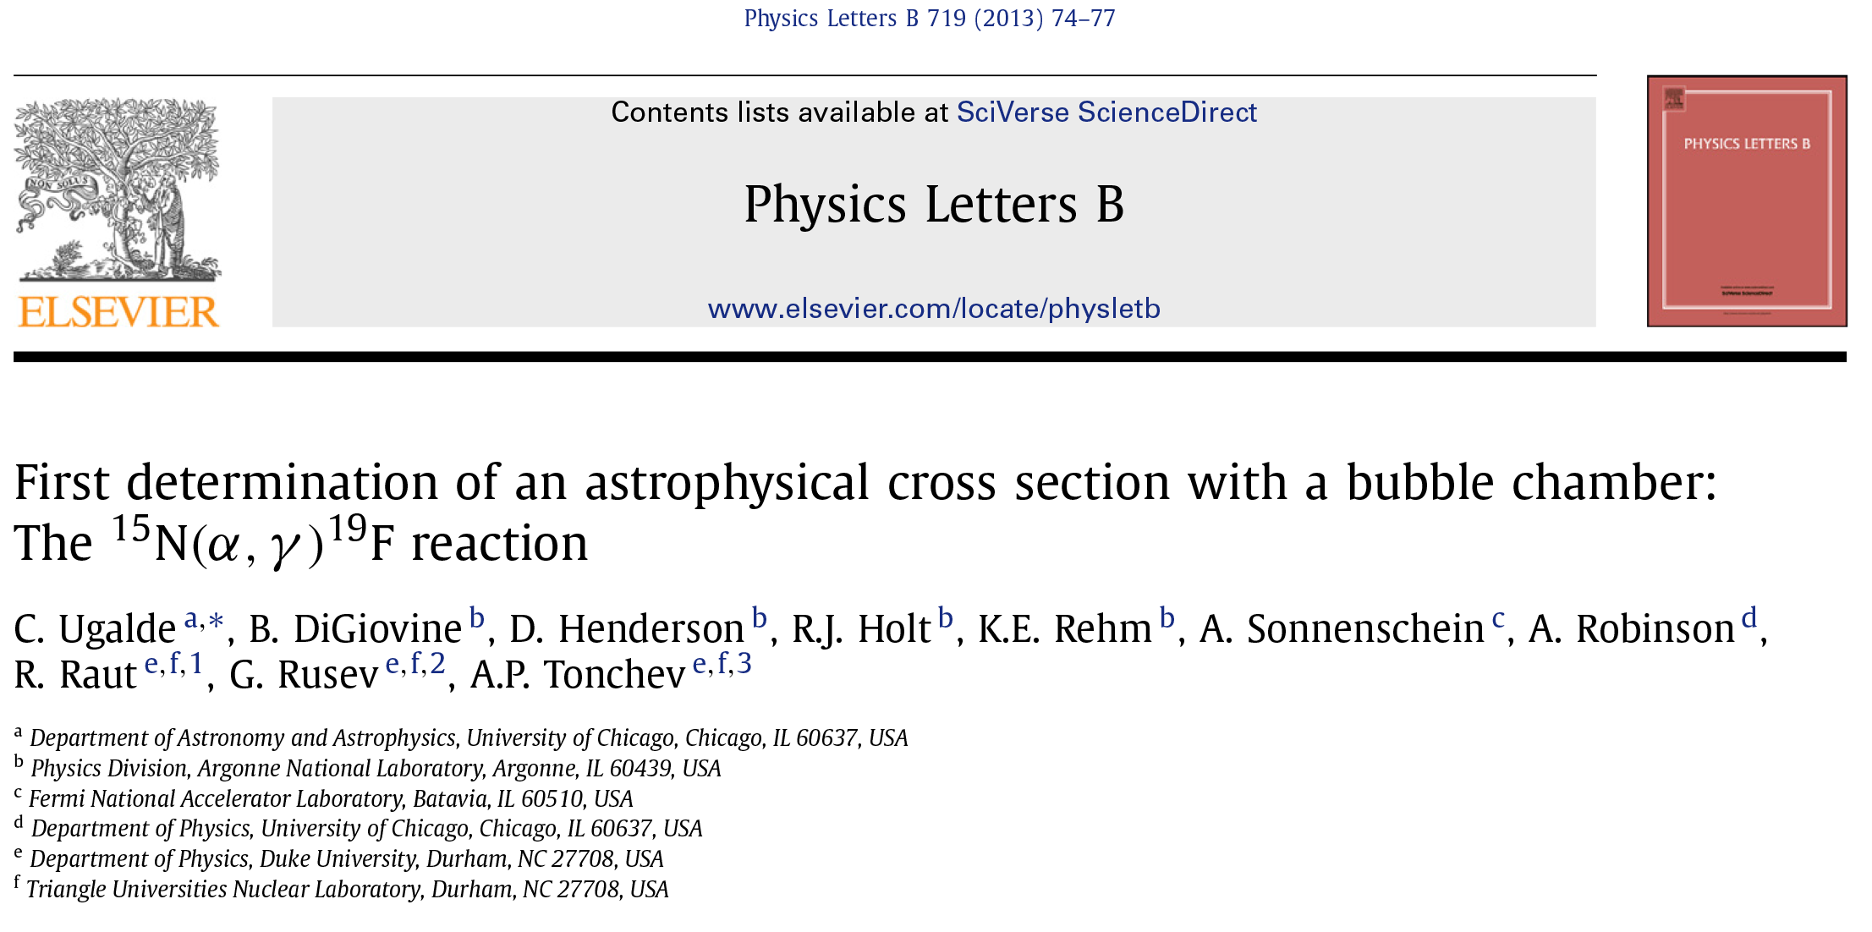
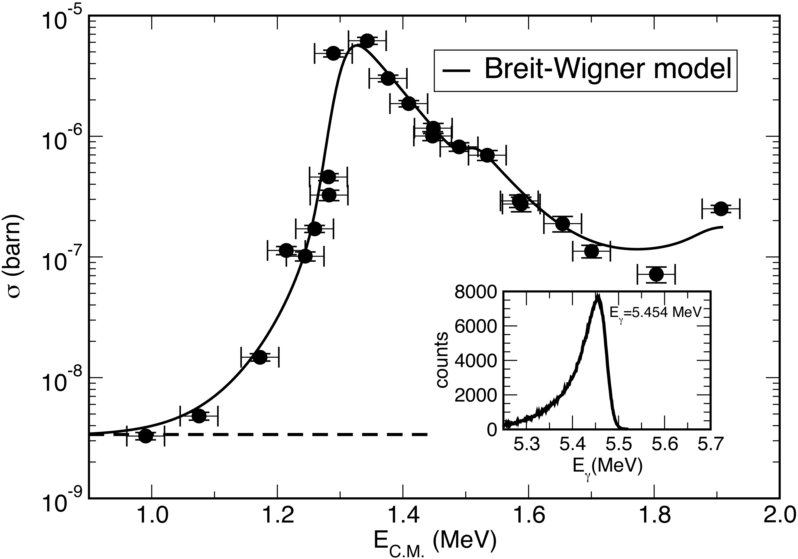
Notes:
Interior Page Design 2

Slide 26
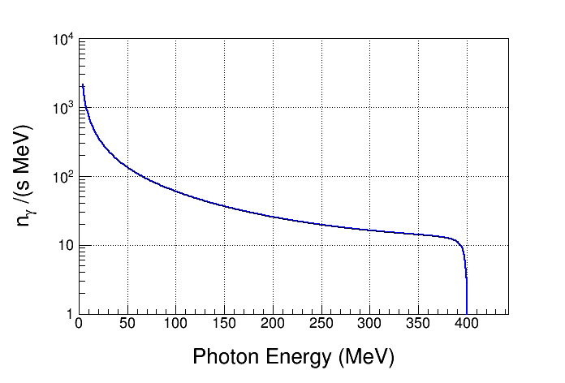
Bremsstrahlung Background at HIGS
Vacuum: 2x10⁻¹⁰ Torr
Residual Gas: Z = 10
Electron Beam Energy: 400 MeV
Electron Beam Current: 41 mA
Interaction Length: 35 m
Strong Bremsstrahlung
Background
Notes:
Calculate the Bremsstrahlung spectrum for HIGS beam using GEANT4

Slide 27
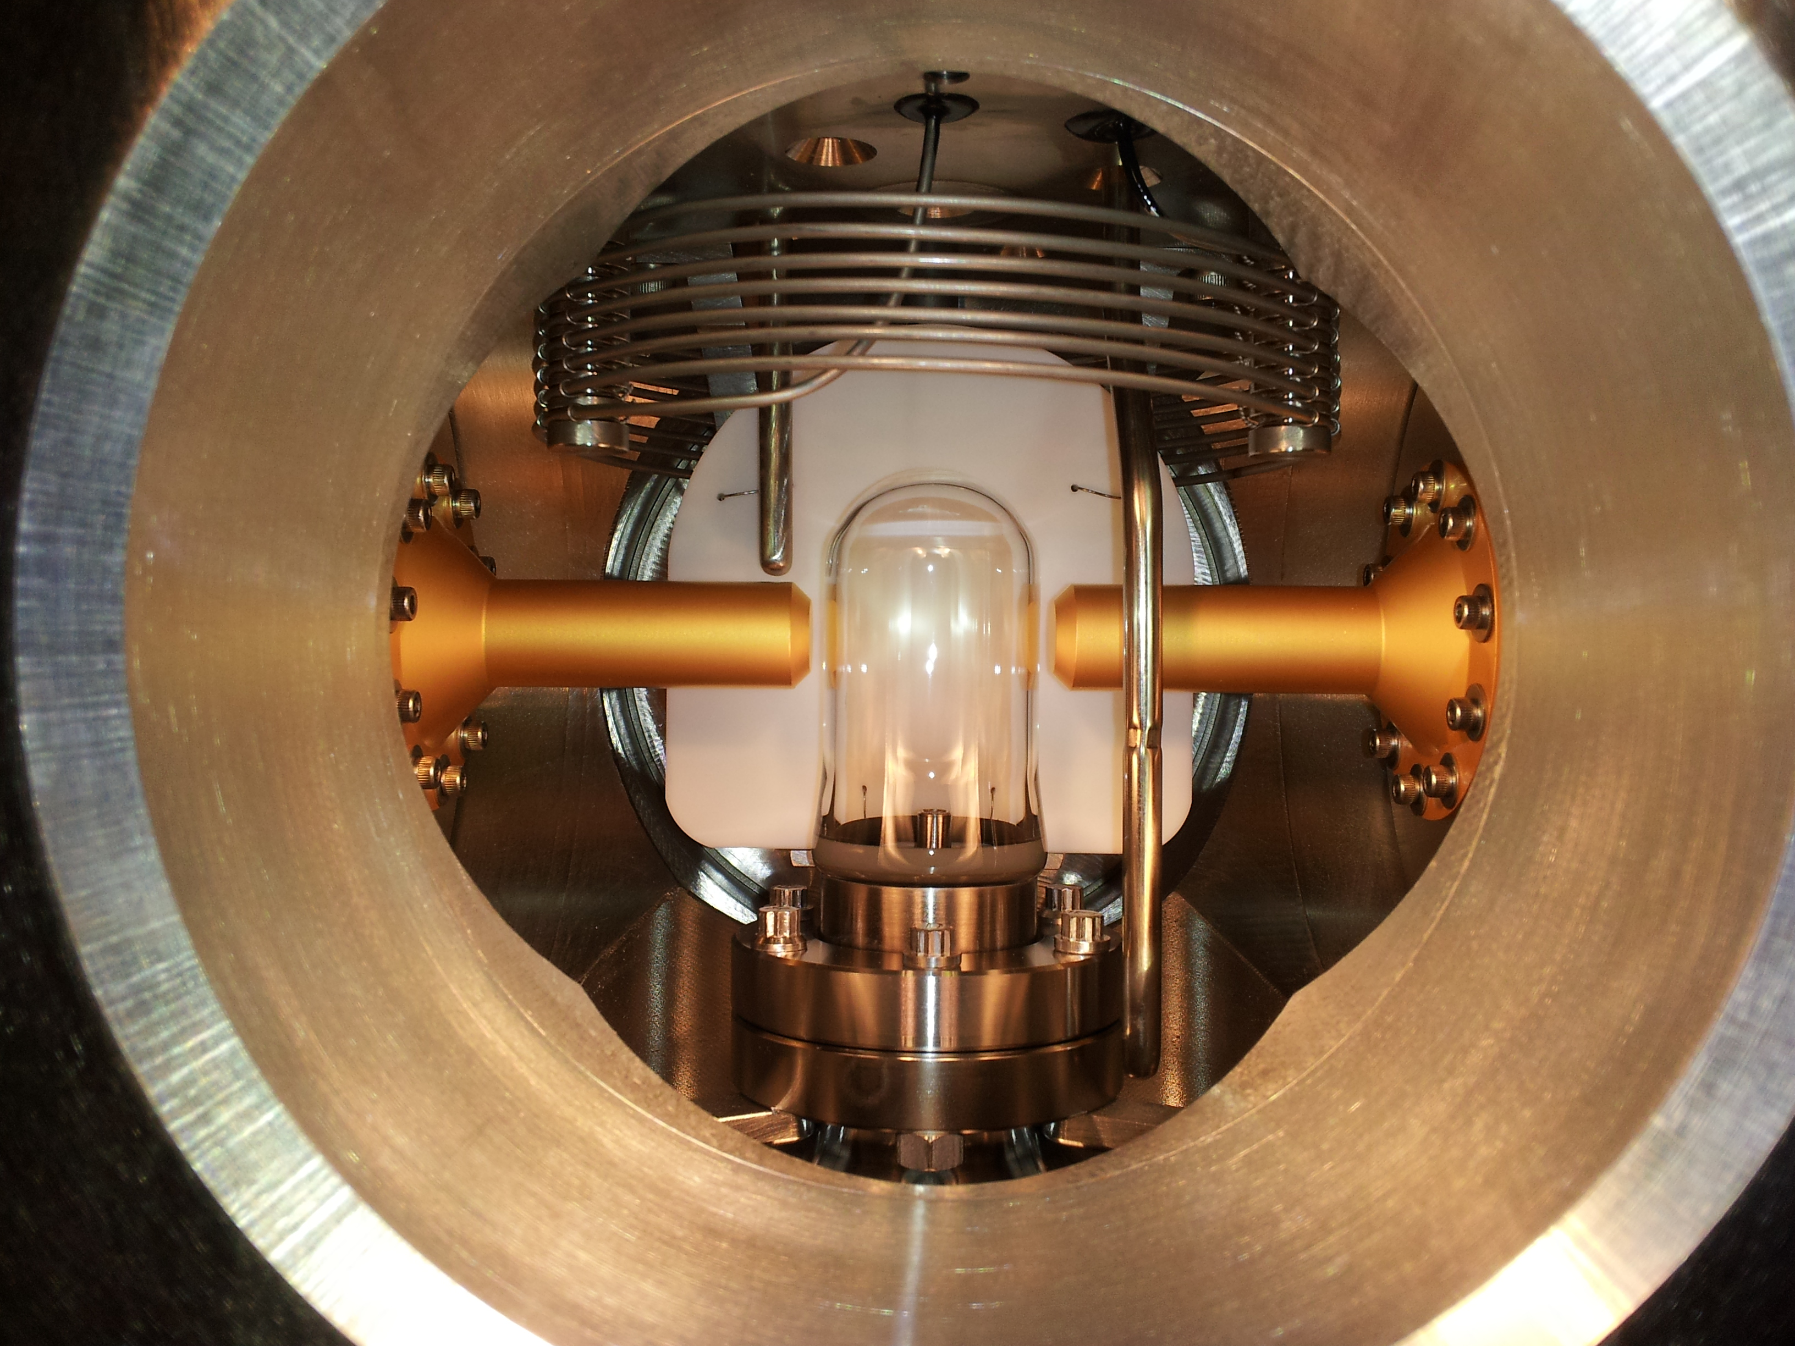
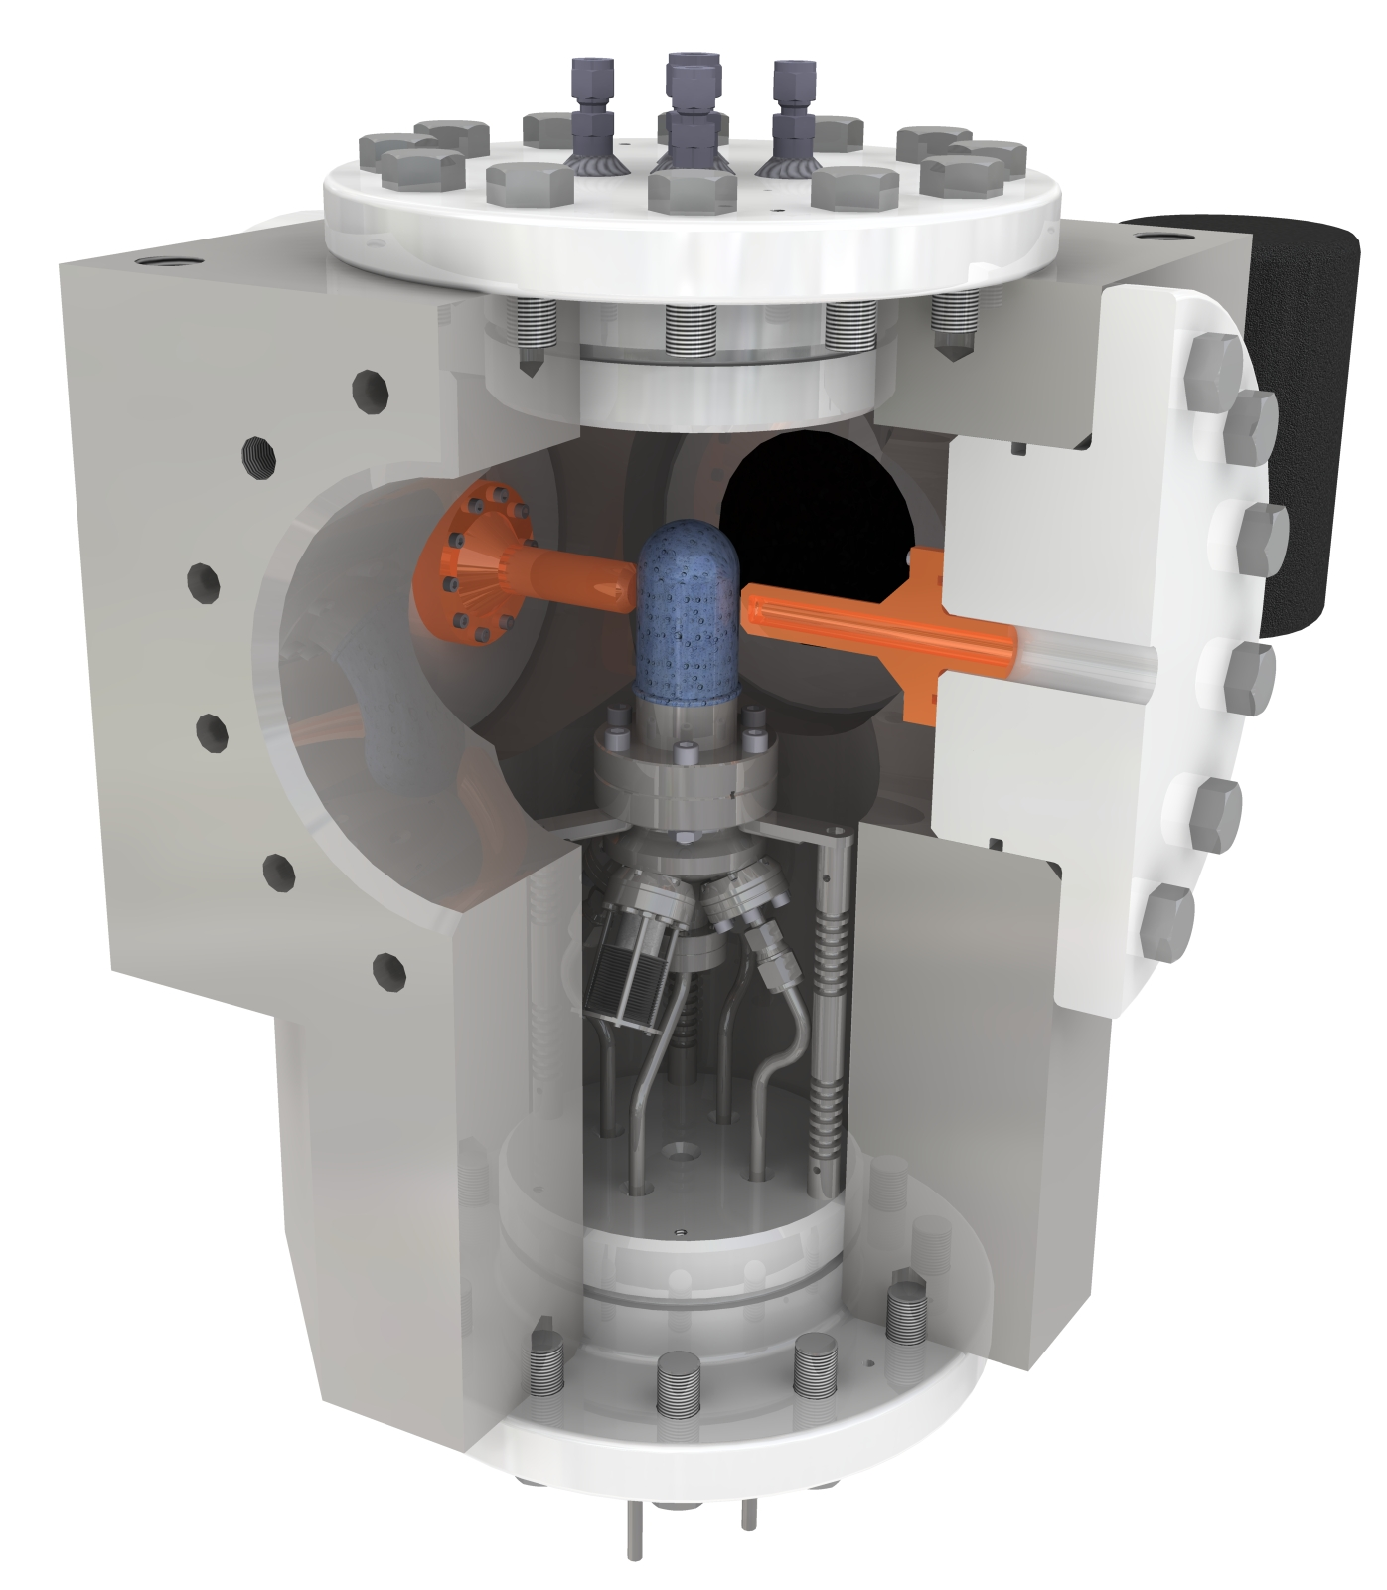
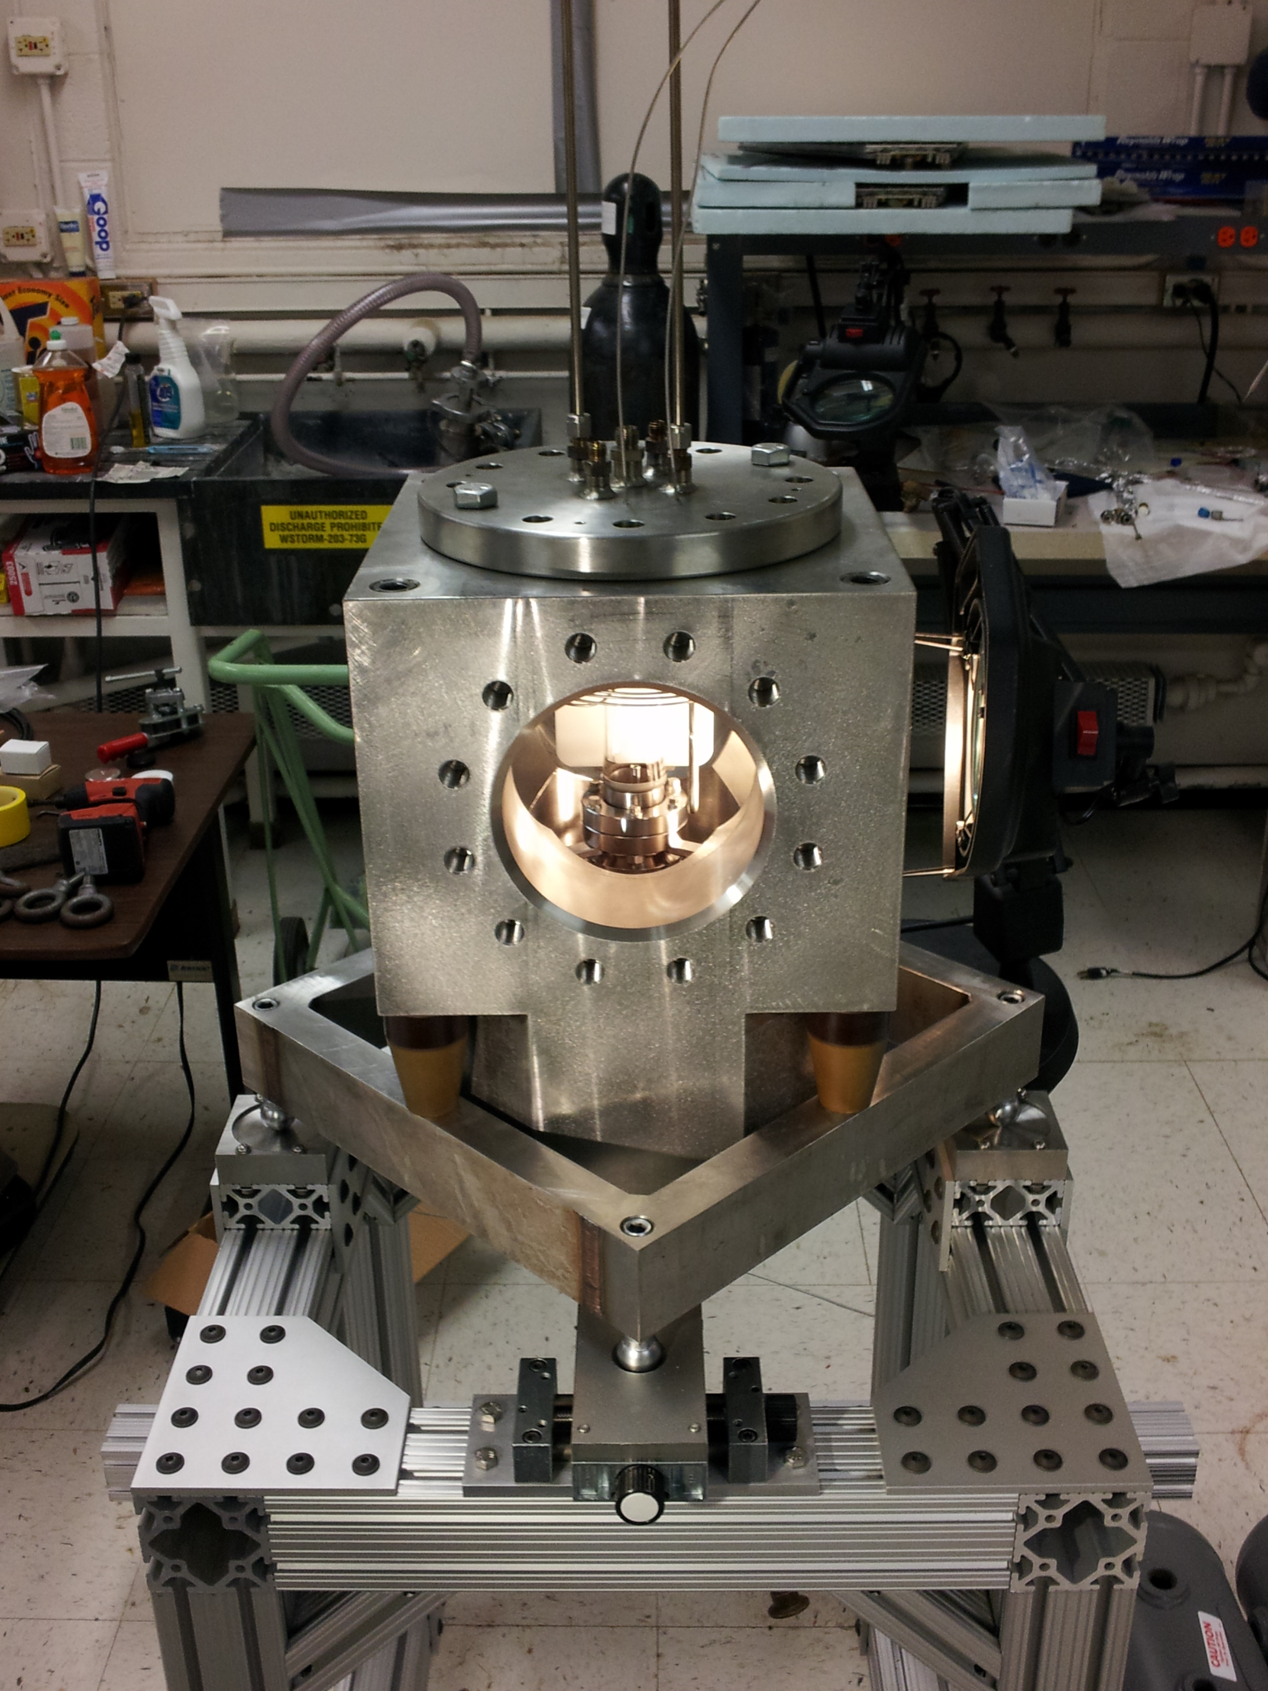

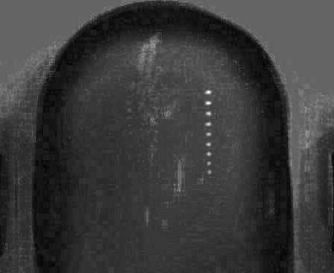
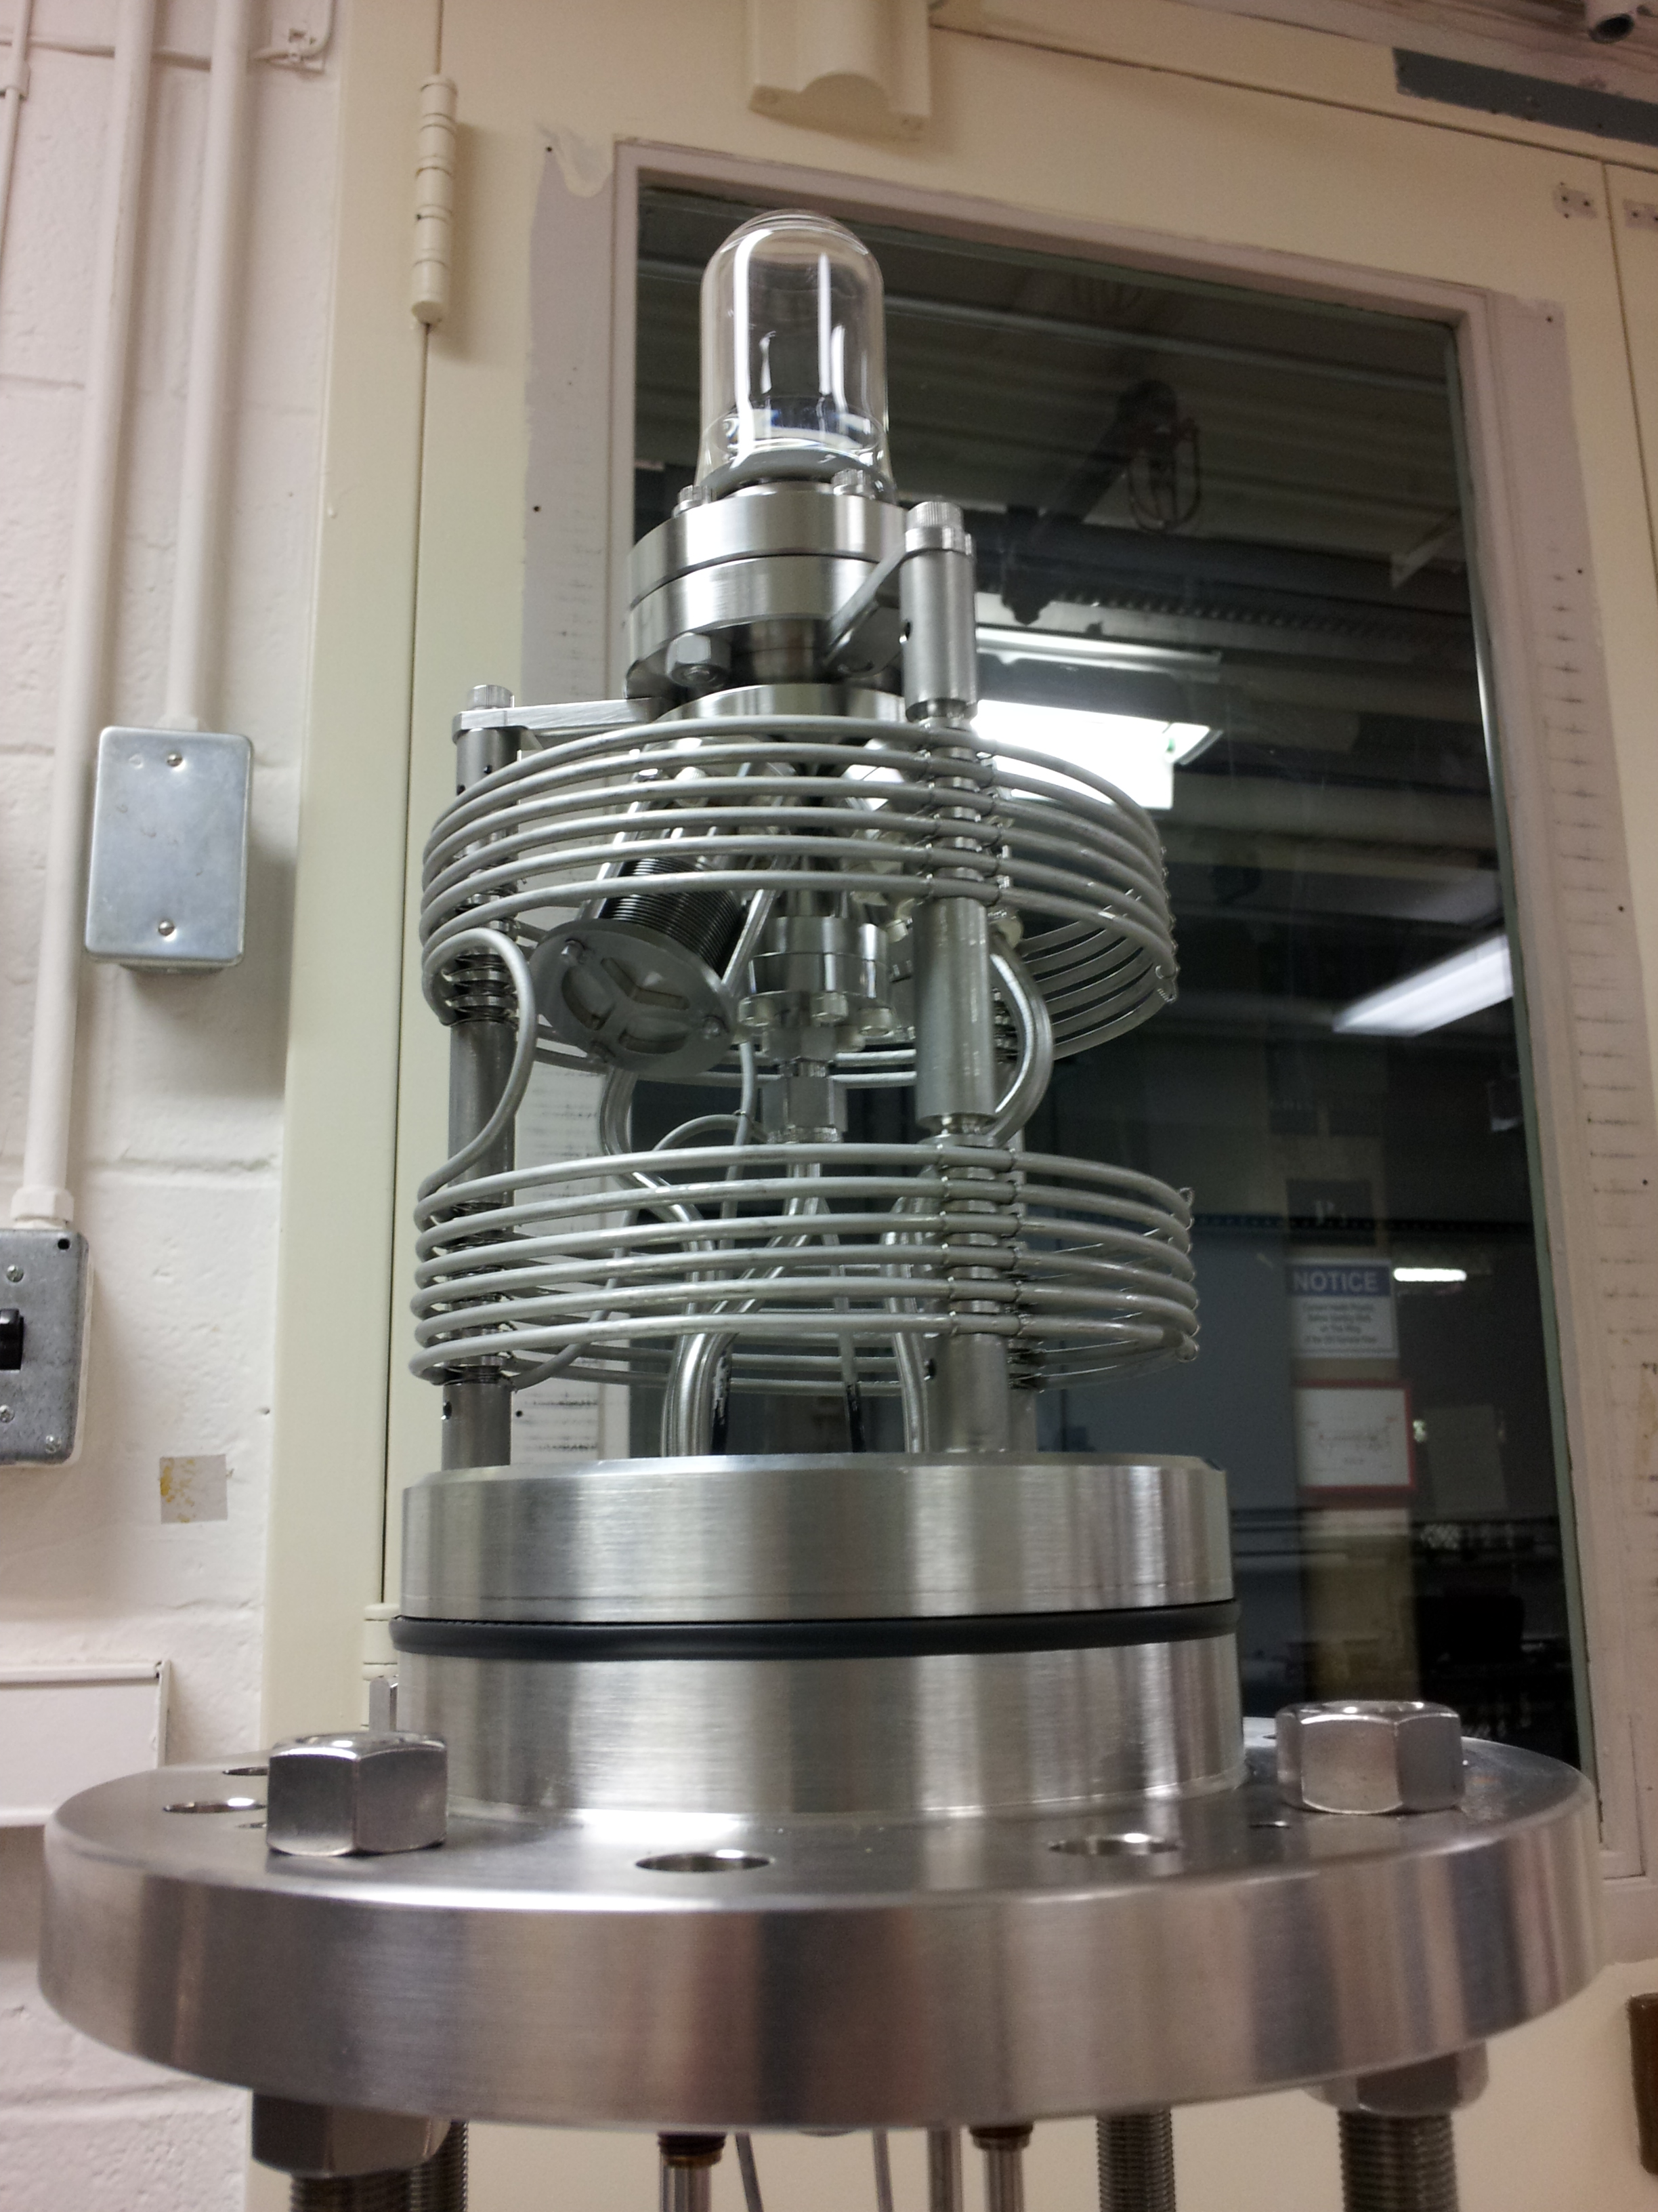
Recent Work
N₂O Bubble Chamber
First γ+O→α+C bubble
April 2013
Notes:
Interior Page Design 2

Slide 28
Superheated Targets
List of superheated liquids to be used in the experiment:
Readout:
  Optical Camera
  Acoustic Signal to discriminate between (γ,α) and (γ,n) events
N₂O Targets | ¹⁶O | ¹⁷O | ¹⁸O
Natural Target | 99.757% | 0.038% | 0.205%
¹⁶O Target |  | Depleted > 5,000 | Depleted > 5,000
¹⁷O Target |  | Enriched > 80% | <1.0%
¹⁸O Target |  | <1.0% | Enriched > 80%
Notes:
Interior Page Design 2

Slide 29
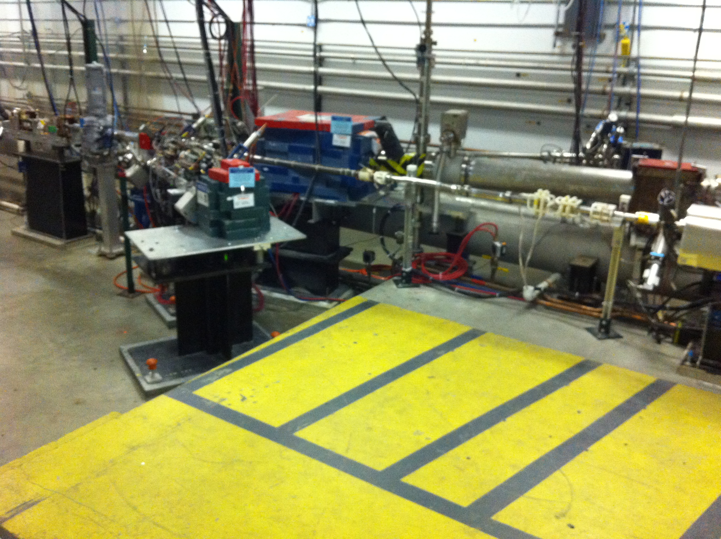
Experimental Setup
2D
Spectrometer
BCM
Mott Polarimeter
5 MeV
Dipole
5D Spectrometer
Bubble
Chamber
location
Notes:
Interior Page Design 2

Slide 30
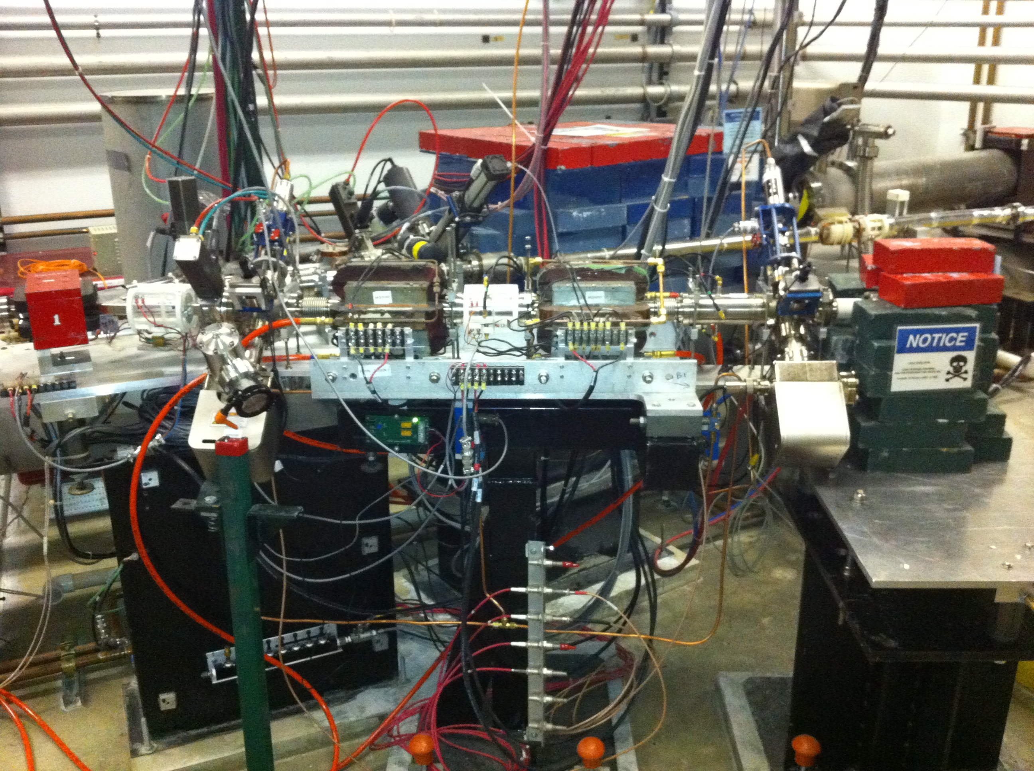
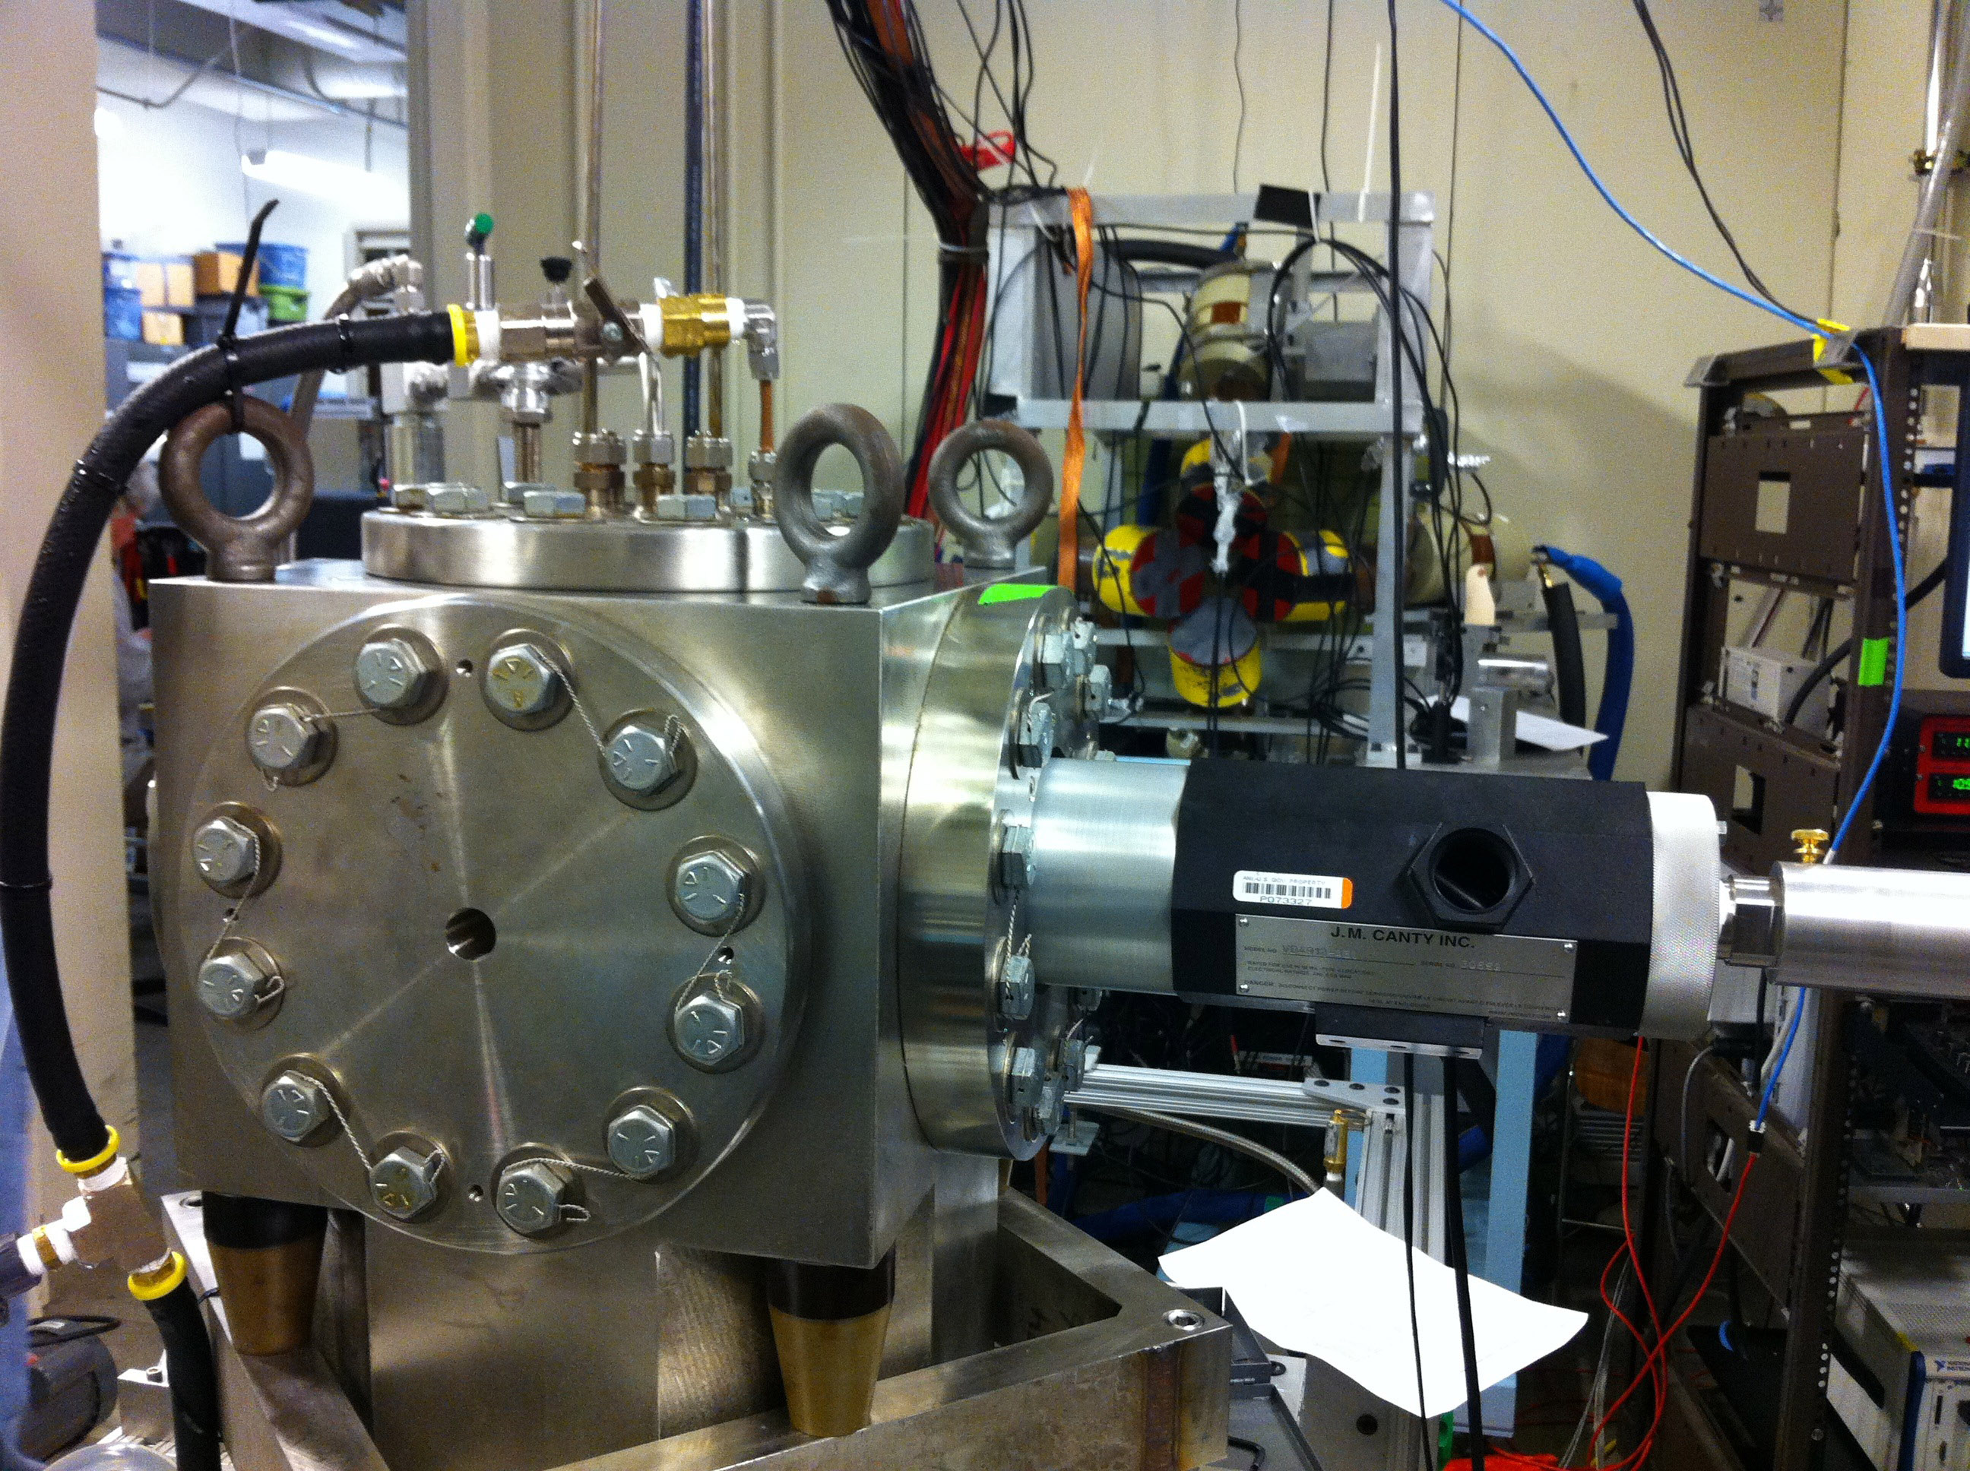
5D Spectrometer
Bubble Chamber at HIGS
Photon Beam
Entrance
Notes:
Interior Page Design 2

Slide 31
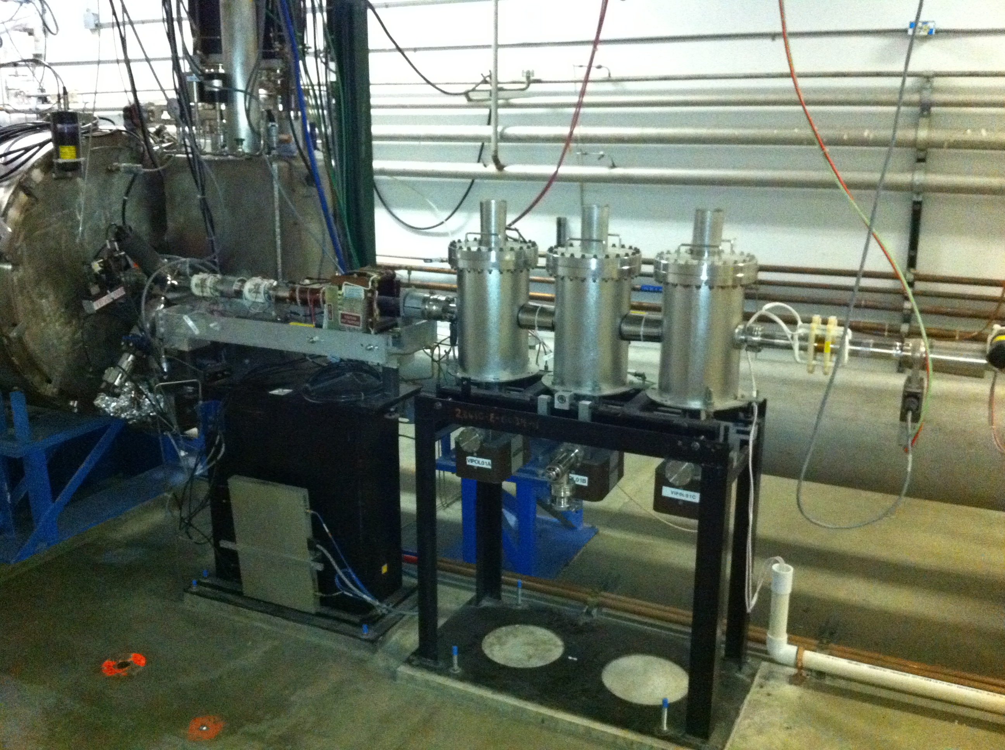
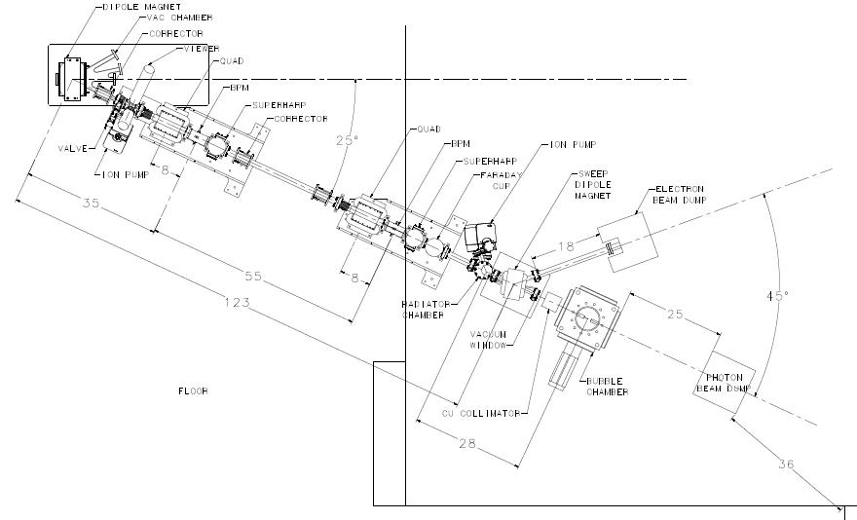
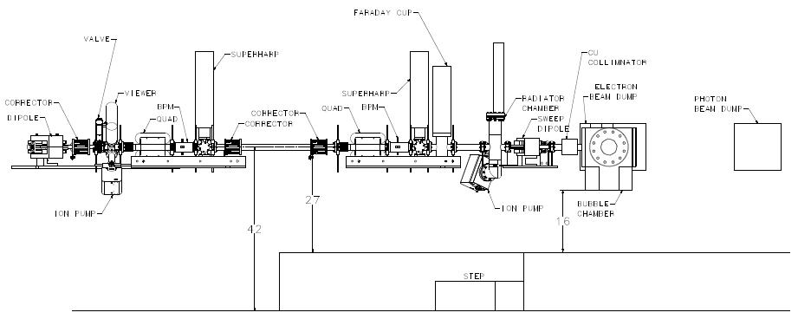
Beamline
New Fast Valve to protect from vacuum failure in front of ¼ Cryo-unit
Replace Dipole
Magnet
2 Superharps to measure beam profile and absolute beam position
Notes:
Interior Page Design 2

Slide 32
Schematics
Power deposited in radiator (100 µA and 8.5 MeV) :
  0.02 mm: Energy loss = 21 keV, P = 2.1 W
  0.10 mm: Energy loss = 112 keV, P = 11 W
Pure Copper and Aluminum (high neutron threshold):
  ⁶³C(γ,n) threshold = 10.86 MeV
  ²⁷Al(γ,n) threshold = 13.06 MeV
Electron K.E.
3.0 – 8.5 MeV
0.01 – 100 µA
Sweep Magnet
Radiator motion and Sweep Dipole current must be in FSD
BCM0L02 and Electron Dump in Beam Loss Accounting (BLA)
Cu Vacuum Window 10 mil
Cu Radiator
0.02 mm
Al Beam Pipe
Cu Photon
Collimator
20 cm
50 cm
Cu Inner
Pipe
Use GEANT4 to optimize this region
Al Photon Dump
10 cm long
20 cm diameter
Bubble Chamber
Superheated N₂O
3 cm long
15°C, 60 atm
Cu Electron Dump
Notes:
Interior Page Design 2

Slide 33
Beam Requirements
Beam Properties at Radiator:
PEPPo achieved p=8.25 MeV/c or K.E.=7.75 MeV. Maximum stable ¼- cryounit cavity gradients achieved: 8.4 MV/m and 6.1 MV/m (7.25 MV/m average). Vacuum in the beam line indicates that field emission and desorbed gas are the most problematic, but improve with processing.
Helium process the ¼-cryounit
Beam Kinetic Energy, (MeV) | 7.9 – 8.5
Beam Current (µA) | 0.01 – 100
Absolute Beam Energy | <0.1%
Relative Beam Energy | <0.02%
Energy Resolution (Spread), σ_{T} /T | 0.06%
Beam Size, σ_{x,y} (mm) | 1 – 2
Notes:
Interior Page Design 2

Slide 34
Absolute Beam Energy
BPM
5 MeV
Dipole
Electron Beam
Momentum
Notes:
Interior Page Design 2

Slide 35
Parameter | Term | Now | Goal
Dipole – linearity | δB/B | 0.25% | 0.02%
Dipole – spatial | δBL/BL | 0.10% | 0.02%
Dipole – reproduce | δB/B | 0.10% | 0.02%
Dipole – power supply | δI/I | 0.20% | 0.02%
Position – surveys | δθ/θ | 0.01% | 0.01%
Position – BPM calibration | δθ/θ | 0.05% | 0.05%
Stray magnetic field | δθ/θ | 0.05% | 0.05%
TOTAL | δP/P | 0.36% | <0.10%
Goal:
  Jay Benesch designed and now fabricating higher quality dipole (more uniformity, higher field)
  New Hall Probe: 0.01% accuracy, resolution to 2 ppm, and a temperature stability of 10 ppm/°C
  Relative beam energy error: <0.02%
Notes:
Interior Page Design 2

Slide 36
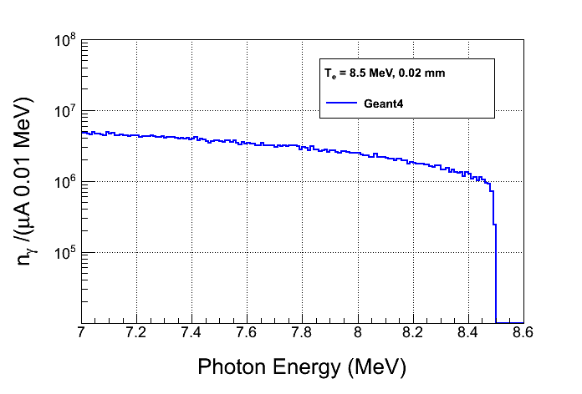
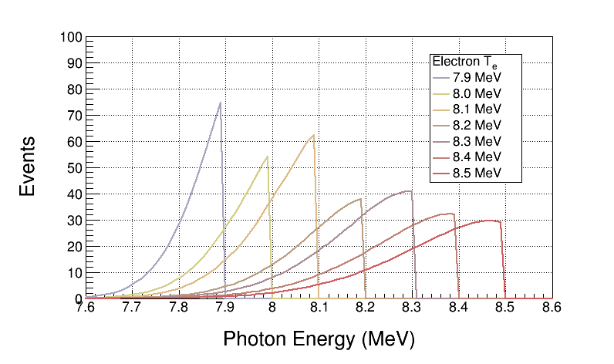
Bremsstrahlung Beam
Use both GEANT4 and FLUKA to calculate Bremsstrahlung spectra
Monte Carlo simulation of bremsstrahlung at radiotherapy energies is well studied, accuracy: 5%
Bremsstrahlung Peaks
¹⁶O(γ,α)¹²C is ideal case for Bremsstrahlung beam and Penfold – Leiss Unfolding :
  Very steep; only photons near endpoint contribute to yield
  No-structure (resonances)

Slide 37
GEANT4 Simulation
Both GEANT4 and FLUKA use models that calculate wrong photo–nuclear cross sections. Both do not allow for user’s cross sections.
  Use GEANT4 and FLUKA to produce the photon spectrum impinging on the super heated liquid.
  Fold the above photon spectrum with our cross sections in stand-alone codes.
Use GEANT4 to design Radiator/Collimator/Dump
Geometry in GEANT4:
Notes:
Interior Page Design 2

Slide 38
Penfold-Leiss Cross Section Unfolding
Measure Yields at: where,
The solution can be written in two forms:
Or, Matrix form:

Slide 39
Statistical Error Propagation
Note:
In case of background Subtraction
With:
Then:

Slide 40
Where:
Although,
For mono-chromatic beam

Slide 41
Results
Radiator Thickness = 0.02 mm
Bubble Chamber Thickness = 3.0 cm. Number of ¹⁶O nuclei = 3.474e22 /cm²
Background subtraction of ¹⁸O(γ,α)¹⁴C . ¹⁷O(γ,n)¹⁶O: Still to do
Electron Beam K. E. | Beam Current (µA) | Time (hour) | y_{i} | dy_{i} (no bg) | dy_{i}/y_{i} (no bg, %) | dy_{i} (with bg) | dy_{i}/y_{i} (with bg, %)
7.9 | 100 | 100 | 545 | 23 | 4.2 | 134 | 24.6
8.0 | 100 | 20 | 581 | 24 | 4.1 | 77 | 13.3
8.1 | 80 | 10 | 852 | 29 | 3.4 | 60 | 7.0
8.2 | 20 | 10 | 634 | 25 | 3.9 | 40 | 6.3
8.3 | 10 | 10 | 812 | 28 | 3.4 | 39 | 4.8
8.4 | 4 | 10 | 746 | 27 | 3.6 | 36 | 4.8
8.5 | 2 | 10 | 763 | 28 | 3.7 | 32 | 4.2
Notes:
Interior Page Design 2

Slide 42
Systematic Error Propagation
For absolute beam energy uncertainty of δE (= 0.1%) and zero relative beam energy uncertainty:
E_{i} (MeV) | dy_{i}/y_{i} (%) | dσ_{i}/σ_{i} (%)
7.9 | 12.5 | 12.6
8.0 | 10.8 | 10.5
8.1 | 9.3 | 9.1
8.2 | 8.0 | 7.1
8.3 | 7.0 | 6.3
8.4 | 6.3 | 5.8
8.5 | 5.6 | 5.2
This is the cross section dependence on energy
Accounted for dN_{ij} due to energy error when calculating dy_{i}

Slide 43
With:
Then:

Slide 44
Where:
Note: Correlation Coefficient =1
No point-to-point systematic

Slide 45
Systematic Error Propagation
No point-to-point systematic

Slide 46
Other Systematic Errors
Beam Current, δI/I | 3%
Photon Flux, δφ/φ | 5%
Radiator Thickness, δR/R | 3%
Bubble Chamber Thickness, δT/T | 3%
Bubble Chamber Efficiency, ε | 5%
Simulation
Then:

Slide 47
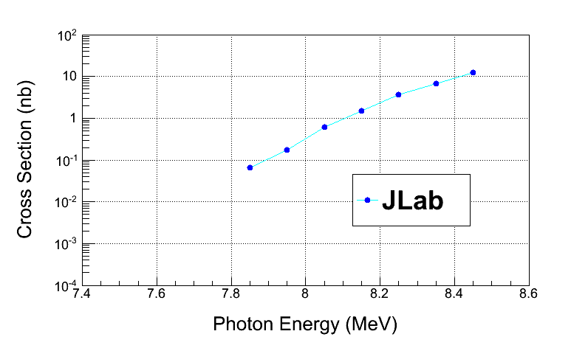
Electron Beam K. E. | Cross Section (nb) | Stat Error (no bg, %) | Stat Error (with bg, %)
7.9 | 0.046 | 4.4 | 24.5
8.0 | 0.185 | 6.0 | 20.7
8.1 | 0.58 | 6.3 | 14.7
8.2 | 1.53 | 8.2 | 13.8
8.3 | 3.49 | 9.1 | 13.3
8.4 | 7.2 | 10.6 | 13.8
8.5 | 13.6 | 12.2 | 14.8
Note: Relative systematic errors do not get amplified in PL Unfolding
Electron Beam K. E. | Cross Section (nb) | Sys Error (Energy, %) | Sys Error (Total, %)
7.9 | 0.046 | 12.5 | 15.3
8.0 | 0.185 | 10.2 | 13.5
8.1 | 0.58 | 8.3 | 12.2
8.2 | 1.53 | 7.0 | 11.4
8.3 | 3.49 | 6.0 | 10.7
8.4 | 7.2 | 5.3 | 10.5
8.5 | 13.6 | 4.7 | 10.1

Slide 48
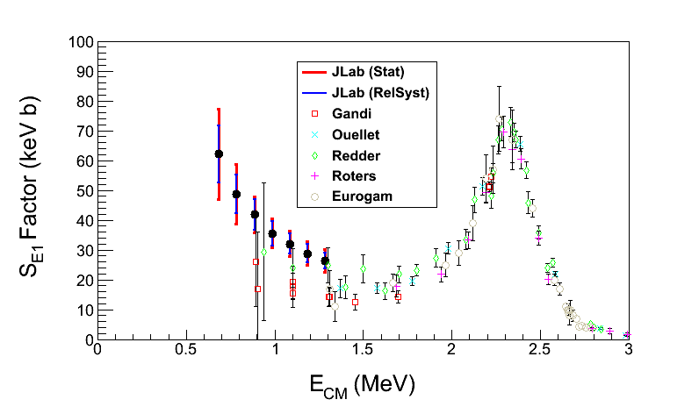
The ¹²C(α,γ)¹⁶O S-Factor
Statistical Error: dominated by background subtraction from ¹⁸O(γ,α)¹⁴C (depletion = 5,000)
Electron Beam K. E. | Gamma Energy (MeV) | E_{CM} (MeV) | Cross Section (nb) | S_{E1} Factor (keV b) | Stat Error (%) | Sys Error (Total, %)
7.9 | 7.85 | 0.69 | 0.046 | 62.2 | 24.5 | 15.3
8.0 | 7.95 | 0.79 | 0.185 | 48.7 | 20.7 | 13.5
8.1 | 8.05 | 0.89 | 0.58 | 41.8 | 14.7 | 12.2
8.2 | 8.15 | 0.99 | 1.53 | 35.5 | 13.8 | 11.4
8.3 | 8.25 | 1.09 | 3.49 | 32.0 | 13.3 | 10.7
8.4 | 8.35 | 1.19 | 7.2 | 28.8 | 13.8 | 10.5
8.5 | 8.45 | 1.29 | 13.6 | 26.3 | 14.8 | 10.1
S_{E1}(300 keV) = 74±21 keV b

Slide 49
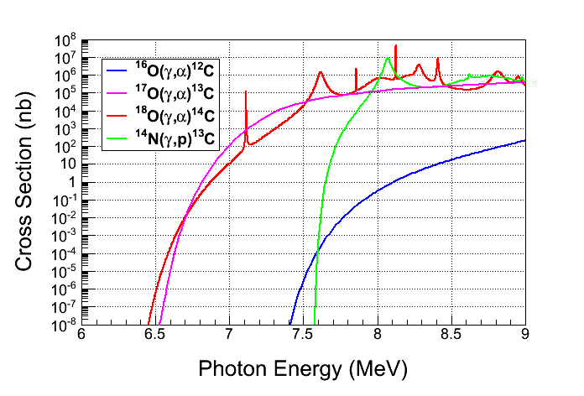
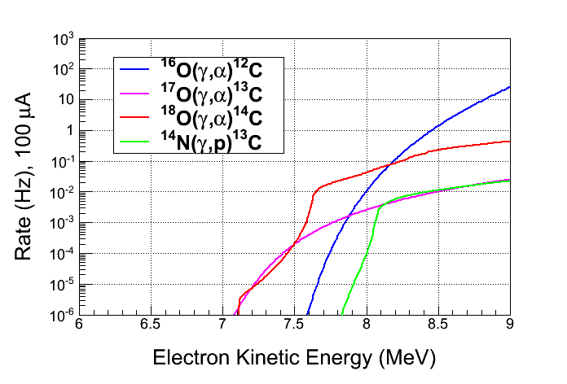
Backgrounds
Background from oxygen
isotopes and nitrogen in N₂O:
  ¹⁸O(γ,α)¹⁴C
  ¹⁷O(γ,α)¹³C
  ¹⁴N(γ,p)¹³C
Natural Abundance:
    ¹⁷O: 0.038%
    ¹⁸O: 0.205%
Expected Rates:
  ¹⁷O(γ,α)¹³C, depletion=5,000
  ¹⁸O(γ,α)¹⁴C, depletion=5,000
  ¹⁴N(γ,p)¹³C, detection eff.= 10⁻⁸
Notes:
Interior Page Design 2

Slide 50
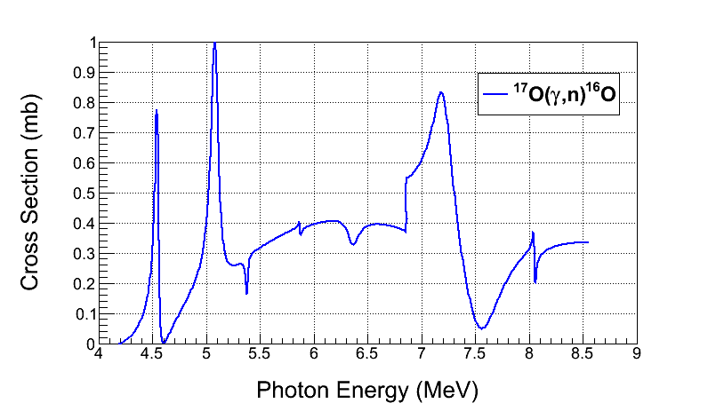
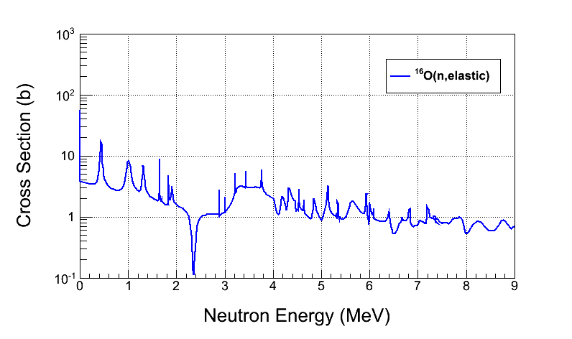
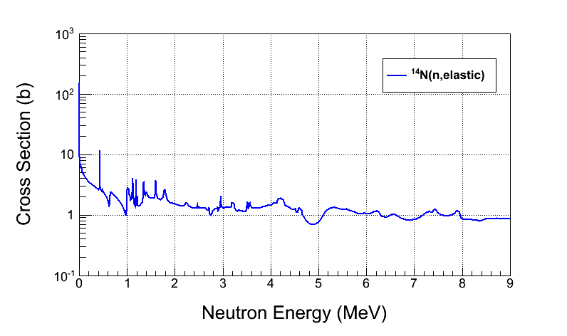
Background from:
  ¹⁷O(γ,n)¹⁶O and secondary (n,n)
  neutron–nucleus elastic scattering
Cosmic–ray background:
  µ±–nuclear
  neutron–nuclear elastic scattering
Reject neutron background using
the acoustic signal (500 factor)
Notes:
Interior Page Design 2

Slide 51
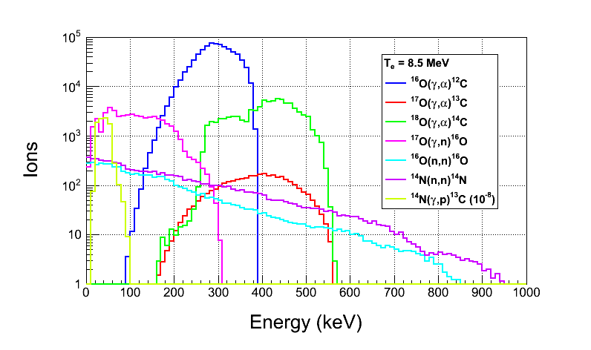
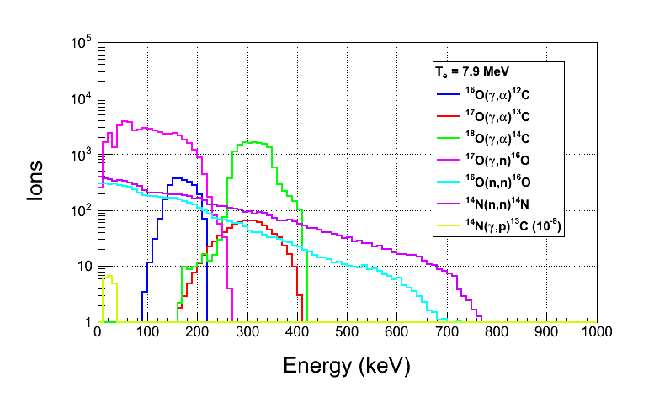
Ion Energy Distributions
Suppress background
with Bubble Chamber threshold
Calculated with Depletion:
  ¹⁷O depletion = 5,000
  ¹⁸O depletion = 5,000
Threshold Efficiency (function
of superheat):
Particle | Efficiency
e± | <10⁻¹¹
γ | <10⁻¹¹
(γ,n) | 2x10⁻³
Notes:
Interior Page Design 2

Slide 52
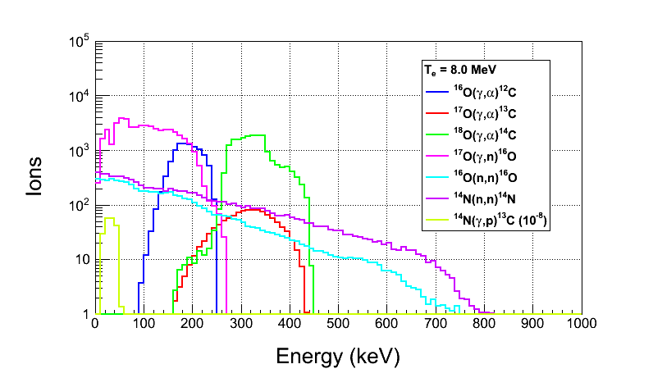



Notes:
Interior Page Design 2

Slide 53

Safety
Super heated liquid N₂O, Nitrous oxide (laughing gas)
  At room temperature, it is a colorless, non-flammable gas, with a slightly sweet odor and taste
High pressure system:
  Design Authority: Dave Meekins
  T =
  P =
Buffer liquid: Mercury
  Closed system
  Volume: 135 mL
0
2
0
OX
0
3
0
Notes:
Interior Page Design 2

Slide 54
Summary and Outlook
Test N₂O Bubble Chamber at HIGS (February 2014)
Perform ¹⁸O(γ,α)¹⁴C and ¹⁷O(γ,α)¹³C experiments at HIGS (Summer 2014)
Test Bubble Chamber at JLab with Bremsstrahlung beam (October 2014)
If successful, run depleted N₂O bubble chamber at JLab ¹⁶O(γ,α)¹²C
Bubble Chamber issues:
  Piezo–electric acoustical signal
  Deadtime study (now τ ± dτ = 10.0 ± 0.9 s)
  Measure O-isotopes depletion
Background tests:
  Measure cosmic–ray background
  Study chamber efficiency vs. superheat
Notes:
Interior Page Design 1

Slide 55
Backup Slides
Notes:
Interior Page Design 1

Slide 56
Cost Estimate
New beamline components:
  New Dipole Magnet and Hall Probe
  2 Super Harps
  Fast Valve
Summary of labor cost by group:
Group | Labor
Survey & Alignment | 3 wks x 2
Magnet Test | 1 wk x 2
Engineering Design | 16 wks
Software | 3 wks x 2
EES | 6 wk x 2
EH&Q | 4 wks
Notes:
Interior Page Design 1

Slide 57
Item | Material Procurement | Shop | Labor
New Dipole Magnet | Dipole Magnet ($8,000) Hall Probe System ($10,000) |  | Design (2 week) Mapping (1 week) EESDC (1 week) Alignment (2 days)
New Beamline | 2 Super Harps (20,000) Fast Valve ($23,000) | Pipes + Pedestals ($20,000) | Design (6 weeks) Alignment (1 week) Software (6 weeks) EES (6 weeks)
Radiator (cooled ladder, FSD) | 0.02 and 0.10 mm Cu foils ($2,000) | $4,000 | Design (2 week) Alignment (2 days)
Sweep Dipole
Electron Dump | Pure Cu ($5,000) | Dump + Pipes ($15,000) | Design (4 weeks) Alignment (1 day)
Cu Collimator | Pure Cu ($5,000) | Collimator + Stand ($5,000) | Design (1 week) Alignment (1 day)
Photon Dump & Stand | Pure Al ($3,000) | $4,000 | Design (1 week) Alignment (1 day)
Safety Review |  |  | 4 weeks
Install |  |  | 6 weeks
Bubble Chamber |  |  | Alignment (1 week)
Total | $76,000 | $48,000 | $80,000
Indirect G&A (55.65%) | $42,300 | $26,400 | $42,500
Indirect Stat & Fringe (57.15%) |  |  | $45,700
Total | $118,300 | $74,400 | $168,200
Notes:
Accelerator is paying for magnet and Hall Probe System.
Accelerator will pay for Fast Valve and its electronics.

Slide 58



CO₂ Superheated Liquid?
Natural Abundance: ¹³C: 1.07%
Depletion: ¹³C depletion=1,000
¹³C(γ,n)¹²C Background
For comparison, ¹⁷O(γ,n)¹⁶O
¹²C(γ,2α)α Background
Notes:
The acoustic signal will suppress neutron events (?). What is the expected background from 3-alpha?

Slide 59
Water Superheated Liquid?
Etching of glass vessel by superheated H₂O
T = 250˚C
P =

Slide 60


