Slide 1

Measurement of ¹⁶O(γ,α)¹²C with a Bubble Chamber and a Bremsstrahlung Beam at Jefferson Lab Injector
Riad Suleiman
January 9, 2014
Notes:
Title Page

Slide 2





B. DiGiovine
D. Henderson
R. J. Holt
K. E. Rehm
J. Benesch
P. Degtiarenko
A. Freyberger
J. Grames
C. Tennant
G. Kharashvili
D. Meekins
M. Poelker
Y. Roblin
R. Suleiman
V. Vylet
A. Robinson
C. Ugalde
A. Sonnenschein
Notes:
Interior Page Design 2

Slide 3
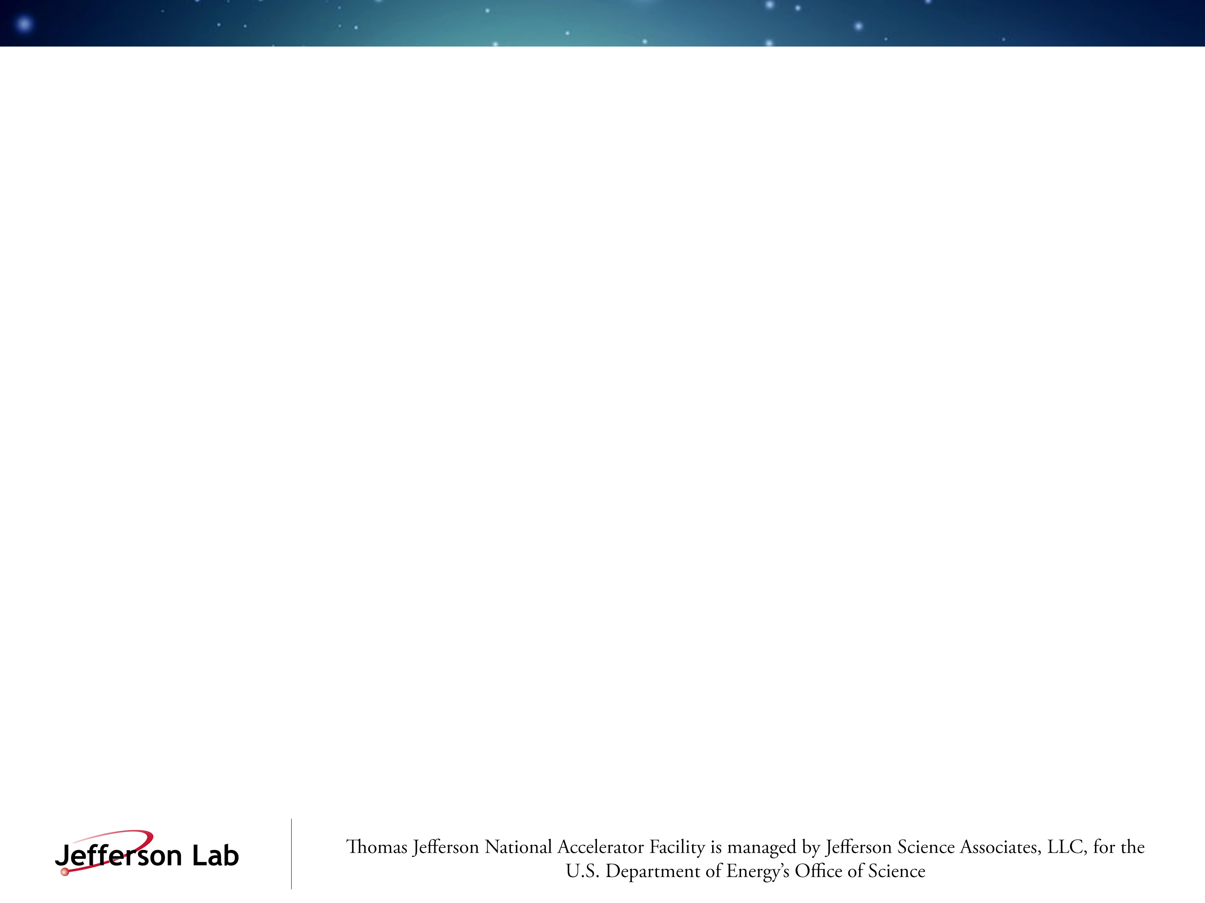
Outline
Nucleosynthesis and the ¹²C(α,γ)¹⁶O Reaction
Time-reversal Reaction: ¹⁶O(γ,α)¹²C
Bubble Chamber Theory and Design
Work at HIGS
Experimental Setup at Jefferson Lab Injector
Bremsstrahlung Beam and Penfold-Leiss Unfolding
Statistical and Systematic Errors
Backgrounds and Ion Energy Distributions
Safety
Summary and Outlook
Notes:
Interior Page Design 1

Slide 4

Relative Abundance of Elements by Weight
Notes:
Interior Page Design 2

Slide 5
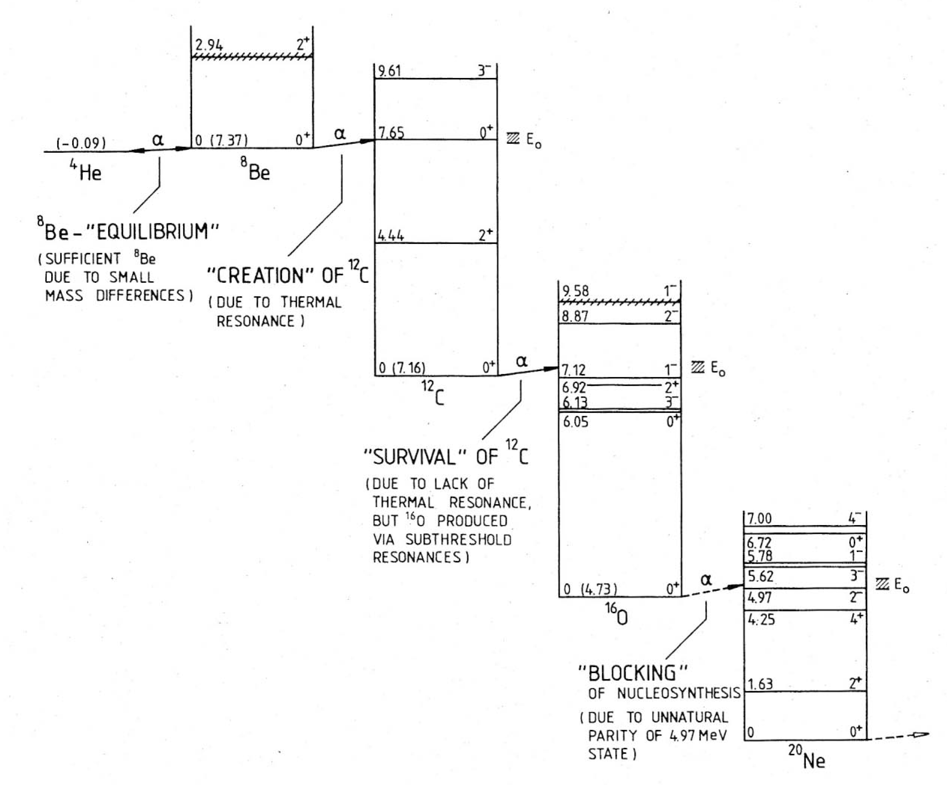
Stellar Helium Burning
Gamow Peak
Rolfs and Rodney, 1988
Notes:
Interior Page Design 2

Slide 6

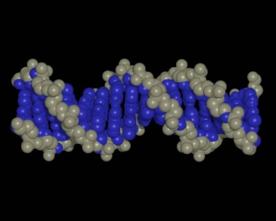

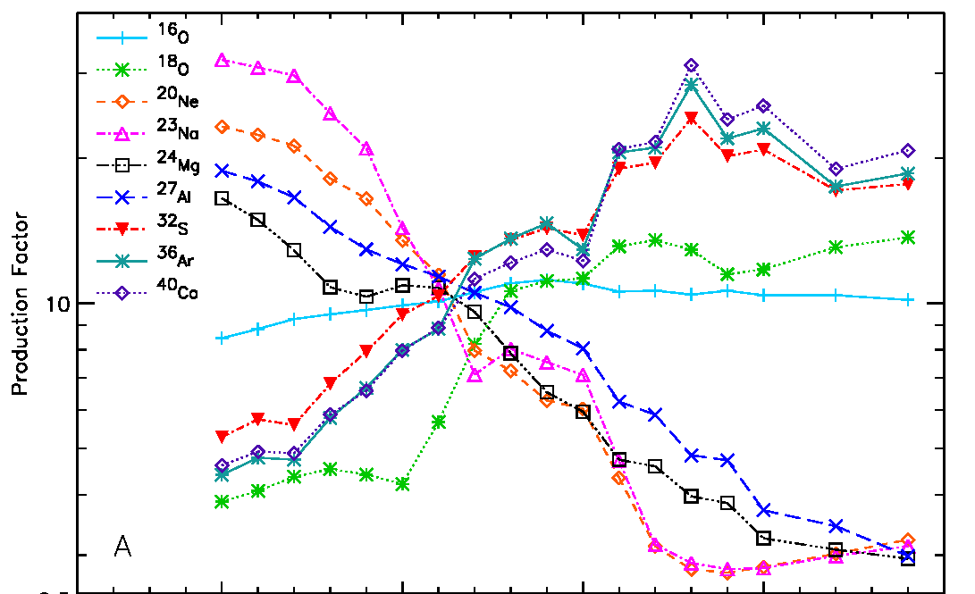
The ¹²C(α,γ)¹⁶O Reaction
The “holy grail” of nuclear astrophysics
Affects the synthesis of most of the elements of the periodic table
Sets the C to O ratio in the universe
Determines the minimum mass a star requires to become a supernova
S. Woosley, A. Heger, Phys. Rep. 442 (2007) 269
Notes:
Interior Page Design 2

Slide 7
Stellar Carbon Burning
Helium burning stage of stellar evolution occurs at T=0.2 10⁹ K
Most effective stellar energy, E_{CM} = 300 keV
He burning at cross section σ ̴10⁻¹⁷ barn
Thermonuclear reaction rate involving two nuclei is:
Notes:
Interior Page Design 2

Slide 8
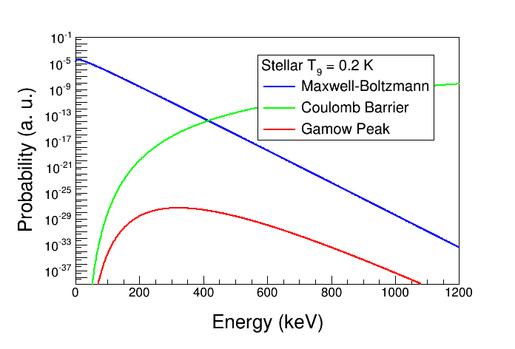
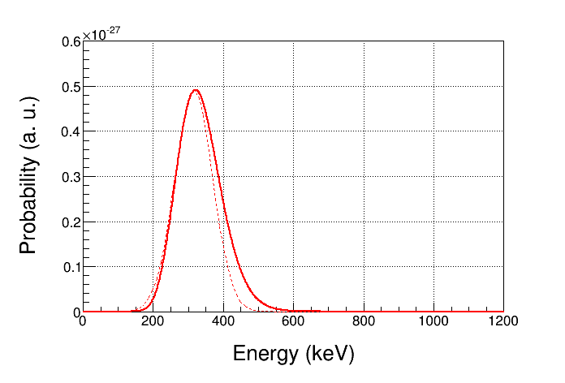
The Gamow Peak
Narrow energy range where thermonuclear reactions is most likely to occur in stellar plasma is a product of two distributions:
  Maxwell-Boltzmann energy distribution with e^{-E/kT}
  Penetration through Coulomb barrier with e^{-b/E½}
For α + ¹²C (Z₁=2, Z₂=6, A=3),
and stellar T=0.2 10⁹ K:
  Gamow Peak, E₀ = 315 keV, W = 54 keV
  Maximum of Maxwell-Boltzmann
  energy distribution, kT = 17 keV
keV
keV
Notes:
Interior Page Design 2

Slide 9
Heroic efforts in search of the holy grail of astrophysics: ¹²C(α,γ)¹⁶O
Previous Experiments:
  Direct Techniques:
    Helium ions on carbon target: ¹²C(α,γ)¹⁶O
    Carbon ions on helium gas: ⁴He(¹²C,¹⁶O)γ
  Indirect Methods:
    β–delayed α decay of ¹⁶N (J^{π}=2–, T_{½}=7.13 sec, BR=0.12%). N → β– + α + ¹²C
    Elastic α – ¹²C Scattering
Experiment | Beam Current (mA) | Detector Efficiency | Target (nuclei/cm²) | Time (h)
Redder | 0.7 | Ge, 35% | ¹²C, 3 10¹⁸ | 900
Ouellet | 0.03 | Ge, 30% | ¹²C, 5 10¹⁸ | 1950
Roters | 0.02 | BGO, 270% | ⁴He, 1 10¹⁹ | 5000
Kunz | 0.45 | Ge, 100% | ¹²C, 3 10¹⁸ | 700
EUROGAM | 0.34 | Ge, 70% | 1E19 | 2100
Notes:
Interior Page Design 2

Slide 10
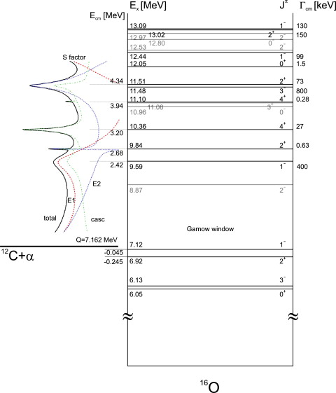
Energy Level-diagram of ¹⁶O
S_{E1}(300) | 70±20
S_{E2}(300) | 70±20
S_{casc}(300) | 70±20
No Resonances but interferences
Notes:
Interior Page Design 2

Slide 11
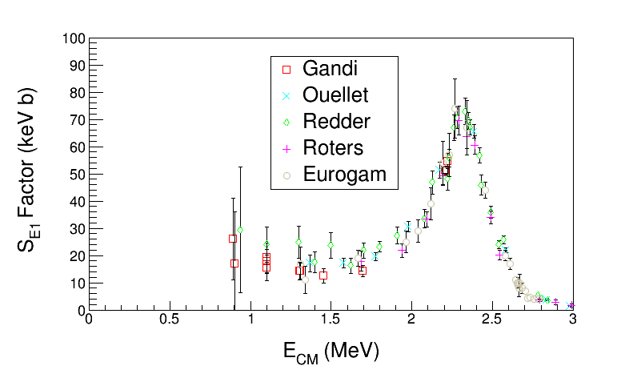
Astrophysical S-Factor ¹²C(α,γ)¹⁶O
Define S-Factor to remove both 1/E dependence of nuclear cross sections and Coulomb barrier transmission probability:
Author | S(300 keV) (keV b)
Buchmann (2005) | 102–198
Caughlan and Fowler (1988) | 120–220
Hammer (2005) | 162±39
Extrapolate to Stellar helium burning at E = 300 keV
Notes:
Interior Page Design 2

Slide 12
(γ,α) and (α,γ) – Reciprocity Relation
A(α, γ)B:
σ(γ,α) is over two orders of magnitude larger than σ(α, γ)
MeV
MeV
Notes:
Interior Page Design 2

Slide 13
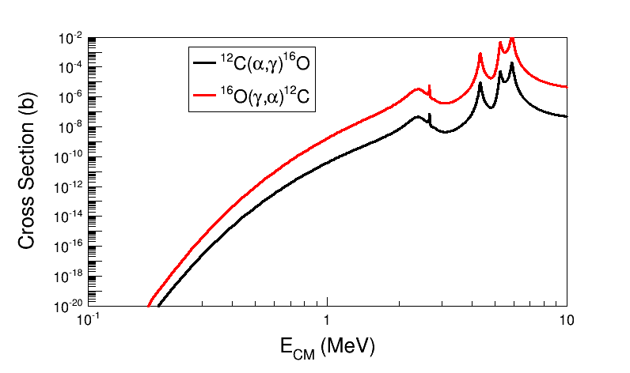
Time Reversal Reaction
¹²C
¹⁶O
α
γ
Notes:
Interior Page Design 2

Slide 14
New Approach: Reversal Reaction + Bubble Chamber
beam
target
signal
Extra gain (factor of 100) by measuring time reversal reaction
Target density up to 10⁴ higher than conventional targets. Number of ¹⁶O nuclei = 3.5 10²² /cm²
Solid Angle and Detector Efficiency = 100%
Superheated liquid will nucleate from α and ¹²C recoils
Electromagnetic debris (electrons and gammas, or positrons) do NOT trigger nucleation (detector is insensitive to γ-rays by at least 1 part in 10¹¹).
γ + ¹⁶O → ¹²C + α
Monochromatic γ beam at HIGS ̴10⁷⁻⁸ γ/s
Bremsstrahlung at JLab ̴10⁹ γ/s (top 250 keV)
Notes:
Interior Page Design 2

Slide 15
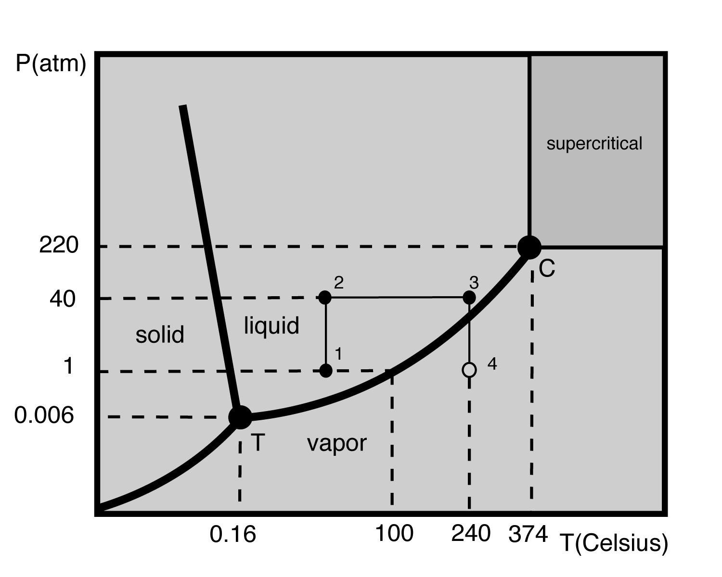
Bubble Chamber Theory and Design
Donald Glaser, 86, won Nobel for inventing chamber to detect subatomic particles (1960)
Dark Matter Search
COUPP PRL106,021203(2011)
PICASSO PLB,682,185(2009)
SIMPLE PRL105, 211301(2010)
Superheat
Notes:
Interior Page Design 2

Slide 16
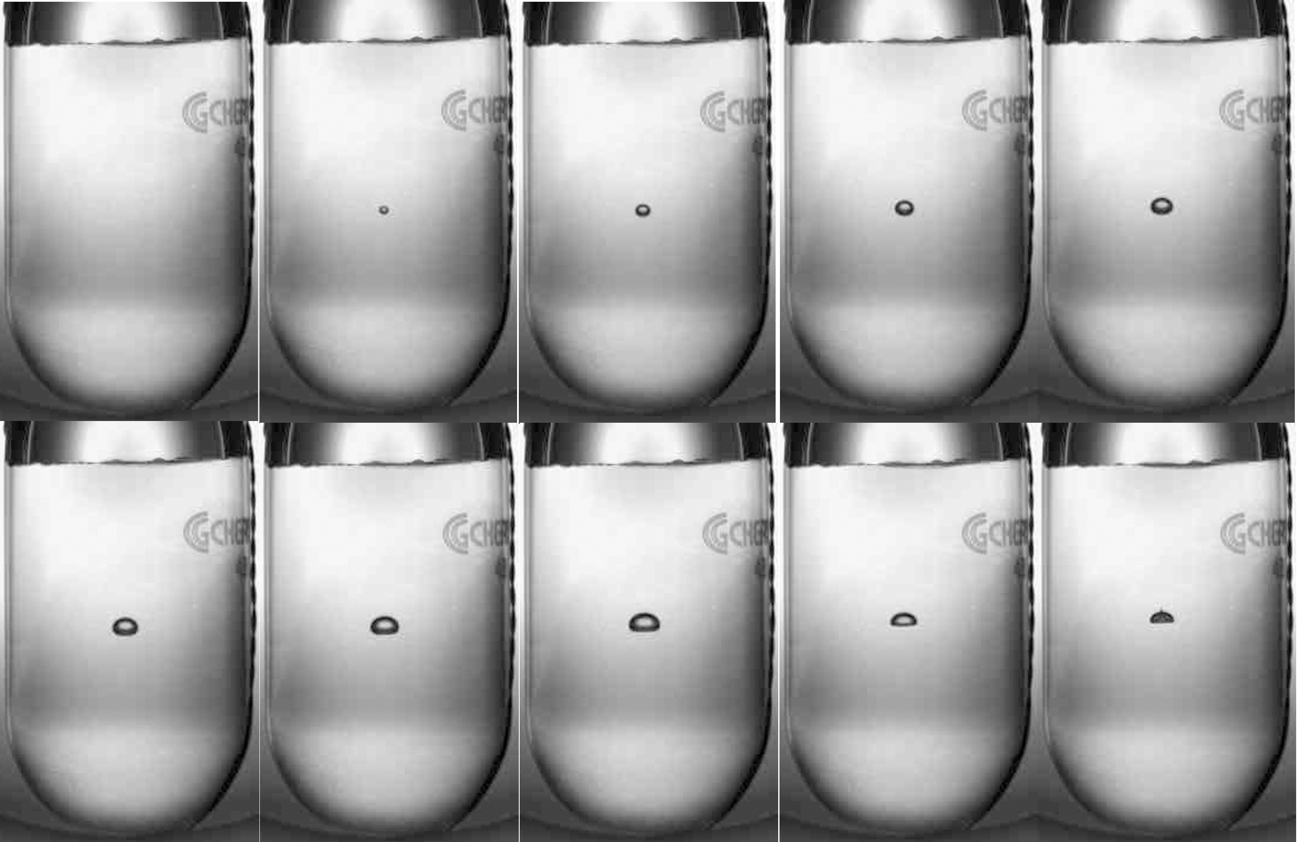
Bubble Growth and Quenching
¹⁹F(γ,α)¹⁵N in R134a
Δt = 10 ms
Notes:
Interior Page Design 2

Slide 17
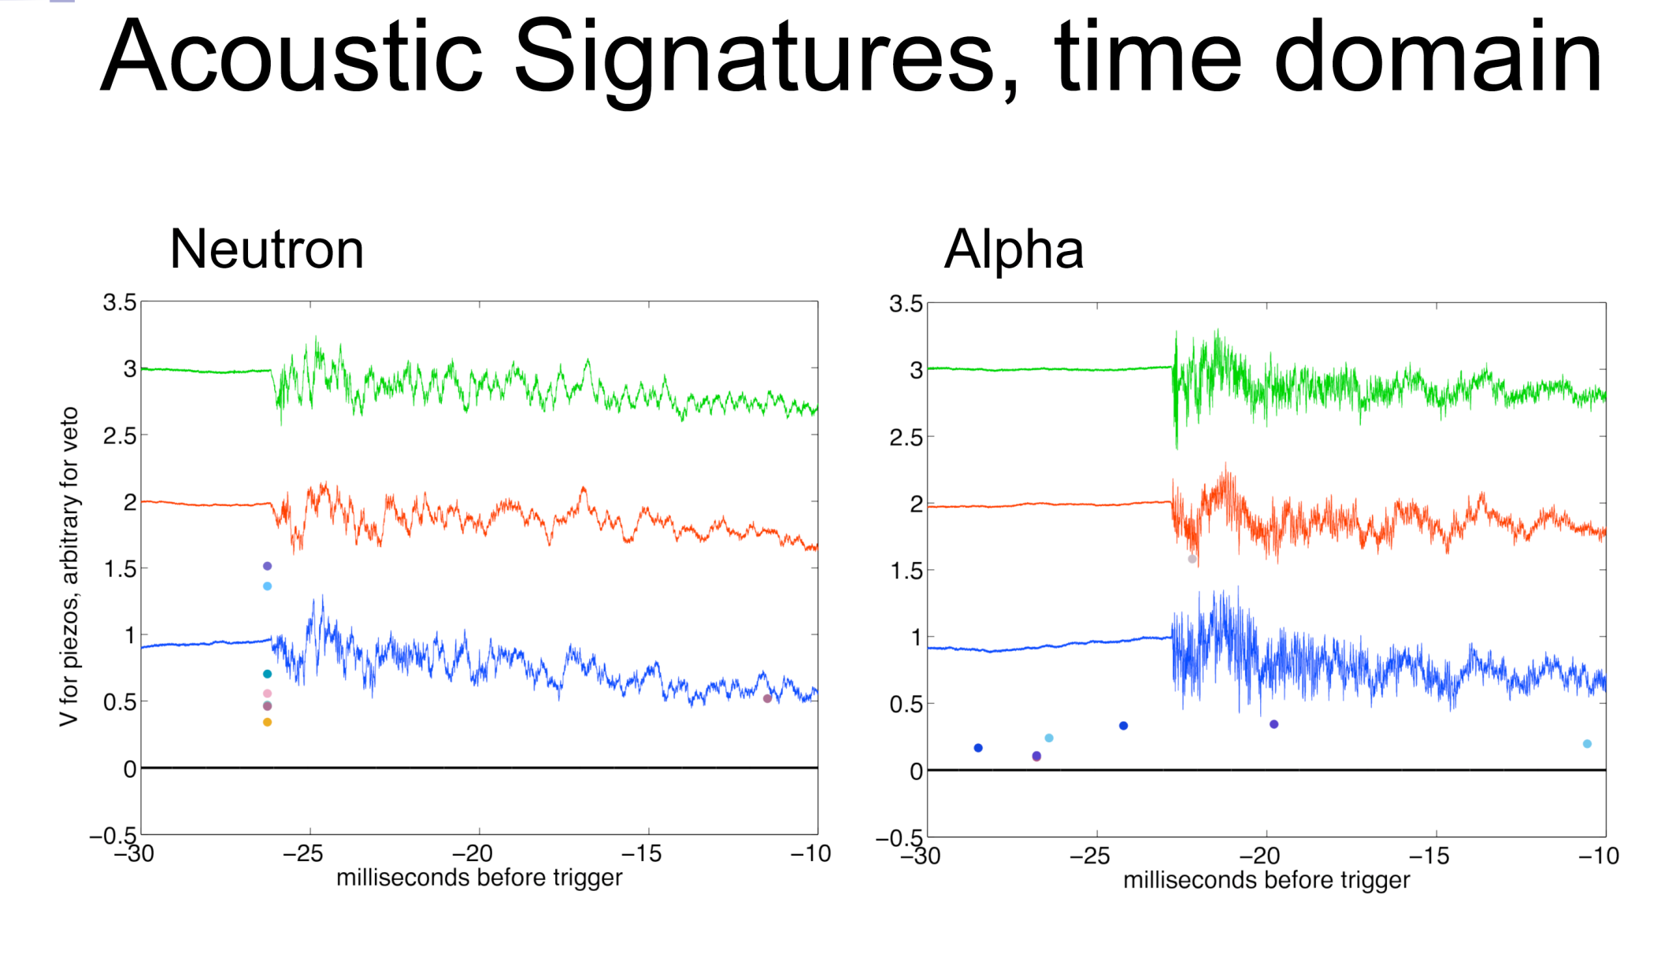
Acoustic Signal: Particle ID
Suppress neutron events by x500 from acoustic signal – FNAL dark matter bubble chambers
COUPP, FNAL, courtesy of A. Sonnenschein
Notes:
What about proton events, i.e, (g,p)?

Slide 18
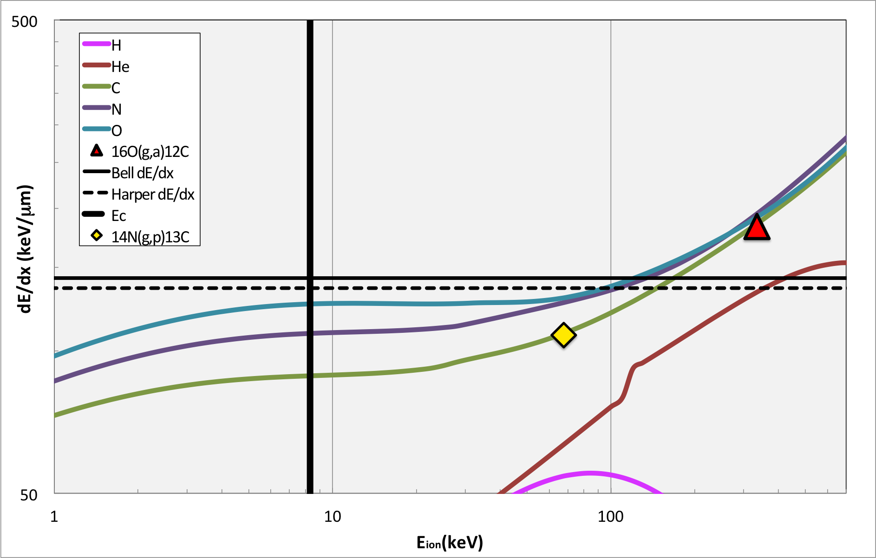
N₂O thresholds, Superheat = 3.3 ^{O}C, Eγ=8.5 MeV

Slide 19
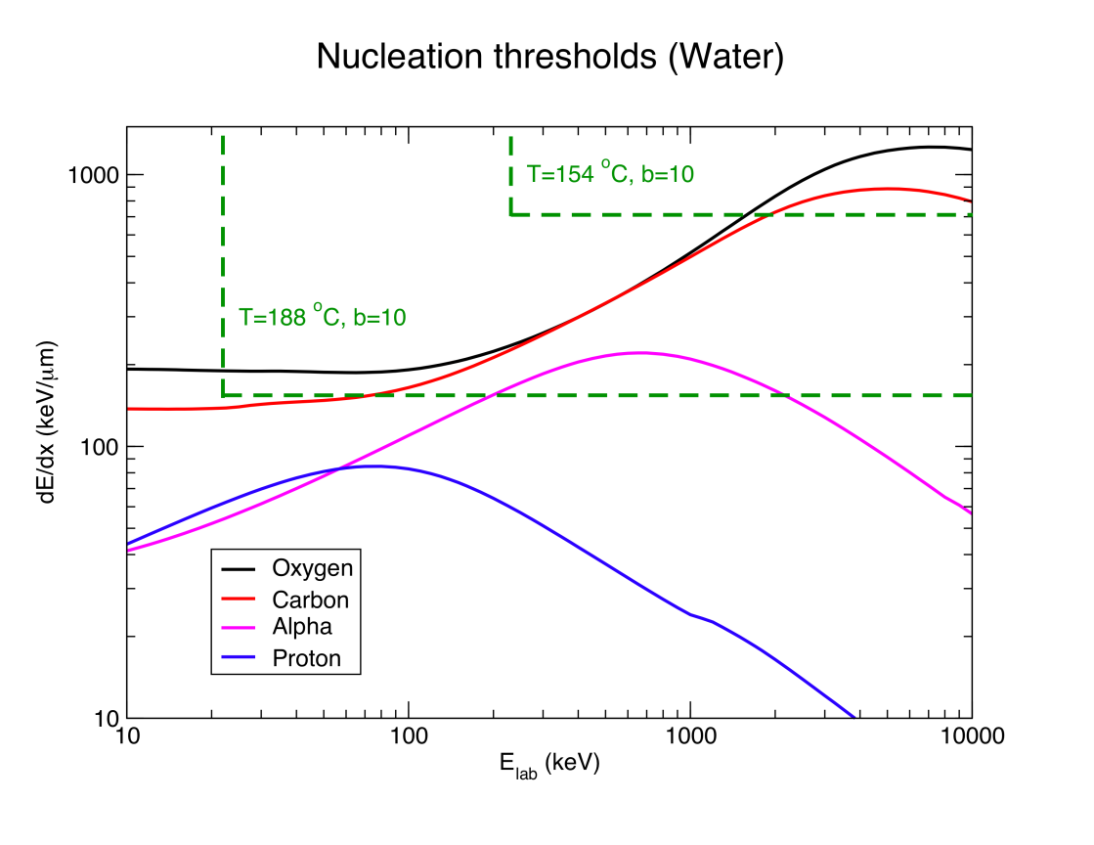
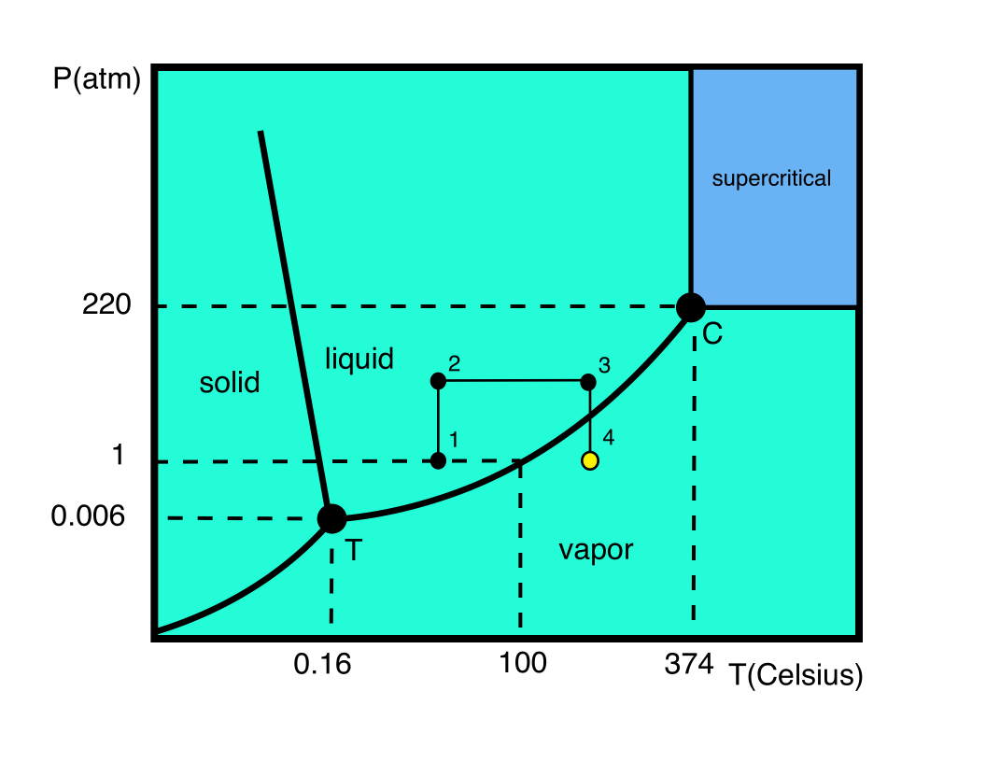
Bubble chamber basics

Slide 20
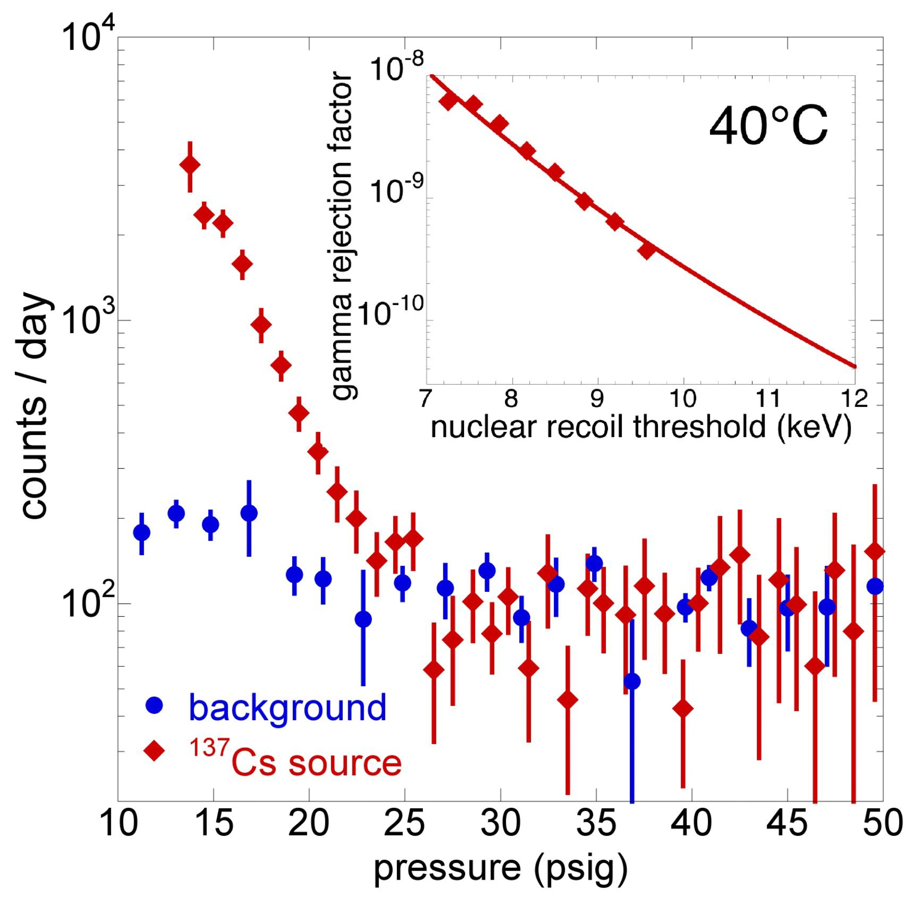
Gamma suppression
COUPP exp. FNAL

Slide 21
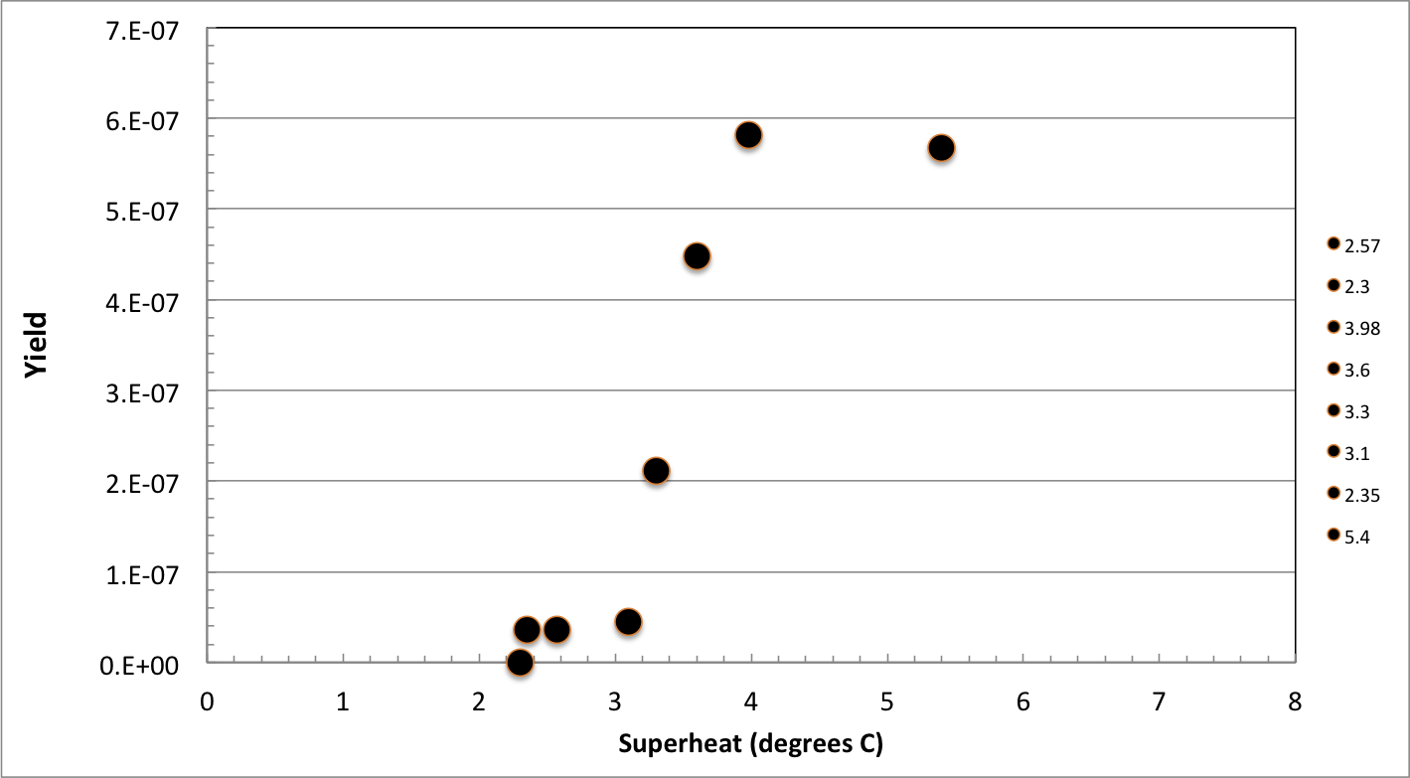
Efficiency Curve
γ+¹⁶O
γ+¹⁴N and γ+¹⁶O
N₂O efficiency curve, HIGS April 2013. E_{γ} = 9.7 MeV
Notes:
Interior Page Design 2

Slide 22
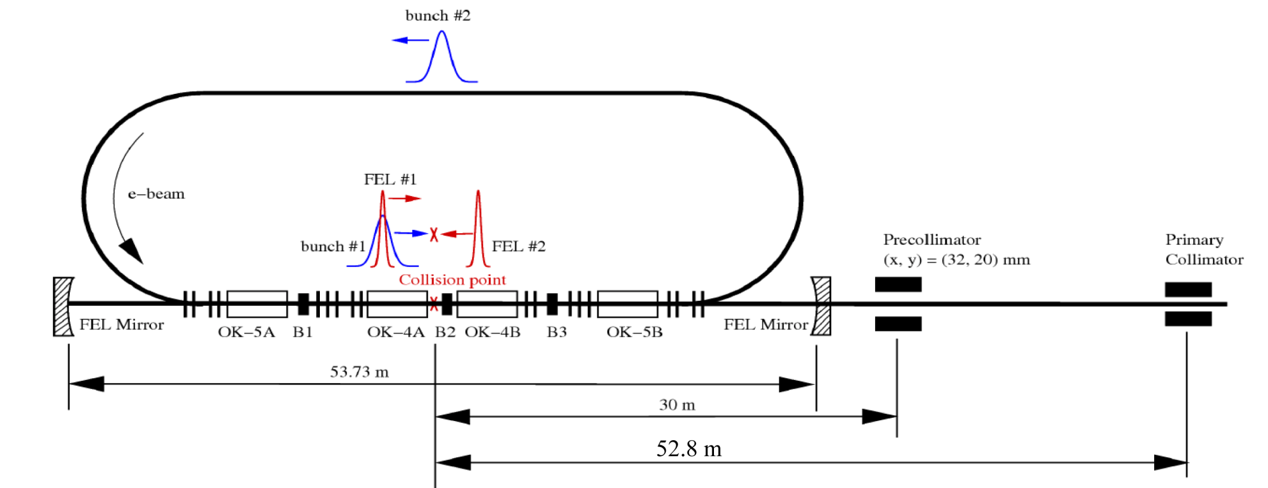
Bubble Chamber at HIGS
High Intensity Gamma Source (HIGS) at Duke University
γ-rays generated by Compton backscattering of free-electron-laser (FEL) light from high-energy electron beam bunches

Slide 23
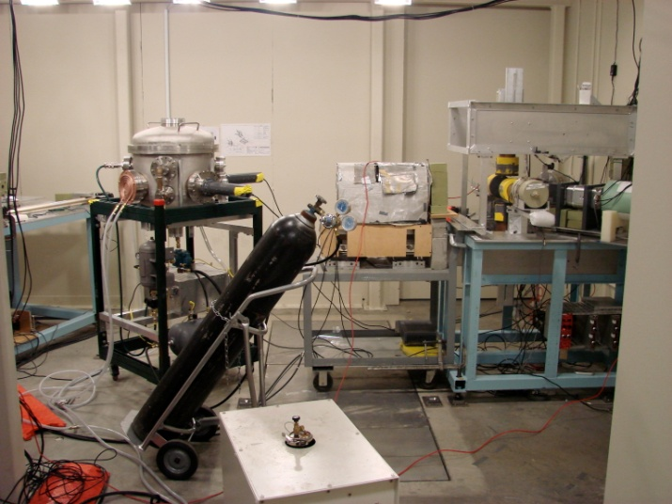
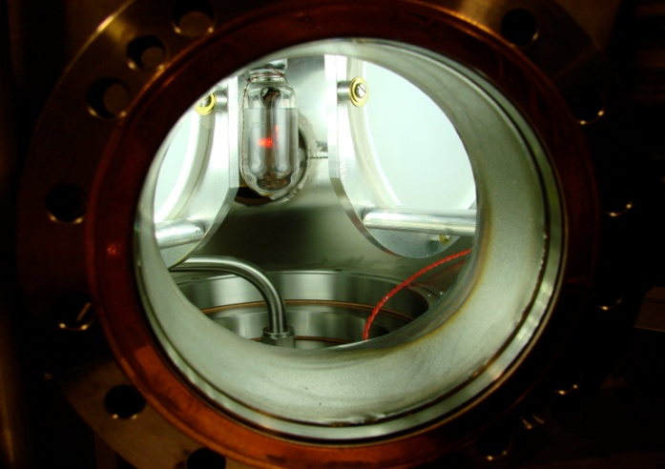
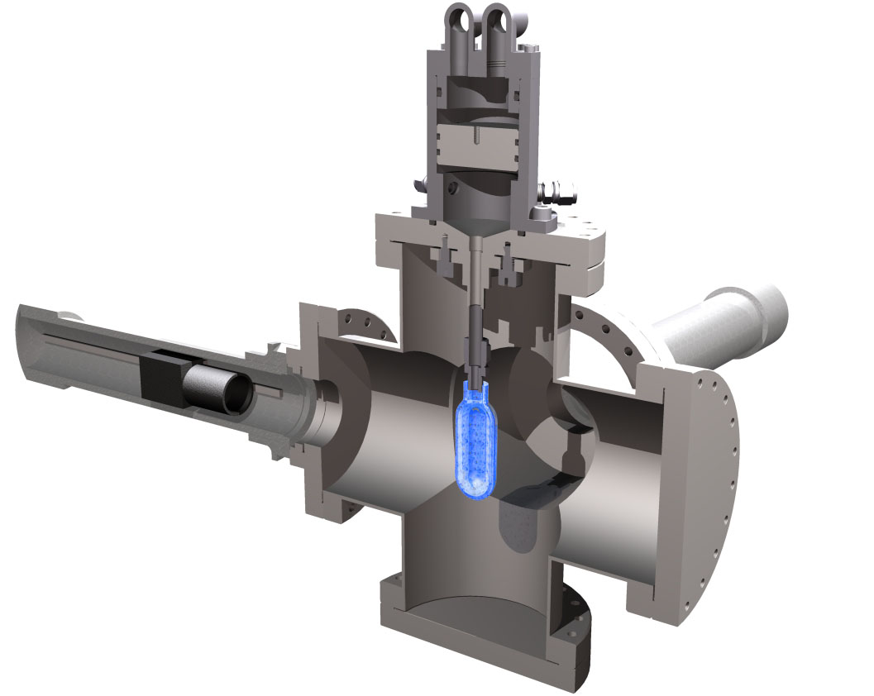
Measuring ¹⁹F(γ,α)¹⁵N at HIGS
2 Fast Cameras
C₄F₁₀ Bubble Chamber
  T = 310 K
  P = 160 kPa – 900 kPa
Notes:
Interior Page Design 2

Slide 24
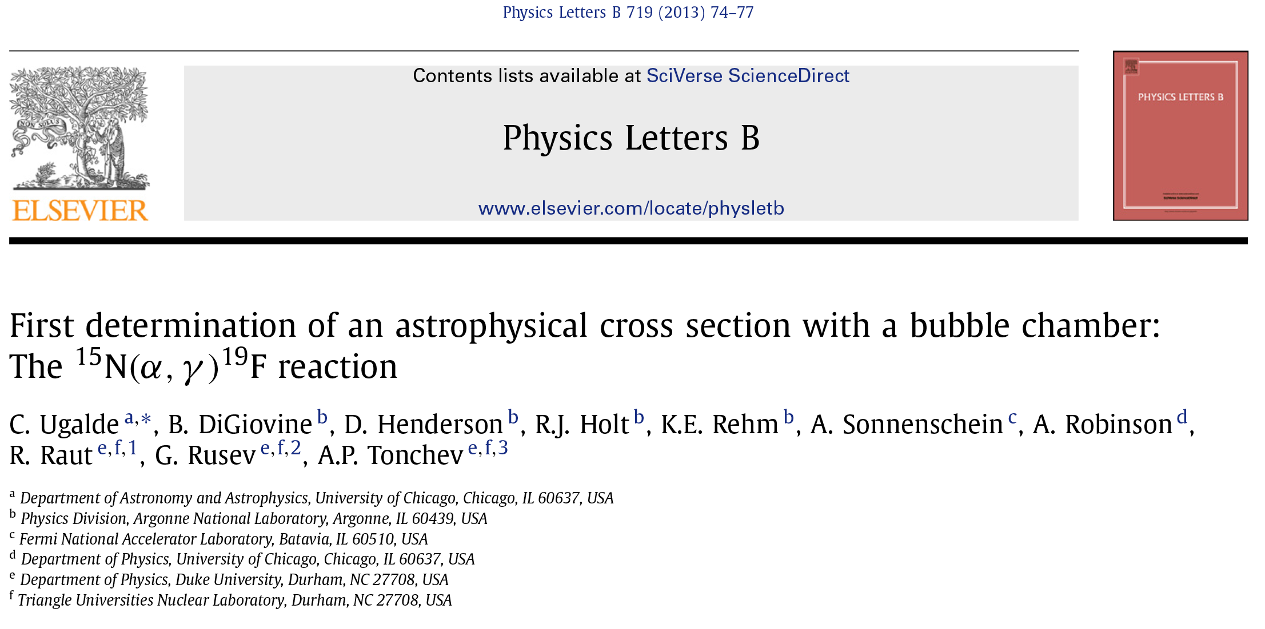
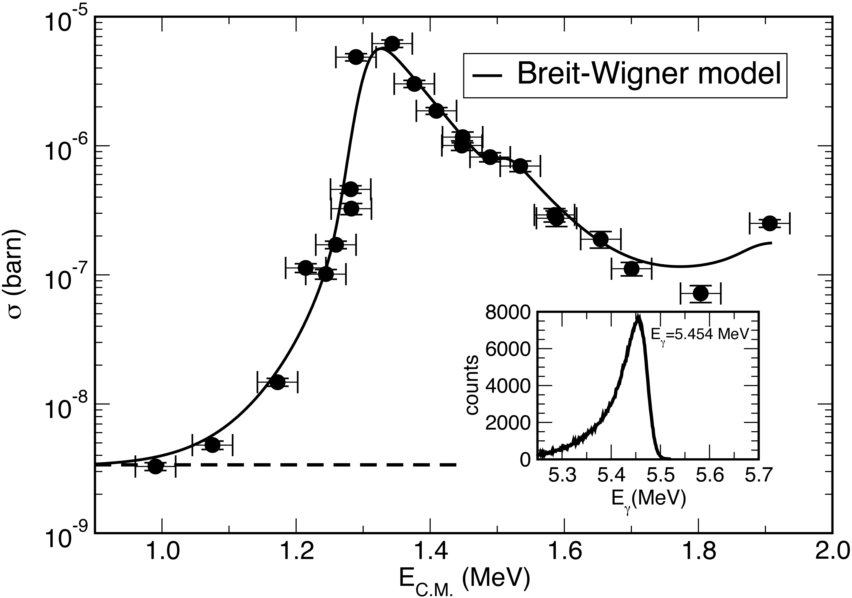
Notes:
Interior Page Design 2

Slide 25
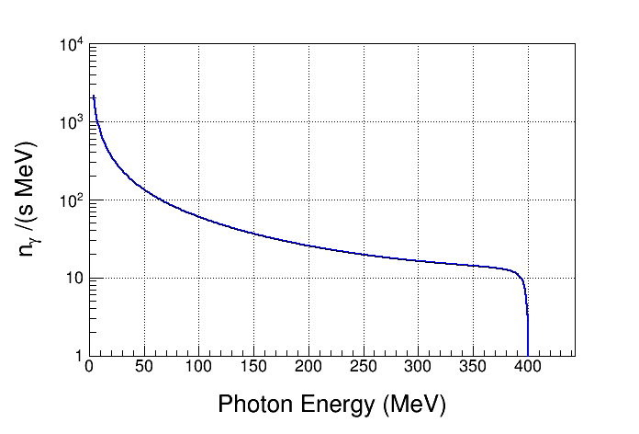
Bremsstrahlung Background at HIGS
Vacuum: 2x10⁻¹⁰ Torr
Residual Gas: Z = 10
Electron Beam Energy: 400 MeV
Electron Beam Current: 41 mA
Interaction Length: 35 m
Strong Bremsstrahlung
Background
Notes:
Calculate the Bremsstrahlung spectrum for HIGS beam using GEANT4

Slide 26
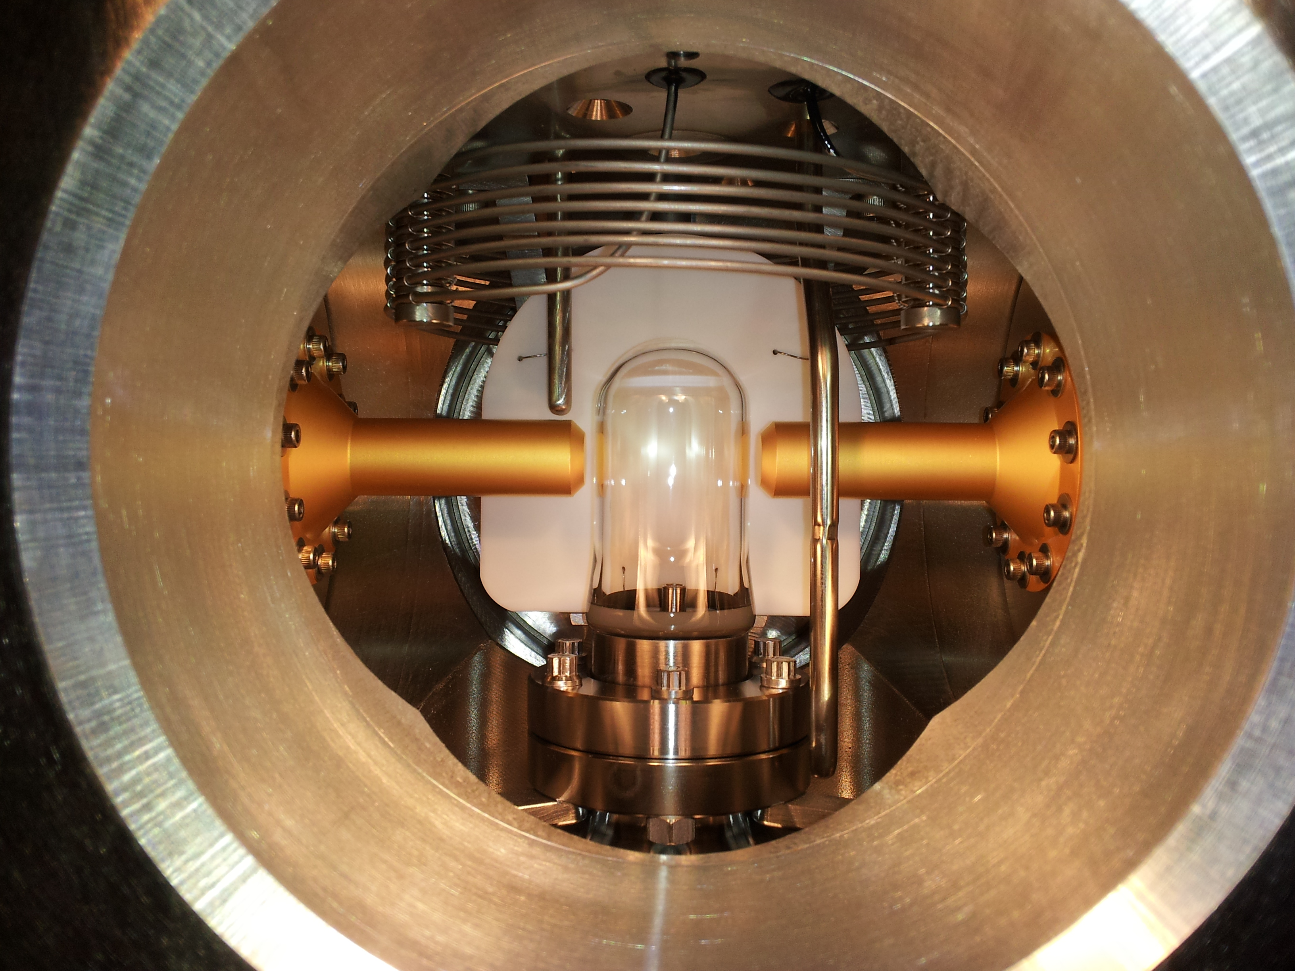
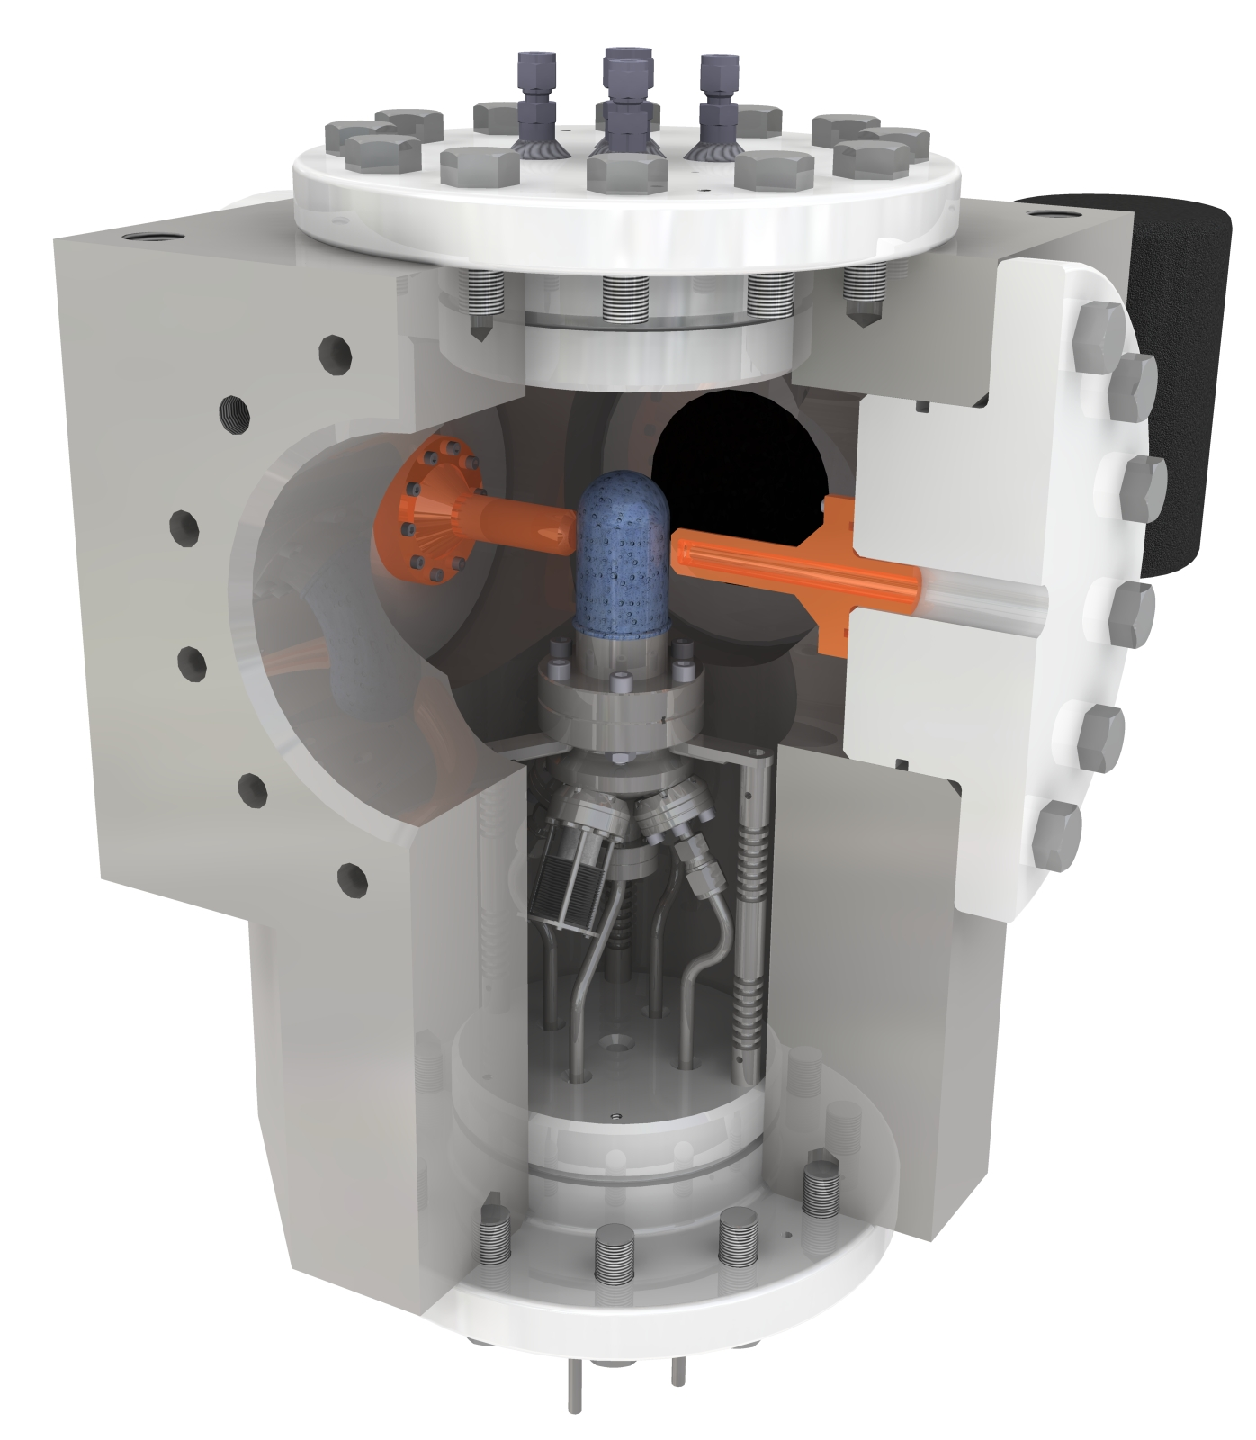
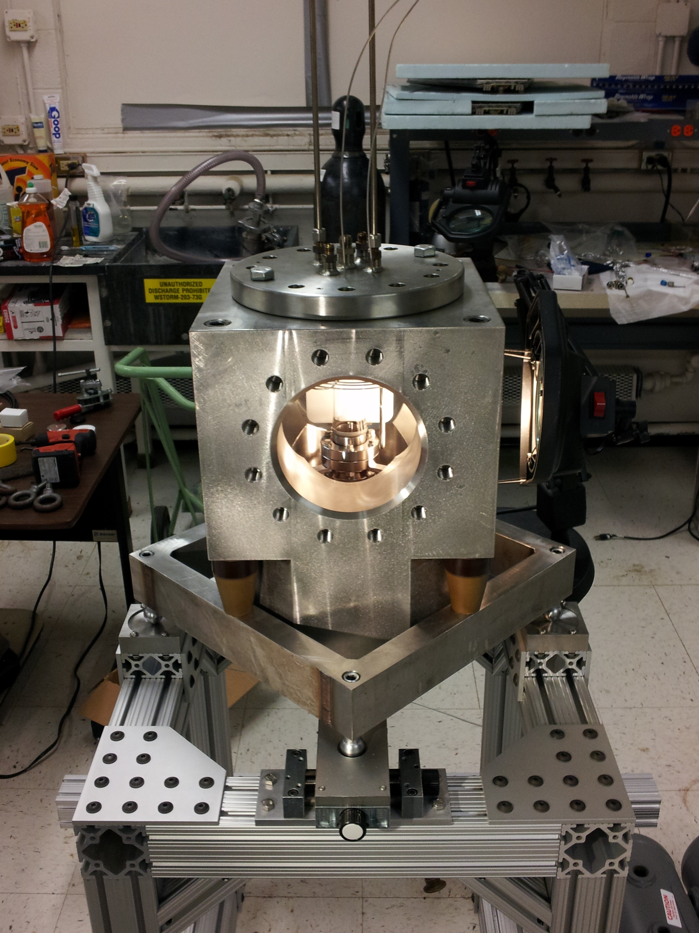

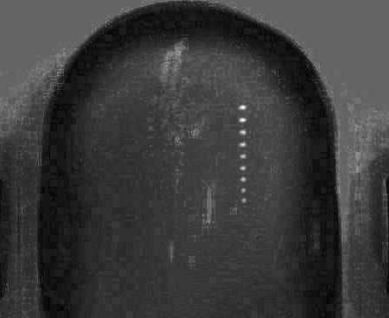
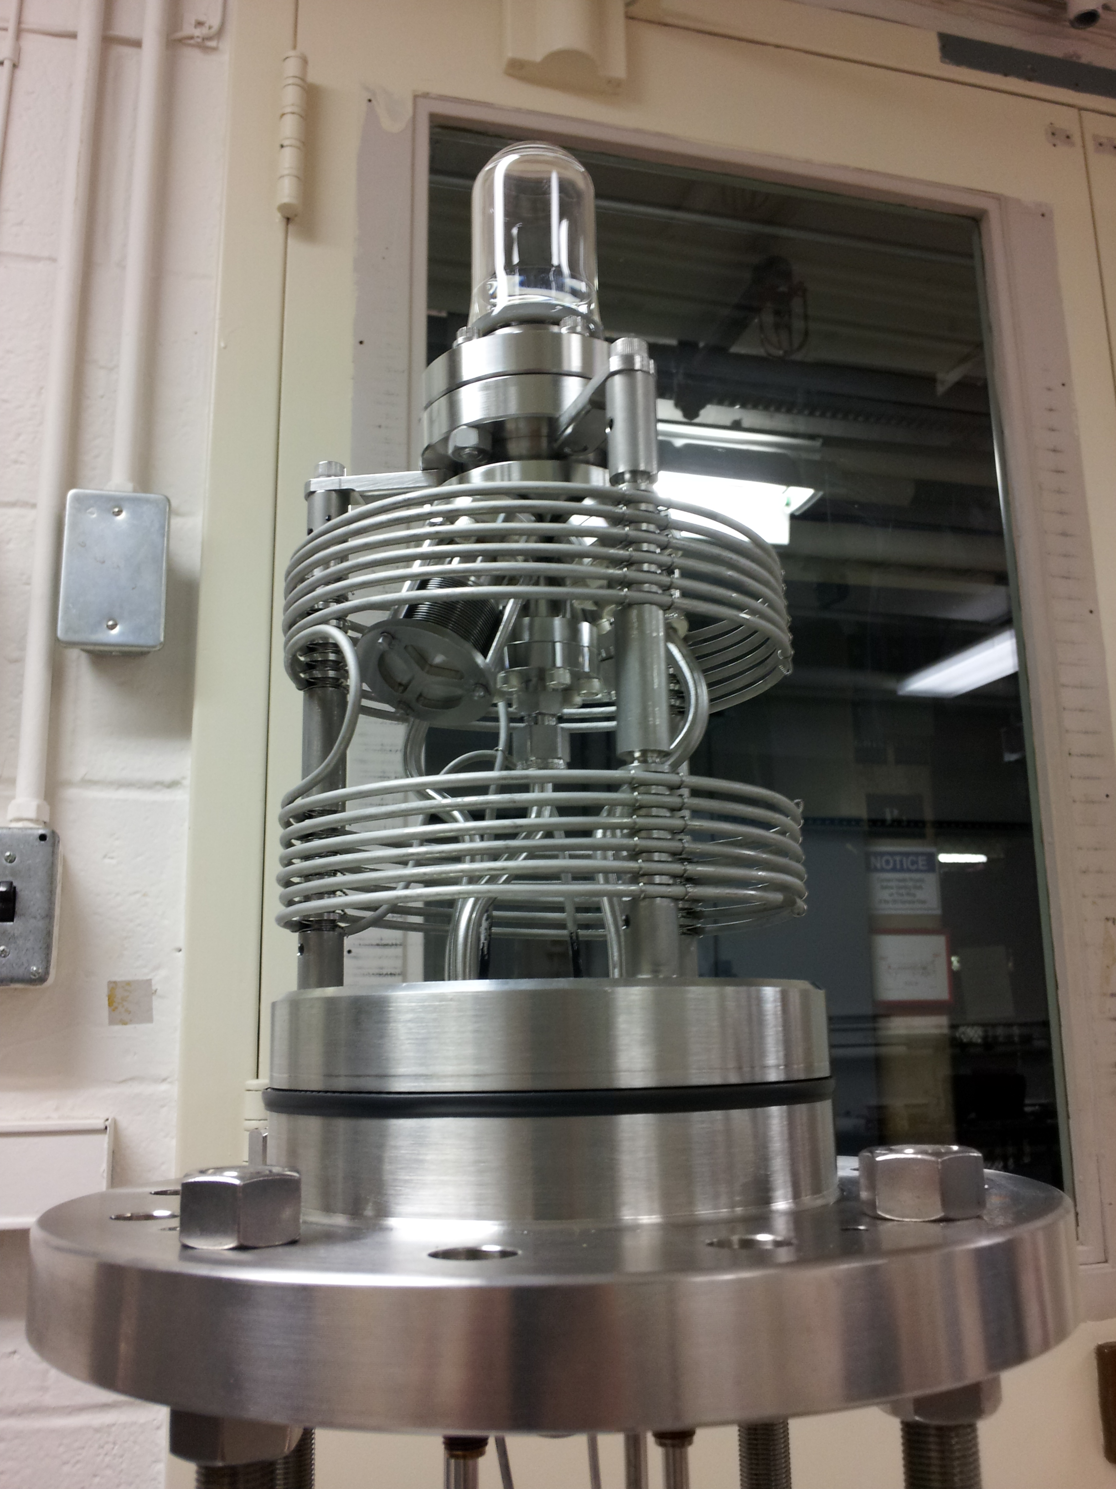
Recent Work
N₂O Bubble Chamber
First γ+O→α+C bubble
April 2013
Notes:
Interior Page Design 2

Slide 27
Superheated Targets
List of superheated liquids to be used in the experiment:
Readout:
  Optical Camera
  Acoustic Signal to discriminate between (γ,α) and (γ,n) events
N₂O Targets | ¹⁶O | ¹⁷O | ¹⁸O
Natural Target | 99.757% | 0.038% | 0.205%
¹⁶O Target |  | Depleted > 5,000 | Depleted > 5,000
¹⁷O Target |  | Enriched > 80% | <1.0%
¹⁸O Target |  | <1.0% | Enriched > 80%
Notes:
Interior Page Design 2

Slide 28
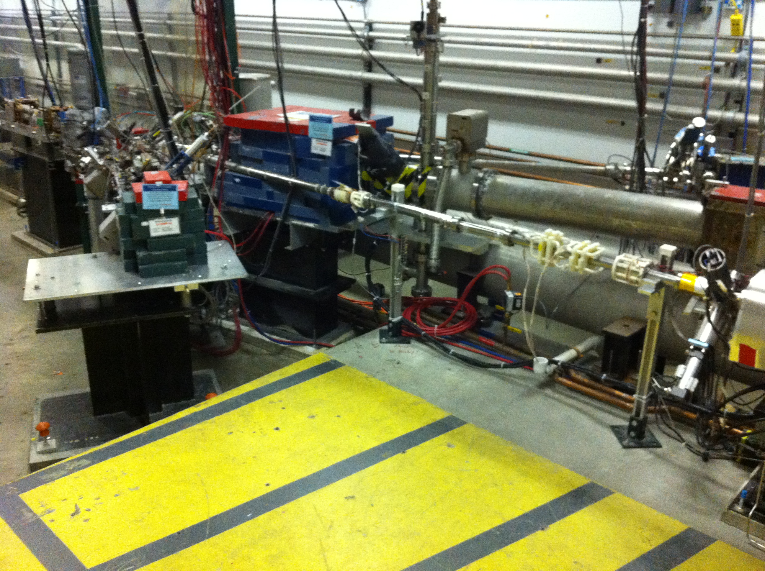
Experimental Setup
BCM
2D
Spectrometer
Mott Polarimeter
5 MeV
Dipole
5D Spectrometer
Bubble
Chamber
location
Notes:
Interior Page Design 2

Slide 29
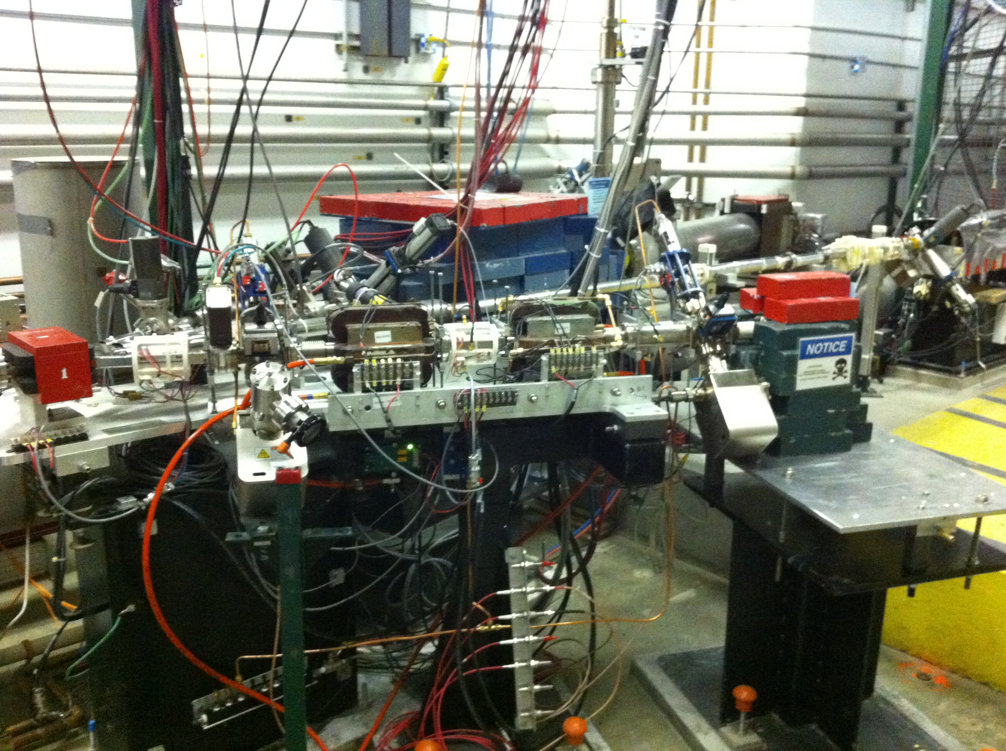
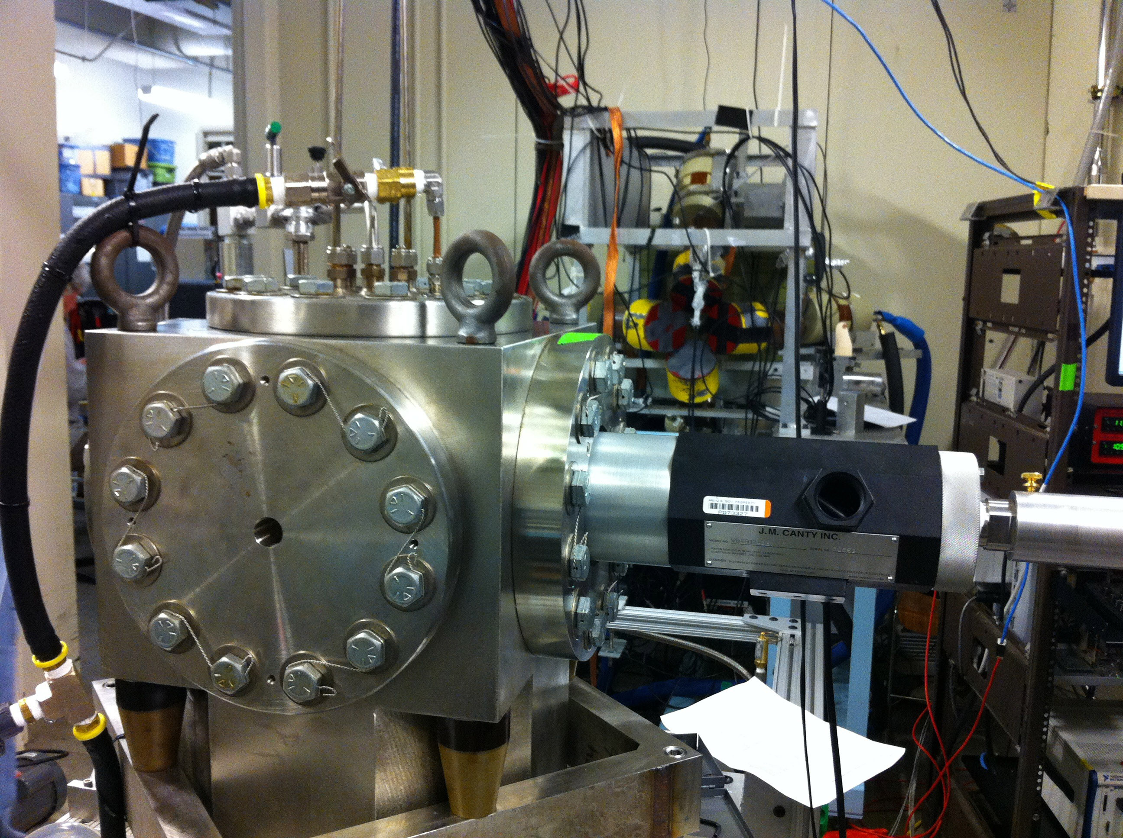
5D Spectrometer
Bubble Chamber at HIGS
Photon Beam
Entrance
Notes:
Interior Page Design 2

Slide 30
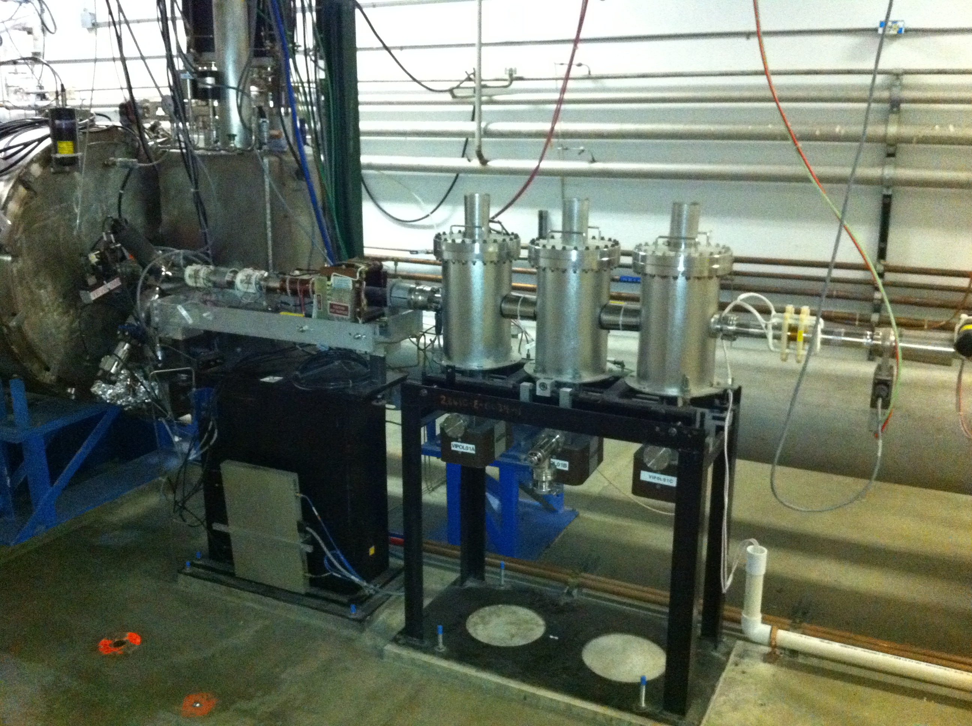
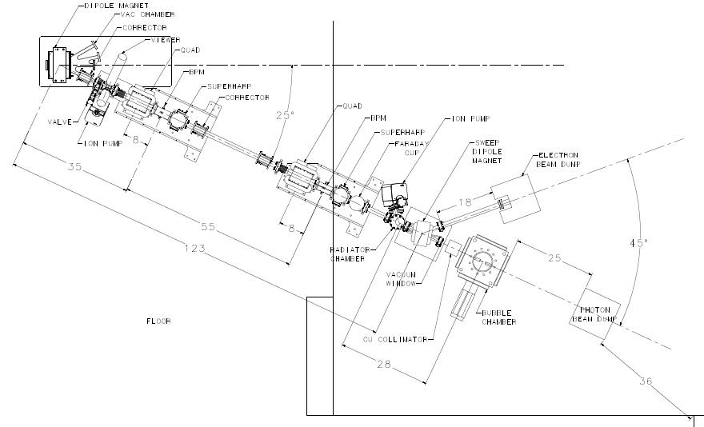
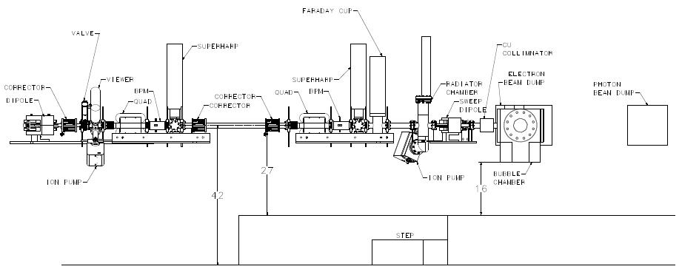
Beamline
New Fast Valve to protect from vacuum failure in front of ¼ Cryo-unit
Replace Dipole
Magnet
2 Superharps to measure beam profile and absolute beam position
Notes:
Interior Page Design 2

Slide 31
Schematics
Power deposited in radiator (100 µA and 8.5 MeV) :
  0.02 mm: Energy loss = 21 keV, P = 2.1 W
  0.10 mm: Energy loss = 112 keV, P = 11 W
Pure Copper and Aluminum (high neutron threshold):
  ⁶³C(γ,n) threshold = 10.86 MeV
  ²⁷Al(γ,n) threshold = 13.06 MeV
Electron K.E.
3.0 – 8.5 MeV
0.01 – 100 µA
Sweep Magnet
Radiator motion and Sweep Dipole current must be in FSD
BCM0L02 and Electron Dump in Beam Loss Accounting (BLA)
Cu Vacuum Window 10 mil
Cu Radiator
0.02 mm
Al Beam Pipe
Cu Photon
Collimator
20 cm
50 cm
Cu Inner
Pipe
Use GEANT4 to optimize this region
Al Photon Dump
10 cm long
20 cm diameter
Bubble Chamber
Superheated N₂O
3 cm long
15°C, 60 atm
Cu Electron Dump
Notes:
Interior Page Design 2

Slide 32
Beam Requirements
Beam Properties at Radiator:
PEPPo achieved p=8.25 MeV/c or K.E.=7.75 MeV. Maximum stable ¼- cryounit cavity gradients achieved: 8.4 MV/m and 6.1 MV/m (7.25 MV/m average). Vacuum in the beam line indicates that field emission and desorbed gas are the most problematic, but improve with processing.
Helium process the ¼-cryounit
Beam Kinetic Energy, (MeV) | 7.9 – 8.5
Beam Current (µA) | 0.01 – 100
Absolute Beam Energy | <0.1%
Relative Beam Energy | <0.02%
Energy Resolution (Spread), σ_{T} /T | 0.06%
Beam Size, σ_{x,y} (mm) | 1 – 2
Notes:
Interior Page Design 2

Slide 33
Absolute Beam Energy
BPM
5 MeV
Dipole
Electron Beam
Momentum
Notes:
Interior Page Design 2

Slide 34
Parameter | Term | Now | Goal
Dipole – linearity | δB/B | 0.25% | 0.02%
Dipole – spatial | δBL/BL | 0.10% | 0.02%
Dipole – reproduce | δB/B | 0.10% | 0.02%
Dipole – power supply | δI/I | 0.20% | 0.02%
Position – surveys | δθ/θ | 0.01% | 0.01%
Position – BPM calibration | δθ/θ | 0.05% | 0.05%
Stray magnetic field | δθ/θ | 0.05% | 0.05%
TOTAL | δP/P | 0.36% | <0.10%
Goal:
  Jay Benesch designed and now fabricating higher quality dipole (more uniformity, higher field)
  New Hall Probe: 0.01% accuracy, resolution to 2 ppm, and a temperature stability of 10 ppm/°C
  Relative beam energy error: <0.02%
Notes:
Interior Page Design 2

Slide 35
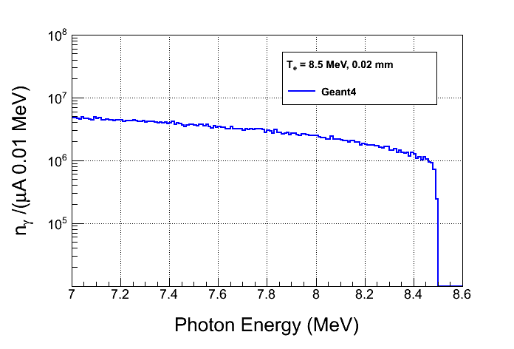
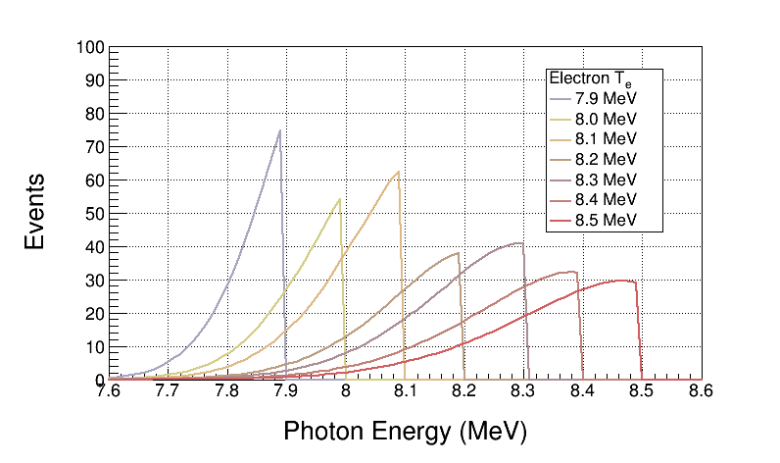
Bremsstrahlung Beam
Use both GEANT4 and FLUKA to calculate Bremsstrahlung spectra
Monte Carlo simulation of bremsstrahlung at radiotherapy energies is well studied, accuracy: 5%
Bremsstrahlung Peaks
¹⁶O(γ,α)¹²C is ideal case for Bremsstrahlung beam and Penfold – Leiss Unfolding :
  Very steep; only photons near endpoint contribute to yield
  No-structure (resonances)

Slide 36
GEANT4 Simulation
Both GEANT4 and FLUKA use models that calculate wrong photo–nuclear cross sections. Both do not allow for user’s cross sections.
  Use GEANT4 and FLUKA to produce the photon spectrum impinging on the super heated liquid.
  Fold the above photon spectrum with our cross sections in stand-alone codes.
Use GEANT4 to design Radiator/Collimator/Dump
Geometry in GEANT4:
Notes:
Interior Page Design 2

Slide 37
Penfold-Leiss Cross Section Unfolding
Measure Yields at: where,
The solution can be written in two forms:
Or, Matrix form:

Slide 38
Statistical Error Propagation
Note:
In case of background Subtraction
With:
Then:

Slide 39
Where:
Although,
For mono-chromatic beam

Slide 40
Results
Radiator Thickness = 0.02 mm
Bubble Chamber Thickness = 3.0 cm. Number of ¹⁶O nuclei = 3.474e22 /cm²
Background subtraction of ¹⁸O(γ,α)¹⁴C . ¹⁷O(γ,n)¹⁶O: Still to do
Electron Beam K. E. | Beam Current (µA) | Time (hour) | y_{i} | dy_{i} (no bg) | dy_{i}/y_{i} (no bg, %) | dy_{i} (with bg) | dy_{i}/y_{i} (with bg, %)
7.9 | 100 | 100 | 545 | 23 | 4.2 | 134 | 24.6
8.0 | 100 | 20 | 581 | 24 | 4.1 | 77 | 13.3
8.1 | 80 | 10 | 852 | 29 | 3.4 | 60 | 7.0
8.2 | 20 | 10 | 634 | 25 | 3.9 | 40 | 6.3
8.3 | 10 | 10 | 812 | 28 | 3.4 | 39 | 4.8
8.4 | 4 | 10 | 746 | 27 | 3.6 | 36 | 4.8
8.5 | 2 | 10 | 763 | 28 | 3.7 | 32 | 4.2
Notes:
Interior Page Design 2

Slide 41
Systematic Error Propagation
For absolute beam energy uncertainty of δE (= 0.1%) and zero relative beam energy uncertainty:
E_{i} (MeV) | dy_{i}/y_{i} (%) | dσ_{i}/σ_{i} (%)
7.9 | 12.5 | 12.6
8.0 | 10.8 | 10.5
8.1 | 9.3 | 9.1
8.2 | 8.0 | 7.1
8.3 | 7.0 | 6.3
8.4 | 6.3 | 5.8
8.5 | 5.6 | 5.2
This is the cross section dependence on energy
Accounted for dN_{ij} due to energy error when calculating dy_{i}

Slide 42
With:
Then:

Slide 43
Where:
Note: Correlation Coefficient =1
No point-to-point systematic

Slide 44
Systematic Error Propagation
No point-to-point systematic

Slide 45
Other Systematic Errors
Beam Current, δI/I | 3%
Photon Flux, δφ/φ | 5%
Radiator Thickness, δR/R | 3%
Bubble Chamber Thickness, δT/T | 3%
Bubble Chamber Efficiency, ε | 5%
Simulation
Then:

Slide 46
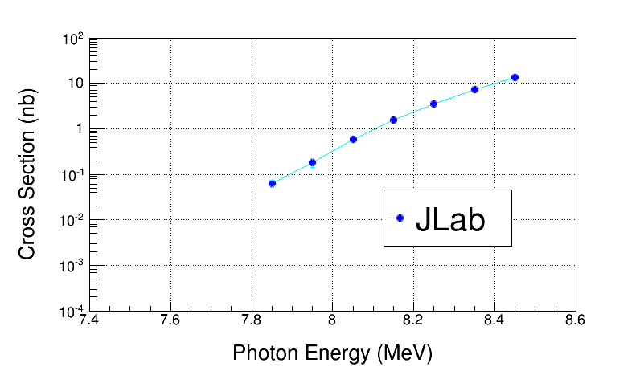
Electron Beam K. E. | Cross Section (nb) | Stat Error (no bg, %) | Stat Error (with bg, %)
7.9 | 0.046 | 4.4 | 24.5
8.0 | 0.185 | 6.0 | 20.7
8.1 | 0.58 | 6.3 | 14.7
8.2 | 1.53 | 8.2 | 13.8
8.3 | 3.49 | 9.1 | 13.3
8.4 | 7.2 | 10.6 | 13.8
8.5 | 13.6 | 12.2 | 14.8
Electron Beam K. E. | Cross Section (nb) | Sys Error (Energy, %) | Sys Error (Total, %)
7.9 | 0.046 | 12.5 | 15.3
8.0 | 0.185 | 10.2 | 13.5
8.1 | 0.58 | 8.3 | 12.2
8.2 | 1.53 | 7.0 | 11.4
8.3 | 3.49 | 6.0 | 10.7
8.4 | 7.2 | 5.3 | 10.5
8.5 | 13.6 | 4.7 | 10.1
Note: Relative systematic errors do not get amplified in PL Unfolding

Slide 47
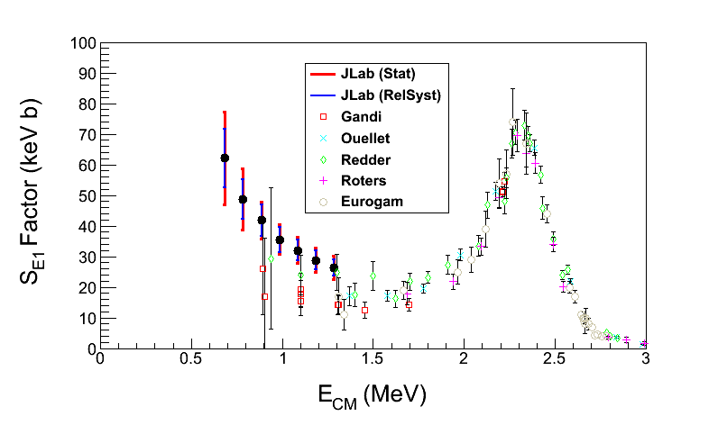
The ¹²C(α,γ)¹⁶O S-Factor
Statistical Error: dominated by background subtraction from ¹⁸O(γ,α)¹⁴C (depletion = 5,000)
Electron Beam K. E. | Gamma Energy (MeV) | E_{CM} (MeV) | Cross Section (nb) | S_{E1} Factor (keV b) | Stat Error (%) | Sys Error (Total, %)
7.9 | 7.85 | 0.69 | 0.046 | 62.2 | 24.5 | 15.3
8.0 | 7.95 | 0.79 | 0.185 | 48.7 | 20.7 | 13.5
8.1 | 8.05 | 0.89 | 0.58 | 41.8 | 14.7 | 12.2
8.2 | 8.15 | 0.99 | 1.53 | 35.5 | 13.8 | 11.4
8.3 | 8.25 | 1.09 | 3.49 | 32.0 | 13.3 | 10.7
8.4 | 8.35 | 1.19 | 7.2 | 28.8 | 13.8 | 10.5
8.5 | 8.45 | 1.29 | 13.6 | 26.3 | 14.8 | 10.1
S_{E1}(300 keV) = 74±21 keV b

Slide 48
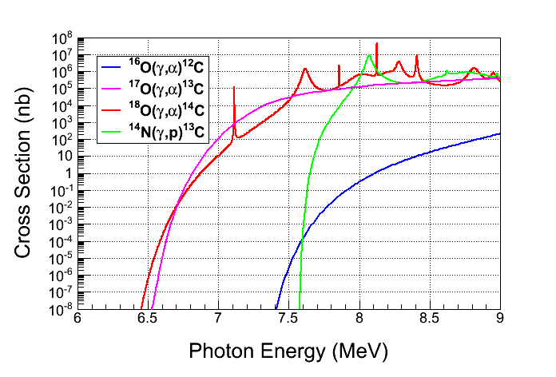
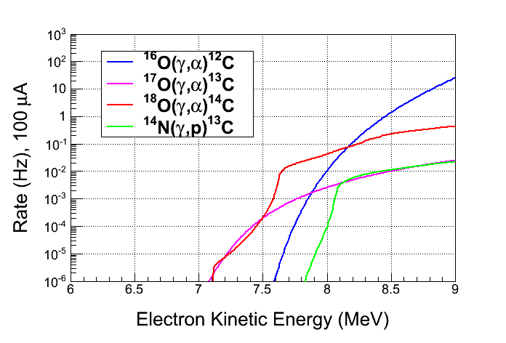
Backgrounds
Background from oxygen
isotopes and nitrogen in N₂O:
  ¹⁸O(γ,α)¹⁴C
  ¹⁷O(γ,α)¹³C
  ¹⁴N(γ,p)¹³C
Natural Abundance:
    ¹⁷O: 0.038%
    ¹⁸O: 0.205%
Expected Rates:
  ¹⁷O(γ,α)¹³C, depletion=5,000
  ¹⁸O(γ,α)¹⁴C, depletion=5,000
  ¹⁴N(γ,p)¹³C, detection eff.= 10⁻⁸
Notes:
Interior Page Design 2

Slide 49
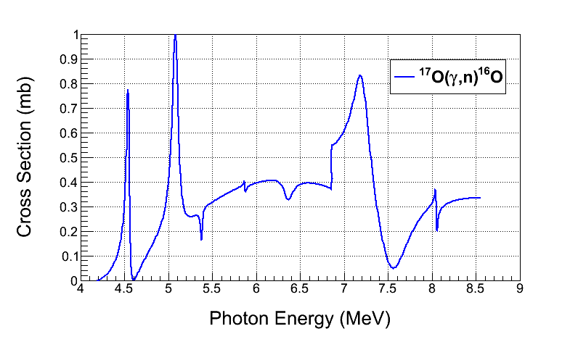
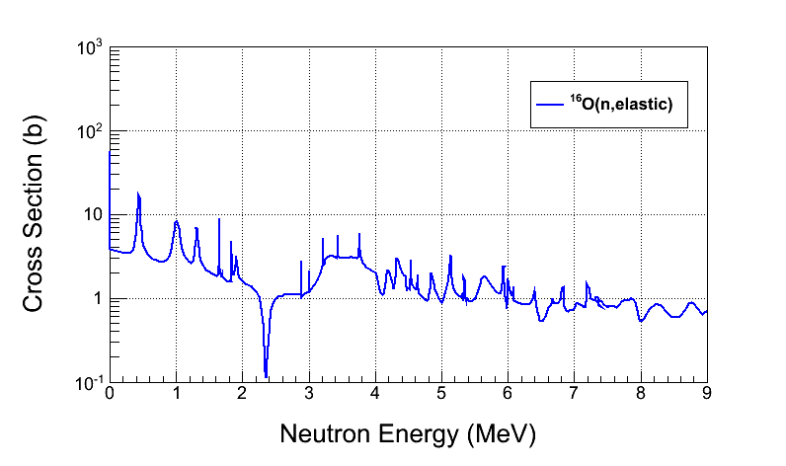
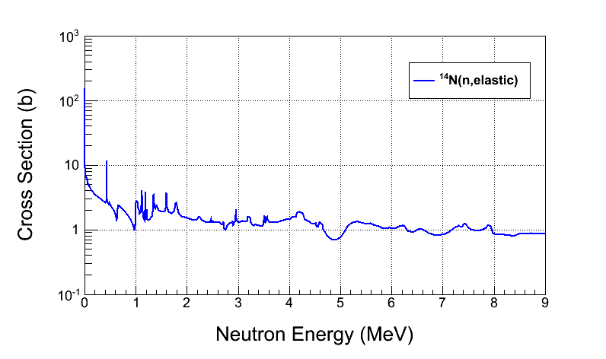
Background from:
  ¹⁷O(γ,n)¹⁶O and secondary (n,n)
  neutron–nucleus elastic scattering
Cosmic–ray background:
  µ±–nuclear
  neutron–nuclear elastic scattering
Reject neutron background using
the acoustic signal (500 factor)
Notes:
Interior Page Design 2

Slide 50
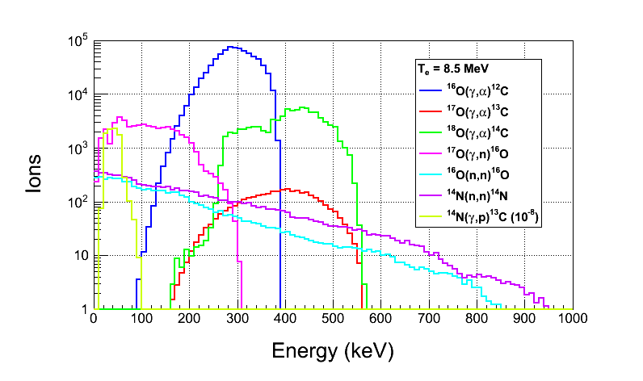
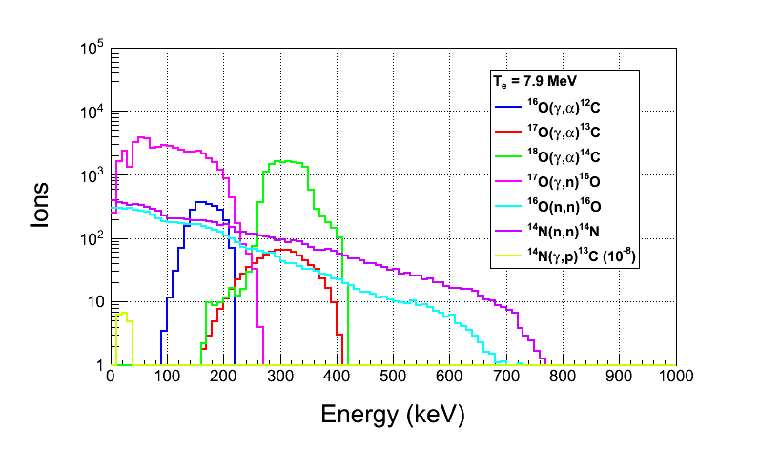
Ion Energy Distributions
Suppress background
with Bubble Chamber threshold
Calculated with Depletion:
  ¹⁷O depletion = 5,000
  ¹⁸O depletion = 5,000
Threshold Efficiency (function
of superheat):
Particle | Efficiency
e± | <10⁻¹¹
γ | <10⁻¹¹
(γ,n) | 2x10⁻³
Notes:
Interior Page Design 2

Slide 51
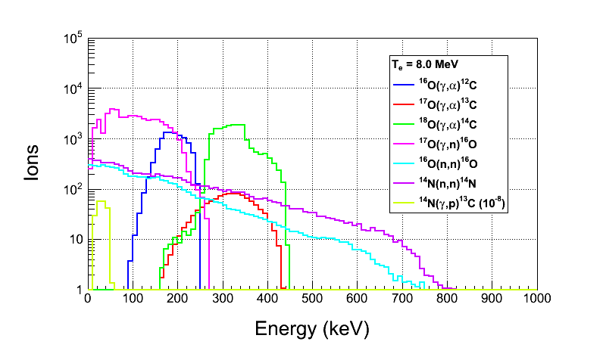
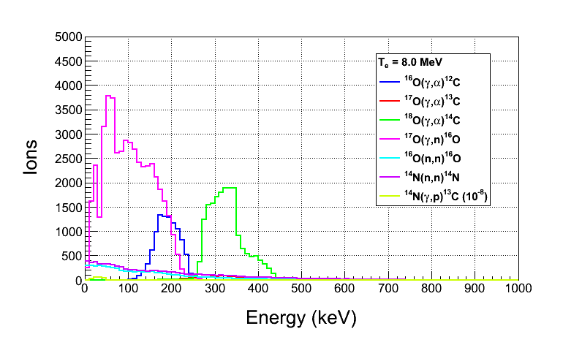
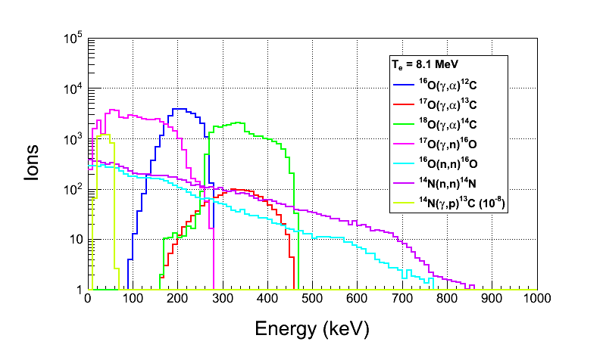
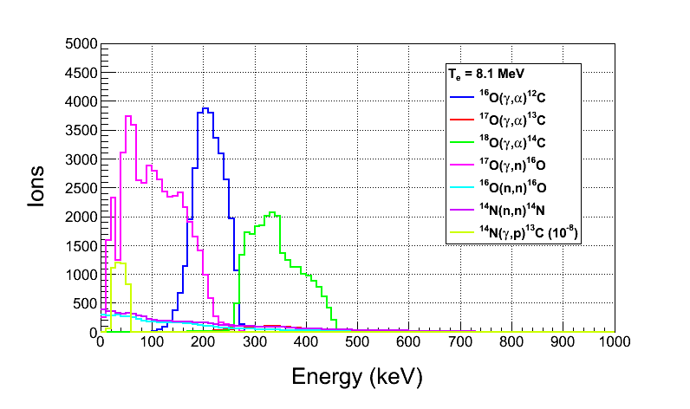
Notes:
Interior Page Design 2

Slide 52

Safety
Super heated liquid N₂O, Nitrous oxide (laughing gas)
  At room temperature, it is a colorless, non-flammable gas, with a slightly sweet odor and taste
High pressure system:
  Design Authority: Dave Meekins
  T =
  P =
Buffer liquid: Mercury
  Closed system
  Volume: 135 mL
0
2
0
OX
0
3
0
Notes:
Interior Page Design 2

Slide 53
Summary and Outlook
Test N₂O Bubble Chamber at HIGS (February 2014)
Perform ¹⁸O(γ,α)¹⁴C and ¹⁷O(γ,α)¹³C experiments at HIGS (Summer 2014)
Test Bubble Chamber at JLab with Bremsstrahlung beam (October 2014)
If successful, run depleted N₂O bubble chamber at JLab ¹⁶O(γ,α)¹²C
Bubble Chamber issues:
  Piezo–electric acoustical signal
  Deadtime study (now τ ± dτ = 10.0 ± 0.9 s)
  Measure O-isotopes depletion
Background tests:
  Measure cosmic–ray background
  Study chamber efficiency vs. superheat
Notes:
Interior Page Design 1

Slide 54
Backup Slides
Notes:
Interior Page Design 1

Slide 55
Cost Estimate
New beamline components:
  New Dipole Magnet and Hall Probe
  2 Super Harps
  Fast Valve
Summary of labor cost by group:
Group | Labor
Survey & Alignment | 3 wks x 2
Magnet Test | 1 wk x 2
Engineering Design | 16 wks
Software | 3 wks x 2
EES | 6 wk x 2
EH&Q | 4 wks
Notes:
Interior Page Design 1

Slide 56
Item | Material Procurement | Shop | Labor
New Dipole Magnet | Dipole Magnet ($8,000) Hall Probe System ($10,000) |  | Design (2 week) Mapping (1 week) EESDC (1 week) Alignment (2 days)
New Beamline | 2 Super Harps (20,000) Fast Valve ($23,000) | Pipes + Pedestals ($20,000) | Design (6 weeks) Alignment (1 week) Software (6 weeks) EES (6 weeks)
Radiator (cooled ladder, FSD) | 0.02 and 0.10 mm Cu foils ($2,000) | $4,000 | Design (2 week) Alignment (2 days)
Sweep Dipole
Electron Dump | Pure Cu ($5,000) | Dump + Pipes ($15,000) | Design (4 weeks) Alignment (1 day)
Cu Collimator | Pure Cu ($5,000) | Collimator + Stand ($5,000) | Design (1 week) Alignment (1 day)
Photon Dump & Stand | Pure Al ($3,000) | $4,000 | Design (1 week) Alignment (1 day)
Safety Review |  |  | 4 weeks
Install |  |  | 6 weeks
Bubble Chamber |  |  | Alignment (1 week)
Total | $76,000 | $48,000 | $80,000
Indirect G&A (55.65%) | $42,300 | $26,400 | $42,500
Indirect Stat & Fringe (57.15%) |  |  | $45,700
Total | $118,300 | $74,400 | $168,200
Notes:
Accelerator is paying for magnet and Hall Probe System.
Accelerator will pay for Fast Valve and its electronics.

Slide 57



CO₂ Superheated Liquid?
Natural Abundance: ¹³C: 1.07%
Depletion: ¹³C depletion=1,000
¹³C(γ,n)¹²C Background
For comparison, ¹⁷O(γ,n)¹⁶O
¹²C(γ,2α)α Background
Notes:
The acoustic signal will suppress neutron events (?). What is the expected background from 3-alpha?

Slide 58
Water Superheated Liquid?
Etching of glass vessel by superheated H₂O
T = 250˚C
P = 68 atm

Slide 59


Slide 60


