Slide 1
Update: Puck and Gun Magnet
March 1, 2016

Slide 2
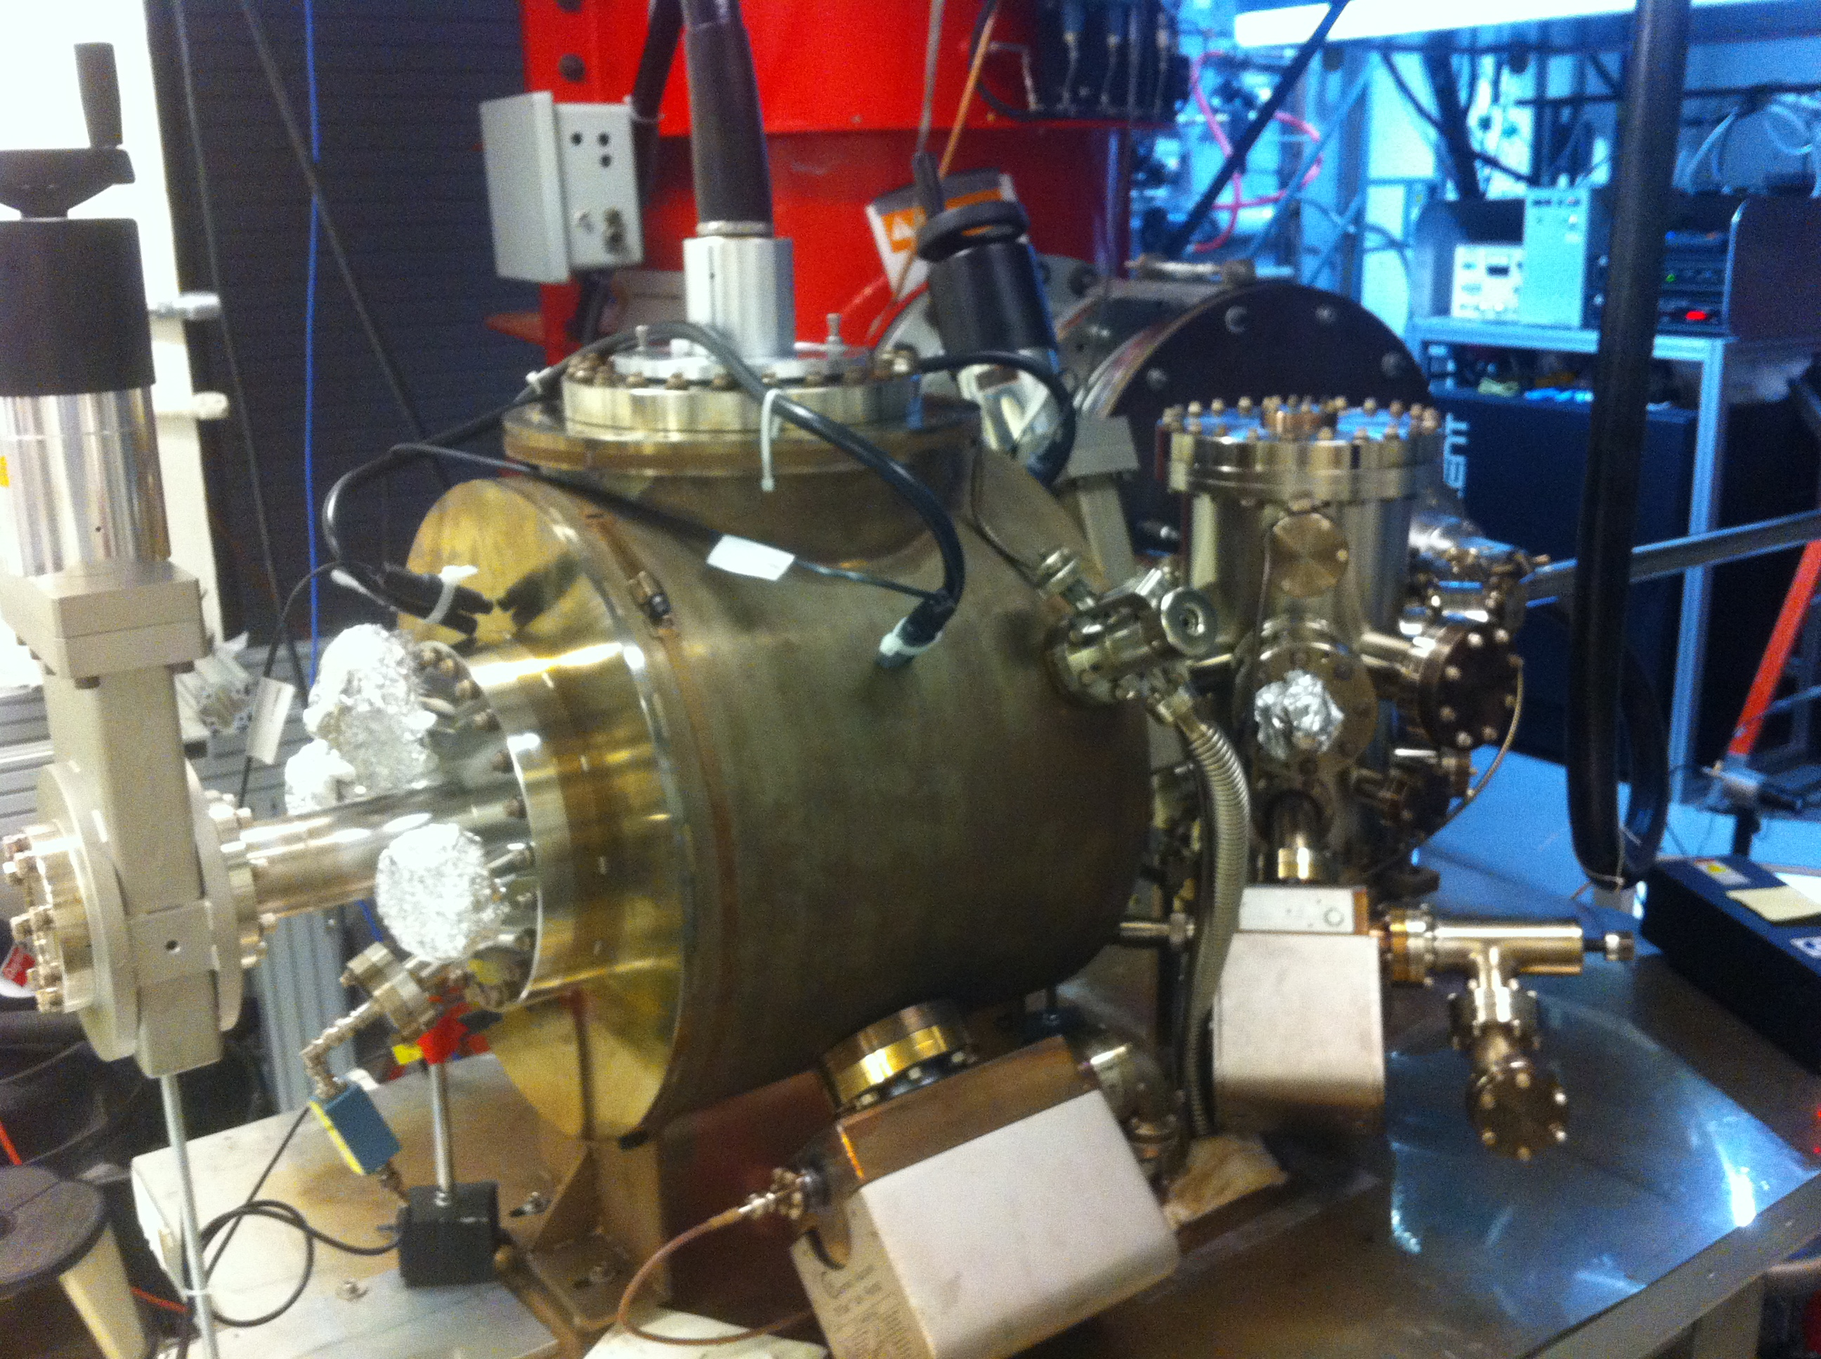
Magnetized Gun
K₂CsSb Preparation Chamber
HV Chamber

Slide 3
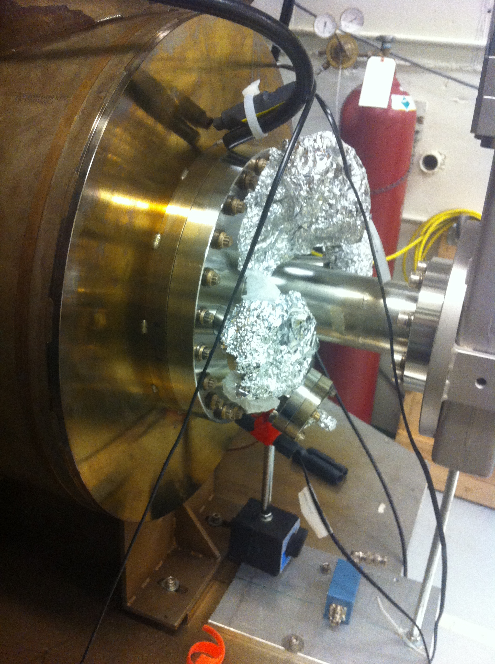

Slide 4
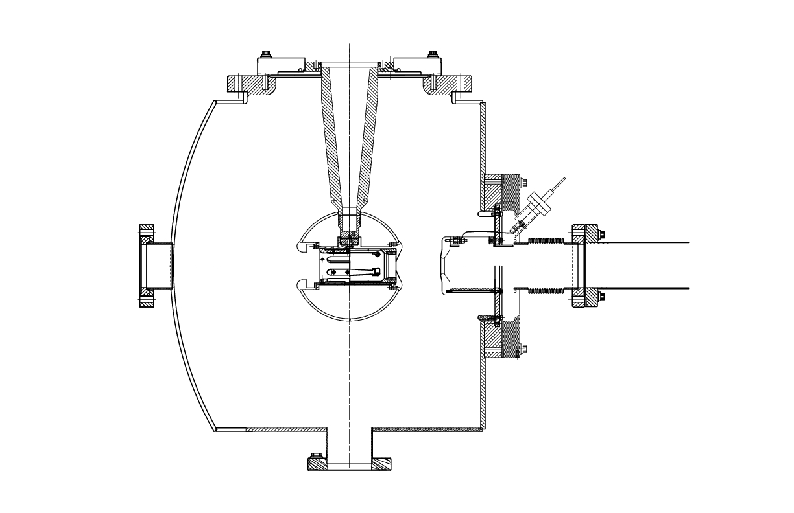
Coil + Steel Puck
Cathode-Anode Gap
6”
Steel Puck
9.0 cm
12”
18”
10”
Moly
6.4 cm
8”
7.5”
Gun Table
0.5”

Slide 5
Steel Puck
Molybdenum and Steel hybrid puck
Designed to enhance field to 2.0 kG at cathode
Use 1010 carbon steel
Re-design new Puck Manipulator End Adapter
Order 4 pucks – map with Coil (August 2016)
Heat Treatment:
Un-heated
200˚C (Sb) and 120˚C (K – Cs) growth
550˚C Heat Cleaning then 200˚C and 120˚C
Multiple

Slide 6
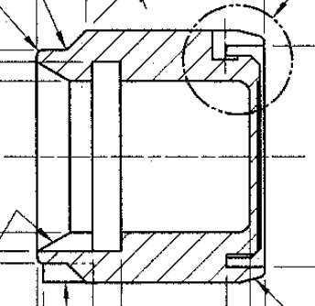
Design I
Moly
10 mm
6 mm
Steel
Brazed – not screwed

Slide 7
Design II
Stainless Steel
2 mm
4 mm
10 mm
2 mm
Steel

Slide 8
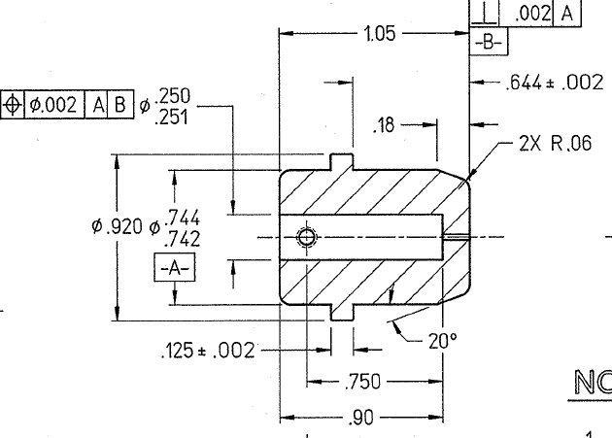
2 mm
Cut this part

Slide 9
Power Supply
Use new spare Dogleg power supply (500A, 80V)
If needed at CEBAF, we can use an old Dogleg
supply (250A, 50V) to keep going
Need to add polarity switch to be able to degauss
steel

Slide 10
Coil
Not bakable – will be mounted on rails. Push downstream out of oven and run LCW through. Move gate valve after beamline solenoid (in place of BPM). Move HV Chamber front foot upstream.
Designed to give 1.4 kG at cathode without steel puck
Bare coil – no cylindrical steel shield/return
Procurement:
Everson Tesla
Buckley Systems
Alpha Magnetics ($20.5k, 12 weeks)
JLab Machine shop
Designer: Gary Hays

Slide 11
Coil Specs (Jay Benesch)
One water cooled magnet coil
Inside diameter 30 cm, round to 0.2 cm
Outside diameter roundness: 0.5 cm
Flatness, each side, 0.3 cm
8 double pancakes (DP). Each DP has 40 turns. Coil is 16 turns wide by 20 turns radial, 320 turns total. Conductor is Luvata 6092 or equivalent copper conductor, 9 mm square with 6 mm round hole for water cooling. These may be soldered or bolted together as vendor prefers, see also potting options below. Vendor should propose input/output flags suitable for 450A.
Eight parallel water cooling circuits, one per double pancake, with 37° flare JIC tube fittings. All eight water connections shall be located on the coil outer diameter within a 15 degree region of the assembly. Vendor shall provide a cooling water specification (flow rate and pressure) for each water circuit assuming 450A current and water inlet temperature of 35°C.
Coil cross-section shall be less than 16 cm Z by 20 cm R.
Vendor shall propose insulation system. Glass-epoxy with at least 110°C capability preferred. Potting may be done as a “bag job”. Tooling could also be built to pot four double pancakes as a coil half with four water circuits and two leads. Bolted jumper plate to electrically join the two halves shall be provided in this case. Or full depth tooling can be built.
Power supply is 500A, 80V and we plan to operate at 450A and 72V.

Slide 12
Size | 11.811” ID, 27.559” OD, 6.242” Z
Conductor | L=50,000 cm, A=0.53 cm²
Coil Weight | 240 kg
Resistance | 0.18 Ω (65°C average T)
Field at Photocathode | 1.4 kG
Voltage | 72 V
Current | 400 A
Resistivity Coefficient: ρ(20°C) = (1.72 + 0.00393 ΔT) 10⁻⁶ Ω cm
R = ρ L/A, ρ = 1.90 10⁻⁶ Ω cm
GTS inlet LCW temperature: 35°C and pressure: 5 bar
Need a booster pump to raise pressure
What is required flow rate?
Measure 5 G magnetic field line and mark with sings

Slide 13
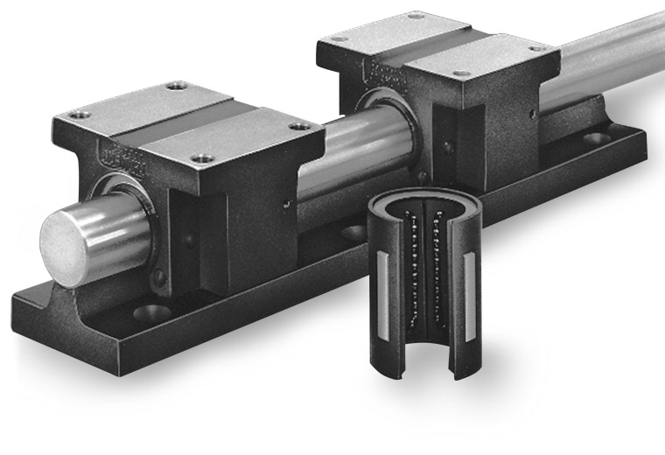
Coil Mount
How much different geometric center from magnetic center?
How uniform field at coil center? any beam steering?
Allow for small adjustments to center solenoid on beam
Gun Table
Rails

Slide 14
Timeline
Power Supply (new spare Dogleg):
Build at Magnet Lab: March
Test and add polarity switch: April
Move to GTS: May
Ready: July 1, 2016
All work has to be completed by September 30, 2016
Coil:
Design: February and March
Procure: April
On-site by end of July
Map (with and w/o puck), check hysteresis and forces: August
Install: August, 2016

