Slide 1
GTS Emittance Measurement
January 3, 2017

Slide 2
Emittance Measurement Techniques
Solenoid and Viewscreen
Single Slit and Viewscreen
Double-slit and Faraday Cup
We assume a round beam ($ε_{x}=ε_{y}$) – measure vertical transverse phase space in one dimension (y) with horizontal slit

Slide 3
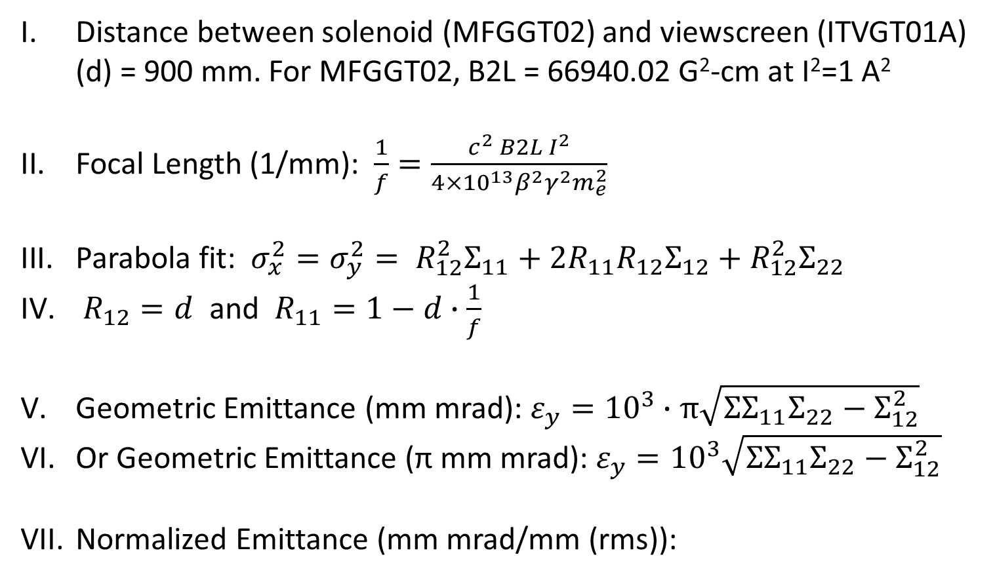
Solenoid and Viewscreen
Distance between solenoid (MFGGT02) and viewscreen (ITVGT01A) (d) = 900 mm. For MFGGT02, B2L = 66940.02 G²-cm at I²=1 A²
Focal Length (1/mm): $\frac{1}{f}=\frac{c^{2} B2L I^{2}}{4×{10}^{13}β^{2}γ^{2}m_{e}^{2}}$
Parabola fit: ${σ_{x}^{2}=σ}_{y}^{2}= R_{12}^{2}Σ_{11}+2R_{11}R_{12}Σ_{12}+R_{12}^{2}Σ_{22}$
$R_{12}=d$ and $R_{11}=1−d∙\frac{1}{f}$
Geometric Emittance (mm mrad): $ε_{y}={10}^{3}∙π\sqrt{ΣΣ_{11}Σ_{22}−Σ_{12}^{2}}$
Or Geometric Emittance (π mm mrad): $ε_{y}={10}^{3}\sqrt{ΣΣ_{11}Σ_{22}−Σ_{12}^{2}}$
Normalized Emittance (mm mrad/mm (rms)):

Slide 4
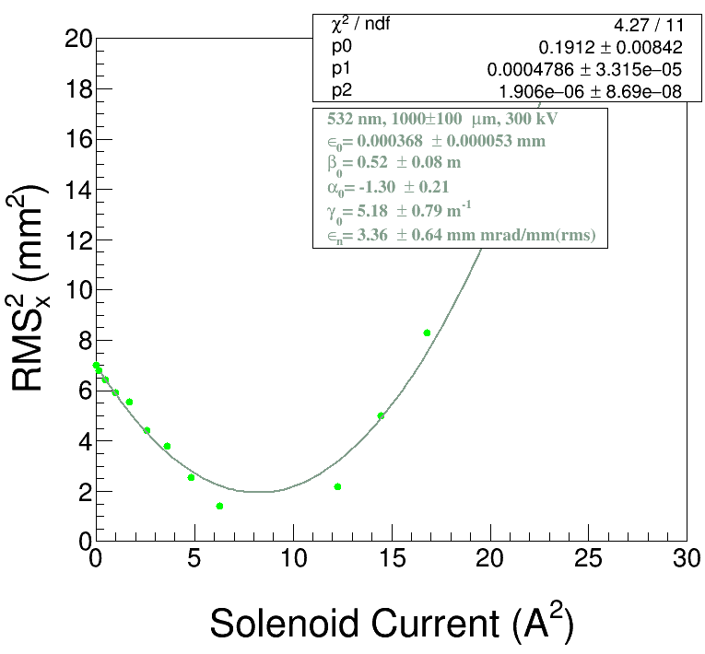
Measurement Details:
Measure laser RMS (± error)
Find camera pixel calibration (mm per pixel ± error)
Record Gun HV
Use low beam current (<50 nA DC, 0.001 pC CW)
${(σ}^{2},I^{2})$ plot has to be symmetric about minimum – unreliable emittance calculation if not
There is a root macro to calculate emittance for Solenoid and Viewscreen technique

Slide 5
Single Slit and Viewscreen
Two Air Core Coils with equal and opposite excitation
$$y_{m}^{′}$$
$$σ_{m}^{′}$$
$$mw$$
Beamlet Intensity Profile
Space-charge Dominated Beam
Emittance Dominated Beamlet
Slit
Viewscreen
Slit Gap (s) = 40 µm
Distance between slit and viewscreen (d) = 500 mm
Measurement steps (m = 1, …, N) with constant $w$ step size
(N $\sim$ 20, $w \sim$ 0.5 mm)

Slide 6
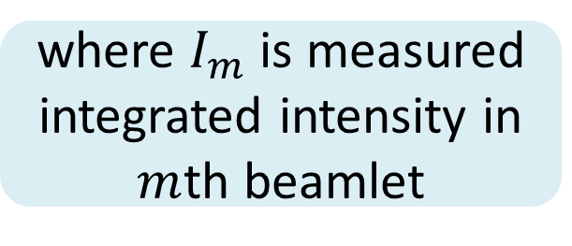
where $I_{m}$ is measured integrated intensity in $m$th beamlet

Slide 7
Measurement Details:
Measure laser RMS (± error)
Find camera pixel calibration (mm per pixel ± error)
Record Gun HV
Power limit of 10 W (30 µA, 350 kV) on first slit (not water-cooled) – otherwise may deform gap
One vertical magnetic beam scanner before first slit – has two pairs of identical air core coils with equal and opposite excitation in each coil – Radiabeam coils with steel core should be fine
Use first viewscreen to calibrate magnetic beam scanner excitations (N $\sim$ 20, $w \sim$ 0.5 mm)
Calibrate beamlet position on second viewscreen
Need to develop scripts for calibrations and to calculate emittance

Slide 8
Double-slit and Faraday Cup
Two Air Core Coils with equal and opposite excitation
Two Air Core Coils with equal and opposite excitation
Faraday Cup to measure Beamlet Current
Space-charge Dominated Beam
Emittance Dominated Beamlet
Slit
Slit
Slit Gap (s) = 40 µm
Distance between two slits (d) = 500 mm
Measurement steps: $100×100$ at 200 Hz (1 minute each measurement)

Slide 9
Measurement Details:
Measure laser RMS (± error)
Find camera pixel calibration (mm per pixel ± error)
Record Gun HV
Power limit of 10 W (30 µA, 350 kV) on first slit (not water-cooled) – otherwise may deform gap
Two vertical magnetic beam scanners: one before first slit and one between two slits – each has two pairs of identical air core coils with equal and opposite excitation in each coil
Measurement steps: $100×100$ at 200 Hz (1 minute each measurement) – Radiabeam coils with steel core are too slow (?)
Need four air core coils and Faraday cup with fast controls and readout
Need to develop hardware, firmware and scripts for calibrations and to calculate emittance

Slide 10
Slits Survey and Alignment
To ensure symmetric transverse phase space distributions:
Beam axis from center of photocathode (electrostatic center of gun) through solenoids and slits to better than 0.1 mm (?)

Slide 11
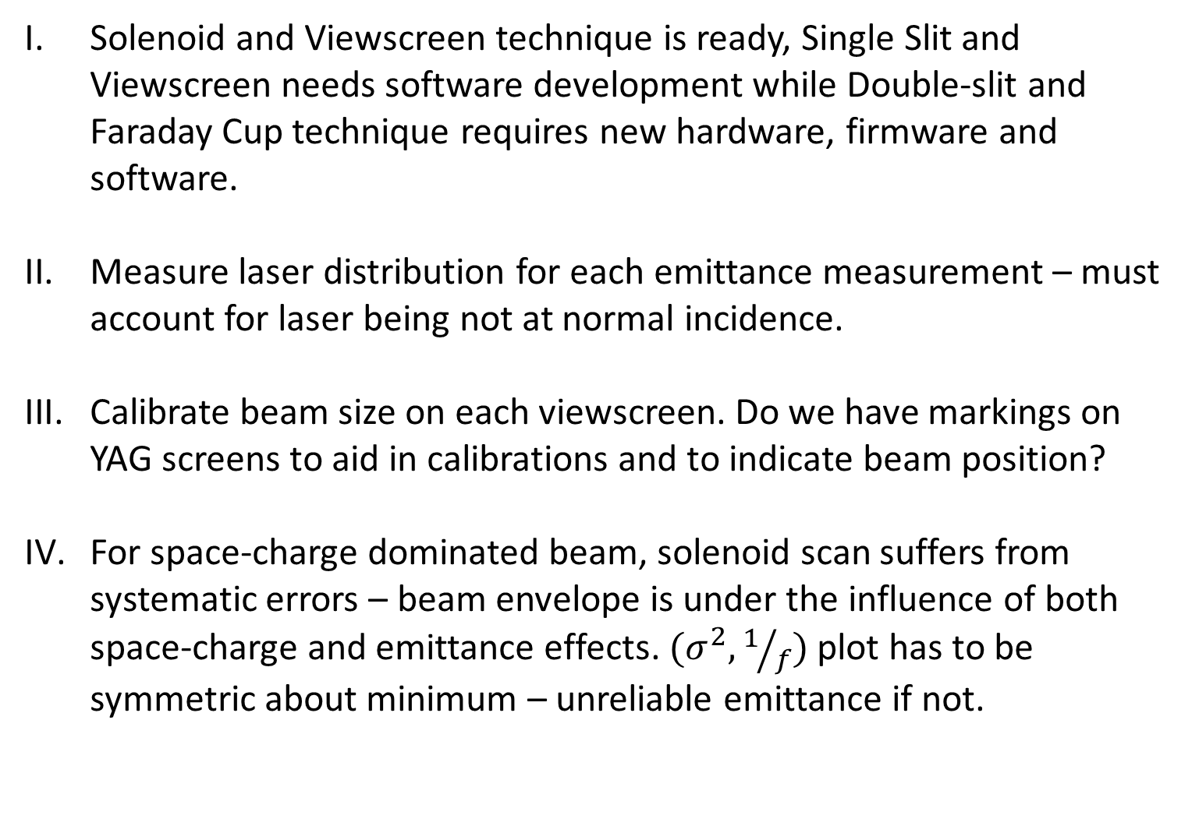
Summary
Solenoid and Viewscreen technique is ready, Single Slit and Viewscreen needs software development while Double-slit and Faraday Cup technique requires new hardware, firmware and software.
Measure laser distribution for each emittance measurement – must account for laser being not at normal incidence.
Calibrate beam size on each viewscreen. Do we have markings on YAG screens to aid in calibrations and to indicate beam position?
For space-charge dominated beam, solenoid scan suffers from systematic errors – beam envelope is under the influence of both space-charge and emittance effects. ${(σ}^{2}, 1/f)$ plot has to be symmetric about minimum – unreliable emittance if not.

