Slide 1
Run I – Setting the Beam Energy
Time | Event | R027 GSET | R027 PSET | R028 GSET | R0 28PSET
1/14/15 19:28 | 5.5 MeV/c setup | 4.81 | 44.2 | 4.81 | -1.2
1/15/15 22:15 | Post chopper and Buncher tests | 4.81 | 42.2 | 4.81 | -2.2
1/16/15 18:00 | Checked phases optimized @ 2D | 4.81 | 42.2 | 4.81 | -1.2
Target thickness extrapolation measurements happen
1/19/15 16:40 | Momentum Measurement 5D | 4.81 | 42.2 | 4.81 | -1.2
Varied cryounit settings for energy spread and spot size tests
1/20/15 00:06 | Very fast Momentum Measurement 5D | 4.81 | 44.2 | 4.81 | 2.3

Slide 2
Run I – Beam Momentum Measurement
Mon, 1/19/15 - SWING
Momentum measurement part 1 https://logbooks.jlab.org/entry/3318147
Momentum measurement part 1 https://logbooks.jlab.org/entry/3318151
Momentum measurement part 1 https://logbooks.jlab.org/entry/3318152
Parameter | Ideal
BL [G-cm] | 7266.0 G-cm
P_Jay [MeV/c] | 5.146 MeV/c
T [MeV] | 4.66 MeV
I need to go back and look at the conditions for this measurement (which magnets were ON, OFF; how the BPM’s orbit was used)

Slide 3
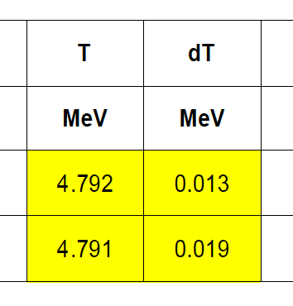
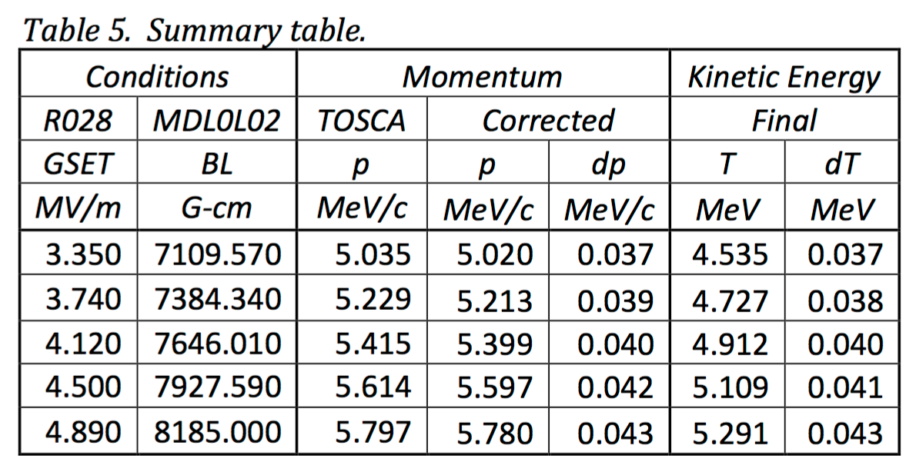
Run I
Rates (preliminary)
Spectrometer (ideal)
Parameter | Ideal
BL [G-cm] | 7266.0 G-cm
P_Jay [MeV/c] | 5.146 MeV/c
T [MeV] | 4.66 MeV
Run II

