Slide 1
UITC Optics Model Status as of July 28, 2014 (Grames/Wang)
S2E Design Plan
Start with Matt’s layout
Consider Cave1 + Cave2 constraints
Use Elegant for initial spatial layout (X,Y,Z) and transverse optics (beam sizes in X, Y)
Address longitudinal dynamics with GPT and Elegant
Iterate
Cave 1
POISSON to model gun and generate 350kV (Er,Ez)
GPT to transform initial conditions to Elegant input at S=20cm
Solenoids set waists at apertures (15 bend, Wien, Apertures, Cryounit)
Chopper optics/layout constrained to 10mrad deflection
Wien filter, chopper cavities, buncher and cryounit will get special component attention
Beam exiting cryounit TBD : GPT, Elegant, Measurement, FEL model ?
Quads set launch from Cave1 to Cave2
Cave 2
Vertical chicane from cryounit CL 42” to HDIce CL 85-3/8”
Quads compensate chicane dipoles and set size at HDIce
Raster specs set distance range to target
Limited space means good idea to thin about diagnostic + target + dump

Slide 2
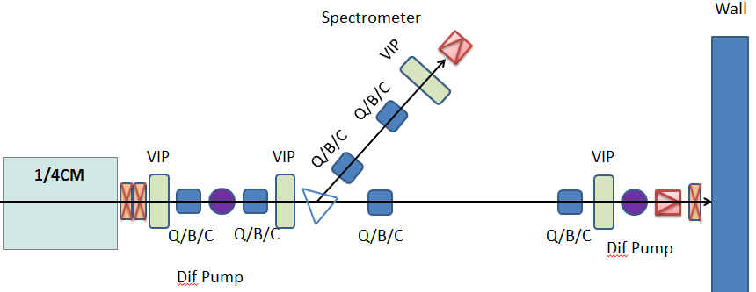
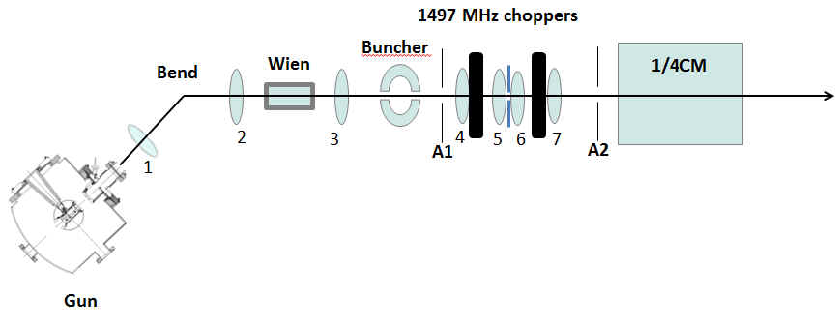
Matt’s Layout
(Horizontal Bend)
(Vertical Bends)

Slide 3
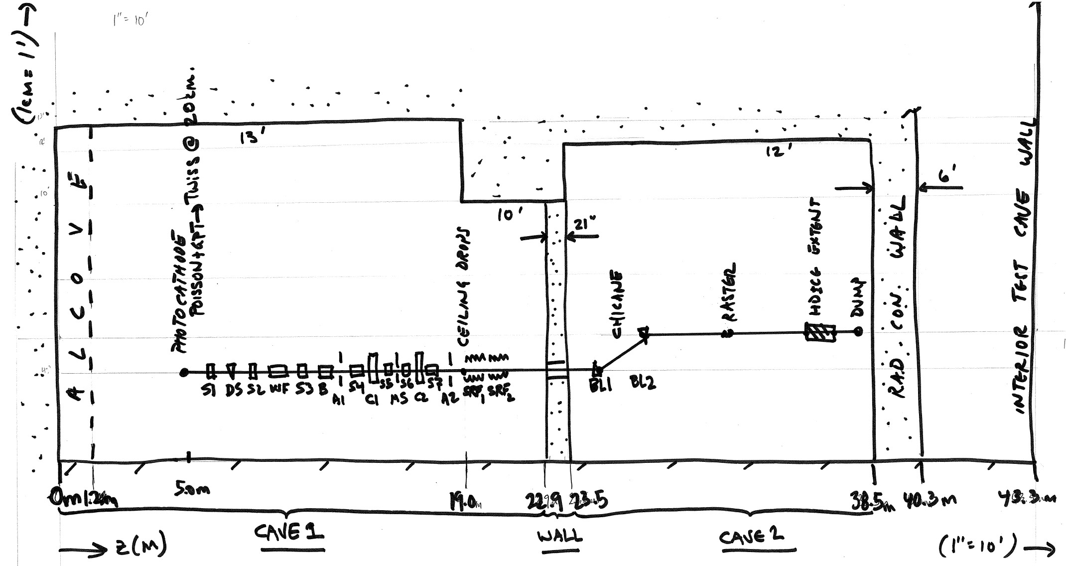
As-found reference for Cave1 +Wall + Cave2

Slide 4
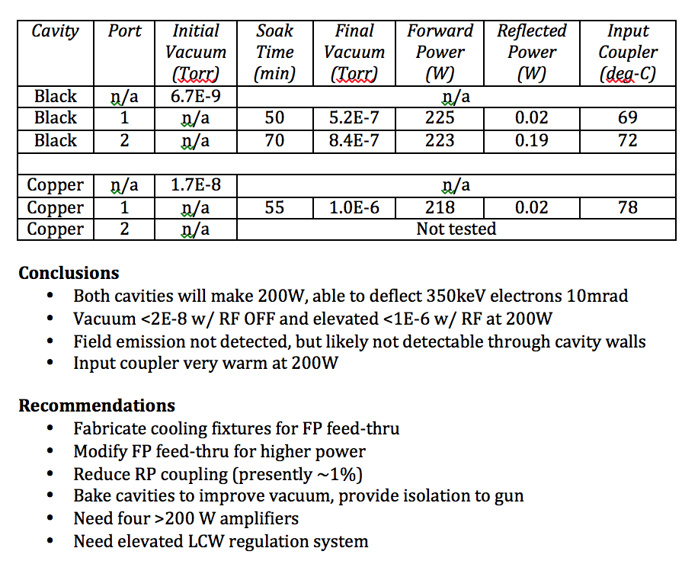
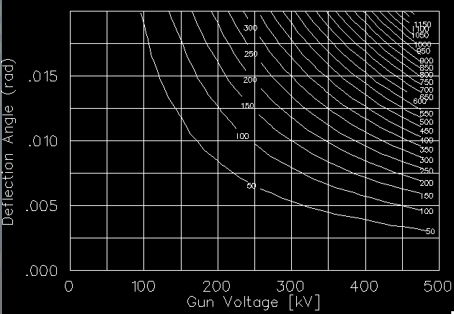
Cave1 - 1497 MHz Chopper Cavity Conditions
300W
200W

Slide 5
Cave2 - Vertical Chicane Geometry
delta-S
85-3/8”
42”
delta-Z
Maybe serves as the momentum spectrometer.
Thus, chose longer arm (smaller angle). 1mm/2203mm is 4.5E-4 (dp/p<0.05%)
 | y [in] | y [cm]
Cryounit Height | 42.0000 | 106.6800
HDIce Target Height | 85.3750 | 216.8525
Difference | 43.3750 | 110.1725
Beam Momentum [MeV/c] | 10.0000
Vertical Bend Angle [deg] | [Rad] | delta-Z [cm] | BL[G-cm] | delta-S [cm]
30.0000 | 0.5236 | 190.8246 | 17266.3219 | 220.3452
35.0000 | 0.6109 | 157.3428 | 20060.6689 | 192.0800
40.0000 | 0.6981 | 131.2986 | 22816.8293 | 171.3981
45.0000 | 0.7854 | 110.1726 | 25529.5567 | 155.8075
50.0000 | 0.8727 | 92.4458 | 28193.6872 | 143.8201
55.0000 | 0.9599 | 77.1437 | 30804.1495 | 134.4959
60.0000 | 1.0472 | 63.6083 | 33355.9744 | 127.2163
Magnet Types | Function | Current Max [A] | Hyst Max [G-cm]
MBV | Existing 5MeV dipole | 3.5000 | 14833.0000
MDL | New 5 MeV dipole | 10.0000 | ?
MBF | 123 MeV spectrometer | 60.0000 | 229144.0000
MBL | 123 MeV chicance | 14.0000 | 50850.0000

Slide 6
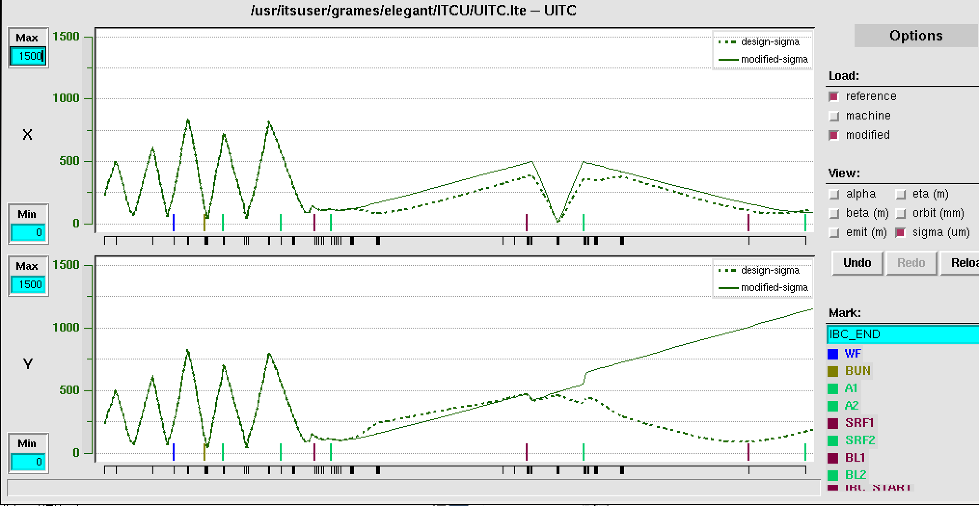
First pass Elegant layout – 350keV Gun to Dump
CAVE1
CAVE2
Buncher
Wien=0
SRF2
BL1
BL2
IBC_S
IBC_E
DS
A1
A2
SRF1
ε_{x}=ε_{y}=4E-8 (probably 2-3x too small)
dp/p = 1E-5 (OK at gun, not later…)
+5 QUADS (SOLID=OFF, DASHED=ON)

Slide 7
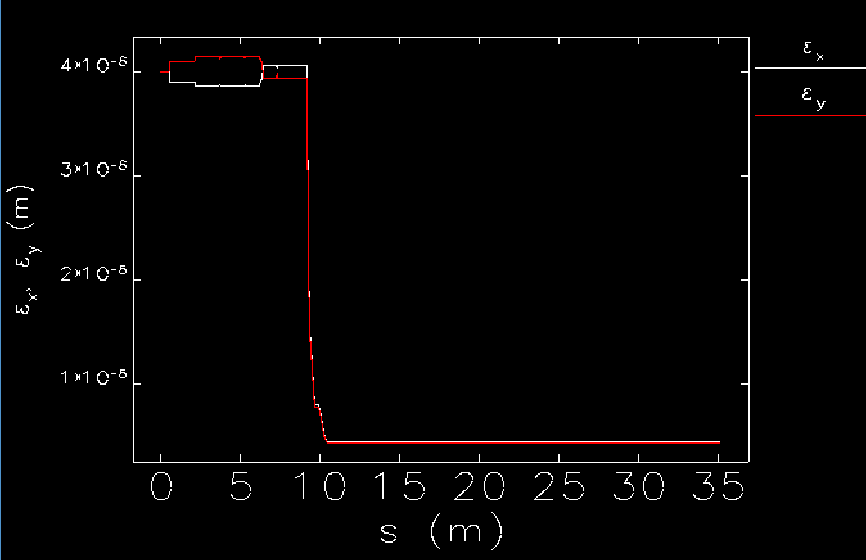
S2E probably means: S2E Cave1 + S2E Cave2, at least initially
Acceleration from 350 keV (0.69 MeV/c) to 10 MeV (10.5 MeV/c) ideally reduces transverse emittance by a factor of about 15. It is doubtful we’ll benefit this amount.
Normalized emittance should be constant. Measurement at CEBAF shows it isn’t and no measurement at 10 MeV (yet)
Options: use measurement; or simulation or model (if agrees with measurement). FEL … !?
P | β_{x} (m) | α_{x} | β_{y} (m) | α_{y} | ε_{x (norm)} (mm-mrad) | ε_{y} _{(norm)} (mm-mrad)
3.1 | 22.79 | −7.42 | 10.20 | −0.67 | 0.42 | 0.16
4.0 | 22.91 | −6.52 | 19.37 | −1.42 | 0.43 | 0.18
6.3 | 9.11 | −2.53 | 30.13 | −8.34 | 0.42 | 0.30
7.2 | 8.68 | −2.41 | 35.13 | −9.53 | 0.47 | 0.33

Slide 8
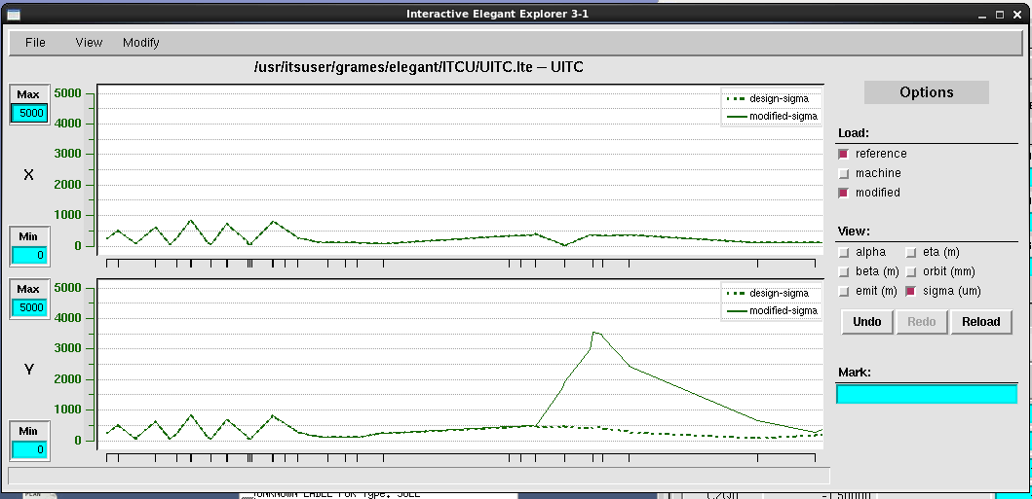
Importance of reasonable dp/p after cryounit
Increasing dp/p from Gun value (1e-5) to more typical – arguably challenging (0.5% = 5E-4)
(Vertical Bends)

Slide 9
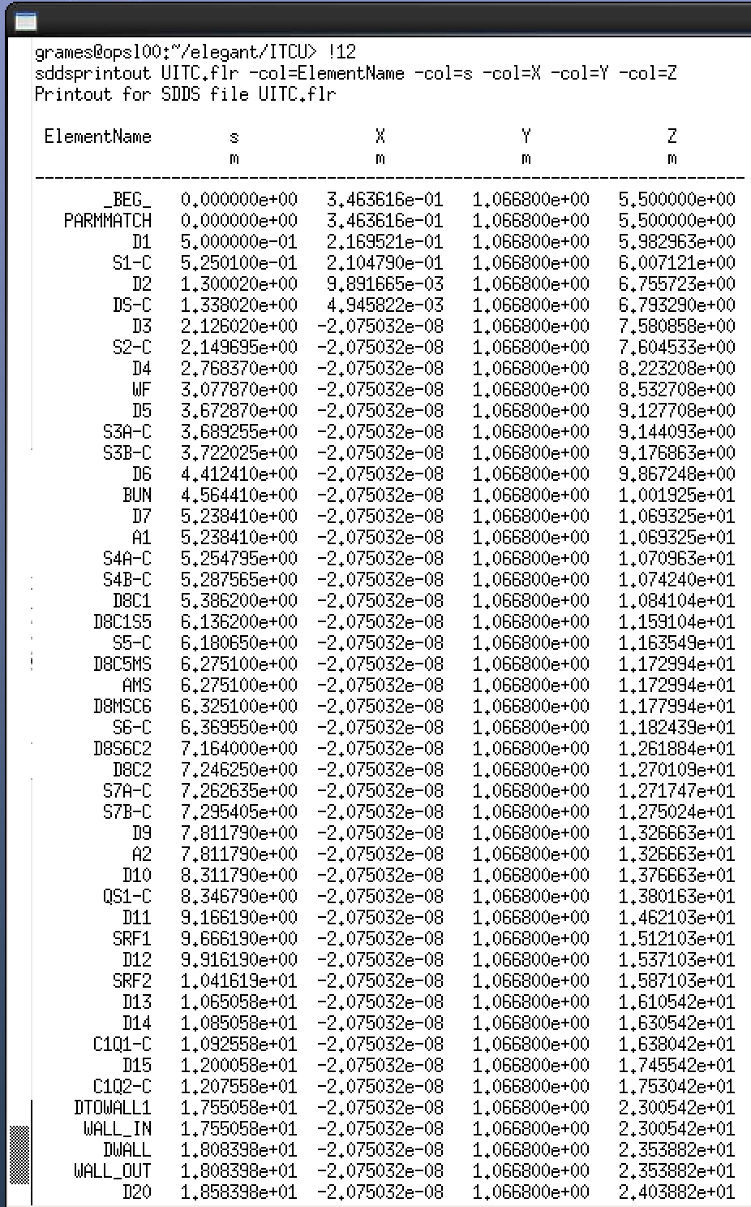
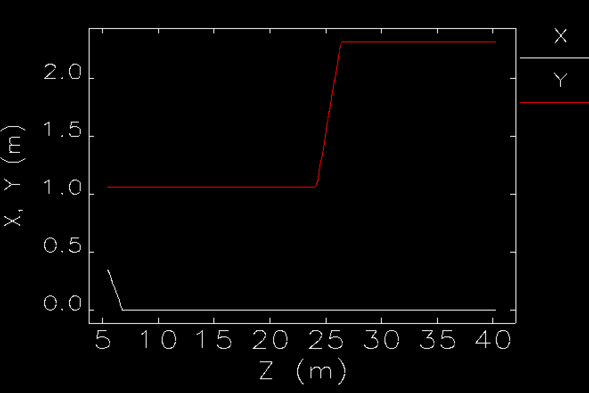
Using Elegant model to generate/address mechanical layout
Floor coordinates of model can be generated and used to generate mechanical layout and answer questions related to construction of both caves.
If we want we can choose (X0, Y0, Z0) to be survey coordinates.
Keep in mind (X,Y,Z) are physical locations and (S) is distance beam travels, i.e S and Z are not the same.

Slide 10
Proposed next steps…
Cave 1
Add gun Twiss output from GPT
Add generic hardware layout for better idea of layout and optical strengths needed
Calculate options for existing Wien and upgrade Wien operating w/ 350keV beam
Benchmark model of chopping optics with calculation
Define input conditions to cryounit, i.e. final solution from Gun to Cryounit
Update baseline optics in Elegant, make sure this makes sense
Fold into GPT for longitudinal study => entering at 350keV vs. 550keV @ CEBAF
Cave 2
Choose (extrapolate from measurement) reasonable cryounit output Twiss
Optimize optics to reach 50-100 um spot size (do we speak 1-sigma, 4-sigma, 90% ?)
Fold raster spec into layout
Geant4 model to assess beam from HDIce to dump?
Define BPM resolution to determine how far from target
Define minimum “keep out” after HDIce for possible asymmetry detectors
Fold into Elegant for transverse study

