Slide 1
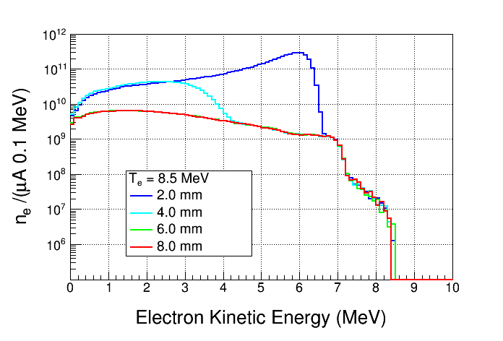
Electrons Exiting Radiator

Slide 2
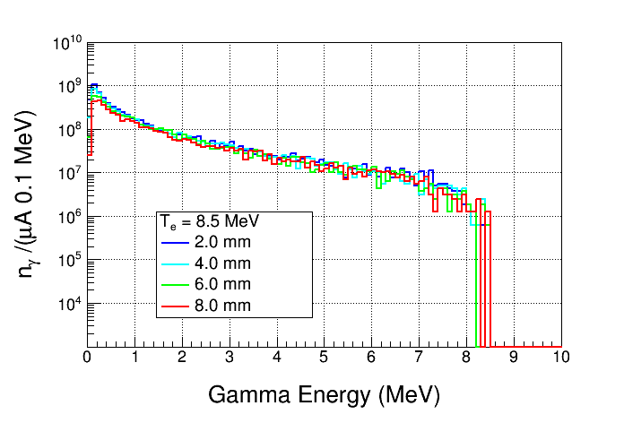
Gammas Entering Chamber

Slide 3
6 mm
2 mm

