Slide 1
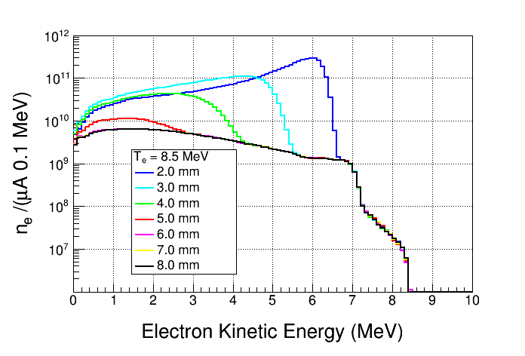
Electrons Exiting Radiator

Slide 2
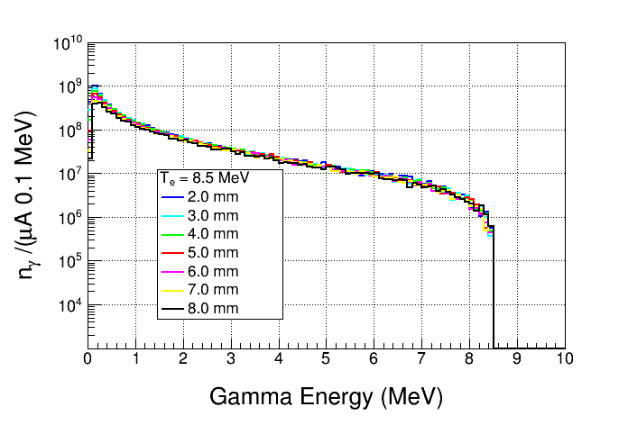
Gammas Entering Chamber

Slide 3
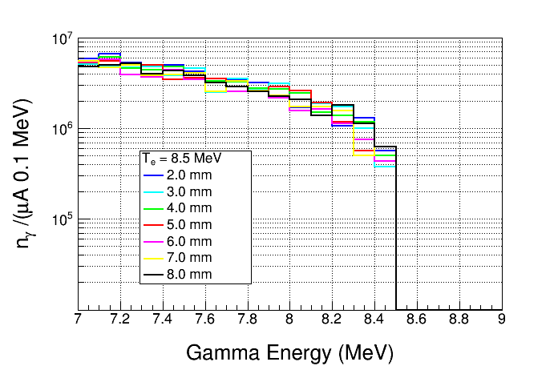
Gammas Entering Chamber

Slide 4
6 mm
2 mm

