Slide 1
Mott DAQ Speed
Raw ADC Data Samples Mode
vs.
Pulse Integral and High Resolution Time Mode

Slide 2
How to speedup DAQ
Reject low-energy electrons:
Increase E-detector hardware threshold
Vetoing dump events
Use faster DAQ mode

Slide 3
Increase E-Detector Hardware Threshold
E-detector discriminator threshold (NIM715) is now at -25 mV
Change threshold to -50 mV will reduce DAQ rate by a factor of 2

Slide 4
Vetoing Dump Events
Use laser ToF to veto dump events in NIM754 logic.

Slide 5
Use Faster DAQ Mode
No Readout of CAEN v775 TDC or SIS3801 Scalers
Instead: use FADC high resolution time and FADC scalers (?) → use new FADC mode
Add block readout

Slide 6
Comparison of:
Raw ADC Data Samples Mode
vs.
Pulse Integral and High Resolution Time Mode

Slide 7
Raw ADC data samples – Run 7673

Slide 8
Raw ADC Data Samples
PTW = 100 ns – 2 µs
PL = 100 ns – 8 µs
Mott Settings:
Programmable Latency (PL) = 60 samples
Programmable Trigger Window (PTW) = 50 samples
Threshold = 0
Each Sample = 4 ns (250 MHz), 0 – 4096 (2¹²)
Mott Readout:
50 samples

Slide 9
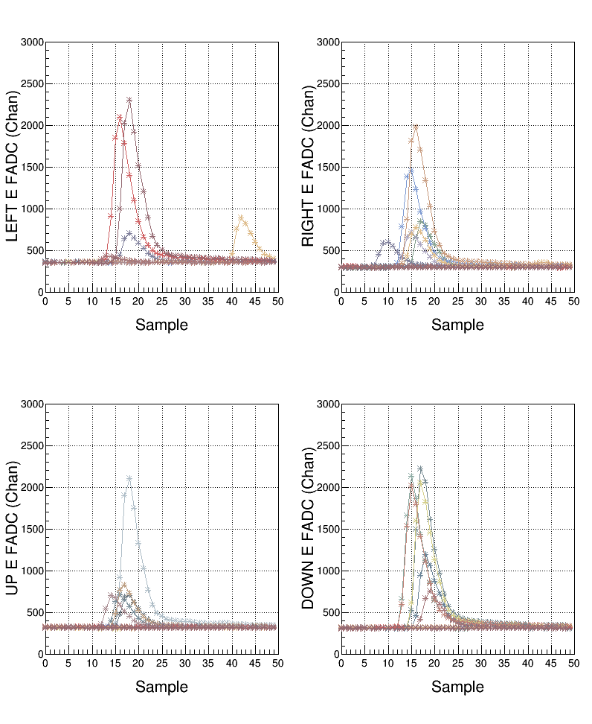
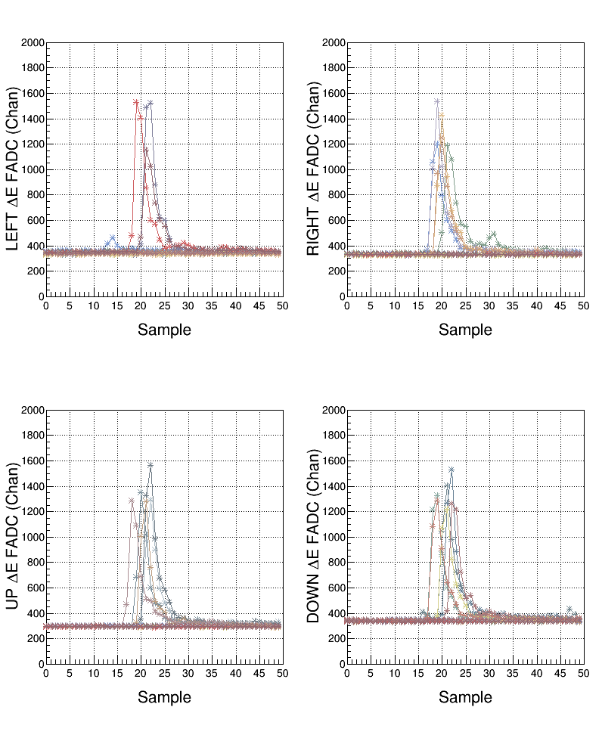
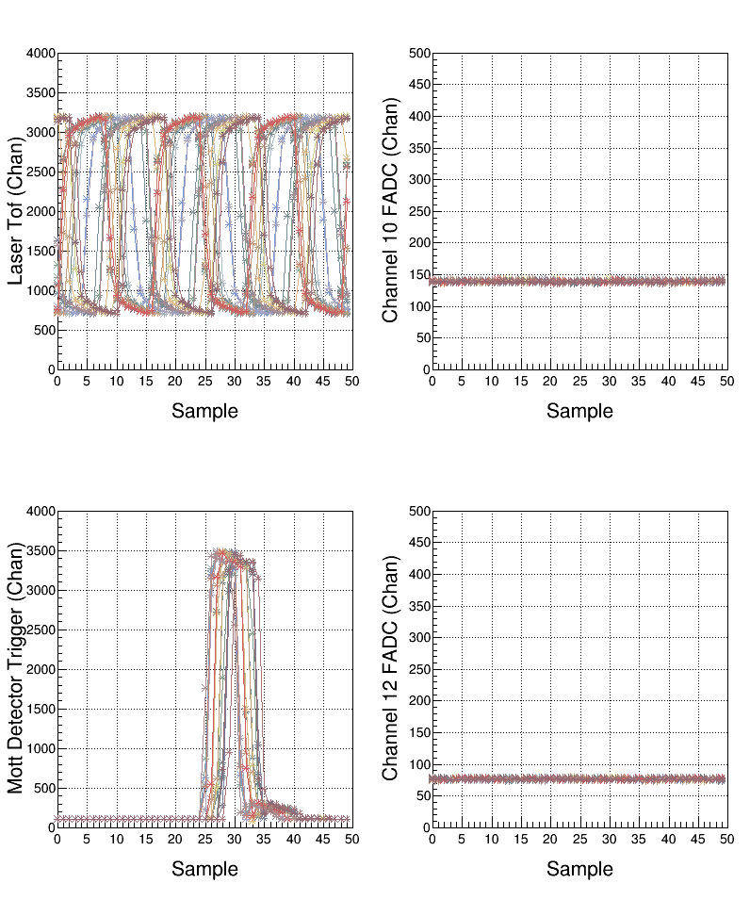
Samples

Slide 10
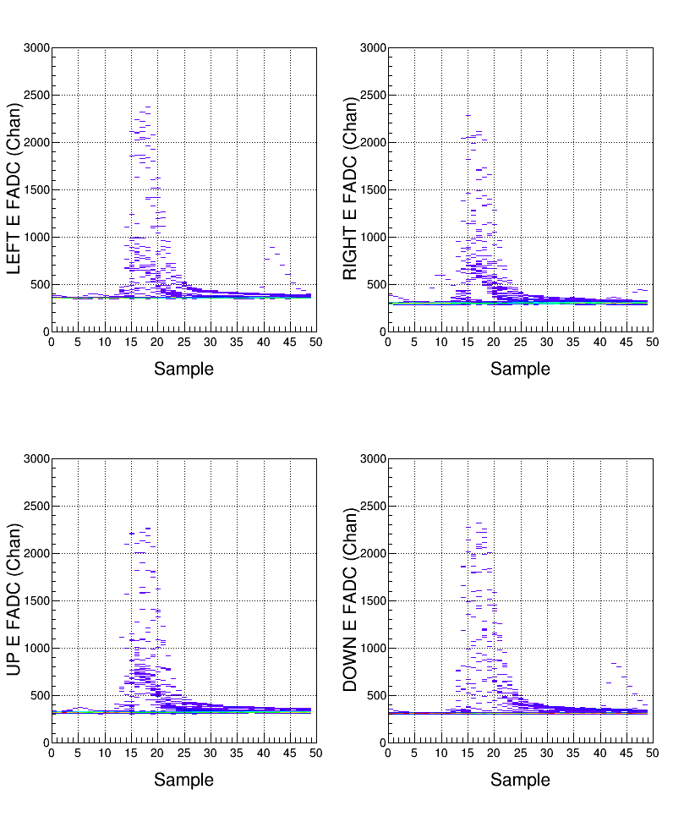
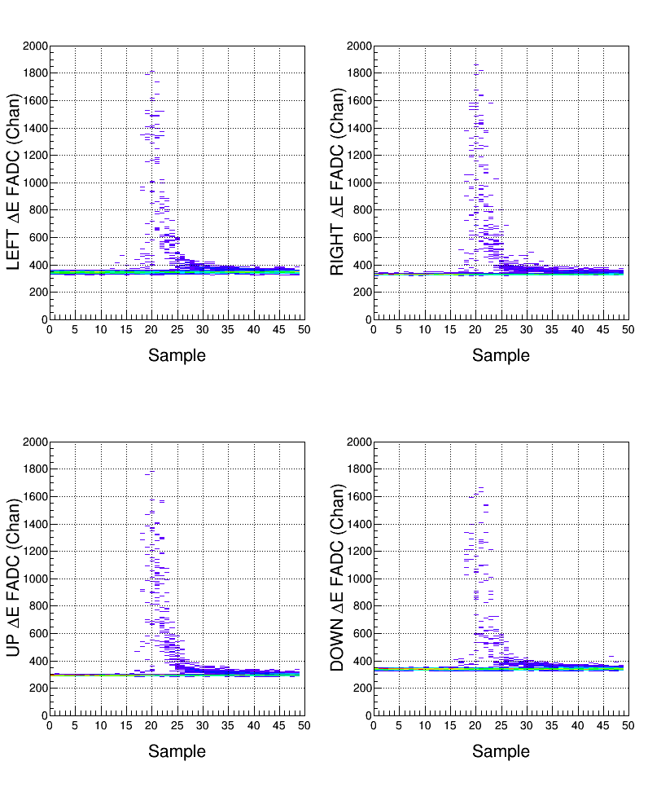
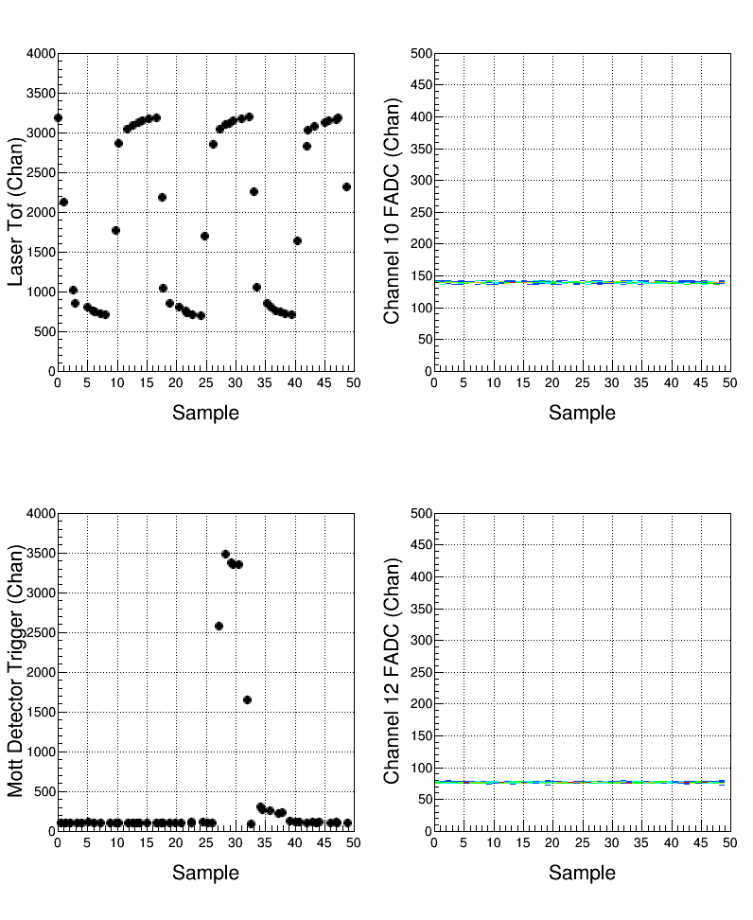
Samples

Slide 11
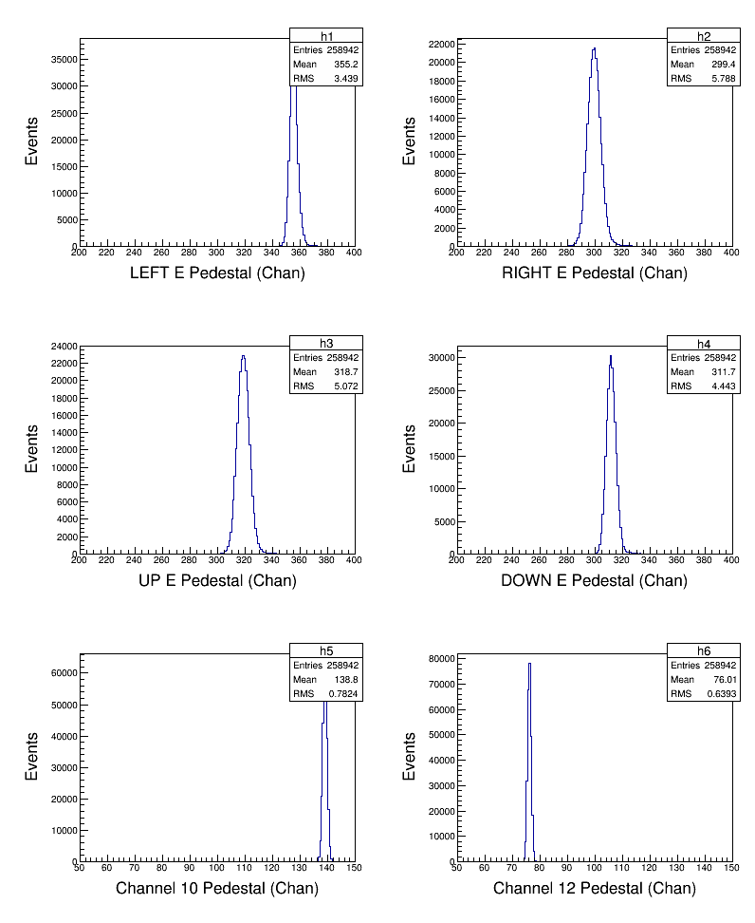
Analysis: Pedestals

Slide 12
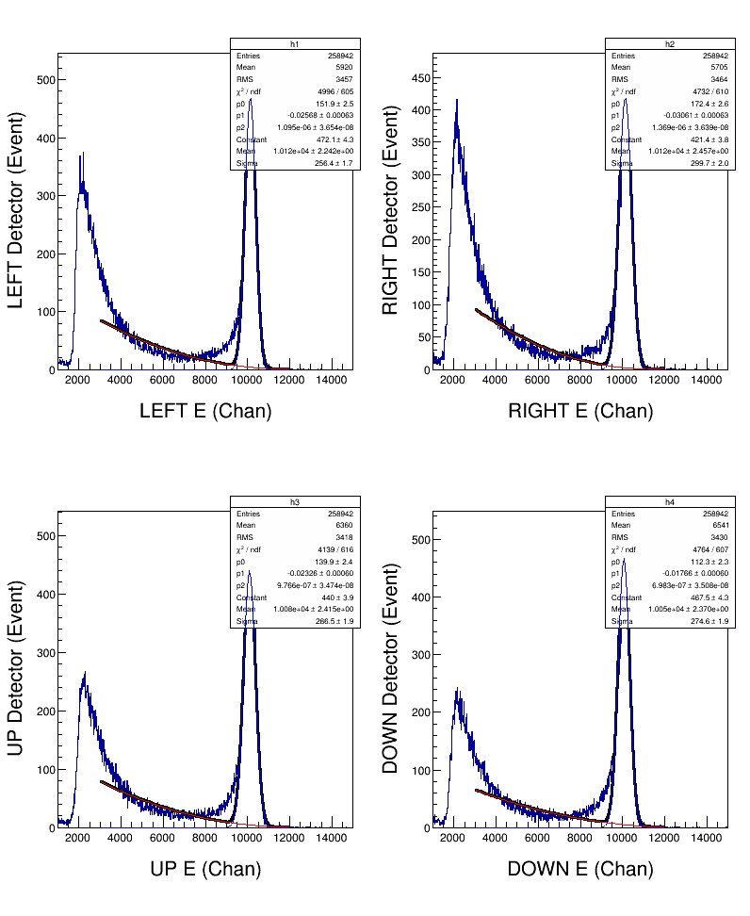
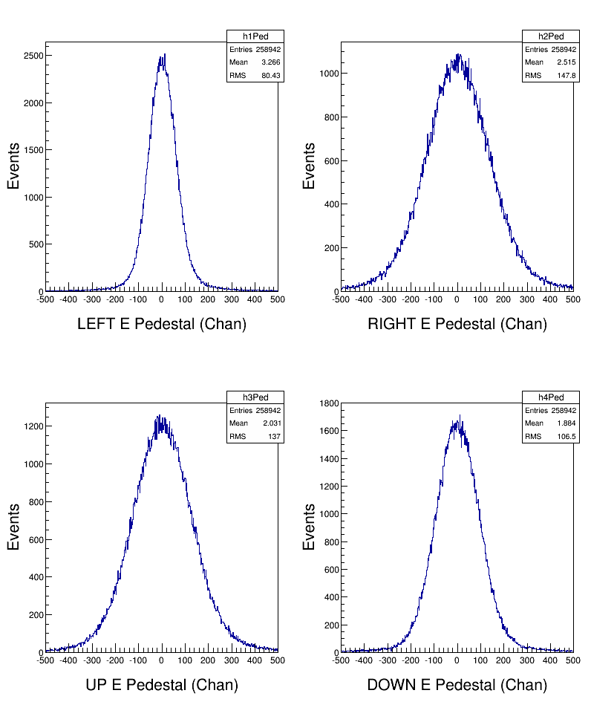
Analysis: Energy
σ_{E} ~ 2.7%

Slide 13
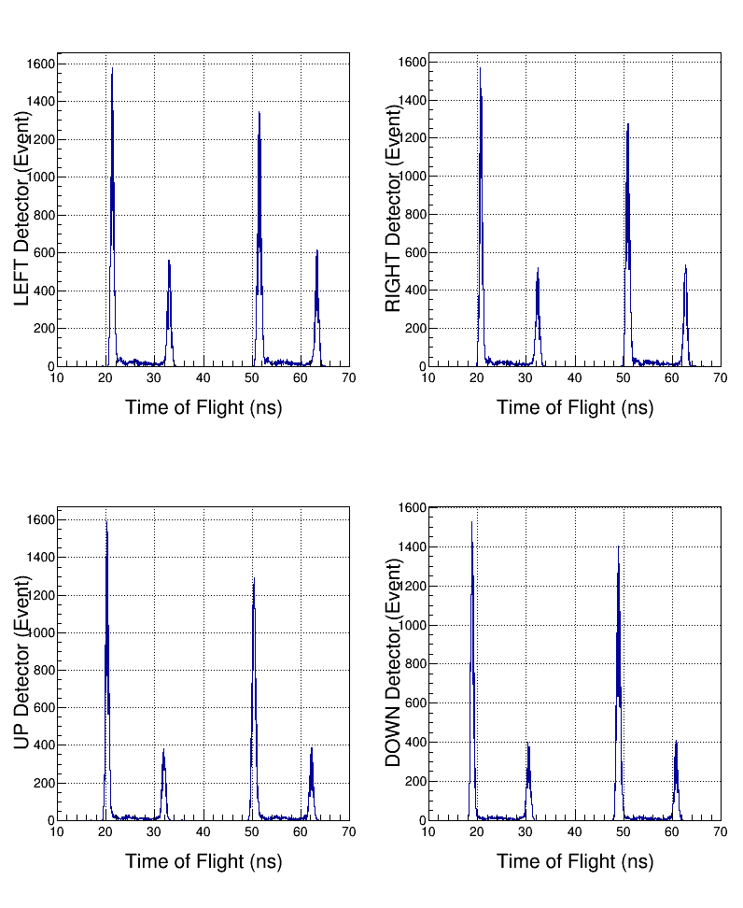
Analysis: Time-of-flight
σ_{t} ~ 0.2 ns

Slide 14
Pulse Integral and High Resolution Time – Run 7672, 7642

Slide 15
Pulse Integral & High Resolution Time
NSB
NSA
TET
PTW
PL
Mott Settings:
PL = 60 samples, PTW = 50 samples, or NW = NSB + NSA?
Programmable Trigger Energy Threshold (TET)
Number of pulses (NP) in PTW = 1 (up to 3 pulses)
Number of Samples Before threshold crossing (NSB) = 5
Number of Samples After threshold crossing (NSA) = 28

Slide 16
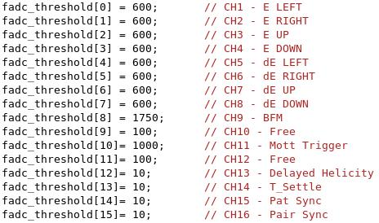
TET

Slide 17
Pulse Integral & High Resolution Time
V_{P}
NSB
NSA
TET
Pedestal
TC
PTW
PL
See
Note 1
Mott Readout:
Pedestal = Average of first 4 samples of window
Peak Value (V_{P})
Pulse Integral = Sum of raw samples MIN(NSB+NSA, PTW)
Pulse Coarse Time = Sample number of first Threshold Crossing (TC)
Pulse Fine Time =
See
Note 2

Slide 18
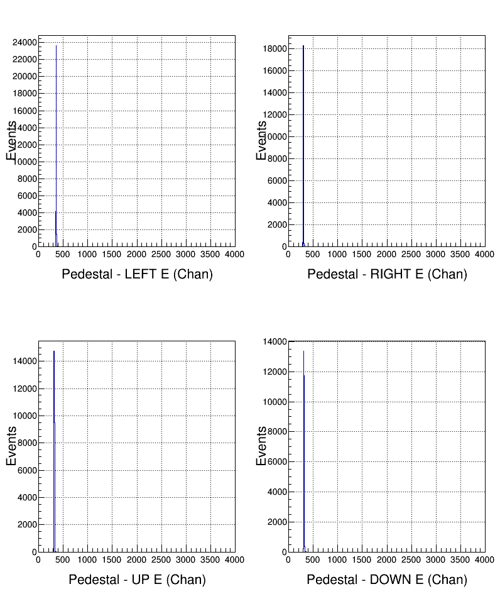
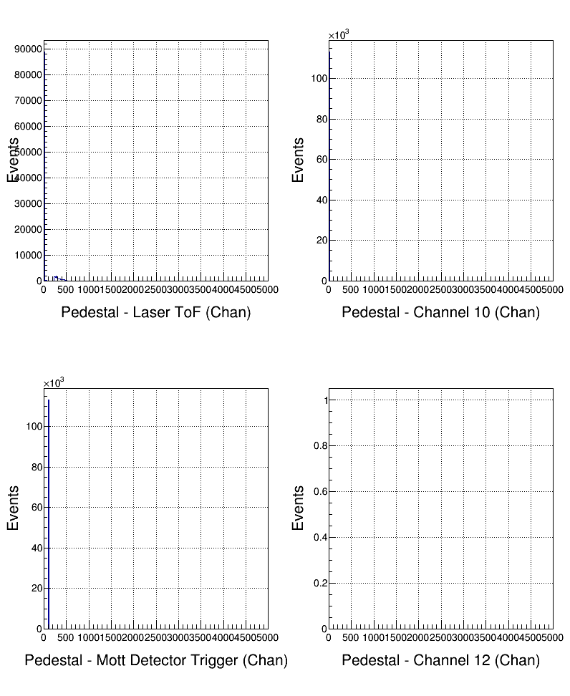
Pulse Pedestal

Slide 19
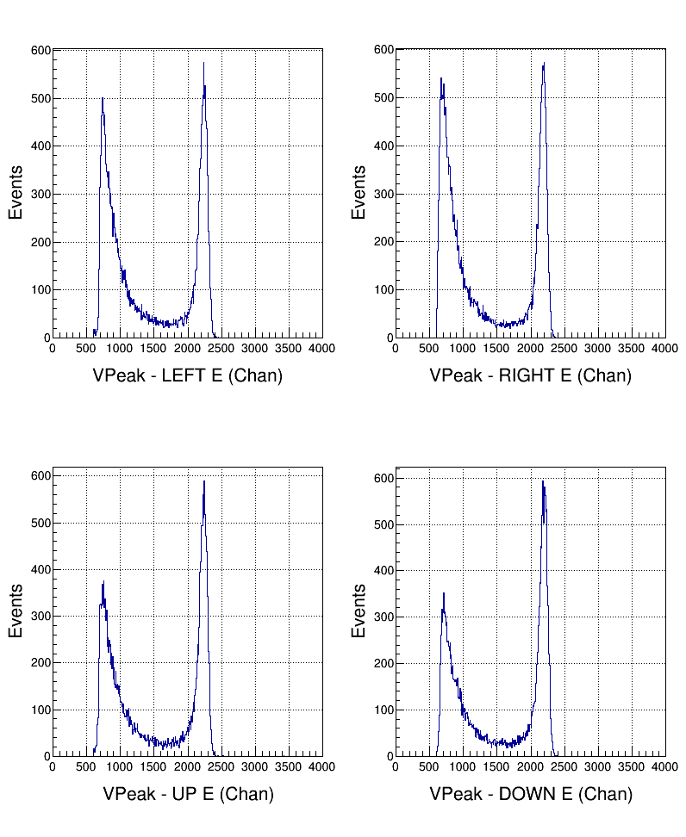
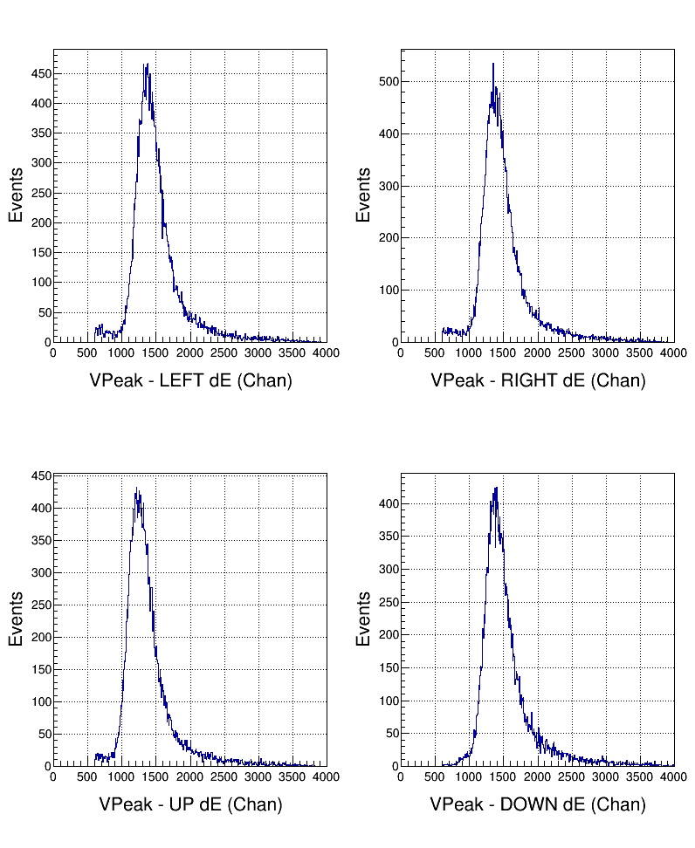
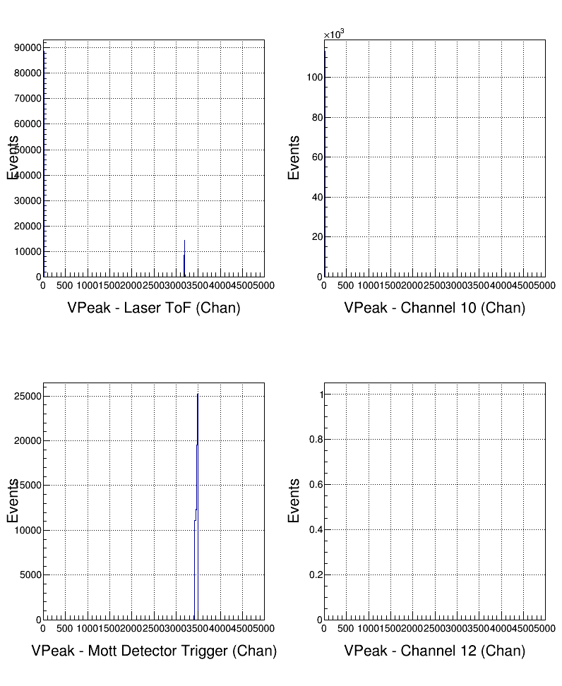
Pulse Peak Value (VP)

Slide 20
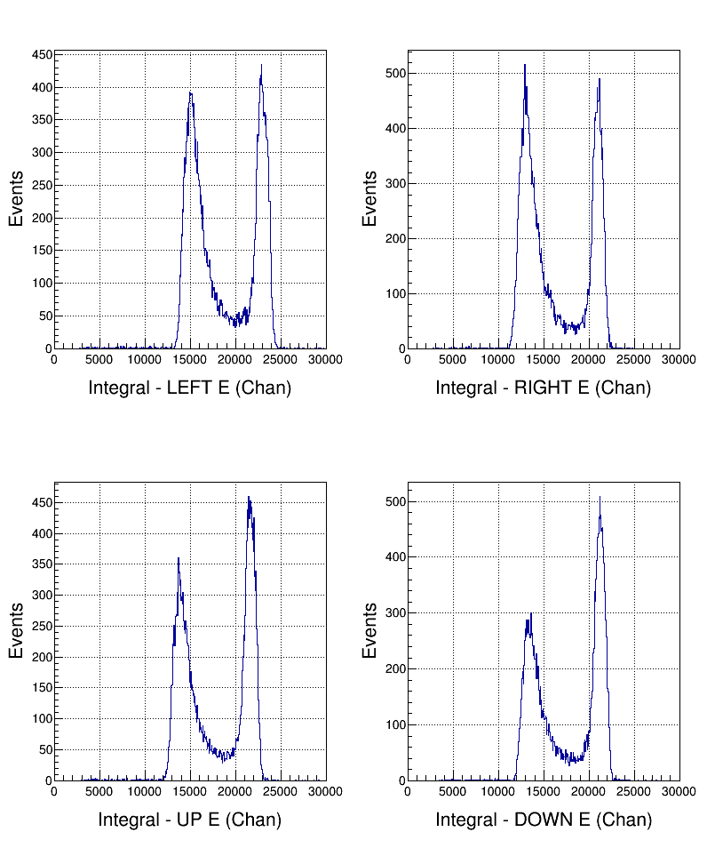
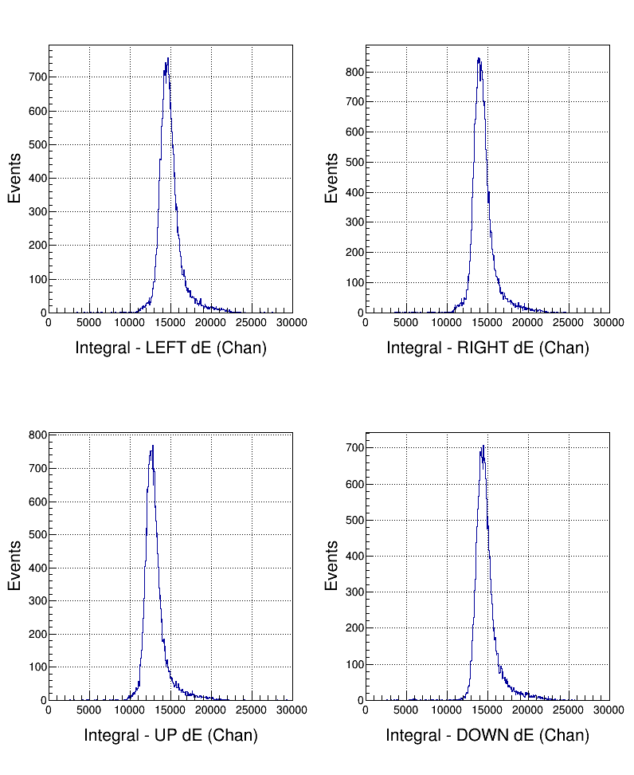
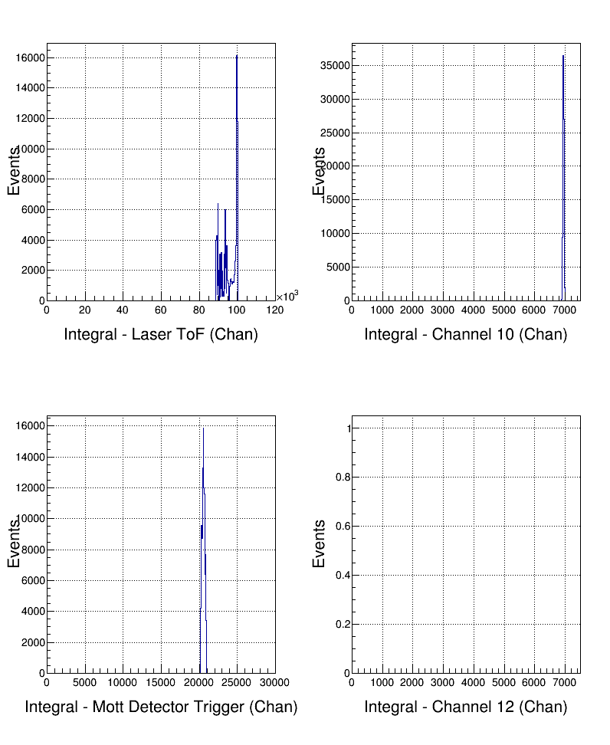
Pulse Integral

Slide 21
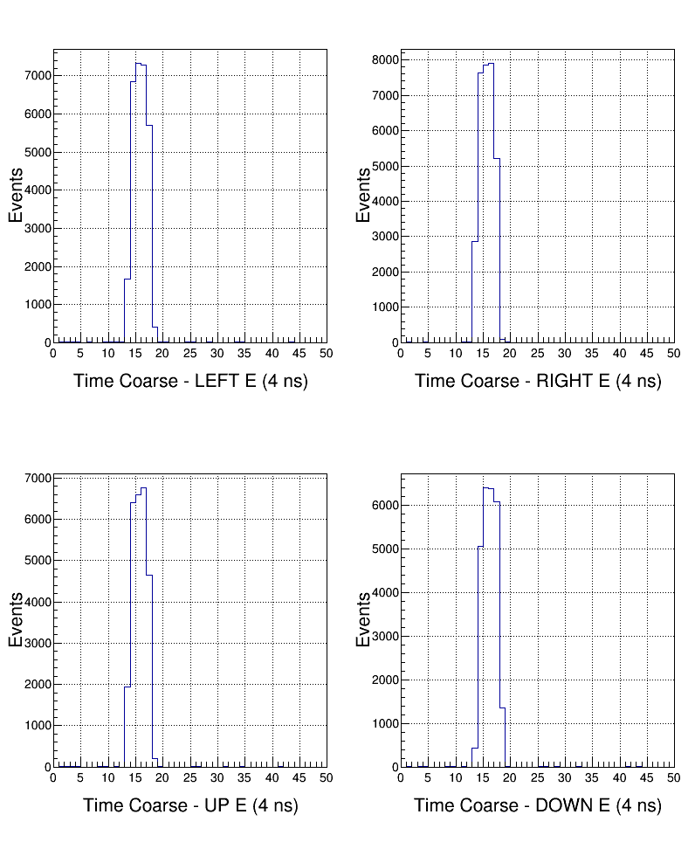
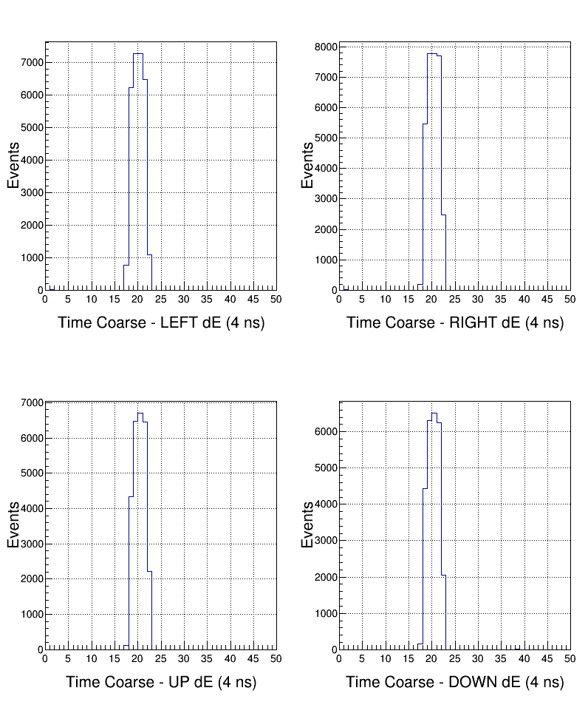
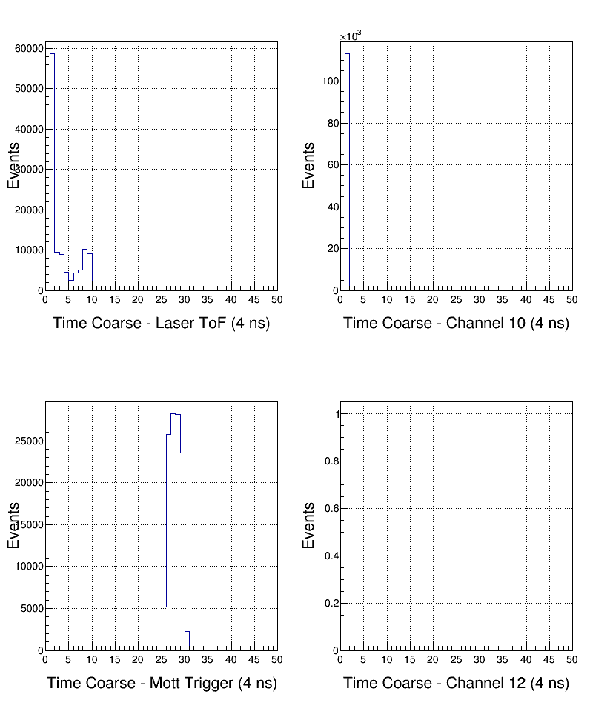
Pulse Coarse Time
See
Note 3

Slide 22
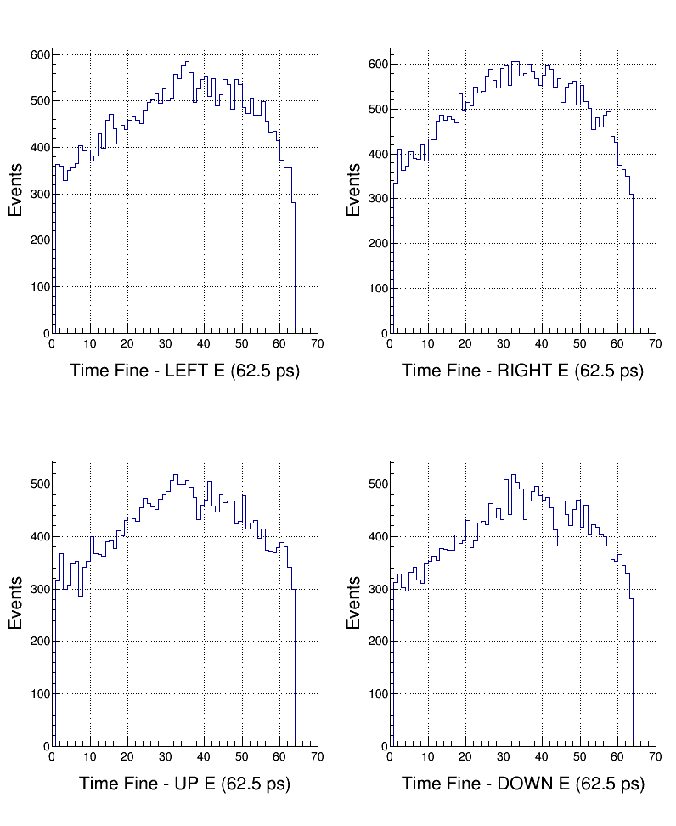
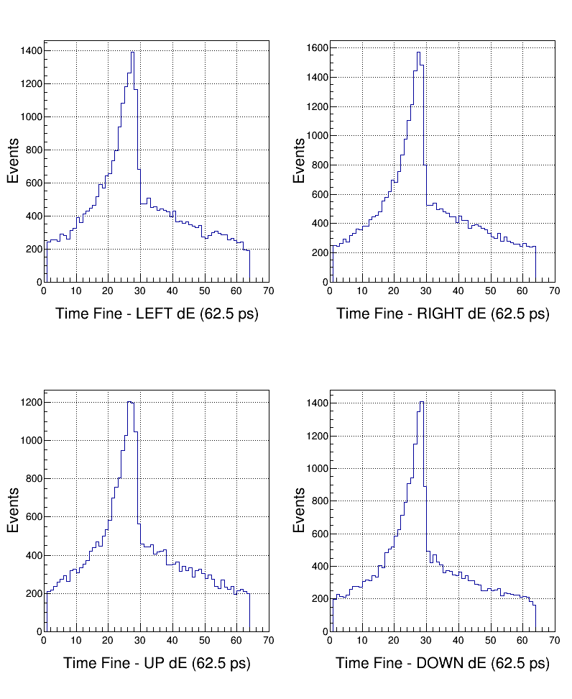
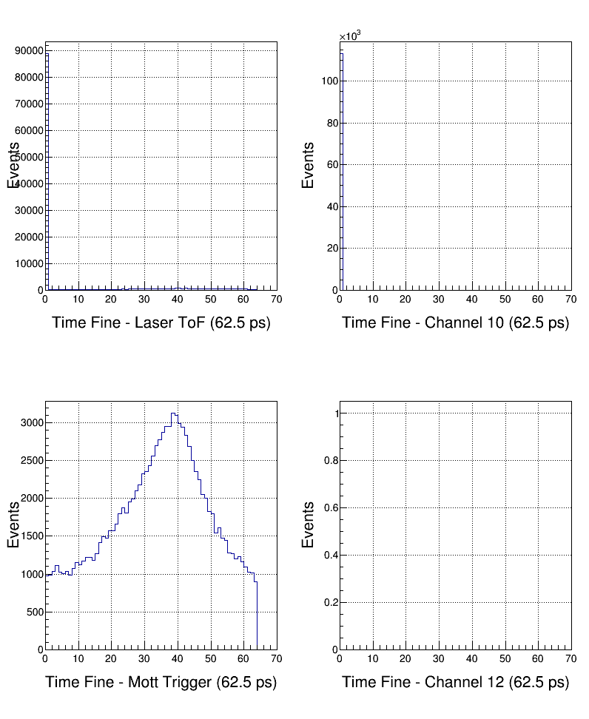
Pulse Fine Time

Slide 23
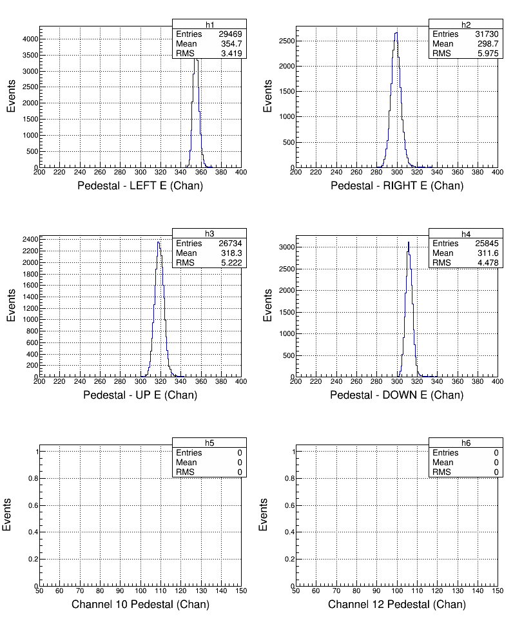
Analysis: Pedestals

Slide 24
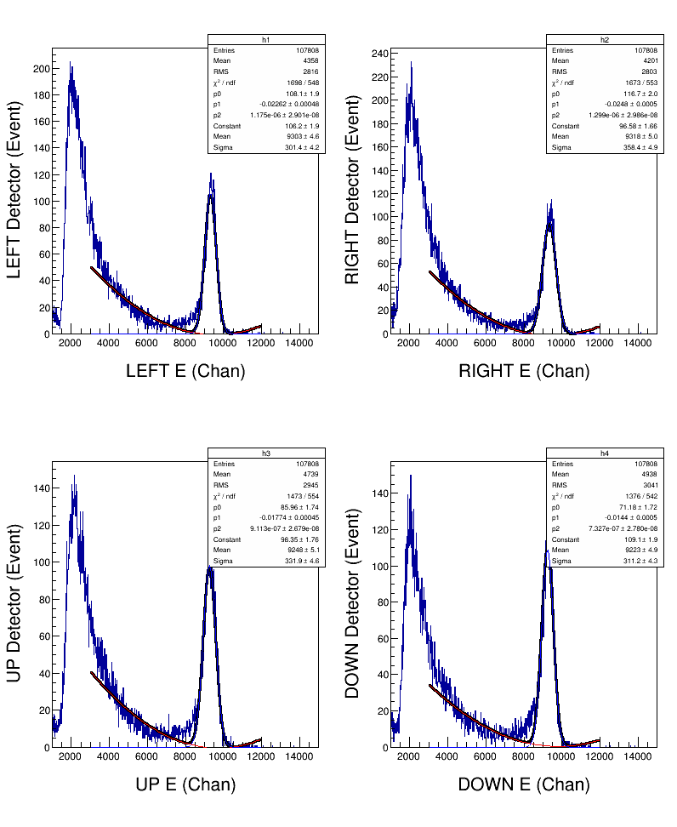
Analysis: Energy
Energy from run 7642
Pedestal from run 7672
σ_{E} ~ 3.2%
The increase partially due to average pedestals being subtracted. New data will have this fixed

Slide 25
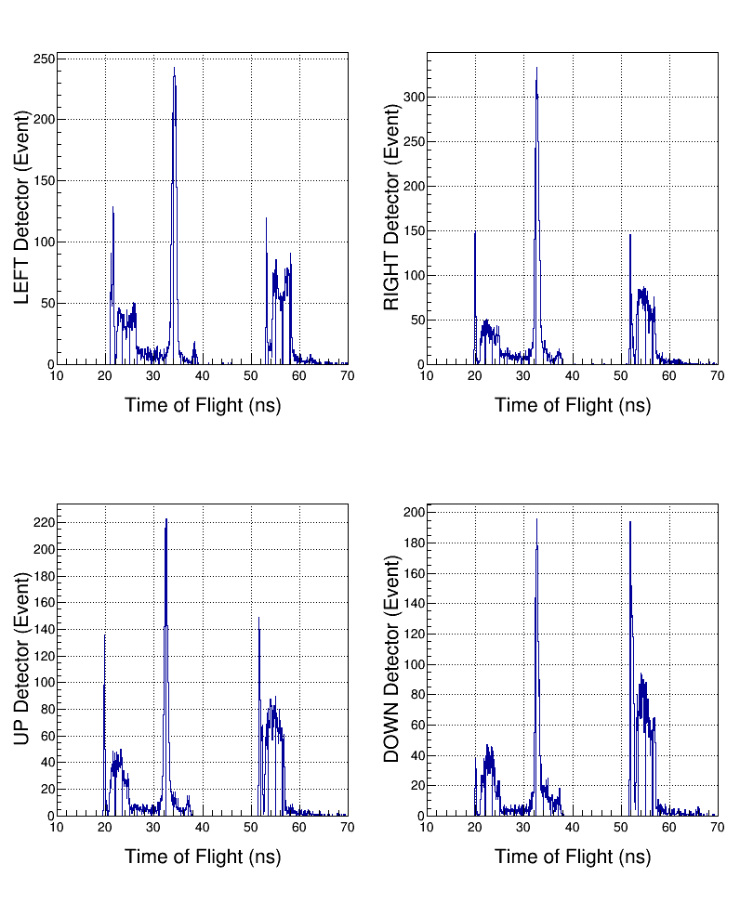
Analysis: Time-of-flight
σ_{t} ~ ? ns

Slide 26
Notes
Note 1
If first sample above threshold then:
course time =1, fine time = 0, and ped = 0
Note 2
MIN(NSB+NSA, PTW): Make sure NSB+NSA is less than PTW.
Otherwise cannot till how many samples were summed; this is
needed for pedestal subtraction.
Note 3
How FADC deal with a periodic square wave. Solution: add
same signal to another channel delayed by ½ period
bad
good
PTW
PL

