Slide 1
>200 keV Wien filter spin rotator
Gabriel G. Palacios Serrano
gabrielp@jlab.org
Under the tutelage of Carlos Hernández-García, Mathew Poelker, and Helmut Baumgart
chgarcia@jlab.org, poelker@jlab.org, hbaumgar@odu.edu

Slide 2
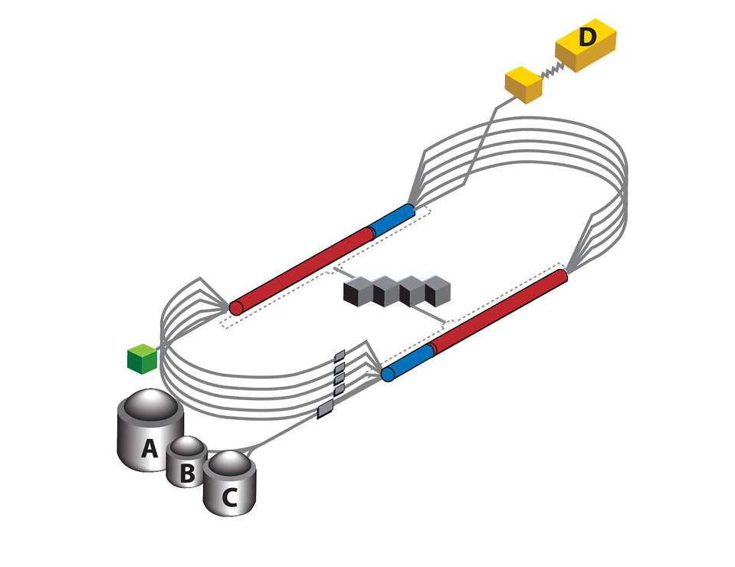
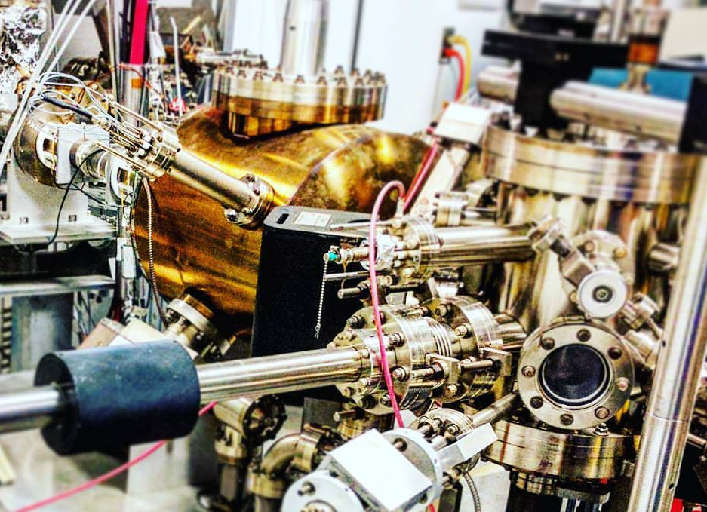
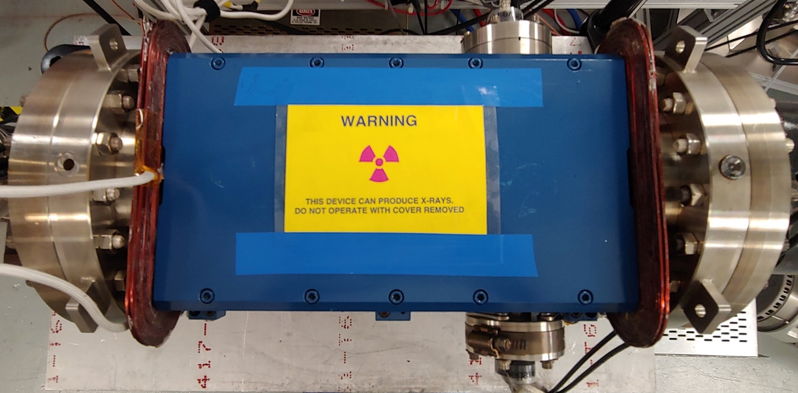
Thomas Jefferson Nation Accelerator Facility (2019)
Introduction
RF acceleration
Photogun
+
Wien
Refrigeration
Bending magnets
Aligned Spin!
Experimental halls

Slide 3
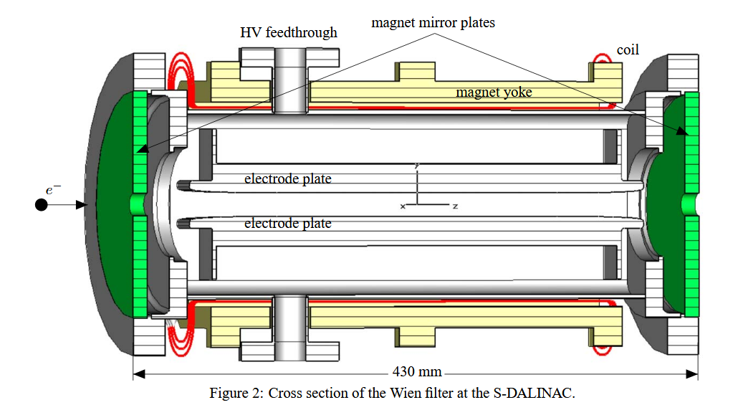
Wien filter
B. Steiner, W. Ackermann. (2007)
The design used at CEBAF is originally from SLAC, and has been replicated at MAMI, MIT-Bates, and S-DALINAC.

Slide 4
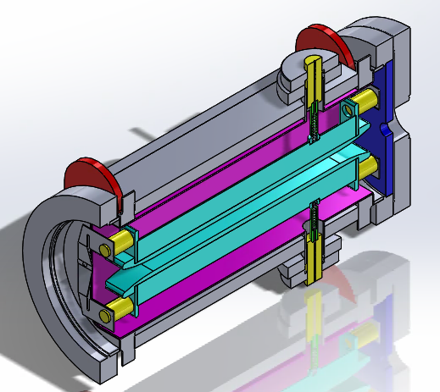
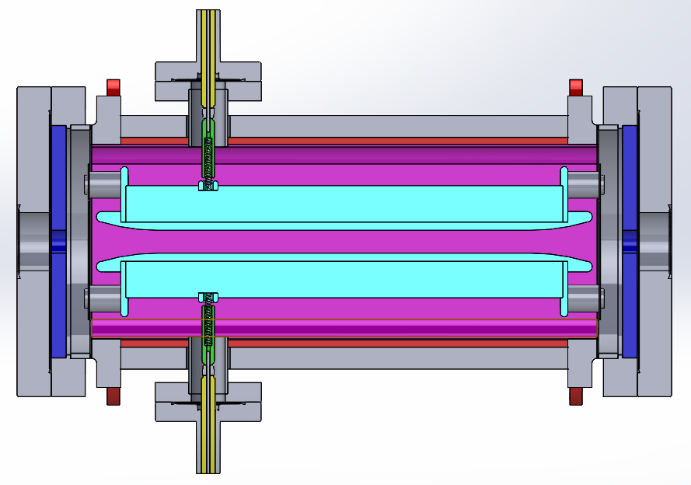
Model description
CEBAF’s 100 keV Wien filter
High voltage feedthrough
42 cm
Magnetic mirrors
Mounting insulators
Vacuum chamber
High voltage plates
Magnet coil
E
Steel shield
v
B

Slide 5
Two objectives
Provide Spin angle control
Do not deviate the beam trajectory
Beam trajectory
100 keV -> 200 keV

Slide 6
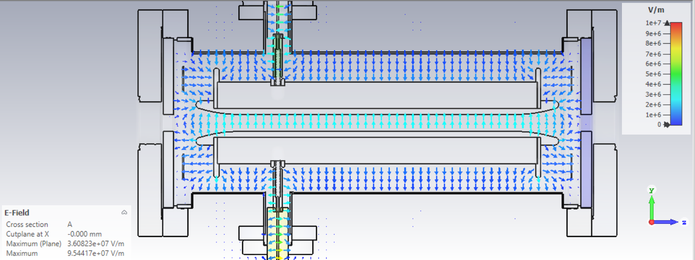
Beam trajectory
Don’t deviate the beam
Equilibrium condition: $q \left(E+v×B\right)=0$
Preserve this relation: $E_{y}=− v_{z} B_{x}$
Beam trajectory
Magnetic field

Slide 7
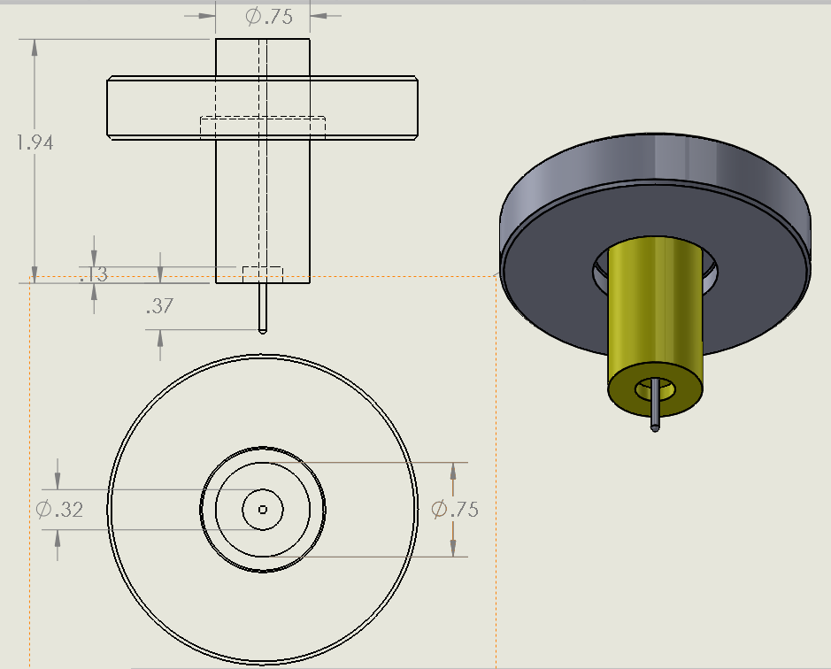
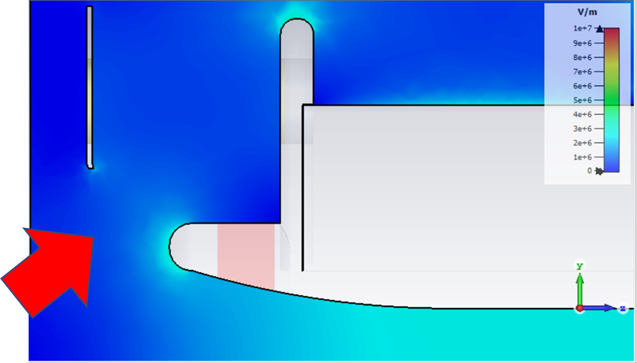
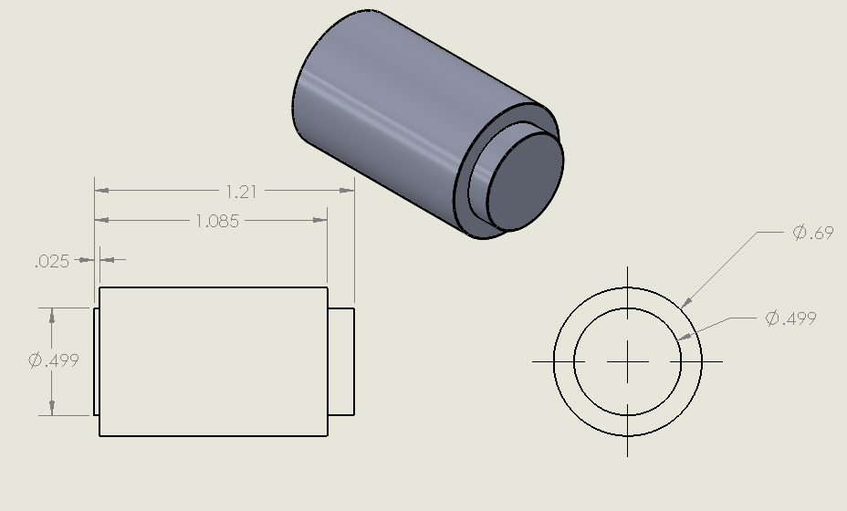
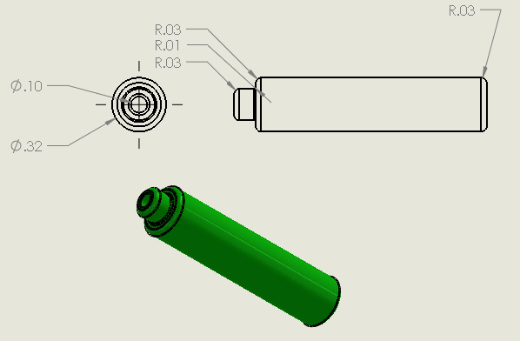
Electrostatics simulations
CST microwave studio
Solidworks models

Slide 8
Beam dynamics
Done with Pulsar physics GPT

Slide 9
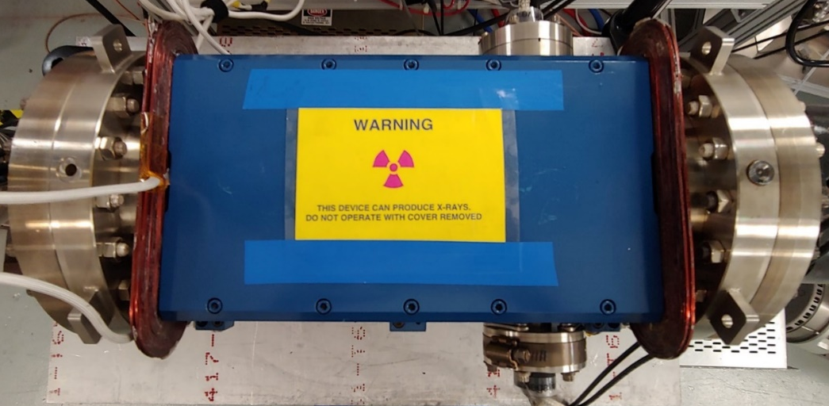
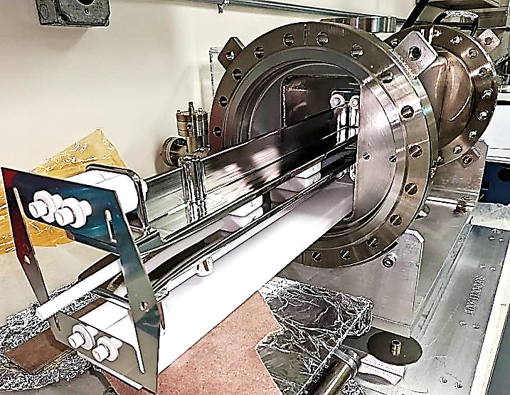
Experiments
Jefferson Lab (2019)
We have built four Wien filters at JLab:
Two 200 keV at CEBAF
In operation since February 2021
32 cm electrode plate
1.5 cm gap
20 kV max achieved voltage per plate
2.7 MV/m max gap electric field
Undergoing optics matching studies.
A shorter-gap 300 keV at UITF
In operation since July 2022
32 cm electrode plate
1.3 cm gap
26 kV max achieved voltage per plate
3.9 MV/m max gap electric field
One with integrated ion pump at test lab
Patent!
Still on the works

Slide 10
300 keV Wien spin rotator
Operation parameters for 300 keV beam at 10 mm gap and 100°spin rotation
KE [keV] | beta | MV/m | Vapp [+-] | B [mT]
300 | 0.7765 | 4.3873 | 21.9368 | 18.8963
Is it possible with the existing set up?

Slide 11
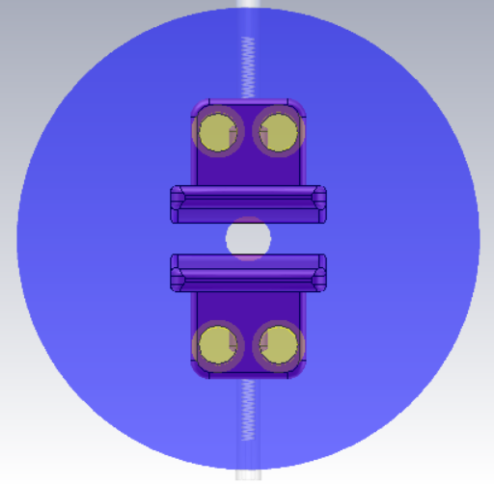
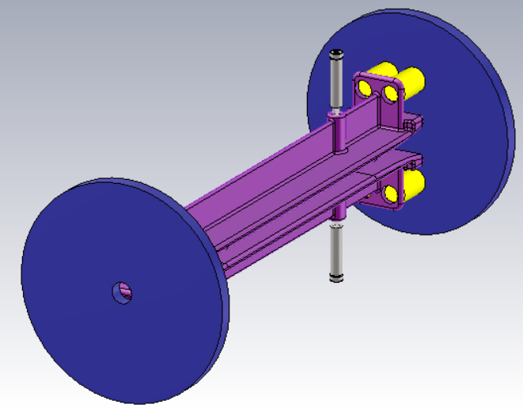
Model
Isometric view showing magnetic mirrors (blue)
10 [mm] gap
At 10 [mm] gap, we are at a shorter gap than the mirror aperture. But stay tuned for beam dynamics.
Frontal view with transparent mirrors to show gap

Slide 12
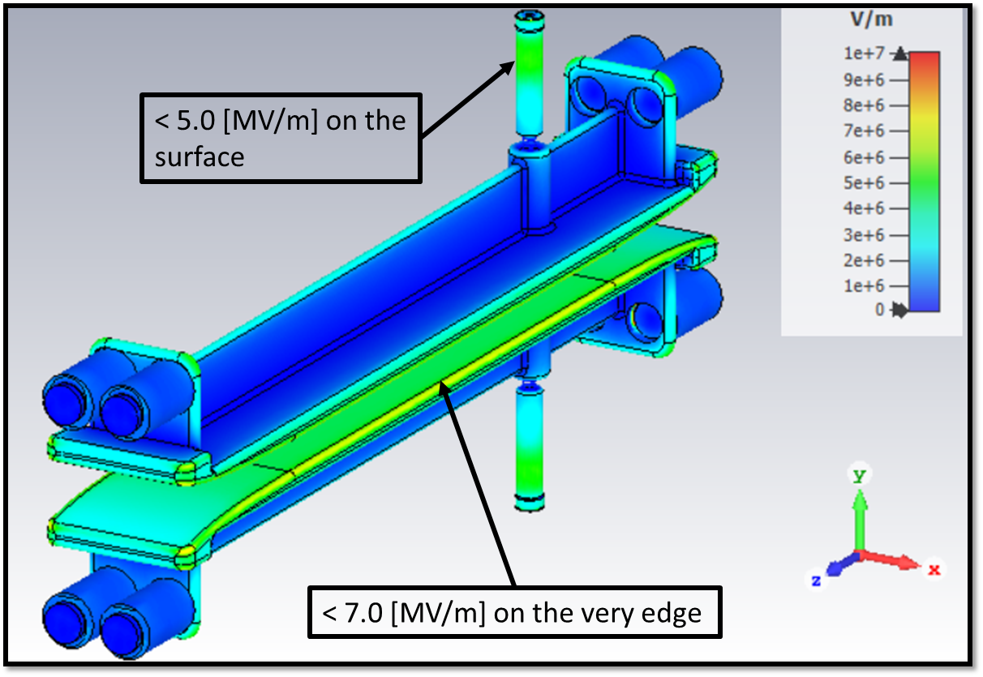
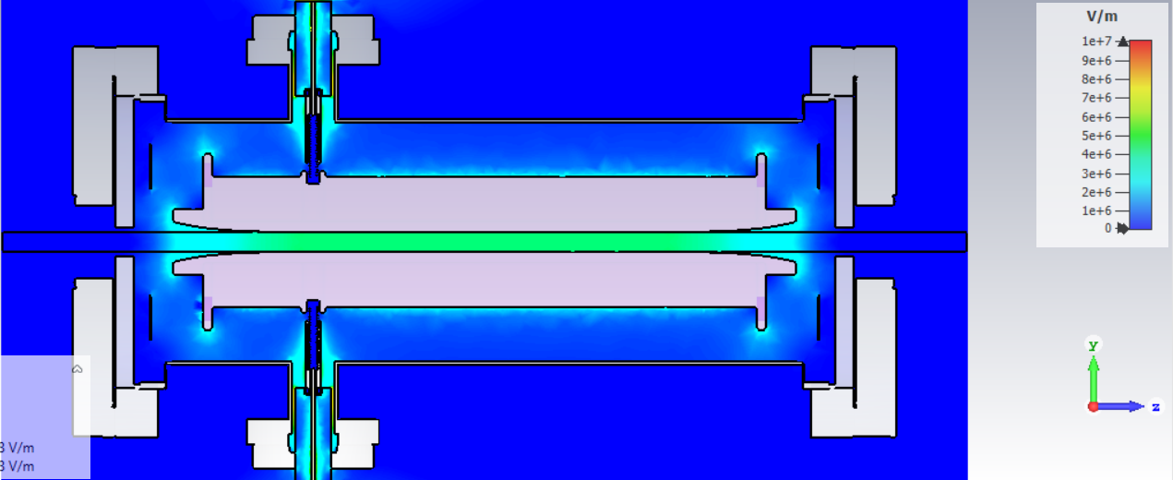
Electric field magnitude
< 3.0 [MV/m]
+21.9368 [kV]
-21.9368 [kV]
< 3.5 [MV/m]

Slide 13
Beam dynamics
Test Gaussian distribution beam @300 keV
Based on the beam dynamics digest by the Darmstadt team
Done with Pulsar physics GPT
The 10 mm gap is just fine!

Slide 14
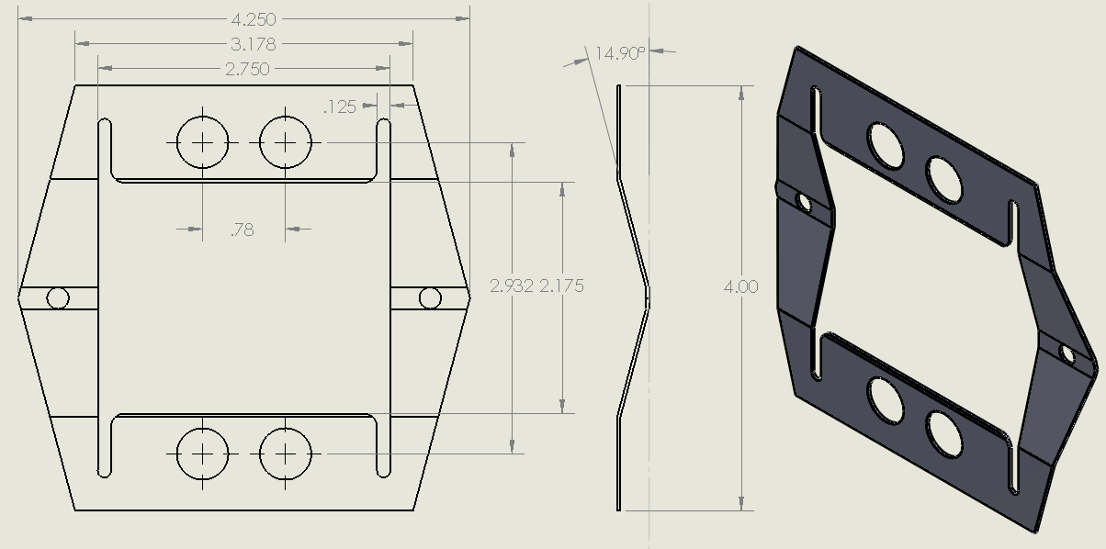
Finally, for 300 keV Wien
HV spring guide
Caveats:
Magnetic field requires more current, larger cross section wire?
Care must be taken on the feedthrough pipe
Magnetic mirror aperture optimization
Electrode Rogowski profile optimization
Electrode manufacturing
Must adjust HV spring guide, spring coil, and electrode mounting spring (or mounting insulators)
Also: for 100° spin rotation
How about other gaps?
If you pick different gaps, the higher voltage might require changing the feedthrough pipe size, impact magnetic profile.
Electrode mounting spring
Gap [mm] | KE [keV] | beta | MV/m | Bias at plate [kV] | B [mT]
10 | 300 | 0.7765 | 4.3873 | 21.9368 | 18.8963
13 | 300 | 0.7765 | 4.3873 | 28.5178 | 18.8963
15 | 300 | 0.7765 | 4.3873 | 32.9052 | 18.8963

Slide 15
FIN
gabrielp@jlab.org
Call me tho

Slide 16
References
K. Tsuno & D. Ioanoviciu. Advances in Imaging and Electron Physics 176. Academic Press (2013)
M. Salomaa & H. A. Enge. Nuclear Instruments and Methods 145 (1977)
B. Steiner, W. Ackermann. Proceedings of PAC07, Albuquerque, New Mexico, USA. (2007)
J. Grames et al. Proceedings of 2011 Particle Accelerator Conference, New York, NY, USA. (2011).
V. Tioukine, K. Aulenbacher. Nuclear Instruments and Methods in Physics Research A 568 (2006)
MOLLER Collaboration. arXiv:1411.4088 [nucl-ex], (2014). https://moller.jlab.org/moller_root/
J. D. Jackson. Wiley, (1975)
J. Grames et al. Physical Review Special Topics - Accelerators And Beams,Volume 7, 042802 (2004)
Solidworks https://www.solidworks.com
CST Studio Suite, “CST Microwave Studio,” 2019. http://www.cst.com
H. Miller, “Surface flashover of insulators,” IEEE Transactions on Electrical Insulation, vol. 24, no. 5, 765 (1989).
G. Palacios et al. Review of Scientific Instruments 89, 104703 (2018)
Pulsar Physics General Particle Tracer http://www.pulsar.nl/gpt

Slide 17
Extra slides
Just in case

Slide 18
Provide Spin angle control
y
y
$\text{Ω}$₀=0°
$\text{Ω}$_{t}
z
z
Initial angle $\text{Ω}$₀
Final angle $\text{Ω}$_{t}
Relativity requires Thomas-BMT to describe the change of spin with respect to time:
$\frac{ds}{dt}=s×$ $\text{Ω}$
For our case:
So the spin rotation angle:
$$B=\frac{mcγ^{2}β\text{Ω}}{eL}$$
Magnetic moment anomaly
Wait, what?
Notes:
Bargmann–Michel–Telegdi

Slide 19
Extras
Using the calculated value of E field = 1.65 MV/m
kicks beam out of z-axis
Using 97 % E (1.61 MV/m) restores the trajectory

Slide 20
Extras

Slide 21
Extras

Slide 22
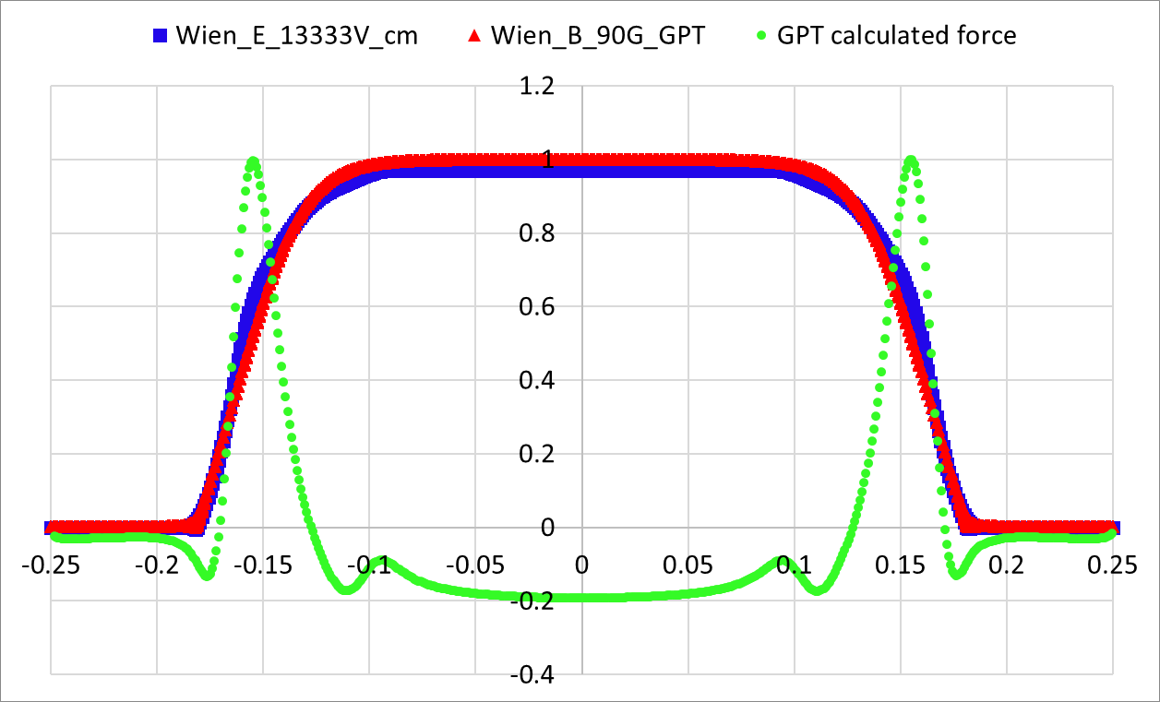
Remember me?
Beam dynamics
Kick due to fringe fields!
Done with Pulsar physics GPT
F_{y}
F_{z}
“No transmission”
vs transmission (97% Ey)*
$$F_{y}=q\left(E_{y}+v_{z}B_{x}\right)=\frac{d }{dt}({{γ m}_{e} v}_{y})$$
$$F_{z}=q\left(E_{z}+v_{y}B_{x}\right)=\frac{d }{dt}({γ{ m}_{e} v}_{z})$$
*Produced with Gaussian distribution test beam

Slide 23
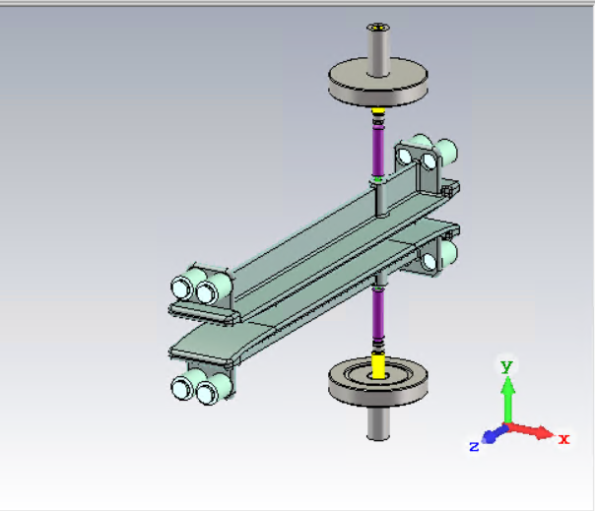
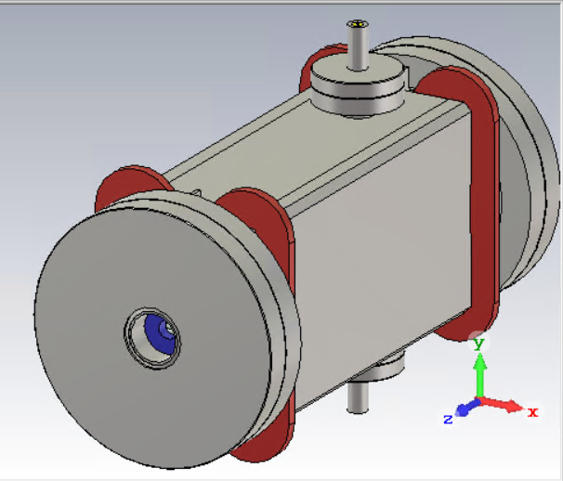
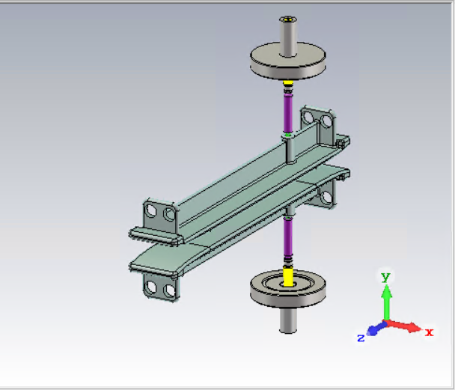
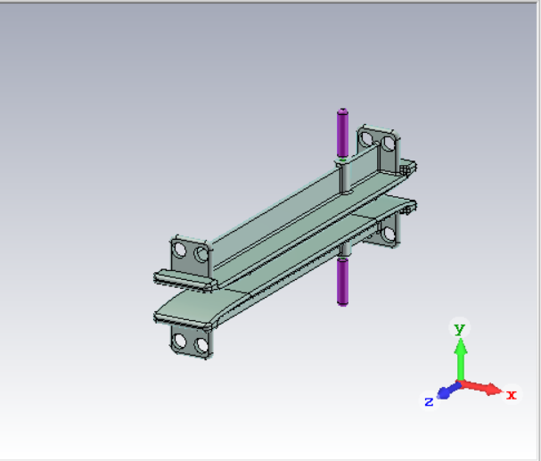
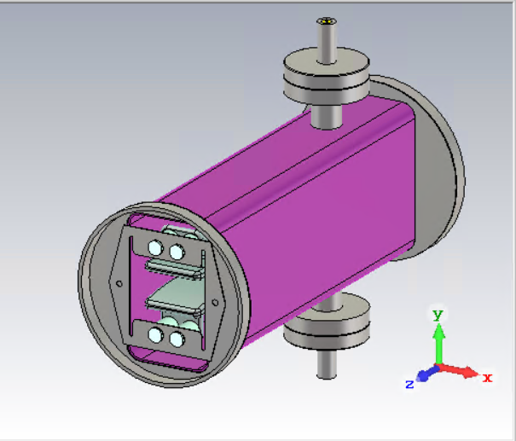
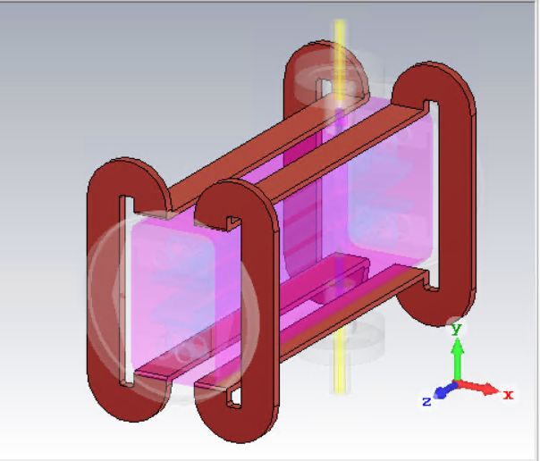
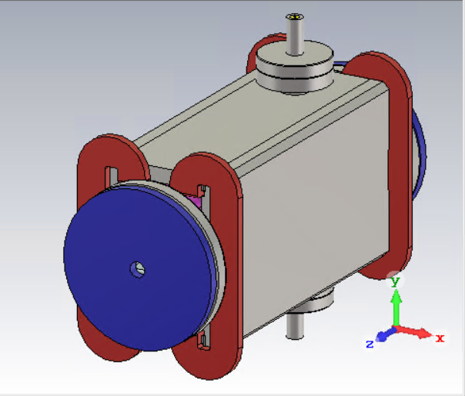
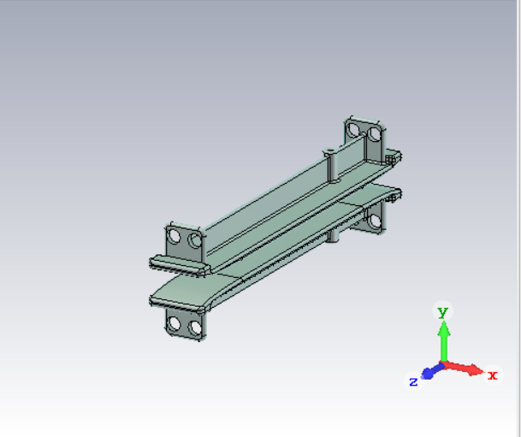
Extras
Isometric view of 3D model of the existing CEBAF 130 keV Wien filter based on SLAC’s original design.
Modelling
The Wien filter is composed of
HV electrode plates with mounting tabs and Rogowski profile
HV spring guide contacts with spring coils
HV electrical feedthroughs with alumina insulators
MACOR mounting insulators
Vacuum chamber with electrode mounting springs
Magnet coils
Magnet mirrors, pole plates and return yokes

Slide 24
Extras
For 100° spin rotation angle and we know the energy:
$$E_{k}=\left(γ−1\right)m_{0}c^{2}$$
$γ=\frac{E_{k}}{m_{0}c^{2}}+1=\frac{200 [keV]}{(0.510 [MeV/c^{2}])c^{2}}+1$ = 1.3914
The normalized velocity:
$$γ=\frac{1}{\sqrt{1−β^{2}}}→β=\sqrt{1−\frac{1}{γ^{2}}}=0.6953$$
And we obtain the magnetic field magnitude (at homogeneous region):
$$B_{x}= \frac{m_{0}cγ^{2}β\text{Ω}}{eL}$$
$$B_{x}=\frac{ (9.1093×{10}^{−31} [kg])(3×{10}^{8} [m/s]){(1.3914)}^{2}(0.6953)\left(\text{1.74533} rad\right)}{(307×{10}^{−3} [m])(1.602×{10}^{−19} [C])}$$
$$B_{x}=13 [mT]$$
Kinetic energy
Relativistic factor
Will use this to get Ey

Slide 25
Extras
We use the magnetic field in the equilibrium condition:
$$E_{y}=−v_{z}∙B_{x}$$
$$E_{y}=−\left(0.6953\right)\left(3×{10}^{8}\left[\frac{m}{s}\right]\right)\left(13×{10}^{−3} \left[T\right]\right)=2.7\left[\frac{MV}{m}\right]$$
So the potential per plate for a 0.015 [m] gap:
$$V=20.3 [kV]$$
To keep the beam trajectory
Which defines the power supply set point

Slide 26
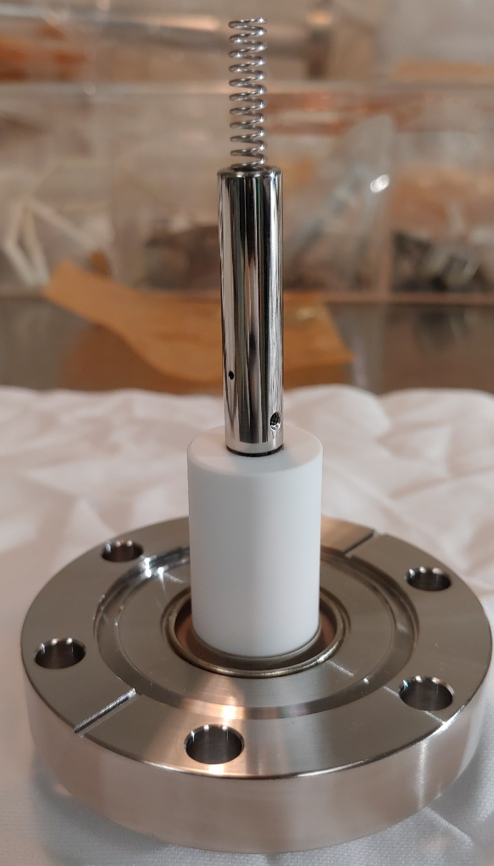
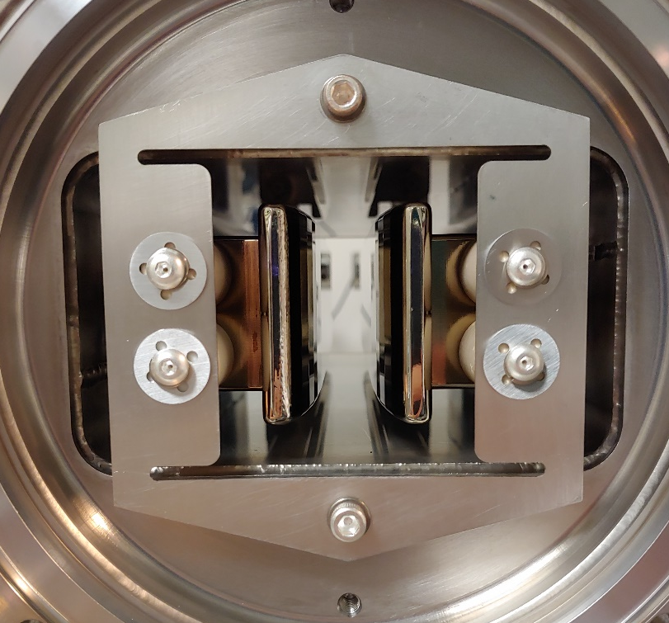
Bake, vacuum check, troubleshoot
Extras
Test, repair
Buy/manufacture
Final product!
Assembly/S&A

Slide 27
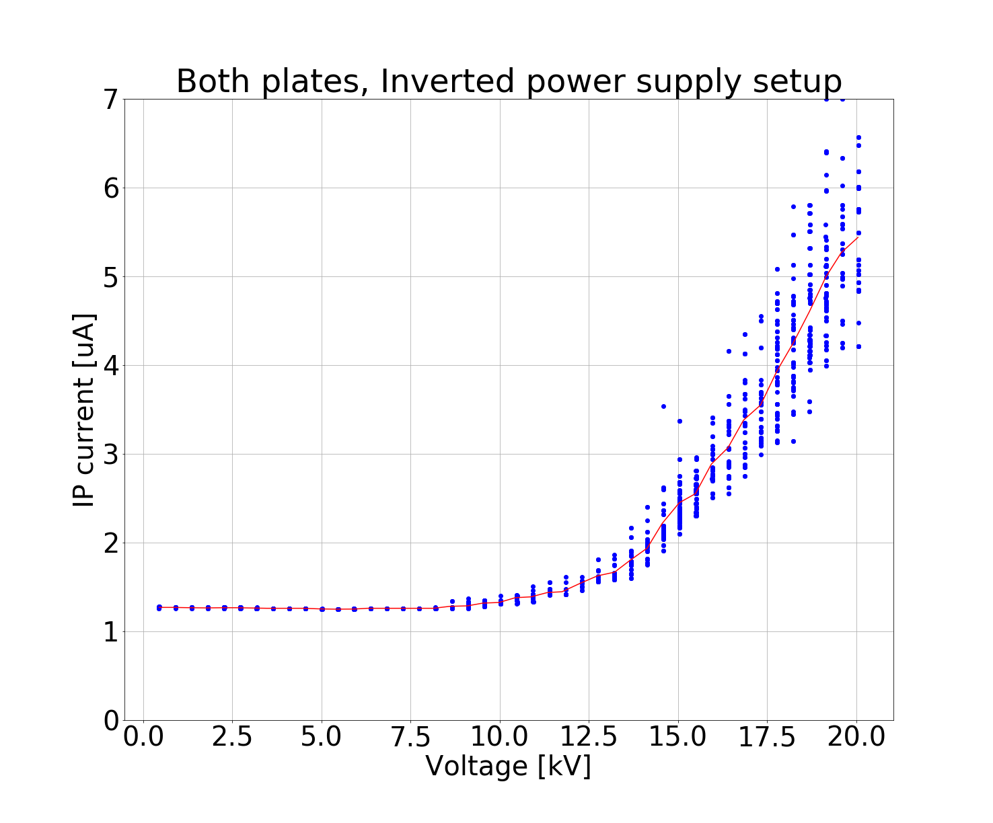
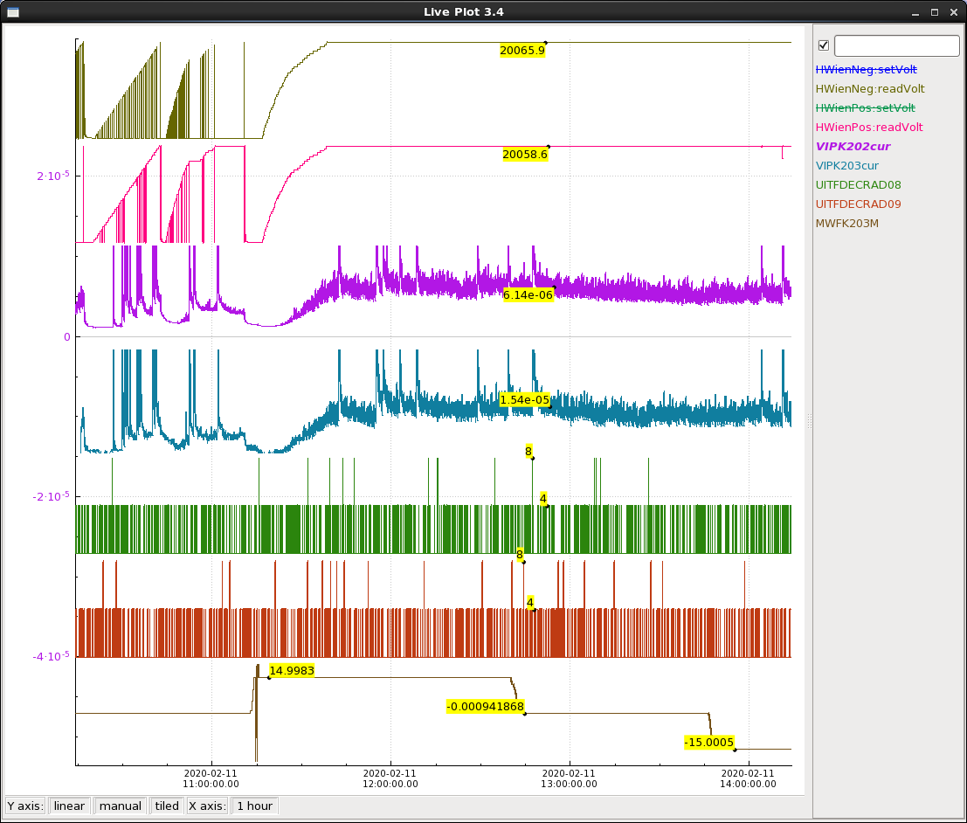
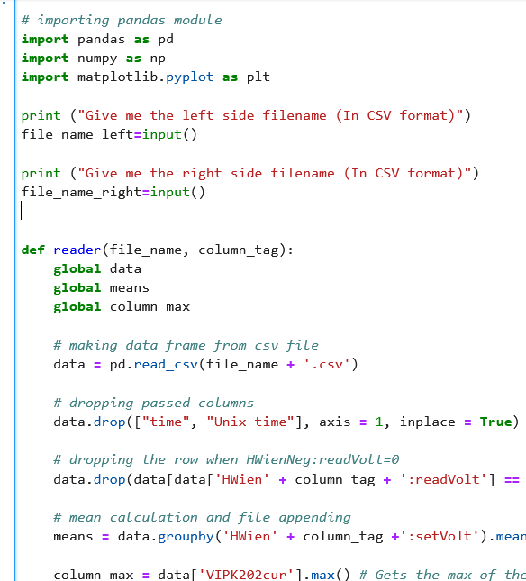
Extras
Monitor on EPICS
Data processing with
Python
Visualization and analysis
Done!

