Slide 1
Bubble Chamber Experimental Readiness Review
September 11, 2014
https://wiki.jlab.org/ciswiki/index.php/Bubble_Chamber

Slide 2
Astrophysical S-Factor ¹²C(α,γ)¹⁶O

Slide 3
Outline
Beam Requirements
Bubble Chamber
Bubble Chamber Status
Test Beamlines
Test Beamline Commissioning
Experiment Beamline
Schedule
Safety Reviews
Readiness Documents

Slide 4
Beam Requirements
Beam Properties at Radiator:
Beam Kinetic Energy, (MeV) | 7.9–8.7
Beam Current (µA) | 0.01–100
Absolute Beam Energy Uncertainty | <0.1%
Relative Beam Energy Uncertainty | <0.02%
Energy Resolution (Spread), σ_{T} /T | <0.06%
Beam Size, σ_{x,y} (mm) | 1–2
Polarization | None

Slide 5
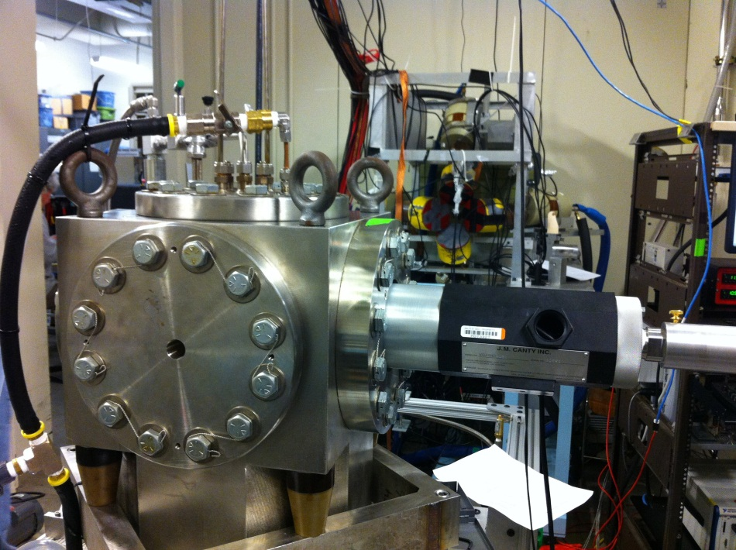
Bubble Chamber
Bubble Chamber at HIGS
April 2013
Photon Beam
Entrance

Slide 6
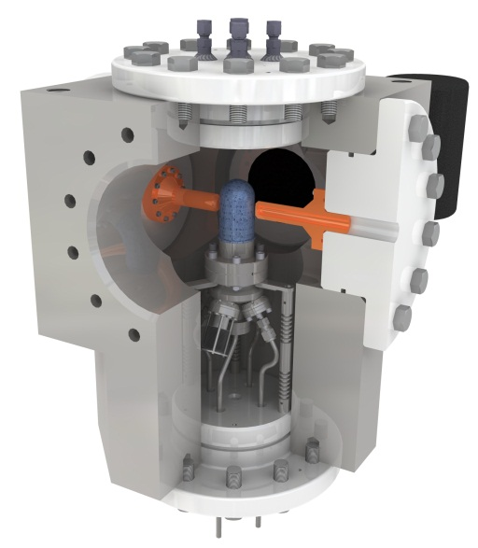
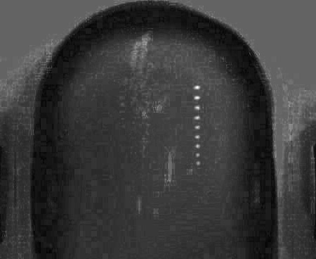
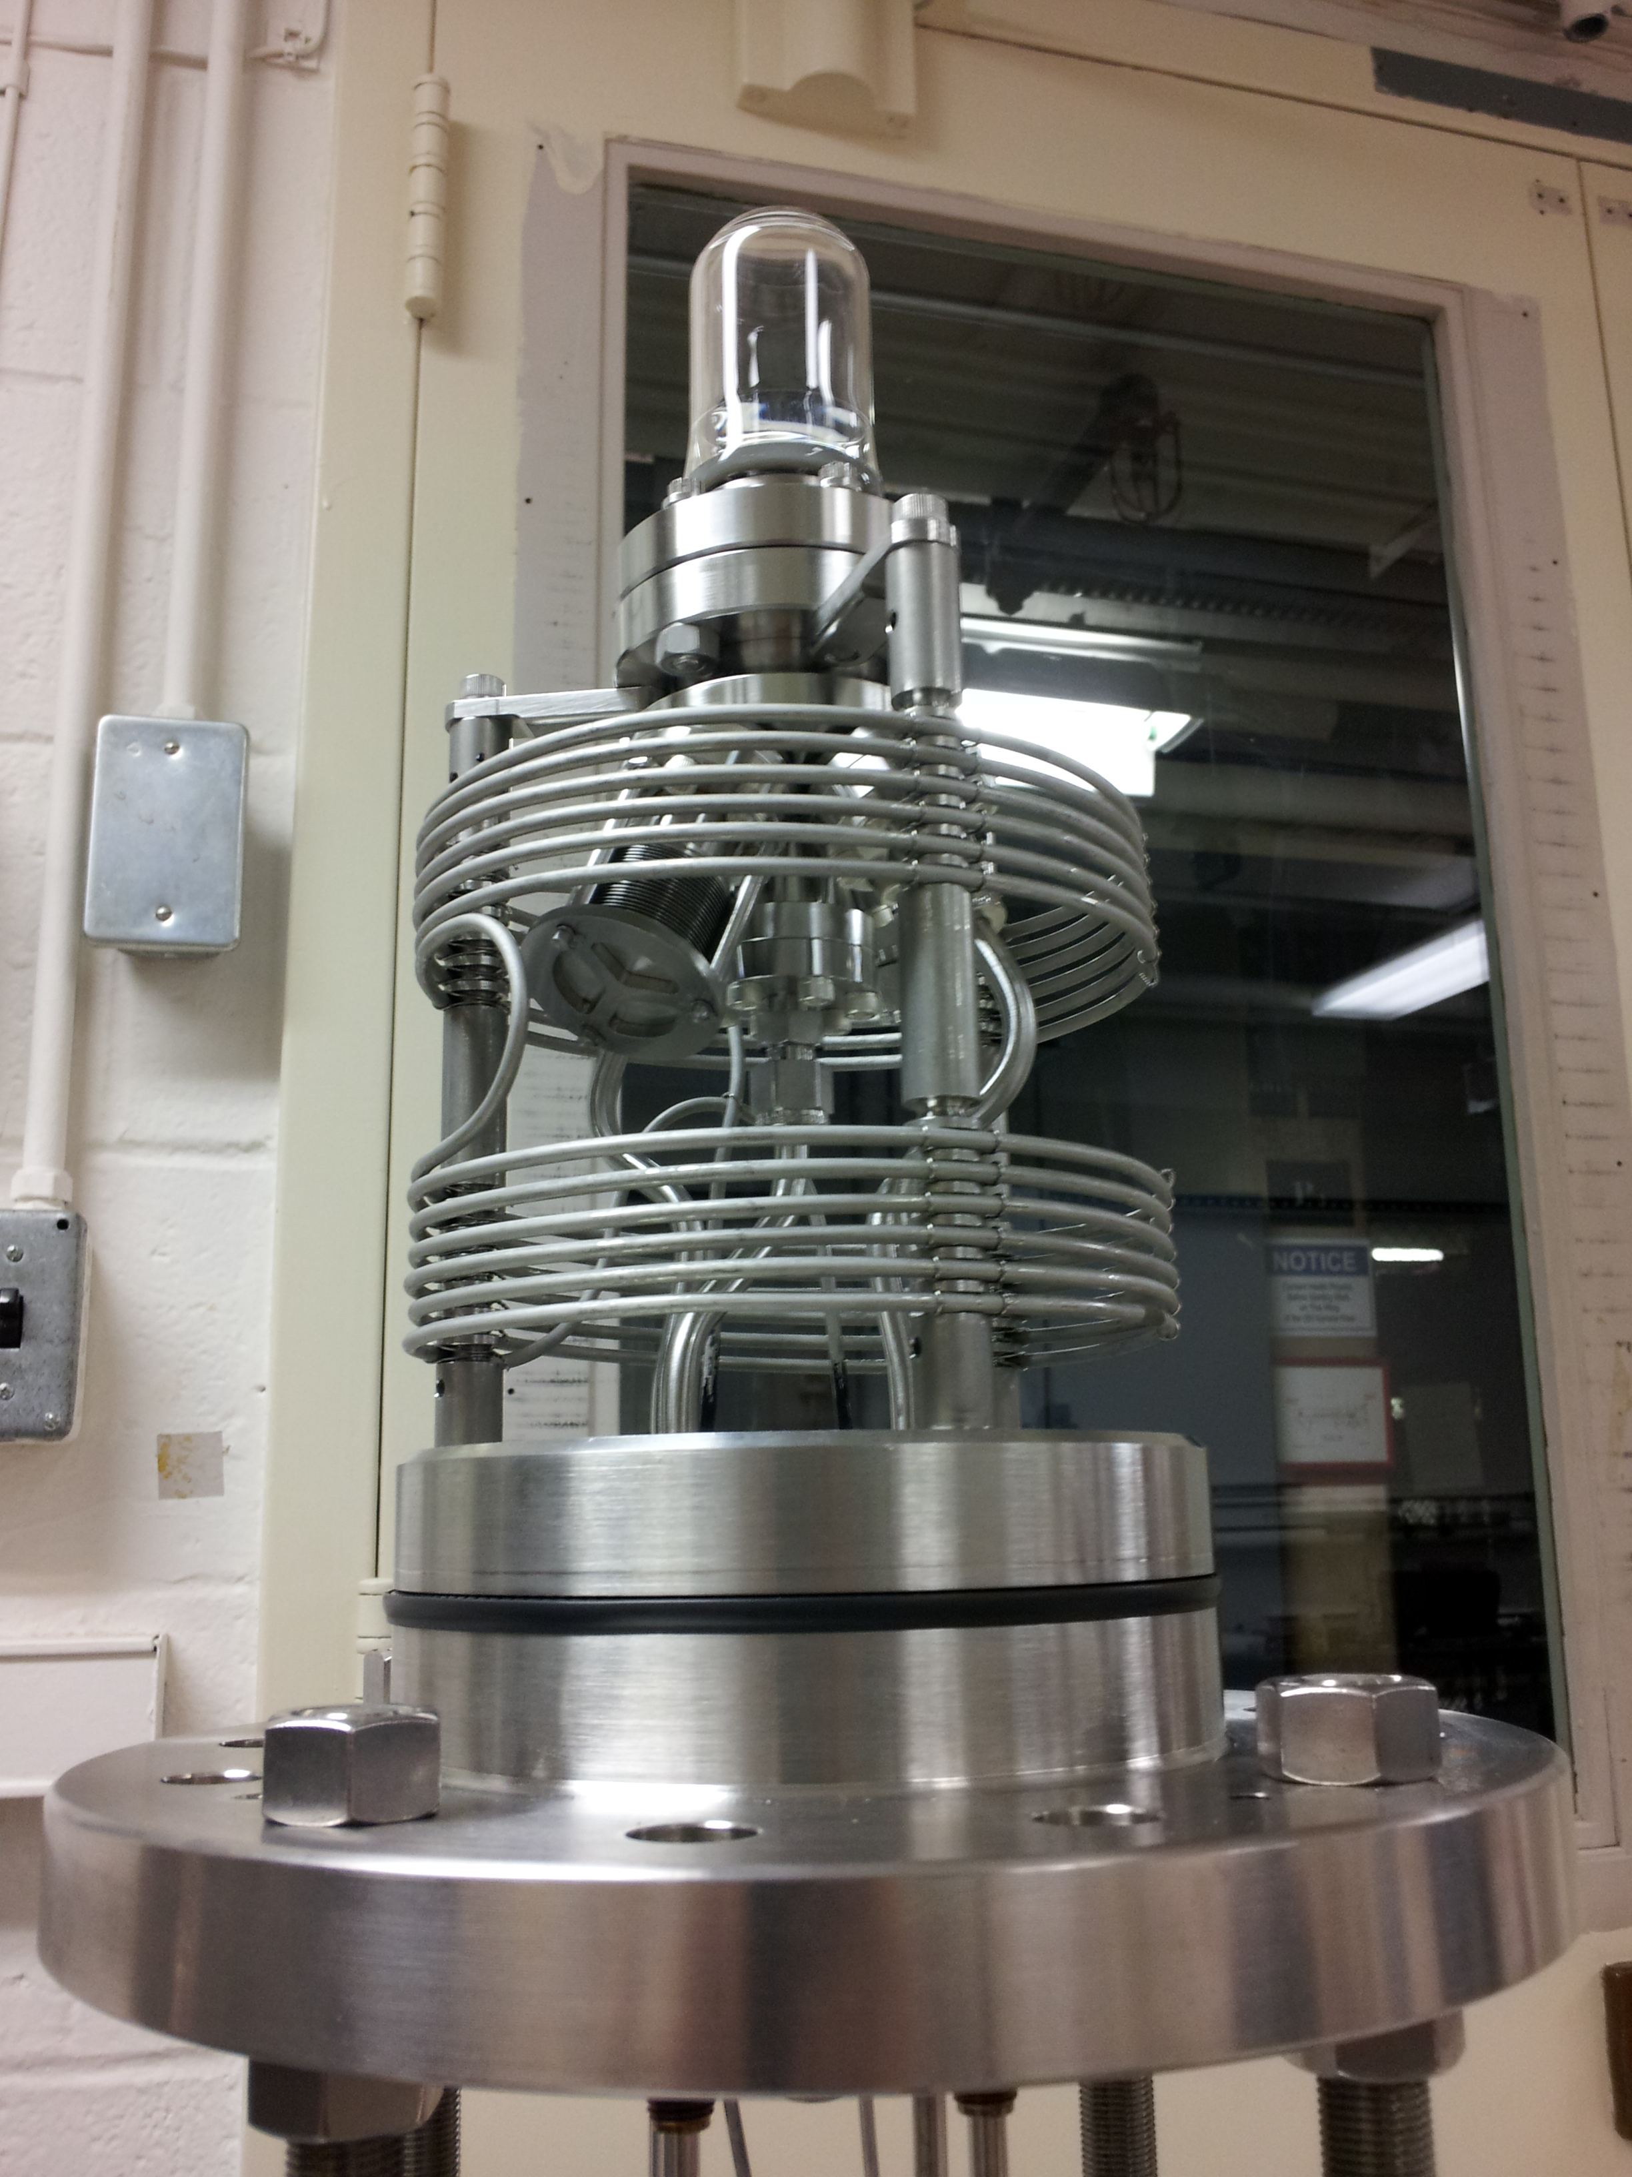
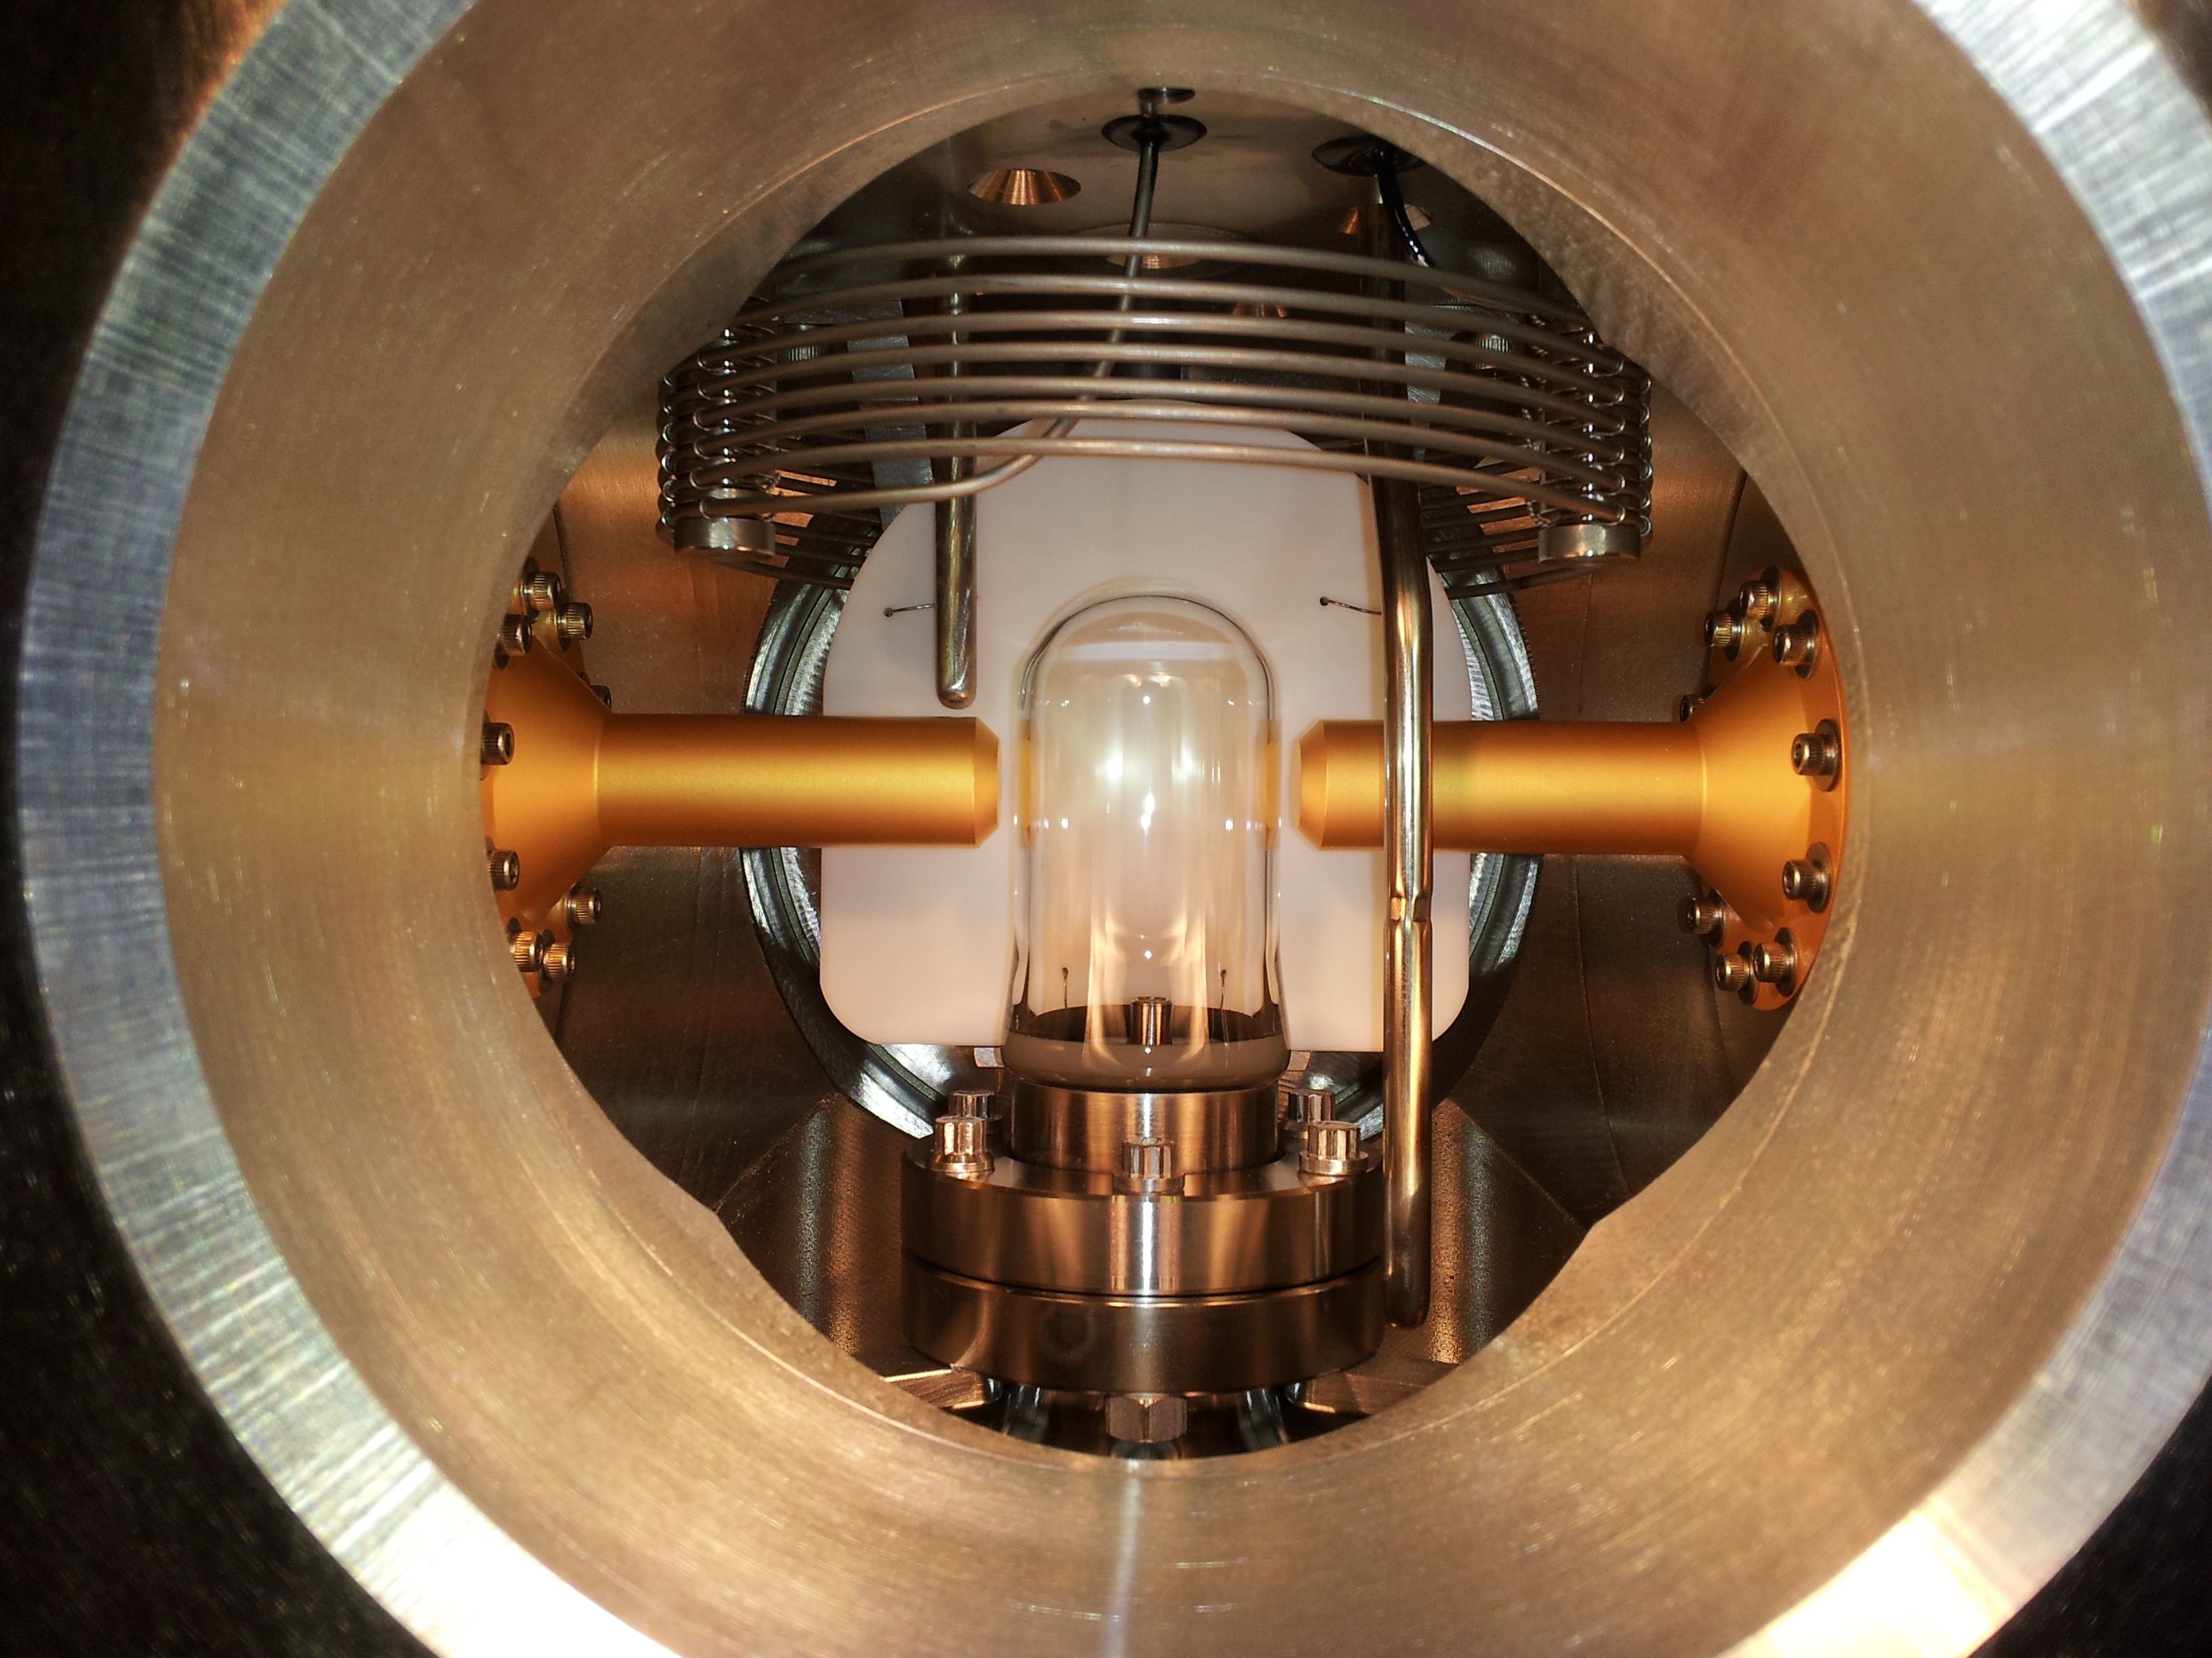
N₂O Bubble Chamber
T = -5˚C
P = 60 atm
First γ+O→α+C bubble
April 2013

Slide 7
Bubble Chamber Status
Problem with buffer liquid: water mixes with N₂O
Changed buffer liquid to mercury
Problem: nucleation at the interface between mercury and the N₂O
Tried differentially cooled mercury (N2O at meniscus is not superheated) … No more bubbles at interface
Finalizing design and ready for testing very soon

Slide 8
Test Beamline

Slide 9
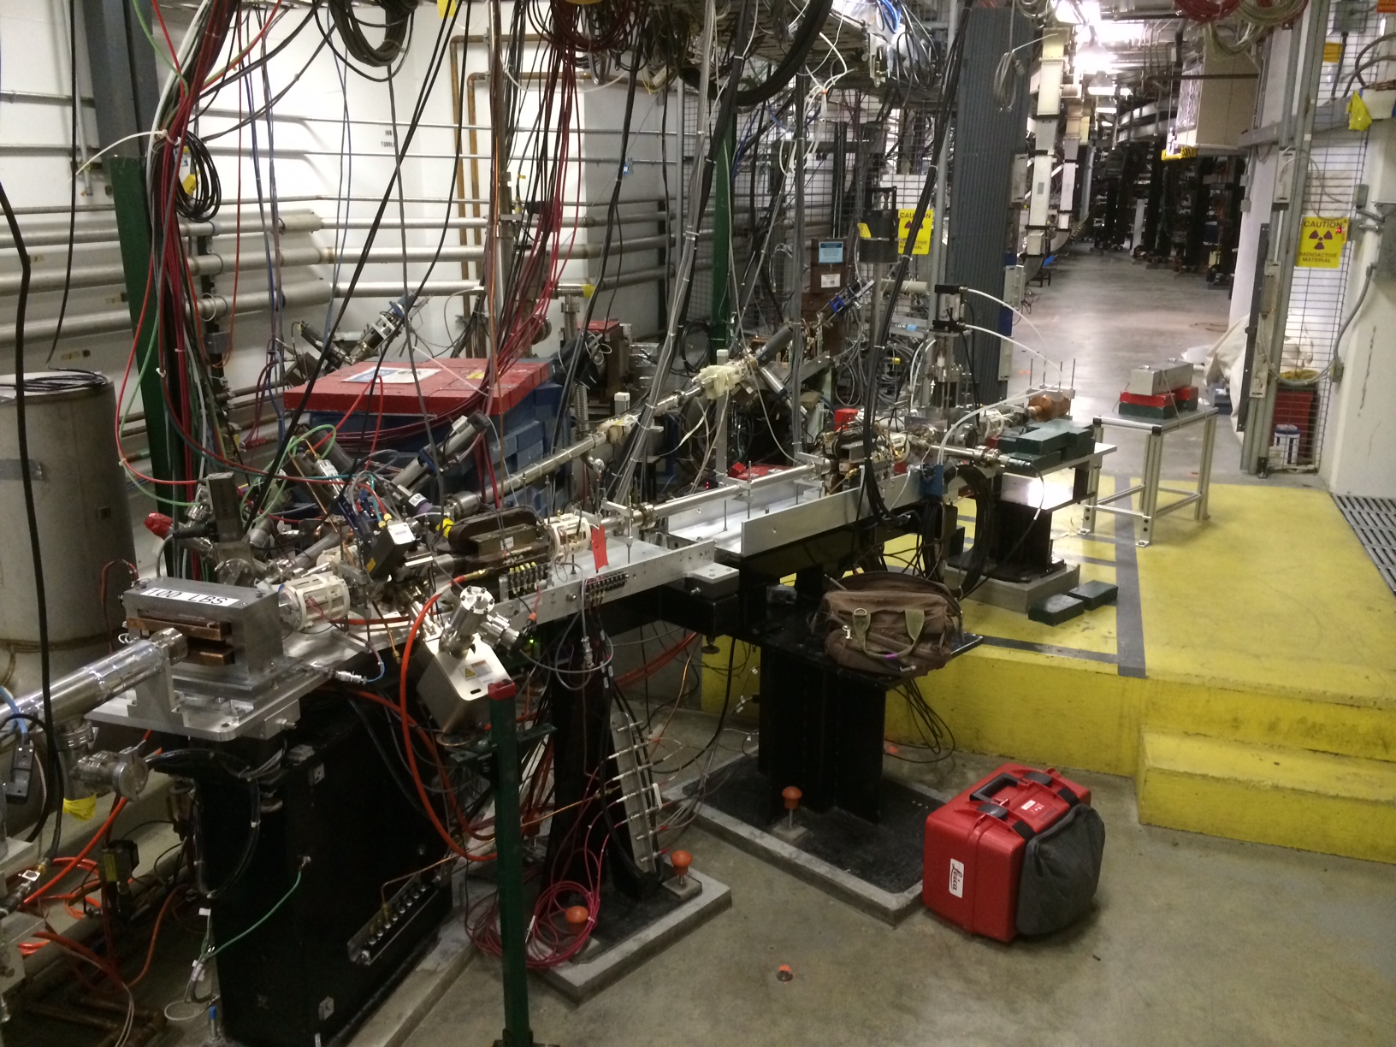

Slide 10
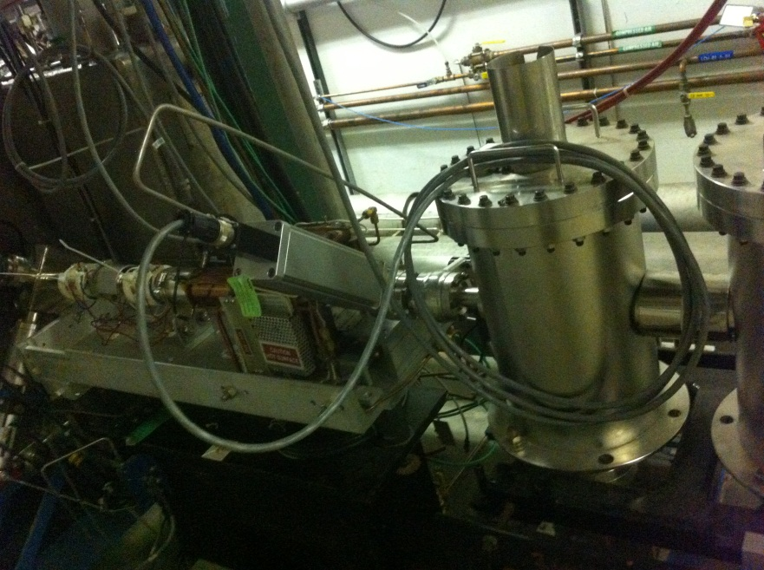
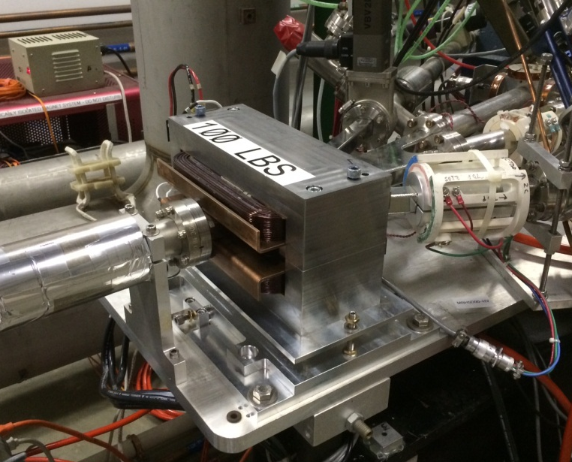
New Beamline Elements
New Beamline elements installed in support of Bubble Chamber experiment:
Fast Valve after ¼ Cryounit
New MDL0L02 Dipole Magnet
protect from vacuum failure in front of ¼ Cryo-unit

Slide 11
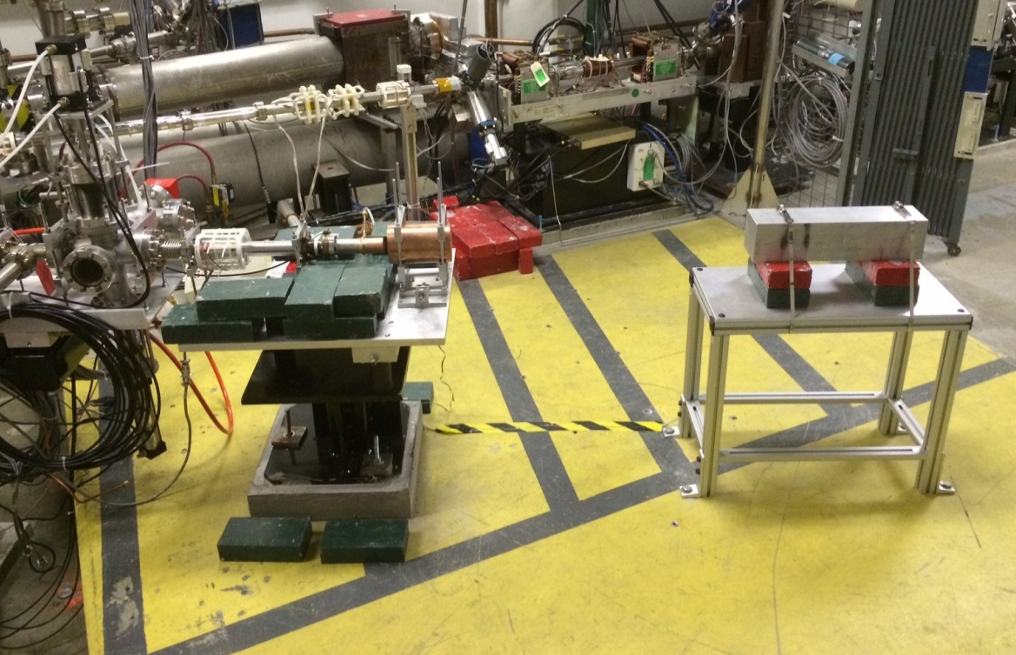
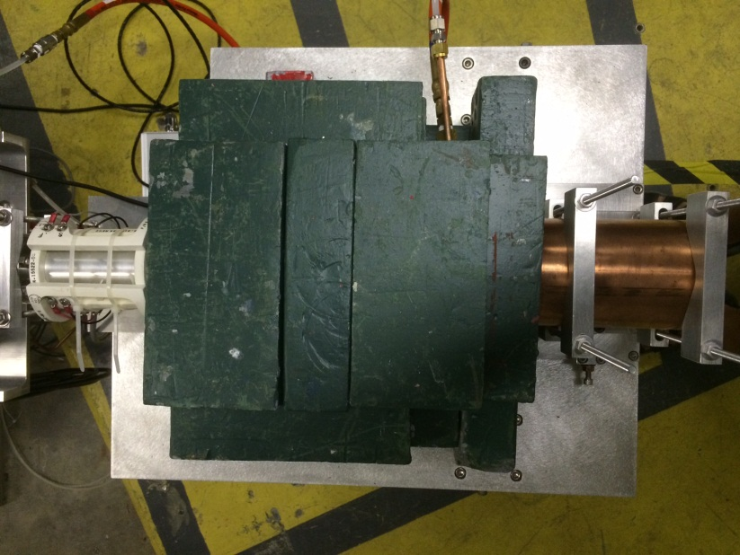

Slide 12
Use pure Copper and Aluminum
Radiator/dump isolated and current in EPICS readback
Electron K.E.
3.0 – 8.7 MeV
0.01 – 100 µA
Cu
Radiator/Dump
6 mm
Al Beam Pipe
Cu Photon
Collimator
Ceramic
Insulator
Al Photon Dump
40 cm long
Bubble Chamber
Superheated N₂O
3 cm long
-5°C, 60 atm

Slide 13
Test Beamline Commissioning
New Test Beamline is ready for Fall 2014 run
Commissioning plan will be submitted:
Checklist of machine protection interlocks and controls (no review is required)
Checkout of beamline with electron beam
Beam Studies:
Momentum measurement
Measure Bremsstrahlung spectra
Operation at high current
Measure beam charge at different currents

Slide 14
Experiment Beamline
Replace thick radiator, with a thin internal radiator and electron dump
To be installed early Summer 2015

Slide 15
Schedule
May 3 – September 18, 2014 | Summer Shutdown, CHL@4K
September 19 – December 22, 2014 | 1.82 GeV/pass
Fall 2104 | Bubble Chamber commissioning at HIGS
December 23, 2014 – February 5, 2015 | Winter Shutdown, CHL@2K
February 6, 2015 – June 12, 2015 | Hall A Physics, Hall D Eng. Run
June 13, 2015 – September 10, 2015 | Summer Shutdown, CHL@2K (?)
Commission Test Beamline
1st Opportunity
in January 2015
2nd Opportunity
in Summer 2015
For helium processing of Cryo-modules

Slide 16
Bubble Chamber Safety Reviews
Superheated liquid: N₂O, Nitrous oxide (laughing gas)
At room temperature, it is colorless, non-flammable gas, with slightly sweet odor and taste
High pressure system:
Design Authority: Dave Meekins
T = -5˚C
P = 60 atm
Buffer liquid: Mercury
Closed system
Volume: 135 mL
(less than VA state reportable limit of 168 mL)
0
2
0
OX
All done at Argonne. How to transfer to JLab?
0
3
0

Slide 17
Readiness Documents
Conduct of Operations (COO)
Experiment Safety Assessment Document (ESAD)
Radiation Safety Assessment Document (RSAD)
Operational Safety Procedures (OSP)
Similar to PEPPo

