Slide 1
Design Update Puck and Gun Magnet
February 16, 2016

Slide 2
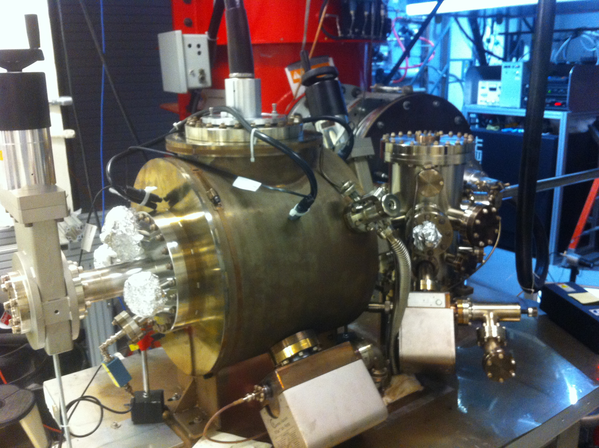
Magnetized Gun
K₂CsSb Preparation Chamber
HV Chamber

Slide 3
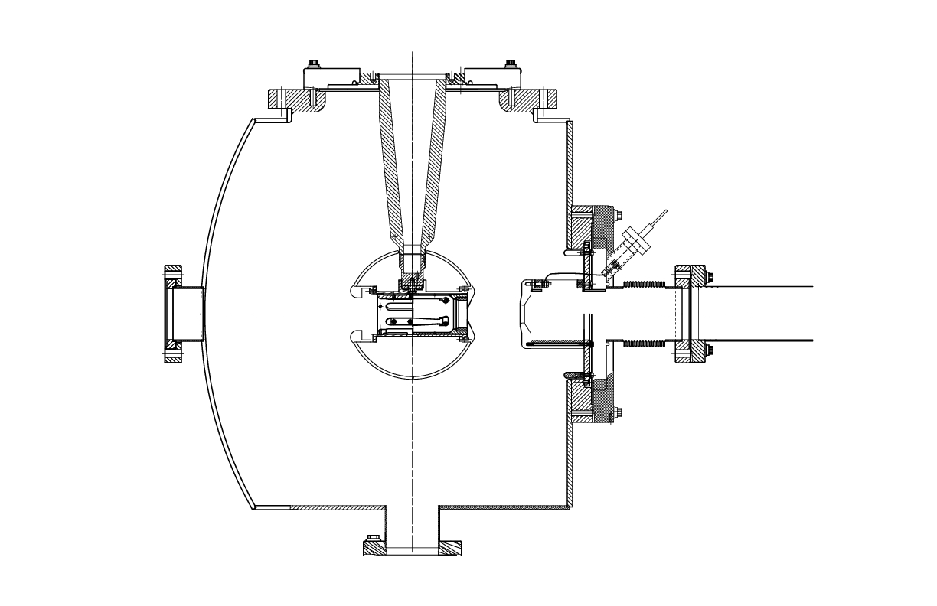
Solenoid + Steel Puck
Cathode-Anode Gap
5”
Steel Puck
9.0 cm
13”
18”
10”
Is it possible to replace this 10’’ flange with one that has shorter ports?
Moly
6.4 cm
8”
7.5”
Gun Table
1”

Slide 4
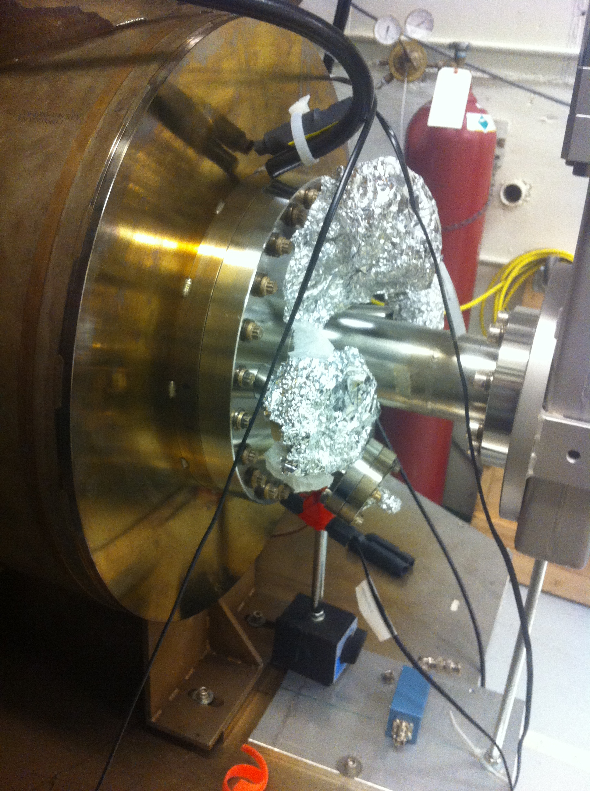

Slide 5
Steel Puck
Molybdenum and Steel hybrid puck – brazing not screwing
Use 1010 carbon steel
Re-design new Puck Manipulator End Adapter
Order 4 pucks – map with Solenoid
Heat Treatment:
Un-heated
200˚C (Sb) and 120˚C (K – Cs) growth
550˚C Heat Cleaning then 200˚C and 120˚C
Multiple

Slide 6
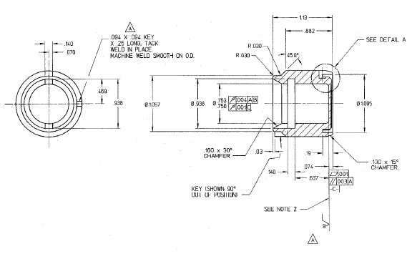
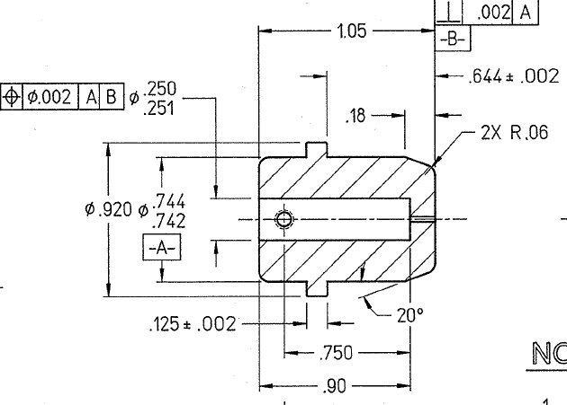
Puck
Puck Manipulator End Adapter

Slide 7
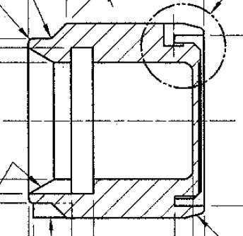
Moly
10 mm
6 mm
Steel

Slide 8
Power Supply
Use new spare Dogleg power supply (450A, 72V)
We have Arne’s permission
If needed at CEBAF, we can use an old Dogleg
supply (270A, 50V) to keep going
Need to add polarity switch to be able to degauss
steel

Slide 9
Solenoid
Not bakable – will be mounted on rails. Push downstream out of oven and run LCW through. Move gate valve after beamline solenoid (in place of BPM).
Single-wound
Once inner diameter is determined, ask companies for design and quote:
Everson Tesla
Buckley Systems

Slide 10
Solenoid Mount
Allow for small adjustments to center solenoid on beam
Gun Table
Rails

Slide 11
Timeline
Power Supply (new spare Dogleg):
Being built at Magnet Lab: March
Test and add polarity switch: April
Move to GTS: May
Ready: July 1, 2016
All work has to be completed by September 30, 2016.
Solenoid:
Design: February and March
Procure: April
Map (with and w/o puck), check hysteresis and forces: July
Install: August, 2016

