Slide 1
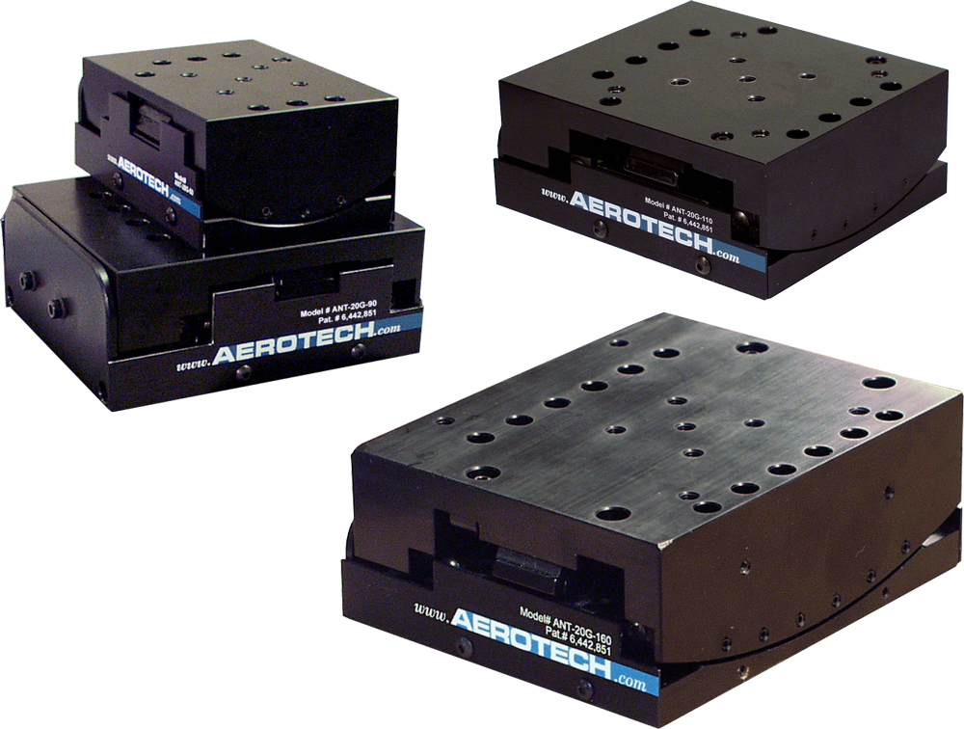
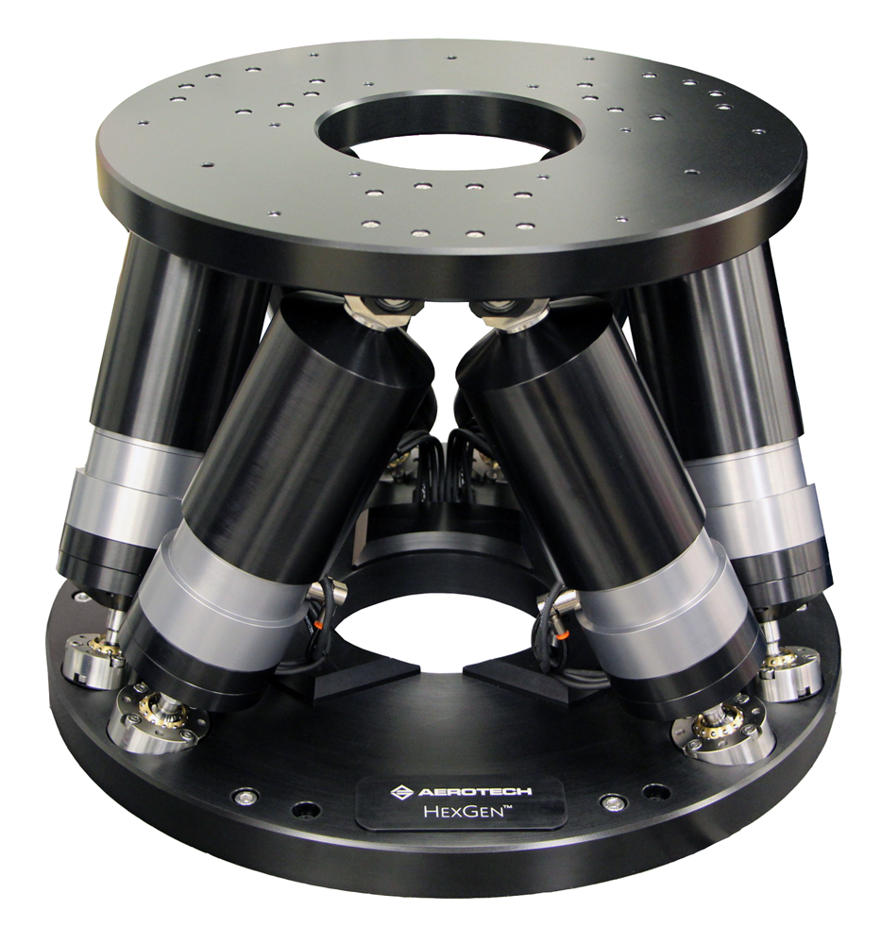
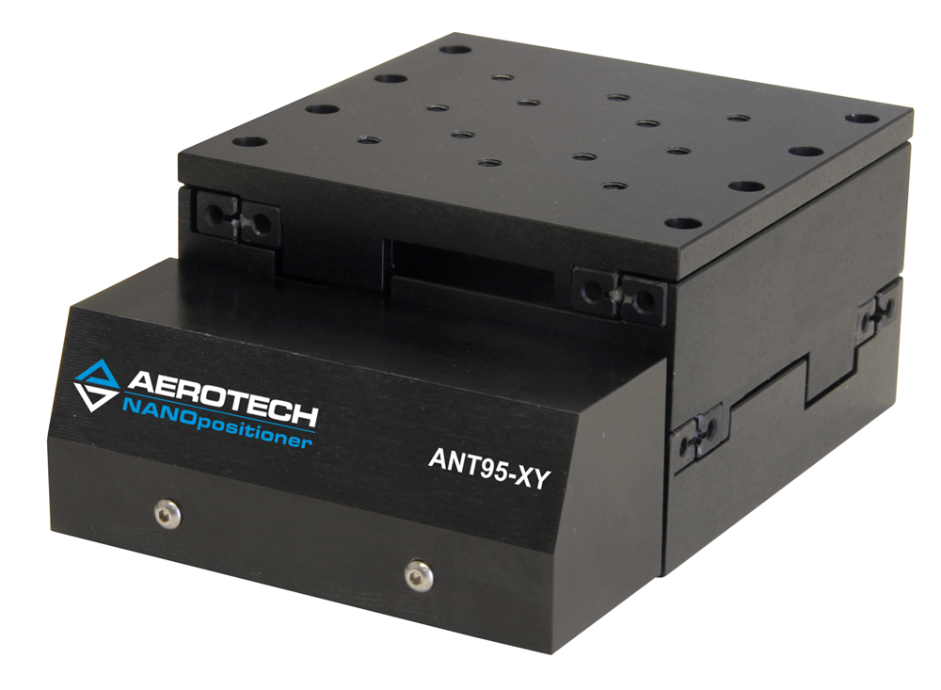
Pockels Cell Stewart Platform – Choices
Four Linear Stages: four degree-of-freedom positioning: x, y, θ_{x}, θ_{y}. EPICS provided.
Hexapod: six degree-of-freedom positioning: x, y, z, θ_{x}, θ_{y}, θ_{z}. EPICS provided.
Home made hexapod. Need to write controls and EPICS

