Slide 1
18” CEBAF gun “a la GTS”
Gabriel Palacios Serrano
gabrielp@jlab.org

Slide 2
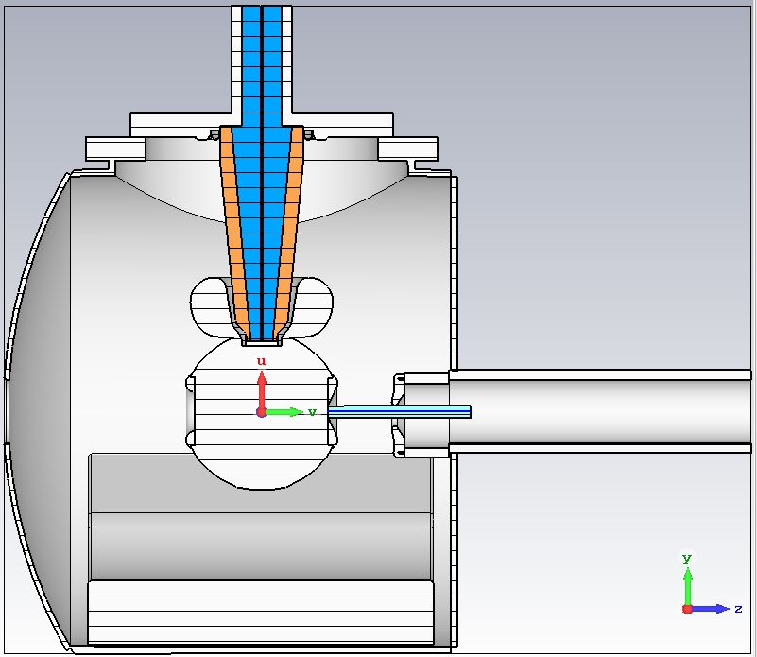
Model
This is the model with the so-called “CEBAF anode” and 6 cm cathode-anode gap.
Material and settings are the same as before:
Closed boundaries everywhere except top and z >0
Alumina for insulator and rubber for cable.
Moveable anode

Slide 3
GPT
I exported the field maps and use them as inputs in the GPT deck for the GTS gun with Dr. Sajini’s parameters, then obtained the dynamics

Slide 4
Parameters
GPT parameters taken from Sajini’s
Qbunch -1e-12 # C
XYrms 0.5e-3 # m
Space charge ON

Slide 5
Anode shifts: Average position

Slide 6
Anode shifts: Emittance

Slide 7
Anode shifts: Spot size

Slide 8
Anode tilts: Average position

Slide 9
Anode tilts: Spot size

Slide 10
Anode tilts: Emittance

Slide 11
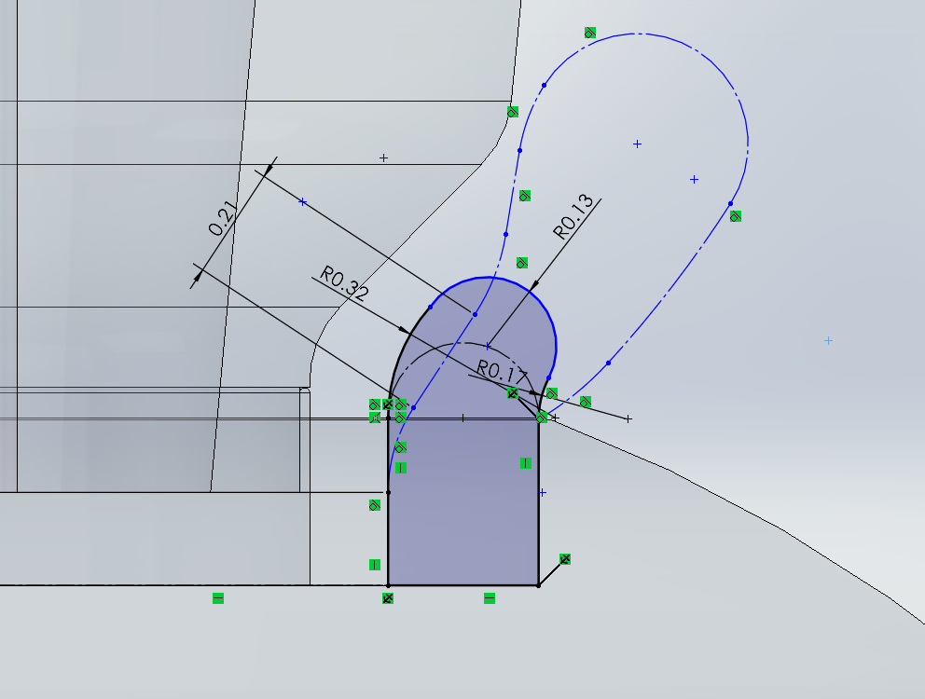
A smaller shield?

Slide 12
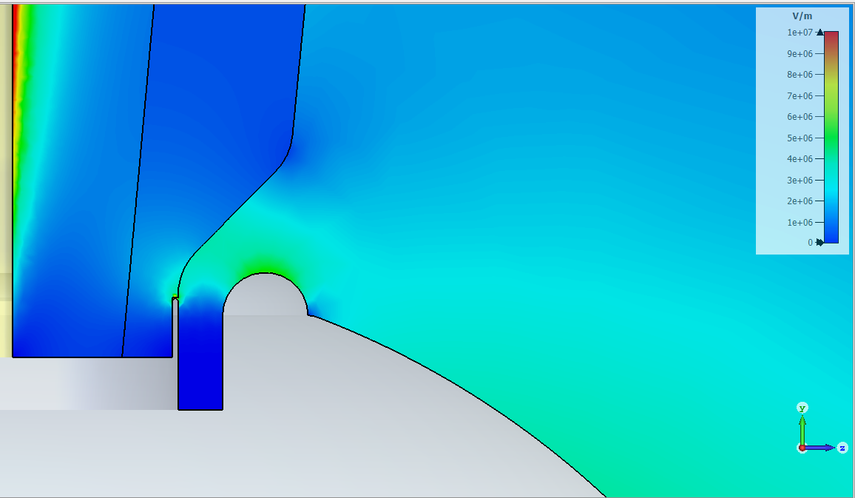
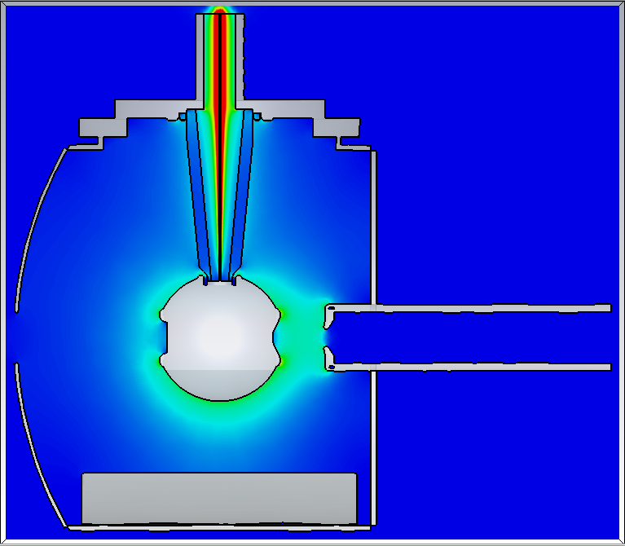
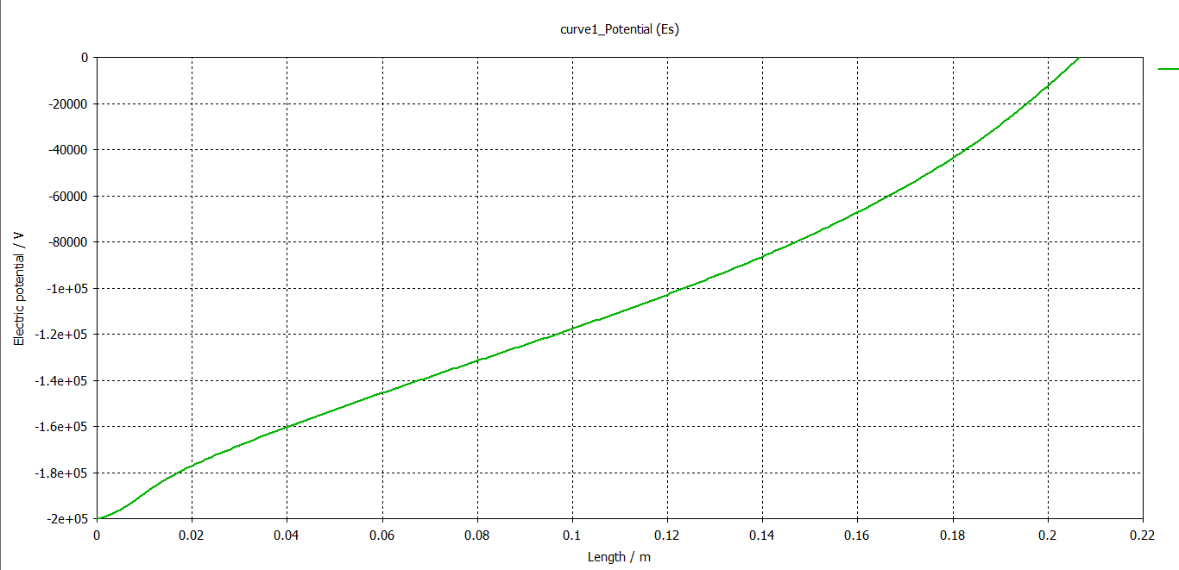
4.2 MV/m
5.3 MV/m

Slide 13
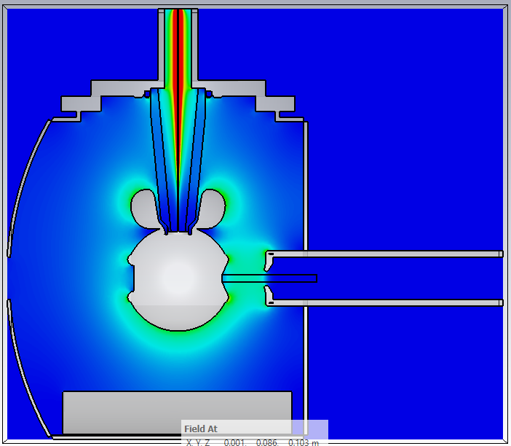
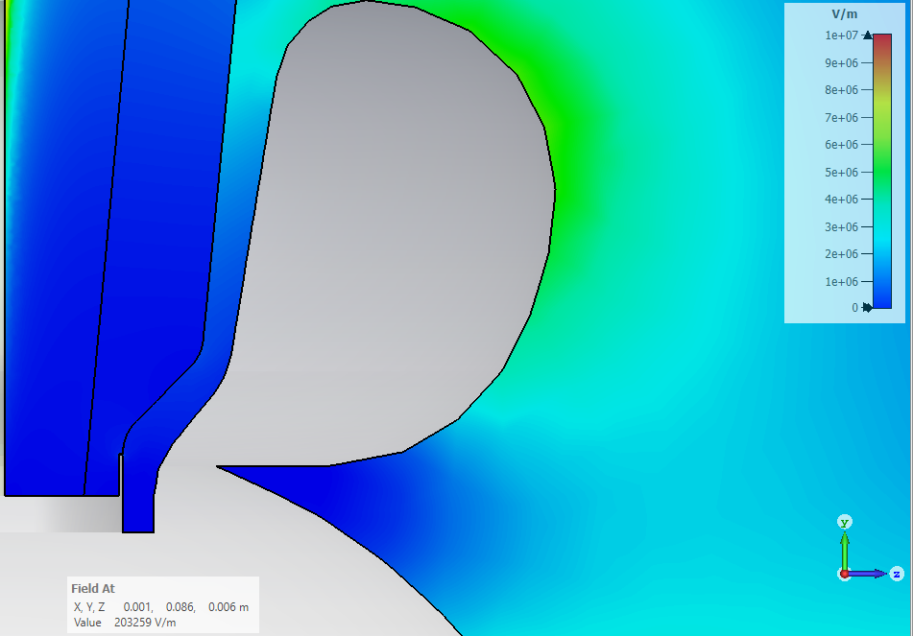
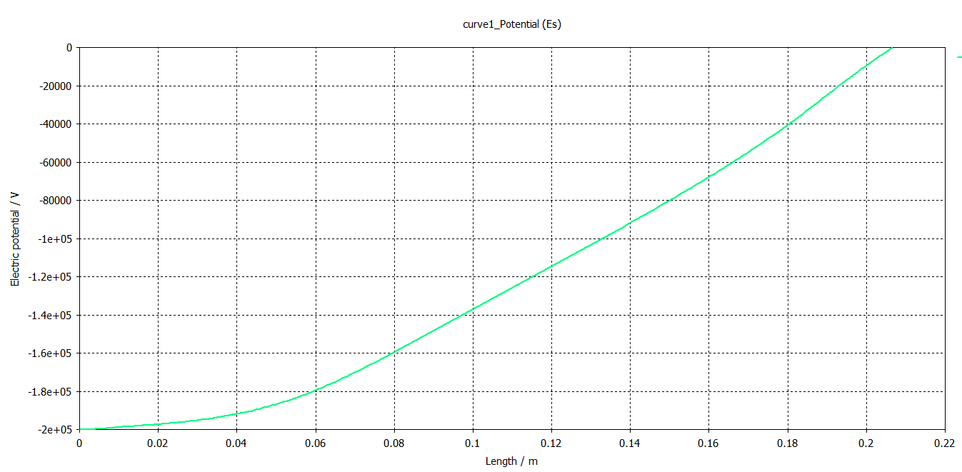
5.5 MV/m
0.1 MV/m

Slide 14
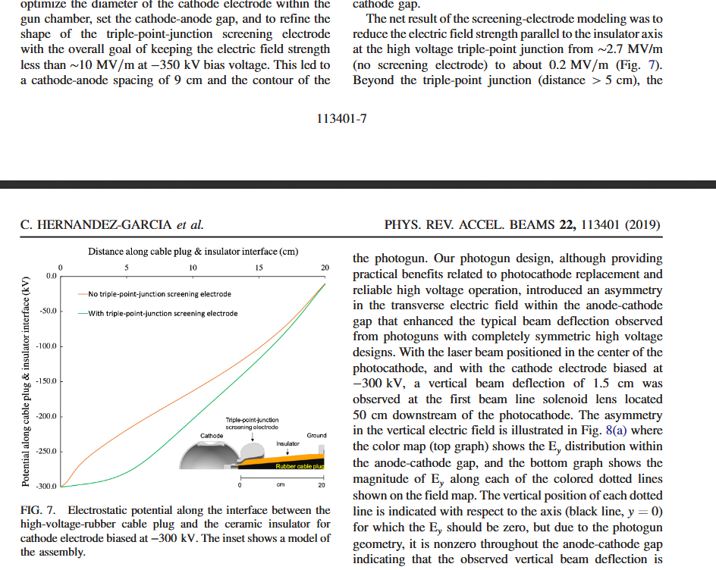

Slide 15
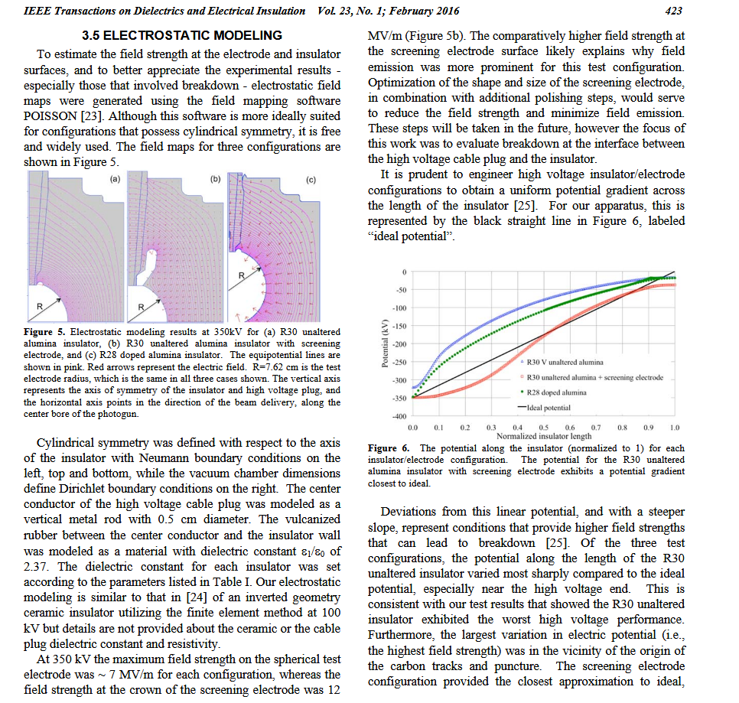

Slide 16
FIN

